Slide 1
NEAMS Annual Review: Fast Reactors

Slide 2
Opening Remarks and Meeting Objectives
David Andersson, NEAMS National Technical Director, Los Alamos National Laboratory
Tanju Sofu, NEAMS Deputy National Technical Director, Argonne National Laboratory
David Henderson, Federal Program Manager, U.S. Department of Energy

Slide 3
Meeting Objectives
Welcome and thank you for your interest in the DOE NEAMS (Nuclear Energy Advanced Modeling and Simulation) program!
Reviews are performed by reactor type in virtual meetings (today’s FR meeting highlighted):
    Light Water Reactors: May 7, 11:00 AM – 5:00 PM ET
    High Temperature Gas-cooled and Fluoride Salt-Cooled Reactors: May 8, 11:00 AM – 4:00 PM ET
    Micro-Reactors: May 12, 11:00 AM – 4:00 PM ET
    Molten Salt Reactors: May 28, 11:00 AM – 4:15 PM ET
    Fast Reactors: May 29, 11:00 AM – 4:00 PM ET
The objectives of this meeting are to review the work performed by the NEAMS program during the past year, solicit feedback from stakeholders, and discuss future priorities – making sure that we are aligned with the needs of the nuclear industry, regulators and broader R&D community.
We welcome and encourage feedback and constructive discussion.

Slide 4
Meeting Logistics
The meeting is virtual and utilizes Microsoft Teams.
Please mute yourself when you are not speaking.
Questions may be asked after each talk (for clarification) or during the main Q&A slot at the end of each session. We have also scheduled time at the end of the day for stakeholders to provide summary feedback and ask any final questions.
You can ask your questions or make comments in the chat, by raising your hand or by unmuting yourself and speaking up – in that order of preference.
Moderators will monitor the chat and call on people raising their hands in the order that they were raised to state their questions.
We will provide email for each presenter if you would like to have a more in-depth discussion. You can also email David Andersson, andersson@lanl.gov.

Slide 5
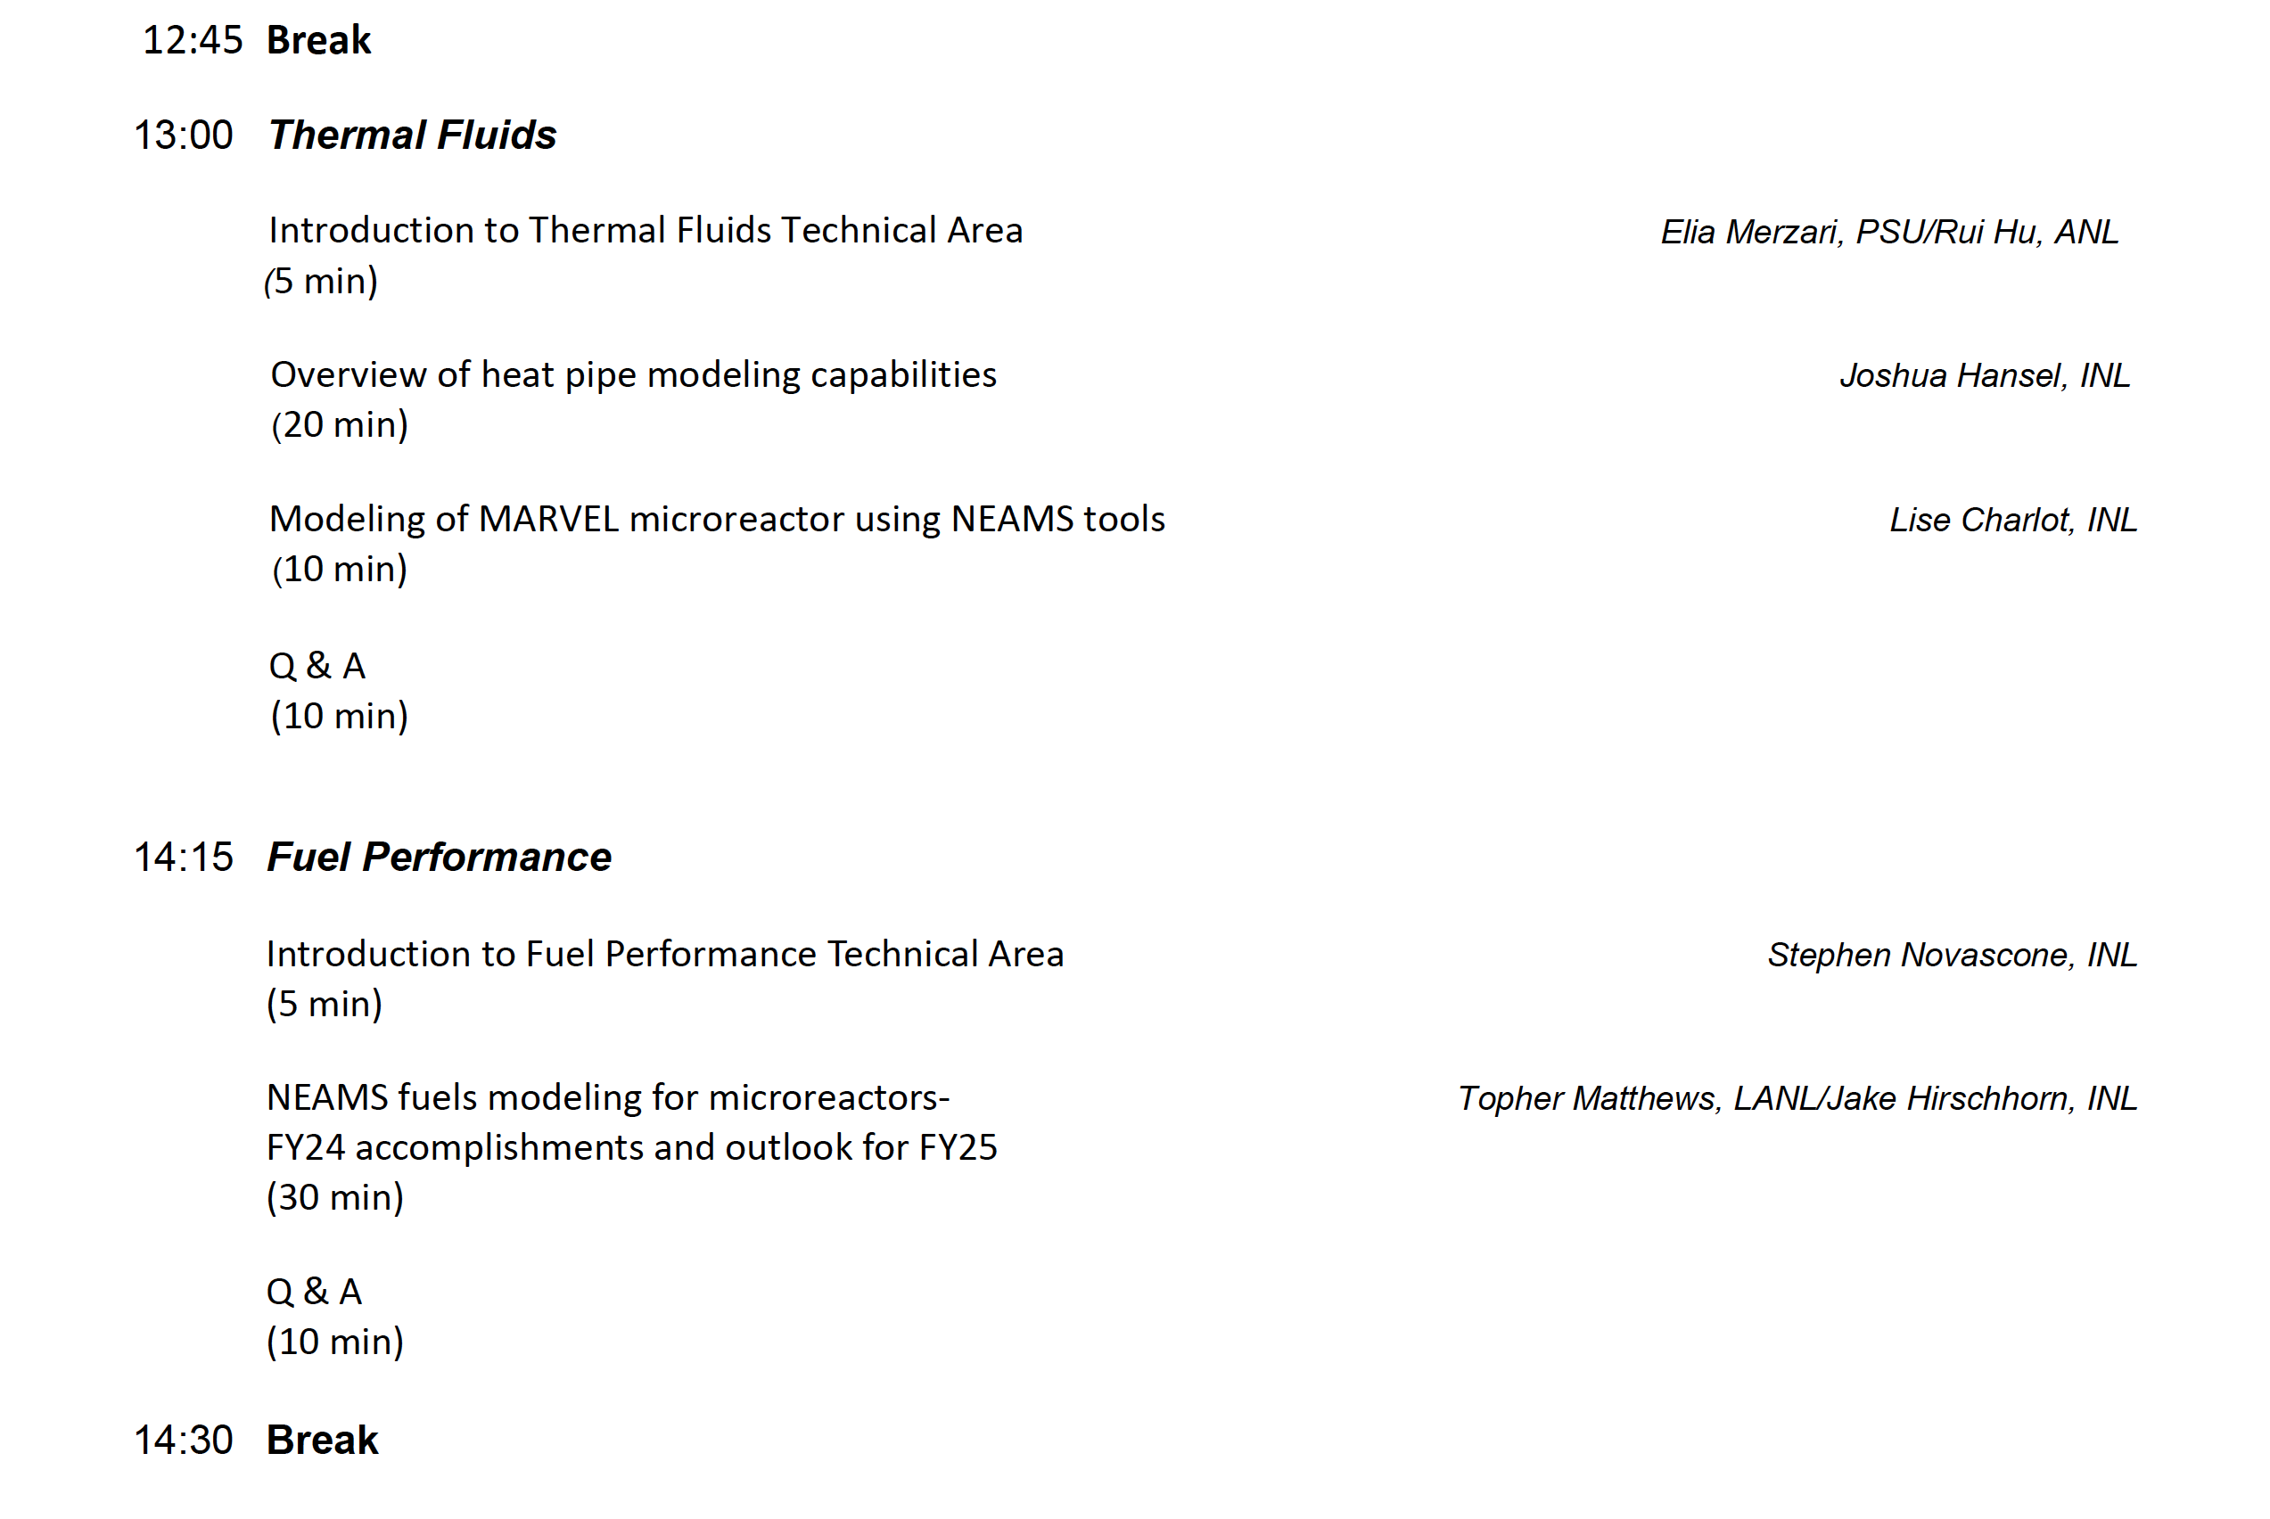
Agenda

Slide 6
NEAMS Overview and Fast Reactors research plan
David Andersson, NEAMS National Technical Director, Los Alamos National Laboratory
Tanju Sofu, NEAMS Deputy National Technical Director, Argonne National Laboratory
David Henderson, Federal Program Manager, U.S. Department of Energy

Slide 7
NEAMS is the DOE-NE Modeling and Simulation Program
Why advanced modeling simulation of nuclear reactors?
  Predictive modeling and simulation enable innovation in design, development, licensing, deployment and operation of nuclear reactors by providing high fidelity results and enhancing the value of available, but often limited, experimental data points.
The NEAMS program aims to address this need by:
  Developing advanced methods, models and simulation capabilities (software) in reactor physics, thermal hydraulics, fuels, materials, chemistry and multi-physics that enhance our ability to simulate the current fleet and advanced reactors.
  Utilizing and advancing new and evolving science and technology such as multi-scale simulations, AI/ML, in-line sensor data and digital twins, and advanced computing platforms to solve high-impact problems.
  Supporting development, licensing, deployment and operation of nuclear reactors by stakeholders through software deployment, maintenance, baseline support, validation and verification.
  Engaging in collaborations and partnerships to enable use of NEAMS tools for advances in reactor technology by stakeholders (industry, NRC, universities, other DOE programs – e.g., Fast Reactor program, AFC program, AMMT program, international, etc.).

Slide 8

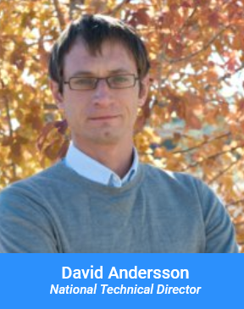
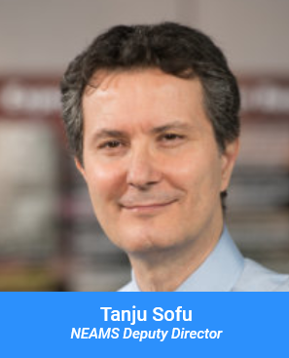
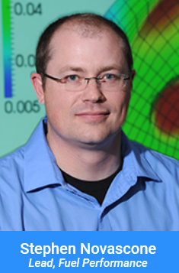
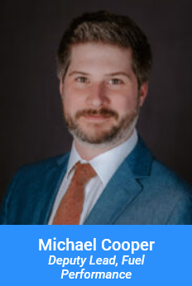
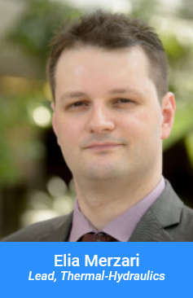


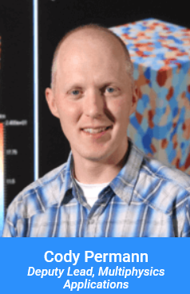
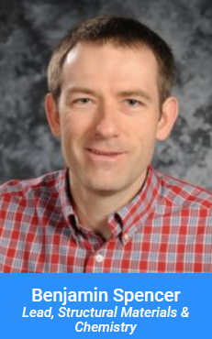
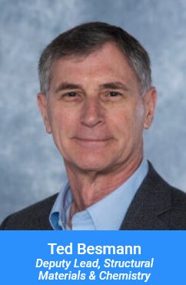
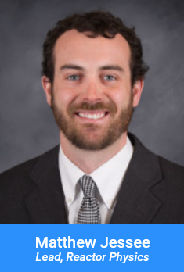
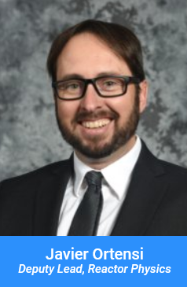
NEAMS Program Structure

Slide 9
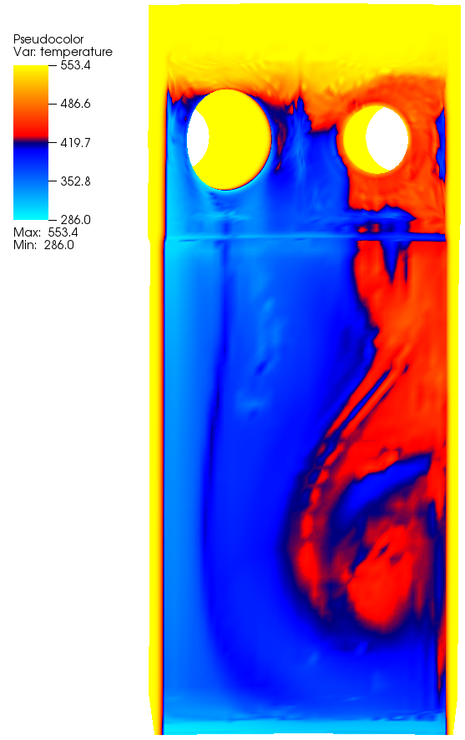
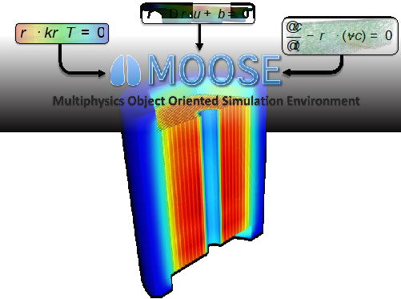
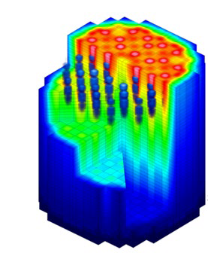
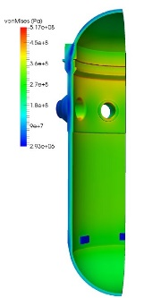
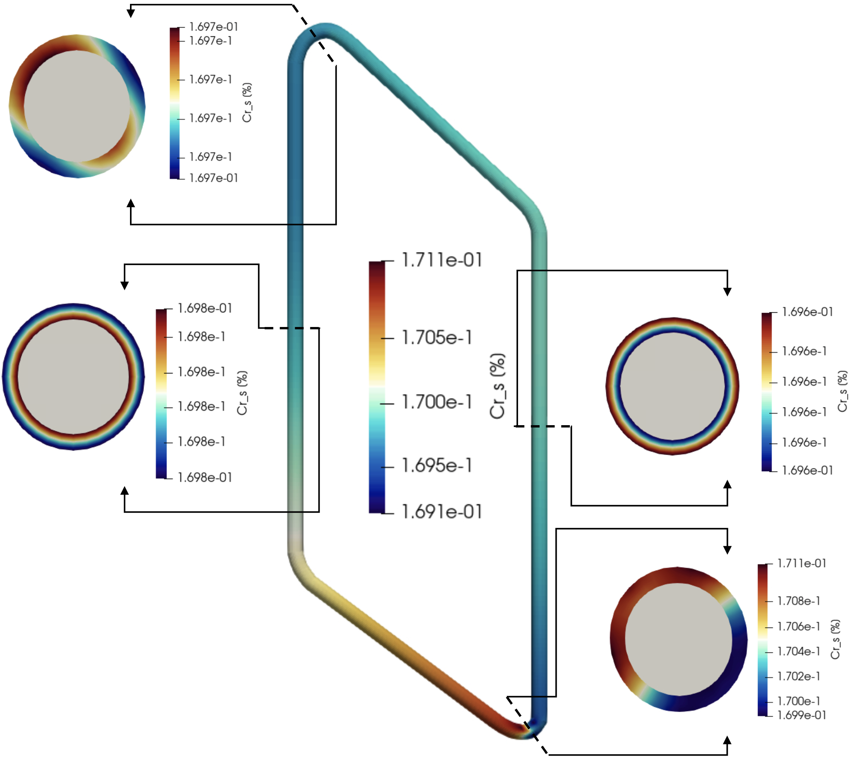
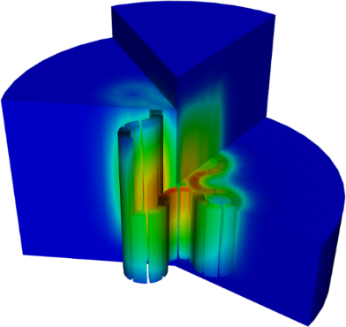
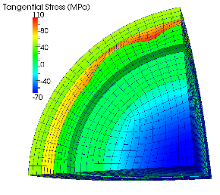
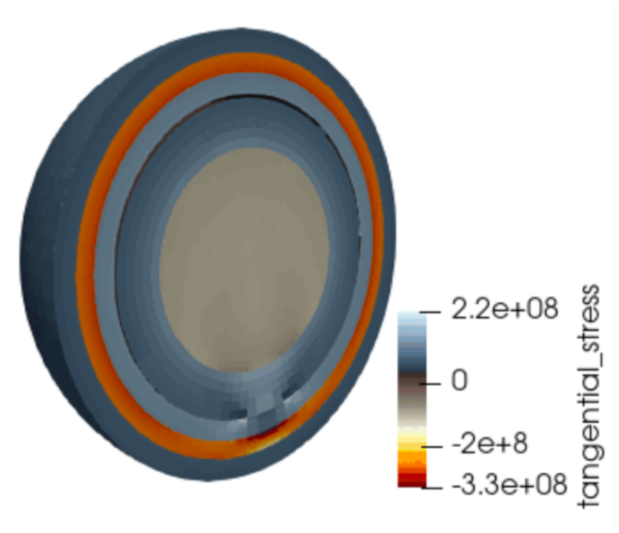

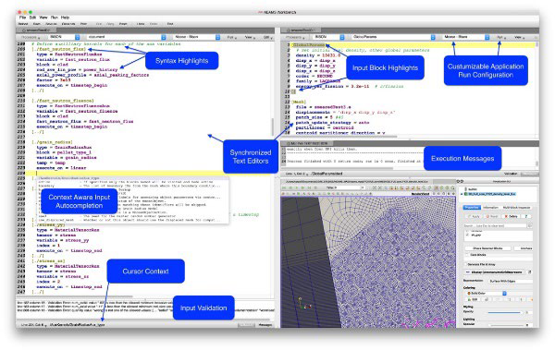
NEAMS Technical Areas and Code Support
Structural Materials and Chemistry
Reactor Physics
Thermal Fluids
Multiphysics Applications
Fuel Performance
Competencies: Multi-scale fuel and cladding performance
Codes: Bison
Lower-length-scale capabilities: DFT, MD, phase field, crystal plasticity (LAPx), cluster dynamics, phase field
Competencies: Multi-scale modeling of materials degradation and chemistry (moltens salts)
Codes: Grizzly/BlackBear, MSTDB-TC/TP, Mole, Saline, SWIFT, MOSCATO
Lower-length-scale capabilities: DFT, MD, phase field, crystal plasticity (LAPx), dislocation dynamics, cluster dynamics
Competencies: Deterministic and stochastic methods for simulating neutron transport and nuclide depletion/decay
Codes: GRIFFIN, Shift, MPACT
Competencies: Multi-scale simulations of thermal fluids and heat transfer in reactor systems
Codes: CTF, SAM, PRONGHORN, Sockeye, Nek5000/NekRS, Cardinal
Competencies: Computational frameworks, multiphysics simulations, reactor specific applications, user interfaces and workflows.
Codes and frameworks: MOOSE, VERA, Workbench
Capabilities are developed for all major reactor types – Light Water Reactors, Gas-Cooled Reactors, Molten Salt Reactors, Metal Cooled Fast Reactors and Microreactors. The reactor specific applications cross-cut the technical areas.
Key success metric: Use of NEAMS technology (either software or R&D) by stakeholder to improve how they “do business.”

Slide 10
Fast Reactors Research Plan
The research plan is driven by stakeholder needs for liquid metal fast reactors.
Develop, V&V and benchmark/demonstrate advanced capabilities for reactor operational states:
  Normal Operation and Anticipated Operational Occurrences
    Reactor physics capabilities for fuel cycle modeling, core monitoring, shielding, etc.
    Fuel performance models for metal, uranium nitride and MOX fuels and cladding materials (HT9 and others).
    Multiscale thermal fluids simulation capability for key phenomena such as thermal striping and thermal stratification.
    Qualification of A709 (supporting the ART program) and development of multi-scale materials modeling capabilities for Gr91 (method development) to support qualification (fitness for service).
  Accident scenarios (Design Basis Accidents and Beyond Design Basis Accidents)
    Reactor physics for transient scenarios including DBAs (flow blockage, etc.) and BDBAs (loss of forced flow, etc.).
    Multiphysics capability for modeling core radial expansion and accounting for core reactivity feedback effects.
    Multiphysics capabilities for impacts of thermal striping and thermal stratification on structural integrity.
    Fuel performance capabilities for FCCI, fuel melting, and cladding breach.
  Coordination of activities with DOE Fast Reactor and AFC programs.

Slide 11
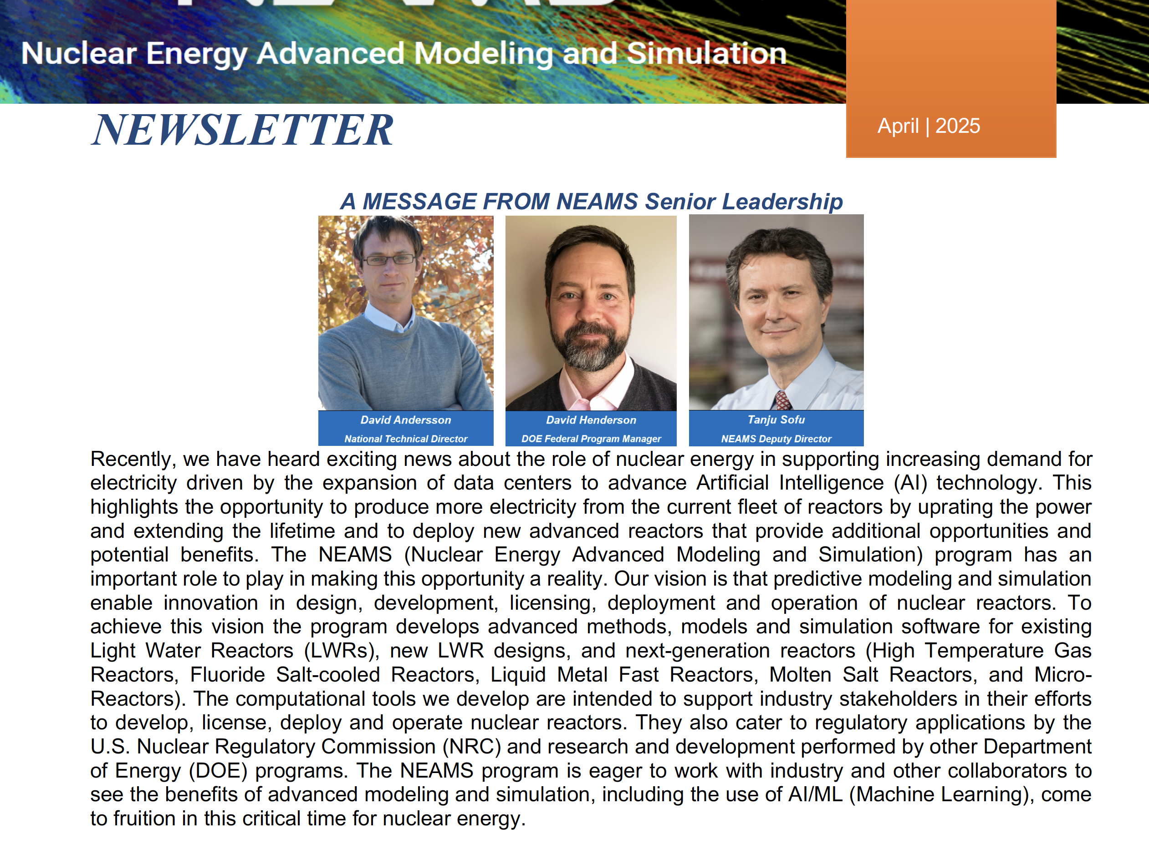
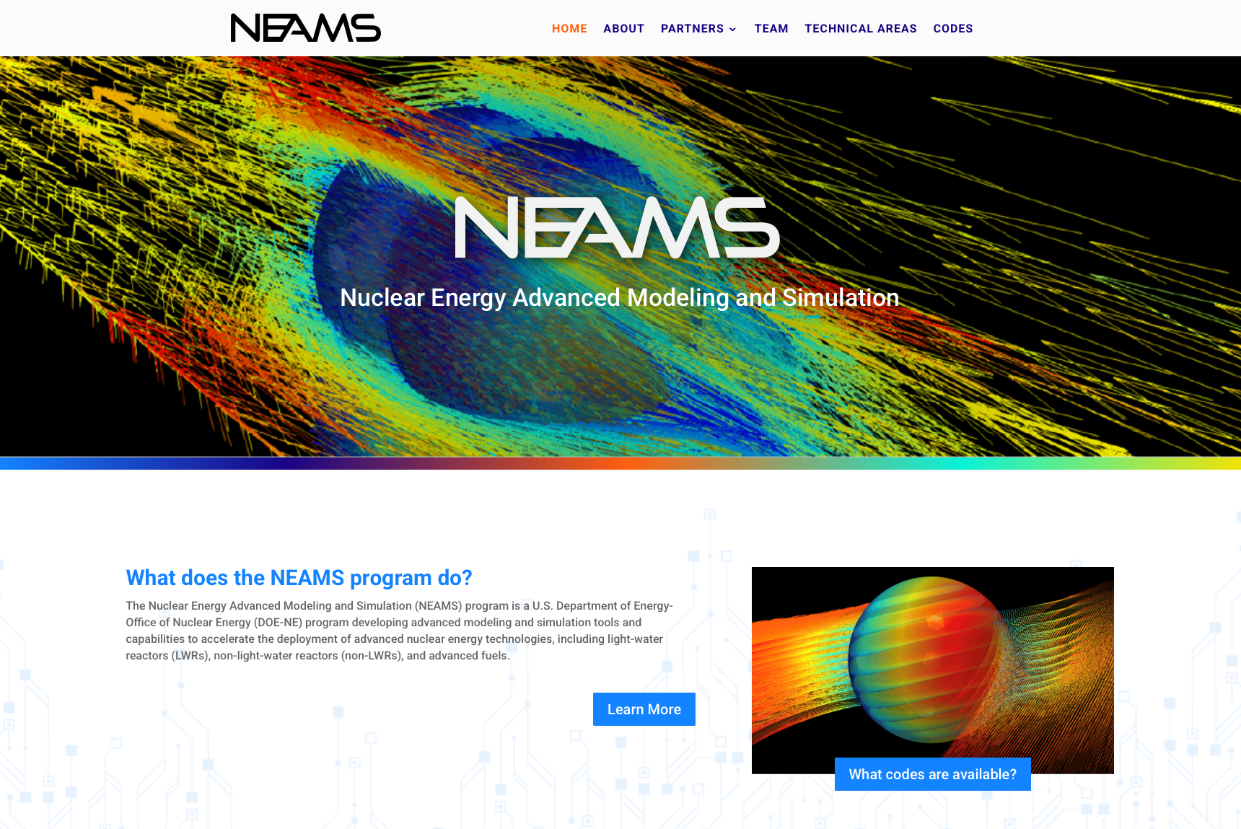
Additional Resources
We have a newsletter - contact David Andersson, andersson@lanl.gov, if you are not on the distribution list and would like to be.
We have a website – neams.inl.gov – where you can find information about the program, newsletters, and soon link to technical reports.
Request access to NEAMS codes through https://inl.gov/ncrc/.
NRIC-NEAMS collaboration on the Virtual Test Bed (VTB) - https://mooseframework.inl.gov/virtual_test_bed/ - where open models can be accessed.

