Slide 1
NEAMS Annual Review: Light Water Reactors

Slide 2
Opening Remarks and Meeting Objectives
David Andersson, NEAMS National Technical Director, Los Alamos National Laboratory
Tanju Sofu, NEAMS Deputy National Technical Director, Argonne National Laboratory
David Henderson, Federal Program Manager, U.S. Department of Energy

Slide 3
Meeting Objectives
Welcome and thank you for your interest in the DOE NEAMS (Nuclear Energy Advanced Modeling and Simulation) program!
Reviews are performed by reactor type in virtual meetings (today’s LWR meeting highlighted):
Light Water Reactors: May 7, 11:00 AM – 5:00 PM ET
High Temperature Gas-cooled and Fluoride Salt-Cooled Reactors: May 8, 11:00 AM – 4:00 PM ET
Micro-Reactors: May 12, 11:00 AM – 4:00 PM ET
Molten Salt Reactors: May 28, 11:00 AM – 4:30 PM ET
Fast Reactors: May 29, 11:00 AM – 4:30 PM ET
The objectives of this meeting are to review the work performed by the NEAMS program during the past year, solicit feedback from stakeholders, and discuss future priorities – making sure that we are aligned with the needs of the nuclear industry, regulators and broader R&D community.
We welcome and encourage feedback and constructive discussion.

Slide 4
Meeting Logistics
The meeting is virtual and utilizes Microsoft Teams.
Please mute yourself when you are not speaking.
Questions may be asked after each talk (for clarification) or during the main Q&A slot at the end of each session. We have also scheduled time at the end of the day for stakeholders to provide summary feedback and ask any final questions.
You can ask your questions or make comments in the chat, by raising your hand or by unmuting yourself and speaking up – in that order of preference.
Moderators will monitor the chat and call on people raising their hands in the order that they were raised to state their questions.
We will provide email for each presenter if you would like to have a more in-depth discussion. You can also email David Andersson, andersson@lanl.gov.

Slide 5
Agenda

Slide 6
NEAMS Overview and Light Water Reactors Research Plan
David Andersson, NEAMS National Technical Director, Los Alamos National Laboratory
Tanju Sofu, NEAMS Deputy National Technical Director, Argonne National Laboratory
David Henderson, Federal Program Manager, U.S. Department of Energy

Slide 7
NEAMS is the DOE-NE Modeling and Simulation Program
Why advanced modeling simulation of nuclear reactors?
Predictive modeling and simulation enable innovation in design, development, licensing, deployment and operation of nuclear reactors by providing high fidelity results and enhancing the value of available, but often limited, experimental data points.
The NEAMS program aims to address this need by:
Developing advanced methods, models and simulation capabilities (software) in reactor physics, thermal hydraulics, fuels, materials, chemistry and multi-physics that enhance our ability to simulate the current fleet and advanced reactors.
Utilizing and advancing new and evolving science and technology such as multi-scale simulations, AI/ML, in-line sensor data and digital twins, and advanced computing platforms to solve high-impact problems.
Supporting development, licensing, deployment and operation of nuclear reactors by stakeholders through software deployment, maintenance, baseline support, validation and verification.
Engaging in collaborations and partnerships to enable use of NEAMS tools for advances in reactor technology by stakeholders (industry, NRC, universities, other DOE programs – e.g., AFC and LWRS for LWRs, international, etc.).

Slide 8
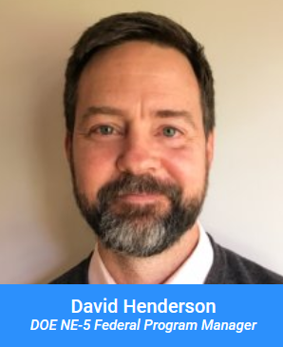
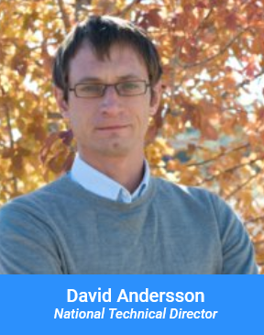
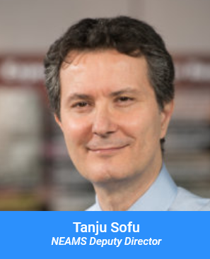
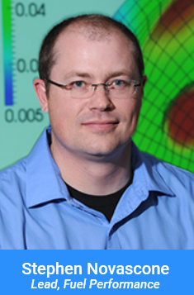
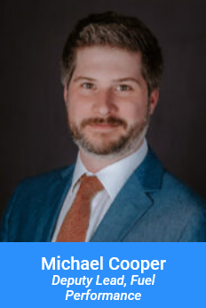
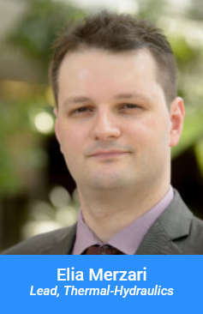

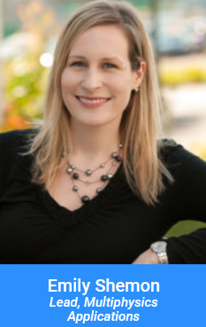
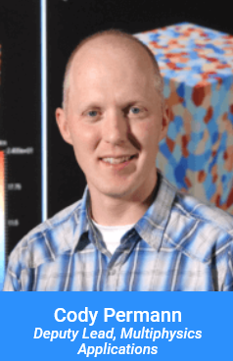
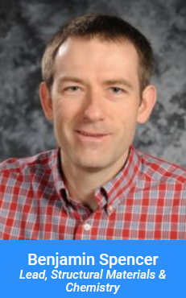
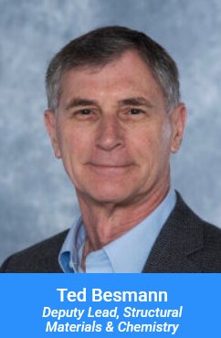
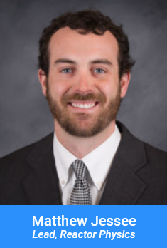
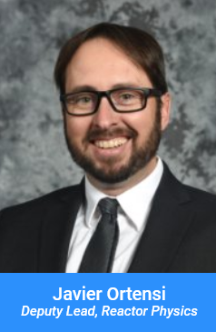
NEAMS Program Structure

Slide 9
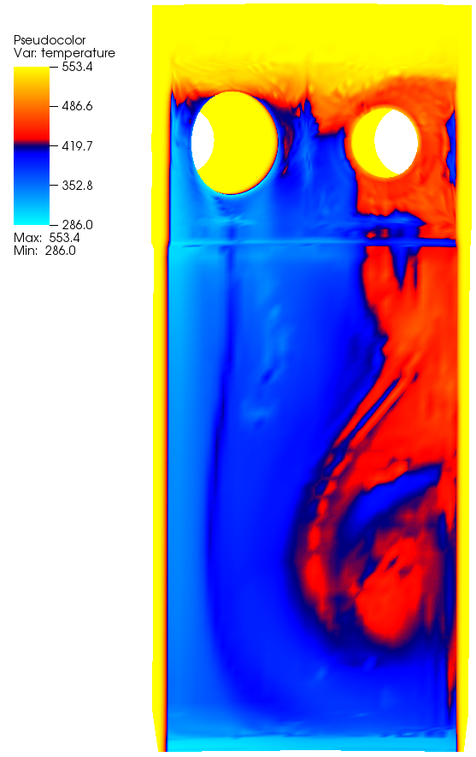
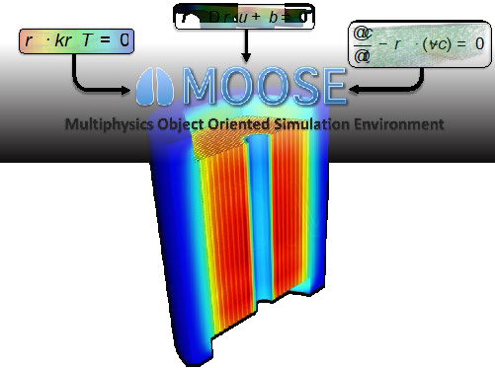
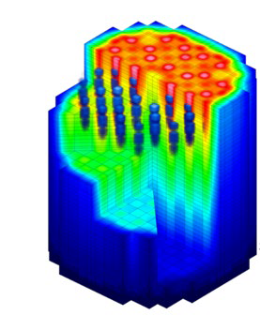
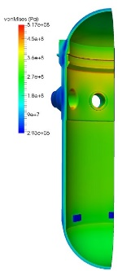
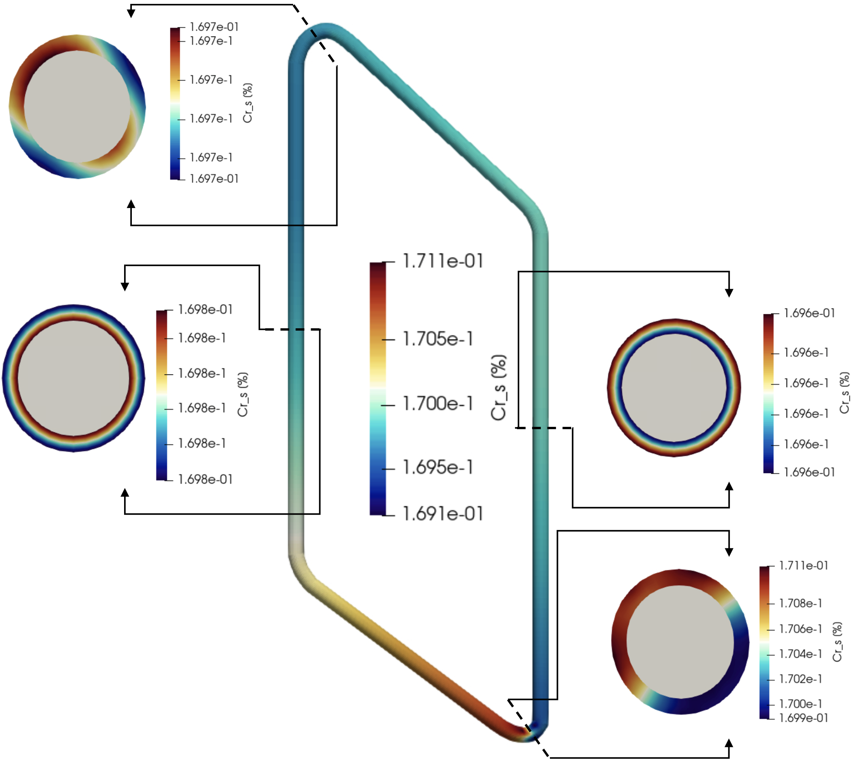
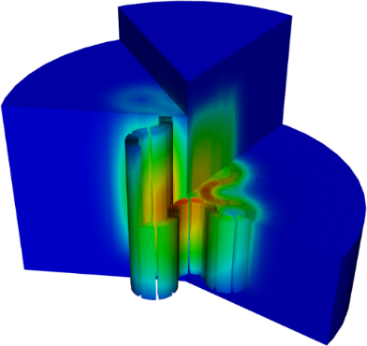
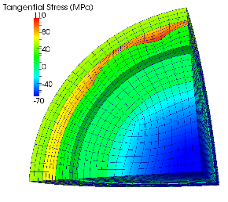
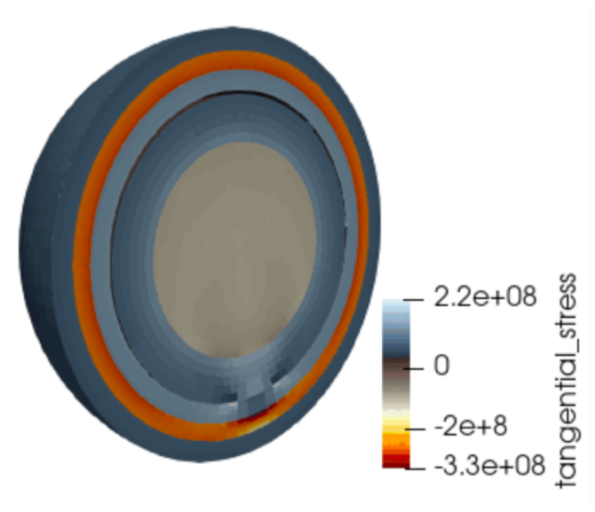

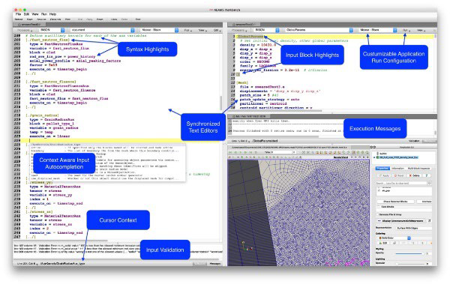
NEAMS Technical Areas and Code Support
Structural Materials and Chemistry
Reactor Physics
Thermal Fluids
Multiphysics Applications
Fuel Performance
Competencies: Multi-scale fuel and cladding performance
Codes: Bison
Lower-length-scale capabilities: DFT, MD, phase field, crystal plasticity (LAPx), cluster dynamics, phase field
Competencies: Multi-scale modeling of materials degradation and chemistry (moltens salts)
Codes: Grizzly/BlackBear, MSTDB-TC, MSTDB-TP, Mole, SWIFT, MOSCATO
Lower-length-scale capabilities: DFT, MD, phase field, crystal plasticity (LAPx), dislocation dynamics, cluster dynamics
Competencies: Deterministic and stochastic methods for simulating neutron transport and nuclide depletion/decay
Codes: GRIFFIN, Shift, MPACT
Competencies: Multi-scale simulations of thermal fluids and heat transfer in reactor systems
Codes: CTF, SAM, PRONGHORN, Sockeye, Nek5000/NekRS, Cardinal
Competencies: Computational frameworks, multiphysics simulations, reactor specific applications, user interfaces and workflows.
Codes and frameworks: MOOSE, VERA, Workbench
Capabilities are developed for all major reactor types – Light Water Reactors, Gas-Cooled Reactors, Molten Salt Reactors, Metal Cooled Fast Reactors and Microreactors. The reactor specific applications cross-cut the technical areas.
Key success metric: Use of NEAMS technology (either software or R&D) by stakeholder to improve how they “do business.”

Slide 10
Light Water Reactors Research Plan
The research plan is driven by the needs of our stakeholders.
Enhance capabilities to support burnup extension.
Develop capabilities for time@Temperature to support power uprates.
Enhance capabilities for Crud Induced Power Shift (CIPS) and Crud Induced Localized Corrosion (CILC) for burnup extension and power uprates.
Develop advanced capability for Fuel Performance modeling of advanced or Accident Tolerant Fuels (ATFs).
Develop and refine capabilities for engineering-scale modeling of structural performance under environmental degradation.
The scope covers both PWRs and BWRs. Many fundamental models are shared.
Coordination of activities with DOE AFC and LWRS programs.

Slide 11
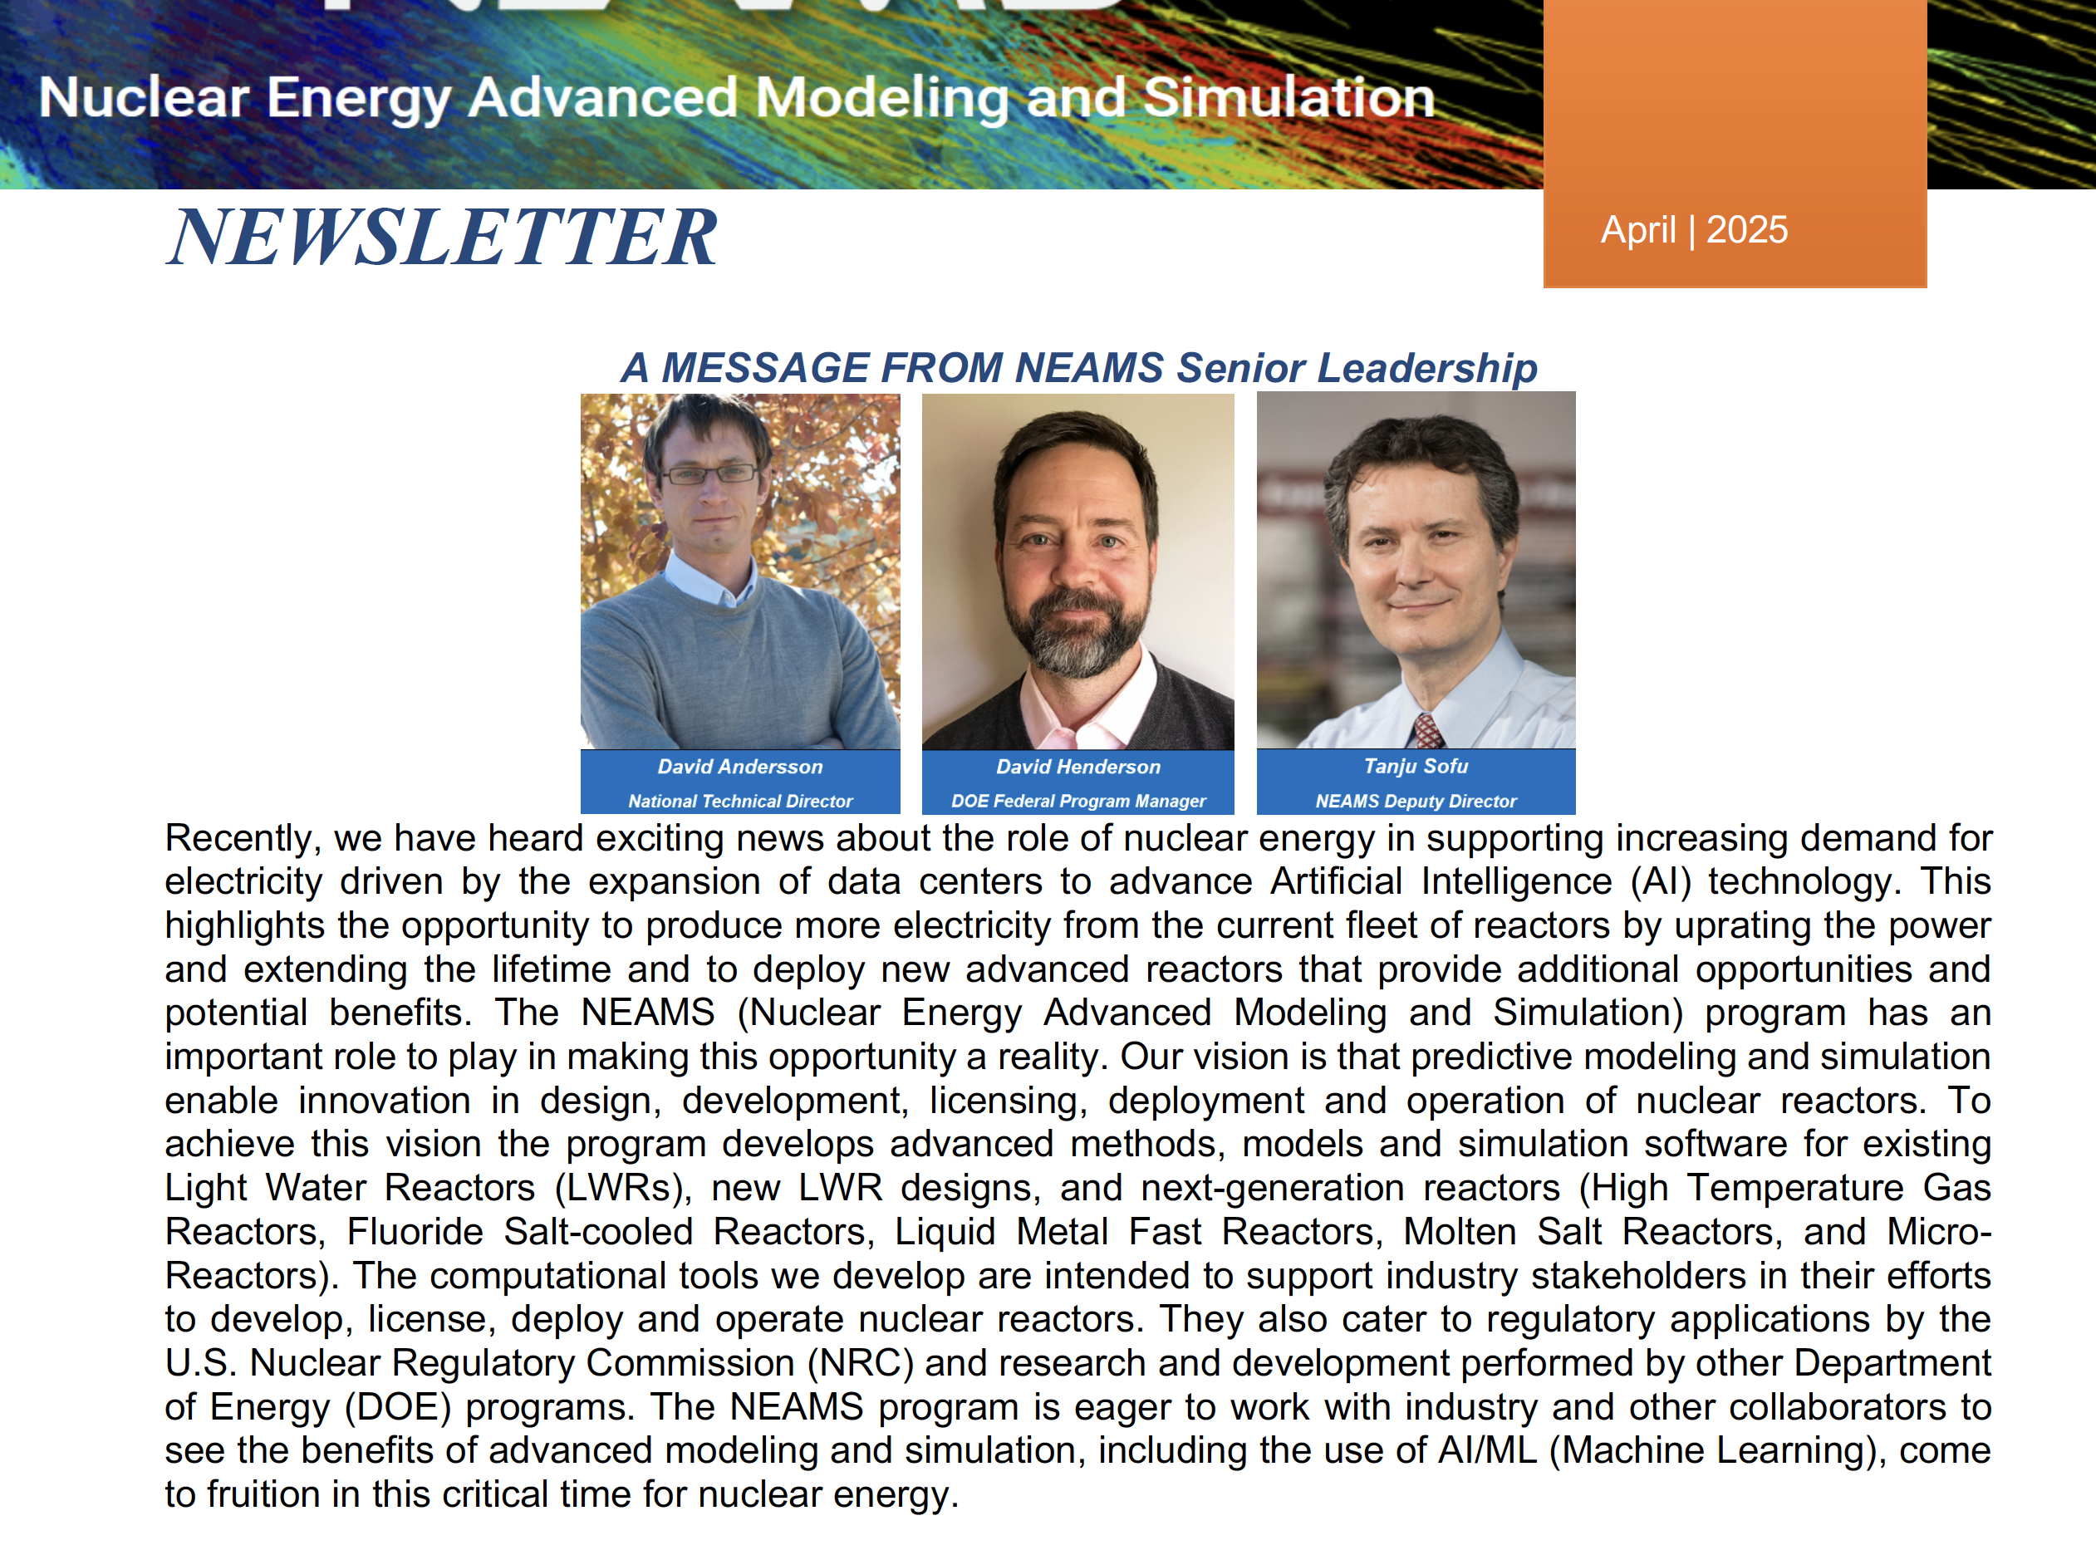
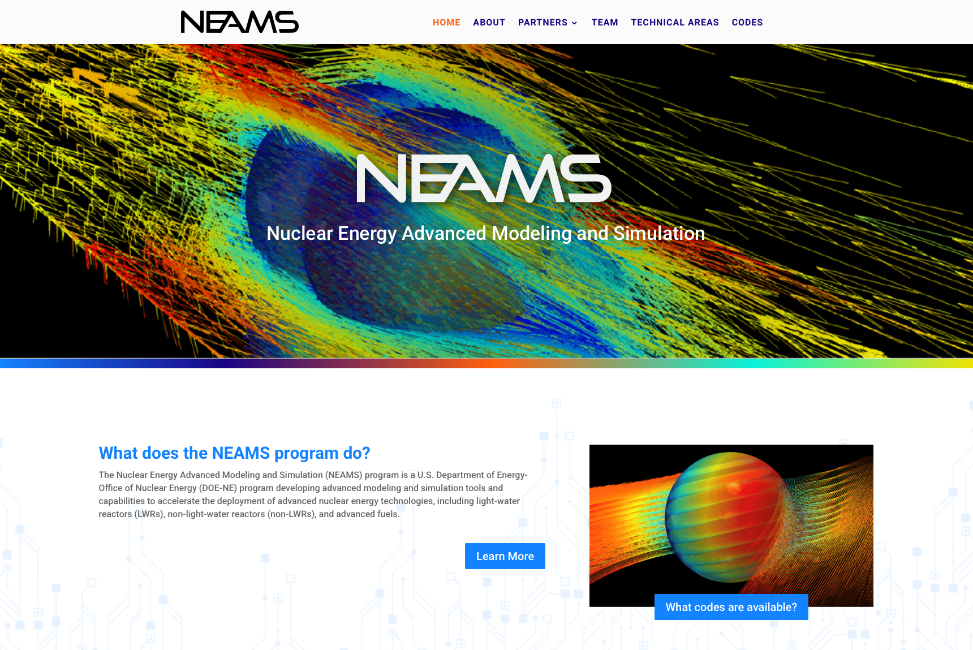
Additional Resources
We have a newsletter - contact David Andersson, andersson@lanl.gov, if you are not on the distribution list and would like to be.
We have a website – neams.inl.gov – where you can find information about the program, newsletters, and soon link to technical reports.
Request access to NEAMS codes through https://inl.gov/ncrc/.
NRIC-NEAMS collaboration on the Virtual Test Bed (VTB) - https://mooseframework.inl.gov/virtual_test_bed/ - where open models can be accessed.

