Slide 1
Cladding Model Development For Time at Temperature
L. Capolungo, A. Rovinelli, M-J. Chen, N. Millitello, S. Blondel, B. Wirth

Slide 2
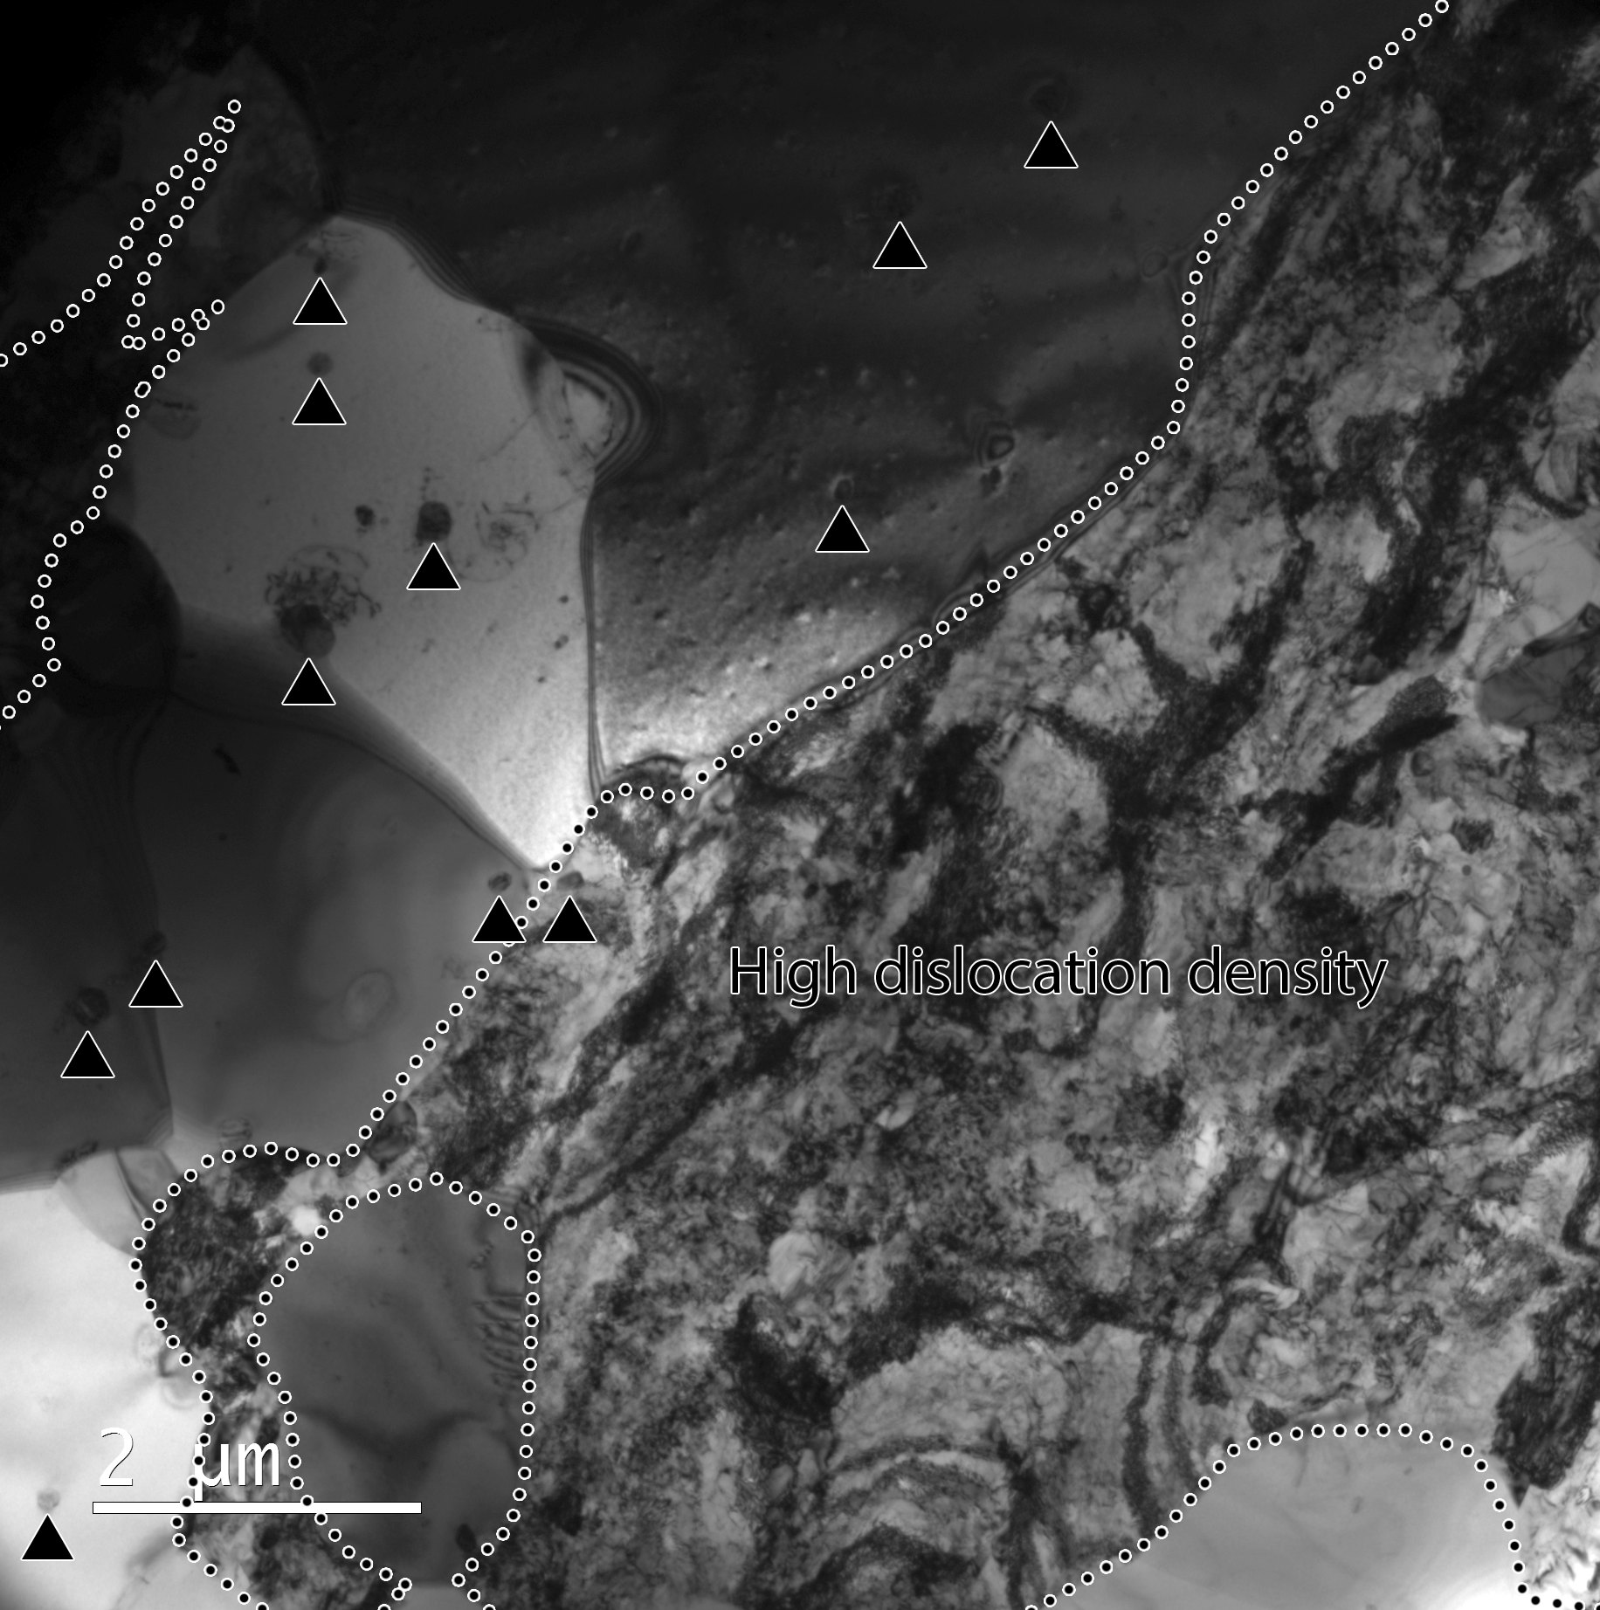
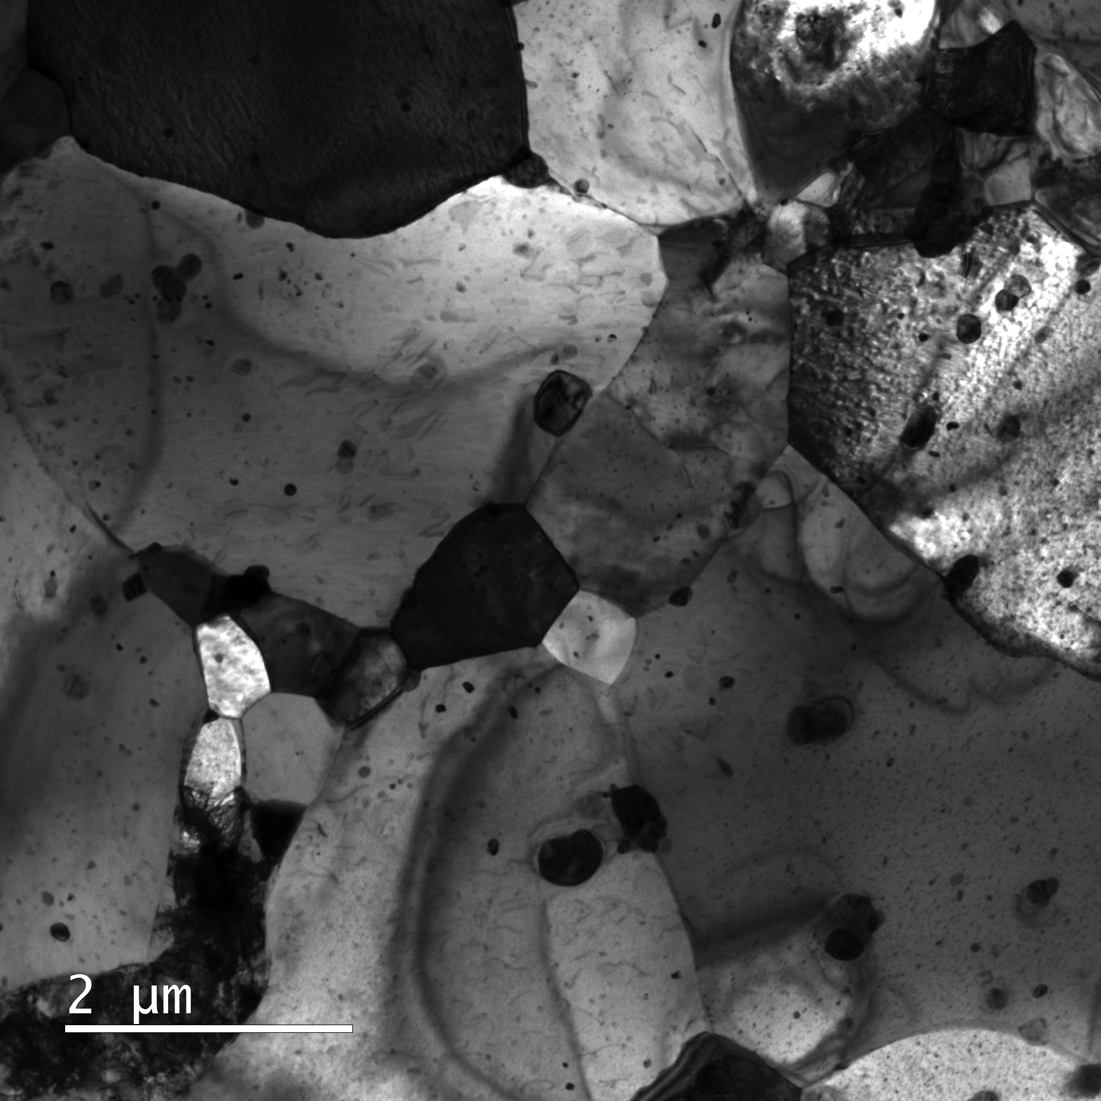
T@T: Problem Statement
Question: What is the impact of a T@T event on the mechanical performance of Zircaloy cladding?
Challenge: Several microstructure evolution processes will be activated during T@T:
Dislocation line recovery
Irradiation loop recovery
Recrystallization
Precipitations, etc.
All of these processes depend on the microstructure of the material when T@T occurs.
How to quantify the relative and absolute roles of each of these processes on mechanical performance?
Zircaloy 4: Microstructure at 200C*
Zircaloy 4: Microstructure after temperature hold at 800C*
* Courtesy of B. Eftink

Slide 3
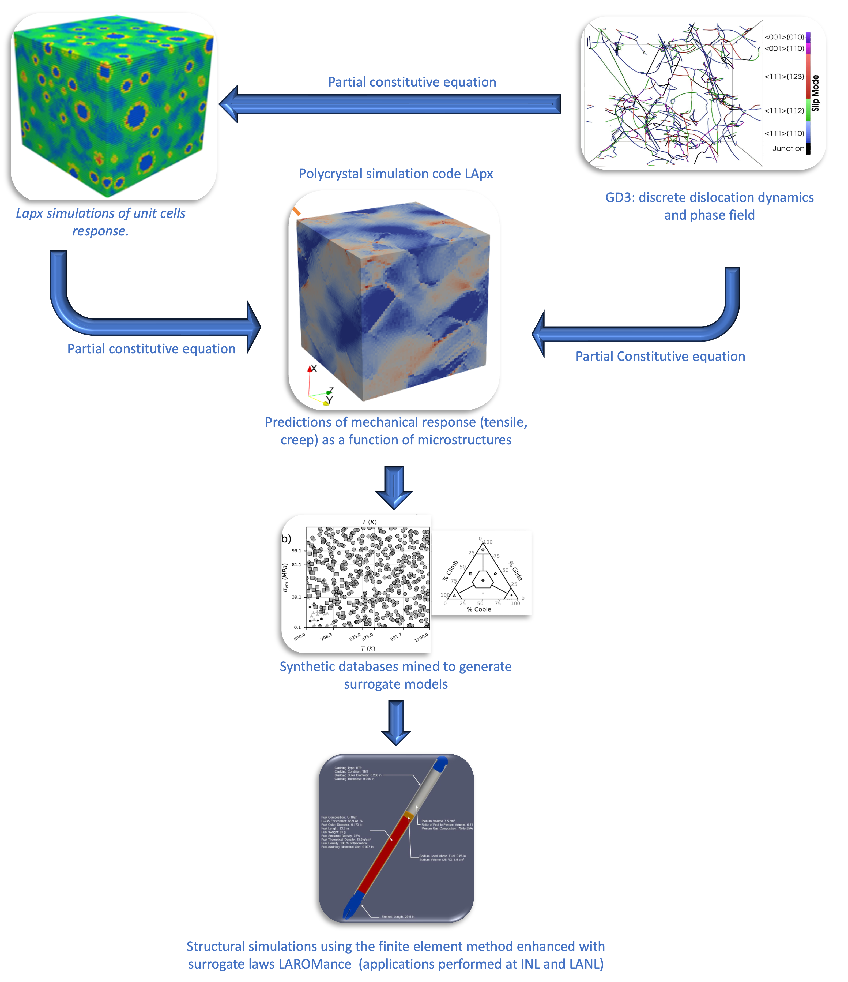
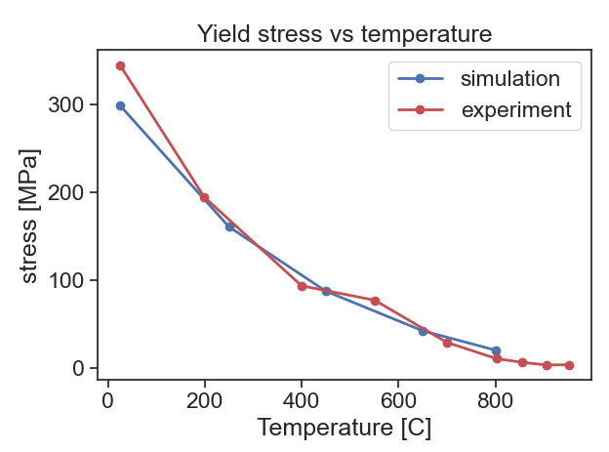
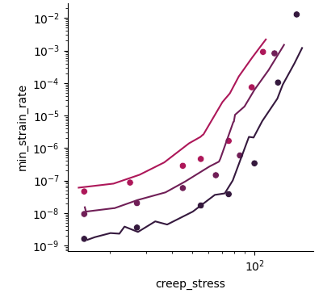
T@T Strategy: Mechanistic Multiscale Models Can be Used to Predict and Rationalize T@T
LApx polycrystal simulation solver for the mechanical response of materials.
LApx captures:
Grain size effects,
Texture,
Dislocation (storage, recovery)
Precipitate (hardening)
Solutes (strengthening)
Irradiation hardening
LApx captures the tensile response of Zircaloy as a function temperature.
The creep response as a function of temperature and stress
Future extensions:
Recrystallization
Cluster dynamics coupling
[1,2]
experiment
~9
~4
~1

Slide 4
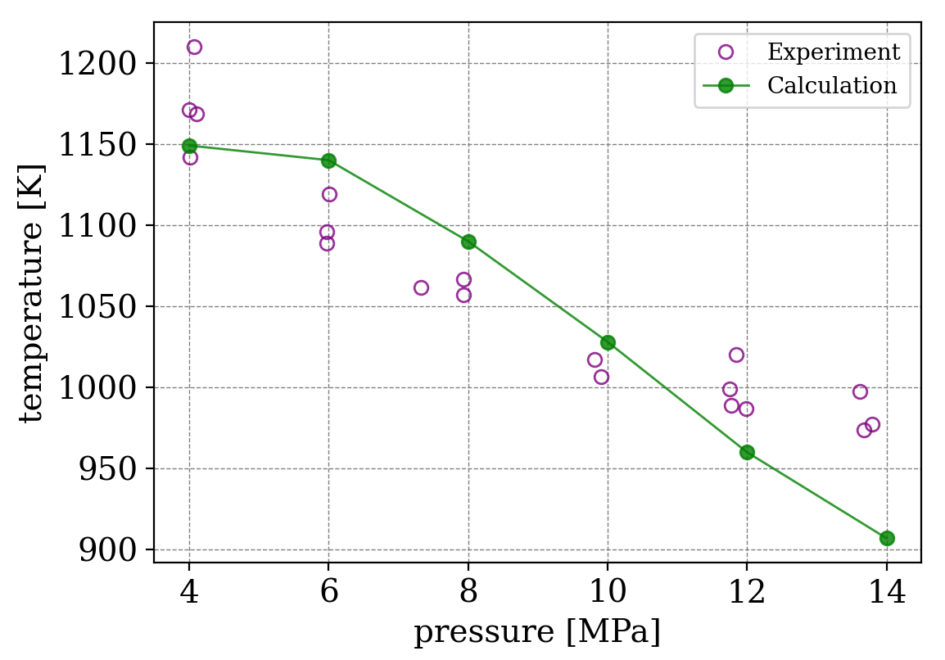
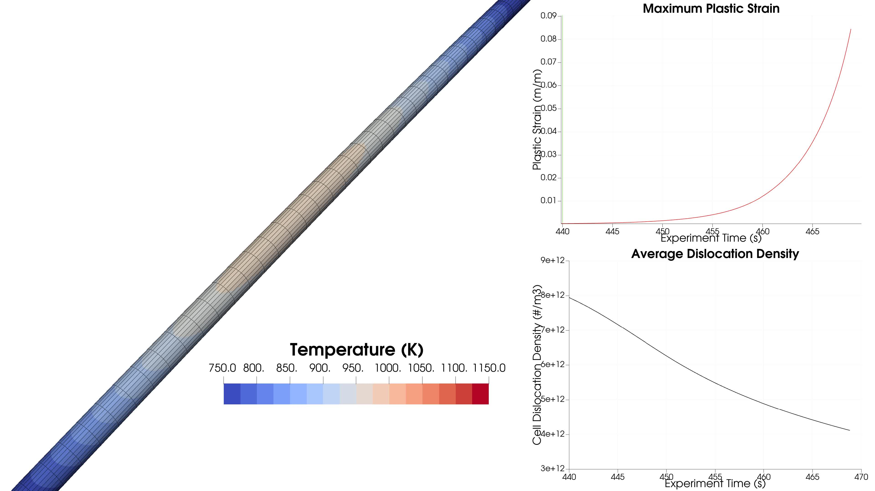
T@T strategy: mechanistic multiscale models can be used to predict and rationalize T@T
LAROMance are microstructure sensitive surrogate models for the response of metals under arbitrary loading scenarios
A LAROMance Zircaloy model was developed and integrated in MOOSE/BISON
LAROMance Zircaloy is found to be able to blindly predict off normal loading scenarios (Rebeka tests)
Future extensions:
Generalize LAROMance to capture grain size, precipitate and irradiation effects
REBEKA tests: Validation of LApx approach
Courtesy of R. Sweet
Burst simulation using LAROMance
The idea: Both Microstructure informed polycrystal (LApx) and surrogate models (LAROMance) can be used to study and rank the likely impact of different microstructure features on the response post T@T

Slide 5

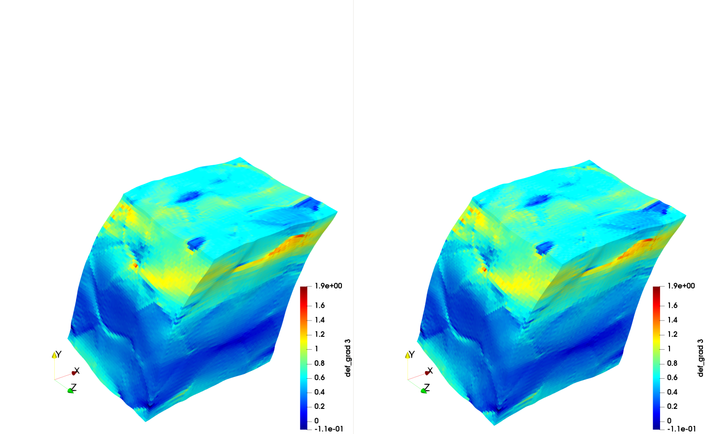
LApx: A High Fidelity and Numerically Efficient Polycrystal Code
Predicts the behavior of composite and engineering materials, including damage and ductile failure (for any constitutive model), under extreme environments
Creep
Fatigue
Complex Loadings
Chemo-mechanical solver
Cyclic load
Dislocation glide
(Cross slip, DSA)
Damage nucleation growth coalescence
Vacancy diffusion mediated plasticity
MATERIAL FINGERPRINT
DISLOCATION CONTENT
DISLOCATION ARRANGEMENT (CELLS VS CELL WALLS)
SOLUTE CONTENT
NON EQUILIBRIUM POINT DEFECTS (INTERSITIALS, VACANCIES, CLUSTERS)
EQUILIBRIUM PRECIPITATES
NON-EQUILIBRIUM PRECIPITATES
TEXTURE
Grain MORPHOLOGY AND SIZE
Ageing
(thermal irradiation)
Zecevic, Lebensohn, Capolungo, MoM, 2022

Slide 6

What is the role of irradiation loop recovery (assume full recovery takes place)?
What is the role of static recovery of dislocations?
What is the role of recrystallization?
Prior to develop models for the dynamic evolution of the microstructure, let us use LApx to bound the problem.

Slide 7
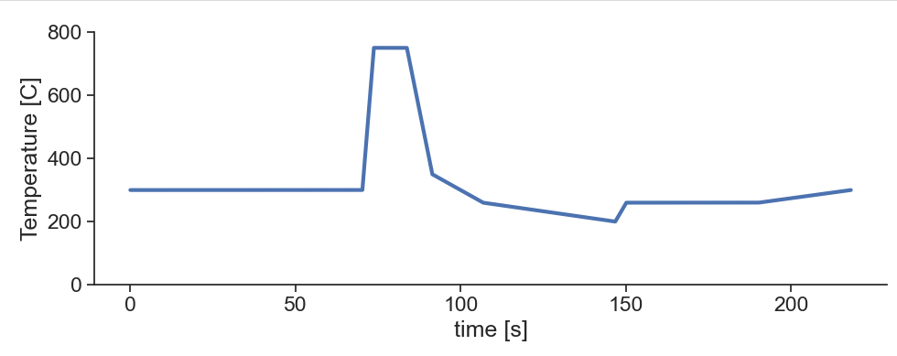

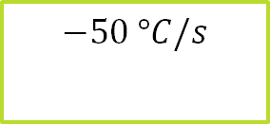

Time at Temperature Effects
$10 s$ at $750 °C$
$$130 °C/s$$
$$−50 °C/s$$

Slide 8
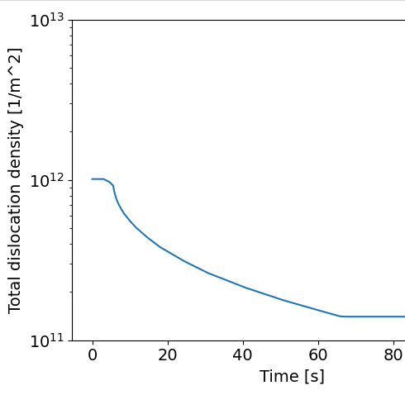
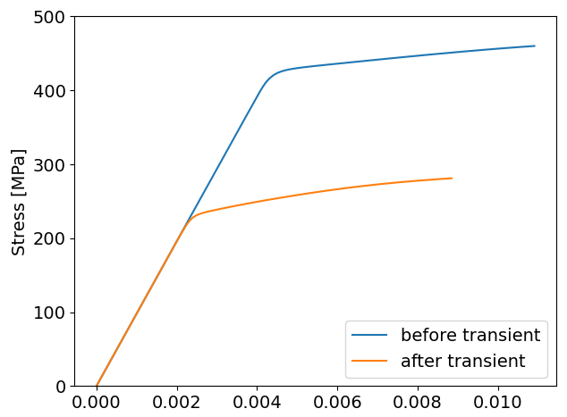
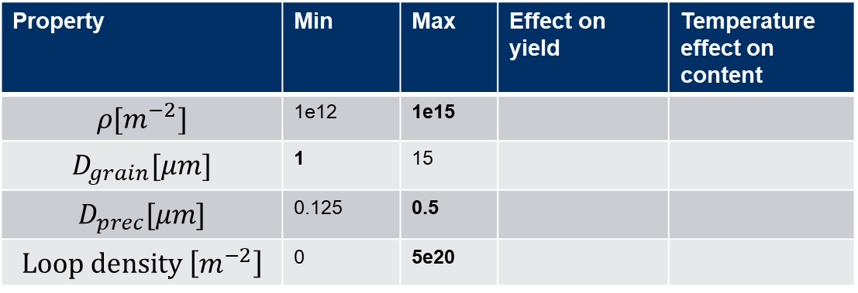



Time at Temperature Effects
2 slides
Property | Min | Max | Effect on yield | Temperature effect on content
$$ρ[m^{−2}]$$ | 1e12 | 1e15
$$D_{grain}[μm]$$ | 1 | 15
$$D_{prec}[μm]$$ | 0.125 | 0.5
$$Loop density \left[m^{−2}\right]$$ | 0 | 5e20
Effect of high t@T
Static recovery
$60 s$ at $750 °C$
Can we identify which microstructure features provides the largest change?
$$130 °C/s$$
$$−50 °C/s$$
Direct effect
Increase density/size
Inverse effect
Decrease density/size

Slide 9
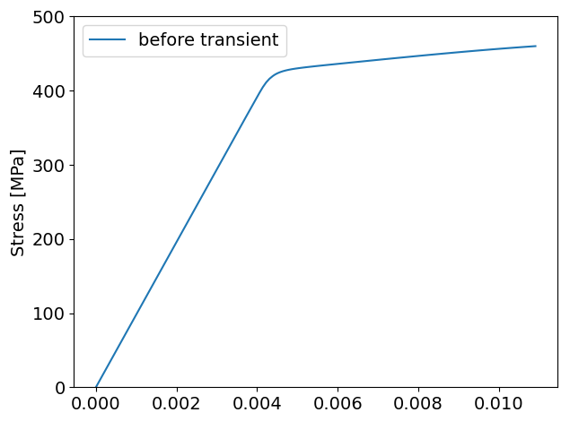
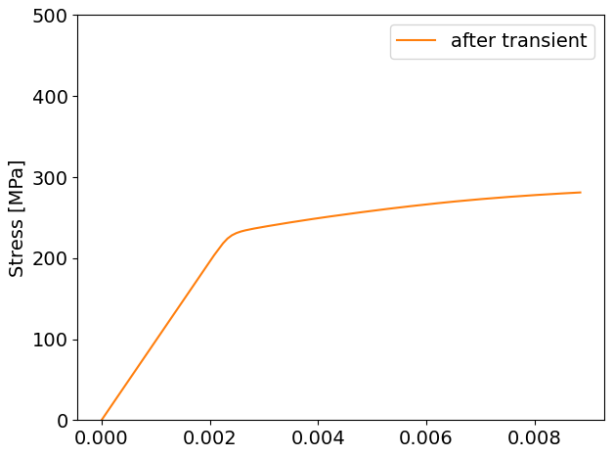
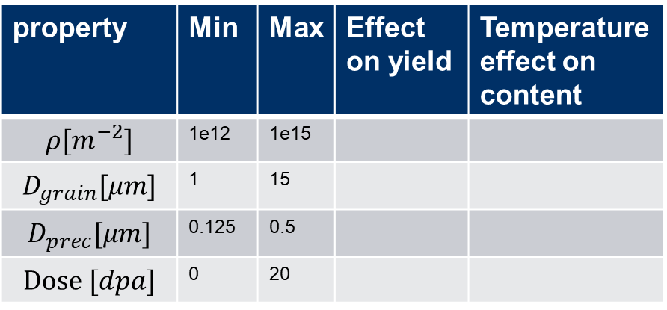


Time at Temperature Effects
2 slides
property | Min | Max | Effect on yield | Temperature effect on content
$$ρ[m^{−2}]$$ | 1e12 | 1e15
$$D_{grain}[μm]$$ | 1 | 15
$$D_{prec}[μm]$$ | 0.125 | 0.5
$$Dose [dpa]$$ | 0 | 20
Different mechanical behavior
Static recovery
$60 s$ at $750 °C$
Can we identify which microstructure features provides the largest change?
$$130 °C/s$$
$$−50 °C/s$$
Direct effect
Increase density/size
Inverse effect
Decrease density/size
Strain accumulates over

Slide 10
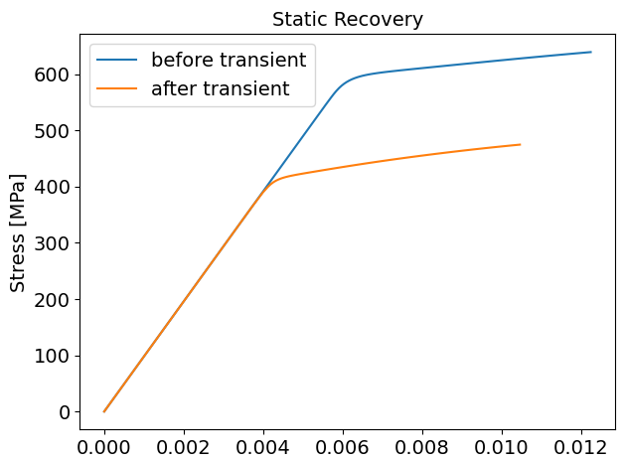
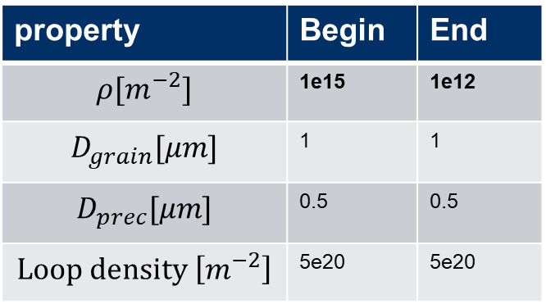
Static Recovery:
The reference is the strongest microstructure:
fine grain
high dislocation density
high precipitate density
and high density of dislocation loops (20 dpa).
The scenario represents only dislocation recovery
property | Begin | End
$$ρ[m^{−2}]$$ | 1e15 | 1e12
$$D_{grain}[μm]$$ | 1 | 1
$$D_{prec}[μm]$$ | 0.5 | 0.5
$$Loop density \left[m^{−2}\right]$$ | 5e20 | 5e20

Slide 11
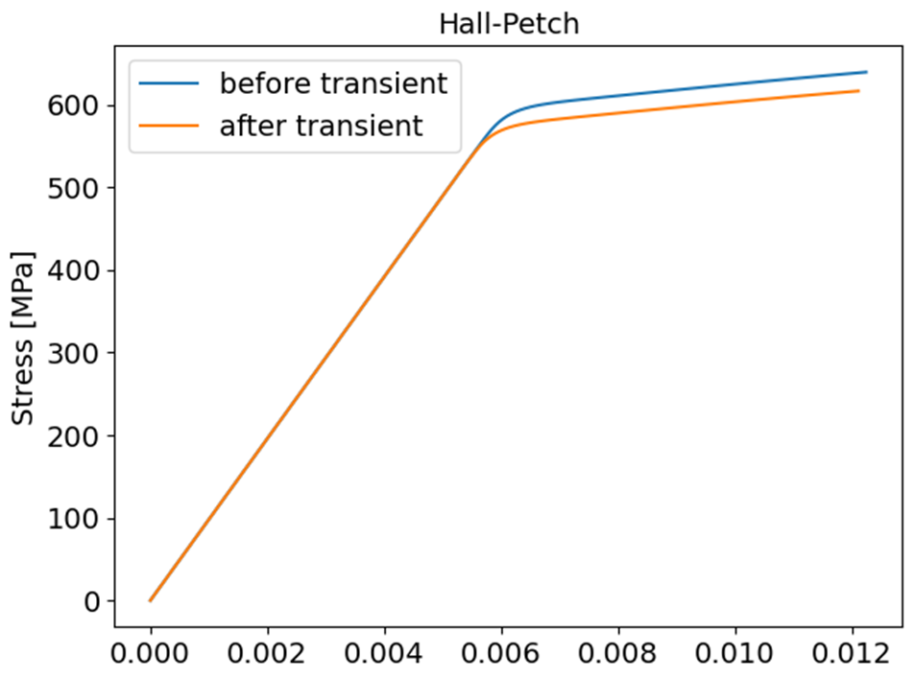
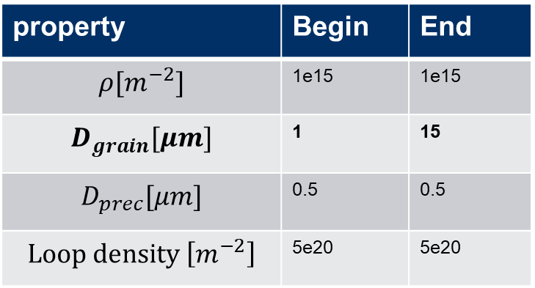
Hall Petch (Grain Size) Effect
We assume the transient will only change grain size without affecting other properties
property | Begin | End
$$ρ[m^{−2}]$$ | 1e15 | 1e15
$$D_{grain}[μm]$$ | 1 | 15
$$D_{prec}[μm]$$ | 0.5 | 0.5
$$Loop density \left[m^{−2}\right]$$ | 5e20 | 5e20

Slide 12
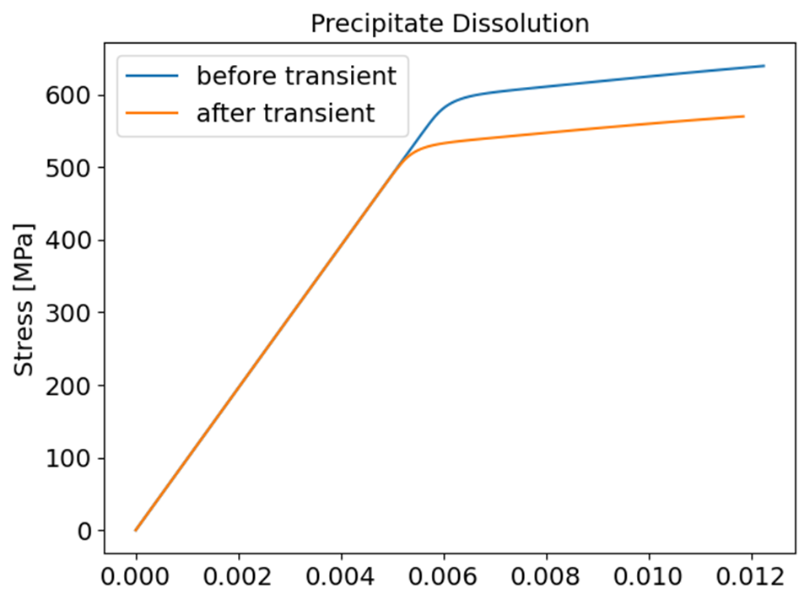
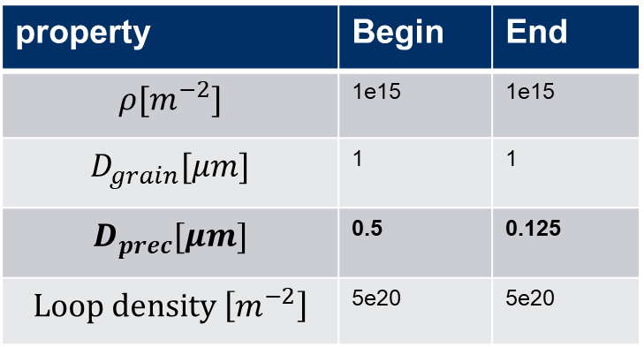
Precipitate Dissolution
We assume precipitate will dissolve and any other feature to stay the same
property | Begin | End
$$ρ[m^{−2}]$$ | 1e15 | 1e15
$$D_{grain}[μm]$$ | 1 | 1
$$D_{prec}[μm]$$ | 0.5 | 0.125
$$Loop density \left[m^{−2}\right]$$ | 5e20 | 5e20

Slide 13
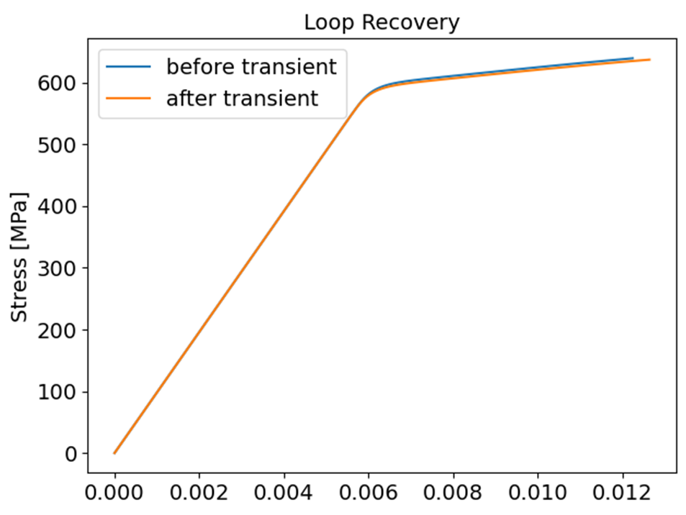
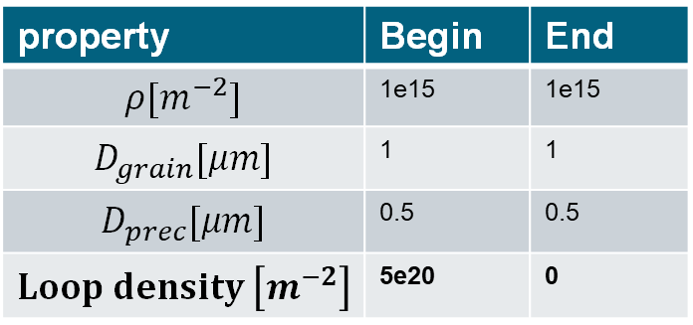
Loop Recovery Effect:
Dislocation loops will dissolve during the high temperature transient
property | Begin | End
$$ρ[m^{−2}]$$ | 1e15 | 1e15
$$D_{grain}[μm]$$ | 1 | 1
$$D_{prec}[μm]$$ | 0.5 | 0.5
$$Loop density \left[m^{−2}\right]$$ | 5e20 | 0

Slide 14
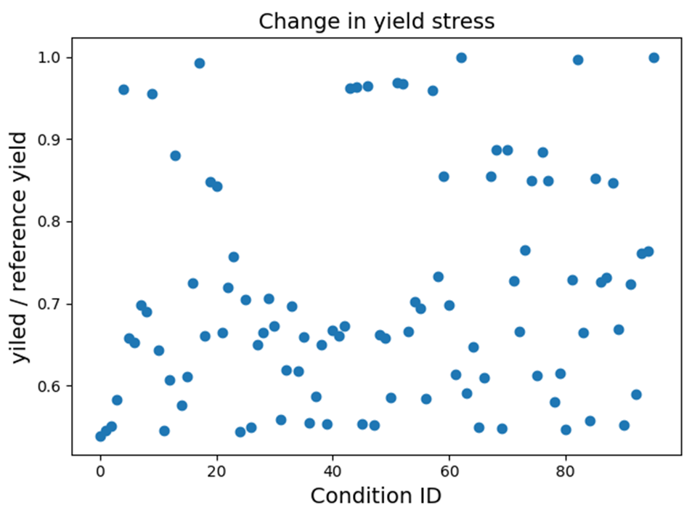
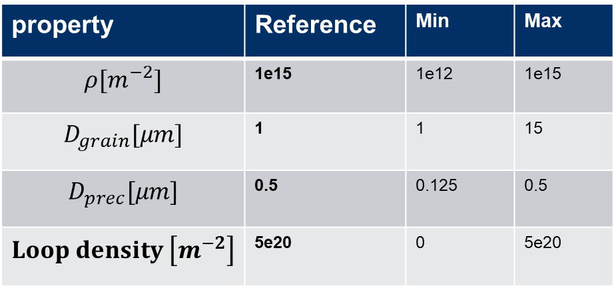
Compounded Effects
The reference stress is selected as the condition with the highest yield stress to start with.
property | Reference | Min | Max
$$ρ[m^{−2}]$$ | 1e15 | 1e12 | 1e15
$$D_{grain}[μm]$$ | 1 | 1 | 15
$$D_{prec}[μm]$$ | 0.5 | 0.125 | 0.5
$$Loop density \left[m^{−2}\right]$$ | 5e20 | 0 | 5e20

Slide 15

Comparison with Experimental Data
Hardness is directly proportional to yield
[1]
[1] Courtesy of Nathan Caps ORNL
The range of variation in the yield strength is within the range of the variation observed in from LApx simulations

Slide 16
Comparison with Experimental Data
Hardness is directly proportional to yield
[1]
Which features provides the greatest contribution to recovery?
[1] Courtesy of Nathan Caps ORNL
The range of variation in the yield strength is within the range of the variation observed in from LApx simulations

Slide 17

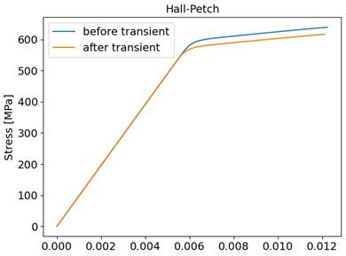

Contribution to Yield Reduction
Dislocation recovery provides the largest change in yield strength (~30%)
Precipitate dissolution ~10%
Hall-Petch (grain size) ~5%
1
2
During dynamic recrystallization dislocation recovers because of:
Annealing
GB migration
Recrystallization is a dynamic effect that need to be included to include the dynamic effect time at temperature
3
4

Slide 18
Can irradiation induced loops evolve drastically during T@T?

Slide 19
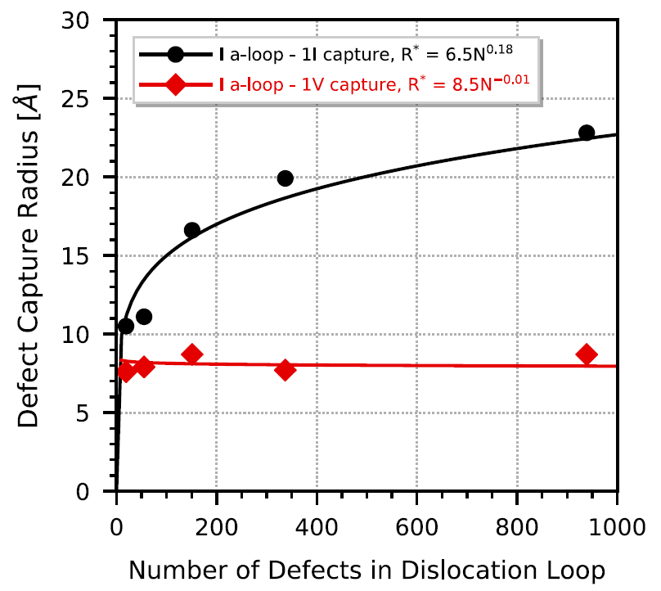
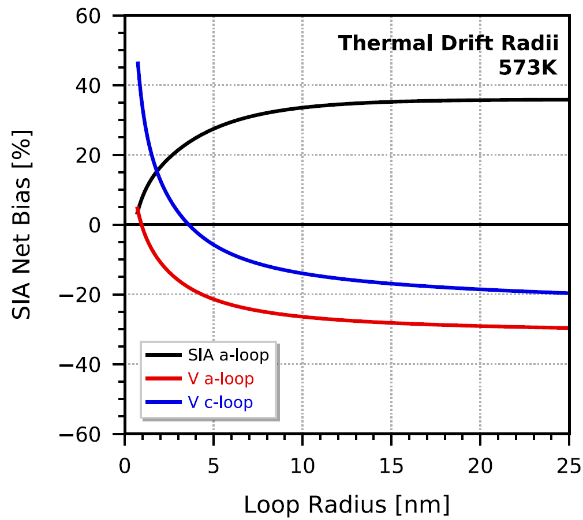
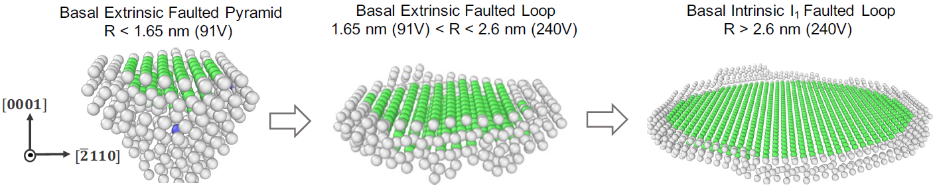
Xolotl α-Zr Overview
Cluster dynamics model that describes microstructural change of α-Zr through rate theory approach
Key model parameters informed through DFT, MS, and MD simulations rather than simplifying assumptions
Defect cluster production directly in energetic cascades
dislocation loop binding energies
defect capture radii
mobile defect diffusivity and anisotropy
Simultaneous nucleation and growth of vacancy and interstitial a-type dislocation loops achieved through bias for self capture
Vacancy c-loops introduced through evolution of pyramidal defects introduced directly in energetic cascades
Strongly correlated with rapid ‘breakaway’ growth mechanism
J. F. March-Rico, “Scale Bridging Computational Modeling of Irradiation Effects in Alpha-Zirconium and its Alloys,” University of Tennessee, 2022

Slide 20
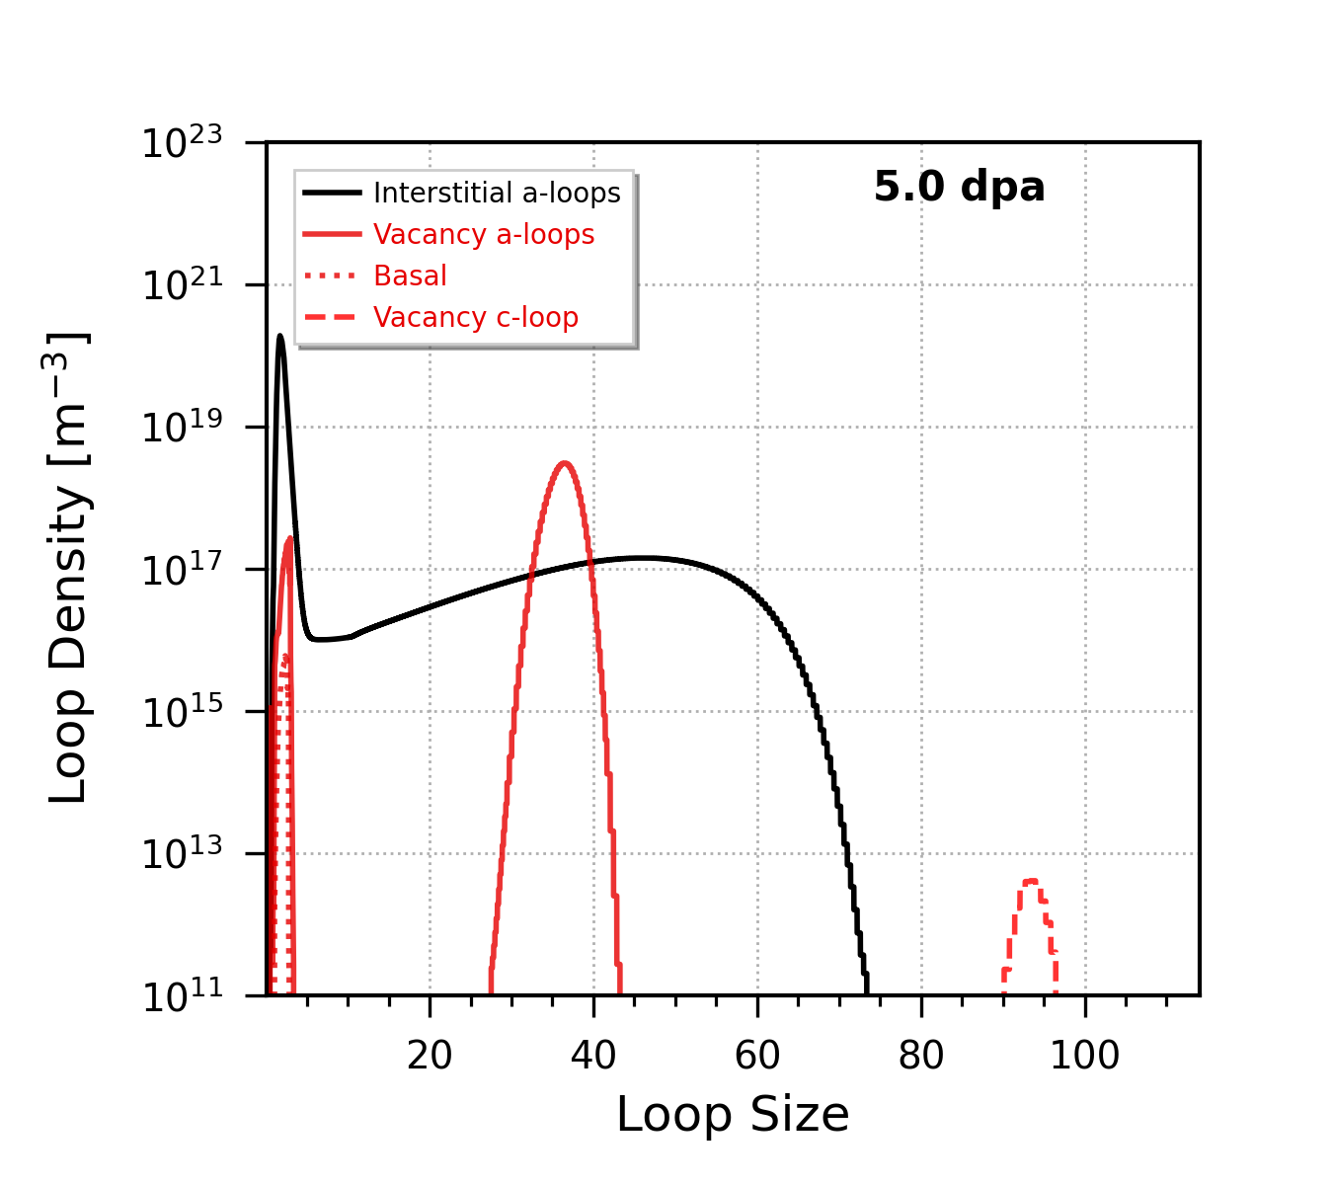
Microstructure Changes During T@T: Irradiation Loops
5 dpa
final vac a-loop
defect density: 5.691e+21 m⁻³
atom density: 5.671e+25 m⁻³
avg diameter: 32.52 nm
5 dpa
post ramp
final vac a-loop
defect density: 1.664e+21 m⁻³
atom density: 7.338e+24 m⁻³
avg diameter: 20.545 nm

Slide 21
Microstructure Changes During T@T: Irradiation Loops
final vac a-loop
defect density: 5.691e+21 m⁻³
atom density: 5.671e+25 m⁻³
avg diameter: 32.52 nm
5 dpa
5 dpa
post ramp
final vac a-loop
defect density: 1.664e+21 m⁻³
atom density: 7.338e+24 m⁻³
avg diameter: 20.545 nm

Slide 22
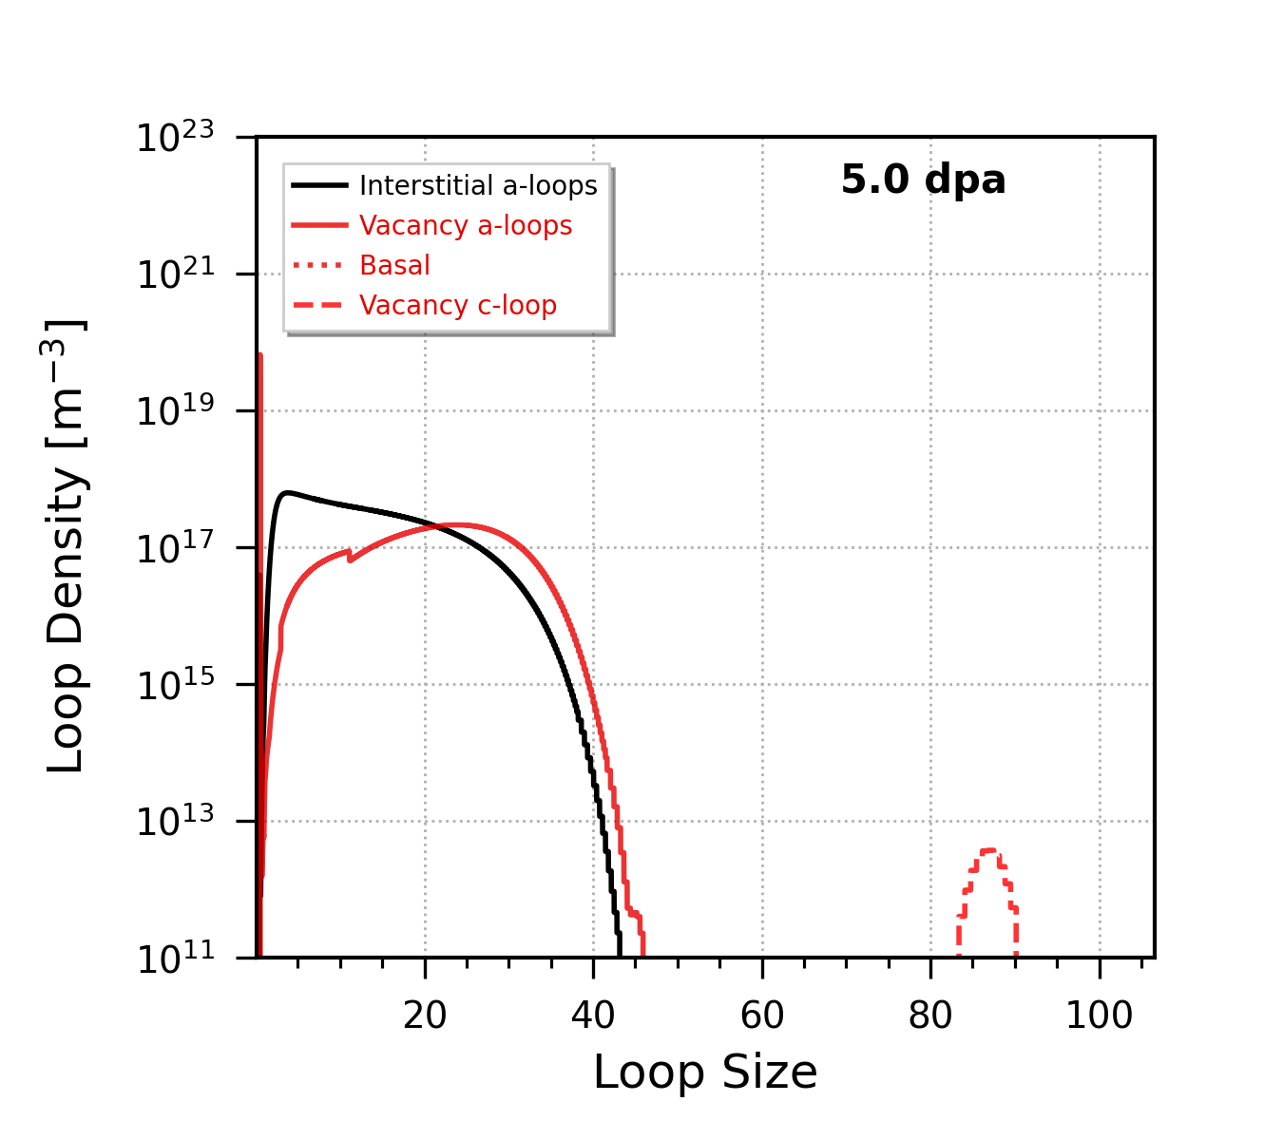
Microstructure Changes During T@T: Irradiation Loops
final vac a-loop
defect density: 5.691e+21 m⁻³
atom density: 5.671e+25 m⁻³
avg diameter: 32.52 nm
final basal
defect density: 1.873e+17 m⁻³
atom density: 1.541e+21 m⁻³
avg diameter: 11.849 nm
final int a-loop
defect density: 7.810e+21 m⁻³
atom density: 5.626e+25 m⁻³
avg diameter: 17.844 nm
5 dpa
20 K/s ramp
to 1100K
w/ irrad.
5 dpa
post ramp
final vac a-loop
defect density: 1.664e+21 m⁻³
atom density: 7.338e+24 m⁻³
avg diameter: 20.545 nm
final basal
defect density: 2.01e+16 m⁻³
atom density: 1.33e+21 m⁻³
avg diameter: 87.241 nm
final int a-loop
defect density: 2.09e+21 m⁻³
atom density: 7.025e+24 m⁻³
avg diameter: 17.3 nm

Slide 23
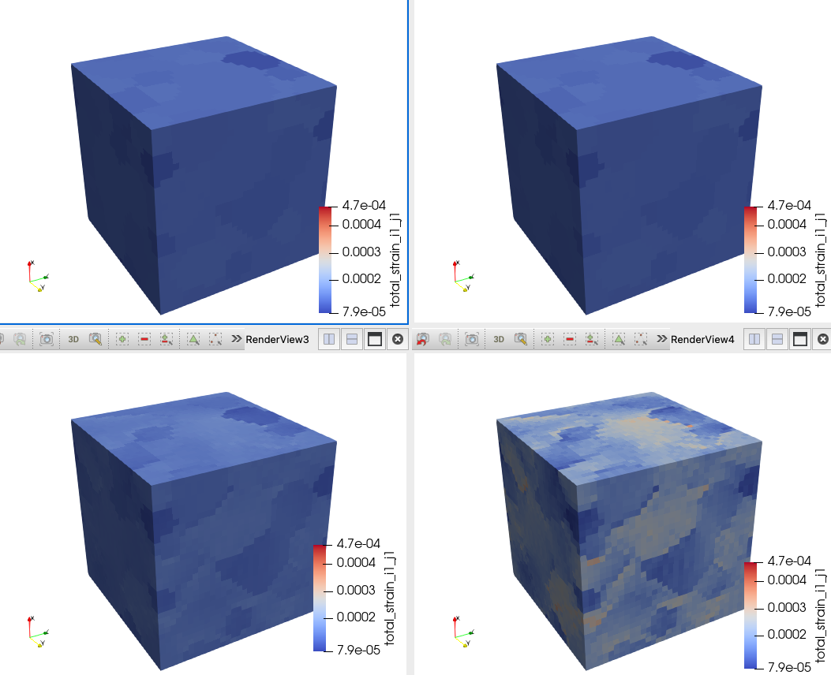
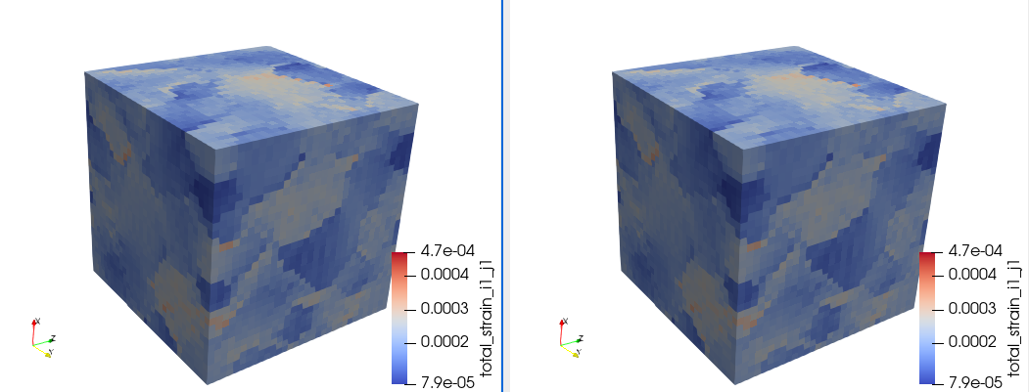
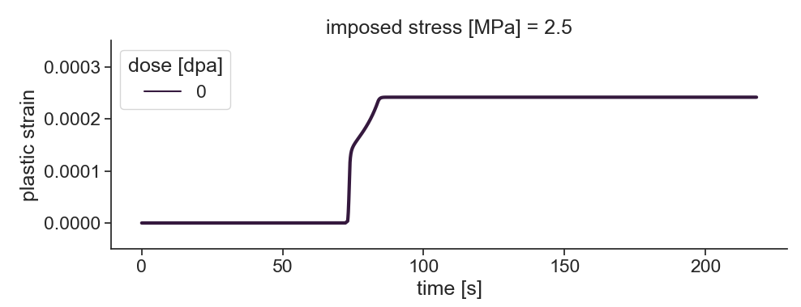
Conclusions
Beginning of hold
End of hold
Summary of work done:
Bounded the likely effects of microstructure change on T@T
Recrystallization likely plays a dominant role on the T@T due to annealing
Irradiation loop recovery and precipitation are important but secondary
Transients begins
No further strain accumulation
Next steps:
Develop a recrystallization model
Improve the Cluster dynamics code to quantify loop recovery post T@T

Slide 24
laurent@lanl.gov

