Slide 1
NEAMS Annual Review: High Temperature Gas-Cooled and Fluoride Salt-Cooled Reactors, Fuels Overview
Stephen Novascone
Michael Cooper

Slide 2
Technical Area Overview
The objective of the Fuels Technical Area is to deliver an integrated set of predictive computational tools for nuclear fuel performance analysis and characterization to enable timely qualification of new fuels and performance optimization. The delivery vehicle is BISON.

Slide 3
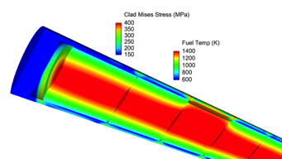
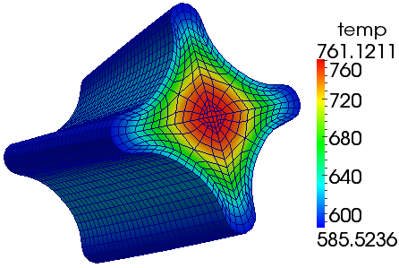
Multi-scale fuel performance: BISON
Fuel performance modeling supported by multiscale studies of cladding and fuel
Multi-dimensional engineering scale assessment of new fuel forms
Mesoscale material development for prediction of microstructure evolution
Insight gained at lower length scales incorporated into BISON via constitutive equations, models, parameters, etc.
BISON
Marmot
TRISO fuel is a particular fuel form of emphasis given it’s use in GCR, FHR and some micro reactors
MOOSE
MOOSE
Stochastic Tools
3D Fuel Performance
Points of contact: Stephen Novascone (INL), Michael Cooper(LANL)

Slide 4
Integrated Priority List
Topics of interest to industry
Fission product release
Pd - SiC attack
Debonding
Kernel migration
Fuel performance modeling (failure fraction)
Fuel performance with oxygen attack (steam ingress LOFC)
Validation, benchmarking and demonstration of capabilities

Slide 5
Milestones
Develop assessments for particle fuel transient experiments and separate effects tests
Implement user-friendly mortar debonding models for TRISO coating layers using Advanced Gas Reactor Program material property data and apply uncertainty quantification to begin to assess model adequacy and data needs
Update and refine TRISO assessment input files to better represent recent developments and to be consistent for TRISO simulations
As development work is completed, begin to assess thermal, mass, and particle-particle stress interactions at the compact scale to provide guidance for follow-on work focused on matrix performance
Complete expansion of the existing multiscale low-temperature Pd penetration model to account for high temperatures and Ag interactions, validate models against experimental data, and quantify uncertainties associated with its predictions
Investigate high-temperature Pd-Ag-SiC interaction mechanisms using molecular dynamics and incorporate them into the Pd penetration phase-field model to predict accelerated fission product release from TRISO particles.

