Slide 1
NEAMS Annual Review: Fast Reactors, Fuels Overview
Stephen Novascone
Michael Cooper

Slide 2
Technical Area Overview
The objective of the Fuels Technical Area is to deliver an integrated set of predictive computational tools for nuclear fuel performance analysis and characterization to enable timely qualification of new fuels and performance optimization. The delivery vehicle is BISON.

Slide 3
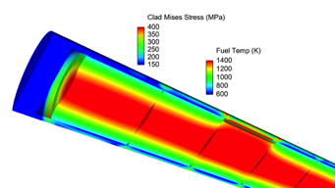
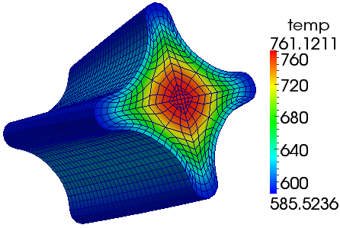
Multi-scale fuel performance: BISON
Fuel performance modeling supported by multiscale studies of cladding and fuel
Multi-dimensional engineering scale assessment of new fuel forms
Mesoscale material development for prediction of microstructure evolution
Insight gained at lower length scales incorporated into BISON via constitutive equations, models, parameters, etc.
BISON
Marmot
TRISO fuel is a particular fuel form of emphasis given it’s use in GCR, FHR and some micro reactors
MOOSE
MOOSE
Stochastic Tools
3D Fuel Performance
Points of contact: Stephen Novascone (INL), Michael Cooper(LANL)

Slide 4
Milestones
UN
Finish development, test and then demonstrate new baseline fuel performance capability for UN fuel swelling models under steady-state and transient conditions
Provide code review and merge support for UN models from LANL.
Metallic
Establish a New BISON-FIPD Integration Powered Assessment Case to Support BISON High-Burnup Fuel-Cladding Mechanical Interaction and Cladding Deformation Models V&V
Implementation and assessment of multi-scale mechanistic cladding-side FCCI model for use in liquid metal fast reactors
Coordinate activities to extend baseline metallic fuel capability to include the effect of FCCI and FIPD input
VTB Model Implementation for X447-DP11 with BISON-FIPD Integration Features and X447 Assessment Case Improvement (including HT9 ROM)

Slide 5
Looking ahead
Continue FCCI work and extend to actinide content
Combine FCCI and HT9 ROM to perform rupture simulations
Open to input

