Slide 1
NEAMS Annual Review: Light Water Reactors, Fuels Overview
Stephen Novascone
Michael Cooper

Slide 2
Technical Area Overview
The objective of the Fuels Technical Area is to deliver an integrated set of predictive computational tools for nuclear fuel performance analysis and characterization to enable timely qualification of new fuels and performance optimization. The delivery vehicle is BISON.

Slide 3
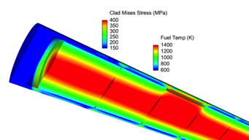
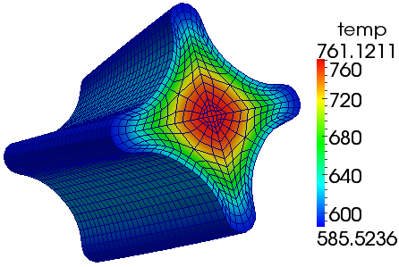
Multi-scale fuel performance: BISON
Fuel performance modeling supported by multiscale studies of cladding and fuel
Multi-dimensional engineering scale assessment of new fuel forms
Mesoscale material development for prediction of microstructure evolution
Insight gained at lower length scales incorporated into BISON via constitutive equations, models, parameters, etc.
BISON
TRISO fuel is a particular fuel form of emphasis given it’s use in GCR, FHR and some micro reactors
3D Fuel Performance
Points of contact: Stephen Novascone (INL), Michael Cooper (LANL)

Slide 4
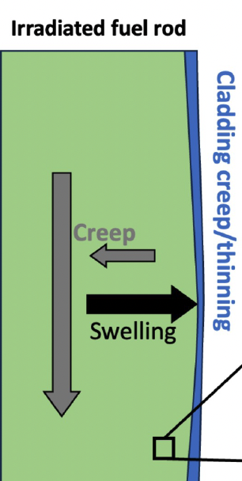
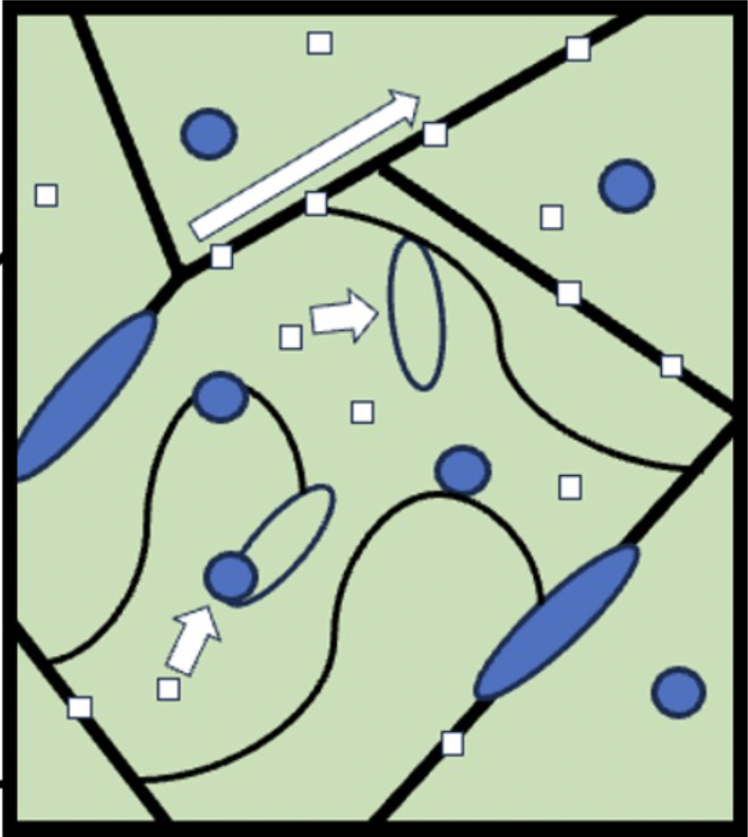
Light water reactors key areas
Uncertainties and deficiencies in fuels models result in a need for larger safety margins that limit efficiency of reactor operation and fuel design
Develop tools and models that improve the prediction of fuel behavior during time at temperature and LOCA scenarios to support power uprates and higher burnups:
Fuel and cladding microstructural, geometric and stress state leading to event
Then, evolution during accident or anticipated operating occurrence
Advanced models are designed to support reducing uncertainties in predictions of these behaviors by capturing underlying mechanisms at play to give more accurate description of behavior
Models designed to capture important mechanisms for fuel/cladding behaviors that relate the specific operating history of the fuel to its behavior during accident or occurrence
Pellet
Pellet-clad mechanical interactions, bonding, axial gas communication
Cladding
Cladding mechanical properties governing strain evolution (steady state and accident -> rupture)
Microstructure
Fission gas release (transient and steady state)
Pellet geometry and mechanical property changes

Slide 5
Milestones
Complete implementation and assessment of high burnup extension fuel performance models during operation and transient conditions in LWRs
Refine UO₂ fuel restructuring and fragmentation in the dark zone for application in transient fission gas release simulations
Complete pressure evolution and bubble fracture models for UO₂ and facilitate integration at the engineering scale
Cluster dynamics simulations of bubble pressure evolution in UO₂ as a function of pellet radius
Demonstrate new plasticity models for doped UO₂ that capture dislocation mechanisms
Application and enhancement of engineering-scale doped UO₂ constitutive modeling capabilities.
NEML2 improvements in support of the doped UO₂ creep rate surrogate model development
Utilize state-of-the-art BISON code capabilities and developmental, multiscale capabilities to provide preliminary, detailed, and blind performance evaluation of selected experiments from the CRAFT-endorsed AFC LOCA test plan.
Implement and merge UO₂ fuel-cladding bonding code into BISON
Predictions of the effect of temperature transients on mechanical response of Zircaloy and demonstration of surrogate model for LOCA-like conditions
Demonstrate zirconium cladding ROM capability on multiple LWR LOCA test problems
Deliver a table documenting identified experiments for use in LWR validation activities including fuels area of interest, available measurements, and ranking of importance.
Define MAMBA3D CILC benchmark problem and perform simulations to enable BISON assessment of cladding corrosion
Use MAMBA3D CILC benchmark calculation output from LANL to inform BISON simulation of cladding temperature increase and oxide layer thickness

Slide 6
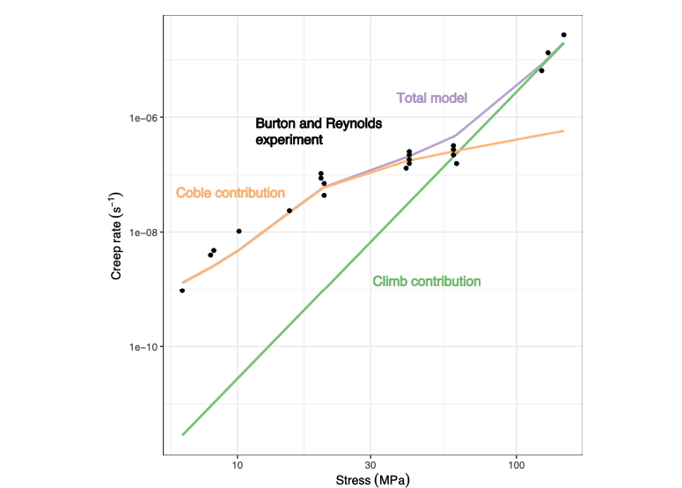
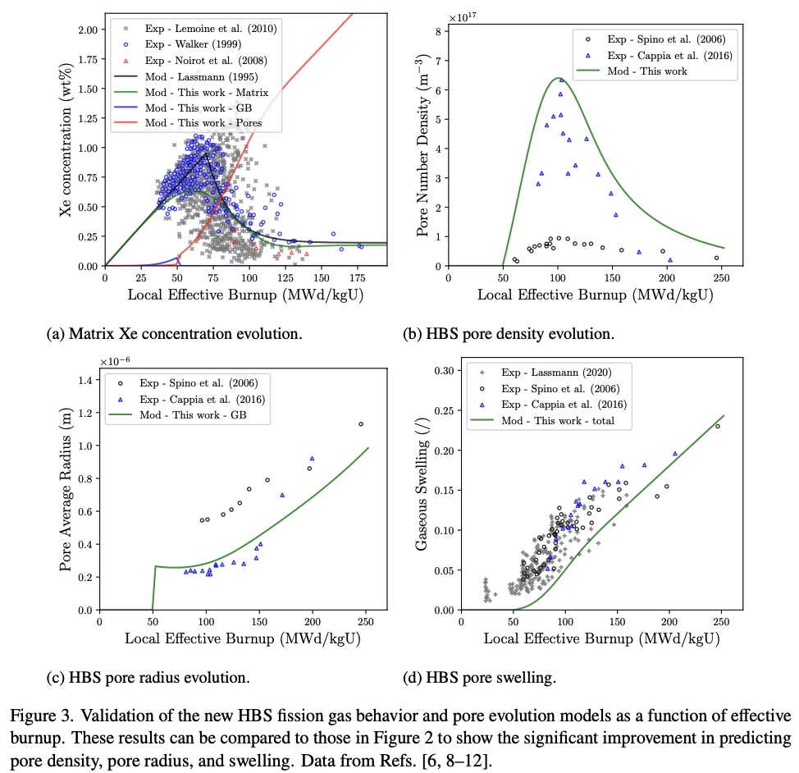
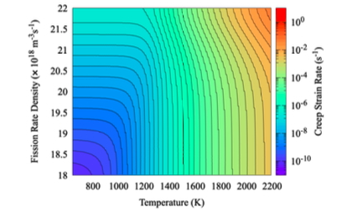
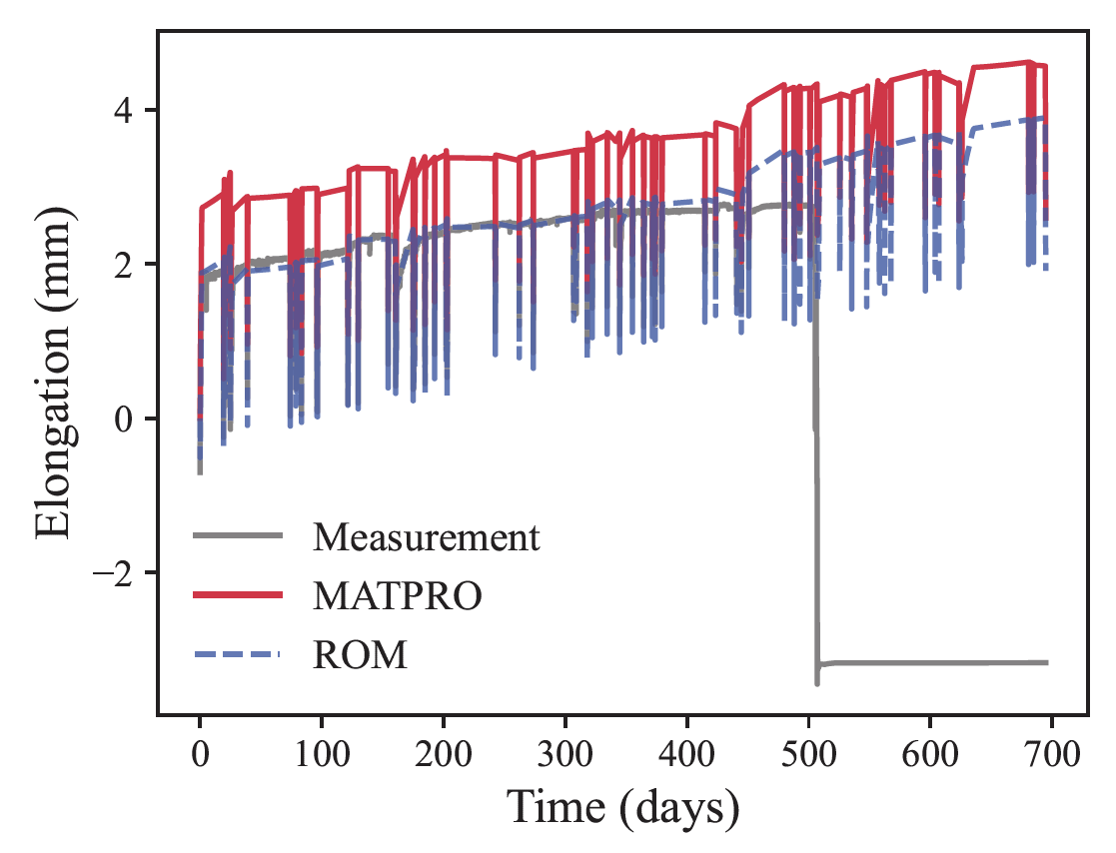
Examples
Simulate fission gas release in high burnup fuel.
Improve models for doped UO₂

Slide 7
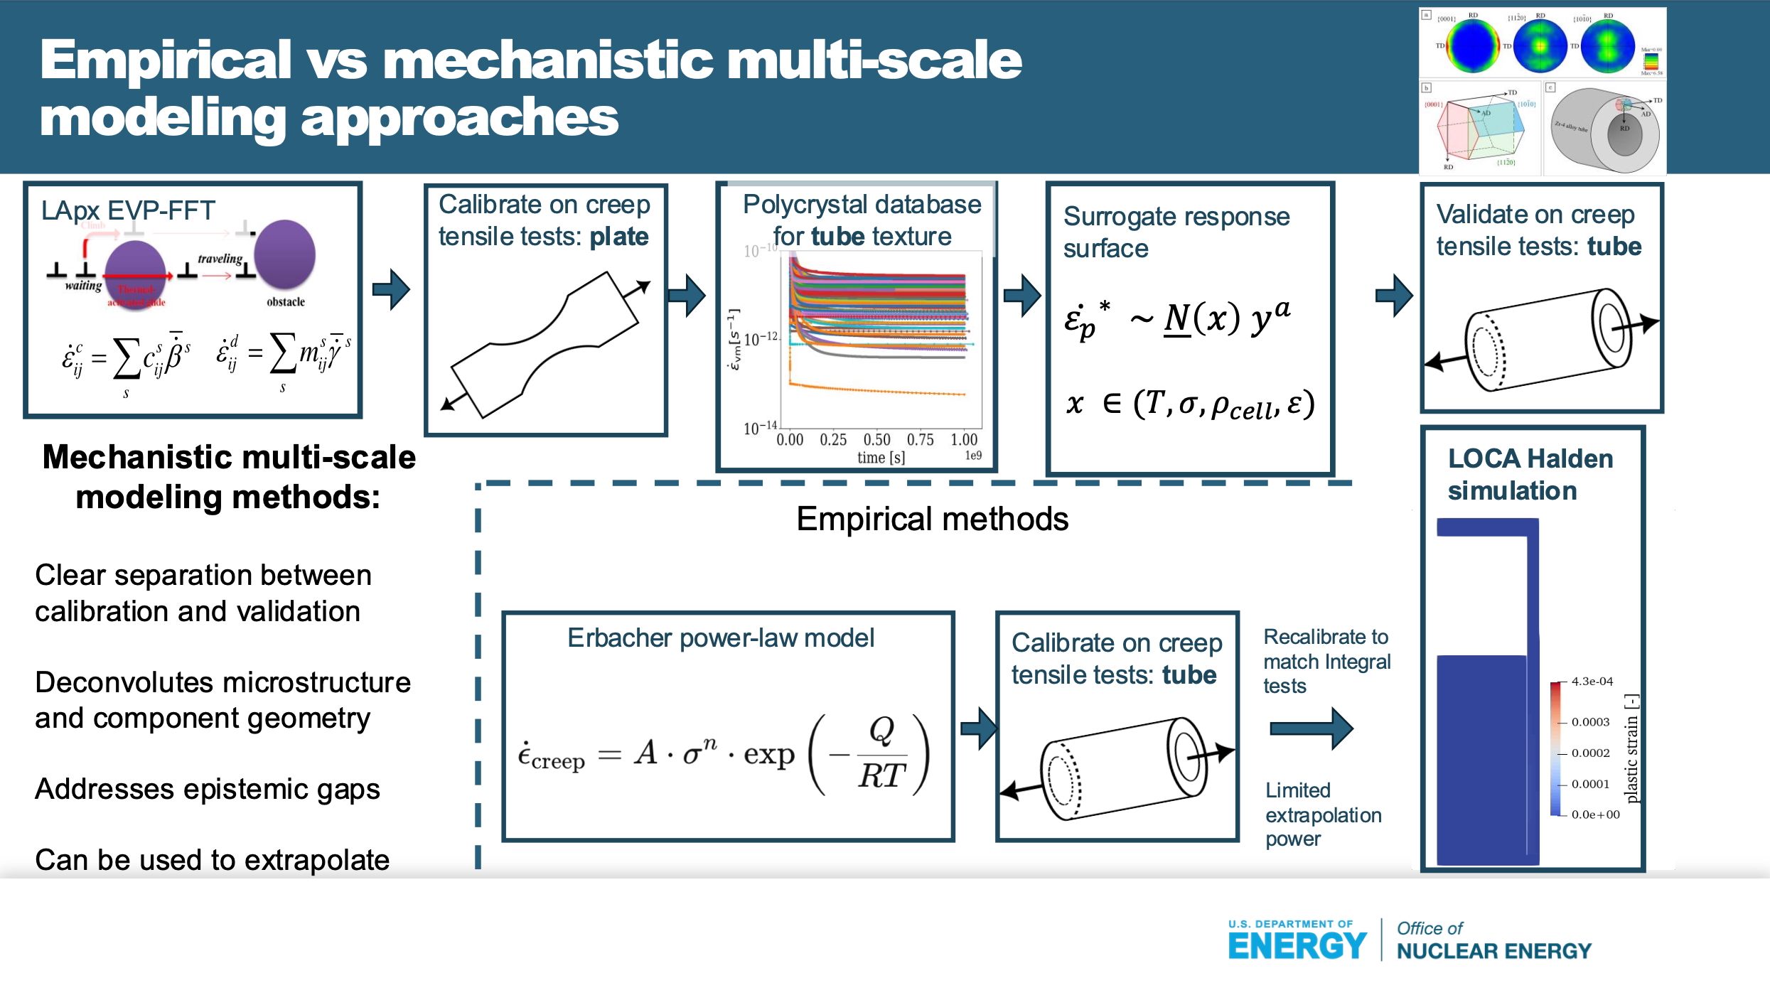
Examples
Behavior of cladding under LOCAs and burnup extension in LWRs.

Slide 8
Adding some depth
The fuel presentations will cover:
LOCA analysis
Advanced development
  High burnup fission gas release
  Mechanical response of fuel
  Cladding constitutive models

