Slide 1
UO₂ pellet model developments: high burnup UO₂, pellet-clad bonding model, doped UO₂, and analysis of Halden data
NEAMS external meeting for Light Water Reactor
Pierre-Clément Simon, Larry Aagesen, Kyle Gamble, Sudipta Biswas, Daniel Schwen, Ryan Sweet, Yifeng Che, Somayajulu Dhulipala, Steve Novascone
Idaho National Laboratory
Michael Cooper, Conor Galvin, Anton Schneider, Topher Matthews, David Andersson
Los Alamos National Laboratory
Nathan Capps
Oak Ridge National Laboratory
INL/MIS-25-84779

Slide 2
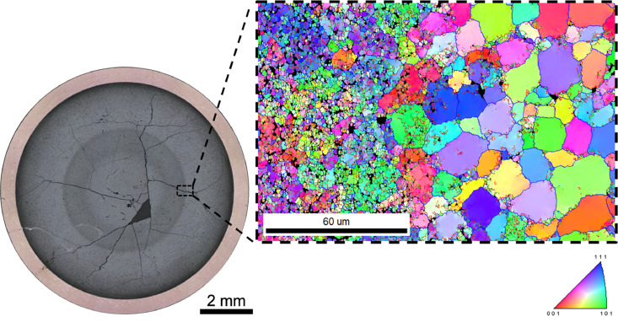
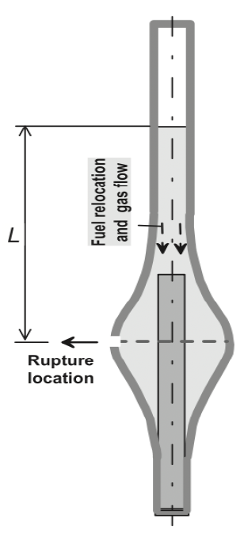
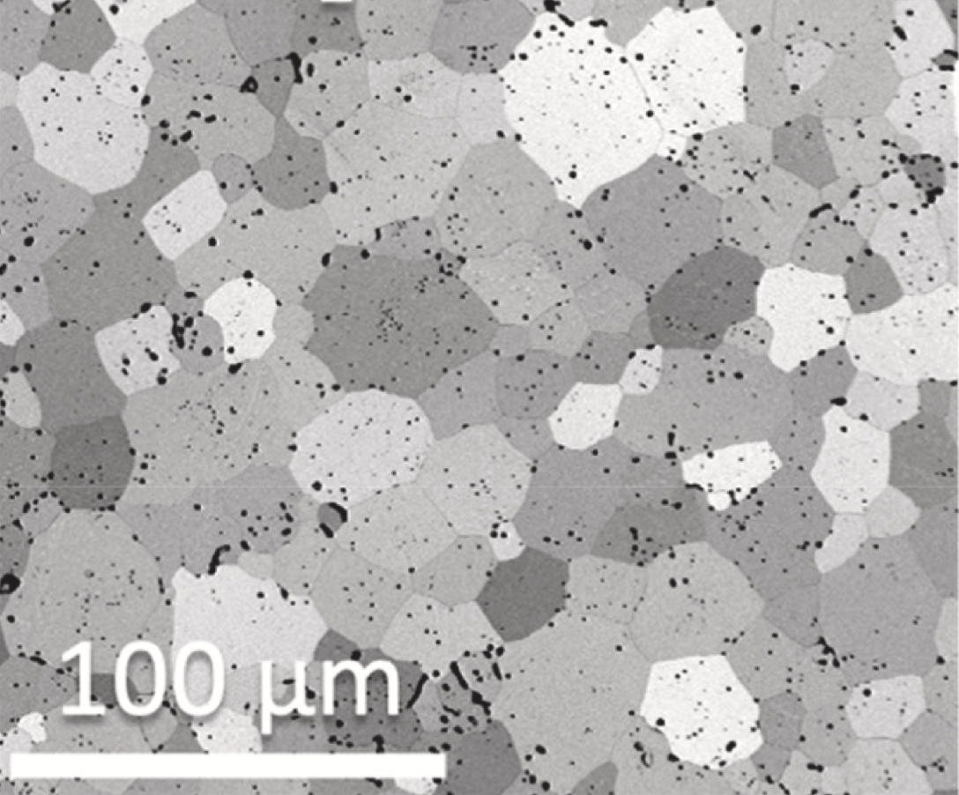
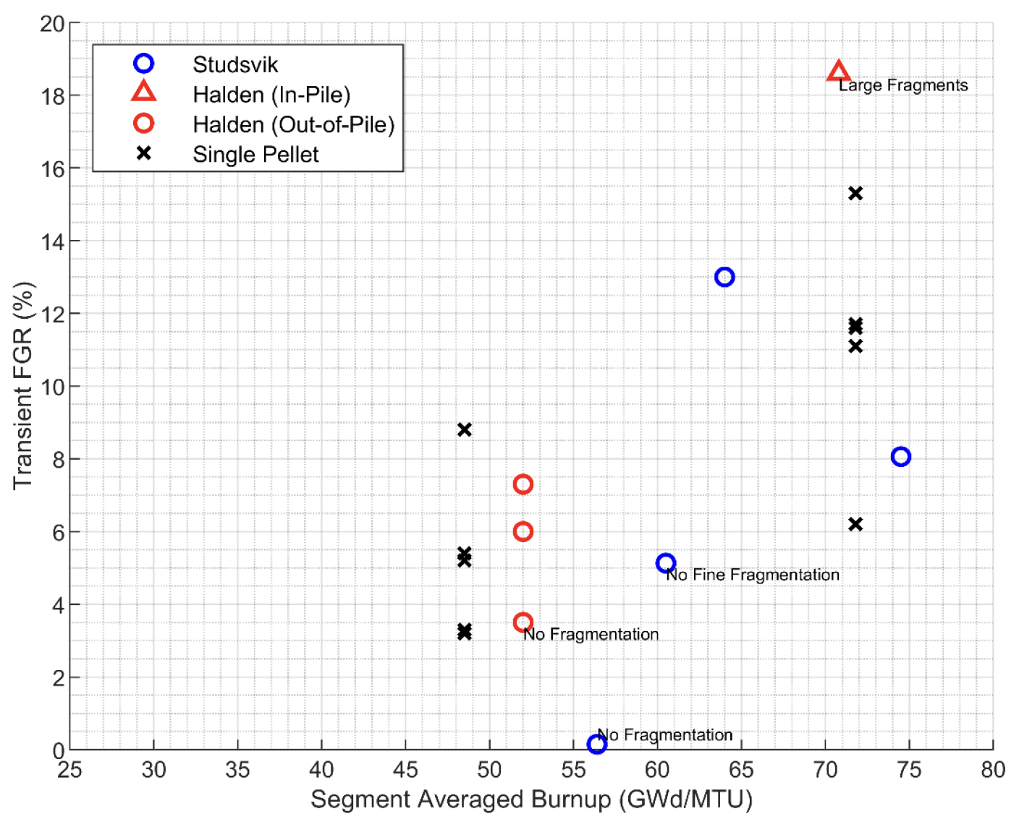
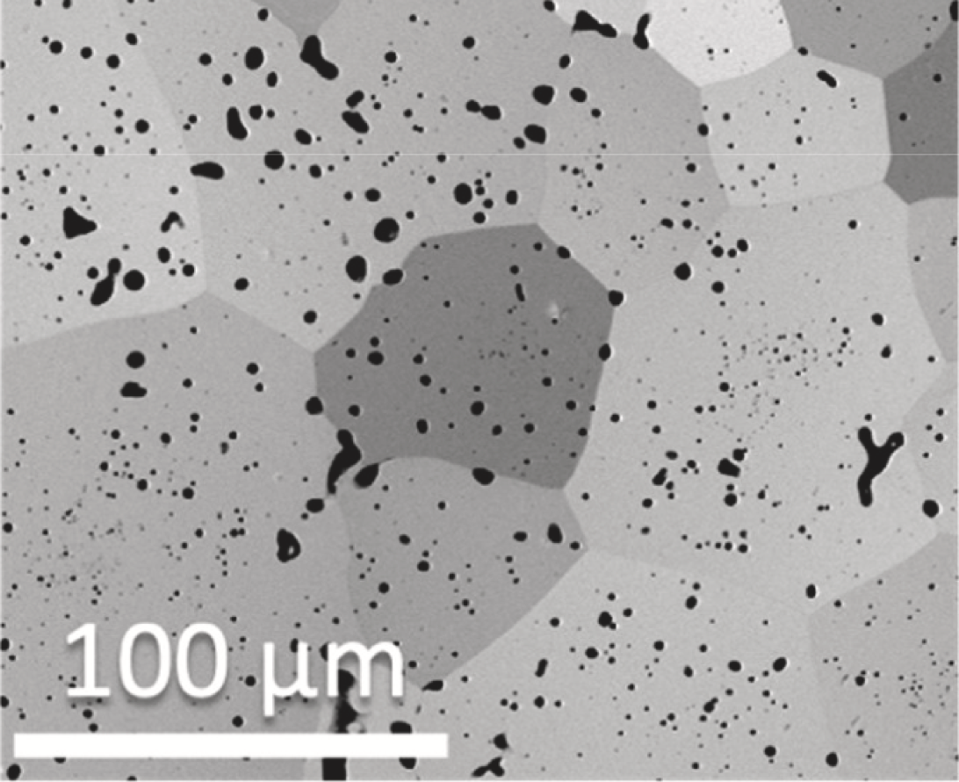
Main goals and challenges being tackled
Goal: Provide predictive fuel performance models for conditions relevant to industry where experimental data is scarce and challenging to obtain and safety margins are large.
Key challenges:
Validation against wide set of conditions
tFGR & High burnup extension
Bonding and axial gas comm.
Doped fuel
Large, unexplained
microstructural changes.
Dopants can positively affect fuel microstructure and properties, making doped fuels a great option for LWR advanced fuels.
But data is limited and uncertainty is high.
Predict fuel relocation, bonding, and axial gas communication to better model ballooning and performance during LOCA.
Key to following regulation guidance.
UO₂
Large scatter in the
tFGR data.
Cr-doped UO₂

Slide 3
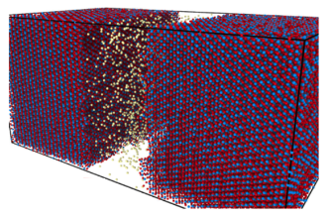
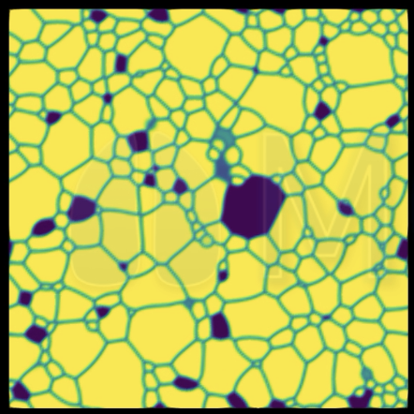
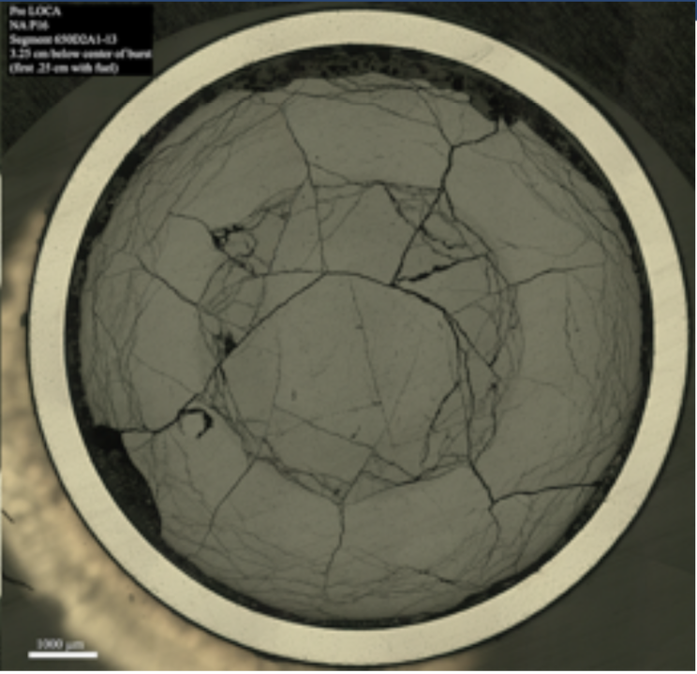
Multiscale approach for mechanistic modeling
Atomic-scale
Bubble behavior, grain boundary strength, and defect kinetics governed by atomic interactions
Meso-scale
Microstructure evolution
Fracture around over-pressurized bubbles
Engineering scale
Pulverization during transient determined by local bubble and microstructure evolution
Diffusivity of Xe and vacancy defect species
Mechanical degradation and fragmentation models
Grain boundary fracture criteria capturing bubble impact
Microstructure changes HBS/dark zone formation
Boundary conditions,
Relevant scenarios
Boundary conditions,
Relevant scenarios
Validation across all length scales: separate effects tests, PIE, mini-fuel, integral rod test

Slide 4
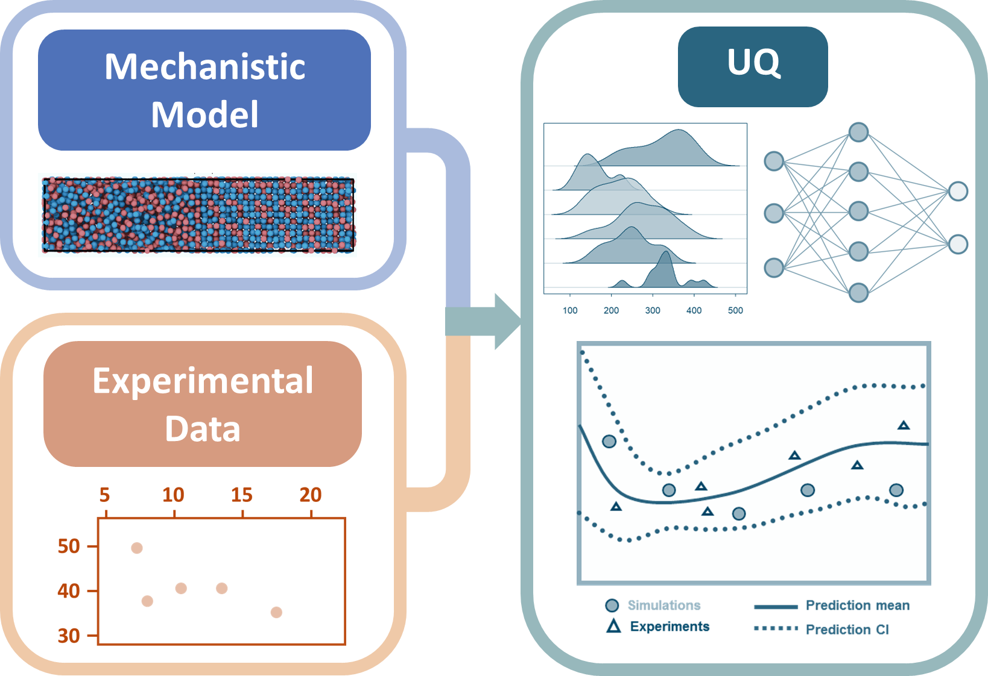
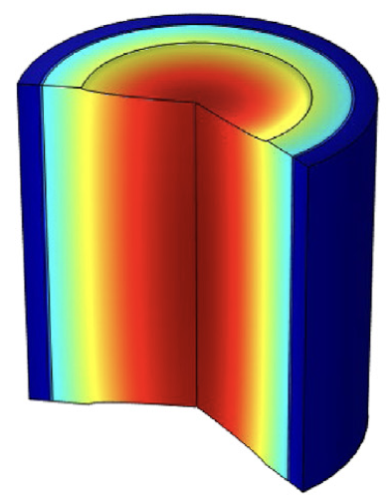
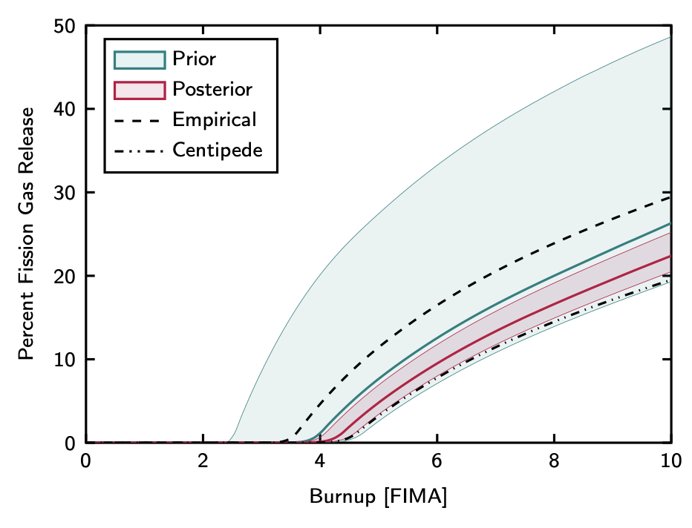
The role of stochastic tools in multiscale, mechanistic modeling
Motivation: Nuclear fuels are qualified through costly and time-consuming integral tests. Computational models and select experiments for validation can accelerate this. Qualification requires rigorous uncertainty quantification (UQ) using disparate and often small datasets.
Challenge: Requires >10⁷ evaluations of many mechanistic models that are computationally expensive.
Role of AI and ML: Surrogates for mechanistic models to accelerate UQ and automate experimental design.
Example: Plastic deformation (creep) and fission gas behavior in UO₂ – key performance phenomena of nuclear fuels.
Train rapid AI models to replicate physics-based mechanistic models
Allows scale bridging and many rapid evaluations of model
1. AI/ML models trained to mechanistic models enabling UQ of disparate, but inter-connected, datasets (creep, fission gas, chemistry, >200 parameters).
Predicted creep rate with uncertainty bands. Colors indicate different temperatures.
Targeted new experiments defined
Use UQ techniques to infer parameters based on existing experiments
Requires >10⁷ evaluations of many models
Predicted U-self diffusivity (underlying parameter for creep).
2. Propagate uncertainties to integral fuel rod behavior to improve safety and operational assessments.
Reduced uncertainty in fission gas release (FGR) from fuel rod simulation
Use AI/ML and UQ to design new experiments that maximize reduction in fuel performance uncertainties
Fuel pellet
Model uncertainty
% FGR
Temperature, stress, etc. for fuel/cladding failure assessment
Burnup [FIMA]
3. Future work to extend to reactor scale and incorporate more models simultaneously – increases dimensionality and the size of AI/ML models.
Ultimate goal: Use mechanistic models to design new rapid experiments and support reactor design, licensing and operation: Optimize fuel qualification programs to reduce timelines and give maximum reduction in uncertainty for given cost.

Slide 5
Uncertainty quantification of mechanistic models
Empirical model approach means that there could be large errors and limited ability to extrapolate
The empirical solution is to create lots of additional data. Expensive and time consuming!
Experimental data may not be available for innovative concepts.
Mechanistic lower length scale informed model means that initial errors are based on atomic scale uncertainty – significant error but can extrapolate reasonably well
Combining UQ and mechanistic models really makes a difference
Images from: Matthews et al, .”Mechanistic multiscale uncertainty propagation in support of accelerated fuel qualification,” Nuclear Technology, submitted

Slide 6
Extension to High Burnup
Understanding transient fission gas release and fuel pulverization
to support high burnup extension

Slide 7
Gaps, background, and goals
Gaps:
  Lack of understanding for high burnup (HBu) behavior:
  How does the microstructure change at HBu?
  How does this affect fission gas release, fuel fragmentation and relocation during normal operations or during a transient?
  Lack of understanding of FFRD during LOCA
Challenges:
  Fission gas behavior is multiscale and complex
  HBu behavior and FFRD are complex phenomenon
  A lack of experimental data at the right conditions, and large scatter
  Empirical model can be overly conservative, or present large uncertainty
Goals:
  Predictive, validated modeling of fission gas behavior, cracking, fragmentation, and relocation
Casey McKinney et al. “Characterization of the radial microstructural evolution in LWR UO2 using electron backscatter diffraction,” JNM 585 (Nov. 2023), p. 154605.
U.S. Nuclear Regulatory Commission (NRC). RIL 2021-13, Interpretation of Research on Fuel Fragmentation, Relocation, and Dispersal at High Burnup. (ADAMS Proprietary Accession No. ML21313A110), 2021.

Slide 8






Engineering scale modeling of fission gas behavior
Intragranular
Gas Generation
Intragranular
bubbles
Bubble
coalescence
Knockout/
Recoil
Incoming lower
length scale work
Diffusion
Non-restructured fuel
Bubble
coverage
saturation
Total local fuel
Dislocations/ Bubbles pinned at dislocations
Micro-
cracking
Trapping/
Resolution
Non-restructured fuel
Empirical
tFGR
Bubble evolution
Intergranular bubbles
Intragranular behavior
Intergranular behavior
Release mechanisms
Gas
transfer
HBS formation
Bubble evolution
High Burnup Structure
Intragranular
Gas Generation
Diffusional release
tFGR from fuel
pulverization,
which exposes
HBS bubbles
Diffusion
Dark zone formation
High Burnup Structure
Small HBS grains
Intergranular bubbles
(Spherical)
The fission gas behavior model describes each step,
including mechanisms driven my microstructural changes

Slide 9
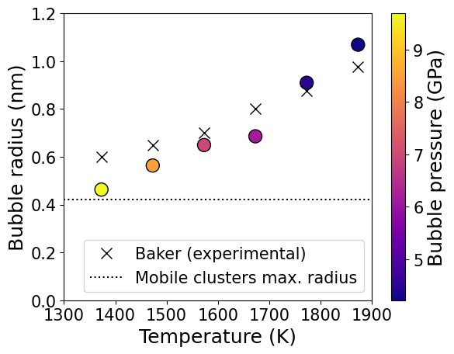
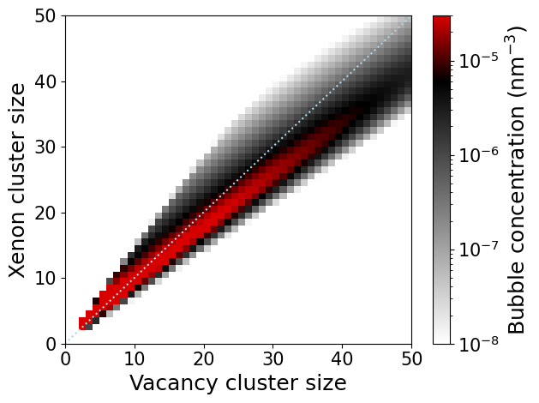
Cluster dynamics simulations of bubble size and pressure evolution in UO₂
Cluster dynamics code Xolotl predicts the full xenon-vacancy phase space for intra-granular bubbles, to inform BISON with grain-boundary gas loss
Good agreement with available experimental measurements
Implemented radiation induced re-solution and defect thermal emission mechanisms
Full bubble size and pressure distribution is essential to describe fission gas evolution properly
Over-pressurization of small bubbles at low temperature is properly predicted (as well as the temperature evolution)
Post-irradiation examination data produced through the AFC program will be used for uncertainty quantification to calibrate lower length-scale parameters and further validate the model.

Slide 10
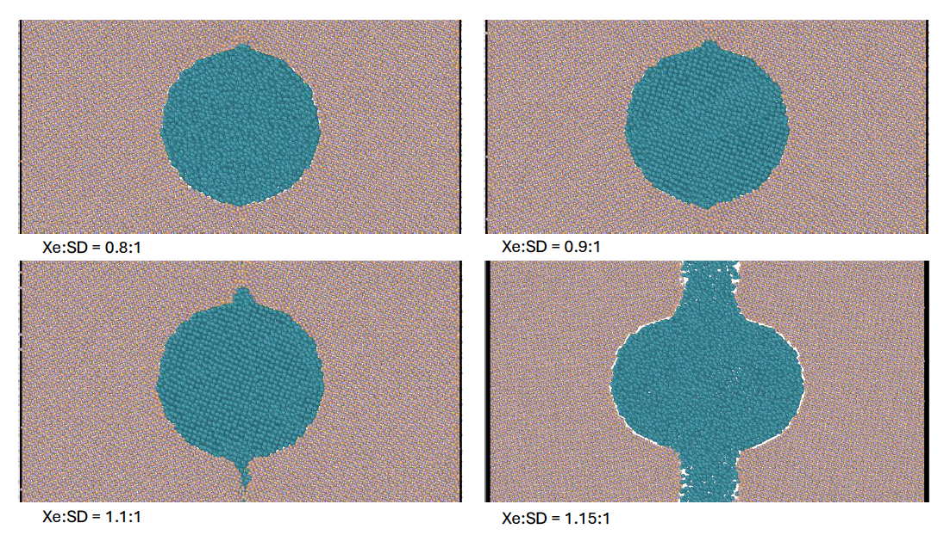
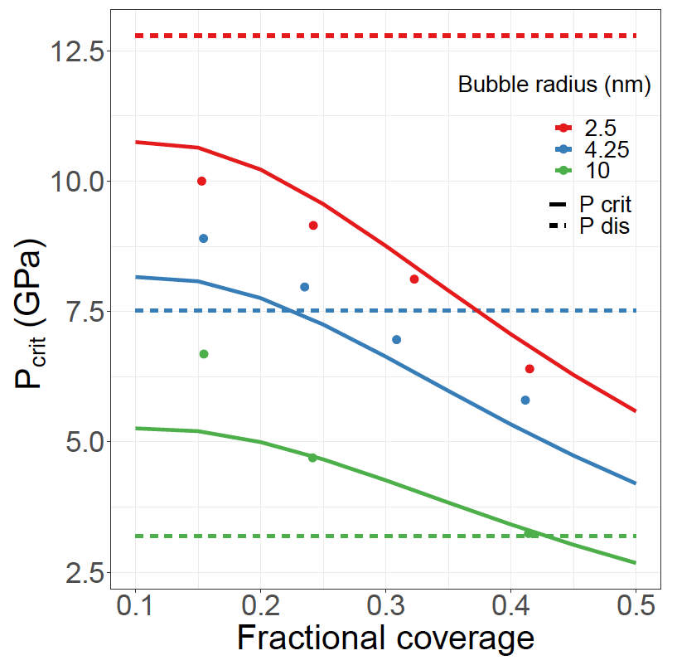
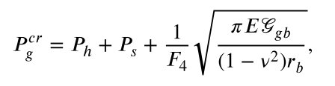
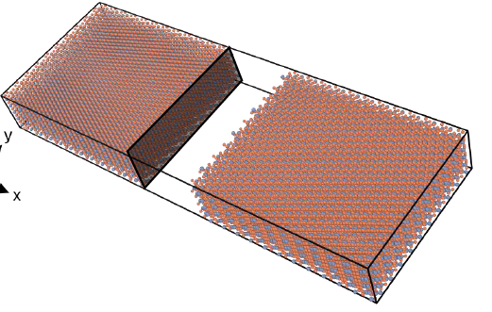
Pressure evolution and bubble fracture models for UO₂ and facilitate integration at the engineering scale
Atomistic data for model
Mechanistic micro-fracture model
Determine the pressure at which microcracking occurs
Different bubble sizes and pressures at grain boundary (steady-state)
Bubbles at a grain boundary simulating micro-fracture
Dislocation punching
Feed into mechanistic model
Fracture energy of grain boundary
Results indicate a process by which fission gas can cause HBS sub-grain boundaries to become more susceptible to pulverization
Mechanism distinguishes between regions in the pellet
x
x
GB micro-cracking pressure threshold
MD-informed pressure relief (microcracking) threshold for use in MARMOT and BISON

Slide 11
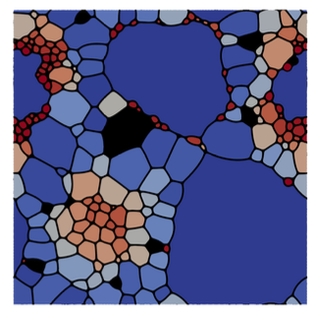
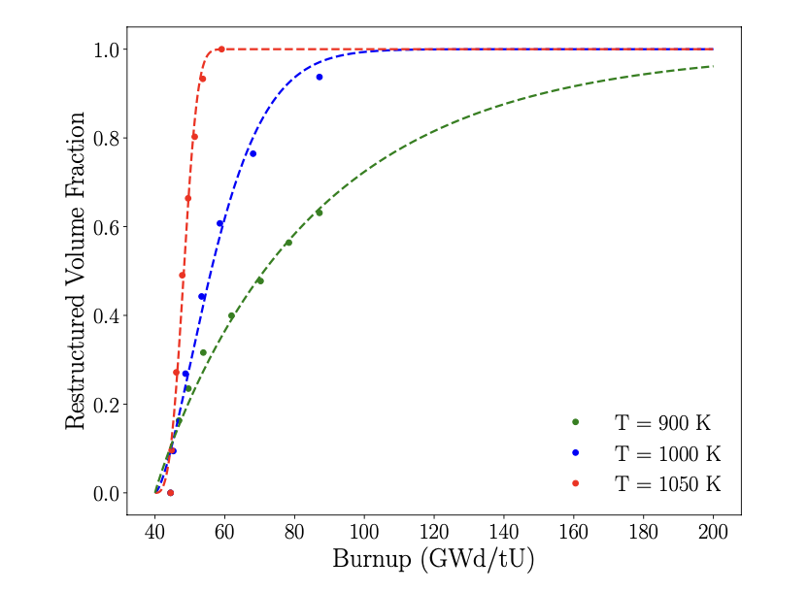
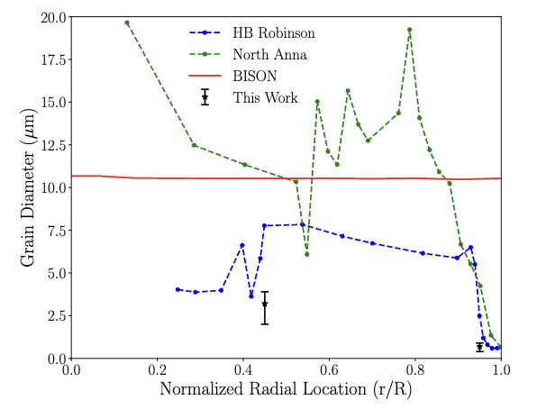
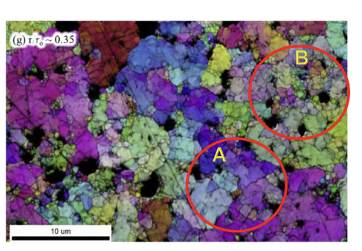
Fuel restructuring and fragmentation in the dark zone
A mesoscale restructuring model has been developed for the high burnup fuel
An energy-based criteria is introduced for subgrain formation
  Subgrains are introduced once dislocation energy exceeds the energy required to form a new subgrains
  Subgrains formation is followed by a coarsening
This effort provides a mechanistic, temperature and burnup rate dependent model for restructuring for BISON
T. J. Gerczak et al., Restructuring in high burnup UO₂ studied using modern electron microscopy, J. Nucl. Mat. 509 (2018) 246–259.

Slide 12
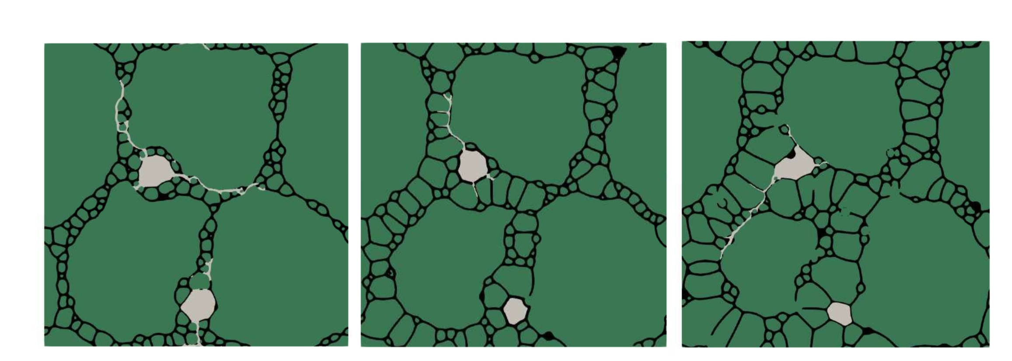
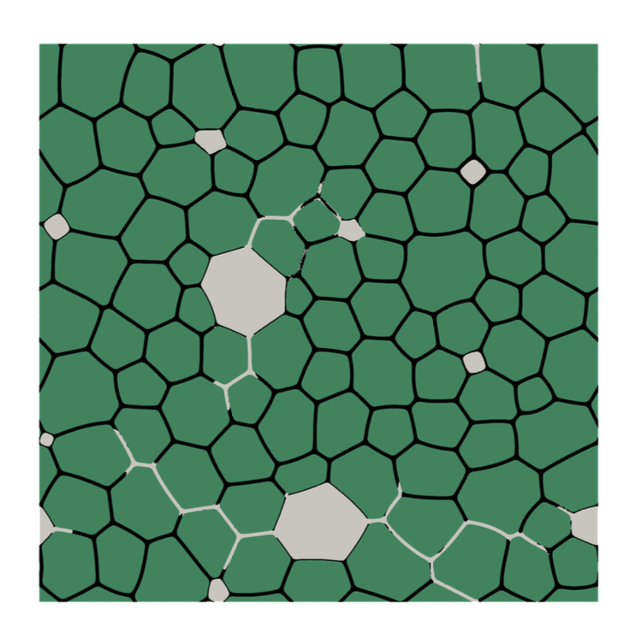
Fuel restructuring and fragmentation in the dark zone
Multiscale model demonstrating pulverization though phase-field fracture simulations
  Fracture properties are obtained from MD calculations
  Microstructures are generated through phase-field simulations
Demonstrates pulverization in partially and fully restructured regions
Provides a pulverization criterion for BISON
Crack propagation leading to pulverization

Slide 13
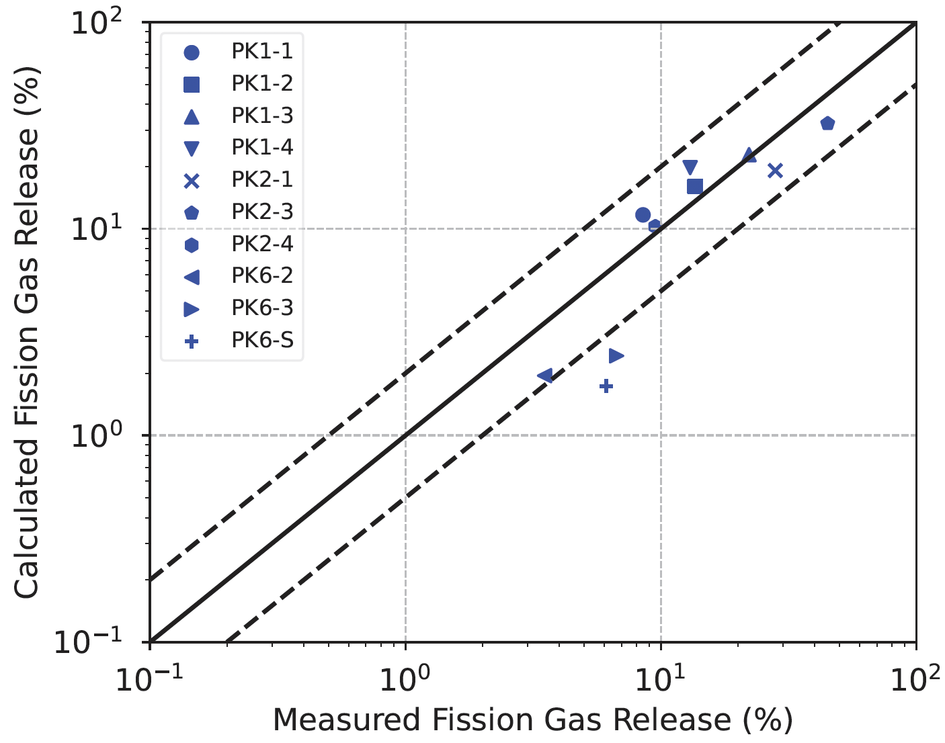
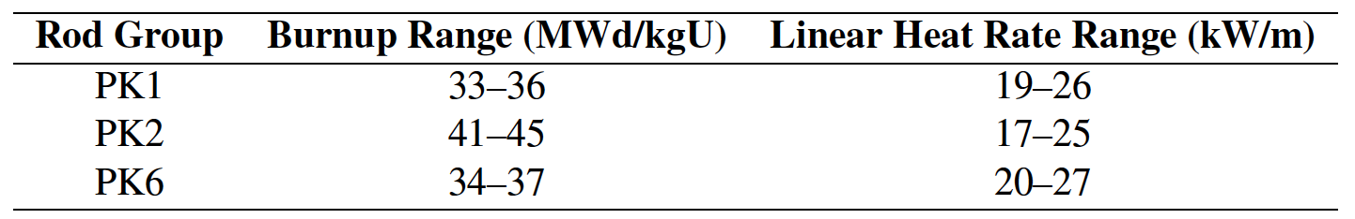
Validation of BISON's fission gas prediction during temperature ramps
The Studsvik Super Ramp investigated the behavior of LWR fuel under a power ramp after base irradiation
BISON is being validated at low burnup (and performing well), but uncertainty quantification is needed (and ongoing)
P.-C. A. Simon et al., Technical Report INL/EXT-24-05038, Idaho National Laboratory, September 2024

Slide 14
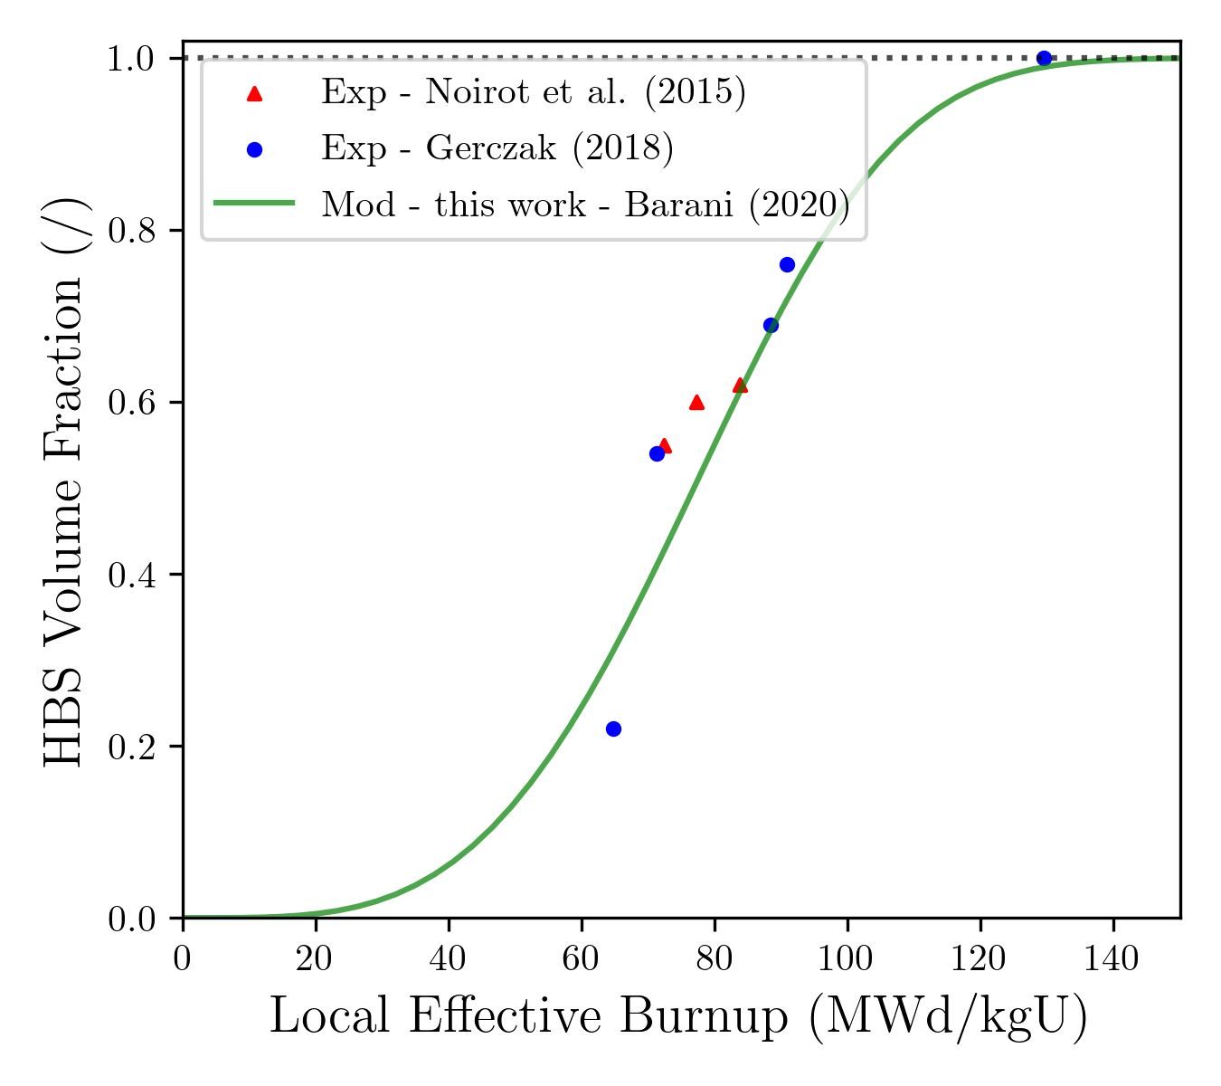
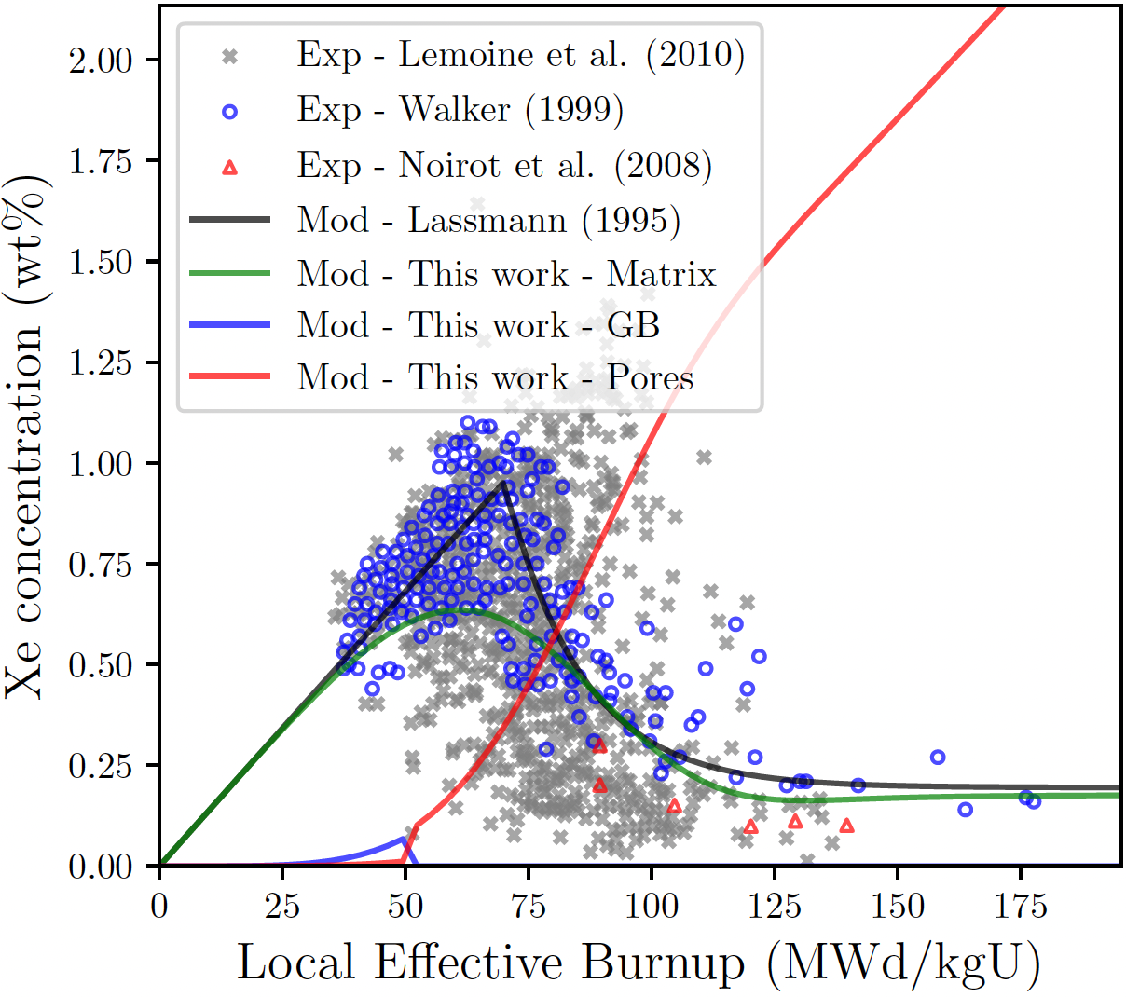
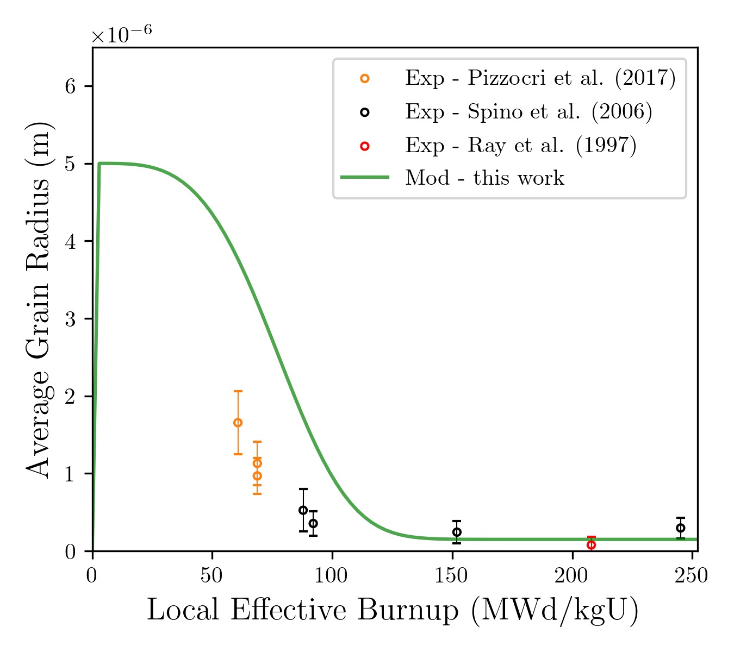


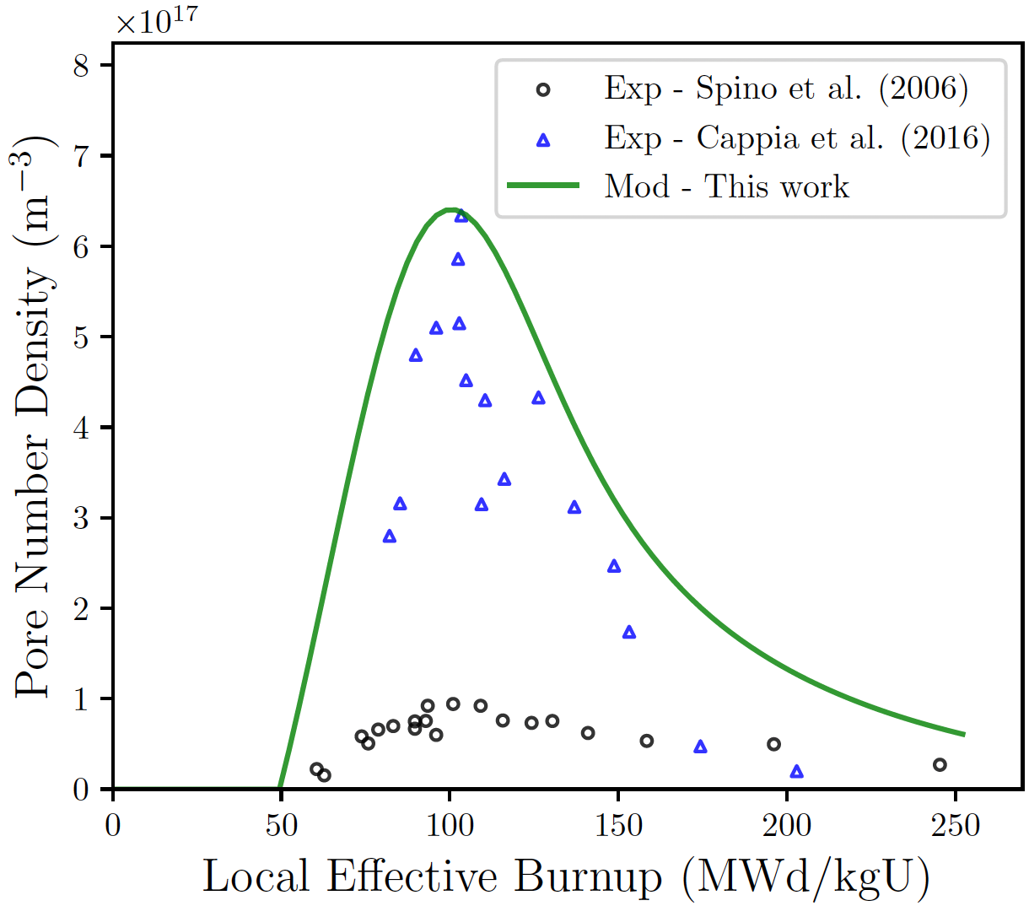
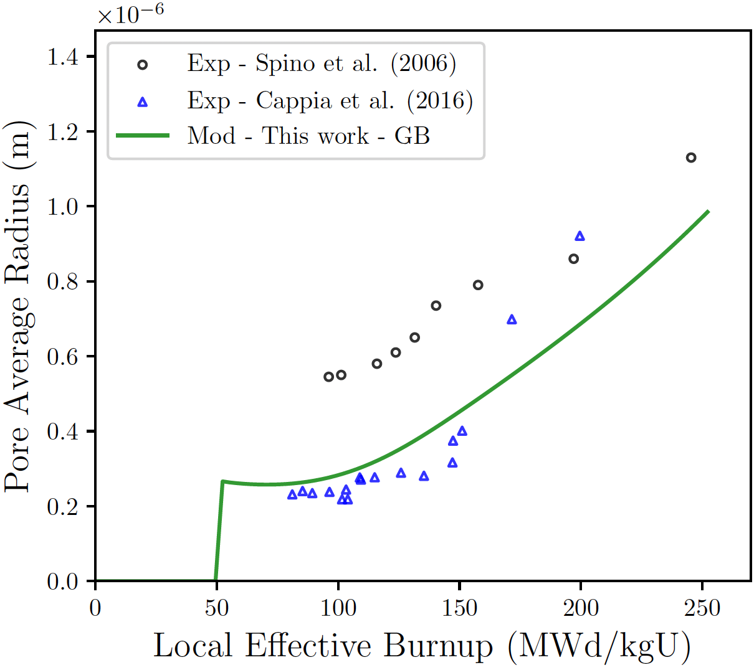
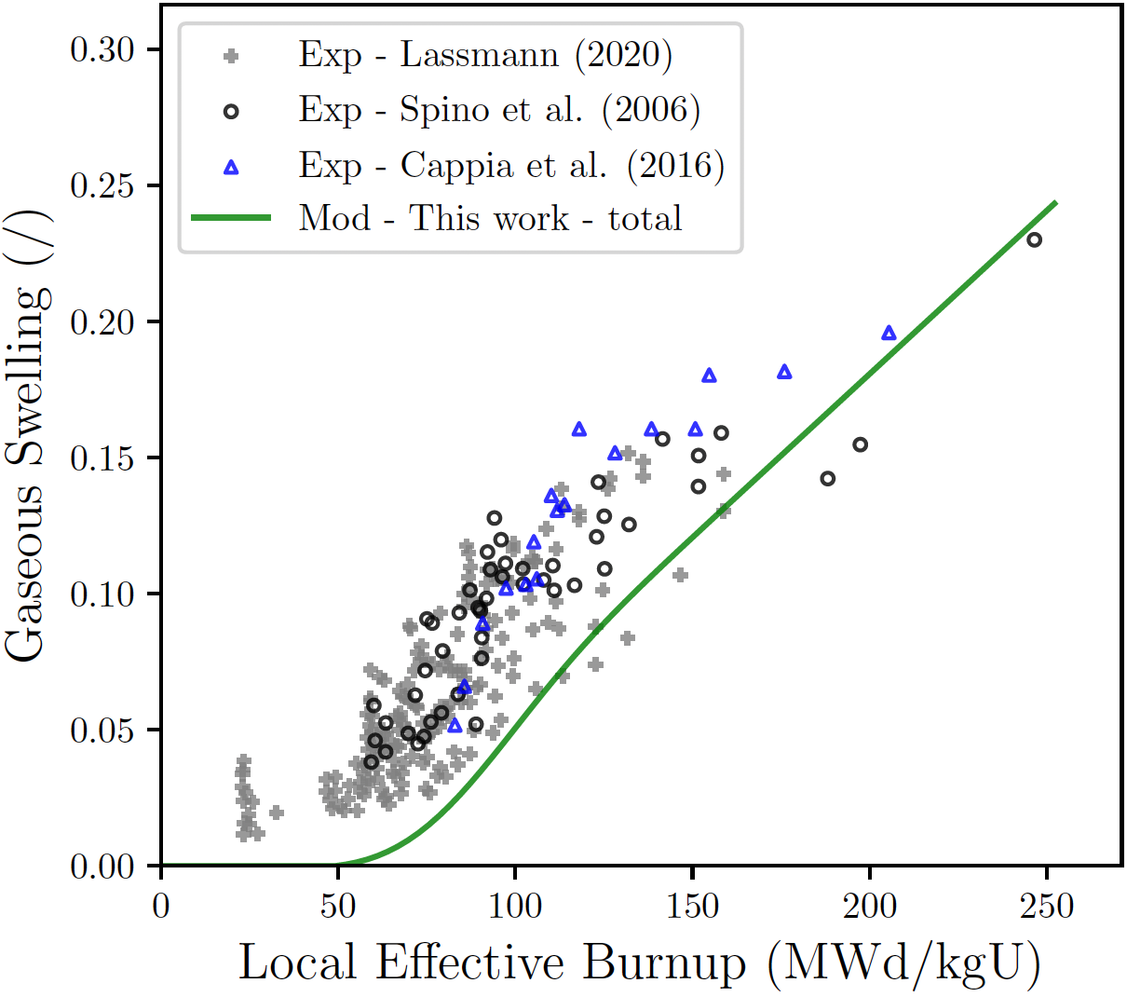
Engineering scale modeling of fission gas behavior at high burnup
High Burnup Structure (HBS) formation and fission gas transition from non-restructured to HBS fuel is adequately captured
New HBS pore evolution models are being implemented to capture:
  the increase and then decrease in pore density
  the initially lower radius and then rapid increase in bubble size
This will inform transient fission gas release
Dark zone formation models are under development
HBS bubbles
matrix
Grain size
HBS formation
Bubble Density
Bubble radius
Swelling
P.-C. A. Simon et al., Technical Report INL/EXT-24-05038, Idaho National Laboratory, September 2024

Slide 15
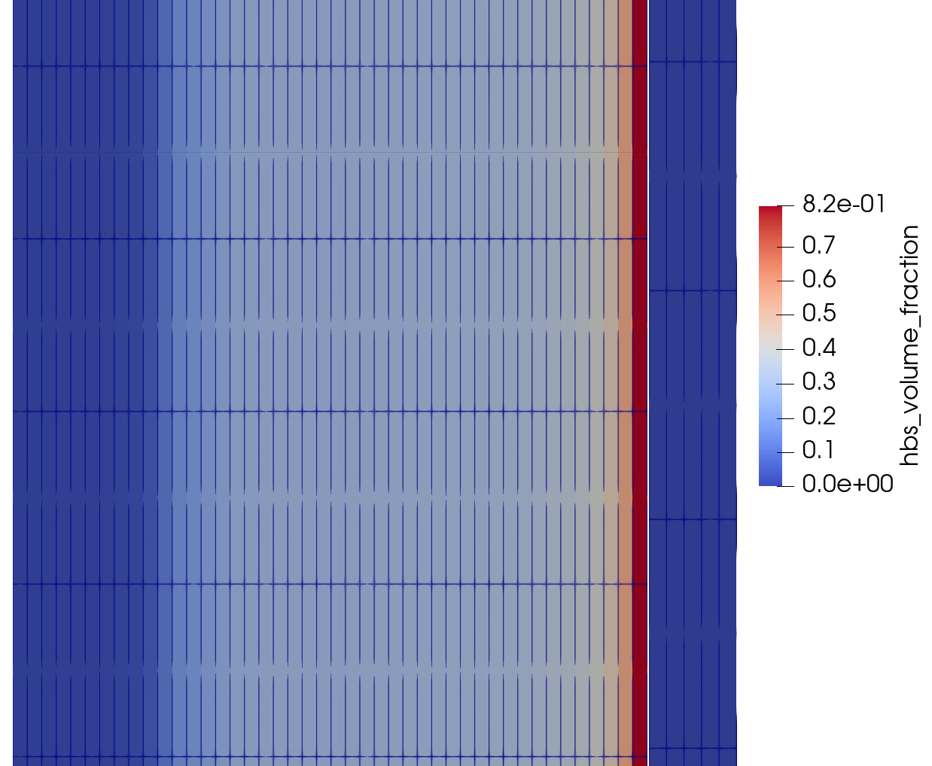
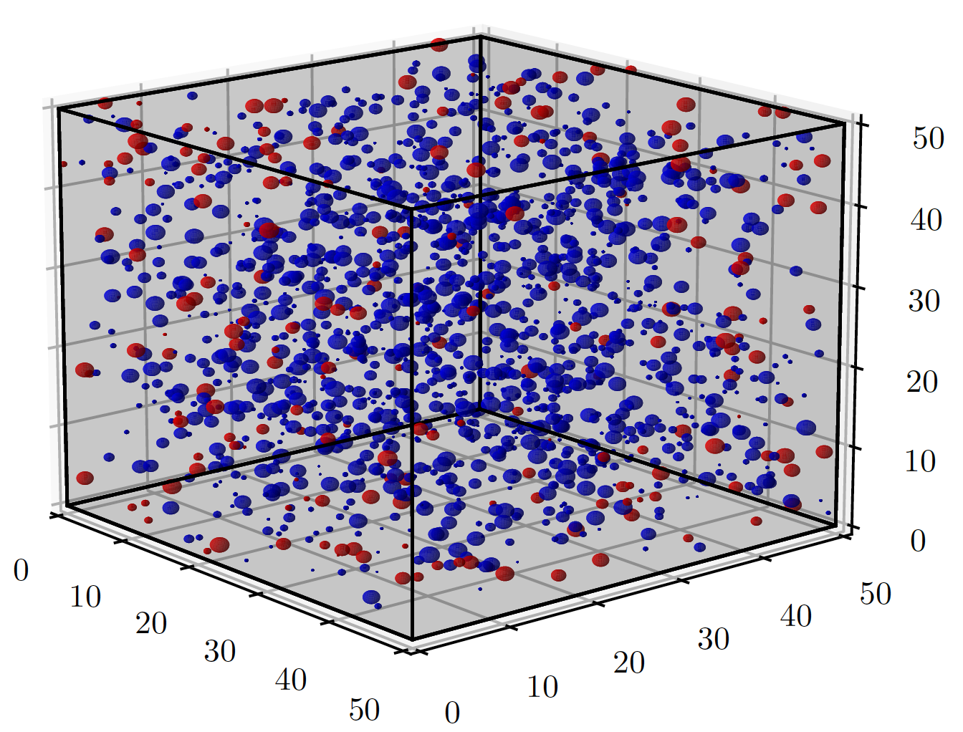
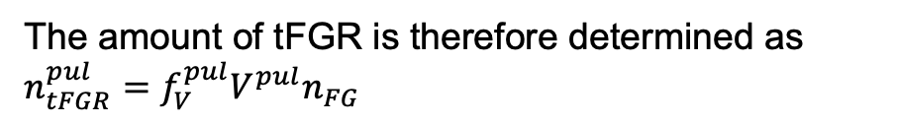
Mechanistic modeling of transient FGR at high burnup
Model derived from the lower length scale efforts for HBS pulverization provide mechanistic predictions in BISON
When pulverization occurs, tFGR is assumed to originate from the bubbles exposed at the surface of fuel fragments
The amount of tFGR is therefore determined as
$$n_{tFGR}^{pul}=f_{V}^{pul}V^{pul}n_{FG}$$
Determine
HBS/pulverized fuel
using LLS models
Some bubbles get exposed to free surfaces and suddenly release FG
Bubble fission gas content
Exposed
Pulverized volume
Fraction of open bubble volume as a function of porosity and bubble/fragment size
This mechanistic model in BISON accounts for tFGR due to HBS pulverization.
We are investigating other contributing mechanisms.
Contained
In fragment
P.-C. A. Simon et al., Technical Report INL/EXT-23-75026, Idaho National Laboratory, September 2023

Slide 16
Blind performance evaluation of selected high burnup experiments
High-burnup commercial fuel irradiated in Byron NPP
Integrated steady-state and transient BISON simulations for commercial fuel irradiation and testing
  Automated mesh refabrication to ensure continuity of properties (FG, microstructure, deformation history)
  Blind analysis of future transient tests
Blind prediction of microstructure using mesoscale methods coupled to BISON
BISON to provide steady-state irradiation conditions MARMOT to analyze fuel at future PIE locations
Framework development is ongoing and expected late-FY25.

Slide 17
Bonding and axial gas communication
Model axial gas communication and bonding to better capture ballooning

Slide 18
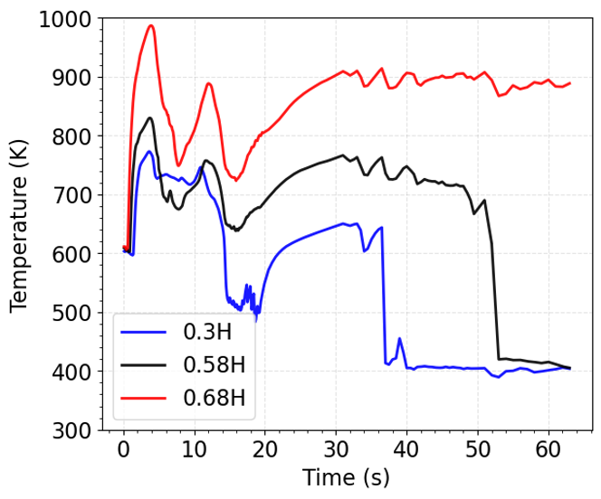
Gas Communication Study on Full Length Rod
Axial gas communication is often assumed to be instantaneous, but new models capture the kinetics, including when gas communication is restricted.
Demonstration problem:
  Full-length rod subjected to a provided LOCA temperature transient
  Considered two cases: small plenum and large plenum
  Initial pressure of 24.4 MPa at LOCA start
  Plastic instability failure criterion assumed
Induces ballooning at upper portion of the fuel rod.
Temperature variation as a function of time at different axial heights for representative full-length rod LOCA transient

Slide 19
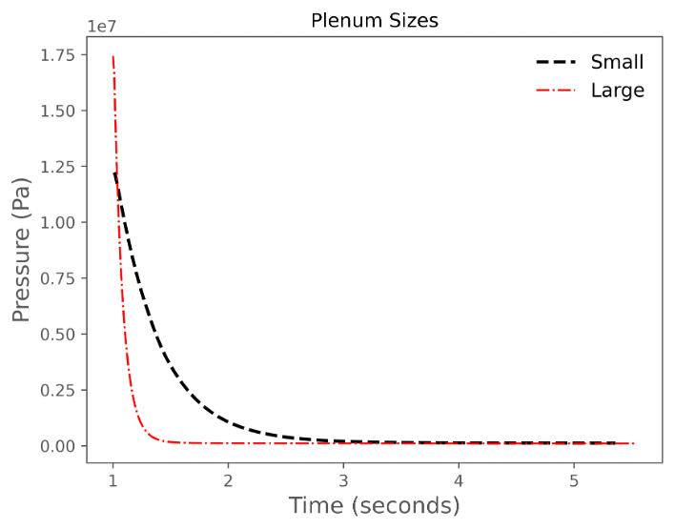
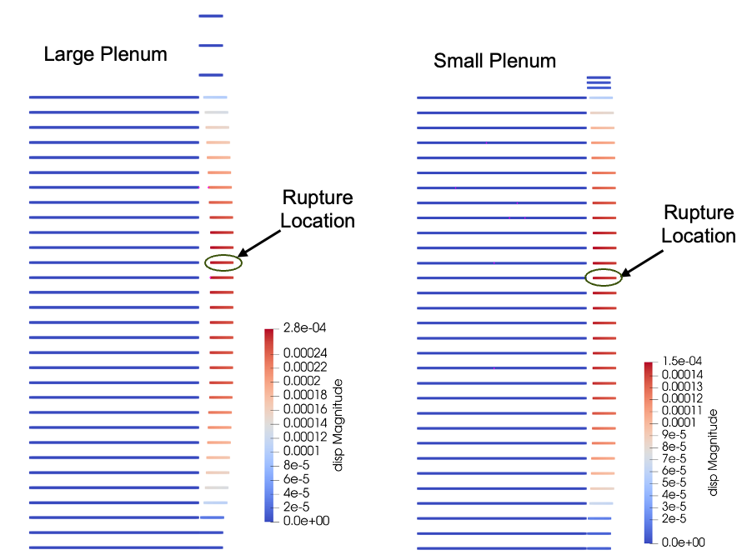
Gas Communication Study on Full Length Rod
Stored energy heating (SEH) loading causes rupture at small balloon sizes
The gap becomes sufficiently large that instantaneous and time varying gas communication are effectively equivalent, but bonding and fuel relocation could affect gas communication
 | Large | Small
Hoop Strain (%) | 6.38 | 3.54
Axial gas communication, bonding, and fuel relocation development are enhancing predictive modeling capabilities for LOCA
Scaled axially by 0.1 and radially by 10. Only the top portion of the fuel rod is shown.

Slide 20
Doped Fuels
Utilize mechanistic modeling to predict the effect of dopants on nuclear fuel performance
and accelerate advanced fuel development

Slide 21
Background
5/7/25 | 21
Los Alamos National Laboratory
Doped UO₂
UO₂
Doped UO₂
Doped UO₂ fuel advanced fuel candidate of light-water reactors (LWRs)
Modify microstructure and mechanical properties to improve overall behavior
Larger grains compared to that of undoped UO₂
Better (softer) margins for pellet-cladding mechanical interactions
  Minimizing the strain exerted by the pellet on the cladding, cladding performance under accident conditions can be enhanced
  In the case of a Loss of Coolant Accident (LOCA) scenario, would reduce the likelihood of cladding failure
Help reduce margins
Larger grains compared to conventional UO₂
Mechanistic models vs. Empirical models
Require fewer data points
Offer better extrapolation in data-scarce conditions
  Can improve engineering predictions under different conditions, e.g., higher burn-up, during transients
Based on physical processes, enabling targeted testing of specific parameters
LLS models can be validated against UO₂ and once the underlying mechanisms identified, be applied to other fuel types

Slide 22
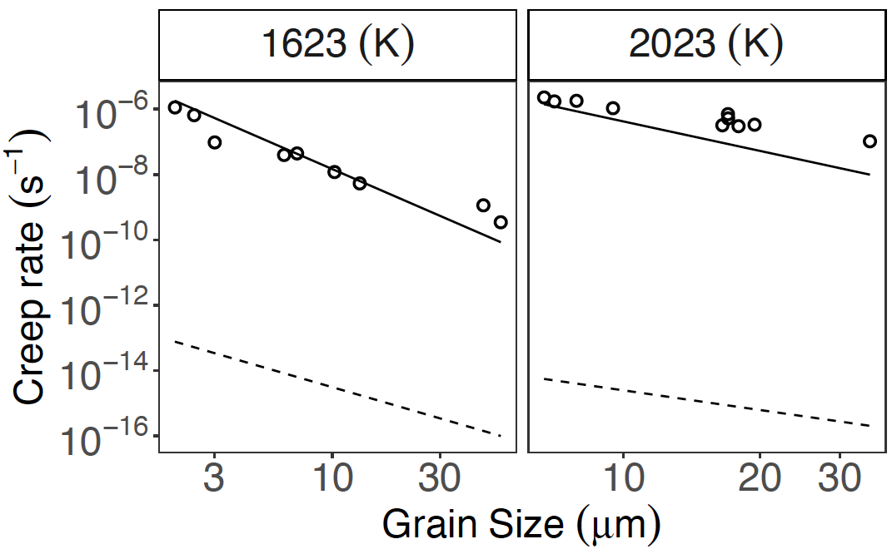
Diffusional creep mechanistic model
Creep mechanistic model
Analytical creep equations informed using atomistic simulations.
Shown that dominant creep diffusional mechanism was grain boundary (Coble).
𝝈
Grain boundary
self-diffusion
𝝈
𝝈
Bulk lattice
self-diffusion
$$\dot{ε}Coble,x= \frac{42\left|Ω_{x}^{GB}\right|D_{x}^{GB} [x^{GB}]πδ}{k_{B}TG^{3}} σ_{v}$$
𝝈
Grain size dependence
Doped UO₂ (larger grains)
Different regions in the fuel pellet
Grain boundary creep
Bulk creep

Slide 23
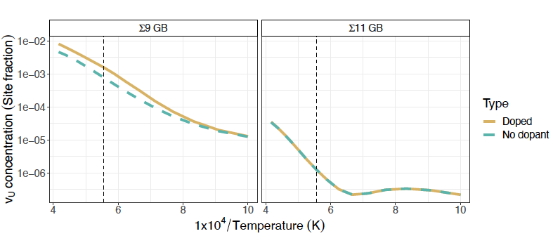
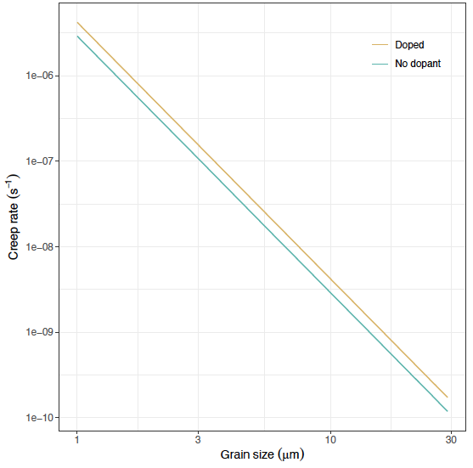
Doped UO₂ – impact of dopants on mechanistic model
Uranium vacancy concentration
Creep rates
Doped
Creep rates (s⁻¹)
Undoped
1800 K
20 MPa
Grain size (µm)
Slight enhancement of creep rates for a given grain size when Cr dopants are added to the GB.
Not enough of an impact to describe enhanced creep seen in doped UO₂
Working on other mechanisms, e.g. dislocation limited climb
Cr accommodated as interstitials – positive charge
  Uranium vacancy concentration goes up slightly
  Can impact:
    Creep rates
    Grain growth

Slide 24
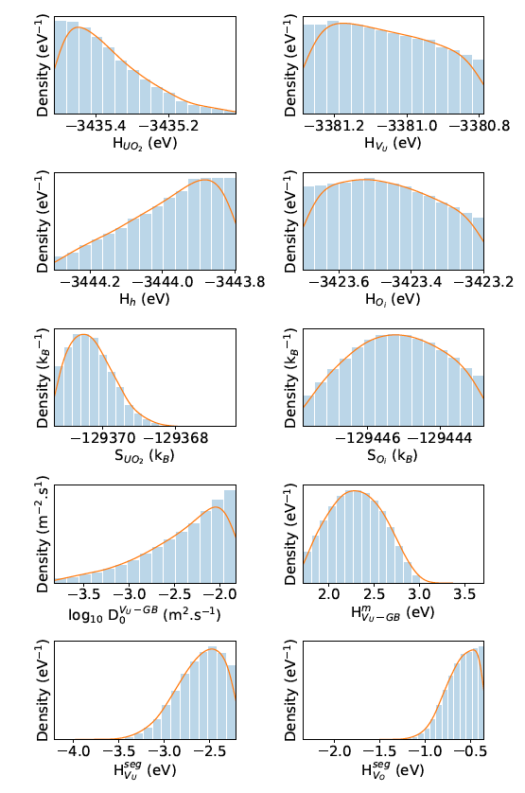
UO₂ uncertainty quantification
Probability density functions on lower length-scale parameters
Model
Creep
Lower length scale input parameters
Model
Diffusion
Bayesian calibration of model against existing data
  Creep, thermodynamics, diffusivity etc.
Enables more accurate prediction of properties as a function of chemistry
Separate effects tests can reduce overall uncertainty

Slide 25
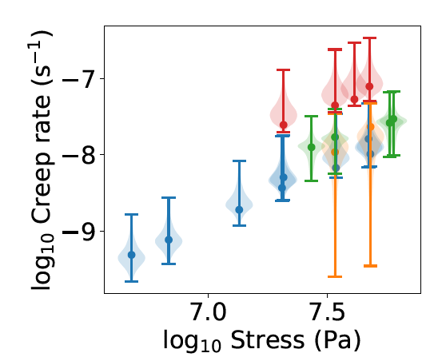
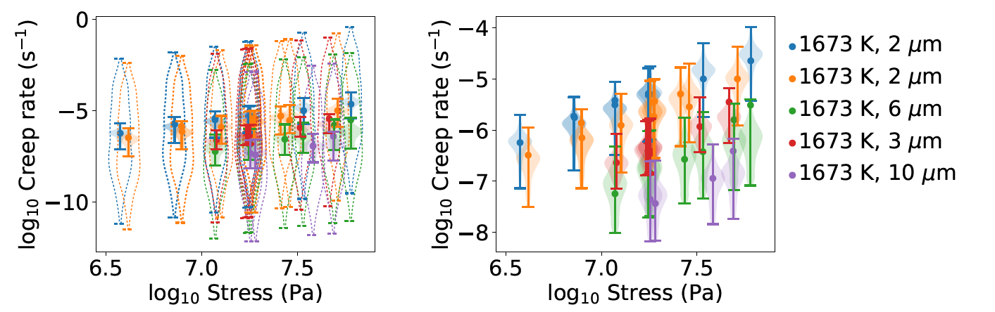
UO₂ creep pushforward posterior
Probability density functions
“Good agreement” is not sufficient from a regulation standpoint, NRC require confidence intervals
Propagate uncertainty from LLS to the creep rates
Aim to push these uncertainties to BISON with mechanistic models
Can use framework to infer environmental conditions of experiment - unknowns
Creep rates in UO₂
Circles: experiments
Dotted violins: prior uncertainty
Full violins: pushforward posterior

Slide 26
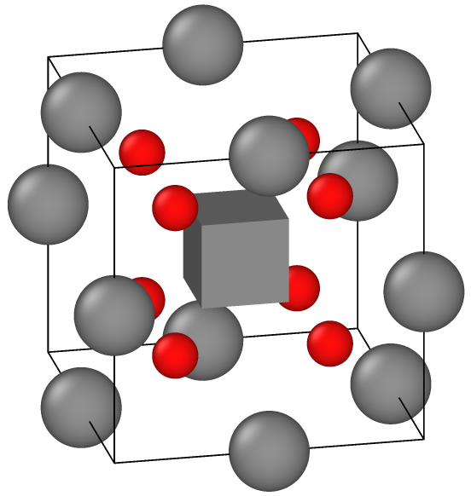
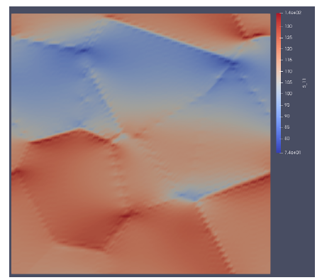
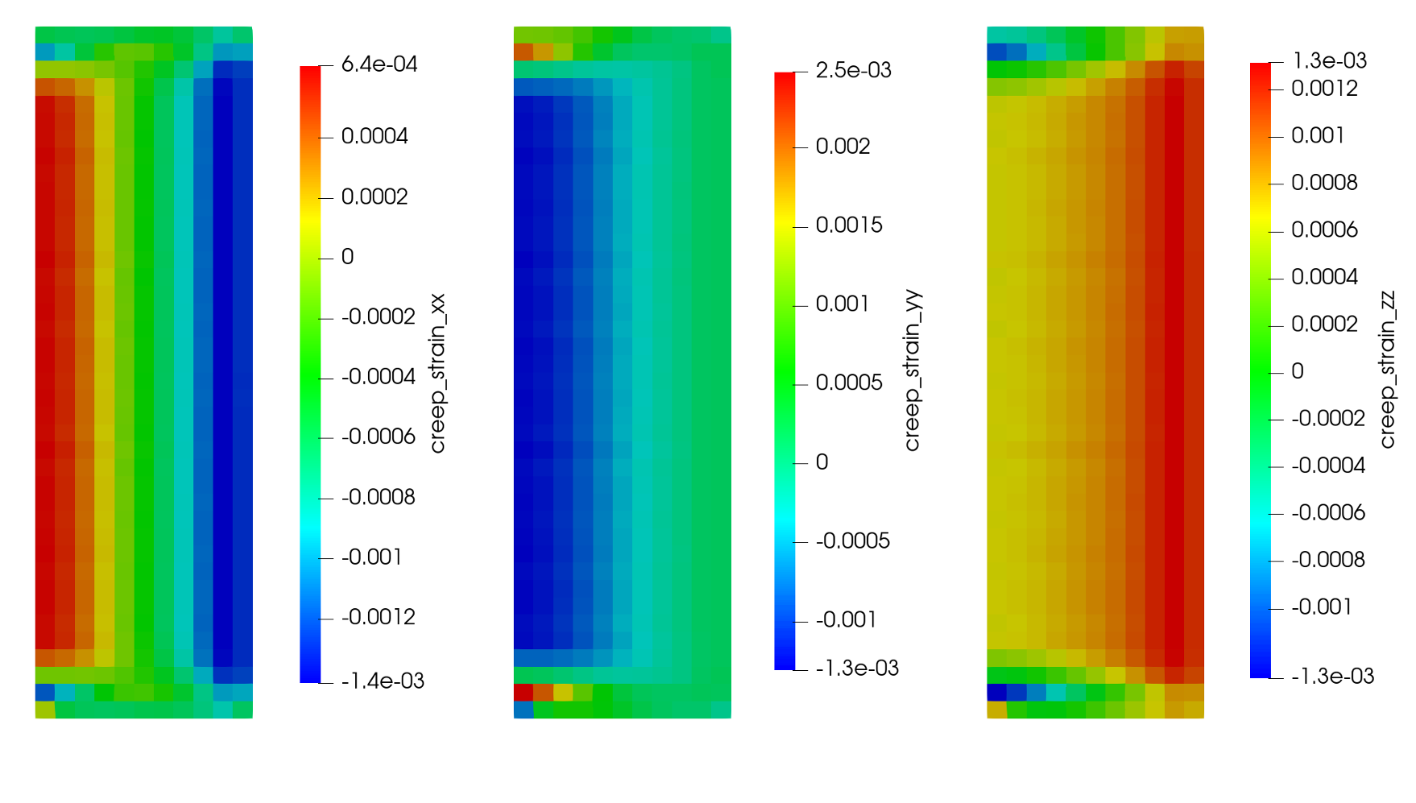
Demonstrate new plasticity models for doped UO₂ that capture dislocation mechanisms
Climb and glide for UO₂ creep
Atomistic data for model with uncertainty
Constitutive polycrystalline model (LApx)
Captures the the mechanistic behavior at the atomistic level
Captures the complex stress/strain and defect evolution at the microstructural level
Enhancement for doped UO₂ creep
Implement into BISON
Enable predictions of how pellet cladding interactions impact cladding rupture (under LOCA conditions) for doped UO₂

Slide 27
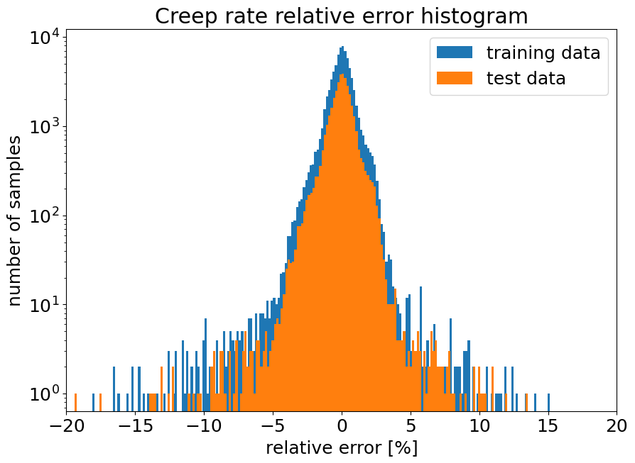
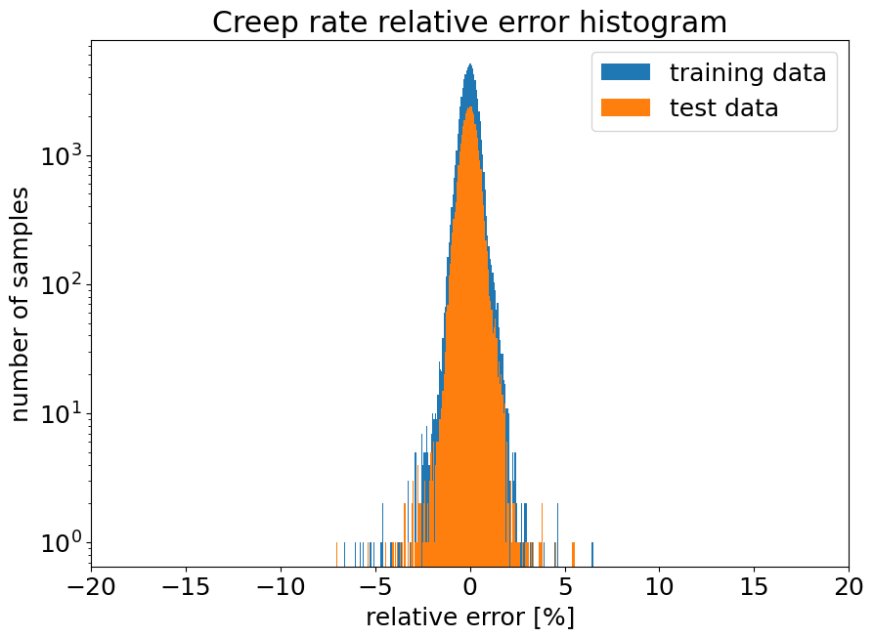
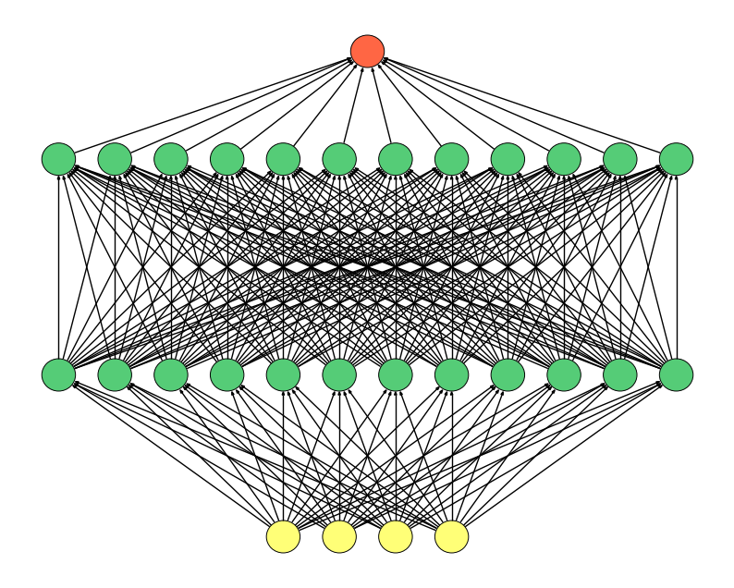
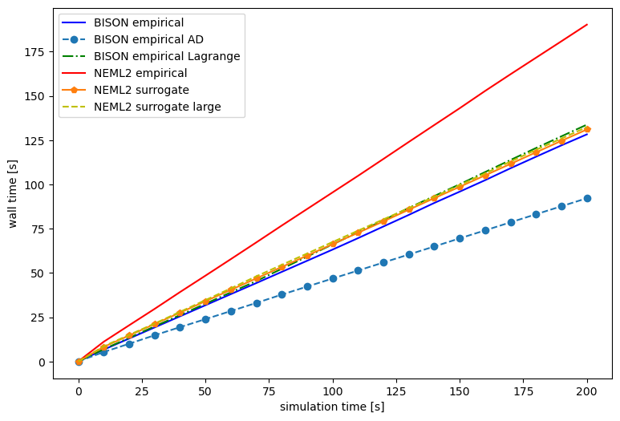
BISON Neural Network Surrogate for UO₂ Creep
Objective: build a surrogate model based on LLS data for BISON
Universal Approximation Theorem
A feed-forward network with a single hidden layer containing a finite number of neurons can approximate continuous functions on compact subsets of R^{n}
PyTorch GPU accelerated training and evaluation in BISON
Competitive performance with
room for increasing the
surrogate complexity
1 hidden layer model
2 hidden layer model
Excellent reproduction of LLS data
Effective scale bridging
60μm
10μm

Slide 28

BISON Integrated Testing
Fuel temperature IFA-716,1 rod 6
Fuel elongation IFA-716,1 rod 6
The LLS-informed creep rate model improves BISON predictions on fuel elongation and temperature
Fission gas release predictions require more attention
More LLS data is required for
  Lower temperatures
  Higher stresses
This model impacts cladding constraints and predicted LOCA behavior
MATPRO
ROM
Integrated testing results show improvements over MATPRO creep model
Fission gas release IFA-716,1 rod 6

Slide 29
Analysis of Halden data for validation
Identify and collect key experimental data for model calibration and validation

Slide 30

Supporting Multiscale Model Validation using the Halden Reactor Database
INL has access to the entirety of the Halden Reactor Experimental Database containing information on all experiments since 1958.
  Accompanied with a web-based search engine.
Ranking tables created for several areas of interest in the current NEAMS work scope including the 5-year plan and IPL.
  High burnup, tFGR, fuel-to-cladding bonding, axial gas communication, fuel pulverization, doped UO₂ (Cr, Gd, Pu), non-HBS FGR
Available measurements for each experiment identified.
Uncertainties on the Halden reactor instrumentation is also provided.
Ranking table of potential validation cases for high-burnup fuels [1]
FGR: fission gas release
RIP: Rod internal pressure
CE: cladding elongation
FCT: fuel centerline temperature
AFR: axial fuel relocation
[1] K.A. Gamble, "Selection and Ranking of Experiments from the Halden Database in Support of Multiscale Model Validation, INL/RPT-25-82778, 22025

Slide 31
Conclusion and future work
We are developing mechanistic models for LWRs related to
  high burnup extension and transient fission gas release
  bonding and axial gas communication
  doped fuels
We are validating our model against a wide range of data (PIE, separate, integral) and quantifying uncertainties.
The IPL currently supports these areas for normal operation conditions, AOO, and BDA.
We welcome suggestions/dialogue on priorities and interest.

Slide 32
Acknowledgements
This work was funded by the Department of Energy Nuclear Energy Advanced Modeling and Simulation (NEAMS) program.
This research made use of the resources of the High Performance Computing Center at Idaho National Laboratory, which is supported by the Office of Nuclear Energy of the U.S. Department of Energy and the Nuclear Science User Facilities under Contract no. DE-AC07-05ID14517.

