Slide 1
NEAMS Industry Impact and Contribution to Fuel Fragmentation Relocation and Dispersal
Nathan Capps¹
Technical Contributors: Bob Salko¹, Ian Greenquist¹, Aaron Wysocki¹, Daniel Schappel¹, Ryan Sweet², Jacob Hirschhorn², Pierre-Clement Simon², Stephen Novascone², Michael Cooper³, Laurent Capolungo³, and David Andersson³
¹Oak Ridge National Laboratory
²Idaho National Laboratory
³Los Alamos National Laboratory

Slide 2
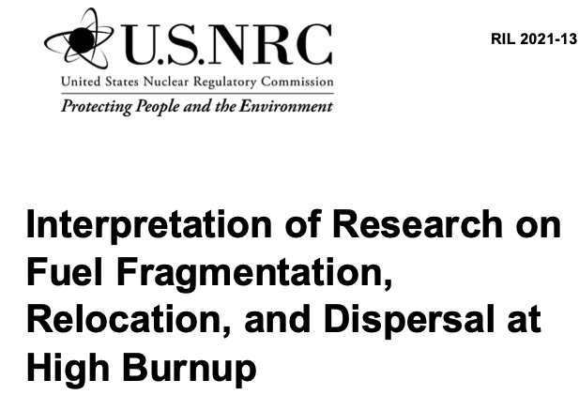

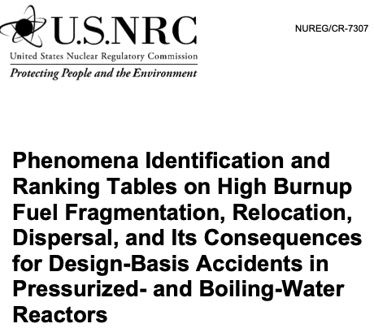
Since 2018, the NEAMS program has actively collaborated with the NRC and U.S. industry on high-burnup FFRD initiatives

Slide 3
The NRC utilized a methodology developed by the NEAMS program to support all dispersal consequence analyses.
Transient of Interest
VERA – Transient Analysis: decay heat or transient power input
VERA - Full Core Steady State Depletion Analysis
BISON – Evaluate performance on down selection based on rods most limiting
TRACE - Cladding surface temps and system conditions
BISON - Simulate rods of interest from steady-state through accident
Perform fuel rod failure analysis
Evaluate failure consequences
Identify Model Gaps
Fuel Rod Failure Identification or Accident Consequence Analysis

Slide 4
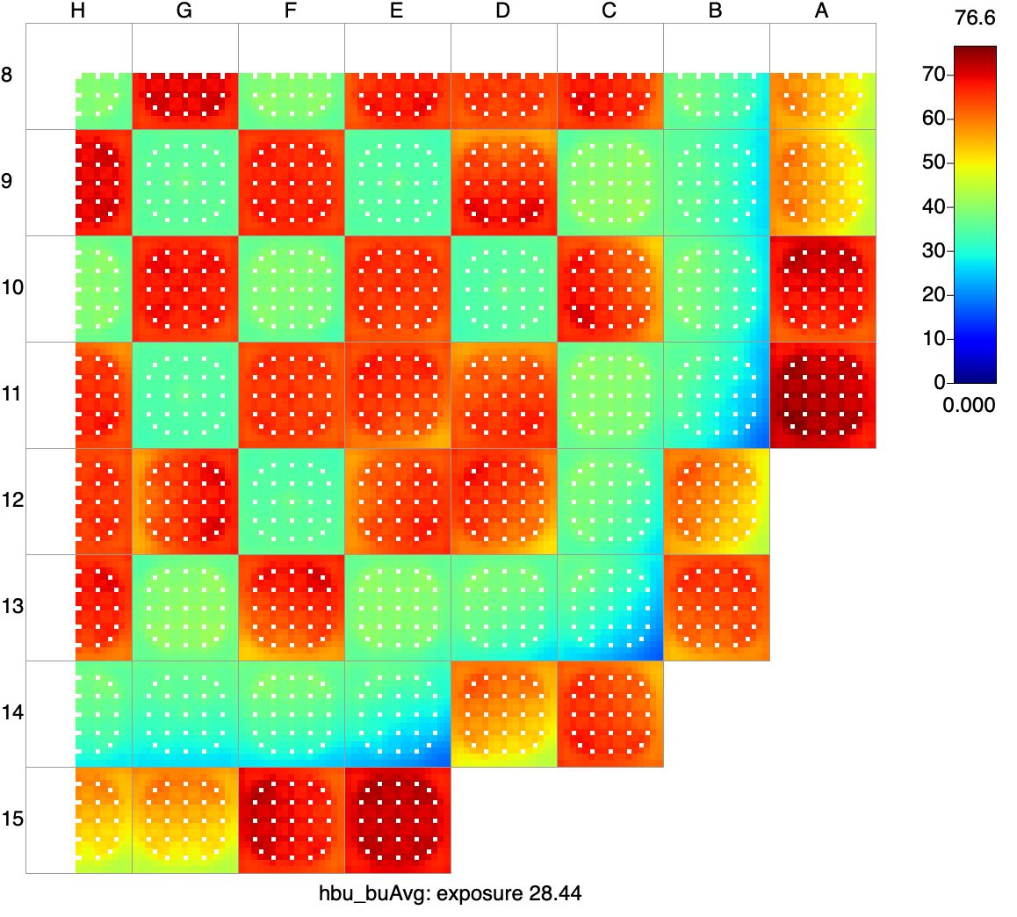
NEAMS developed the methodology and applied it to both PWR and BWR systems to support analyses for both FFRD and no-burst Scenarios
BWR Core Map with High Burnup Assemblies
PWR High Burnup Core Map
High burnup assemblies

Slide 5
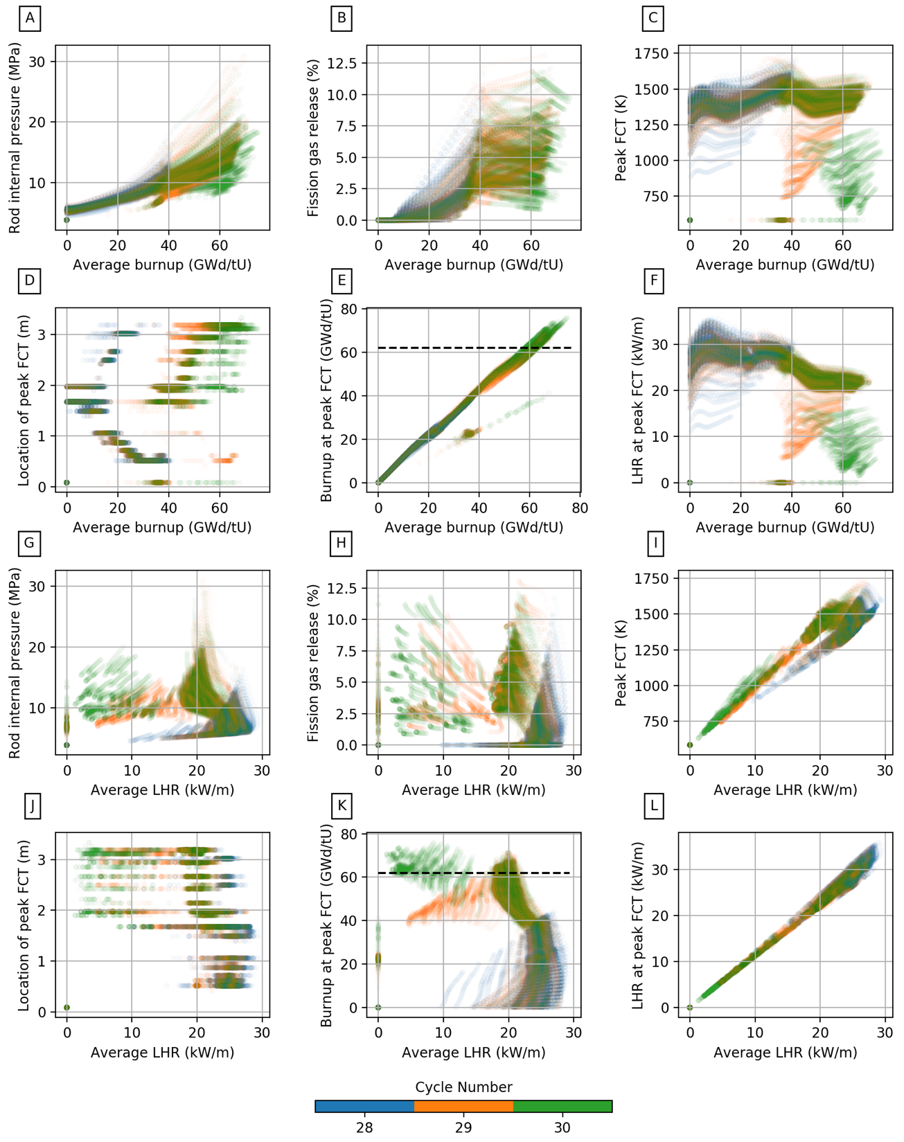
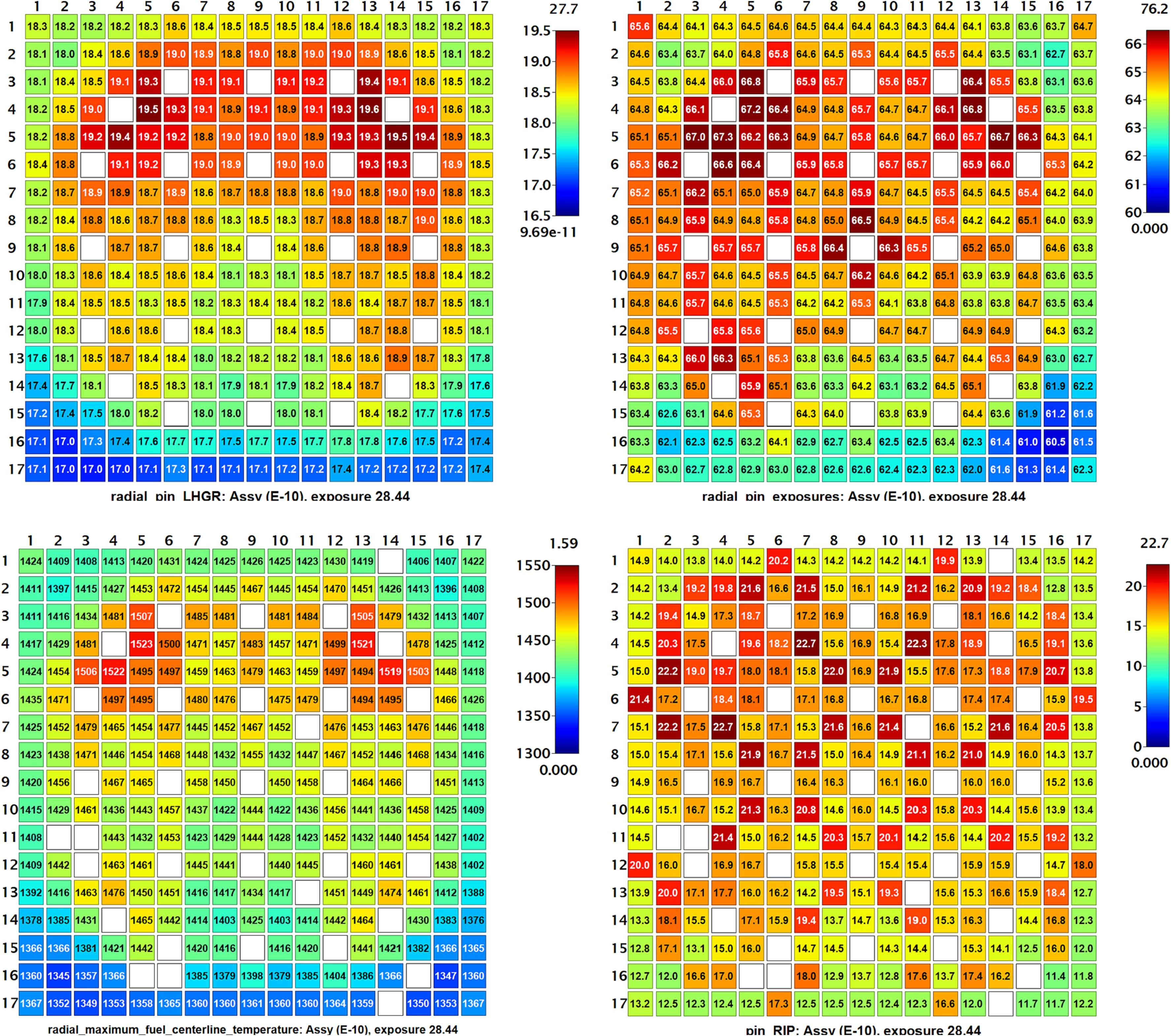
The high-fidelity analysis showed that core designs had a direct impact on fuel operating conditions and potentially on FFRD susceptibility

Slide 6
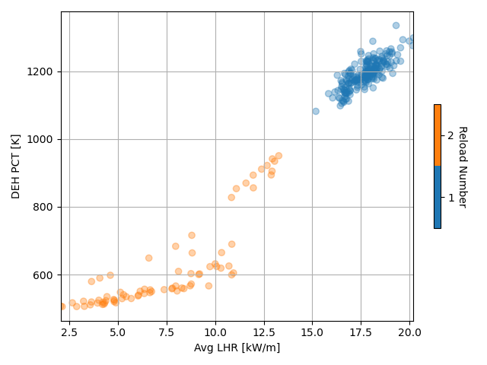
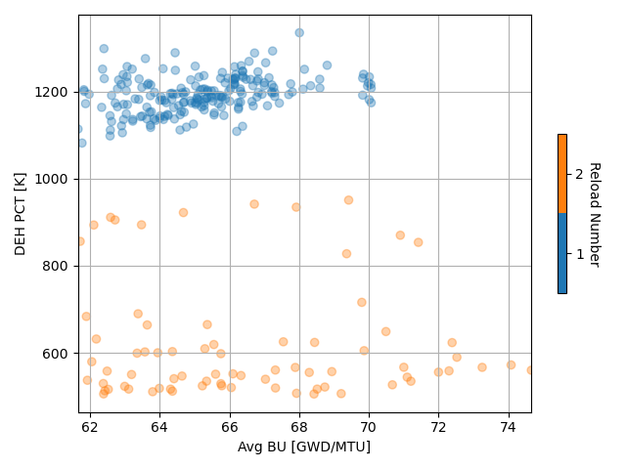
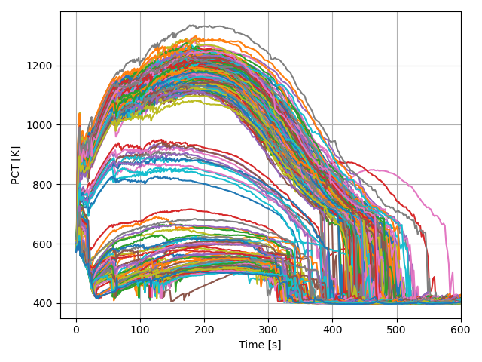
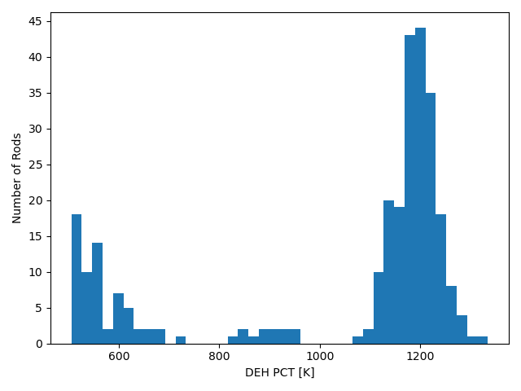
Identified trends between LHR and PCT indicated that FFRD LOCA tests may not accurately represent prototypical conditions

Slide 7
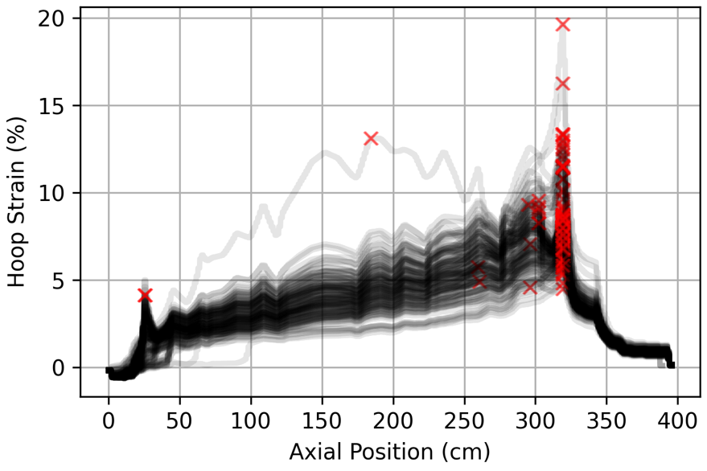
Initial FFRD analyses suggested that the entire rod might be susceptible to dispersal; however, high-fidelity results indicated otherwise

Slide 8
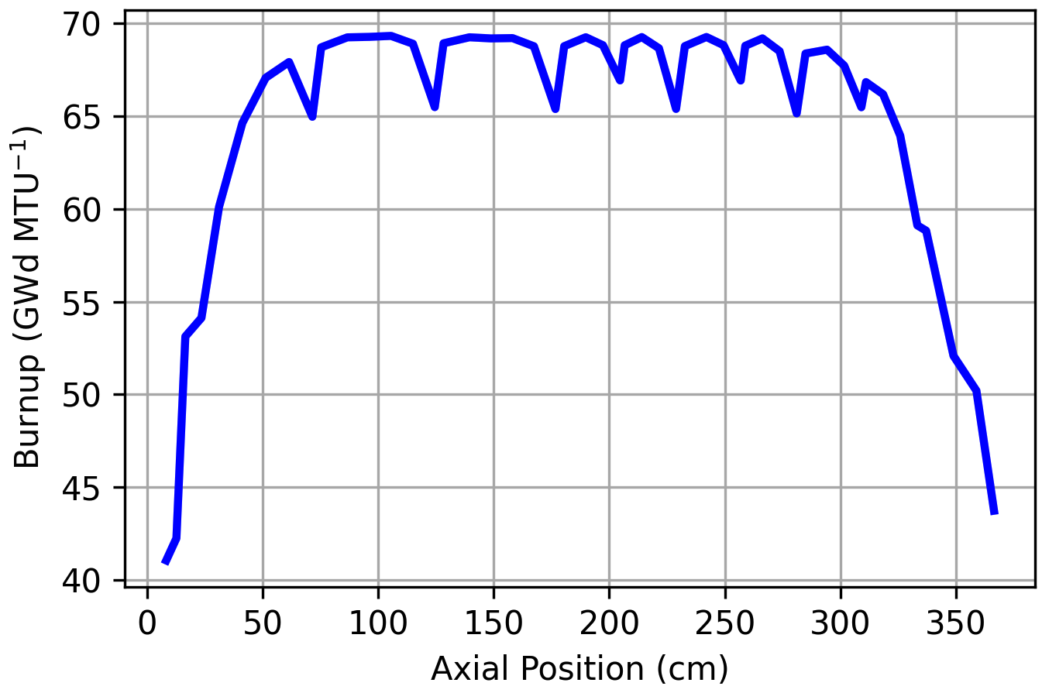
Fuel susceptible to FFRD can then be estimated and refined based on assumptions made throughout the analysis
Assumption: Assembly structural features pin FFRD
 | NRC RIL 1 mm | NRC RIL 2 mm | Turnbull
Average fuel fuel susceptible to FFRD per failed rod (kg) | 0.048 | 0.060 | 0.018
Total fuel fuel susceptible to FFRD simulated rods (kg) | 7.35 | 9.18 | 2.72
Total fuel fuel susceptible to FFRD in full core (kg) | 330.9 | 413.7 | 122.4
Margin of Error (kg) | ±53.7 | ±67.1 | ±19.9
FFRD Susceptibility: 100-500 kg of dispersed fuel

Slide 9
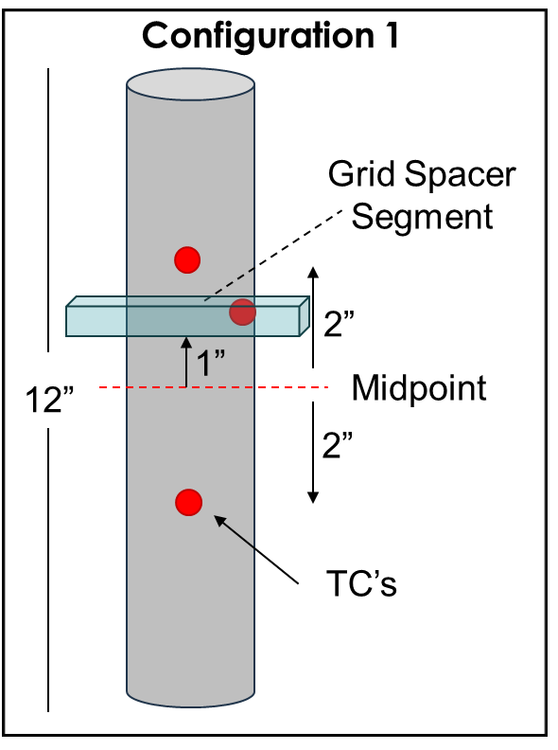
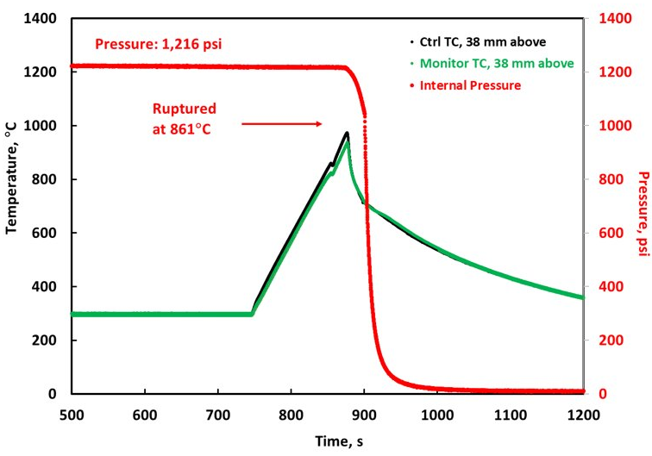
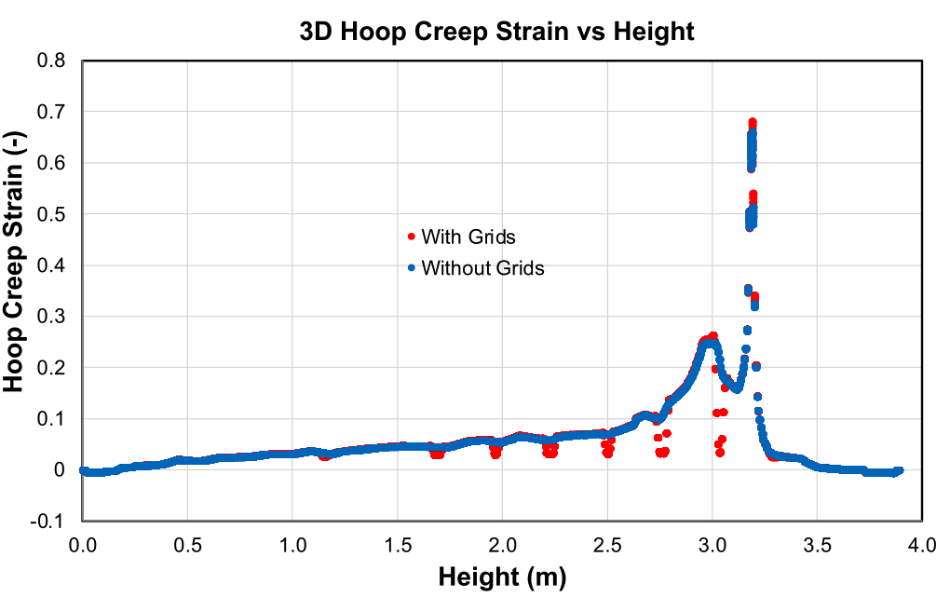
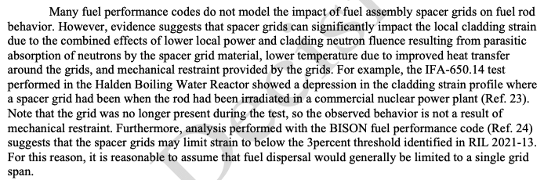
High-fidelity tools were used to evaluate modeling assumptions, refine safety margins, and design a LOCA test incorporating a grid spacer
NEAMS Analysis – Impact of spacer grids and mixing veins
Parameter | Value | Units
Rodlet Length | ~30 | cm
Environment | He | —
Internal pressure at 300°C | 8.27 | MPa
Temperature ramp from 300°C | 5 | °C/s
Terminal temperature | 1,000 | °C
Hold time | 0 | s
Rupture Temperature | 861 | °C
Rupture Width | 0.64 / 0.64 | mm
Rupture Length | 4.7 / 5.6 | mm
Text pulled from DG - 1434

Slide 10
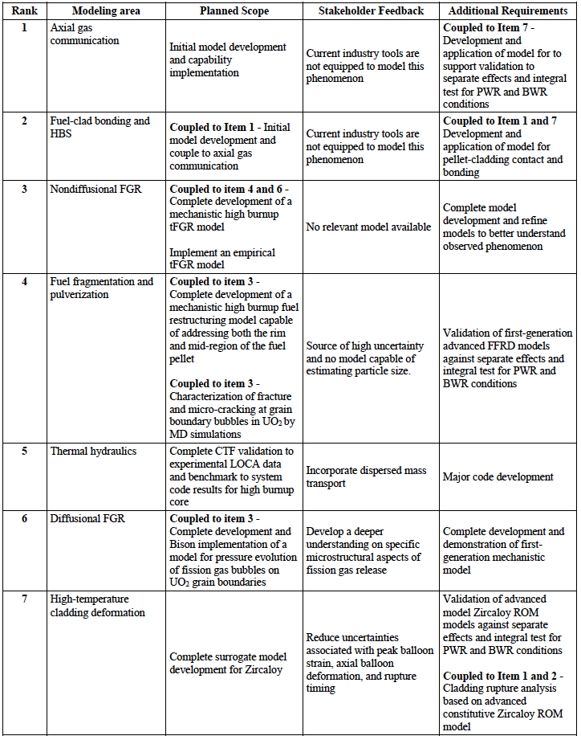
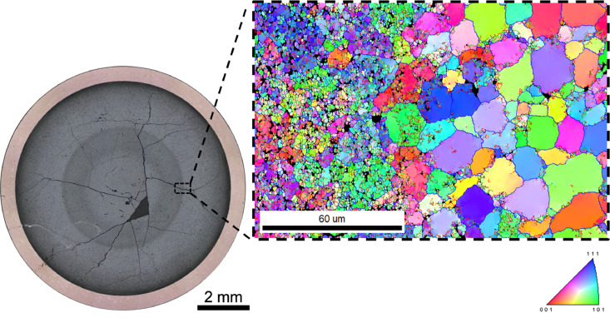
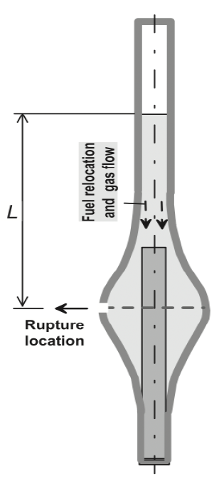
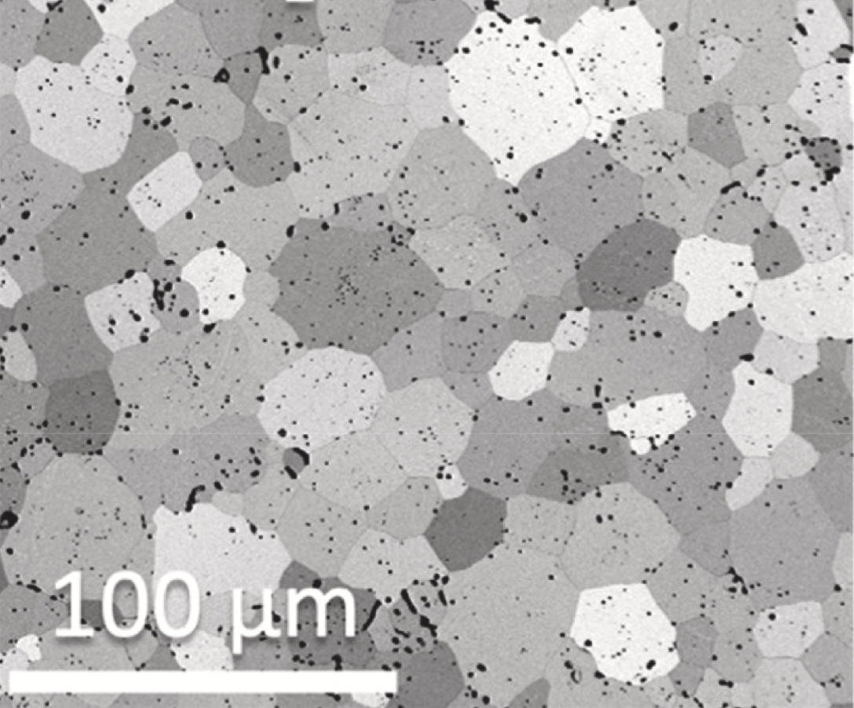
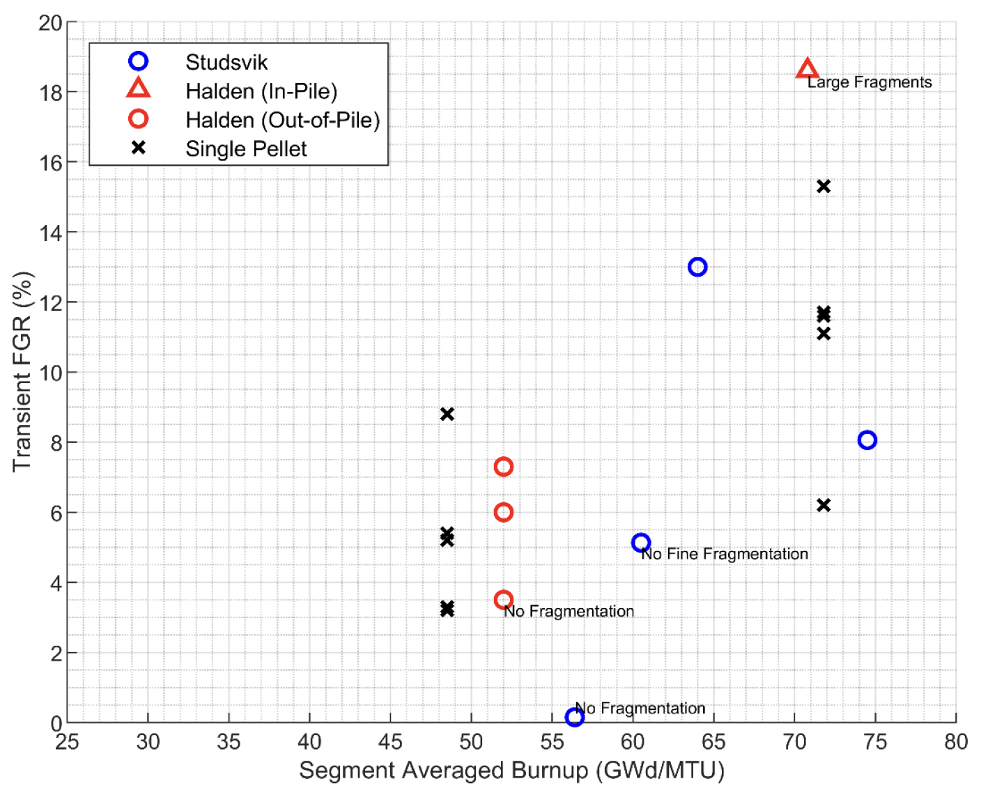
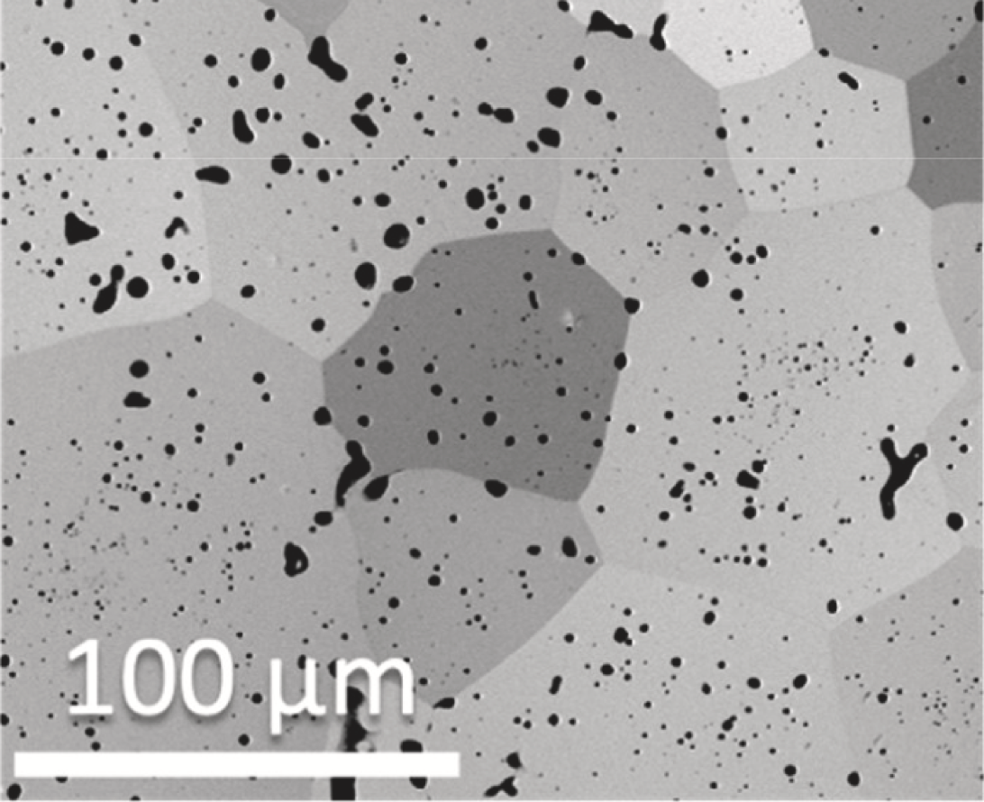
NEAMS’ mission is to advanced critical capabilities defined by the industry and quantify margins through the application of mechanistic models and high-fidelity tools
High burnup extension
Bonding and axial gas comm.
Doped fuel
Large, unexplained microstructural changes.
Dopants can positively affect fuel microstructure and properties, making doped fuels a great option for LWR advanced fuels.
But data is limited and uncertainty is high.
Predict fuel relocation, bonding, and axial gas communication to better model ballooning and performance during LOCA.
Key to following regulation guidance.
UO₂

Slide 11
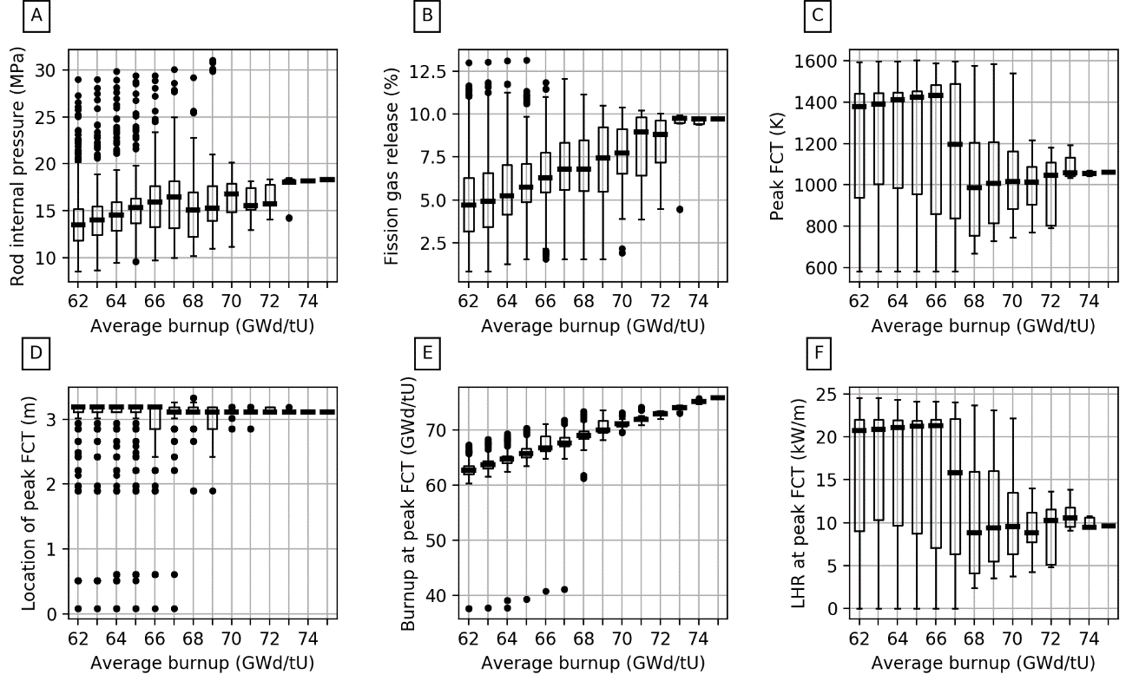
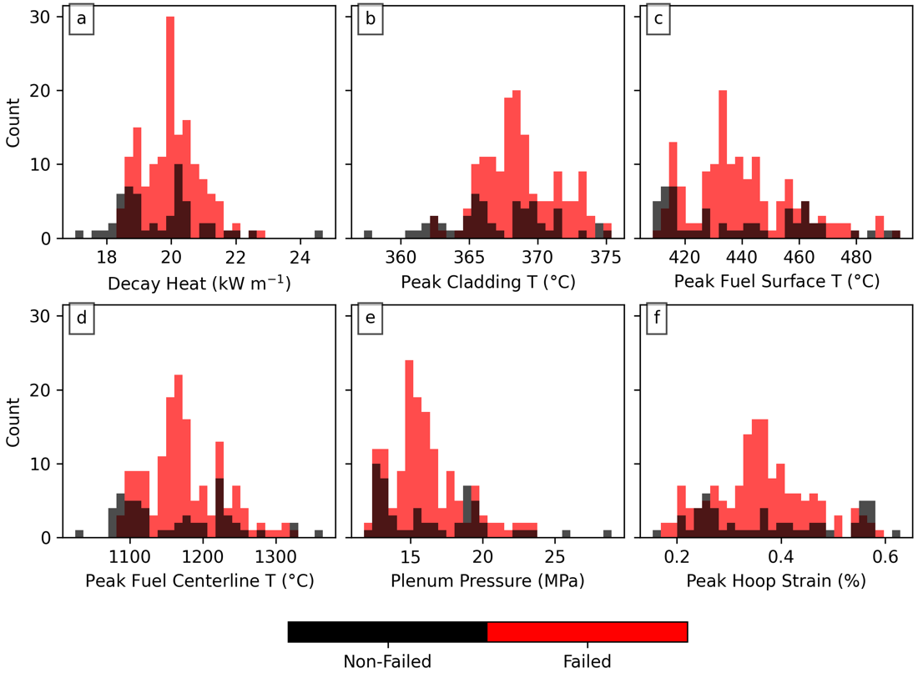
NEAMS tools and models have been instrumental in addressing and accelerating burnup extension, and through the EPRI CRAFT community, identified future activities for program to continue to making meaningful contributions.
Email: cappsna@ornl.gov

