Slide 1
MSR Depletion and Future MSR Work
Presented by Eva Davidson, Oak Ridge National Laboratory
NEAMS MSR Applications Team
May 28, 2025
NEAMS Annual Review: Molten Salt Reactors

Slide 2
Objective
Cross sections need to be generated to perform Griffin depletion calculations
For this work, the MSRE model was used to perform depletion simulations
Griffin calculations at steady state were compared against Monte Carlo simulations
In this presentation:
Overview of Griffin results generated with different cross section sets
Description of how different cross section sets were applied in Griffin depletion calculations
Comparison of Griffin depletion calculations for the MSRE model
Overview of current MSR Multiphysics work being performed by ANL, INL and ORNL
Overview of future work to be performed by ANL, INL and ORNL MSR Multiphysics teams next fiscal year

Slide 3
Simulations are only as accurate as the cross sections that are generated to represent the fuel salt at each state point
Transport Solver | Cross Section/ Energy Structure | K-eff | Difference (pcm)
Shift Monte Carlo | CE | 1.01086 ± 0.00008 | Ref.
Griffin (CFEM-Diffusion) | Shift Macro 8G | 1.012334 | 147.4
Griffin (CFEM-Diffusion) | Shift Micro 8G | 1.012334 | 147.4
Griffin (CFEM-Diffusion) | Shift Macro 16G | 1.008670 | -219.0
Griffin (CFEM-Diffusion) | Shift Micro 16G | 1.008672 | -218.8
Depletion in Griffin can be performed with either macroscopic or microscopic cross sections.
Macroscopic cross sections do not enable the user to look at specific isotopic inventories during depletion whereas microscopic cross sections allow users to track individual isotopes generated during depletion calculations.
Steady state calculations performed at beginning of cycle (BOC) with cross sections generated with Shift and no depletion.
Contact: Donny Hartanto (hartantod@ornl.gov)

Slide 4
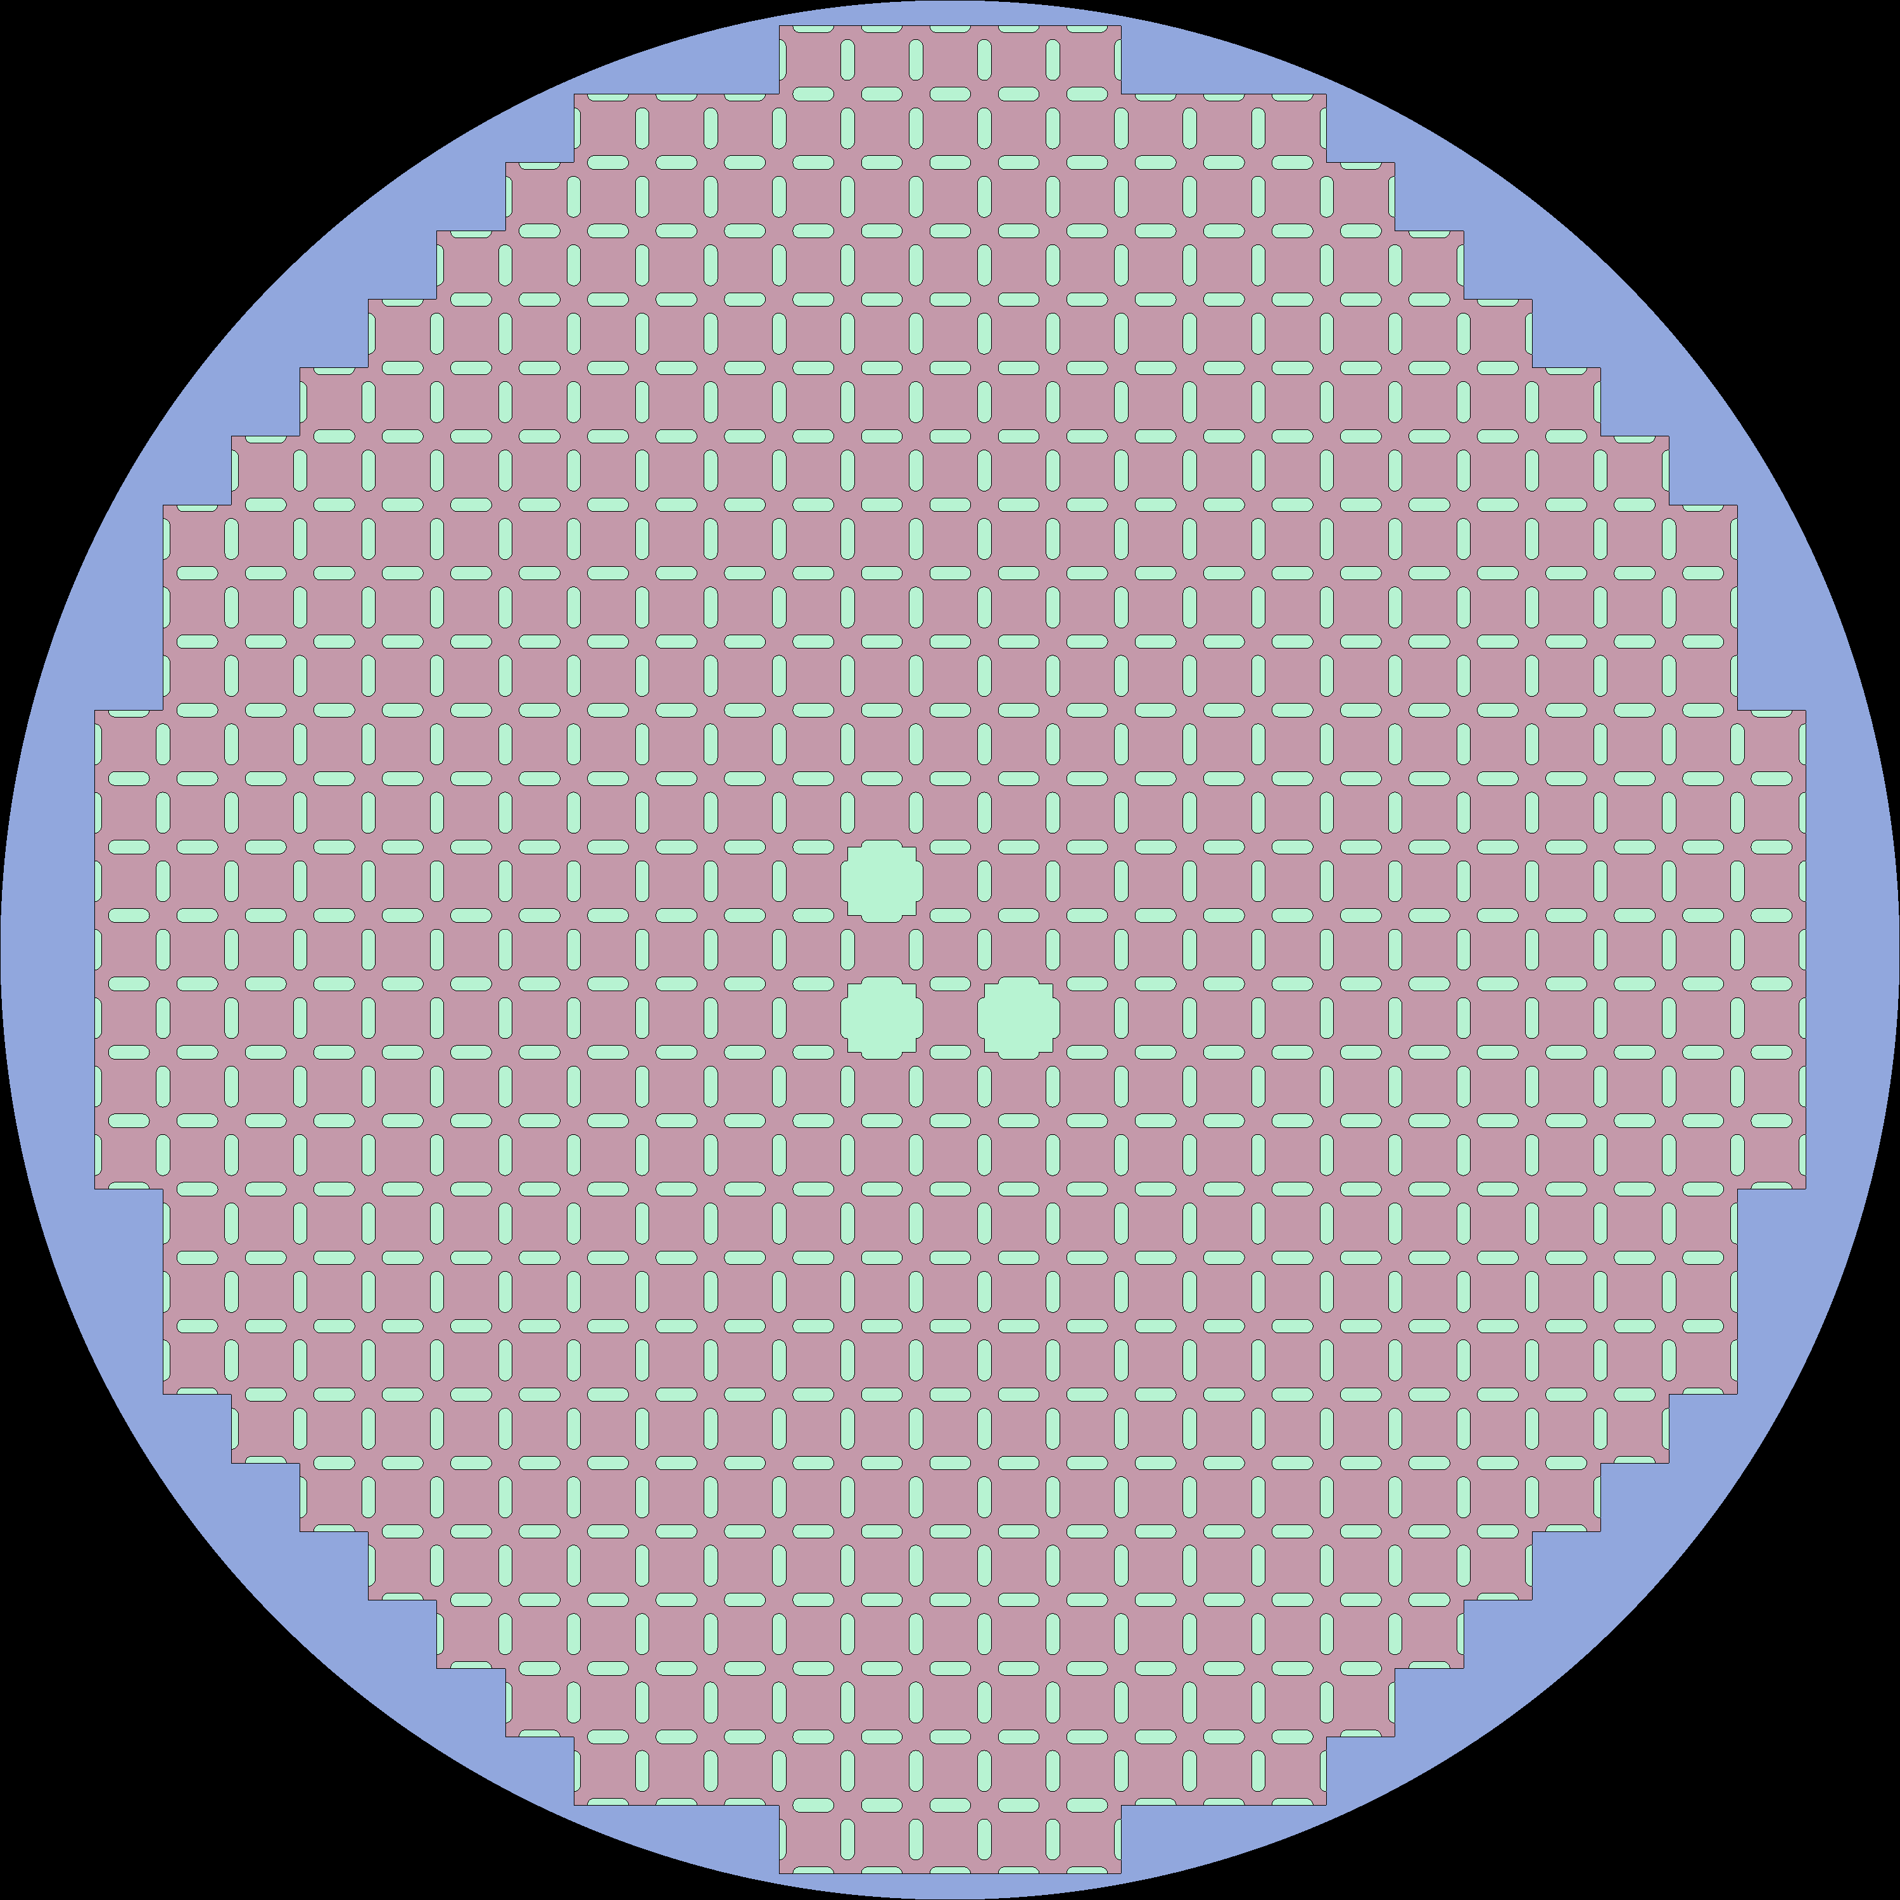

Griffin Microscopic Depletion for MSRE
Cross sections generated for three distinct fuel salt regions which includes core, radial and axial fuel salt) at:
The first state (BOC)
16 burnup states along depletion simulation
Depletion calculations using macroscopic cross sections generated with Shift has been demonstrated.
Depletion calculations using microscopic cross sections generated by Shift is under development.
Griffin requires that isotopic composition list stays constant throughout the depletion
That means trace isotopes that build up later in the depletion calculation need to have cross sections built at the beginning of the cycle.
For this work, cross sections generated for 423 isotopes from ENDF/B-VII.1
Multiple salt regions (core fuel salt, radial fuel salt, and axial fuel salt)
Contact: Donny Hartanto (hartantod@ornl.gov)
Notes:
Currently Shift generates a zero value for scattering cross sections for trace isotopes whereas OpenMC generates a non-zero value for scattering cross sections for trace isotopes.
This issue is being addressed in Shift and is in the process of being rectified. These non-zero values are ONLY on the scattering matrix diagonal, so all of the group-to-group is lumped into the within-group value. Another approach will be taken in Shift to not lump the group to group scattering with the within-group terms

Slide 5
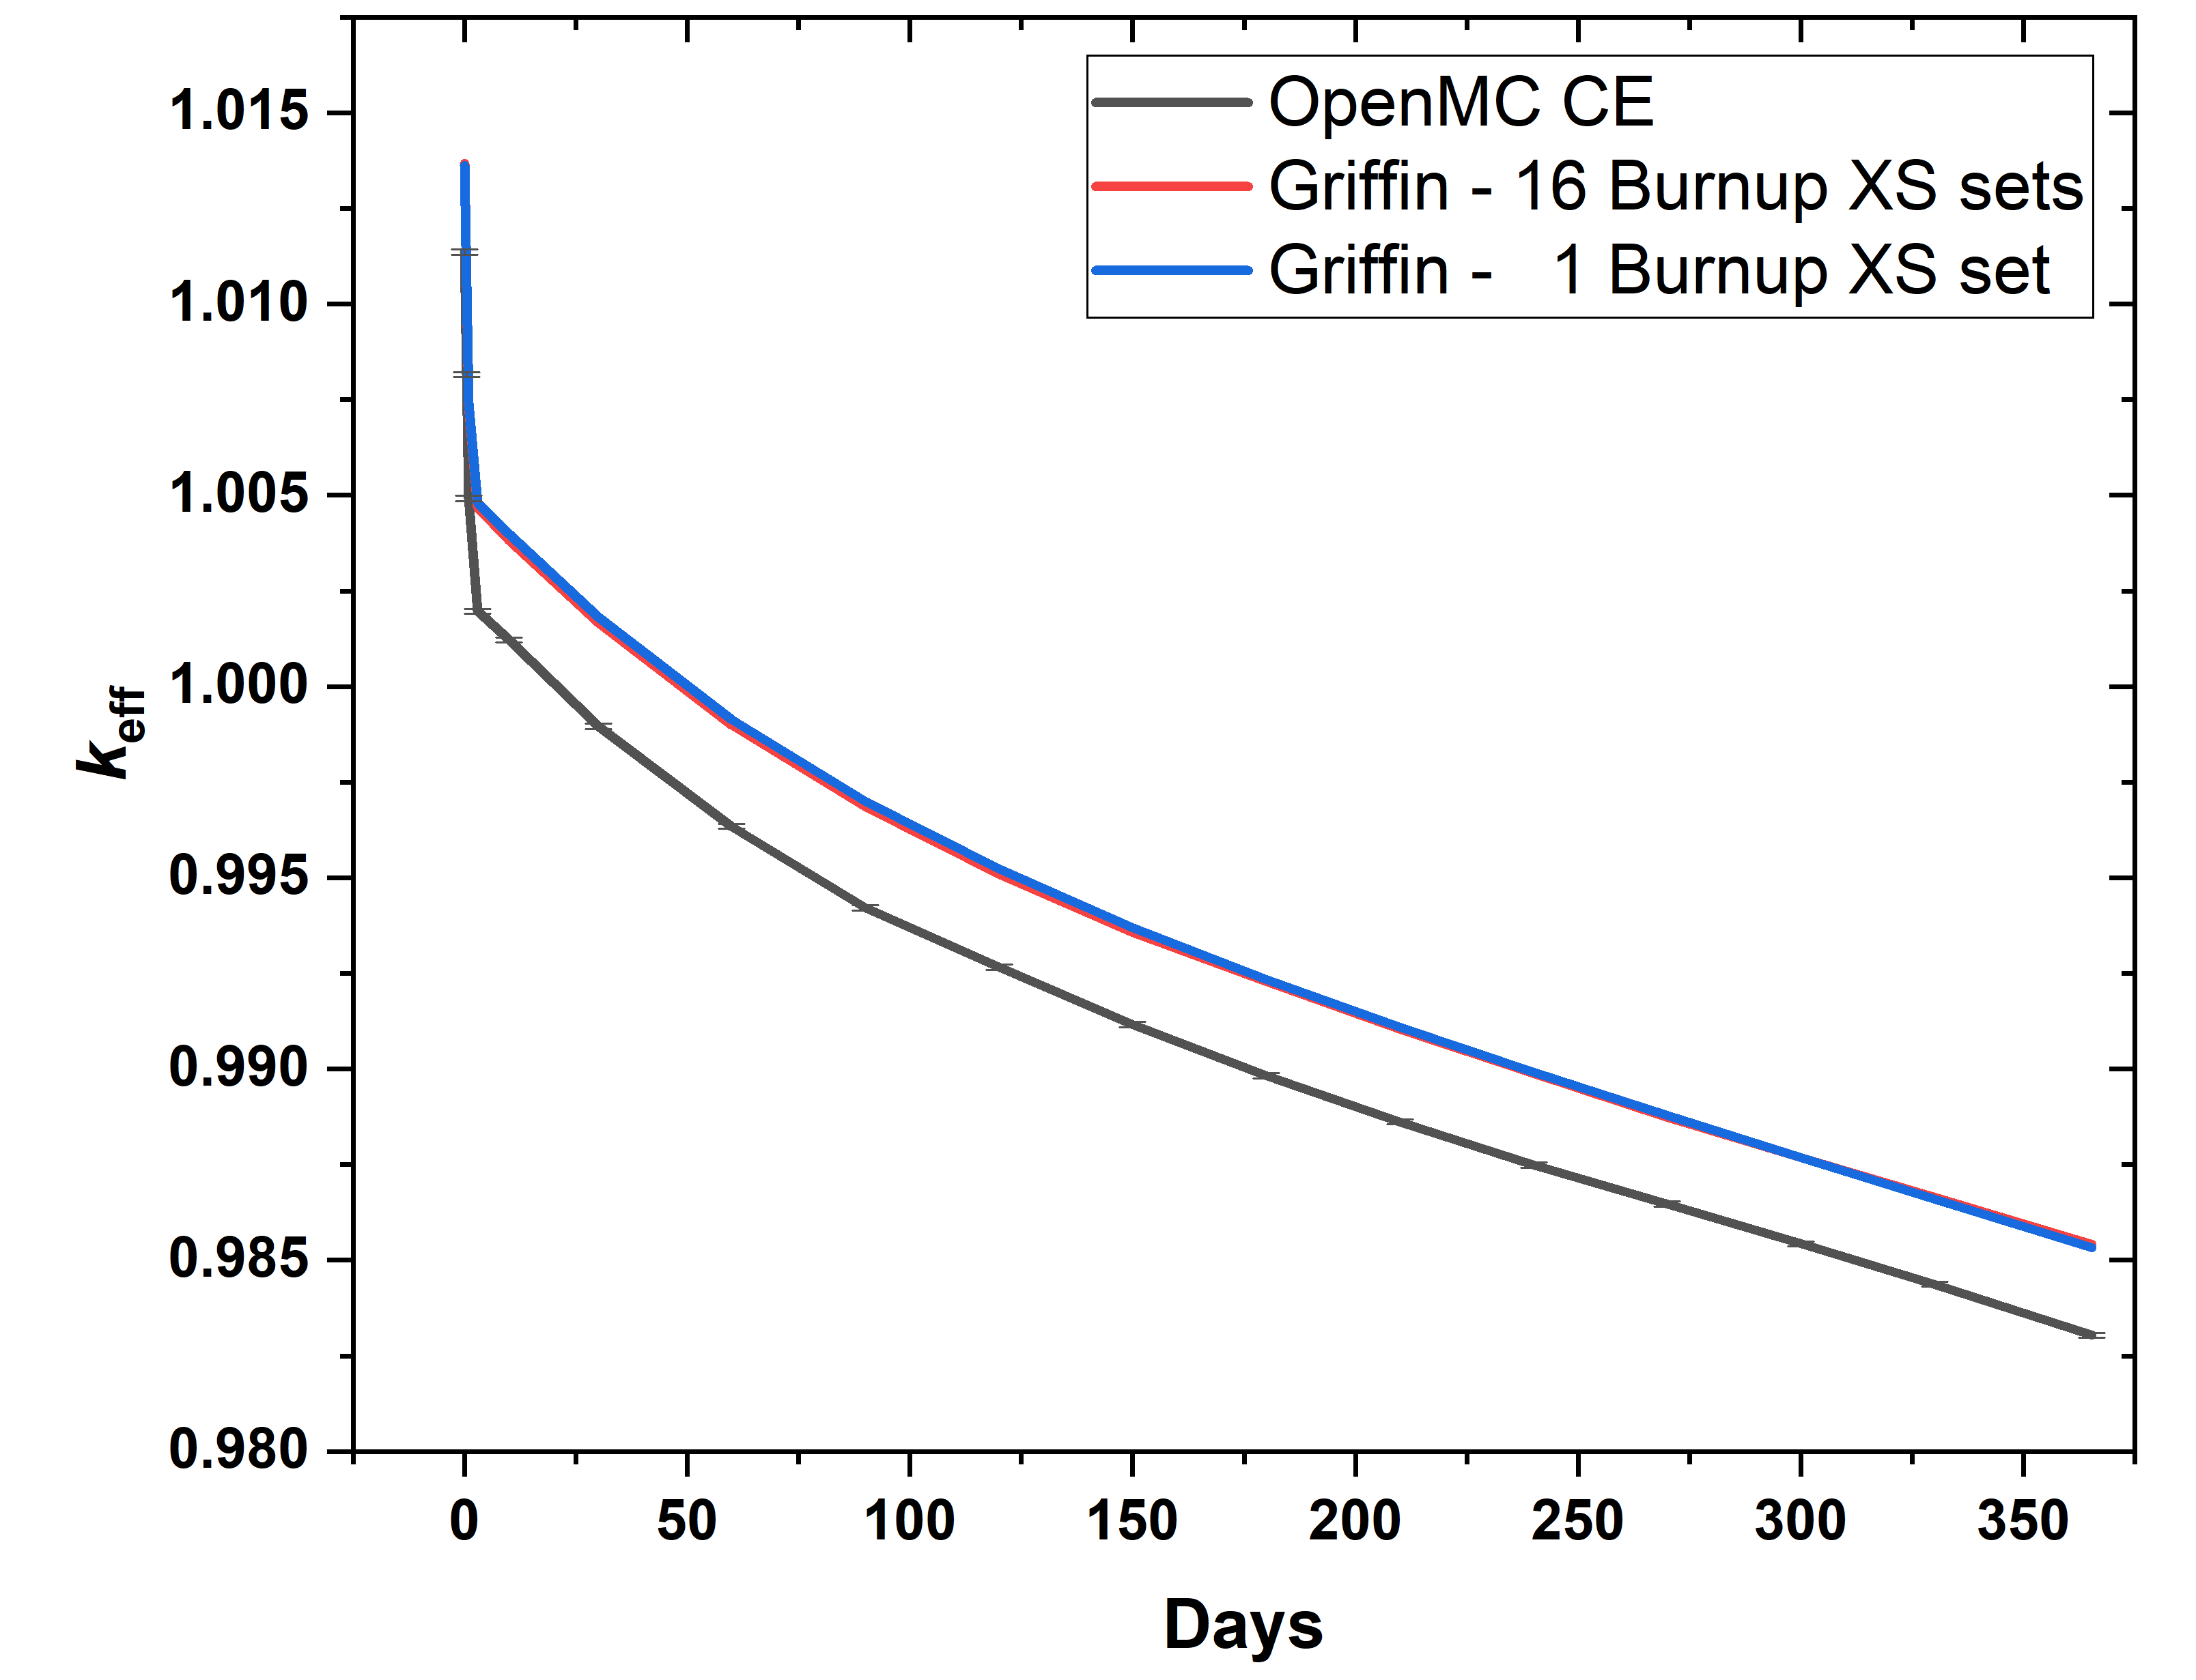
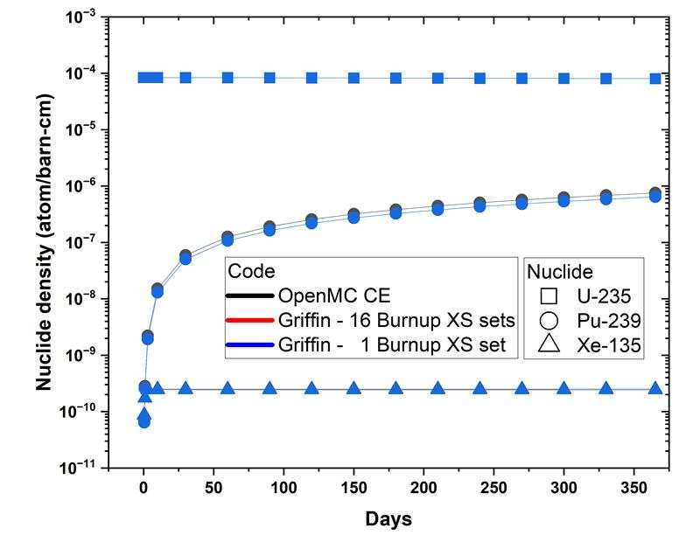
Griffin Microscopic Depletion with OpenMC cross sections
OpenMC used to generate cross sections at BOC (1 burnup point) and at 16 burnup points (grids) for MSRE depletion simulation
Two sets of Griffin MSRE depletion calculations were performed:
With cross sections generated at BOC for the entire simulation
16 different cross section sets associated with each depletion point in the simulation
Results indicate that there is negligible difference between the two Griffin cases for the MSRE
Figure on left shows negligible difference between two Griffin simulations performed with the two different sets of cross sections. Difference between OpenMC and Griffin throughout depletion is comparable to simulation at BOC.
Figure on right shows that for U-235, Pu-239 and Xe-135, the isotopic inventory from Griffin simulations are comparable to the isotopic inventory obtained from OpenMC
Contact: Donny Hartanto (hartantod@ornl.gov)
Notes:
423 isotopes from ENDF/B-VII.1

Slide 6
Demonstrate Initial Steady State Capability This Year
Model Development and Neutronics:
Develop a proposed fast-spectrum MSR (LOTUS) model.
Set up a Griffin depletion model for an MSR pool type reactor and generate cross sections for the model at steady-state conditions.
Find relevant experiment measurements to compare with the simulation results.
Thermal-Hydraulics:
Develop model for thermal-hydraulic loop for the MSR primary loop including the reactor core, primary loop, intermediate loop, and heat removal system using Pronghorn and SAM.
Neutronics/Thermal-Hydraulics coupling:
Coupling Griffin/Pronghorn for nuclear analysis of MSR models.
Develop Griffin steady-state core model for both fast and thermal MSRs to be coupled with the Pronghorn/SAM model for core analysis
Neutronics/Thermal-Hydraulics/Chemistry coupling:
Demonstrate modeling of off-gassing in MSR cores using the coupled Griffin/Pronghorn/Thermochimica model.
Demonstrate corrosion modeling using Pronghorn PNP model in support of long-term reactor operation
Demonstrating species tracking using coupled Griffin/Pronghorn/Thermochimica and validating these species tracking models, where possible, with MSRE experimental data.
Demonstrate the capability of Griffin/Pronghorn (or SAM)/Thermochimica coupling for modeling species transport of important fission products
Contact: Ting Fei (tfei@anl.gov), Mauricio Tano Retamales (Mauricio.tanoretamales@inl.gov),
Eva Davidson (davidsonee@ornl.gov)

Slide 7
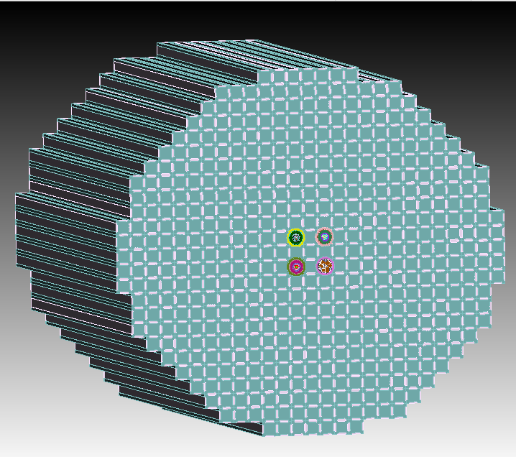
Projected activities for fiscal year 2026
Develop initial capability for salt spill accident modeling
Preliminary Multiphysics uncertainty quantification process for MSRs based on MOOSE stochastic tools (multiyear effort)
Preliminary demonstration of operational transient capability for both thermal and fast molten salt reactors coupling reactor physics, T/H and chemistry (multiyear effort)
Detailed MSRE mesh
Contact: Ting Fei (tfei@anl.gov), Mauricio Tano Retamales (Mauricio.tanoretamales@inl.gov),
Eva Davidson (davidsonee@ornl.gov)

