Slide 1
MSR Species Transport Multiphysics Simulations and Applications
Presented by Tingzhou Fei, Argonne National Laboratory
NEAMS MSR Applications Team
May 28, 2025
NEAMS Annual Review: Molten Salt Reactors

Slide 2
Introduction
Species transport is unique in MSRs with flowing fuel and has potential impact on core neutronics, depletion, corrosion, transient behavior.
Efforts in the following areas were initiated in FY24 and continue in FY25:
  Depletion (Griffin + Shift + MOOSE Stochastic Tools):
    Providing the source term for species transport models
    Inferring transfer rates from MSRE FP measurements and applying to the entire nuclide inventory
  Xe transport (Pronghorn/SAM+Griffin):
    Important for Xe poisoning effect, including both diffusion in graphite and mass transfer between liquid and gas.
  Noble gas mass interphase mass transfer (Griffin-Pronghorn and Mole)
    Important for volatile species tracking
  Noble metal (NekRS)
    Isotope plate out on component surface.

Slide 3
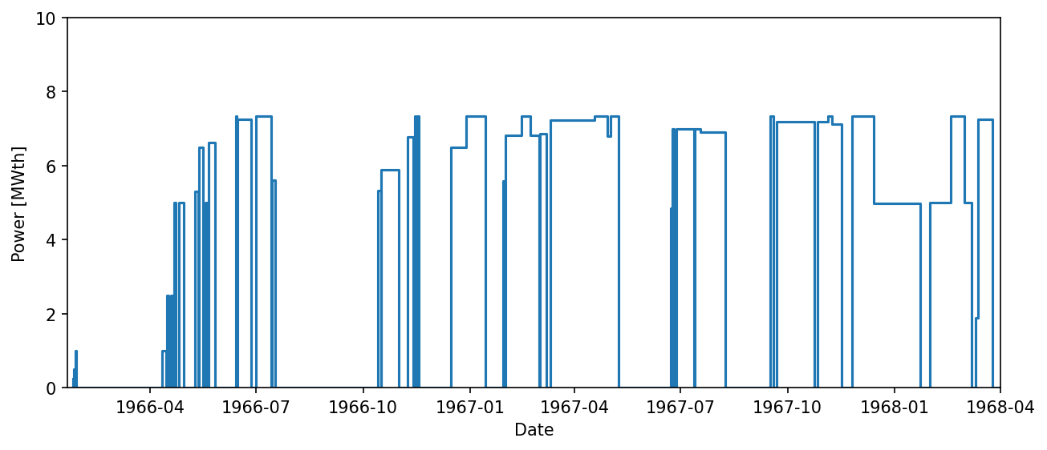
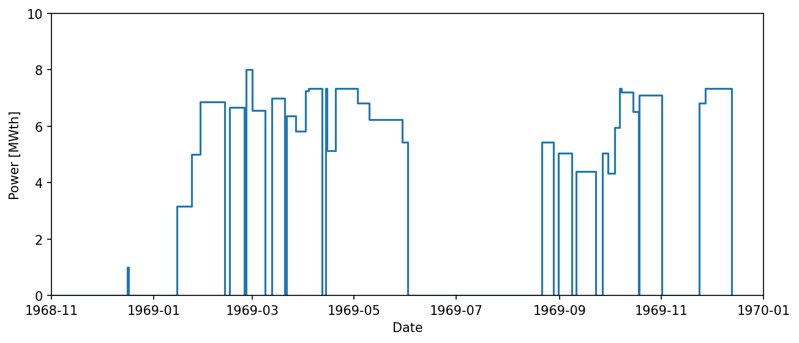
MSRE Fuel Depletion with Griffin
MSRE depletion calculation was performed using standalone Griffin’s Bateman solver with XS from Shift
  Used as the basis for the Redox potential calculation and compared against experimental data
  Based on digitized power history, material addition and removal data for both U-235 and U-233 operation
Several materials are added to the fuel salt during operation (Be, Zr, ²³⁵U, etc.)
Predictions for salt-seeking isotopes are reasonably good, although C/E values for those with noble-gas precursors are understandably below unity
Comparisons for noble metals are significantly different, indicating they are not well-mixed in the salt and likely deposit on the structural surface.
FY25 depletion work focuses on coupling neutronics with depletion (more detail in next presentation)
U235 Operation
U233 Operation
Contacts: Tingzhou Fei (tfei@anl.gov), Shayan Shahbazi (sshahbazi@anl.gov), Donny Hartanto (hartantod@ornl.gov),

Slide 4
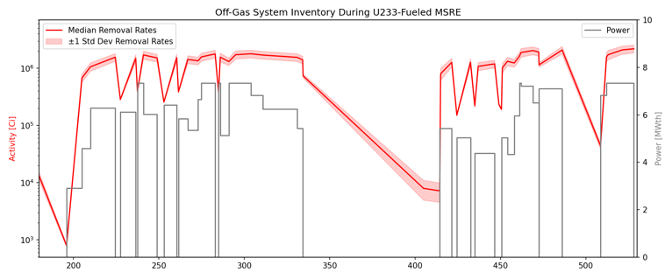
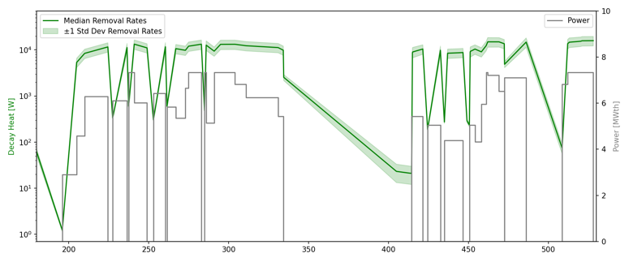
Parameter Inference with Griffin and Stochastic Tools
Demonstrated the usage of stochastic tool for Griffin depletion simulation.
  Various FPs were radiochemically measured in gas sample capsules from the MSRE pump bowl
  The gas-borne percentage (GBP) can be used to infer corresponding transfer rates of isotopes from the fuel
  Stochastic Tools module was utilized to sample the transfer rates across normal distribution with mean & std dev
    The elemental transfer rates is applied in Griffin to estimate the total FP inventory accumulated in the OGS (e.g., activity [Ci] & decay heat [W])
Transfer Rate for Element(s): | Kr, Xe | Rb, Cs | Nb | Mo | Tc, Ru | Sb | Te | Br, I
Inferred transfer rate (s⁻¹): | 1E-4 | 2E-10 | 2E-9 | 1E-8 | 5E-9 | 4E-9 | 5E-9 | 3E-9
Inferred from the GBP of: | ⁸⁹Sr, ¹⁴⁰Ba | ¹³⁷Cs | ⁹⁵Nb | ⁹⁹Mo | ¹⁰³Ru | ¹²⁷Sb | ¹³²Te | ¹³¹I
GBP value used (%): [1] | 3.0, 0.027 | 23 | 0.4 | 0.3 | 1.1 | 0.18 | 0.2 | 0.2
Contacts: Shayan Shahbazi (sshahbazi@anl.gov)

Slide 5
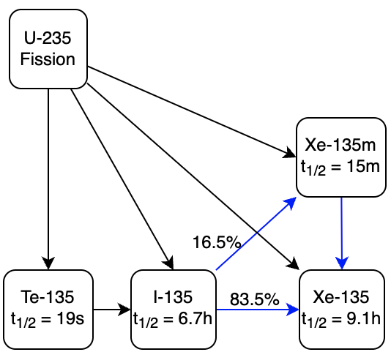
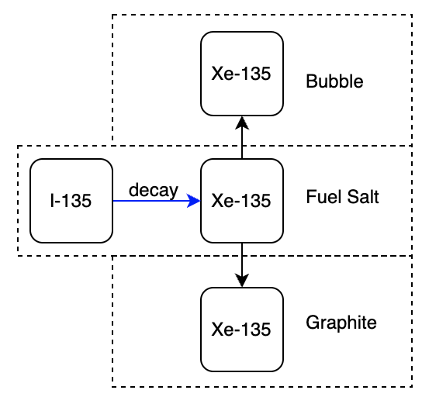
Xenon Transport (I)
Xenon poisoning in MSR is highly impacted by Xenon transport
  Xe-135 concentration is small compared to that of I-135 due to its large absorption. When the reactor is shut down or reduced in power, Xe-135 concentration can increase due to I-135 decay.
  Xenon can dissolve in salt, diffuse into graphite, transfer from salt to gas bubble that is removed in the off-gas system
  For multiphysics simulations, use TH code (Pronghorn/SAM) to solve the Xe-135 concentration and Griffin for solving the eigenvalue of the system.
Both SAM-Griffin and Pronghorn-Griffin models are used.
  The Xenon poisoning effect reaches a peak about 4 hr after reactor shutdown.
Contacts: Tingzhou Fei (tfei@anl.gov), Jun Fang (fangj@anl.gov), Mauricio E. Tano Retamales (mauricio.tanoretamales@inl.gov), Travis Mui (tmui@anl.gov)

Slide 6
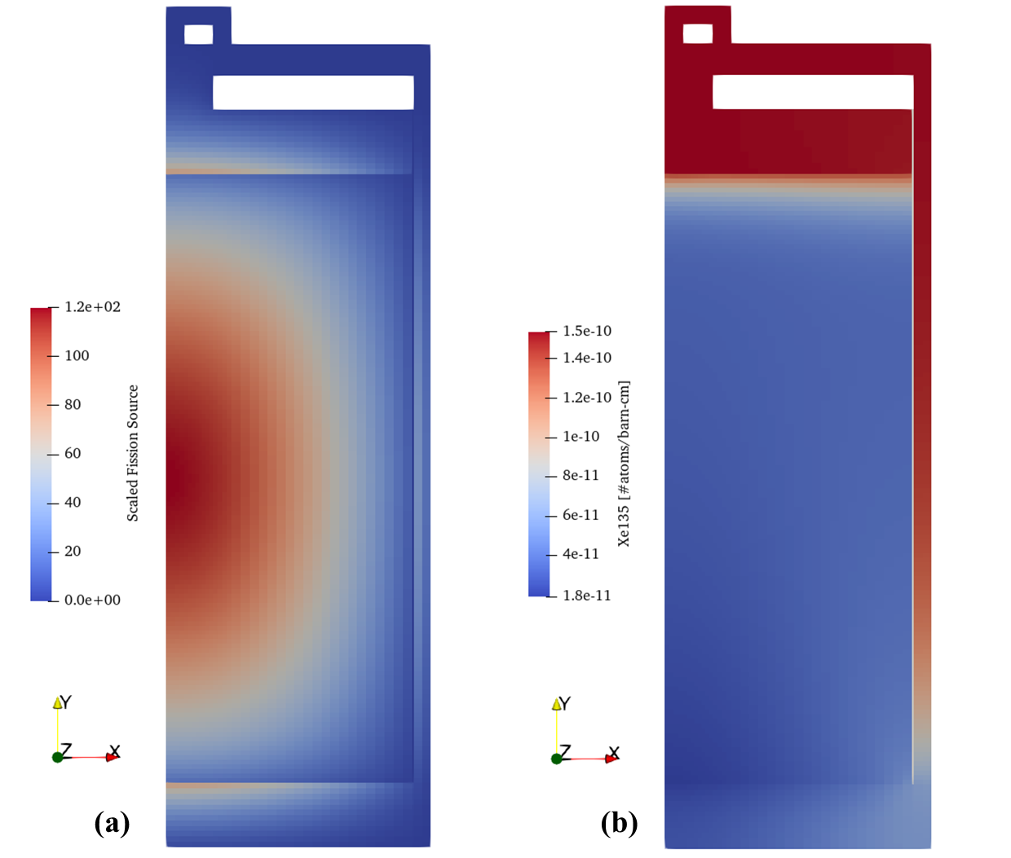
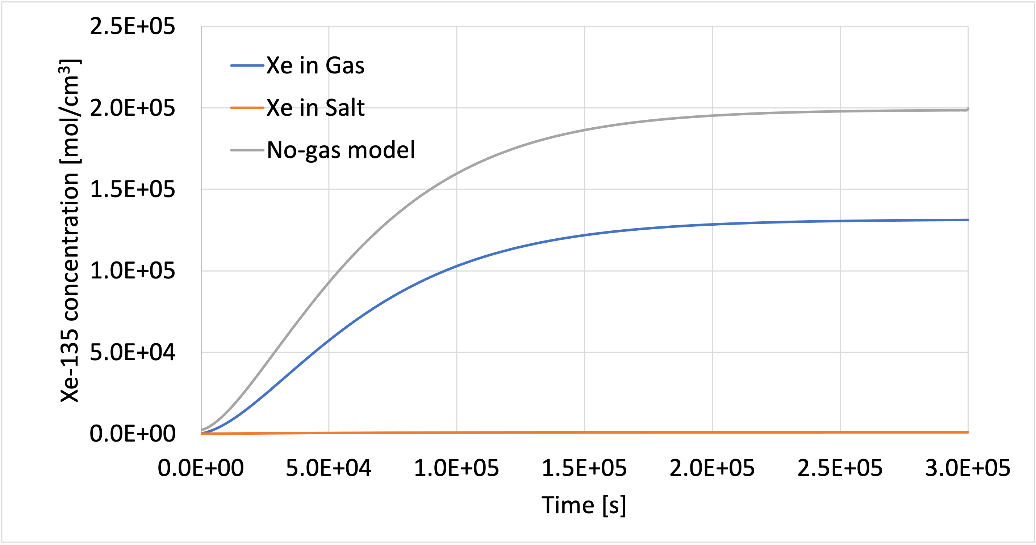
Xenon Transport (II)
Both models show reasonable Xenon poisoning effect
  The Xe concentration depends on the mass transfer coefficient from salt to graphite and to gas. SAM-Griffin model results in similar Xenon poisoning effect comparing to MSRE measurement (~-800 pcm).
  The Pronghorn-Griffin model results in Xe poisoning of -410.0 pcm, which aligns well with that from the SAM-Griffin models.
Pronghorn-Griffin Calculated Xe Distribution
Ongoing study focuses on the effect of including the gas phase
  Gas velocity affect Xenon concentration
SAM calculation with gas model
Transfer Coefficient | Xe in Fuel [atoms/barn-cm] | Xe in Graphite [atoms/barn-cm] | Reactivity change [pcm]
5e-3 | 9.93E-11 | 6.95E-12 | -430.75
1e-2 | 9.93E-11 | 1.40E-11 | -505.85
5e-2 | 1.00E-10 | 7.70E-11 | -1170.97
Contacts: Tingzhou Fei (tfei@anl.gov), Jun Fang (fangj@anl.gov), Mauricio E. Tano Retamales (mauricio.tanoretamales@inl.gov), Travis Mui (tmui@anl.gov)

Slide 7
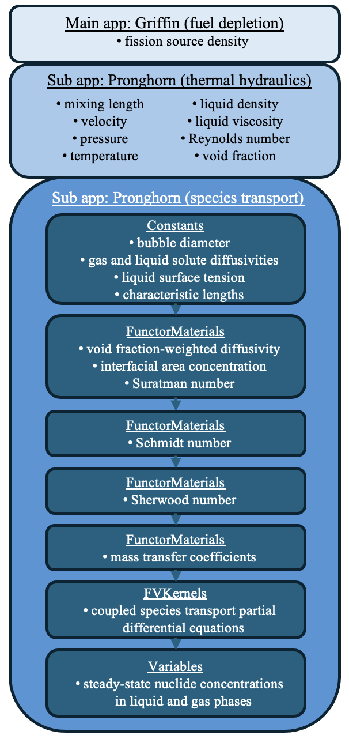
Noble Gas Mass Transfer (I)
Previous study shows the importance of the mass transfer coefficient correlation in predicting noble gas transport, motivating closer examination of available mass transfer correlations:
  Two historical Sherwood number correlations are considered for comparison: (1) Kress and (2) Calderbank & Moo-Young
  Pronghorn-Griffin calculates relevant neutronics and TH parameters prior to performing interphase mass transfer by calculating the interfacial area concentration and utilizing an empirical Sherwood number correlation
Demonstrated tracking of ⁹¹Kr and its beta decay chain (⁹¹Br, ⁹¹Rb, ⁹¹Sr, ⁹¹Y) in MSRE flow loop
  Only ⁹¹Kr is transferred to cocirculating bubbles
Results indicate that the transfer of Kr from fluid to gas is greater in the fission-dense core region when using Kress, whereas it is greater in the ex-core regions when using Calderbank & Moo-Young
Contacts: Shayan Shahbazi (sshahbazi@anl.gov), Mauricio E. Tano Retamales (mauricio.tanoretamales@inl.gov)
Notes:
We need to define species in the TH code.
This is two phase flow.

Slide 8
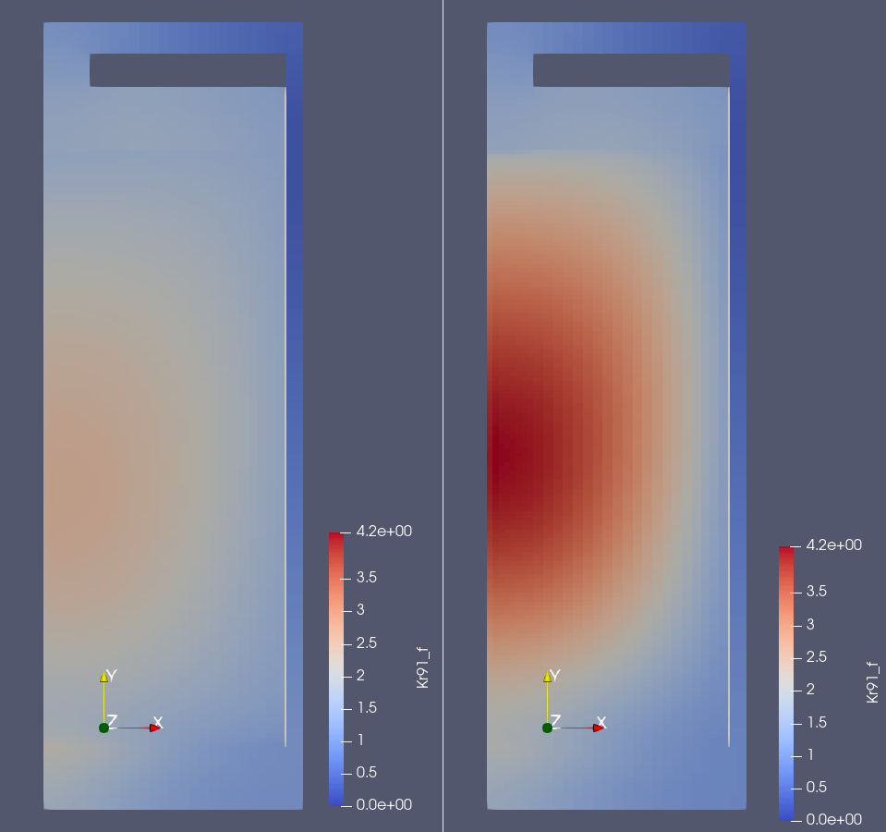
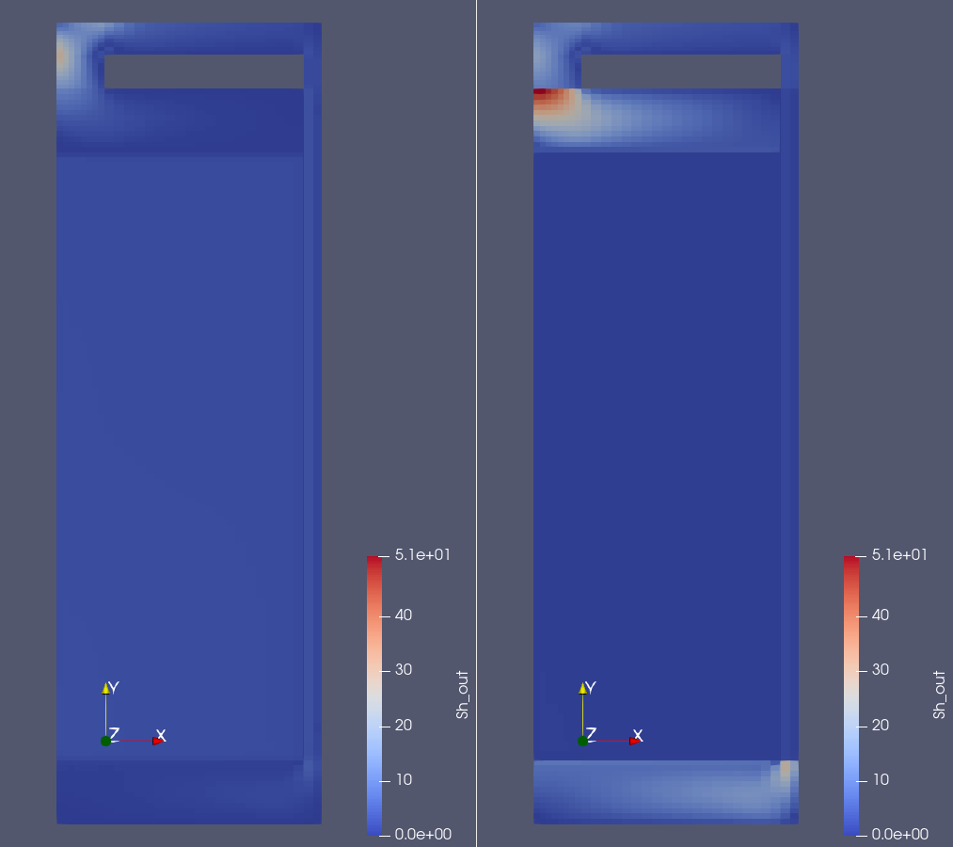
Noble Gas Mass Transfer (II)
⁹¹Kr in the fluid when using Kress (left) or Calderbank & Moo-Young (right)
Sherwood number calculated when using Kress (left) or Calderbank & Moo-Young (right)
Contacts: Shayan Shahbazi (sshahbazi@anl.gov), Mauricio E. Tano Retamales (mauricio.tanoretamales@inl.gov)

Slide 9
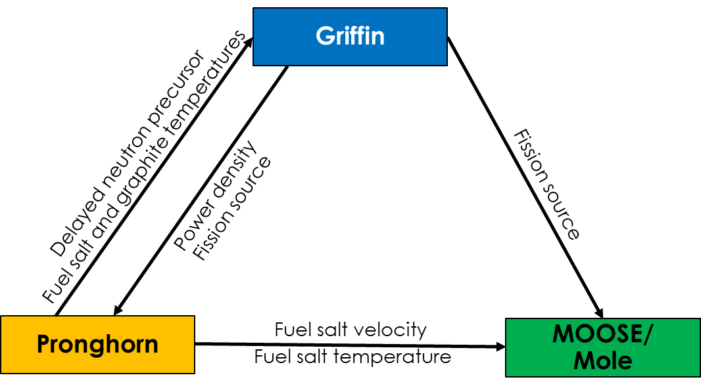
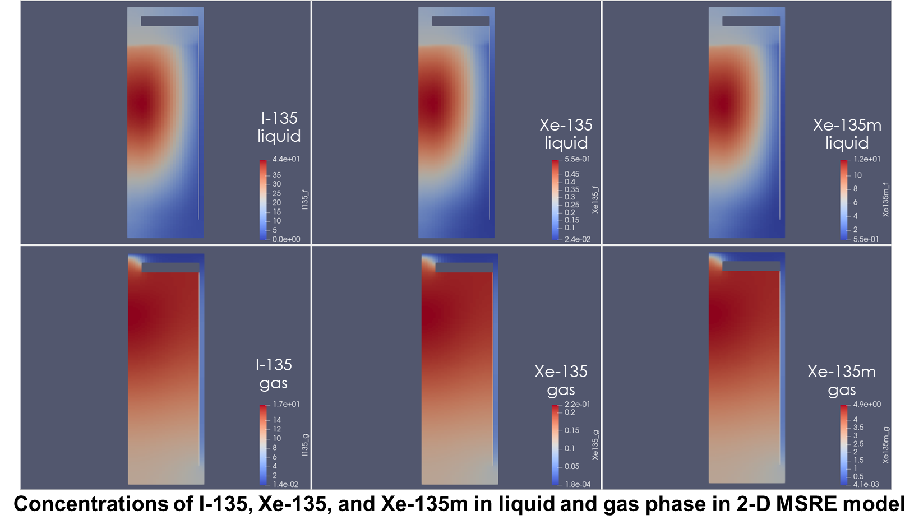
Noble Gas Mass Transfer (III)
Mole is added to the Pronghorn-Griffin calculation to calculate the mass transfer coefficient.
Coupling Scheme
Mole provided the Henry gas constant used in the mass transfer calculation (Lee, K.O, et al, 2024)
Lee, K.O., Williams, W.C., McFarlane, J. et al. Semi-empirical model for Henry’s law constant of noble gases in molten salts. Sci Rep 14, 12847 (2024). https://doi.org/10.1038/s41598-024-60006-9
Contacts: Donny Hartanto (hartantod@ornl.gov), Mauricio E. Tano Retamales (mauricio.tanoretamales@inl.gov), Mole Developer: William Gurecky (gureckywl@ornl.gov)
Notes:
The goal is to have build-in mass transfer correlation from MOOSE/Mole

Slide 10
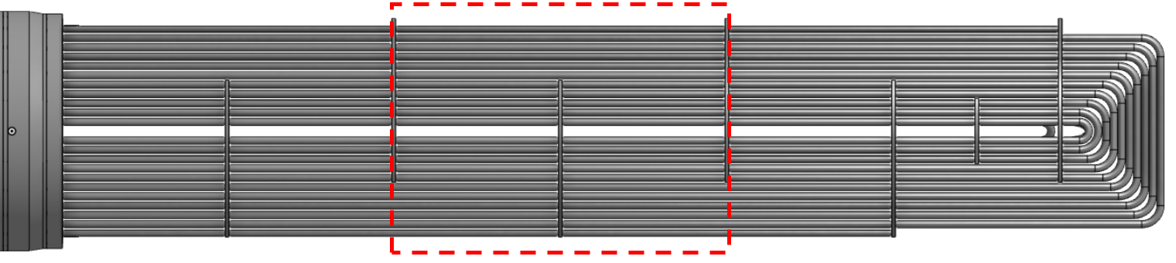
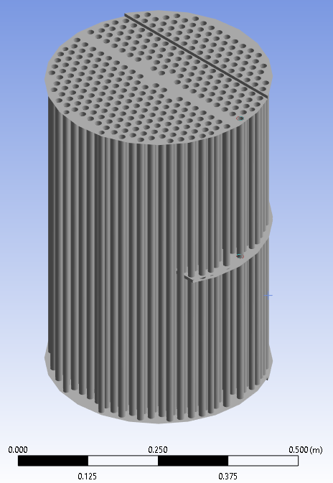
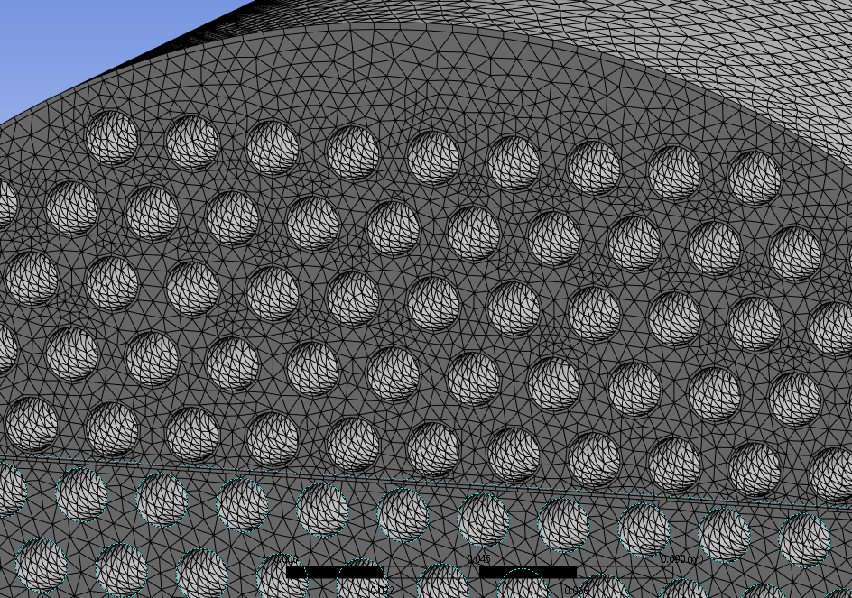
Noble Metal Deposition
Griffin depletion benchmark shows noble metal deposition is significant. HX is a particular concern (e.g., local decay heat generation, heat transfer degradation, etc.)
FY25: set up a high-fidelity standalone TH model (with NekRS) for a periodic unit domain.
The ultimate goal of the study is to examine the effect of local deposition of particles on MSR HX and to develop a scheme for multiscale coupling (CFD-level to system-level).

Slide 11
Conclusion
Demonstrated the Griffin standalone depletion.
  Preliminarily validated against MSRE data using standalone depletion calculation
  Difference for noble metal isotopes is observed, highlighting the importance for noble metal species transport.
  Demonstrated the usage of the stochastic tool for Griffin depletion with removal rate distribution inferred from experiment measurement.
Preliminarily demonstrated the Xenon transport calculation
  Captures the Xenon poisoning peak correctly.
  Xenon transfer among gas, liquid, and graphite need to be modeled and is under investigation.
  The effect of mass transfer correlation for noble gas is examined (MOOSE/Mole for calculating the mass transfer coefficient is demonstrated).

