Slide 1
Analysis of burst susceptibility during LBLOCA in a high-burnup BWR core
Ian Greenquist, Aaron Wysocki, Mehdi Asgari, Nathan Capps, Shane Henderson, Bob Salko
Oak Ridge National Laboratory
Oak Ridge, Tennessee

Slide 2
Introduction
Motivation
The US nuclear industry is seeking cycle length extension to improve economics of the current LWR fleet
High fidelity modeling and simulation may be needed for margin improvement and demonstrating no burst during LOCA at high burnup
Objectives
Perform first-of-a-kind, high-fidelity high burnup BWR LOCA analyses
Work with industry stakeholders to obtain prototypic conditions
Identify critical parameters impacting cladding burst
Incorporate latest BISON models into the workflow

Slide 3
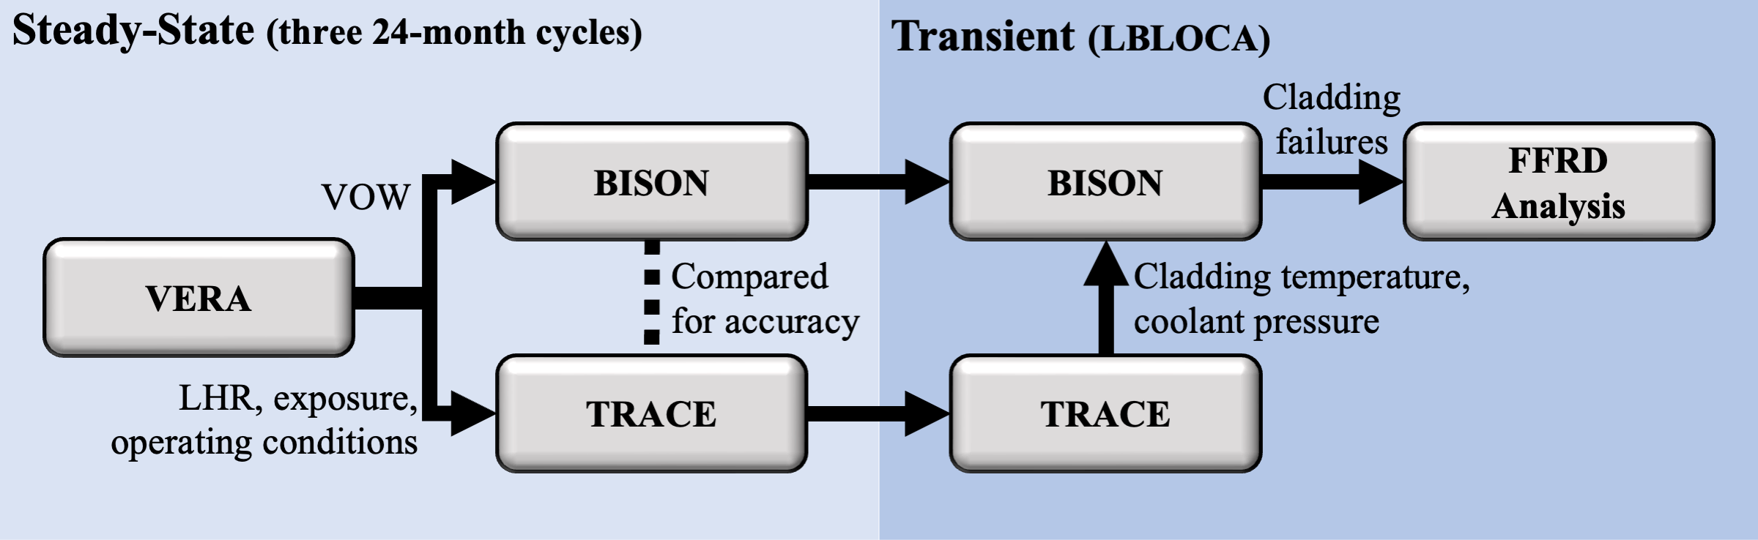
Multiphysics Workflow

Slide 4
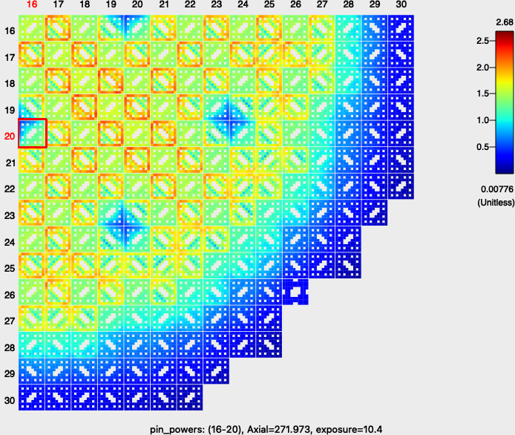
VERA Model of Limerick High Burnup Core
Pin-by-pin model of Limerick Unit 1
VERA depletion of 3 cycles with high burnup LTAs
BISON simulation of fuel performance for selected pins
Depletion calculations
Quarter core with mirror BC
~50 exposure points per cycle
Axial model
Lower reflector to upper nozzle
60 axial planes
TCP0 scattering model
Radial model
From center of core to RPV OD
Mid-cycle power distribution at 272 cm axial location
4

Slide 5
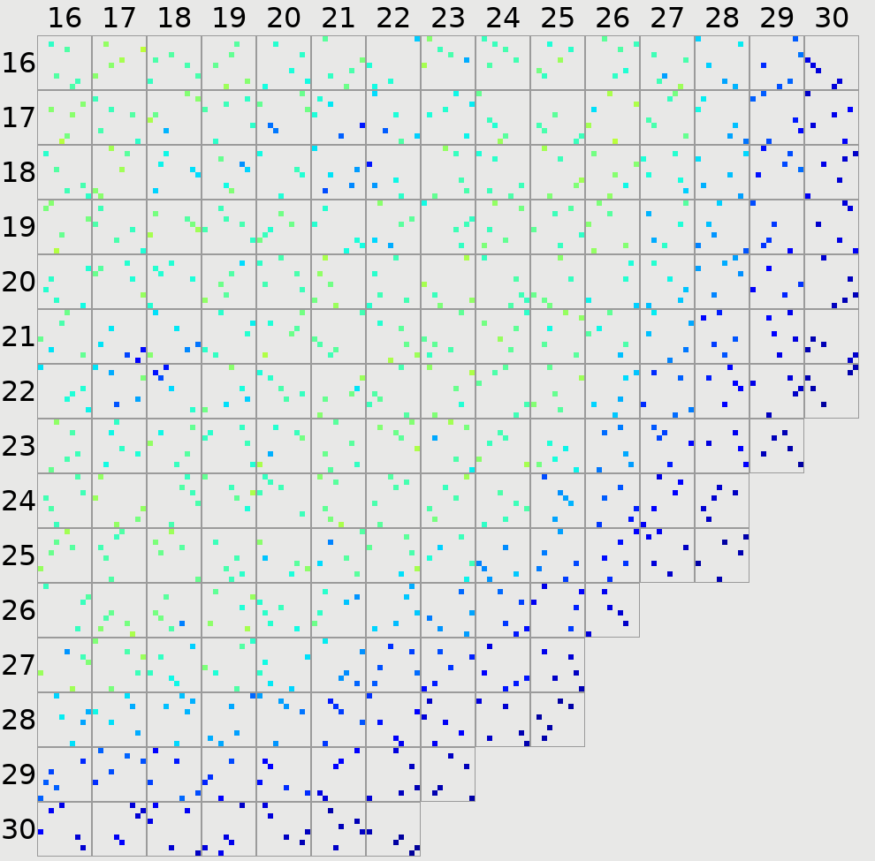
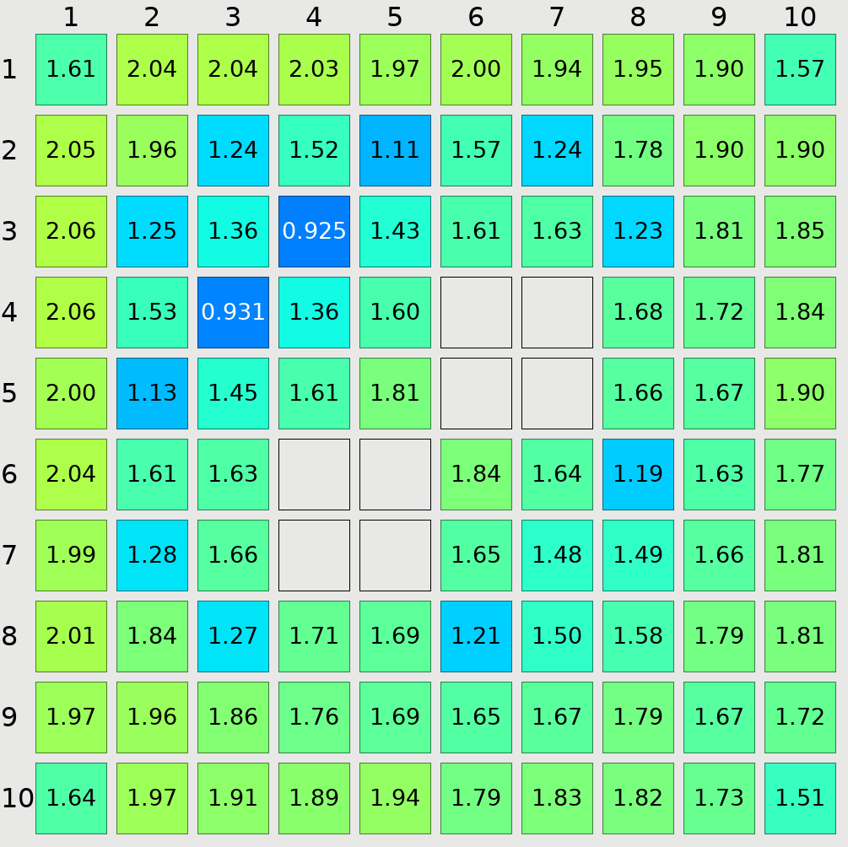
BISON Steady State
VERAOneWay (VOW) used to set up BISON models from VERA results for selected pins
Quarter core contains 17,572 rods
Downselect to a representative fraction
5 rods per assembly: 955
Orthogonal sampling
Parameters like enrichment and length were not considered
Pins selected for BISON analysis
Assembly power distribution

Slide 6
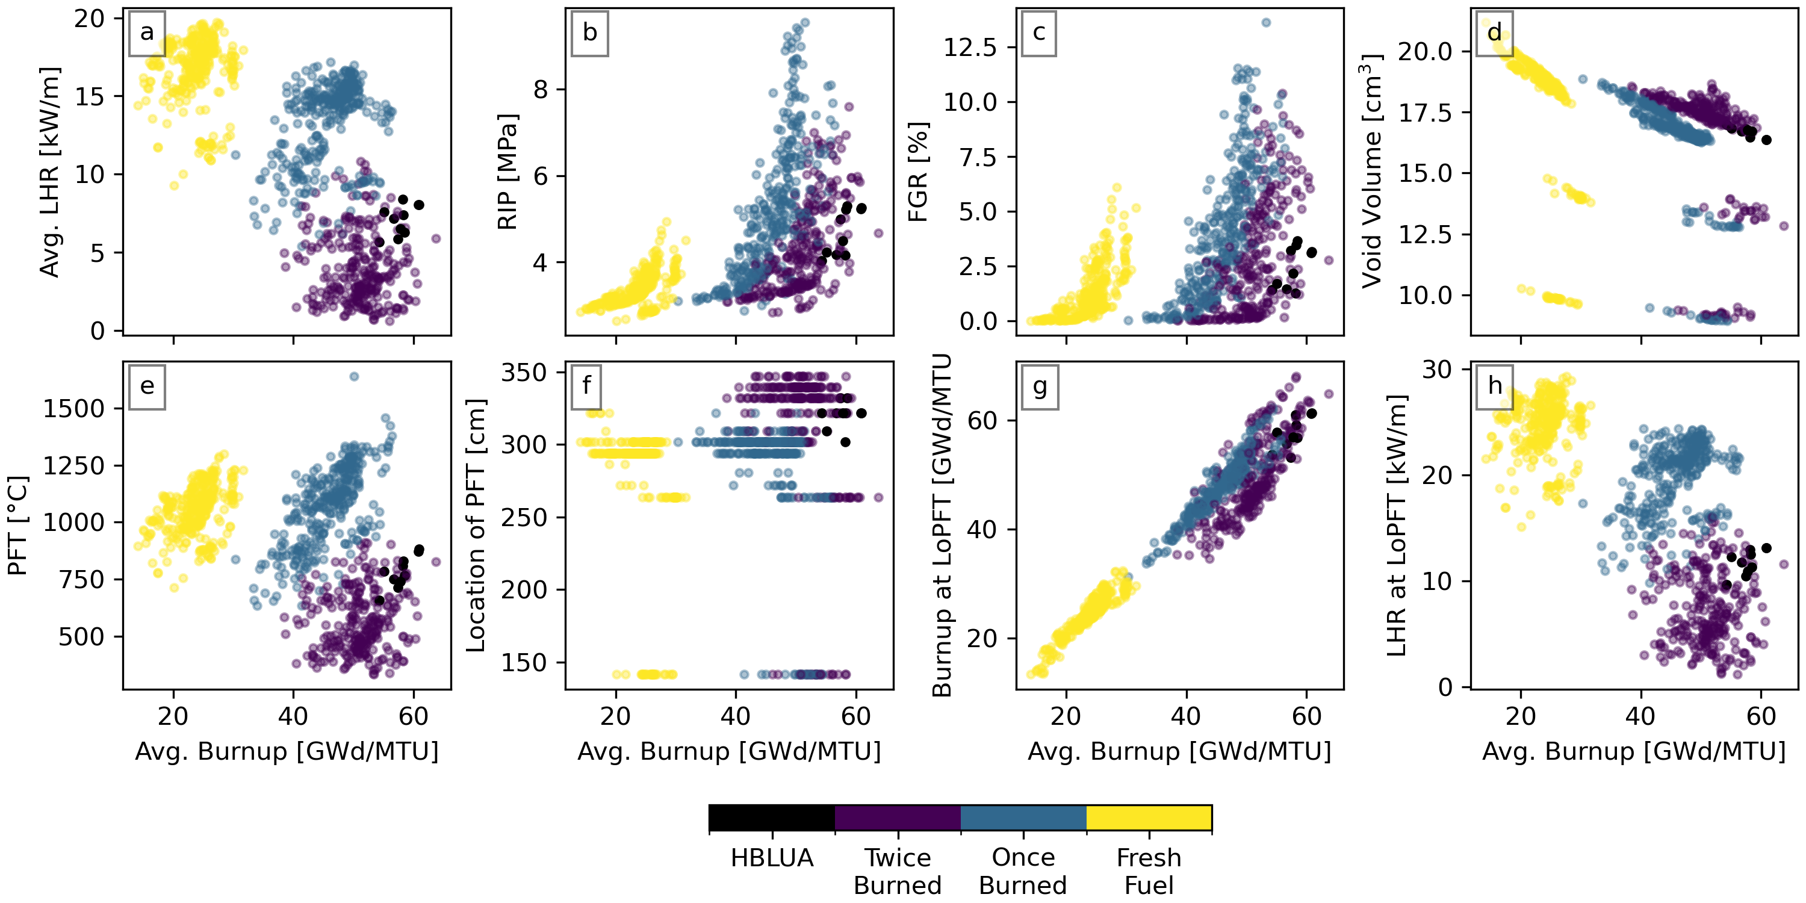
BISON Steady State
End of cycle predictions
Colored by # of irradiation cycles
Capps et al., High-burnup boiling water reactor steady-state operating conditions and fuel performance analysis, (2025) Annals of Nuclear Energy

Slide 7
TRACE Modeling Objective/Background
The objective is to establish a TRACE model for assessment of TH conditions in high burnup fuel during a BWR LOCA
Utilizes a similar approach as was applied successfully in FY22/23 for LOCA assessments in PWRs:
Establish a TRACE BWR LOCA model with appropriate core fidelity
Apply VERA pin-by-pin axial power and burnup profiles to the TRACE model for selected high burnup pins
Perform the TRACE LOCA analysis to characterize the transient cladding temperature and coolant conditions experienced by the high burnup rods
Results will inform LOCA experimental conditions and made available as boundary conditions for BISON fuel performance analysis

Slide 8
TRACE Core Representation
A suitable TRACE model was obtained from NRC with balance-of-plant performance and component sizing consistent with a 764-bundle BWR plant
Contains all plant features needed to realistically model LOCA
GNF2 fuel model has been created in TRACE
All 191 assemblies in the quarter core are modeled as individual channels, each containing multiple Bison rods
Rod-by-rod axial powers and burnups taken from VERA cycle 18 simulation
Steady state fuel temperatures were confirmed to agree reasonably well (within ~100 K) between TRACE and BISON

Slide 9
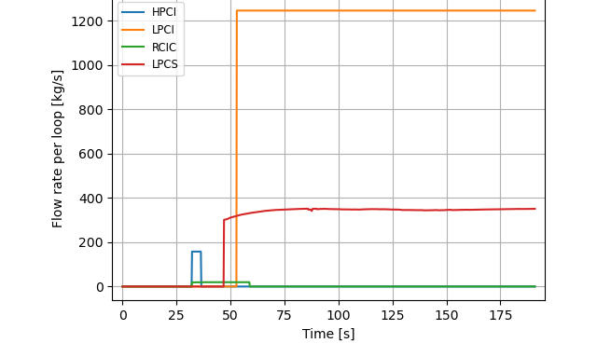
LOCA Event Progression
Simulated event progression and timings are consistent with expected behavior
Current simulation assumes no ECCS failures; limiting single failure analysis and other studies will be pursued in the future
Simulation Time (s) | Event
0.0 | Break occurs (0.1 s duration)
0.0 | Scram initiates
0.5 | MSIV closure begins (3.0 s duration)
1.0 | Both recirculation pumps trip
32.3 | HPCI injection begins
32.3 | RCIC injection begins
46.9 | LPCS injection begins
53.0 | LPCI injection begins
112.6 | Max PCT occurs

Slide 10
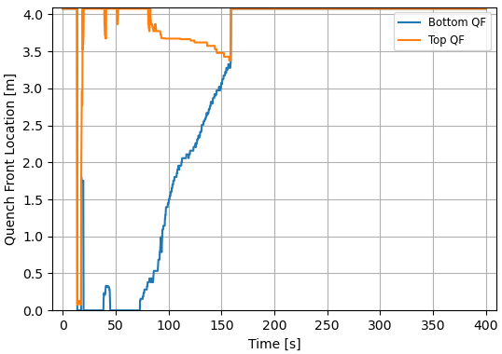
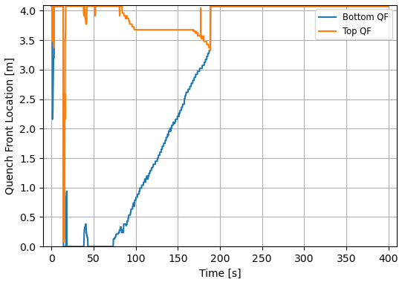
Top and Bottom Quench Fronts
TRACE predicts bottom-up quenching due to vessel reflooding, and top-down due to core spray
Lower power rods exhibit higher quench front velocity and earlier rewet
Rod Avg. Burnup – 54.7 GWd/tU
Rod Avg. Burnup – 26.1 GWd/tU

Slide 11
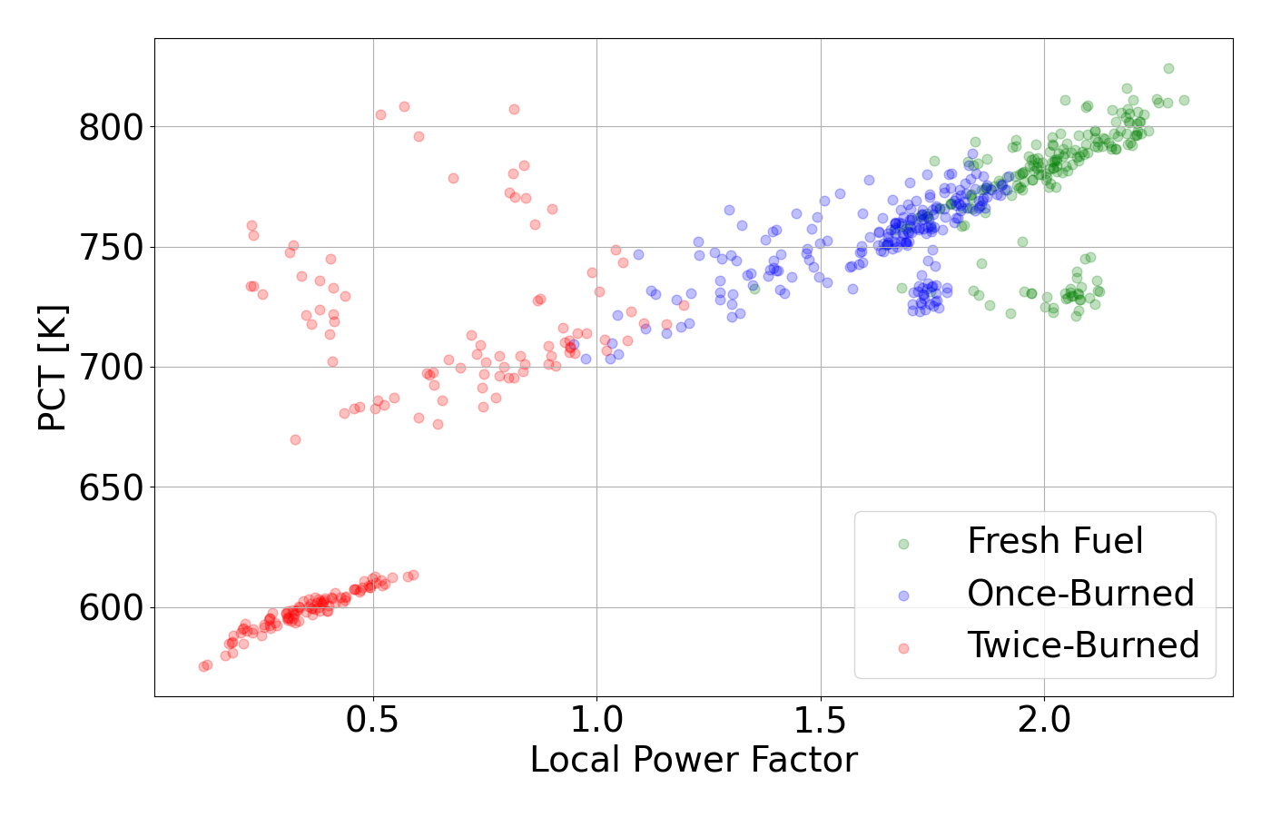
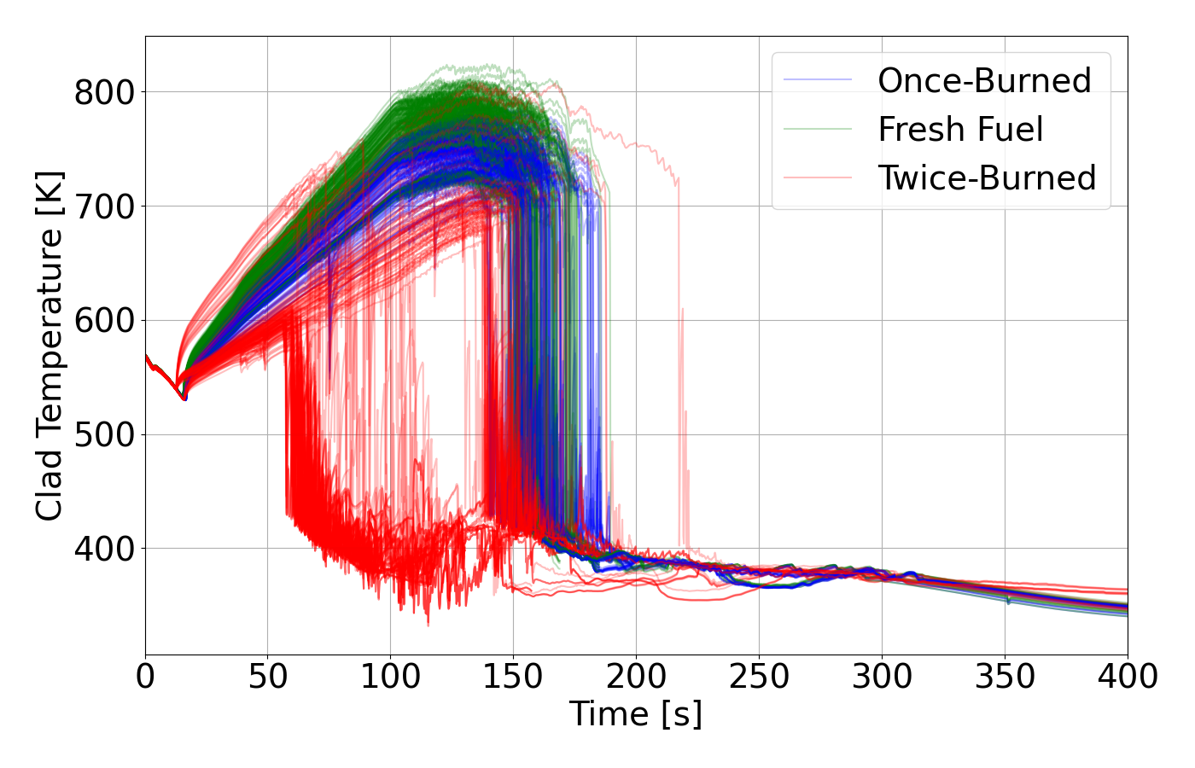
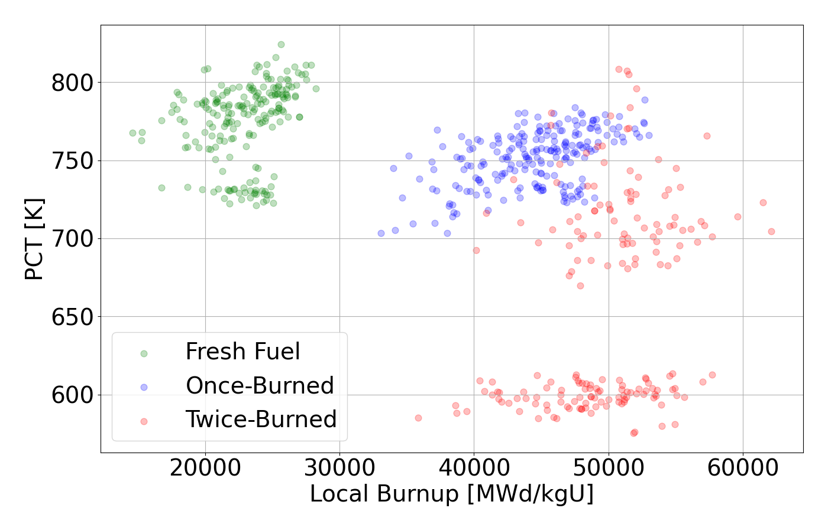
TRACE Transient Results
PCT vs. Local Power Factor
The PCT reached by each rod generally increases with the local and assembly power factor
Higher burnup rods tend to exhibit lower PCT
PRELIMINARY RESULTS
Clad Temperature at Location of PCT
PCT vs. Local Burnup

Slide 12
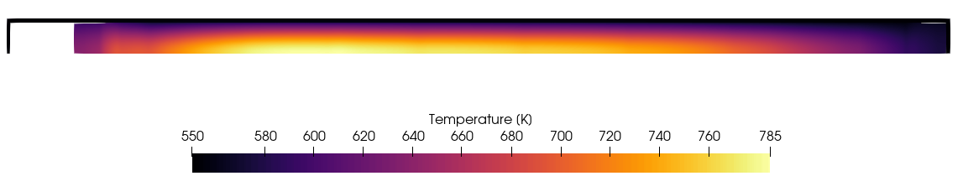
BISON Transient
Append TRACE data to end of simulations
Custom Python script
Switch cladding creep model to LOCA
Add cladding failure models
Additional outputs
Simulations ongoing
8.10 s

Slide 13
Summary
Workflow demonstrated for high-fidelity modeling of LOCA transient in a high burnup core
Cladding rupture analysis performed using strain rate and Chapman correlations
Test new BISON models that impact clad burst susceptibility
This will be discussed in more detail in the next talk
Remaining FY25 activities:
Finish transient BISON simulations
Expand on the burst analysis and investigate parameter sensitivity
Examine impact of local subchannel effects for LOCA (CTF vs. TRACE)
Investigate impact of break size on LOCA behavior

