Slide 1
Initial Progress on NEAMS Tool Validation using Southwest Experimental Oxide Fast Reactor (SEFOR) Experimental Data
Donny Hartanto¹, Ahmed Abdelhameed², Yan Cao², Eva Davidson¹, Emily Shemon²
¹Oak Ridge National Laboratory
²Argonne National Laboratory
hartantod@ornl.gov
May 29, 2025
NEAMS Annual Review: Fast Reactors

Slide 2
Introduction
SEFOR Experimental Program (1969-1972)
A 20 MWth experimental sodium-cooled fast reactor fueled with MOX, located in Arkansas
Designed for the systematic determination of the Doppler reactivity at temperatures up to the vicinity of fuel melting
Carried out for 2 different cores, Core I and II. Slightly harder neutron spectrum in Core II.
Conducted zero (low) power tests, static tests up to transient tests
NEAMS FY25 Activity:
Collaboration with the DOE-NE ART Fast Reactor Program & OECD/NEA to leverage the SEFOR benchmark for code validation
Objective:
Calculate the reactivity of SEFOR at different temperatures using Griffin
Obtain the Doppler and isothermal reactivity feedback coefficients
Compare calculated results with the experimental data
Validate NEAMS tools
Two different configurations of Core I: Core I-E and Core I-I
MCC-3
Cross Section Generation
33-g neutron
cross section
Griffin
Neutronics
Temperature-induced
thermal expansion
Shift
Monte Carlo Neutronics
BISON
Fuel Performance

Slide 3
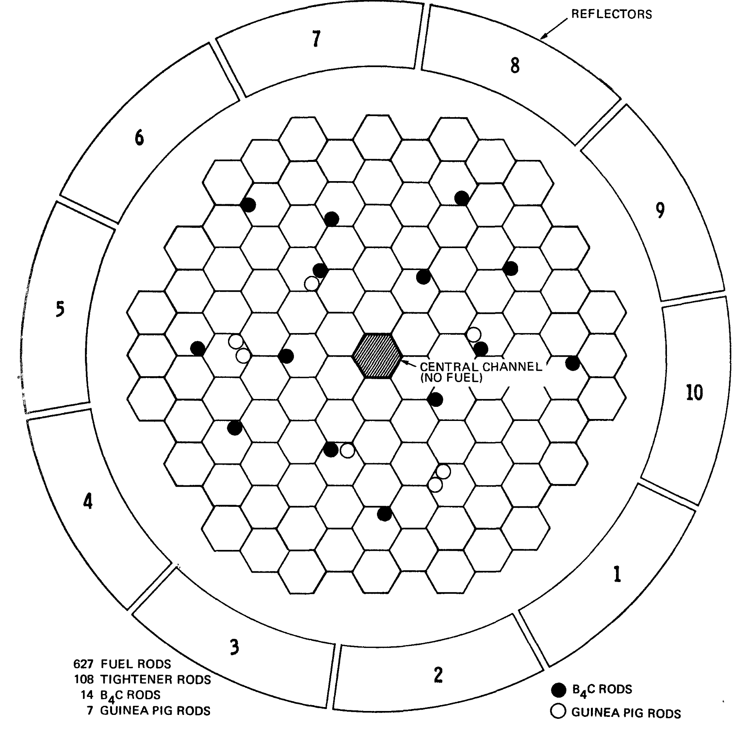
SEFOR Assembly & Core
Assembly
Total assembly: 191
Types of rods:
Fuel
Tightener
B₄C
Guinea Pig
Instrumented Fuel Rod
Core I-E
Core I-I
Noble, L. D., et al., Results of SEFOR Zero Power Experiment, GEAP-13588, US Atomic Energy Commission, GEAP-13588, 1970
Fuel Rod

Slide 4
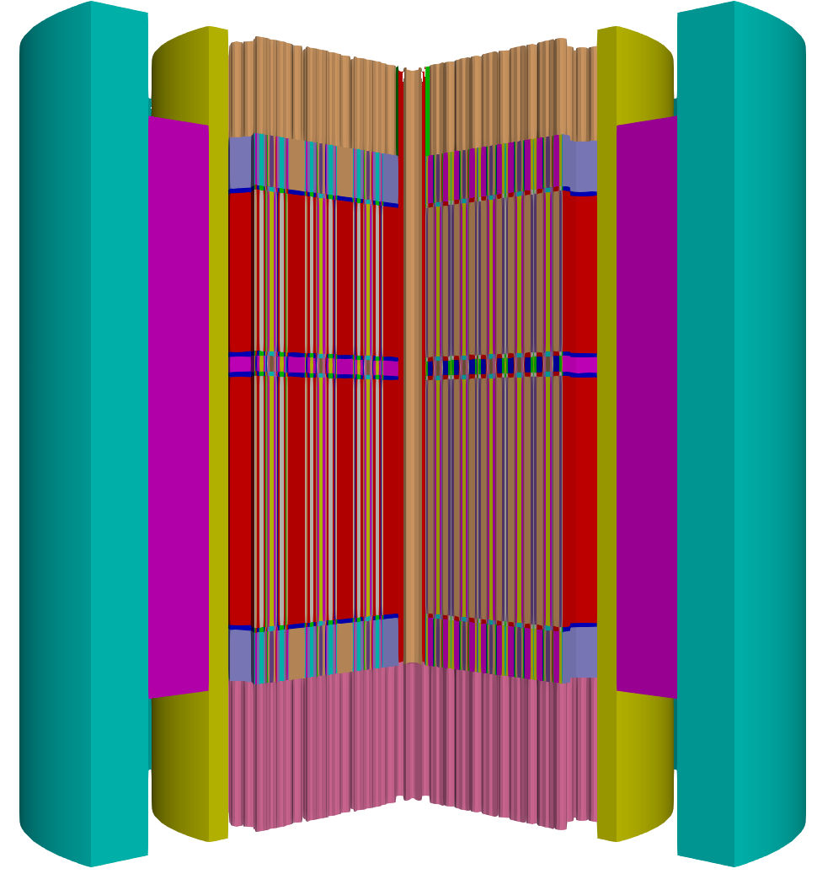
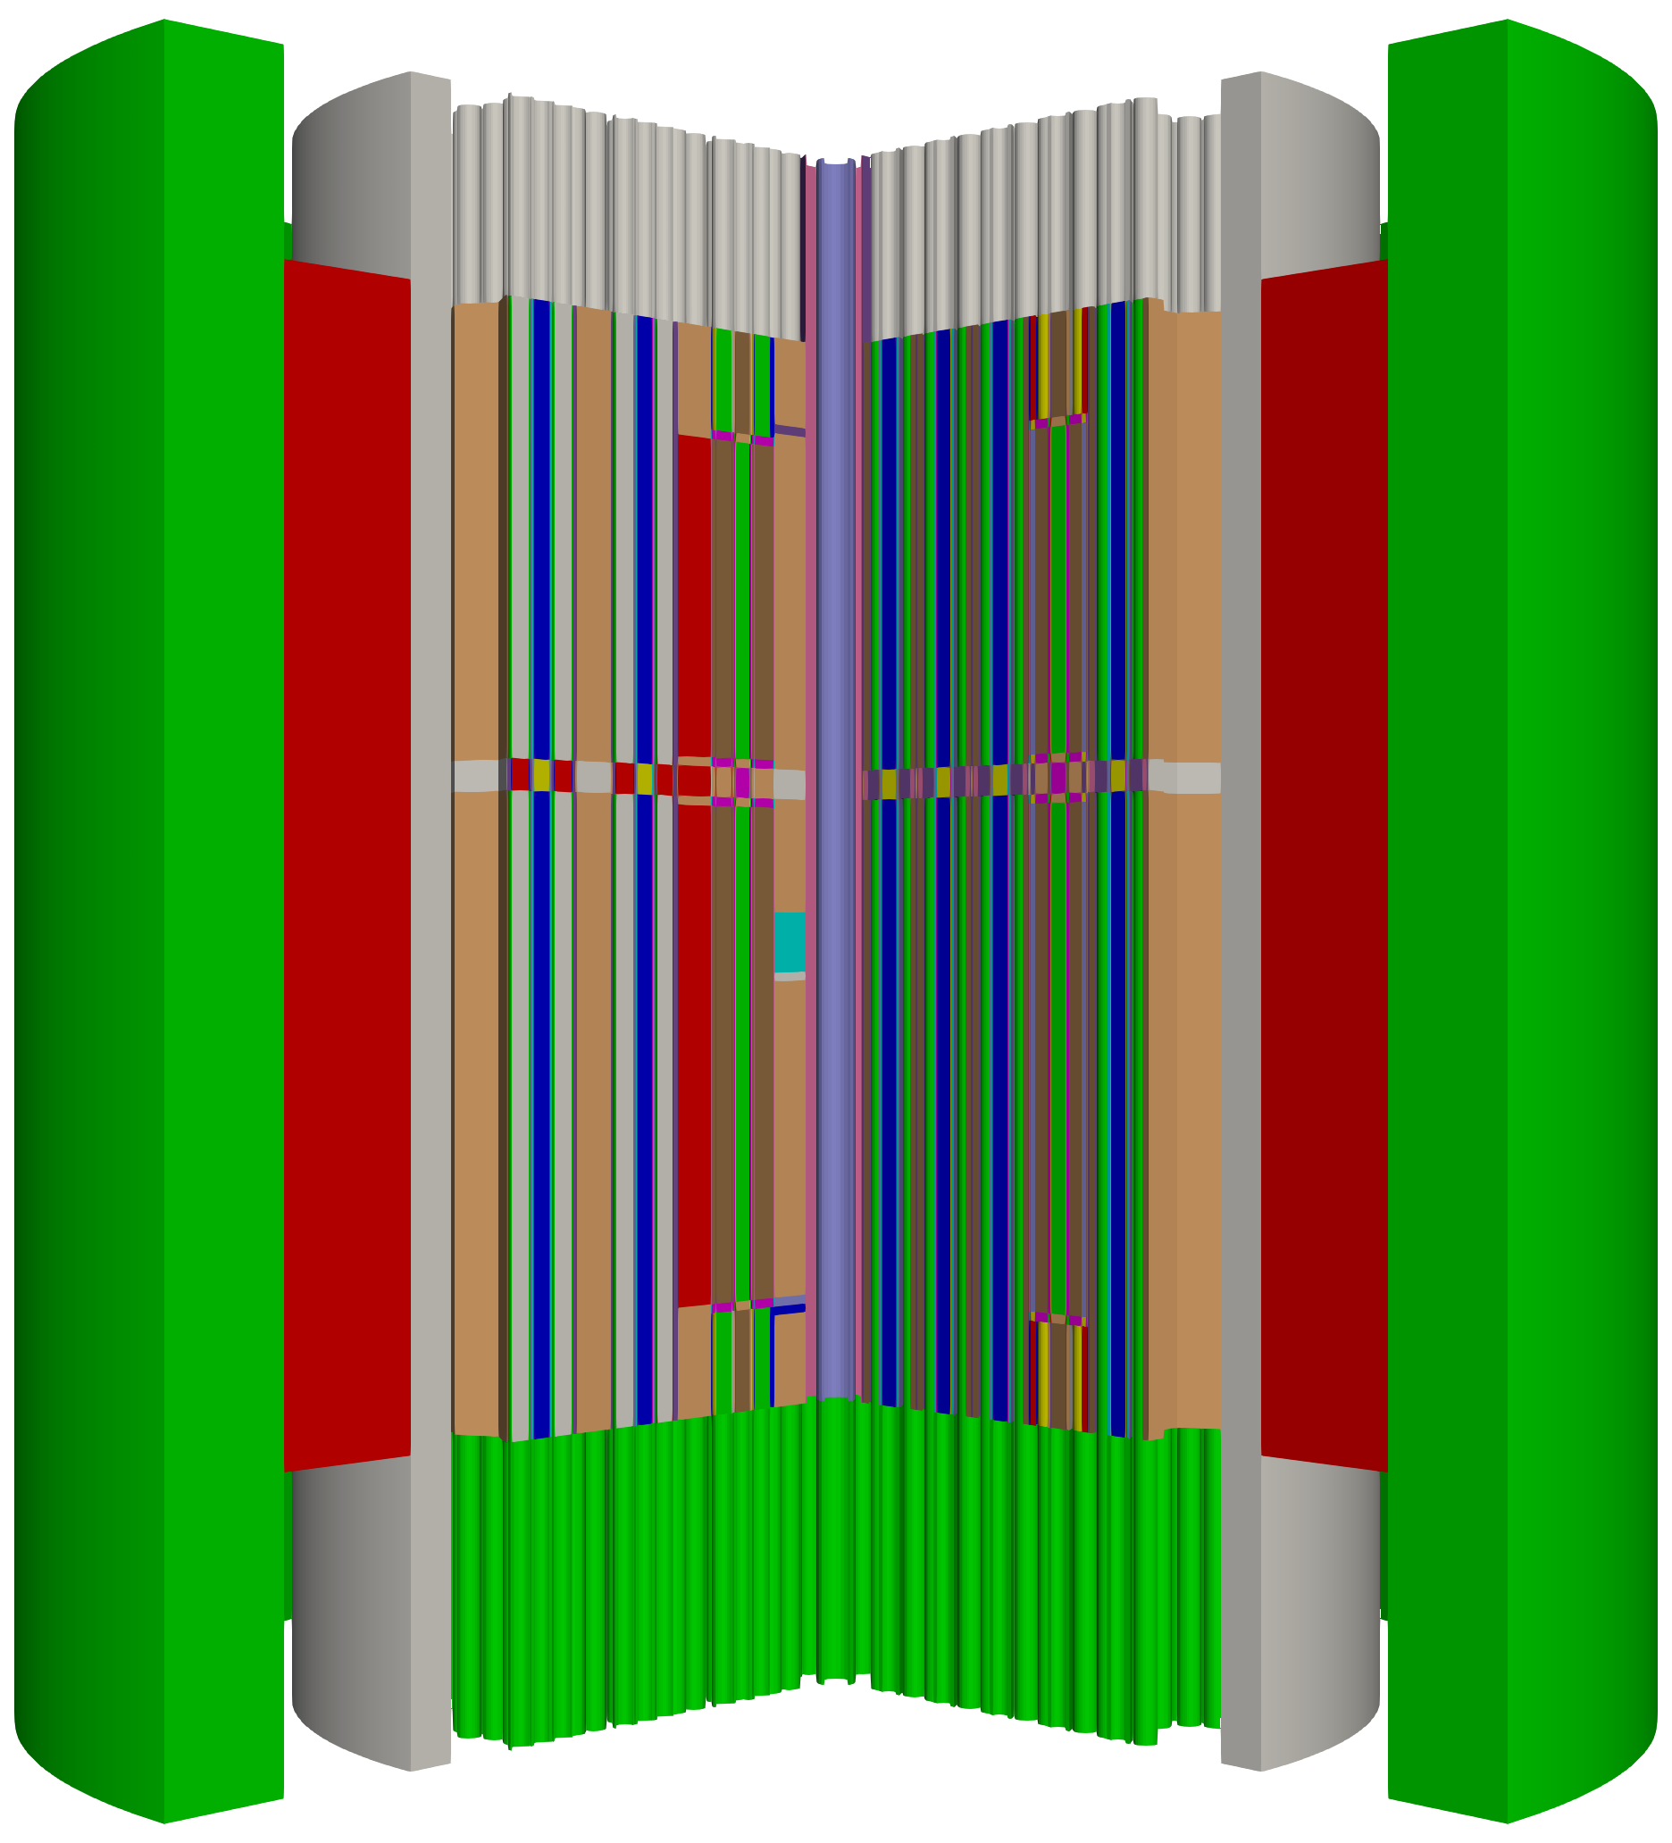
MOOSE Reactor Module & Griffin
 | Core I-E | Core I-I
Num of DOFs | 4.189E+10 | 1.128E+11
Num of local DOFs | 2.07E+07 | 5.81E+07
Mesh nodes total | 2.36E+06 | 6.17E+06
Mesh nodes local | 1.42E+03 | 3.82E+03
Mesh elements total | 3.30E+06 | 8.90E+06
Mesh elements local | 1.60E+03 | 4.58E+03
MOOSE Reactor Module was used to prepare the geometry
Computing SEFOR core, Griffin solved 33-group neutron transport equation using DFEM-S_{N} method
Order of Legendre moments for scattering: 3
Number of polar/azimuthal angles: 3 / 4 or 6
With CMFD Acceleration
Simulated on Sawtooth of INL HPC
2016 CPUs for Core I-E and 6048 CPUs for Core I-I
Core I-E at 450 K | k_{eff} | Comp. time (h) | Diff. (pcm) with Shift
ENDF/B-VII.0 | 1.013960 | 7.35 | 142.9
ENDF/B-VII.1 | 1.012693 | 7.52 | 130.8
Mesh for Core I-E
Mesh for Core I-I

Slide 5
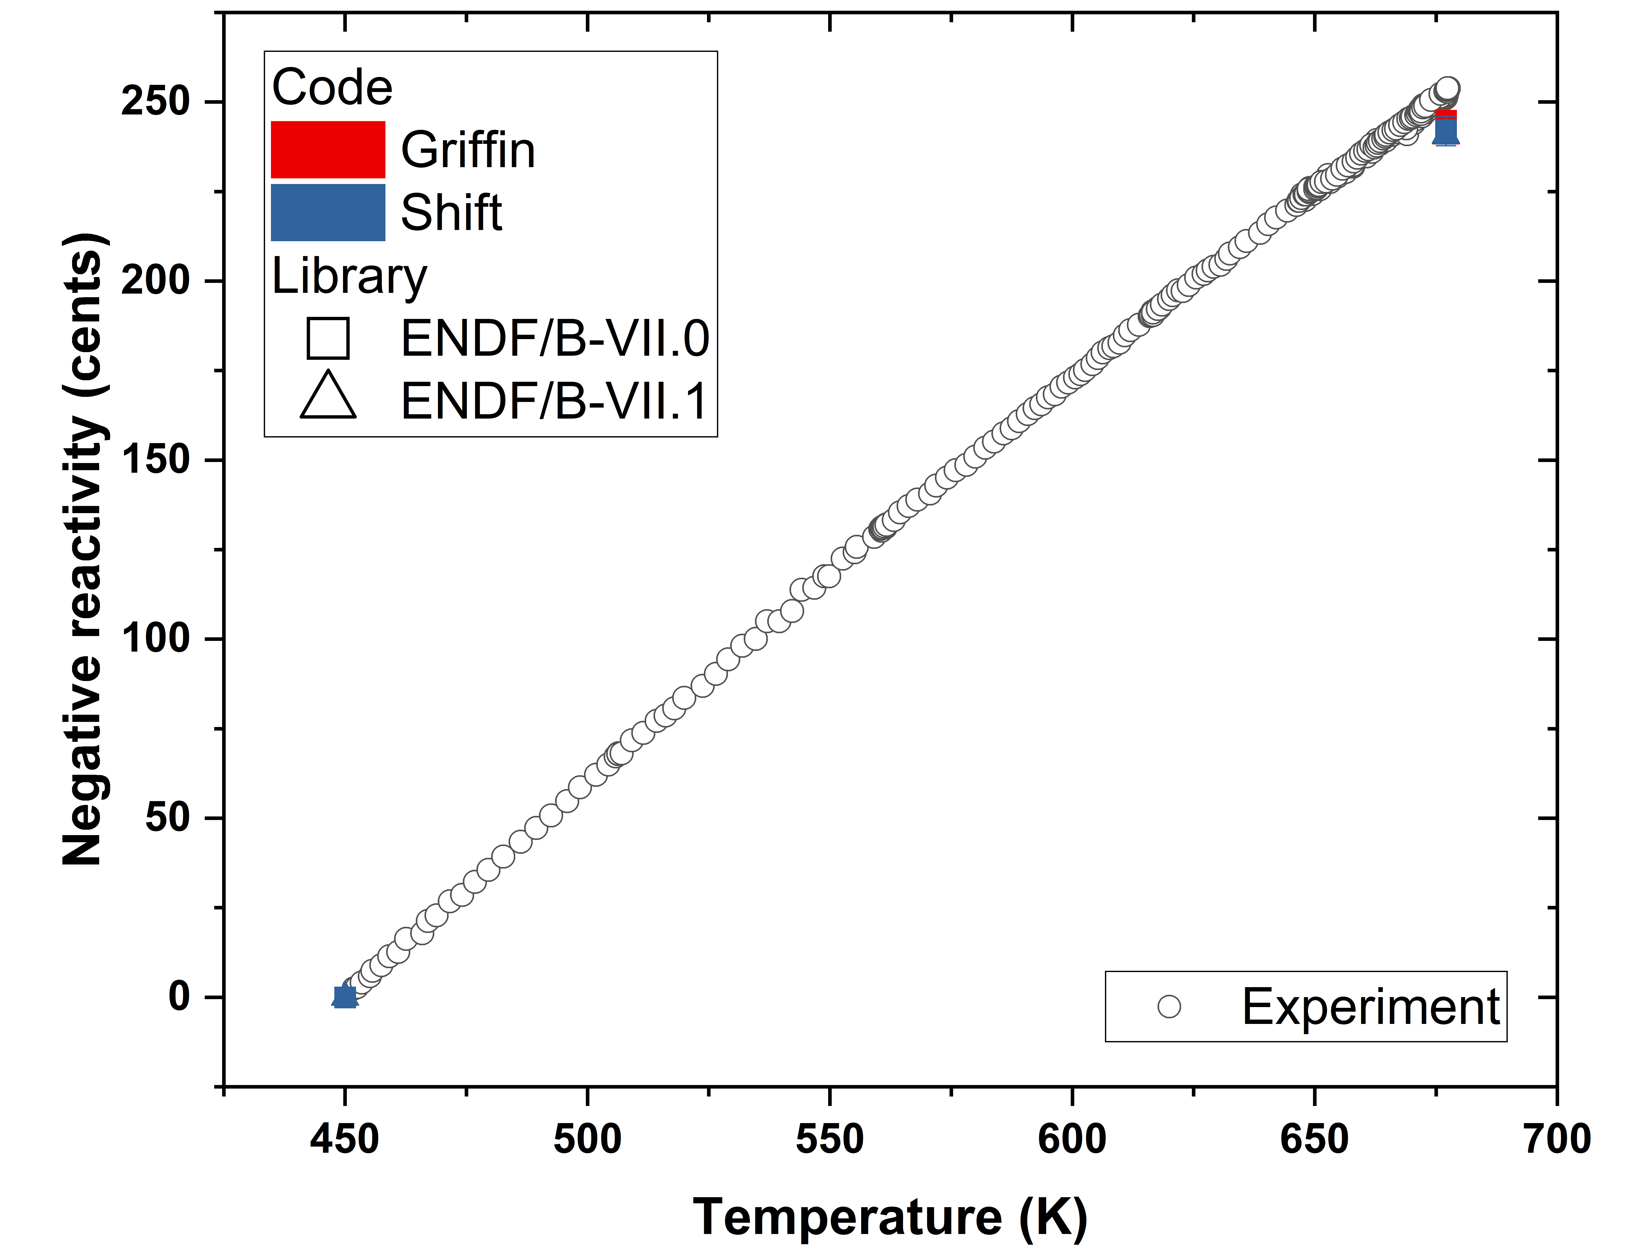
Results of Core I-E
The isothermal temperature measurement data was fitted to separate the fuel Doppler effect (α_{Doppler}) and the rest of the reactivity feedback from the temperature of the surrounding structures including thermal expansion (γ)
Griffin results show a very good agreement with measurement
Core I-E | α_{Doppler} (¢) | γ (¢/K) | Integral dk
Measurement (677 K) | -274 | -0.648 | 0.00810
Calculation (677 K)
Shift - ENDF/B-VII.0 | -274.57 ± 2.88 | -0.573 | 0.00831 ± 0.00007
Shift - ENDF/B-VII.1 | -276.96 ± 2.89 | -0.562 | 0.00799 ± 0.00005
Griffin - ENDF/B-VII.0 | -273.01 | -0.580 | 0.00804
Griffin - ENDF/B-VII.1 | -269.10 | -0.576 | 0.00801
Reactivity inserted during isothermal temperature test
García-Cervantes, E. Y., et al., Status of SEFOR Benchmark Phase I: Isothermal Tests, Proceedings of BEPU 2024, Tuscany, Italy, May 19-24, 2024.

Slide 6
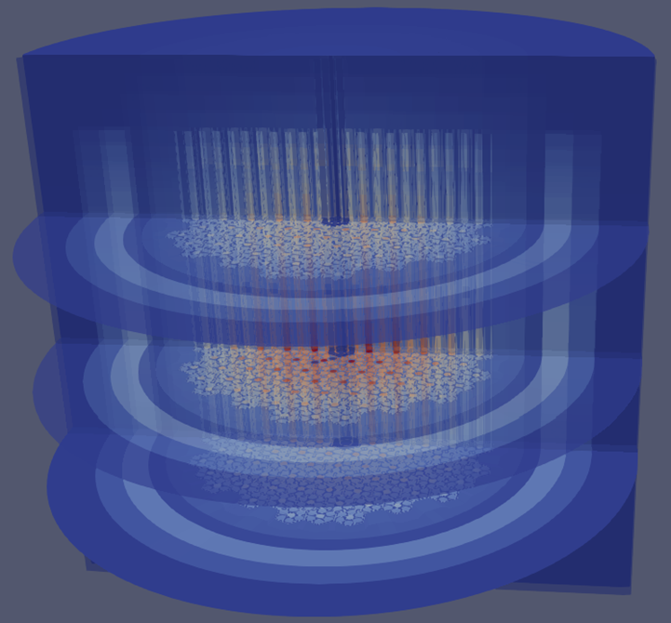
Results of Core I-I
Experimental data for SEFOR Core I-I are compared against Griffin-calculated reactivity worth (Δρ) from Doppler and thermal expansion effects, with a reference case at 450K.
Temperature | α_{Doppler} (¢) | γ (¢/K) | Integral dk Griffin | Integral dk Measurement
677 K | -309.257 | -0.578 | 0.00826 | 0.00764
644 K | -313.430 | -0.597 | 0.00722 | 0.00660
560 K | -316.971 | -0.689 | 0.00455 | 0.00374
Flux distribution of Core I-I
General Electric, Southwest Experimental Fast Oxide Reactor Development Program Twenty-Fourth Quarterly Report February-April 1970, GEAP-10010-24, AEC Research and Development Report, May 1970

Slide 7
Conclusion
Griffin (with MC²-3 cross sections) has been validated for several Doppler reactivity measurements in SEFOR Core I-E and Core I-I
The heterogeneous SEFOR mesh was successfully constructed using the MOOSE Reactor Mesh Module without relying on external meshing tools
Griffin efficiently completed the heterogeneous core mesh calculations on INL HPC within a reasonable timeframe
Future work will incorporate BISON for initial multiphysics calculations of the SEFOR core during the isothermal test phase (FY26). In the next phase (FY27 and beyond), SAM will be integrated to model steady-state and transient conditions.

Slide 8
Acknowledgements
The Fast Reactor Program (FRP), as part of the DOE-NE Advanced Reactor Technology (ART) portfolio, supports efforts to use SEFOR to validate codes in the Argonne Reactor Computation (ARC) code suite for design and/or licensing purposes.
The SEFOR benchmark activities are also part of the collaborative efforts under the NEA/WPRS/UAM-SFR SEFOR benchmark as well as a bilateral activity between US and France. The collaboration on this activity with CEA colleagues Elias Garcia-Cervantes and Laurent Buiron for providing benchmark specifications is also great appreciated.
This research made use of the resources of the High Performance Computing Center at Idaho National Laboratory, which is supported by the Office of Nuclear Energy of the U.S. Department of Energy and the Nuclear Science User Facilities under Contract No. DE-AC07-05ID14517.

