Slide 1

Multiphysics Simulations for Microreactors
Yinbin Miao, Ahmed Abdelhameed, Yan Cao, Soon Kyu Lee, Lander Ibarra, Adam Kraus, Kun Mo, Nicolas Stauff
Argonne National Laboratory
Christopher Matthews
Los Alamos National Laboratory
May 12, 2025
NEAMS Annual Review: Microreactors (Virtual)

Slide 2
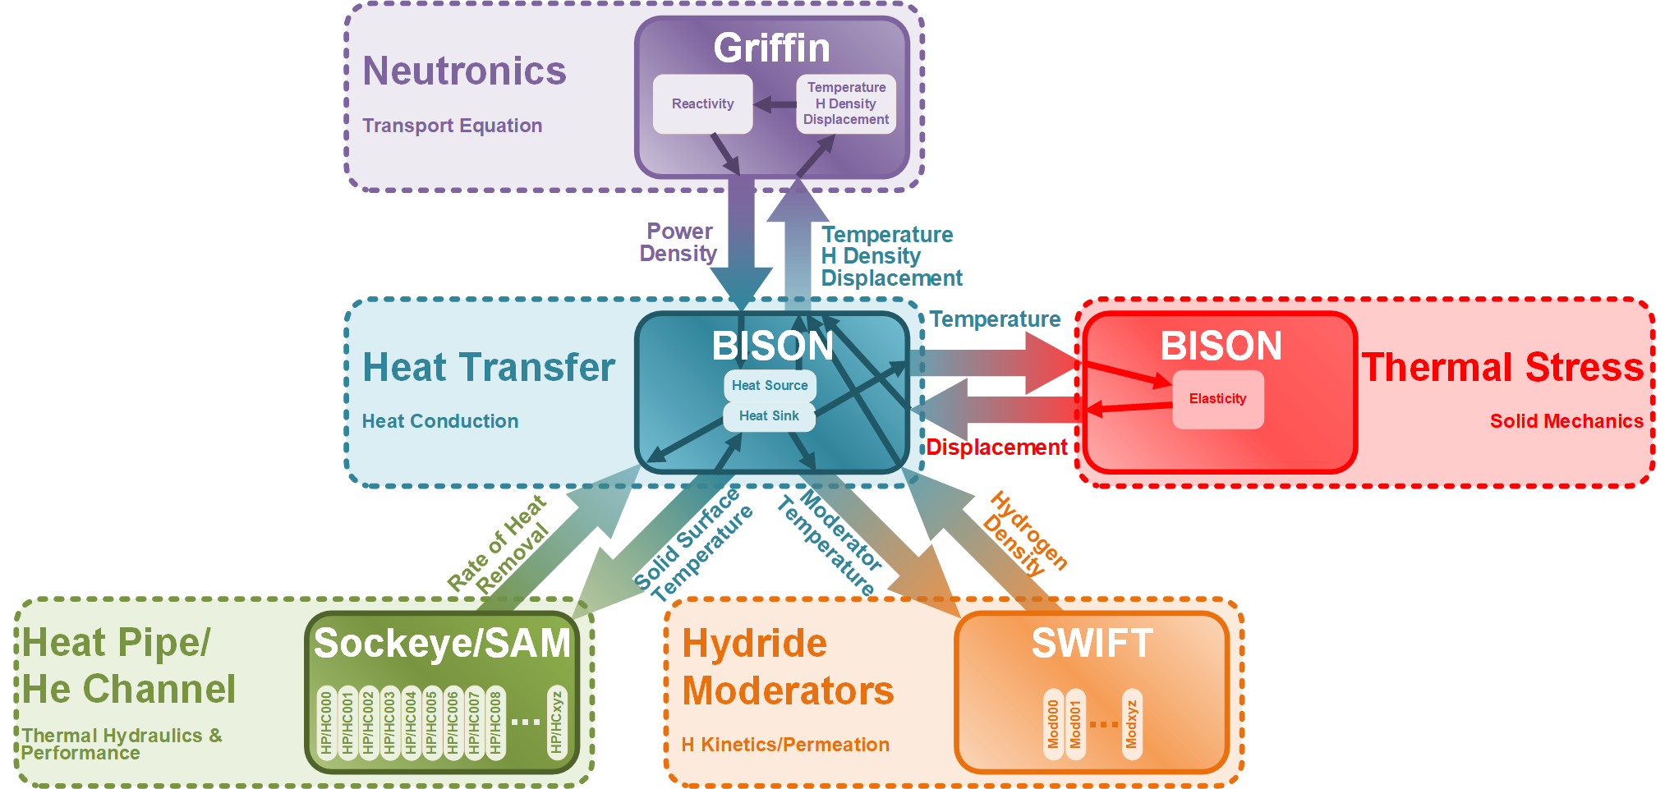
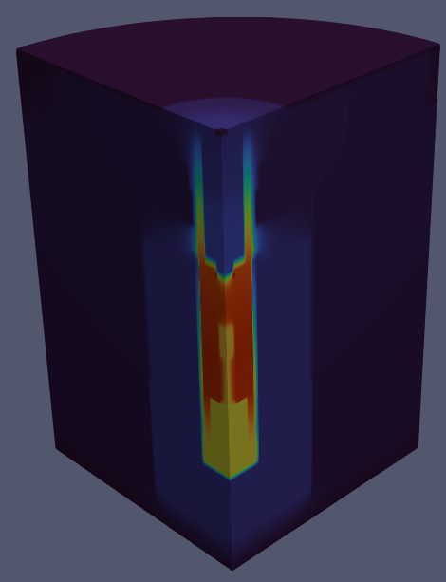
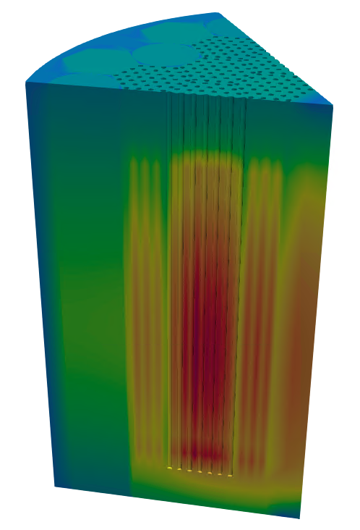
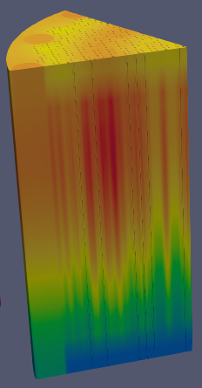
Overview
Objectives
  Evaluate/demonstrate NEAMS tools’ capabilities in multiphysics (MP) microreactor modeling & simulations.
  Give feedback to developers/experiences to stakeholders
Investigated microreactors
  Gas-Cooled Microreactor (GCMR)
  Heat-Pipe Microreactor (HPMR)
  KRUSTY (Topical Presentation)
  MARVEL (MRP) (Topical Presentation in TF Session)
Physics (MOOSE Apps)
  Meshing (MOOSE Reactor Module)
  Neutronics (Griffin)
  Heat conduction / solid mechanics (BISON)
  Heat pipe performance (Sockeye)
  Coolant channel (SAM/THM)
  Hydride moderator (SWIFT)
A Typical MultiApps Hierarchy for Microreactor Simulations
KRUSTY
HPMR
GCMR
2

Slide 3
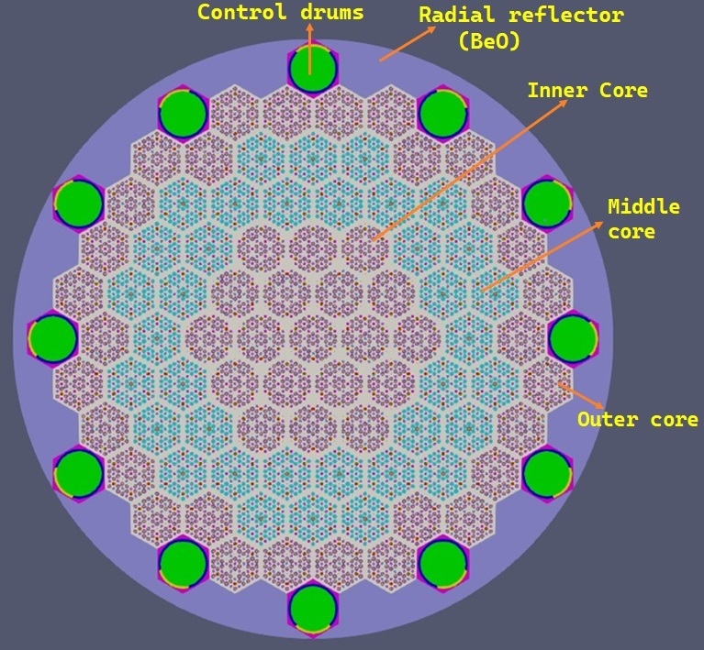
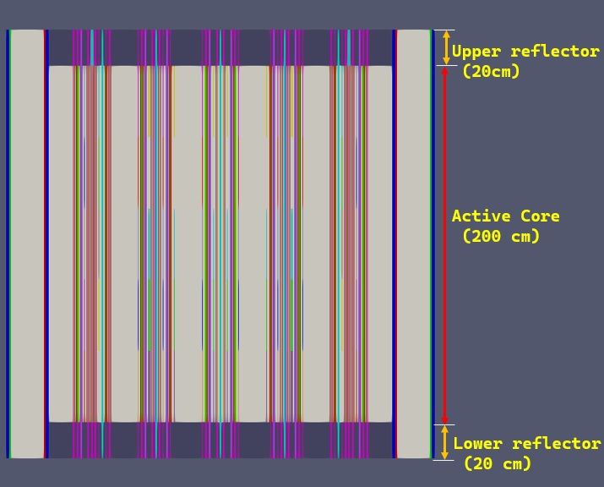
Gas-Cooled Microreactor (GCMR)
Developed full-core multiphysics models using Griffin-BISON-SAM-SWIFT
  High-fidelity steady-state model
  Transient scenarios w/ localized & global effects
  Hydrogen evolution in hydride moderators
  Multiphysics model-informed TRISO failure assessment
Ongoing work
  Modeling of extended set of transient scenarios
  Heterogeneous TRISO modeling approach
  Fission products poisoning effects
  Balance-of-plant (BOP) implementation
GCMR Core Design
3

Slide 4
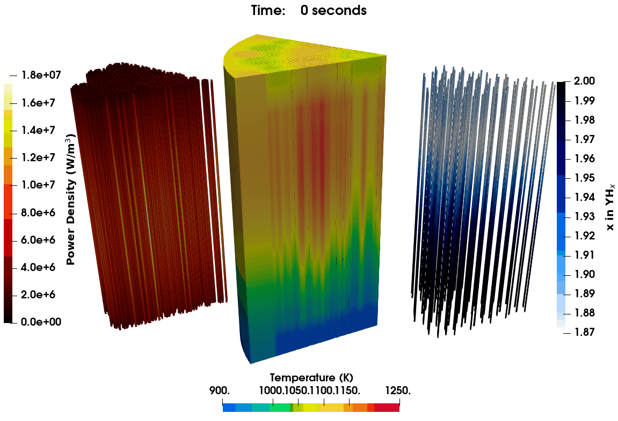
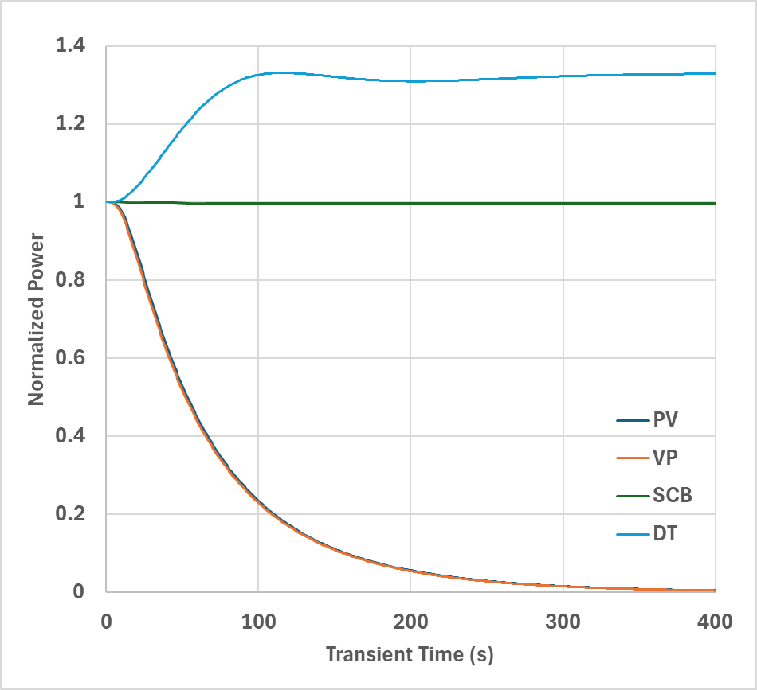
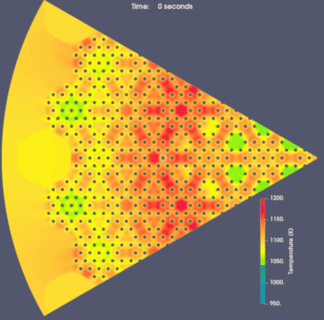
GCMR Full-Core Transients
Modeled transient scenarios w/ localized & global effects
  Null Transient (steady-state confirmation)
  Single Channel Blockage (SCB)
  Coolant Depressurization (PV)
  Coolant Loss of Velocity (VP)
  Inlet Temperature Drop (DT)
Multiphysics Predictions of a GCMR Coolant Depressurization Transient
Power Evolution in Various Transient Cases
Single Channel Blockage
4

Slide 5
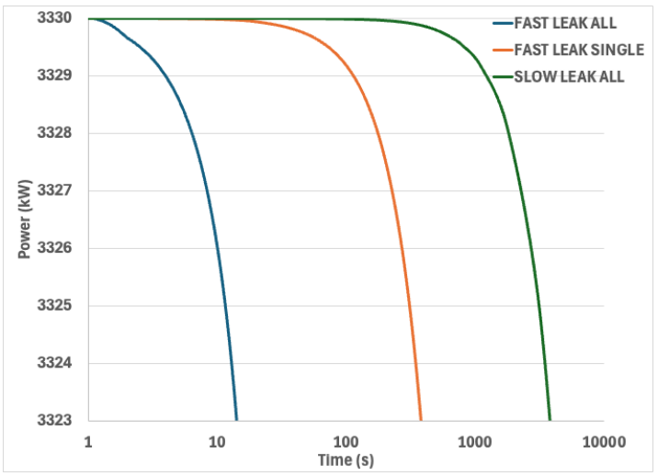
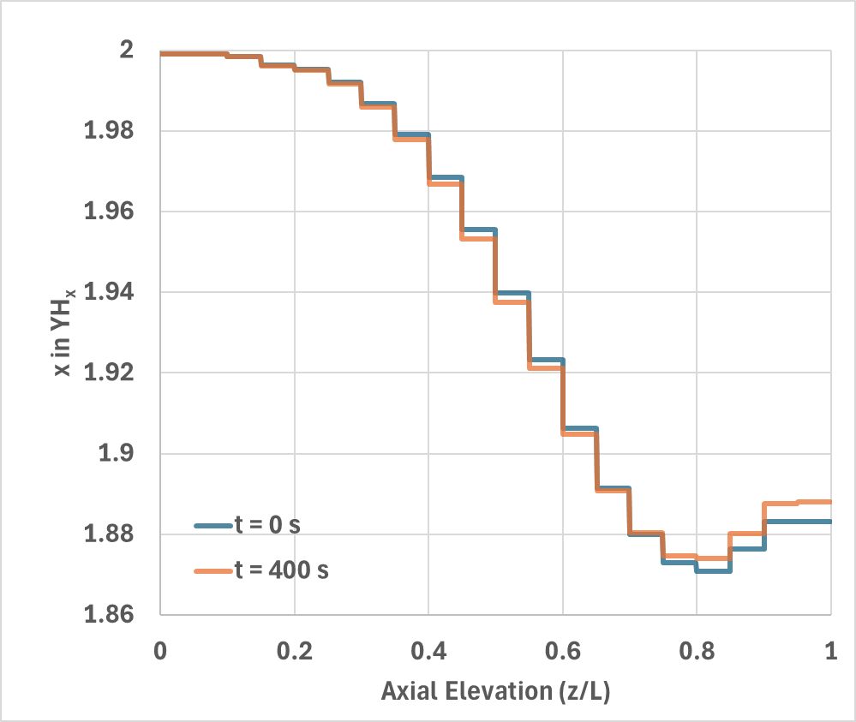
Integration of Hydride Moderator Performance
Hydride moderators enhance microreactor compactness & economics
Integrated hydride performance (SWIFT) with multiphysics microreactor models
  Modeled hydrogen redistribution, permeation, and leaks
  Studied steady-state and transient behaviors
Insights
  Hydrogen behaviors impact MR performance
  Hydrogen kinetics is slower than neutronics
GCMR Steady-State Results (w/ & w/o SWIFT)
Parameter | w/ SWIFT | w/o SWIFT
T_{fuel} (K) (avg/max/min) | 1090 / 1210 / 911 | 1089 / 1212 / 910
T_{mod} (K) (avg/max/min) | 1070 / 1173 / 913 | 1069 / 1175 / 912
k_{eff} | 1.02894 | 1.02926
GCMR Power Drop during Hydrogen Leak Events of Different Severity
Hydrogen Concentration Evolution during the GCMR Coolant Depressurization
5

Slide 6
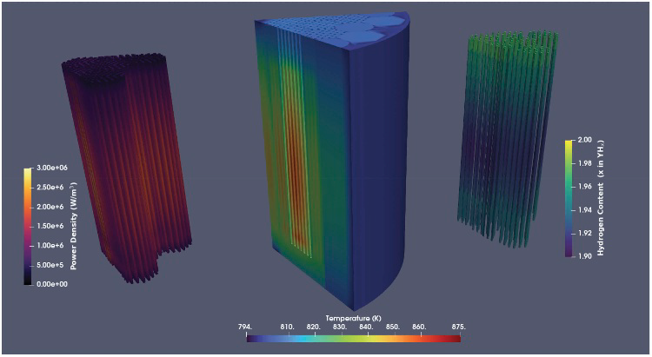
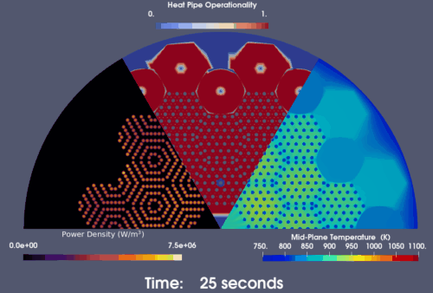
Heat-Pipe Microreactor (HPMR)
Developed full-core multiphysics models using Griffin-BISON-Sockeye-SWIFT
  High-fidelity steady-state model
  Transient scenarios
    Load following
    Heat pipe failure including cascade failure events
    Control drum rotation (Topical Presentation)
  Hydrogen evolution in hydride moderators
  Multiphysics model-informed TRISO failure assessment
Ongoing work
  Startup transient with advanced HP models
  Improved solid mechanics integration
  OECD/NEA Benchmark
Normal Operation Status of the Full-Core HPMR
(from left to right: power density, temperature, hydrogen)
Heat Pipe Cascade Failure Predicted by the Model
(Overpowered HPMR + A Single Heat Pipe Failure Event)
6

Slide 7
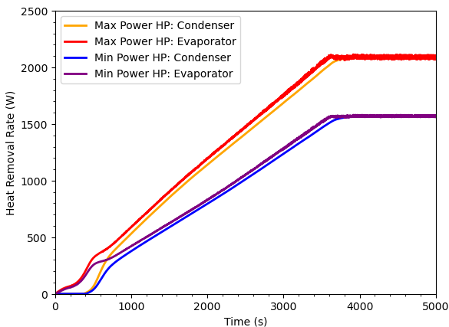
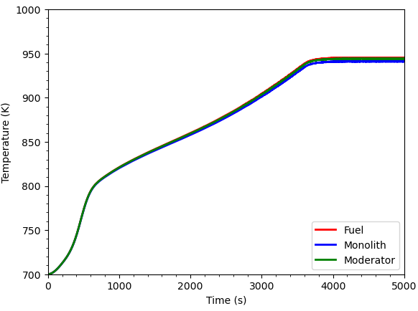
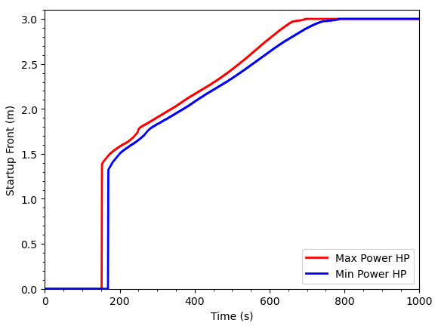
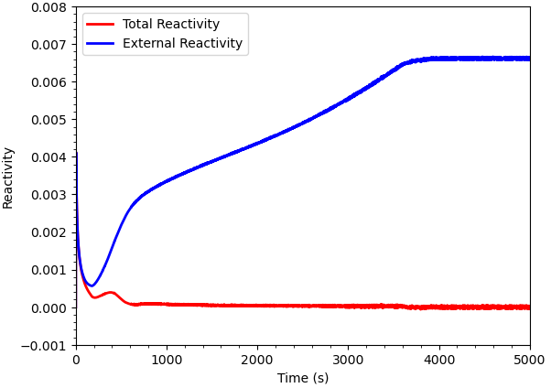
HPMR: Multiphysics Startup Model
HPMR heat pipe modeling
  Core designs/models for both Na/K HPs
    Extensive validation for Na-HPs
  Effective conduction model/Advanced Model
    Enables HPMR startup modeling
Current status
  Established the multiphysics HPMR startup model
Ongoing/future work
  To investigate high-fidelity neutronics model implementation
HP heat removal rate evolution during HPMR Startup
Temperature evolution during HPMR Startup
 | K-HPMR | Na-HPMR
k_{eff} | 1.03269 | 1.05446
T_{fuel} (K) (max/min/avg) | 866/814/844 | 1002/935/973
T_{mod} (K) (max/min/avg) | 862/815/842 | 998/938/972
HP Startup Front Movement
Reactivity evolution during HPMR Startup
7

Slide 8
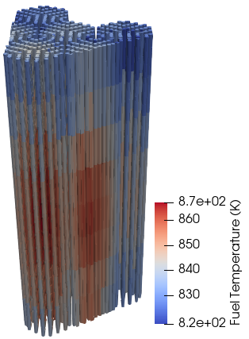
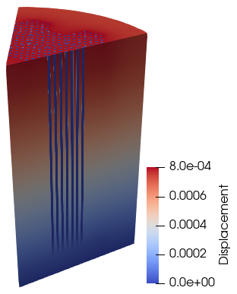
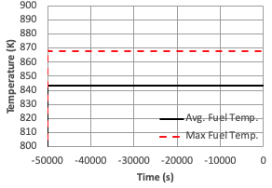
HPMR: Integration of Solid Mechanics Model
Solid mechanics model was integrated
  Capture thermal expansion effects on neutronics
  Provide irradiation conditions for TRISO analyses
Current status
  Full-core steady-state multiphysics model with solid mechanics
    Thermal expansion and thermal stress
Ongoing/future work
  Solid mechanics integration under transient conditions
  TRISO fuel performance analyses informed by the full-core multiphysics model with solid mechanics
Steady-state multiphysics results with solid mechanics
 | k_{eff}
w/o Solid Mechanics | 1.048531
w/ Solid Mechanics | 1.048486
Δk_{eff} | 4.498 pcm
8

Slide 9
Multiphysics Simulation of Control Drum Rotation in HP-MR
Ahmed Abdelhameed
Argonne National Laboratory

Slide 10
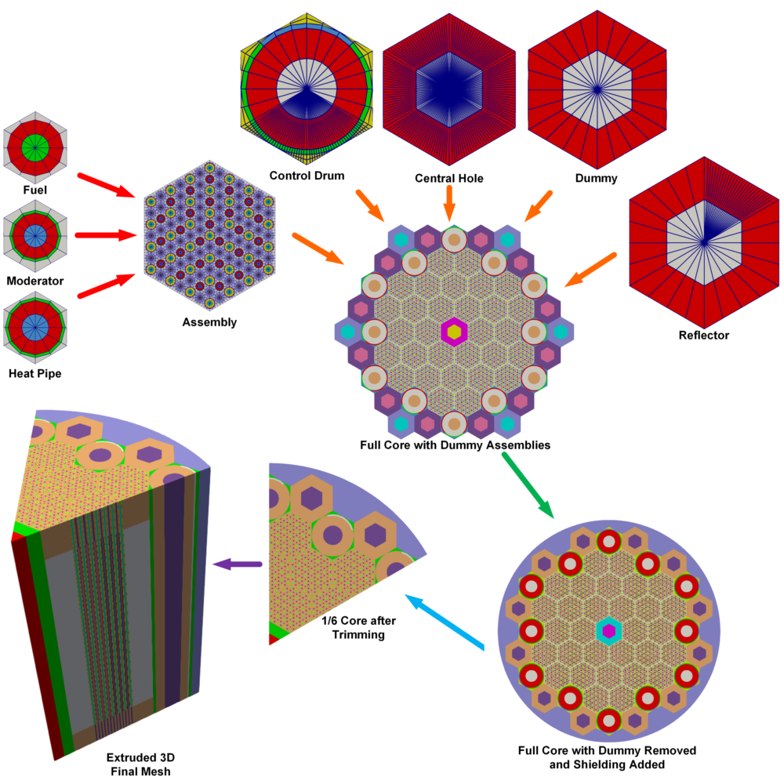
HPMR: Control Drum Rotation (CDR)
Motivation is to show the multiphysics model can calculate reactivity changes introduced by control drum motion
  Ex: inadvertent control drum reactivity insertions
Core Design
Mesh: MOOSE Reactor Module
  Different mesh densities for Griffin & BISON
Cross-sections: Serpent
  Tabulated over various control drum rotations and core temperatures to support accurate physics coupling
Neutronics: Griffin (DFEM-SN CMFD)
Eigenvalue
Power distribution
Reactivity coefficients
Verified against Monte Carlo Simulation [1]
HPMR Mesh Generation
[1] N.E. Stauff et al., High-Fidelity Multiphysics Modeling of a Heat Pipe Microreactor Using BlueCrab. Nucl. Sci. Eng., 1–17 (2024)
10

Slide 11
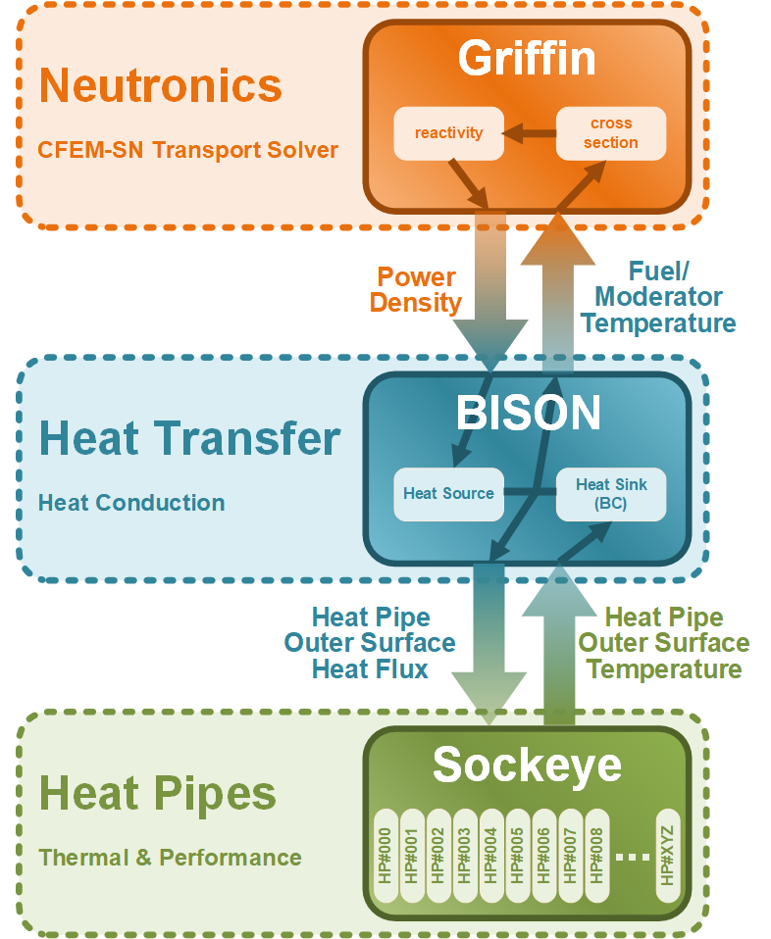
HPMR CDR: Transient Description
  Performed dynamic 3D simulation to capture transient behavior of inadvertent control drum motion (upcoming VTB model)
    Single Physics (Neutronics)
    Multiphysics
  Two scenarios simulate accidental motion of one Control Drum, initially inserted at 40°
  to maintain core criticality.
(6 out of 12 CDs due to symmetry)
Scenario I: 5°/s outward (1s) → 5°/s inward (2s)
Scenario II: 20°/s outward (1s) → 20°/s inward (2s)
MultiApp Hierarchy of the HPMR Model
11

Slide 12
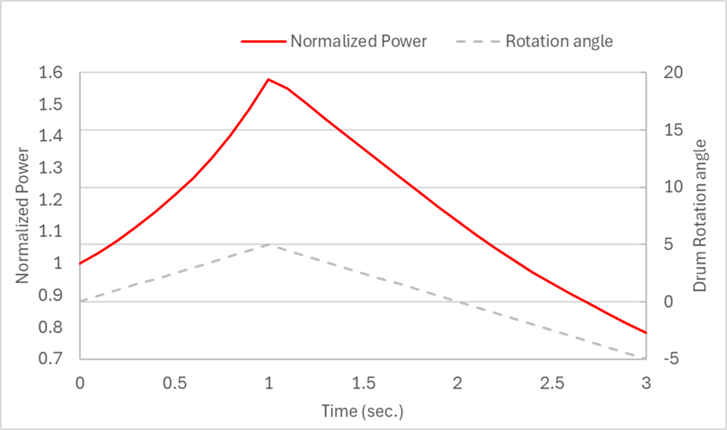
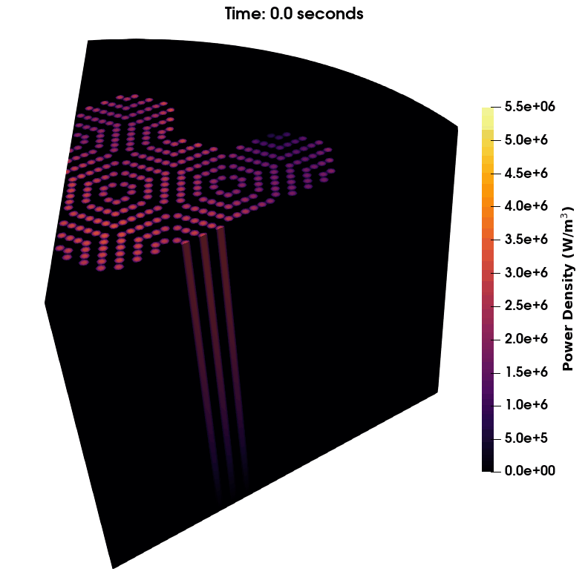
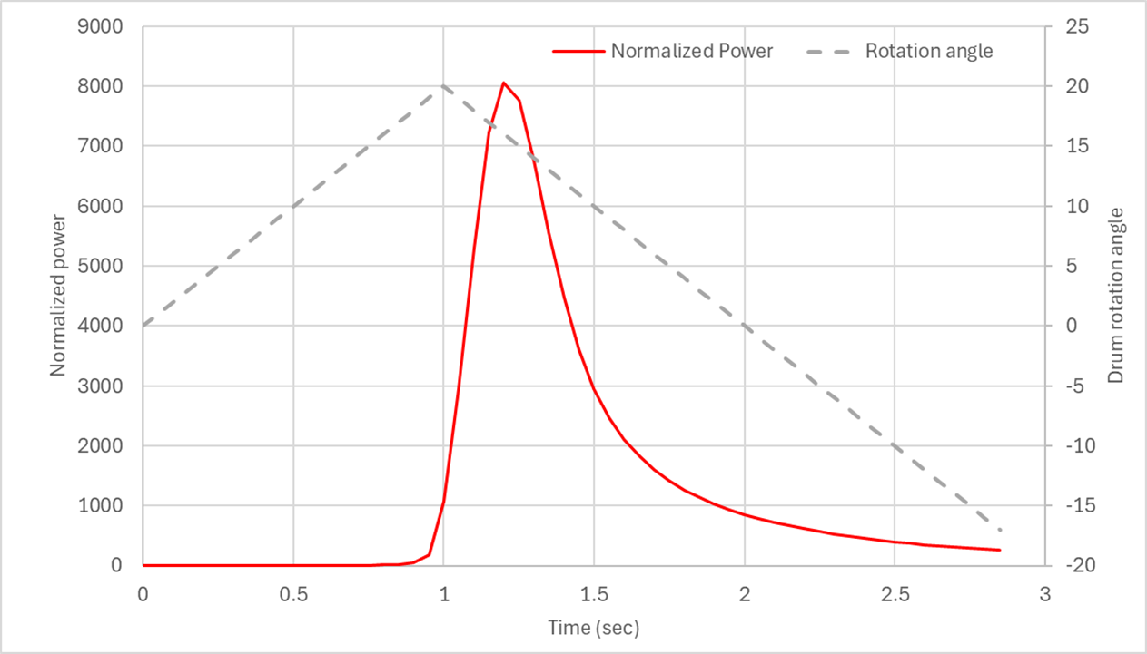
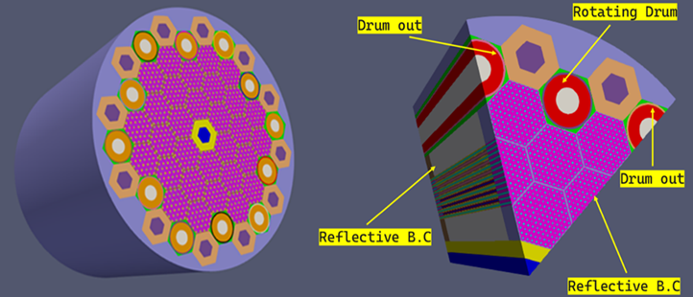
HPMR CDR: Single Physics Results
  Single physics simulation of control
  drum rotation (Griffin-only)
  As control drums rotate outward, they
  insert reactivity, causing core power
  to rise.
  Faster rotation leads to a sharper power
  spike, followed by a power drop when the
  drums rotate back inward.
Investigated Control Drums
Neutronics Single-Physics Results
12

Slide 13
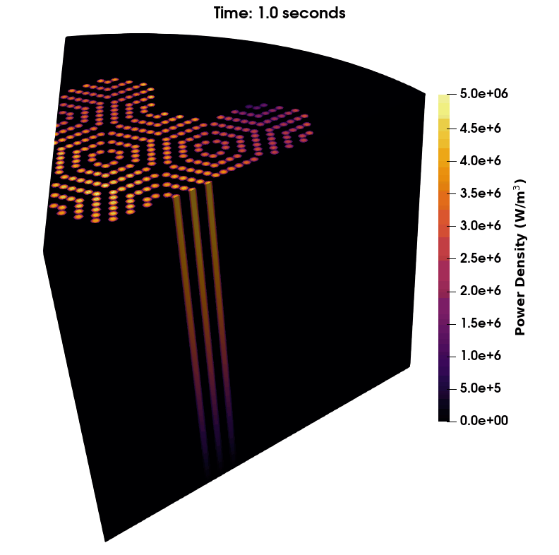
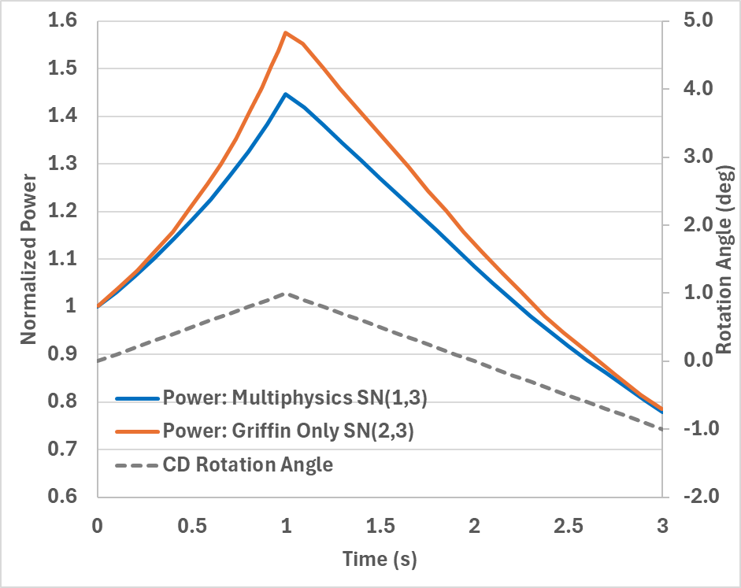
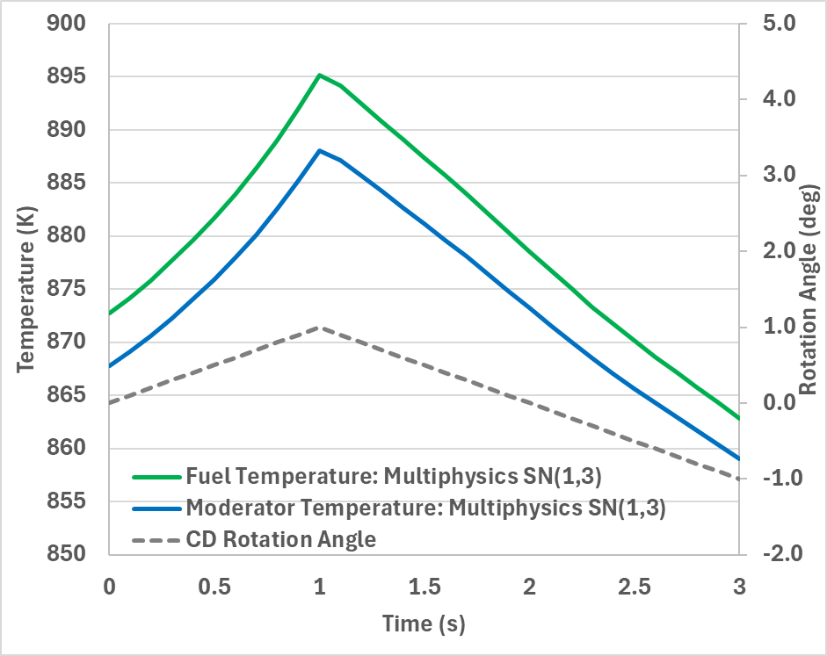
HPMR CDR: Multi-Physics Results
Multiphysics simulation of inadvertent control drum rotation (Griffin-BISON-Sockeye)
  Captures the coupled effects of neutronic reactivity changes and thermal feedback
  Significant differences observed between single-physics and multi-physics simulations
  Multiphysics approach is essential to accurately capture kinetics during CDR
5°/s outward (1s) → 5°/s inward (2s)
Multiphysics HPMR CDR Results
13

Slide 14
Multiphysics Simulation of KRUSTY Reactivity Insertion Tests
Yan Cao
Argonne National Laboratory

Slide 15
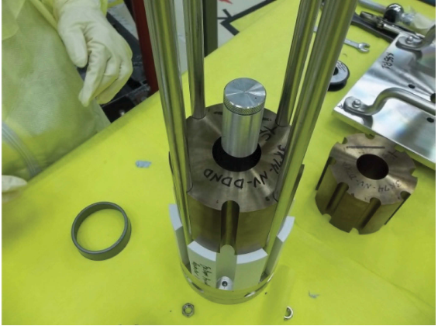
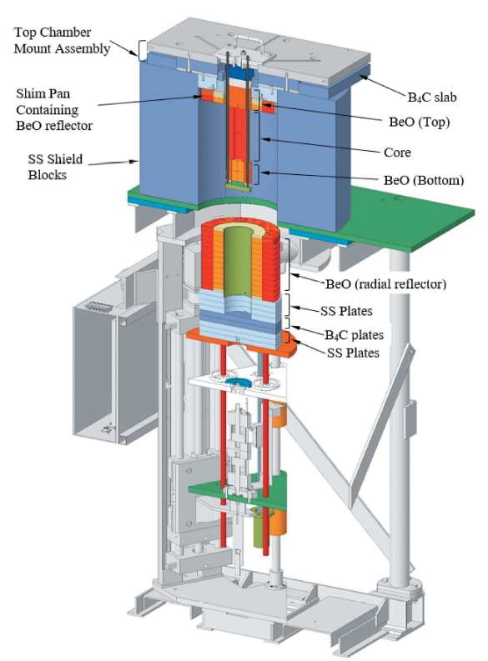
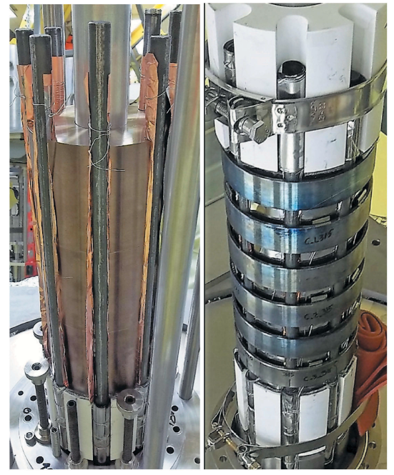
KRUSTY Critical Experiments
Motivation: Perform multiphysics NEAMS code validation using unique microreactor critical experiments data
KRUSTY
  NASA/NNSA Kilopower project
  HP-cooled fast spectrum reactor (up to 5kWth)
  Critical experiments at NCERC (COMET)
Unique data for NEAMS tool validation
  Reactivity insertion tests (15 Ȼ, 30 Ȼ and 60 Ȼ, warm critical experiments with power increasing to a few kWs).
  26-h Nuclear system tests (start-up tests, steady state tests, load-following tests, safety transients).
KRUSTY UMo Fuel [1]
KRUSTY on COMET [1]
KRUSTY core with HPs [2]
[1] T. Grove et al., “Kilowatt reactor using stirling TechnologY (KRUSTY) cold critical measurements,” Nucl. Technol., 206, sup1, S68 (2020).
[2] R. G. S. David et al., “Results of the KRUSTY Nuclear System Test,” Nucl, Technol., 206, sup1, S89 (2020).
15

Slide 16
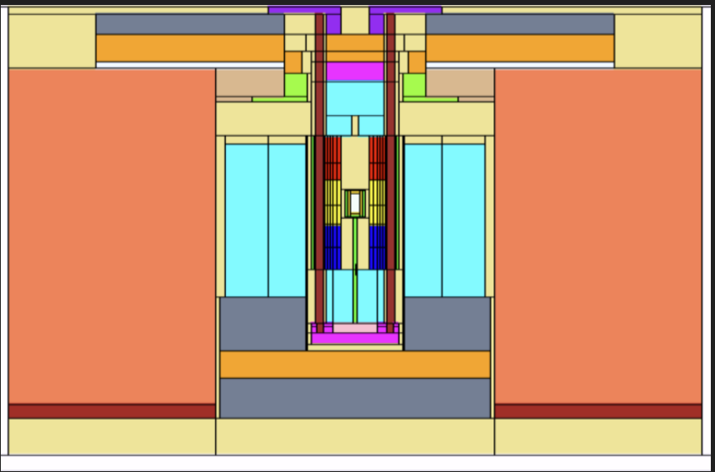
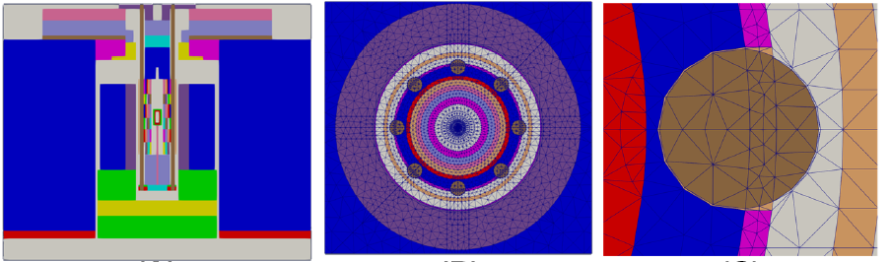
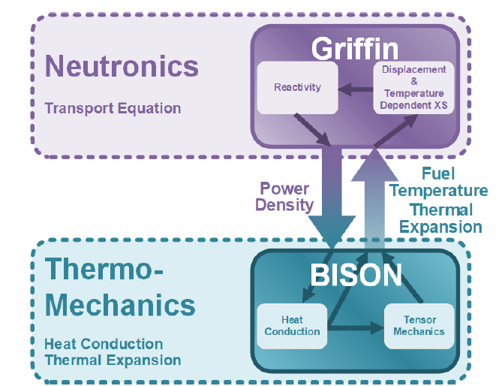
Single- and Multi-Physics Models
Neutronic models based on ICSBEP benchmark models:
Hybrid multigroup cross section generation approach:
  MC²-3 generated cross sections for reflectors (high-order anisotropic scattering)
  Serpent generated cross sections for all other regions
Griffin neutronics model:
  Mesh model + 22-g cross sections.
  DFEM-SN + CMFD acceleration
Heat transfer model:
  BISON + MOOSE heat transfer module.
Solid mechanics model:
  Simplified model to capture key mechanical features impacting neutronics.
Multiphysics coupling model:
  Two-level MOOSE MultiApp hierarchy (No heat pipes)
Simplified Monte Carlo Model
MOOSE Mesh Model
16

Slide 17
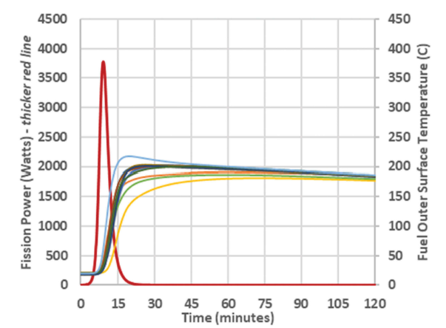
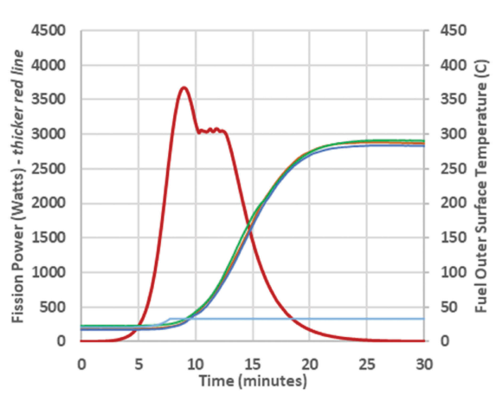
Warm Critical Experiments
15 Ȼ insertion tests [3]:
  External reactivity inserted by pushing radial reflectors on the platen upward to cover more fuel region (reducing neutron leakage)
  Radial reflector pushed once for ~15 Ȼ insertion
  Power peaked around 3.75 kW; measured fuel disk surface temperatures lagged the reactor power
30 Ȼ insertion tests [3]:
  Repeated the first 15 Ȼ insertion
  The second 15 Ȼ reactivity was inserted in multiple steps to maintain core power at about 3 kW
  Held constant power ~ 2.5 minutes.
15 Ȼ
15 Ȼ
15 Ȼ
[3] D. Poston, et al., “Results of the KRUSTY Warm Critical Experiments,” Nucl. Technol., 206, sup1, S78-88 (2020).
17

Slide 18
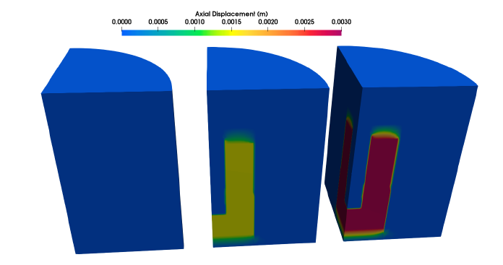
Reactivity Insertion Model
Reactivity insertion was modeled by displacing the radial reflectors mesh block.
The displacement is calculated by forcing a Dirichlet boundary condition on the bottom of the BISON solid mechanics model.
Automatic control for inserting the second part of 15 Ȼ in the 30 Ȼ tests:
    Reflector shifted upward by 0.126 mm every step when Power < 3 kW (total 150 seconds)
No shift
15 Ȼ insertion
30 Ȼ insertion
18

Slide 19
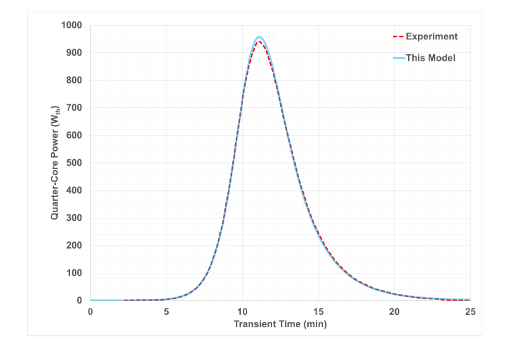
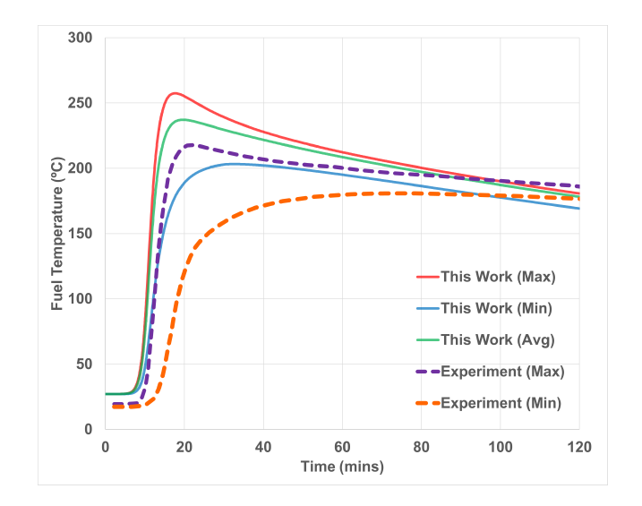
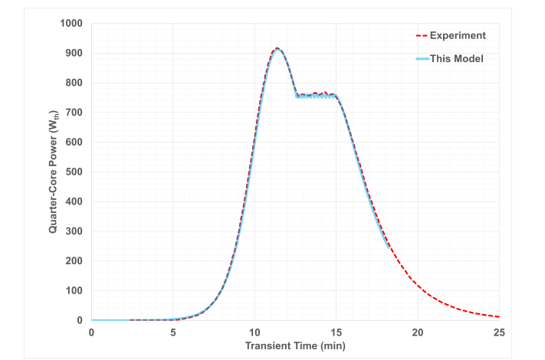
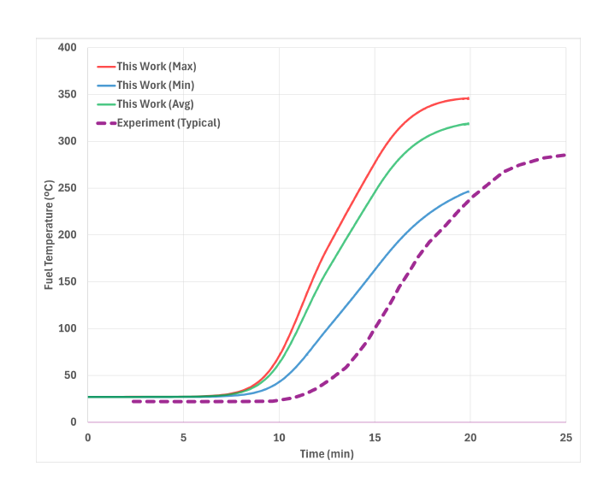
Multiphysics Results
15 Ȼ tests power
15 Ȼ tests temperature
Satisfactory match of the power distributions/evolutions with measurements.
Comparable fuel temperatures calculated by NEAMS tools with experiments despite known issues on delayed responses of the thermal couples
Good agreements on the estimated total reactivity insertions to experiment values.
Demonstrated NEAMS multiphysics modeling capabilities for predicting reactor dynamic responses.
30 Ȼ tests power
30 Ȼ tests temperature
Total Inserted ρ(Ȼ) | 15 Ȼ | 30 Ȼ
Exp (β_{eff} = 650 pcm) | 15.7 | 29.9
Cal(β_{eff} = 690 pcm) | 14.3 | 29.7
19

Slide 20
Conclusions
Demonstration and validation achievements
  GCMR: full-core multiphysics model for steady-state & transients (VTB)
  HPMR: full-core multiphysics model for steady-state & transients (VTB, journal paper)
  KRUSTY: code validation using reactivity insertion warm critical tests (VTB, paper submitted)
Future work
  GCMR/HPMR: Expand/enhance/demonstrate high-fidelity models using latest code features
    Evaluation of online cross-section generation, depletion/burnup effects, shielding performance, etc.
    Advanced thermomechanical model integration with corresponding reactor & TRISO analyses.
    Integration of secondary cooling system/BOP models to enhance transient analyses.
  KRUSTY
    Code validation using the nuclear system test results
    Integration of advanced heat pipe model is needed
Contact Information
Yinbin Miao ymiao@anl.gov
Ahmed Abdelhameed aabdelhameed@anl.gov
Yan Cao ycao@anl.gov
20

