Slide 2

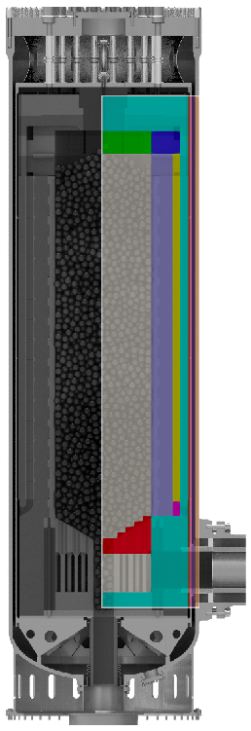
Development of a system-level model for the pebble-bed gas-cooled reactor with SAM/Griffin
Zhiee Jhia Ooi, Ling Zou, Thanh Hua, Jun Fang, Rui Hu
Argonne National Laboratory

Slide 3
Introduction
NEAMS HTGR applications focus:
Develop models of HTGR phenomena
Demonstrate code applicability to challenging HTGR problems
Drive code development through user assessment
Perform code verification and validation
Activities:
System-level modeling of pebble bed HTGRs with SAM/Griffin
Modeling of the prismatic High Temperature Test Facility (HTTF):
System level with SAM
CFD modeling of lower-plenum mixing with nekRS
3

Slide 4
Introduction
Development of a system-level modeling methodology for the pebble-bed gas-cooled reactor using SAM
Motivation:
Capture important features/trends of the reactor during transient scenarios
Improve usability and user experience
Minimize computational resources with minimal compromise to the accuracy
Minutes vs. hours/days in higher fidelity simulations
Leverage SAM’s 0-D/1-D component system
Two-prong approach of model development and SAM code capability development when necessary
4

Slide 5
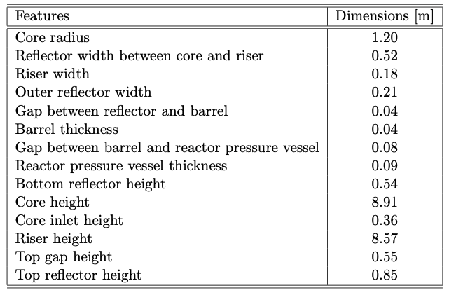
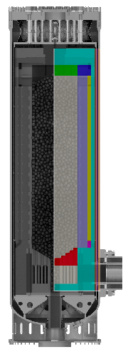
Reactor description
Generic design: 200 MW general gas-cooled reactor (GPBR200)
Power: 200 MW-th
Pressure = 6 MPa
Helium-cooled at 78.6 kg/s under steady-state (T_{in} = 533 K)
Roughly 223,000 pebbles (6 cm diameter) with an average packing factor of 0.61
Source: Stewart et al. (2021)
5

Slide 6
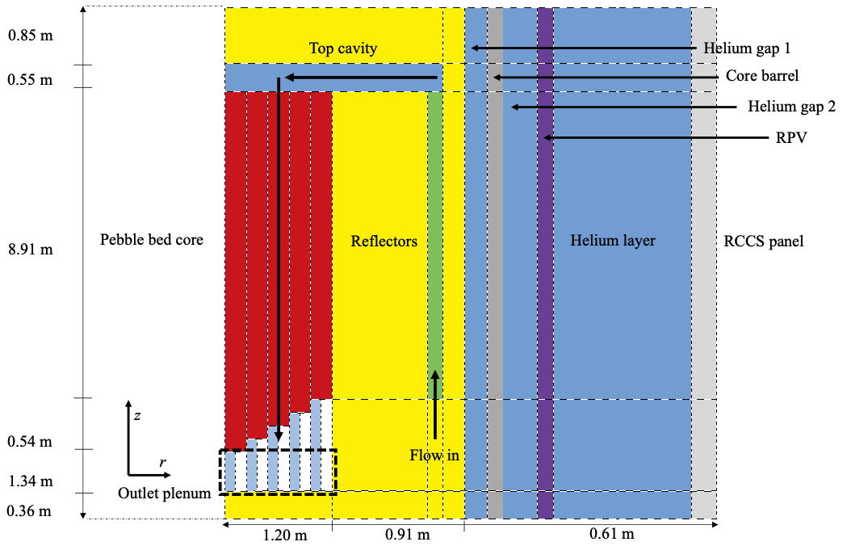
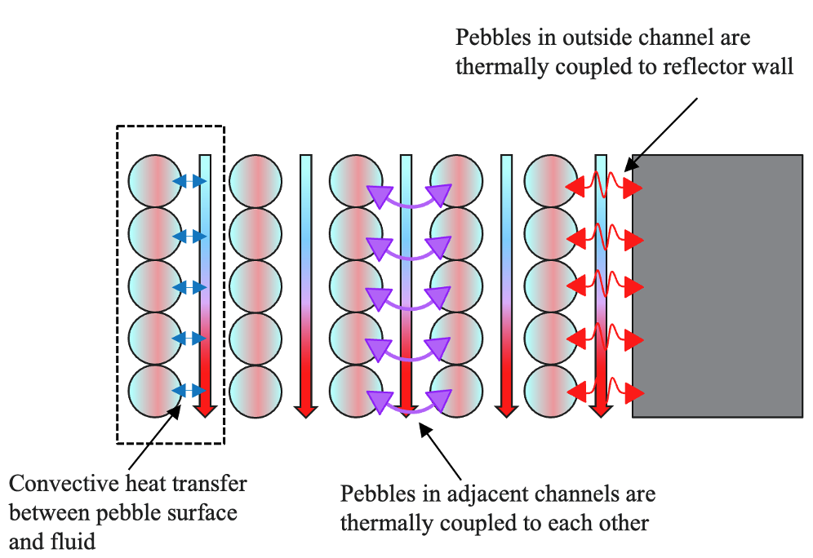
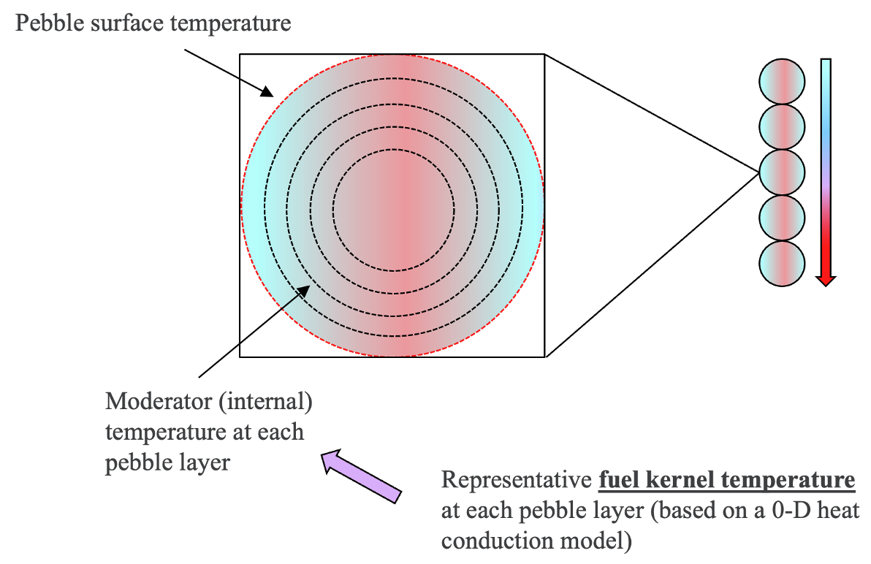
Model description – SAM core channel model
Utilizes SAM PbCoreChannel components with PebbleBed heat structures:
1-D fluid component with built-in spherical heat structures
In every channel, each axial node is represented by one representative pebble
Five across the radial direction: to capture radial heat transfer
Captures different heat transfer mechanisms: convective, conductive, radiative heat transfers
Additional models to capture pebble, moderator, and kernel temperature
6

Slide 7
Model description – Neutronics
Two approaches to model the neutronics side of the reactor:
SAM standalone model with SAM’s internal PKE capability:
Reliance on PKE information (decay constant, prompt neutron generation time, reactivity feedback coefficients) from Griffin model developed by INL (Stewart et al. 2021)
Reactivity feedback coefficients in the SAM model based on the distributions in the Griffin model
SAM/Griffin coupled model:
SAM models the T/H; Griffin models the neutronics (developed by INL from Stewart et al. 2021)
Uses MOOSE’s MultiApp system to transfer information between SAM and Griffin
Temperature
SAM
Griffin
Power density
7

Slide 8
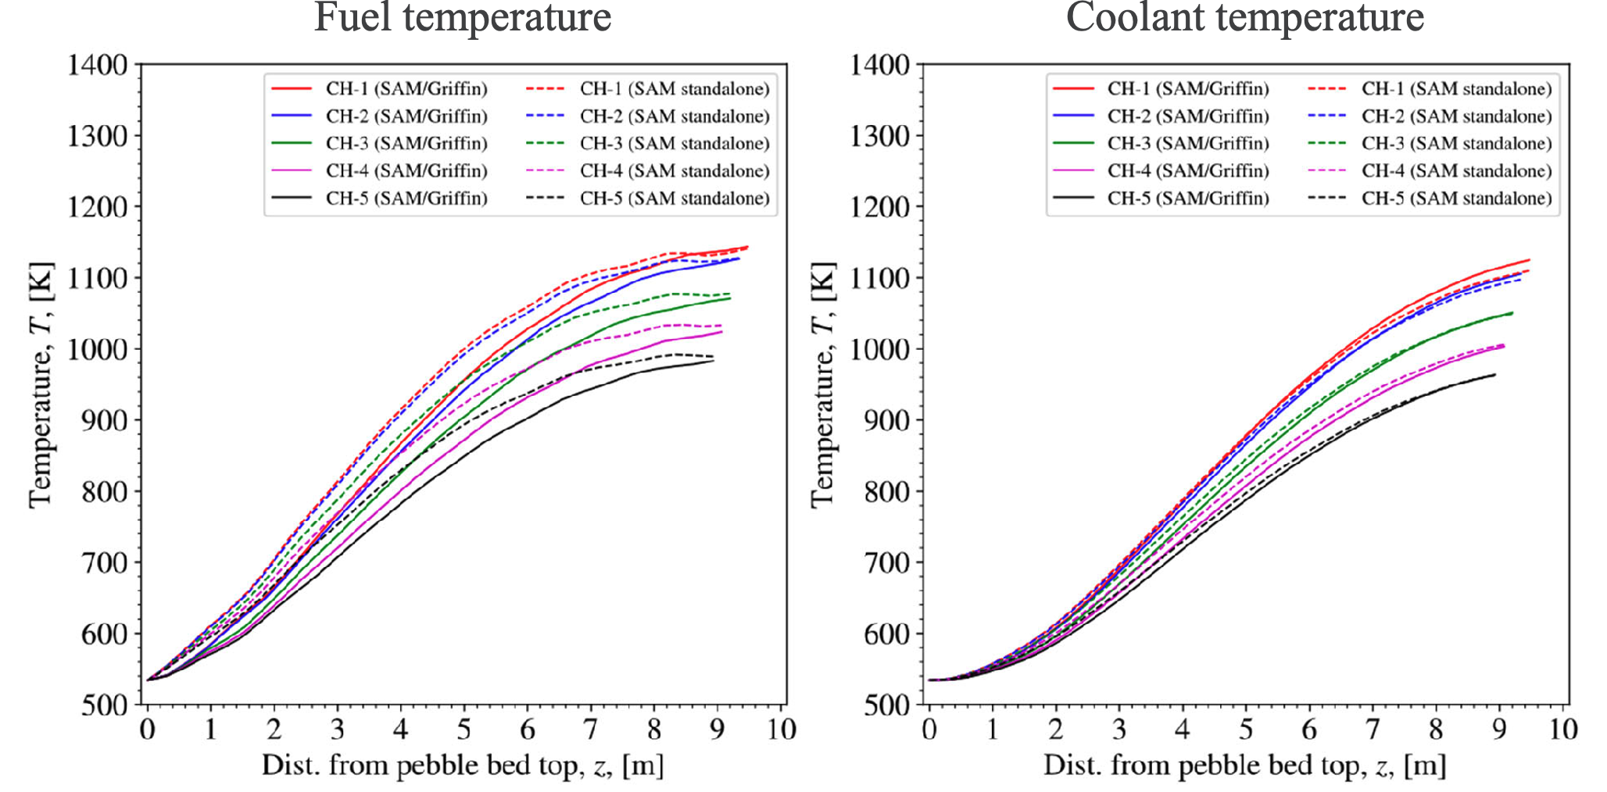
Results and discussions: Steady-state
Steady-state comparison between the SAM standalone (PKE) and the SAM/Griffin coupled model
Solid line: SAM/Griffin
Dashed line: SAM standalone PKE
8

Slide 9
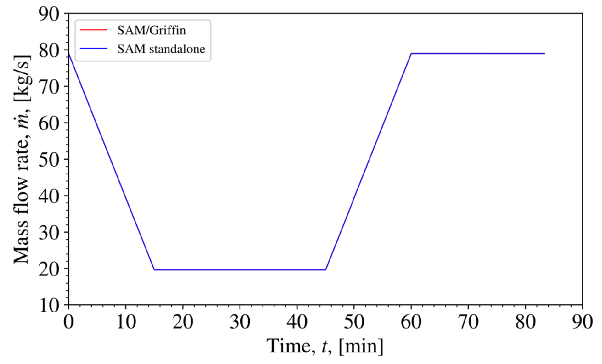
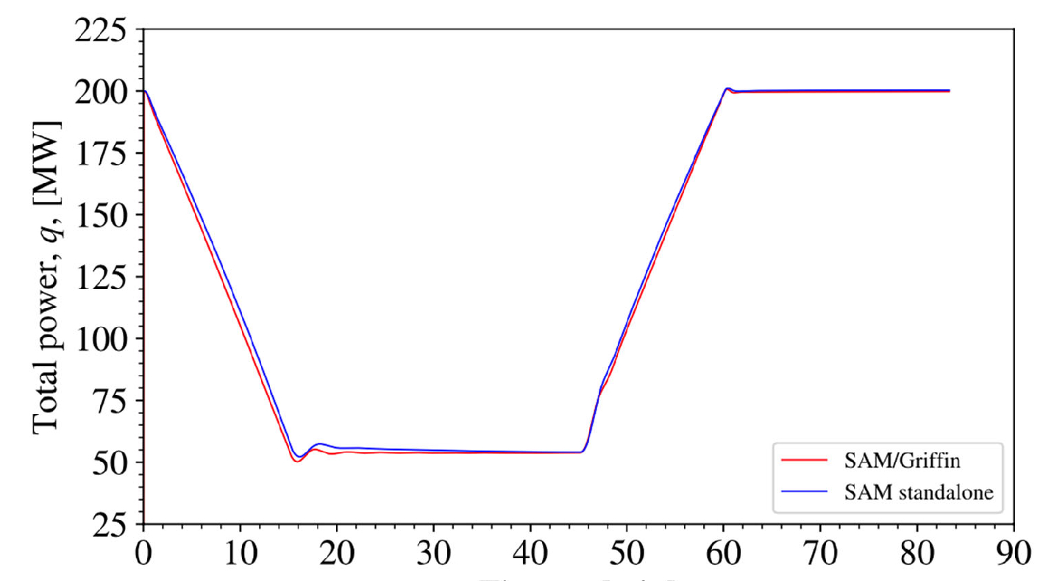
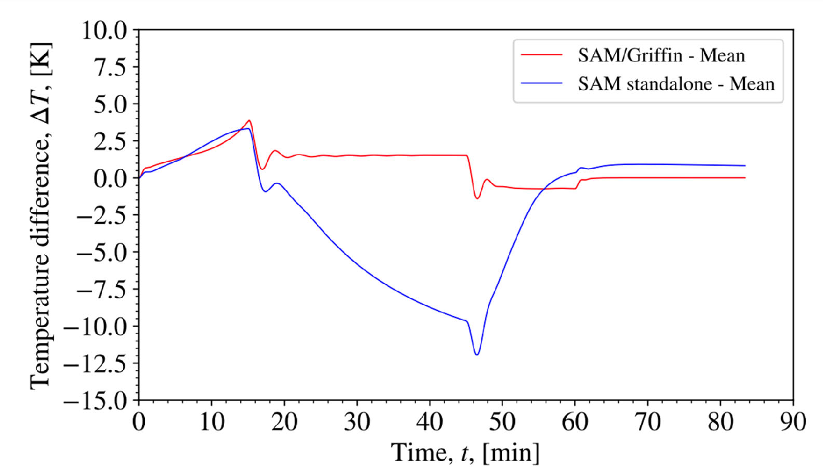
Results and discussions: Load-following transient
Mass flow rate
Compares SAM standalone (PKE) and the SAM/Griffin coupled model during transient
Changes in system mass flow rate results in changes in temperature and power due to reactivity feedbacks.
Good agreement in power level changes
Differences in the average fuel temperature due to differences in power density
System power level
Fuel temperature change
9

Slide 10
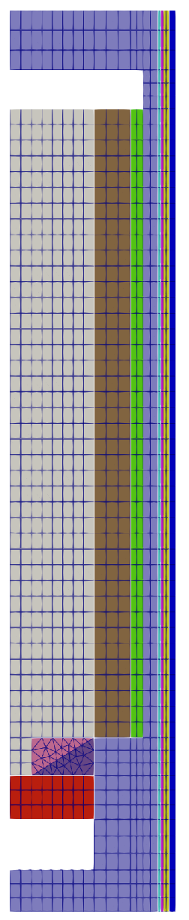
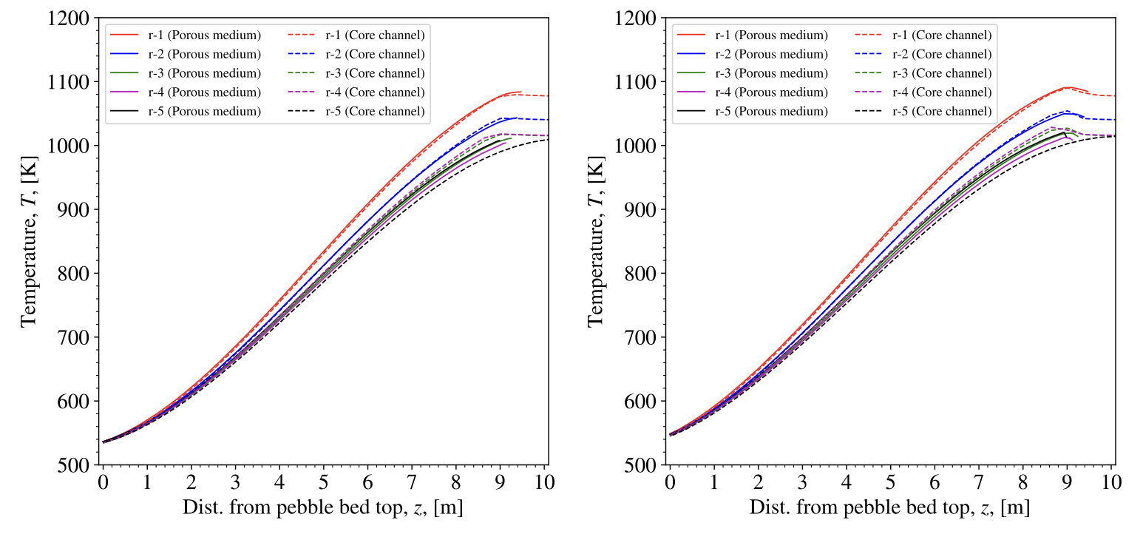
Comparison with higher fidelity model: steady-state
Higher fidelity model: Porous media model
MOOSE N-S module + porous media closure models in SAM. T/H only (no neutronics). Longer running time.
Purpose: Comparison with the SAM core-channel model.
Excellent agreement during steady-state.
Porous media model mesh
Fuel temperature
Coolant temperature
10

Slide 11
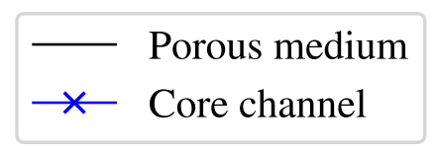
Comparison with higher fidelity model: transient
De-pressurized and pressurized loss-of-forced-cooling (DLOFC and PLOFC) transients
Smooth line: SAM porous media model. Marked line: SAM core-channel model.
Average fuel temperature comparison during DLOFC and PLOFC:
Excellent agreement during DLOFC.
Core channel model shows overpredictions during PLOFC
Average fuel temperature
DLOFC
PLOFC
11

Slide 12
Summary
Developed system-level model for the pebble-bed HTGR using SAM’s component system
Requires fewer computational resources and is faster-running
Captures the major T/H behaviors well during steady-state and transients
Close collaboration with INL team for neutronics modeling
Ongoing and future work:
To improve the accuracy/physics of the model
To improve user experience by packaging/automating the building of the pebble bed into a single component
Further benchmark/comparison with other transients
12

Slide 14
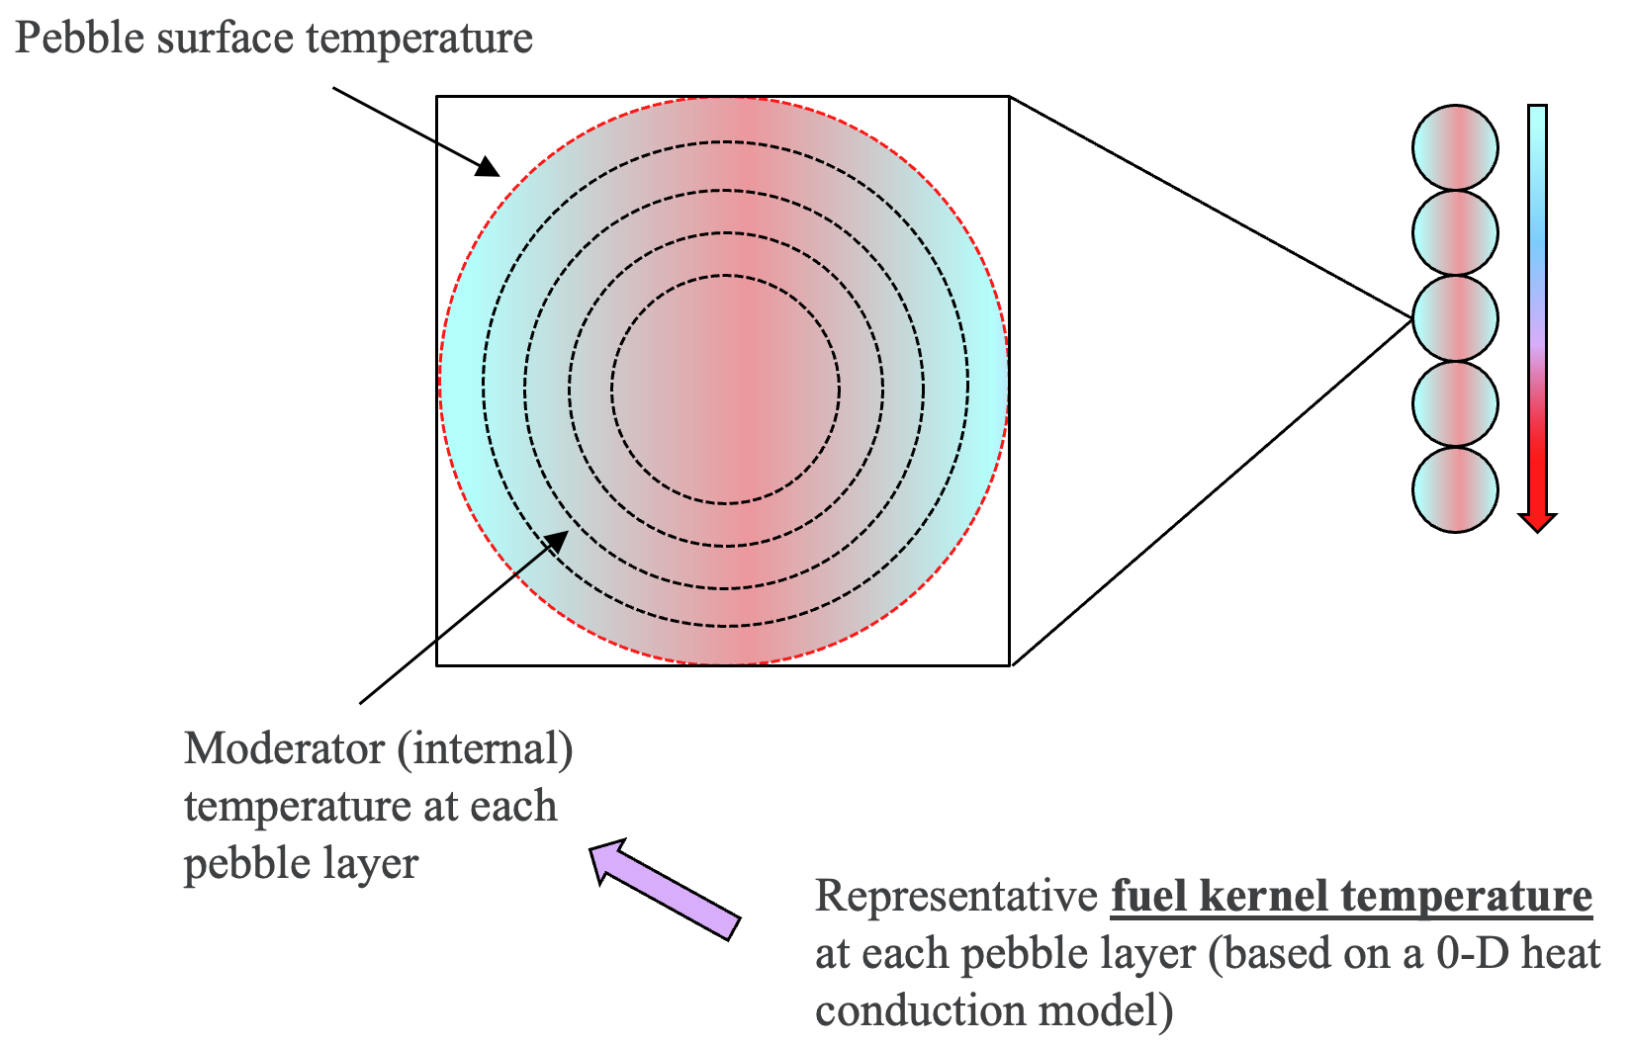
Model description – SAM core channel model
Additional models to capture pebble, moderator, and kernel temperature
Based on heat conduction equation
Also implemented an empirical model from TINTE for fuel kernel temperature
Only one kernel temperature per pebble layer
Based on empirical data and assumptions specific to the PMBR-400
14

