Slide 1
Introduction to Multiphysics Applications Technical Area
Bob Salko, Oak Ridge National Laboratory LWR Work Package Manager
Emily Shemon, Argonne National Laboratory Technical Area Lead
Cody Permann, Idaho National Laboratory Technical Area Deputy Lead
NEAMS LWR Stakeholder Meeting
5/7/2025

Slide 2
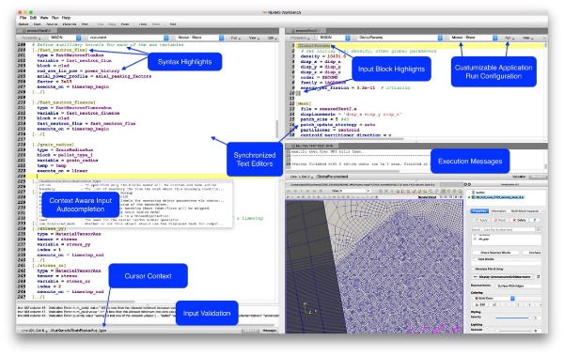

Multiphysics Applications Technical Area Overview
Reactor Applications
Engage with stakeholders
Apply tools to reactor technologies
Identify code gaps
Perform V&V
Publish mature models on NRIC Virtual Test Bed
Multiphysics Framework Development
Enhance MOOSE to provide a robust & efficient infrastructure for code developers and users
Development of VERAOneWay for integration of BISON & VERA
Deployment & User Workflows
Deploy software containers on INL HPC for easy access
Enhance the NEAMS Workbench GUI for enabling user workflows
Notes:
What we do:
Reactor Applications – Engage with stakeholders, apply tools to reactor technologies, identify gaps to drive code development, perform V&V, share mature models via NRIC Virtual Test Bed (VTB) and publications
MOOSE Development – Support MOOSE-based applications, multiphysics coupling, meshing, deployment, and ensure framework is robust and performant
Workbench Development – Provide GUI for input preparation, job submission & output inspection, support application workshops, integrate with INL HPC

Slide 3
Light Water Reactor Highlights
FY24 Milestones | FY25 Milestones
Fuel Fragmentation, Relocation, and Dispersal
High-Burnup BWR LOCA Burst Analysis Framework Development and Demonstration (https://doi.org/10.2172/2472686) Summarize work on fuel burnup extension remaining R&D gaps (https://doi.org/10.2172/2397442) | Identify critical parameters affecting burst susceptibility of BWR fuel during large break loss-of-coolant accident M4 completed on establishing new input format for VERA OneWay to fully leverage new features in BISON Assess existing VERA CRUD modeling capabilities including demonstration using existing model, and develop common benchmark for comparison of ORNL and LANL versions of MAMBA
Time at Temperature
Develop time-at-temperature and perform initial scoping study evaluation (NEAMS time-at-temperature strategy document circulated) | Demonstration of VERA to model a BWR AOO that is limiting in terms of fuel exceeding dryout
3

Slide 4
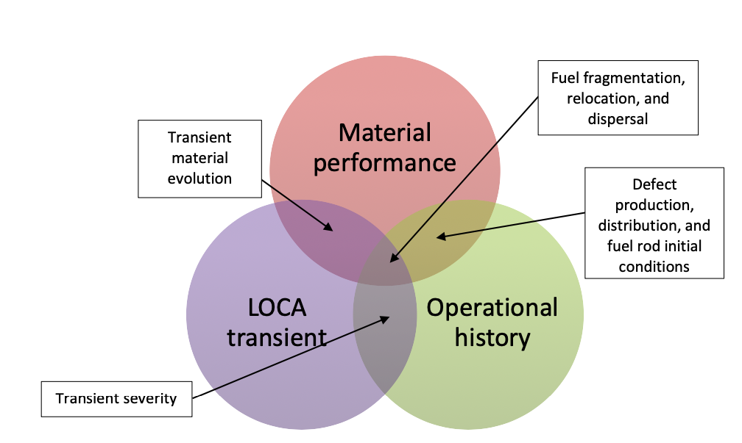
Light Water Reactor Applications
Focused on supporting economic improvements to current LWR fleet
Fuel fragmentation, relocation and dispersal (FFRD)
Working to identify critical parameters affecting burst susceptibility (previously PWR, now BWR)
VERA model of 3 cycles of Limerick Unit 1 used to initialize TRACE and BISON models of LOCA
First of a kind high fidelity, high burnup BWR LOCA analysis
Time-at-temperature
Utilizing high fidelity tools for analysis of transients of interest, phenomena importance, and model uncertainty
Developed strategy white paper with input from industry stakeholders
Stakeholder interactions
Hosted LWR stakeholder meeting @ EPRI in March 2024 to solicit industry feedback on progress and priorities
Bi-annual EPRI CRAFT meetings on FFRD and time-at-temperature
Close collaboration with AFC
Determination of FFRD susceptibility and post-CHF behavior requires understanding of multiple reactor characteristics
4
Notes:
For industry interaction, I would also add "Participation in the bi-annual EPRI CRAFT meetings on FFRD and TaT". Some additional points to make about the BWR modeling work... "-First of a kind high fidelity, high burnup BWR LOCA analysis", "-Working to identify critical parameters affecting burst susceptibility", "-VERA One Way used to pass high burnup depletion data into Bison", "-TRACE used for prediction of BWR LOCA behavior and for prescribing Bison boundary conditions". Feel free to select as few or many of those as needed and let me know if you need anything else.

