Slide 1
Introduction to Multiphysics Applications Technical Area
Emily Shemon, Argonne National Laboratory
Technical Area Lead
Cody Permann, Idaho National Laboratory
Technical Area Deputy Lead
May 12, 2025
NEAMS Annual Review: Microreactors

Slide 2

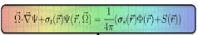
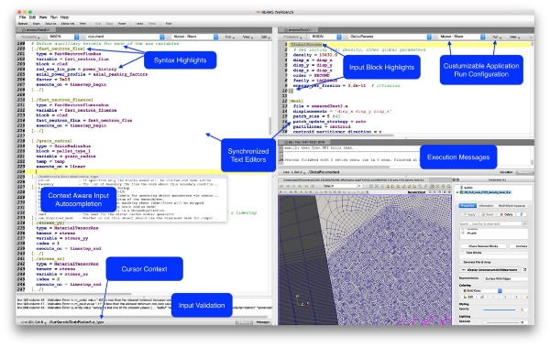



Multiphysics Applications Technical Area Overview
Reactor Applications
Engage with stakeholders
Apply tools to reactor technologies
Identify code gaps
Perform V&V
Publish mature models on NRIC Virtual Test Bed
Multiphysics Framework Development
Enhance MOOSE to provide a robust & efficient infrastructure for code developers and multiphysics users
Deployment & User Workflows
Deploy software containers on INL HPC for easy access
Enhance the NEAMS Workbench GUI for enabling user workflows
Notes:
What we do:
Reactor Applications – Engage with stakeholders, apply tools to reactor technologies, identify gaps to drive code development, perform V&V, share mature models via NRIC Virtual Test Bed (VTB) and publications
MOOSE Development – Support MOOSE-based applications, multiphysics coupling, meshing, deployment, and ensure framework is robust and performant
Workbench Development – Provide GUI for input preparation, job submission & output inspection, support application workshops, integrate with INL HPC

Slide 3
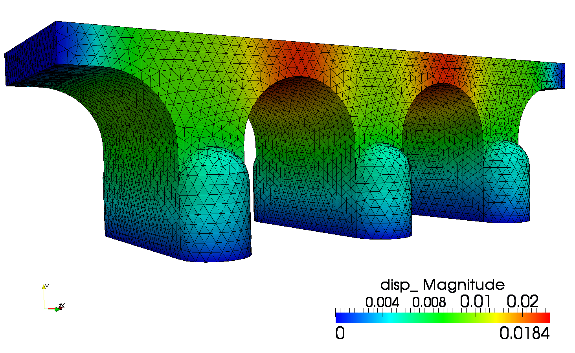
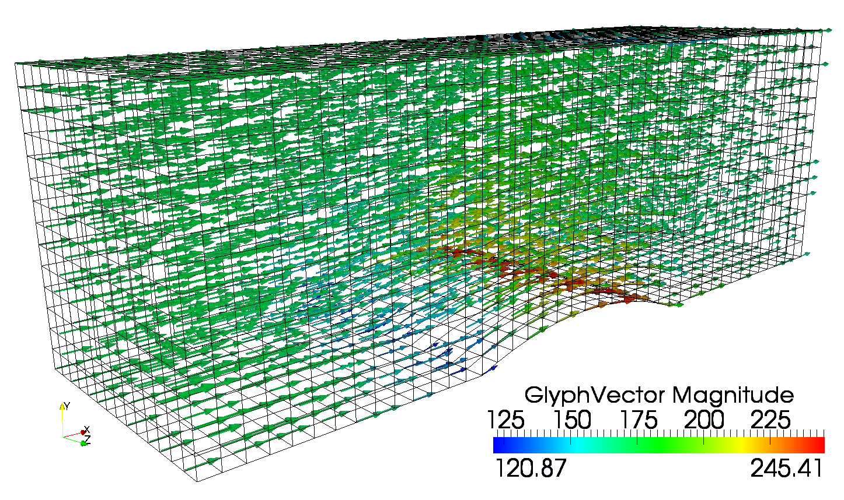
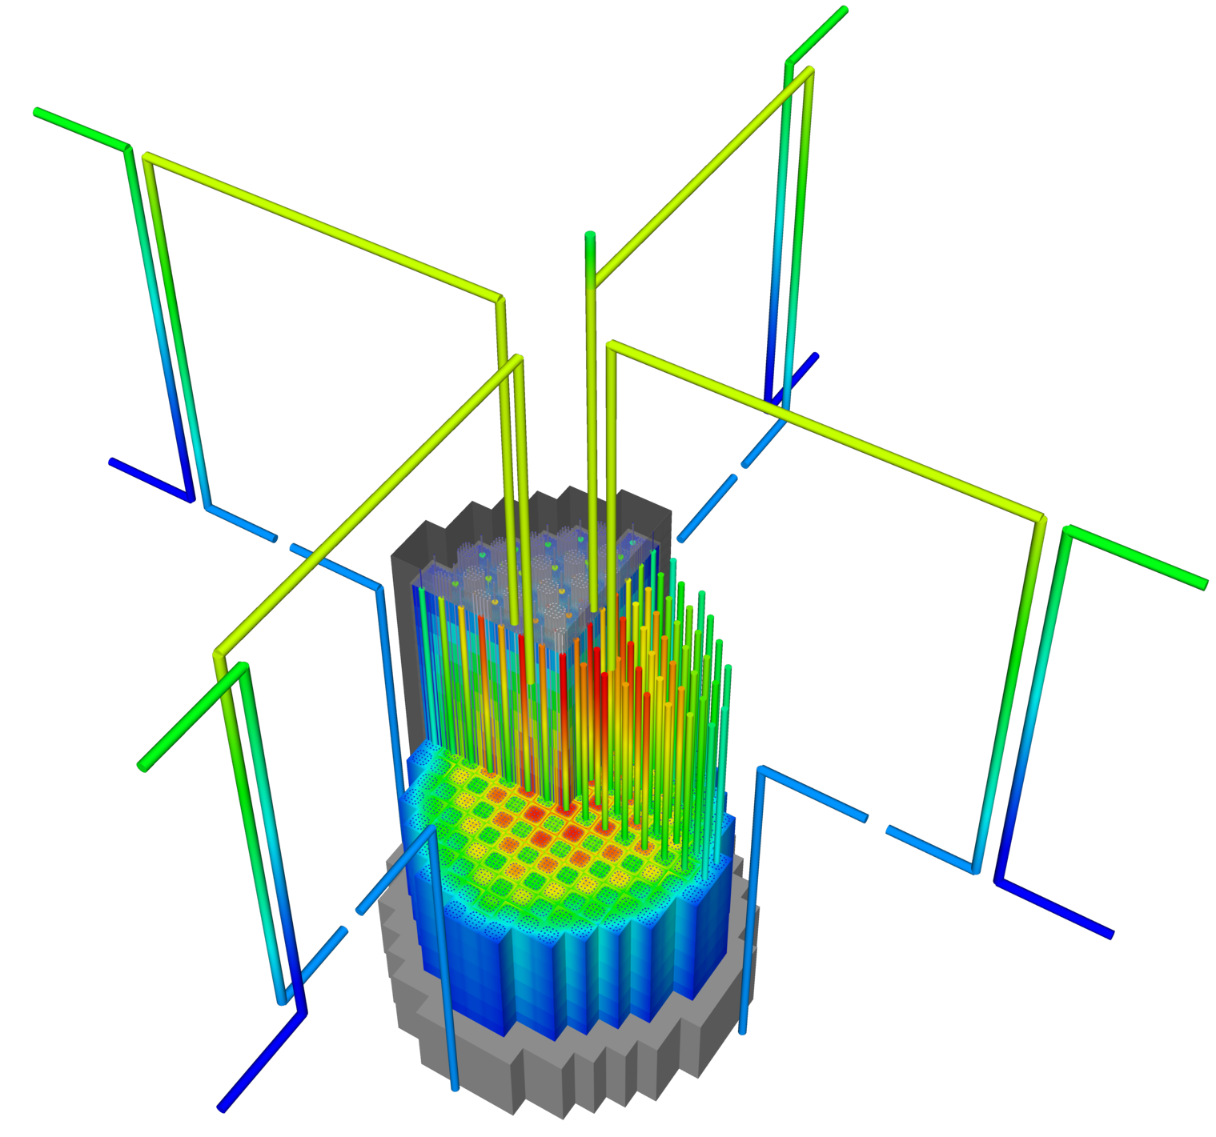
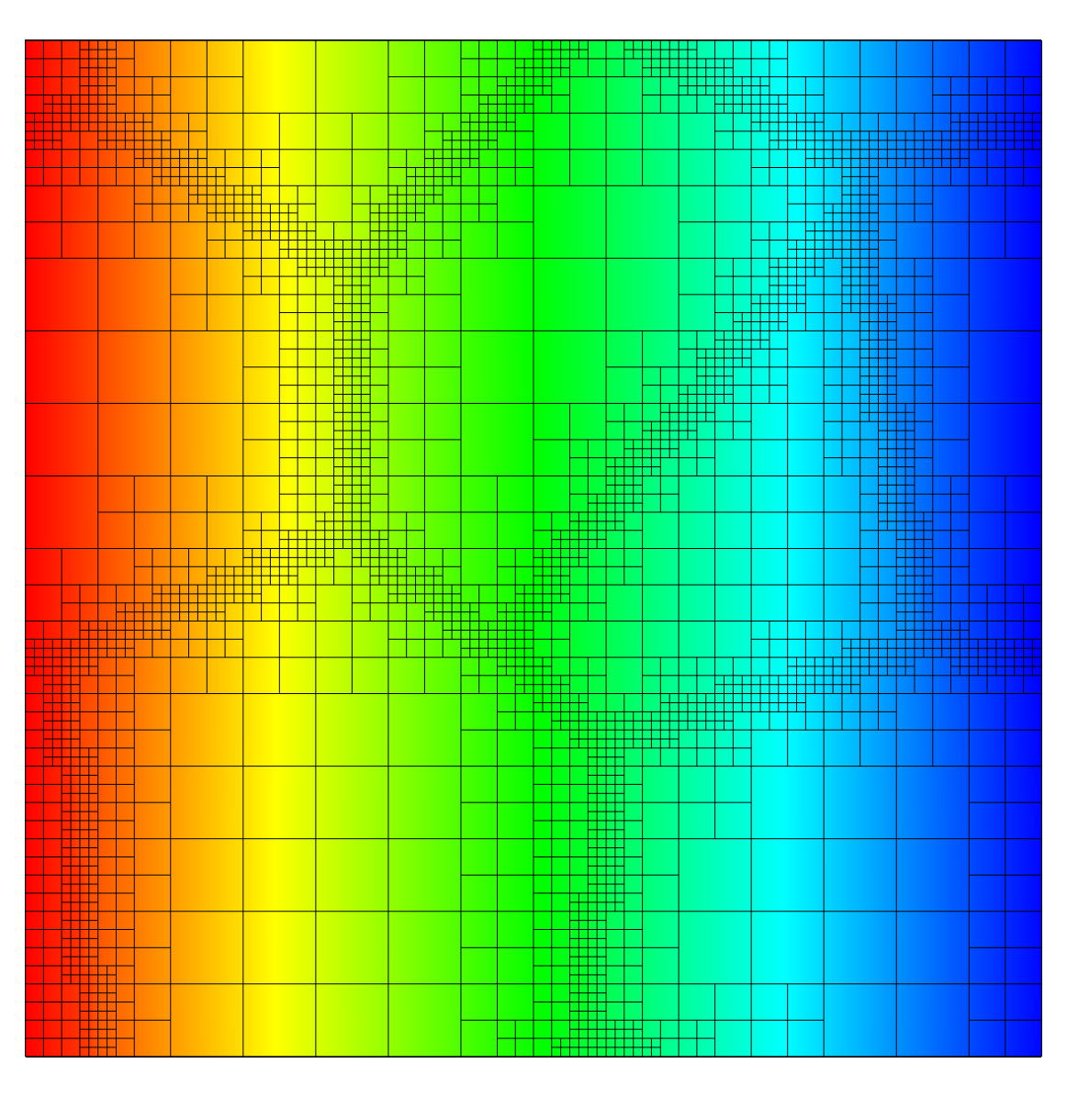

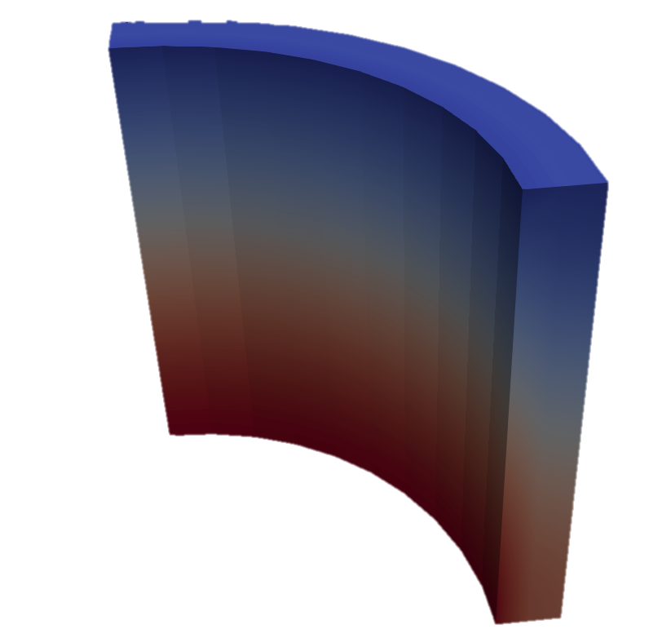
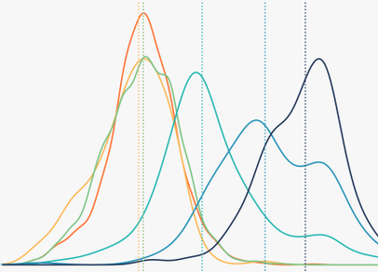
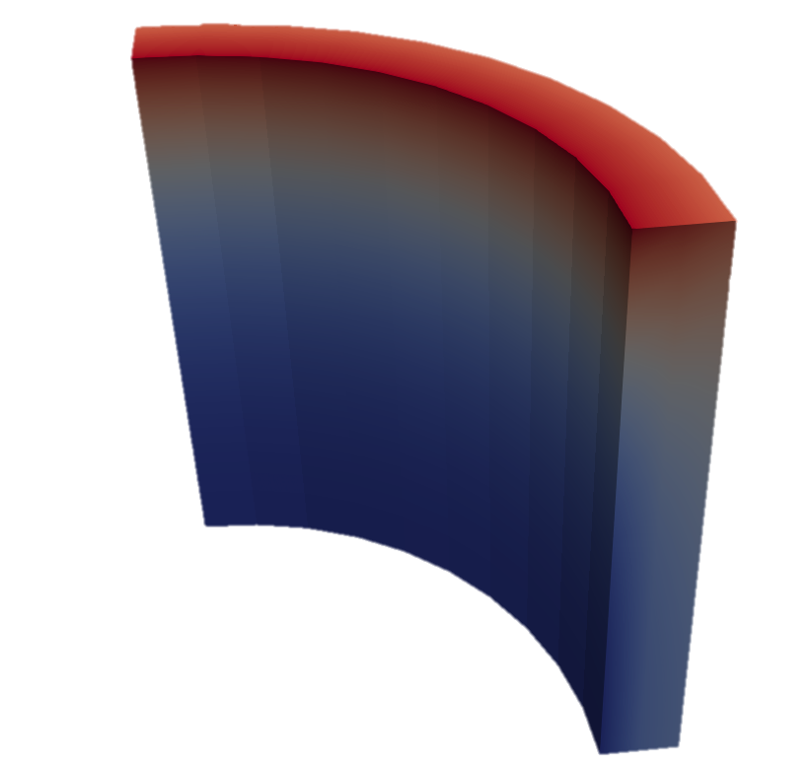

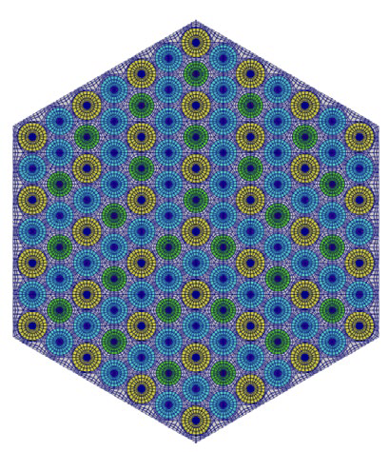
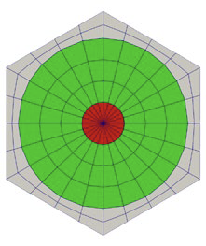
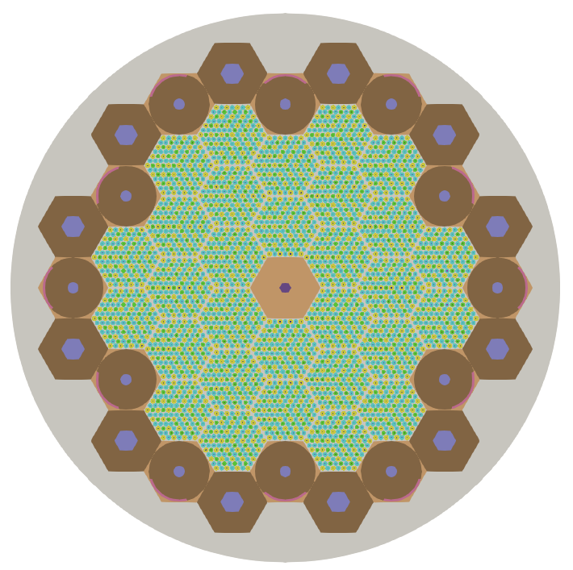
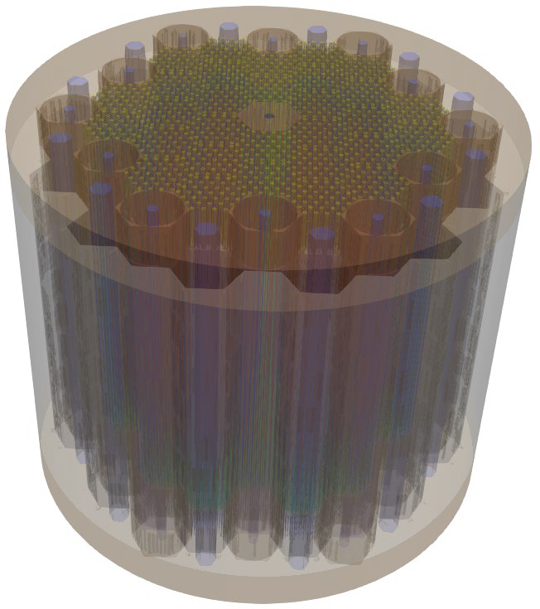
MOOSE Ecosystem
What is MOOSE?
Open-source
Massively Parallel
NQA-1 Compliant
Flexible multiphysics coupling options
MOOSE also contains modules…
mooseframework.org
MOOSE Stochastic Tools Module enables parameter sampling, UQ and sensitivity analysis
Recent efforts:
Physics/Component system
(simpler input files)
LSP integration for live syntax completion/validation
Kokkos/MFEM integration for GPU accelerators
MOOSE Reactor Module enables rapid construction of reactor geometry finite element meshes
Chemical Reactions
Contact
Electromagnetics
Fluid Properties
Fluid Structure Interaction
Function Expansion Tools
Geochemistry
Heat Transfer
Level Set
Navier Stokes
Optimization
Peridynamics
Phase Field
Porous Flow
Ray Tracing
Reactor
Reconstructed Discontinuous Galerkin
Solid Mechanics
Solid Properties
Stochastic Tools
Subchannel
Thermal Hydraulics
XFEM
3

Slide 4
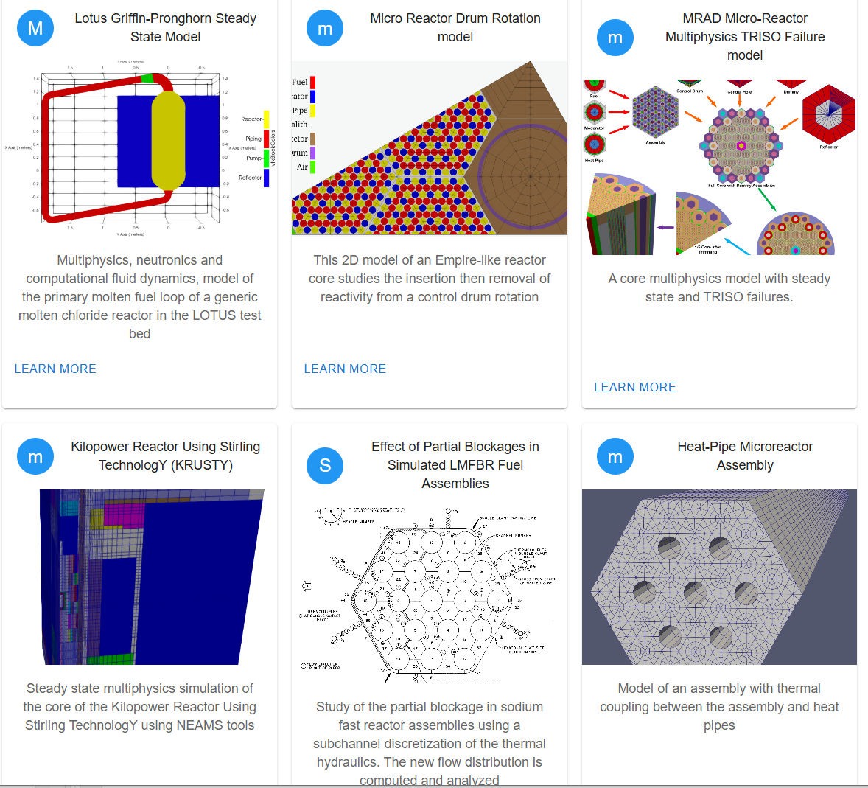
Reactor Cross-Cutting Highlights
FY24 Milestones | FY25 Milestones
MOOSE and Workbench “front-end” improvements
Containerized deployment Language server protocol (LSP) integration (link) 2D & 3D reactor geometry meshing improvements (link) | Initiate support for Constructive Solid Geometry (CSG) to improve Monte Carlo workflows Improved MOOSE/Workbench integration
MOOSE “back-end” improvements
Flexible execution strategies, algorithms for transient solves, and modular system for encapsulating physics (link) Physics application support (Griffin, BISON, etc) (link) | Add support for polyhedral elements, AI input generation, hardware accelerators Deployment of concise physics syntax
NRIC Virtual Test Bed Contributions https://mooseframework.inl.gov/virtual_test_bed/
Selected model highlights: High Temperature Test Facility (HTTF) TH model (link) TRISO fuel failure analysis in a heat-pipe microreactor (link) LOTUS molten chloride fast reactor neutronics & TH (link) ABTR SFR cross section generation and reactor physics calculation (link) | Recent and upcoming model highlights: KRUSTY microreactor experiment steady state and 15 cent reactivity insertion (link) Fast reactor core bowing-related demonstrations
4

Slide 5
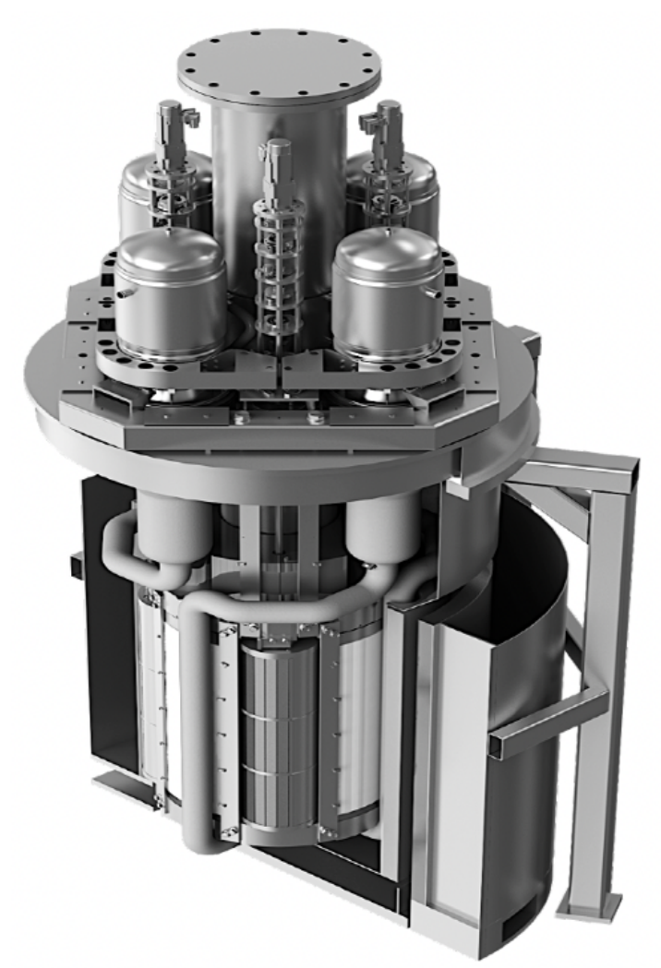
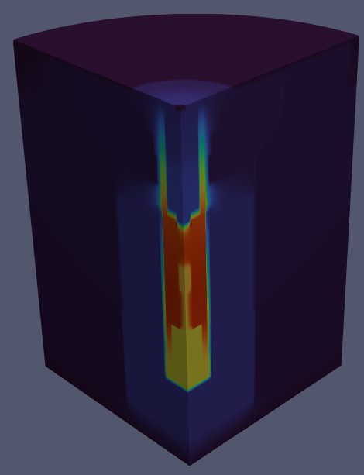
Microreactor Highlights
FY24 Milestones | FY25 Milestones
DOE MRP’s MARVEL Microreactor Modeling
MARVEL steady-state and transient modeling (link) Extend the SWIFT code to model ZrH with application to MARVEL | Improve MARVEL multiphysics model and perform code-to-code comparisons
Heat Pipe Microreactor Modeling
High-fidelity multiphysics steady-state and transient models for full-core heat-pipe microreactors (link, link, VTB model) | Add advanced heat pipe models and preliminary solid mechanics integration Full-core HPMR startup modeling
Gas Cooled Microreactor Modeling
Design a gas-cooled microreactor core and establish corresponding high-fidelity multiphysics steady-state and transient models (link, VTB model) | Multiphysics simulations of various transient scenarios with model enhancements including fission product poisoning, heterogeneous TRISO modeling, and balance of plant.
KRUSTY Experiment Modeling
KRUSTY steady state and 15 cent reactivity insertion warm critical test modeling (link, VTB model) | Code validation based on KRUSTY reactivity insertion warm critical tests (15/30/60 cent) (journal paper submitted)
MARVEL
KRUSTY
5
Notes:
MARVEL: Making core thermal fluids more detailed (SAM to Subchannel) and coupling with systems code (SAM)

Slide 6
Contact Information
NEAMS Multiphysics Applications Leads
Emily Shemon – eshemon@anl.gov
Cody Permann – cody.permann@inl.gov
6

