Slide 1
Introduction to Multiphysics Applications Technical Area
Emily Shemon, Argonne National Laboratory
Technical Area Lead
Cody Permann, Idaho National Laboratory
Technical Area Deputy Lead
May 29, 2025
NEAMS Annual Review: Fast Reactors

Slide 2

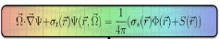
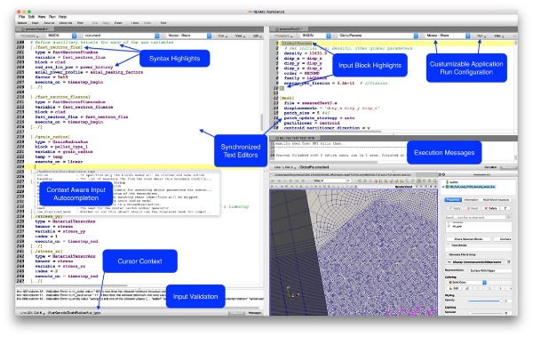



Multiphysics Applications Technical Area Overview
Reactor Applications
Engage with stakeholders
Apply tools to reactor technologies
Identify code gaps
Perform V&V
Publish mature models on NRIC Virtual Test Bed
Multiphysics Framework Development
Enhance MOOSE to provide a robust & efficient infrastructure for code developers and multiphysics users
Deployment & User Workflows
Deploy software containers on INL HPC for easy access
Enhance the NEAMS Workbench GUI for enabling user workflows
Notes:
What we do:
Reactor Applications – Engage with stakeholders, apply tools to reactor technologies, identify gaps to drive code development, perform V&V, share mature models via NRIC Virtual Test Bed (VTB) and publications
MOOSE Development – Support MOOSE-based applications, multiphysics coupling, meshing, deployment, and ensure framework is robust and performant
Workbench Development – Provide GUI for input preparation, job submission & output inspection, support application workshops, integrate with INL HPC

Slide 3
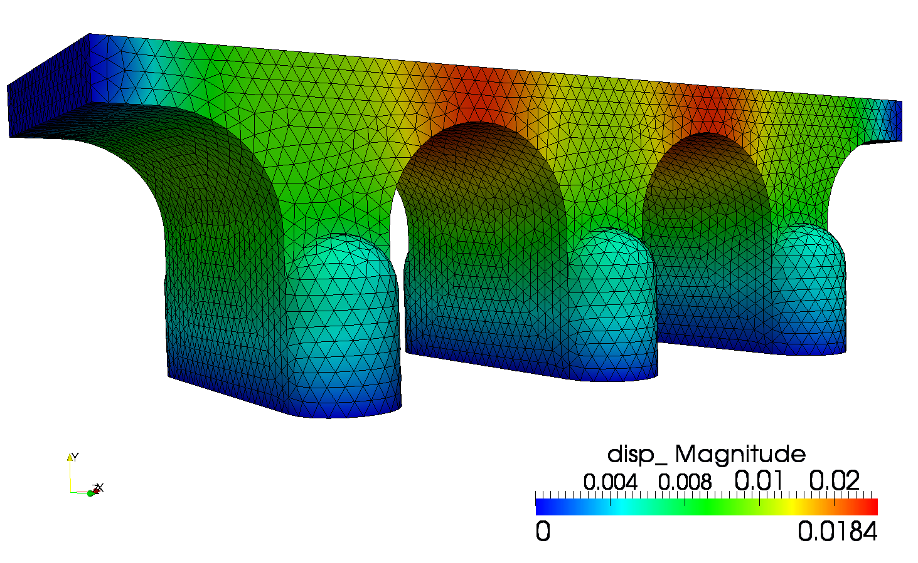
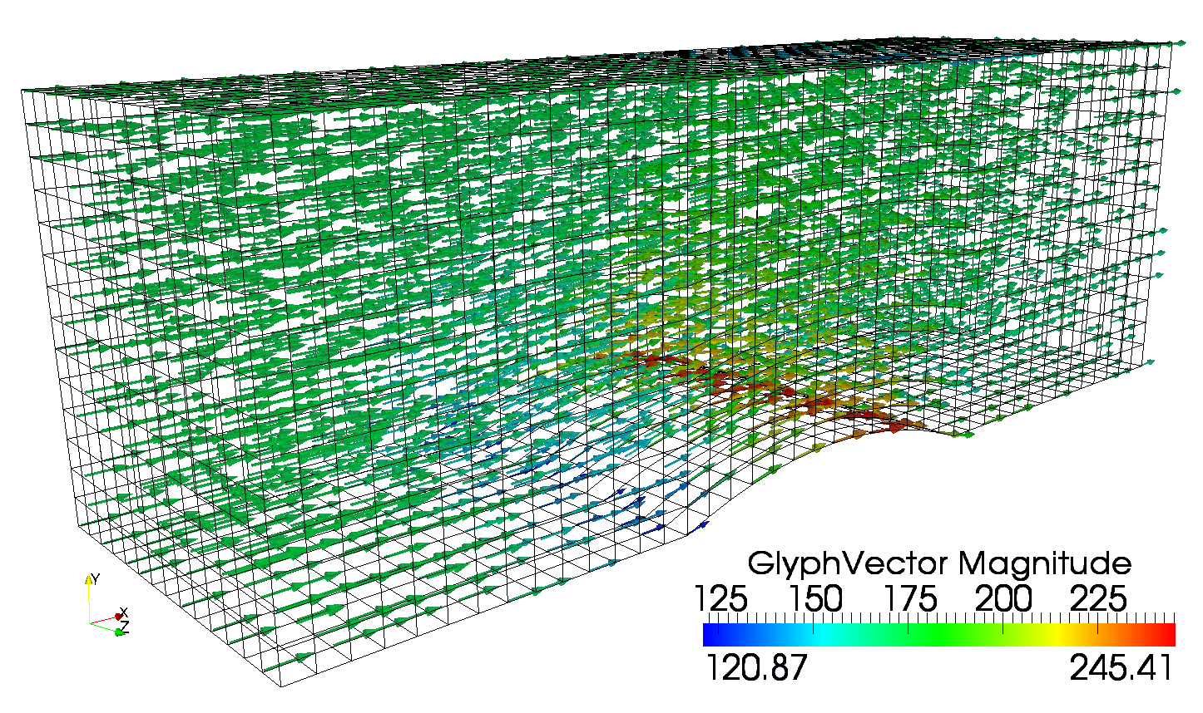
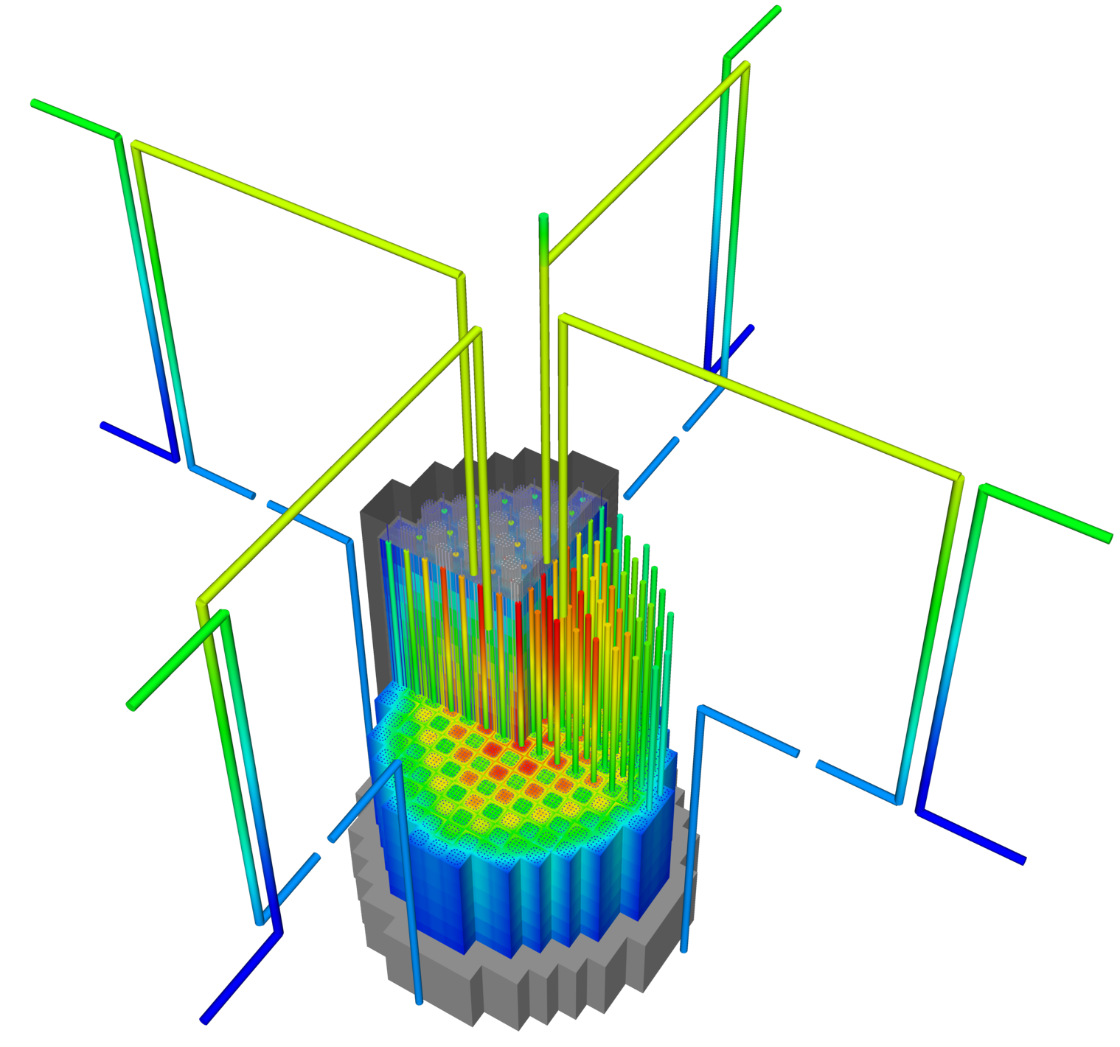
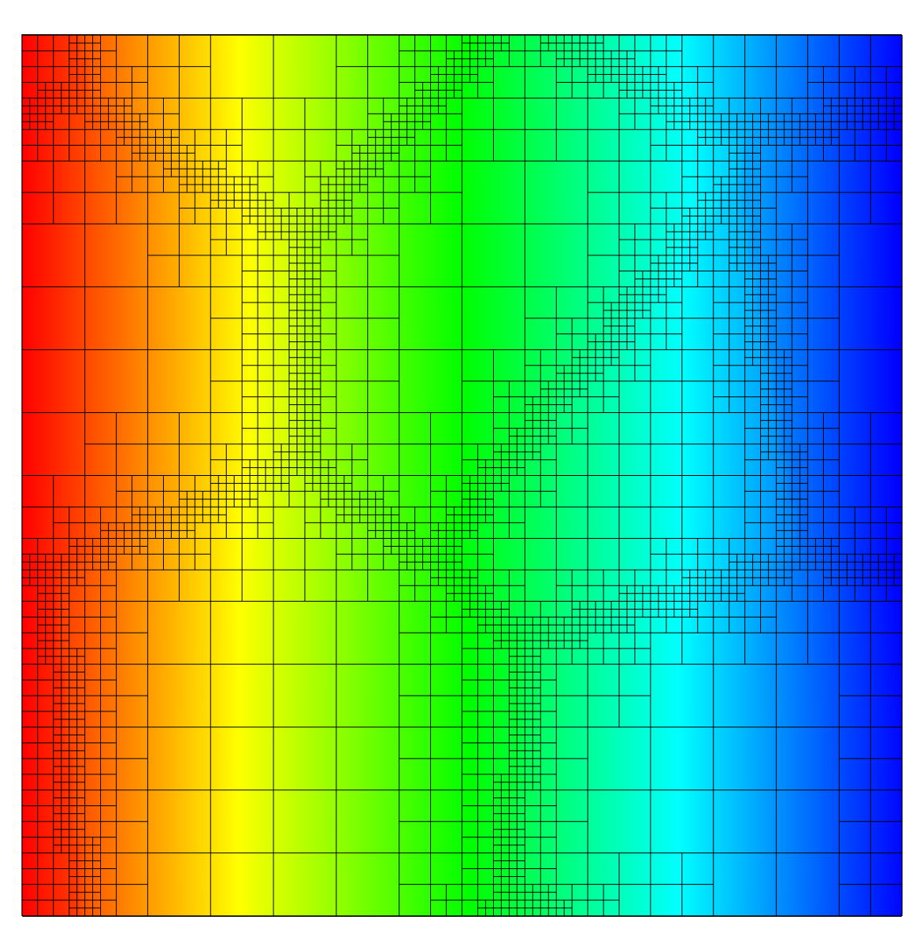

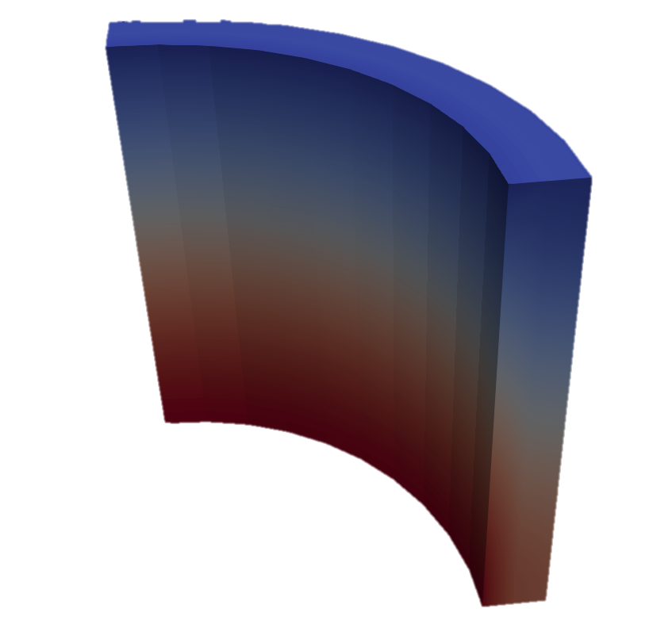
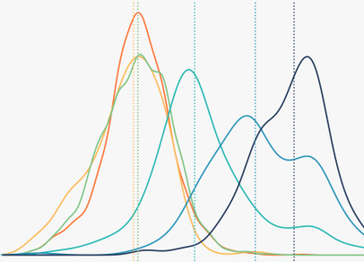
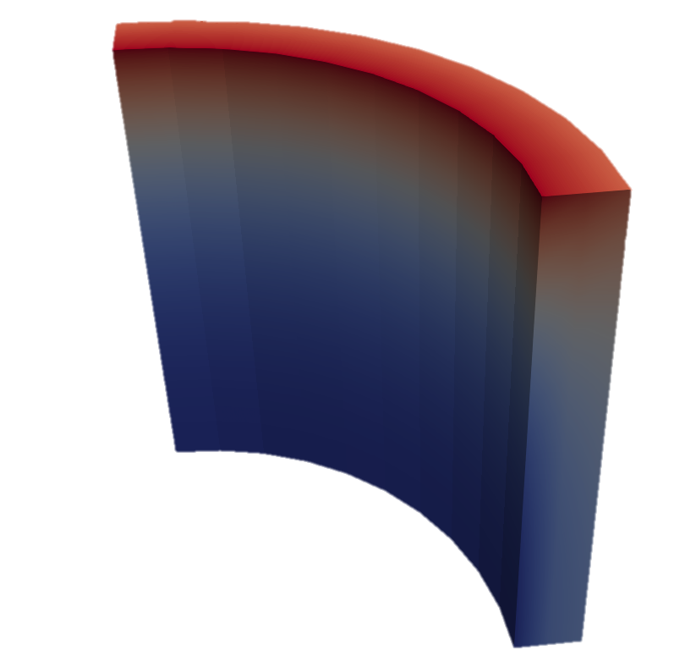

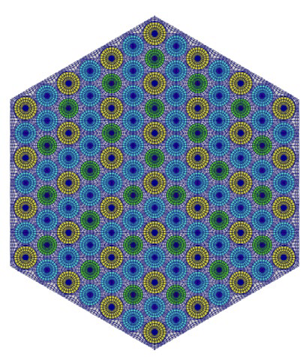
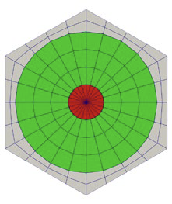
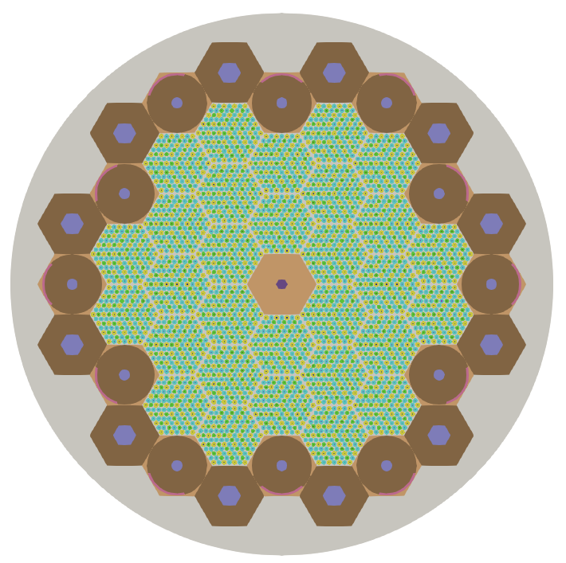
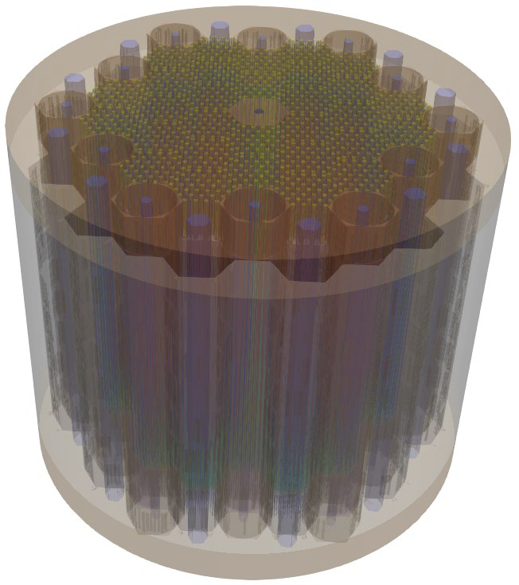
MOOSE Ecosystem
What is MOOSE?
Open-source
Massively Parallel
NQA-1 Compliant
Flexible multiphysics coupling options
MOOSE also contains modules…
mooseframework.org
MOOSE Stochastic Tools Module enables parameter sampling, UQ and sensitivity analysis
Recent efforts:
Physics/Component system (simpler input files)
LSP integration for live syntax completion/validation
Kokkos/MFEM integration for GPU accelerators
MOOSE Reactor Module enables rapid construction of reactor geometry finite element meshes
Chemical Reactions
Contact
Electromagnetics
Fluid Properties
Fluid Structure Interaction
Function Expansion Tools
Geochemistry
Heat Transfer
Level Set
Navier Stokes
Optimization
Peridynamics
Phase Field
Porous Flow
Ray Tracing
Reactor
Reconstructed Discontinuous Galerkin
Solid Mechanics
Solid Properties
Stochastic Tools
Subchannel
Thermal Hydraulics
XFEM
3

Slide 4
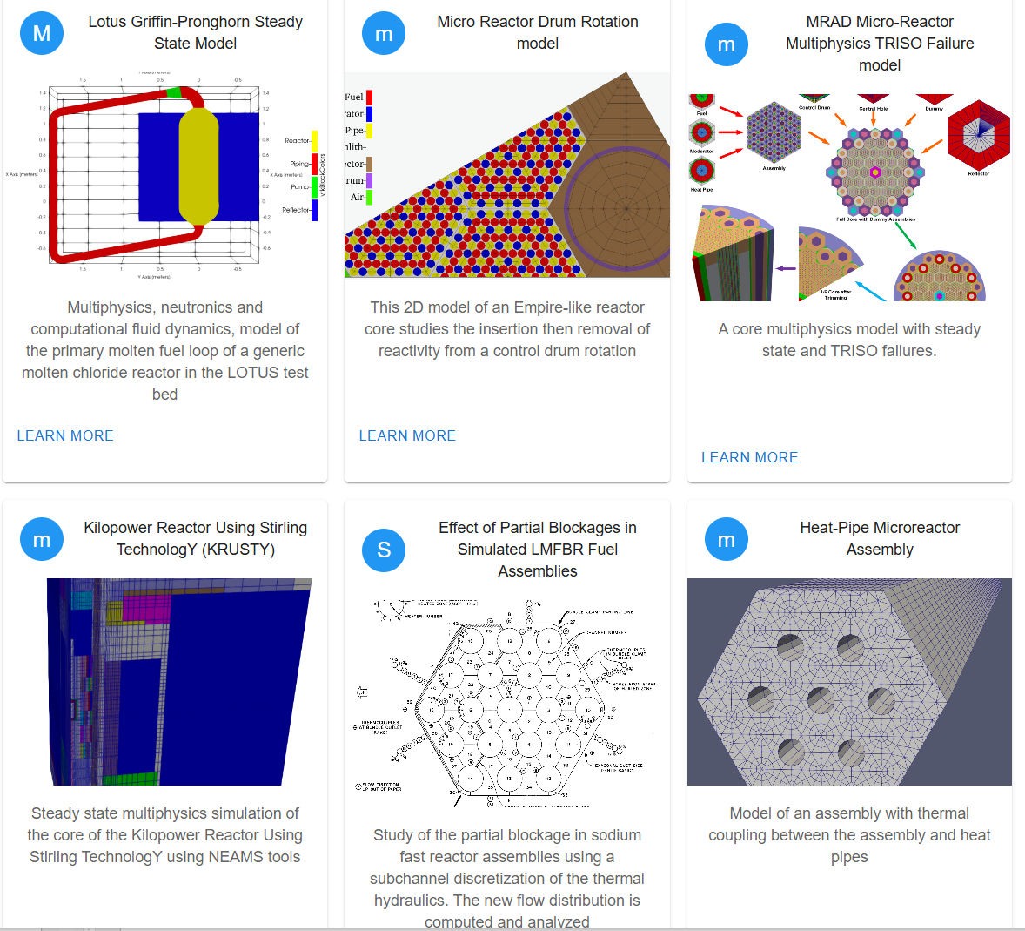
Reactor Cross-Cutting Highlights
FY24 Milestones | FY25 Milestones
MOOSE and Workbench “front-end” improvements
Containerized deployment Language server protocol (LSP) integration (link) 2D & 3D reactor geometry meshing improvements (link) | Initiate support for Constructive Solid Geometry (CSG) to improve Monte Carlo workflows Improved MOOSE/Workbench integration
MOOSE “back-end” improvements
Flexible execution strategies, algorithms for transient solves, and modular system for encapsulating physics (link) Physics application support (Griffin, BISON, etc) (link) | Add support for polyhedral elements, AI input generation, hardware accelerators Deployment of concise physics syntax
NRIC Virtual Test Bed Contributions https://mooseframework.inl.gov/virtual_test_bed/
Selected model highlights: High Temperature Test Facility (HTTF) TH model (link) TRISO fuel failure analysis in a heat-pipe microreactor (link) LOTUS molten chloride fast reactor neutronics & TH (link) ABTR SFR cross section generation and reactor physics calculation (link) | Recent and upcoming model highlights: KRUSTY microreactor experiment steady state and 15 cent reactivity insertion (link) Fast reactor core bowing-related demonstrations
4

Slide 5
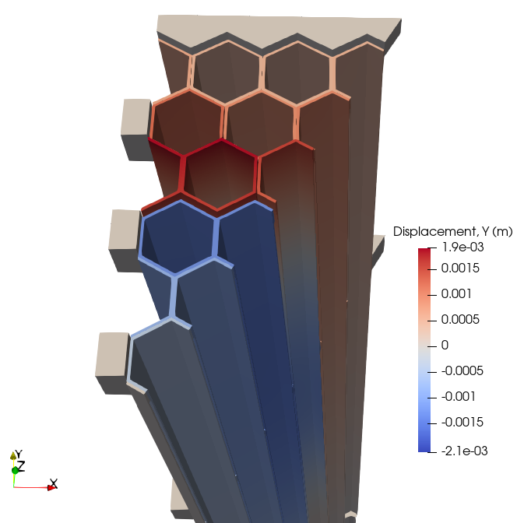
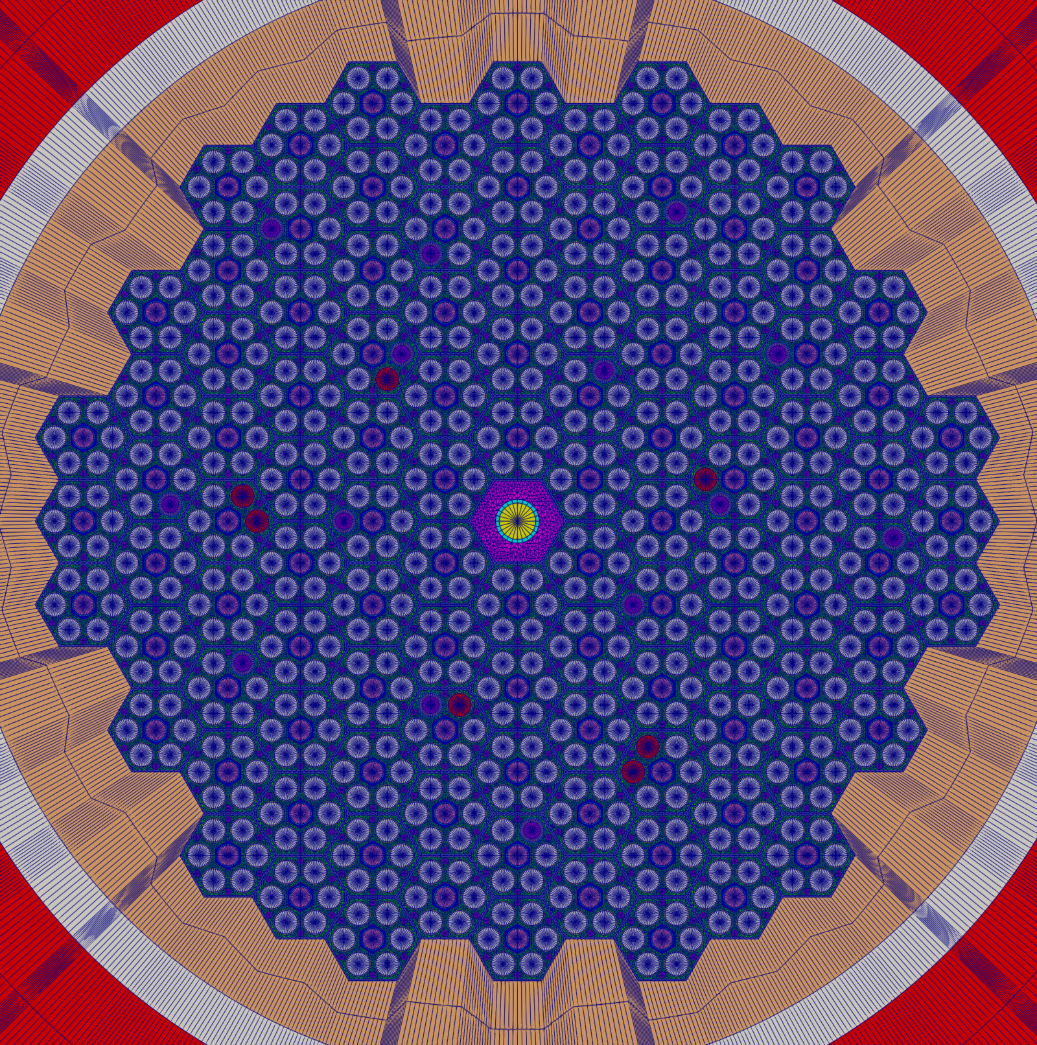
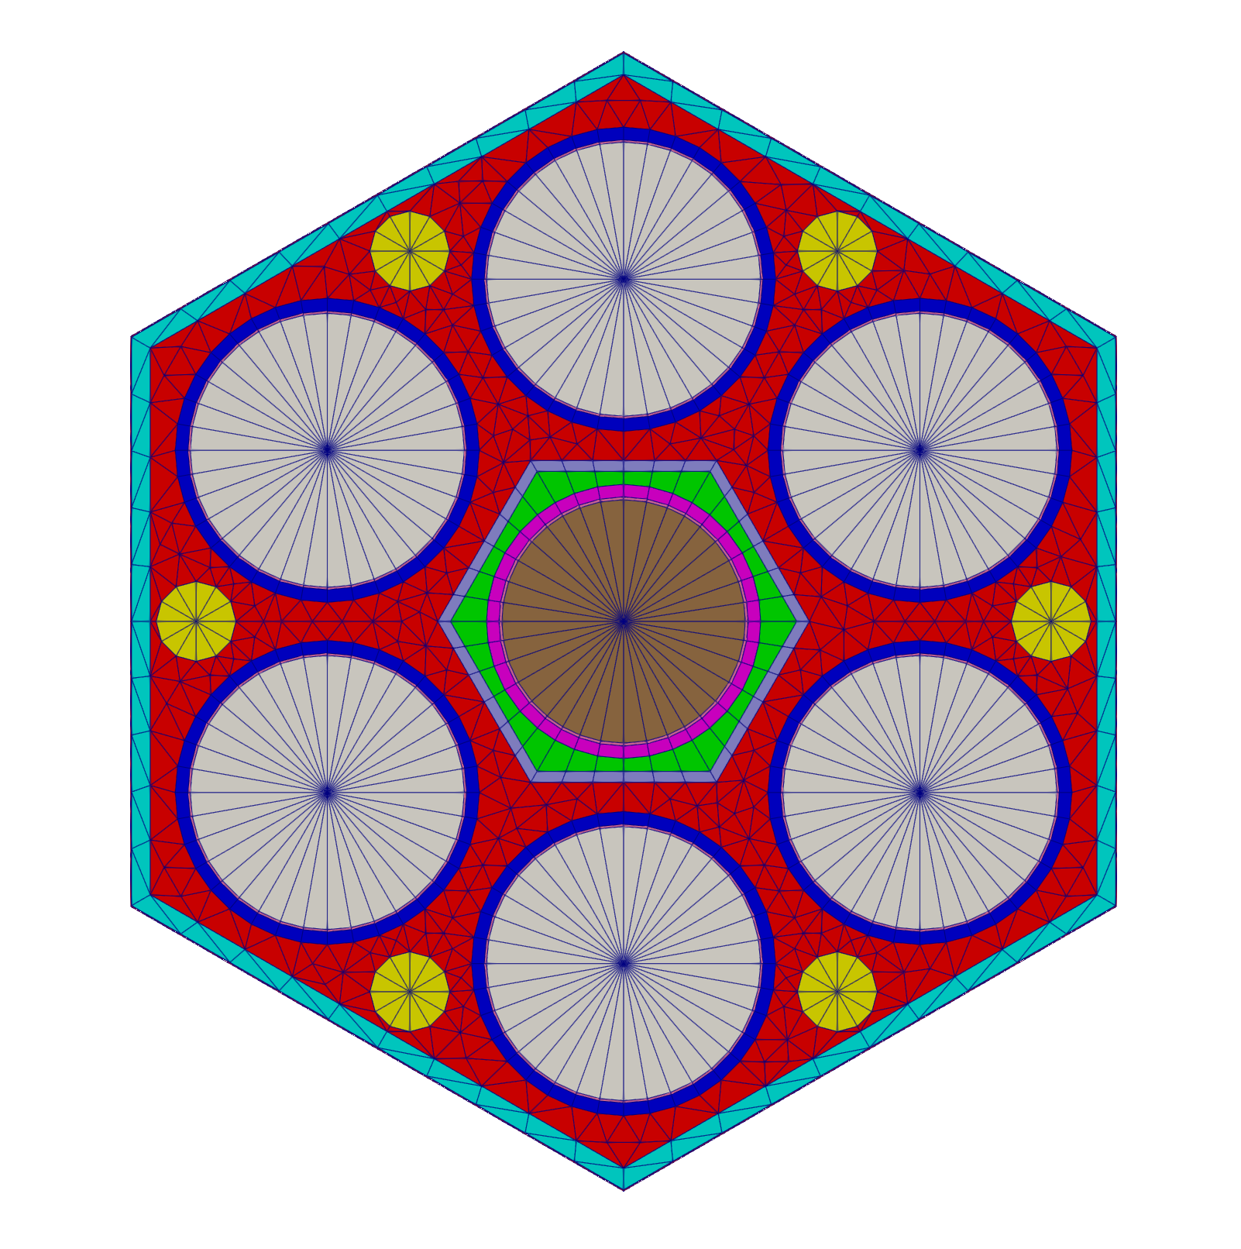
Fast Reactor Highlights
FY24 Milestones | FY25 Milestones
Lead-Cooled Fast Reactor Modeling
High-fidelity multiphysics assembly simulation and hot channel factor prediction (link, VTB RP model, VTB Cardinal model) | (n/a)
Sodium-Cooled Fast Reactor Modeling
Develop multiphysics capability to predict core bowing and associated reactivity feedback: complete thermo-mechanics and thermal fluids bowing demonstration based on ABR1000 (link) and perform thermo-mechanical core bowing verification work (link, VTB models) | Continue core bowing model development: integrate neutronics, identify available validation data, extend core bowing verification work (joint with ART FRP) Code validation for reactor physics phenomena using SEFOR fast reactor data (joint with ART FRP)
User Workflow
Open-source PyARC connections with NEAMS Griffin software | Upgrade PyARC to incorporate language server features (joint with ART FRP)
Duct displacement in IAEA VP4
Standard FA
SEFOR Core I-E
5

Slide 6
Contact Information
NEAMS Multiphysics Applications Leads
Emily Shemon – eshemon@anl.gov
Cody Permann – cody.permann@inl.gov
6

