Slide 1
Progress on a Multiphysics Approach for Predicting Reactivity Feedback due to Fast Reactor Core Bowing
Nick Wozniak, Gang Yang, Yiqi Yu, Ahmed Abdelhameed, Emily Shemon
Argonne National Laboratory
nwozniak@anl.gov
May 29, 2025
NEAMS Annual Review: Fast Reactors

Slide 2
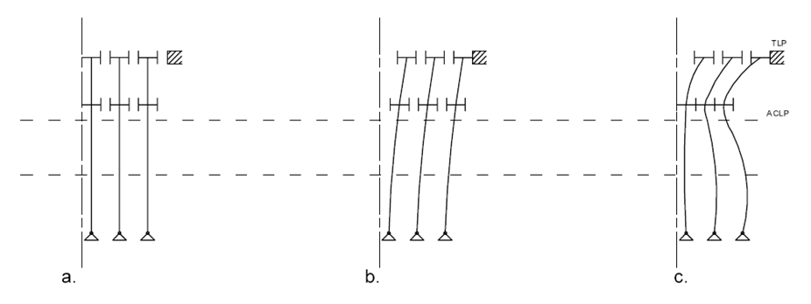
Fast Reactor Core Bowing Phenomenon
Motivation: Fast reactors are highly sensitive to neutron leakage. Thermal bowing and irradiation creep and swelling cause assemblies to deform and bow in different configurations
  Core restraint system guides the amount of bowing and the shape of each assembly
  Reactivity feedback from assembly movement should be negative during accidents
  Assembly handling loads at refueling must be kept reasonable despite bowing
Understanding of core bowing comes from EBR-I, EBR-II, and FFTF
Cold zero power
Hot full power
TLP
Restraint
ACLP
Active Core
Limited free-bow core restraint system concept showing radial expansion in the core region¹
1. J. J. Grudzinski and C. Grandy, “Fuel Assembly Bowing and Core Restraint Design in Fast Reactors,” in Proceedings of the ASME 2014 International Mechanical & Engineering Congress & Exposition, Montreal, Canada: ASME, Nov. 2014, p. V06BT07A026. doi: 10.1115/IMECE2014-38331.
Notes:
Mention the curved shape of assemblies
Core region deforms outward, and gaps expand (lower reactivity feedback)
Restraint ring helps drive maximum outward bowing
KEEP IT SHORT

Slide 3
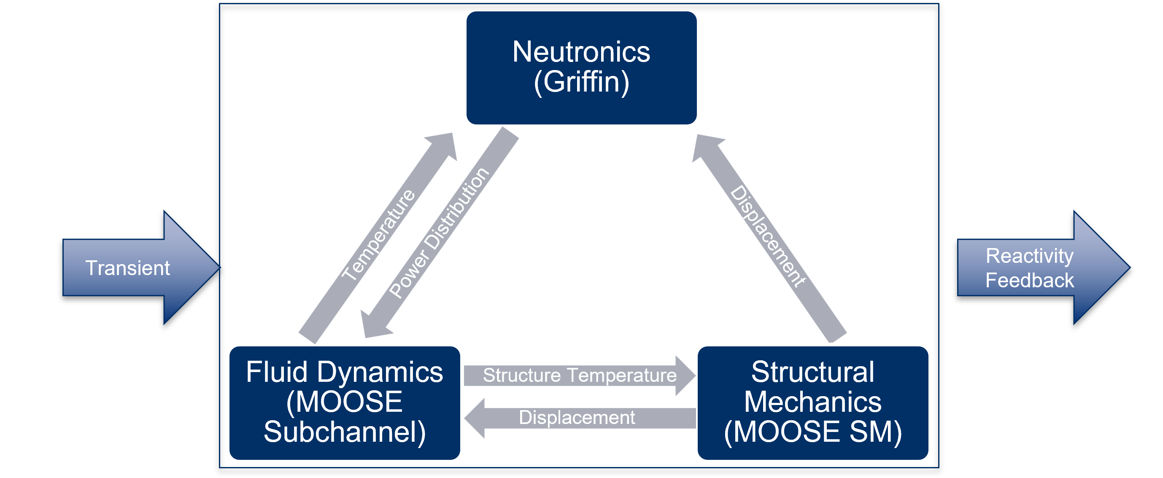
Advanced Mod/Sim Objectives
Objective: Leverage MOOSE multiphysics framework-based tools to directly model core bowing and reactivity feedback. There is no present capability to do this, although previous efforts under NEAMS demonstrated feasibility of the concept².
Existing Approaches
NUBOW-3D + Perturbation theory
  Beam model bending, low fidelity
  Offline coupling, file transfer
SAS4A/SASSYS-1
  Simple radial expansion model, no bowing
  Detailed radial expansion with bowing, uses average assembly
SAM with Point Kinetics
  Simple radial expansion model, no assembly bowing
  Coupling with Structural Mechanics
Proposed Approach
2. E. Merzari et al., “Multi-Physics Demonstration Problem with the SHARP Reactor Simulation Toolkit,” Argonne National Lab. (ANL), Argonne, IL (United States), ANL/NE-15/44, Dec. 2015. doi: 10.2172/1236454.
Notes:
Delineate the different approaches
How is fuel temperature calculated – developing built-in capability in SC module
MOOSE Approach to directly model deformation reactivity
SAS
Simple Model: “The simple model calculates the average radial expansion at the core midplane assuming straight line expansion between the above core load pads and the grid plate. Because straight line expansion is modeled, this model only considers thermal expansion.”
Detailed Model: “The detailed model calculates the axial profile of the core radius from the behavior of an average assembly. All assemblies are assumed to move radially in proportion to their distance from the core centerline. This model accounts for thermal expansion and assembly bowing.”
SAM: Takes into consideration different contributions of the inlet grid plate and above core load pad expansions.

Slide 4
Multi-Year Roadmap
TM: Thermo-mechanics
TF: Thermal fluids
RP: Reactor Physics
Today
IAEA VPs for core bowing
7 & 19 asmbly
US-Japan bilateral benchmark
SAM vs.SC
7 & 19 asmbly
Increase core size, SS, startup, transient
Notes:
This is showing FY dates
Ending dates for some of the tasks aren’t firmly set, they are variable
V&V of MOOSE’s thermo-mechanical solvers specifically for this application
V&V of Griffin for this application, and comparison to conventional perturbation-based approach (US-Japan CNWG partnership)
Multiphysics coupling of thermo-mechanics, thermal fluids, and reactor physics in a staged process to allow code developers time to incorporate feedback
Provide “predictive” reference solution to determine regimes of validity of faster running, more approximate methods

Slide 5
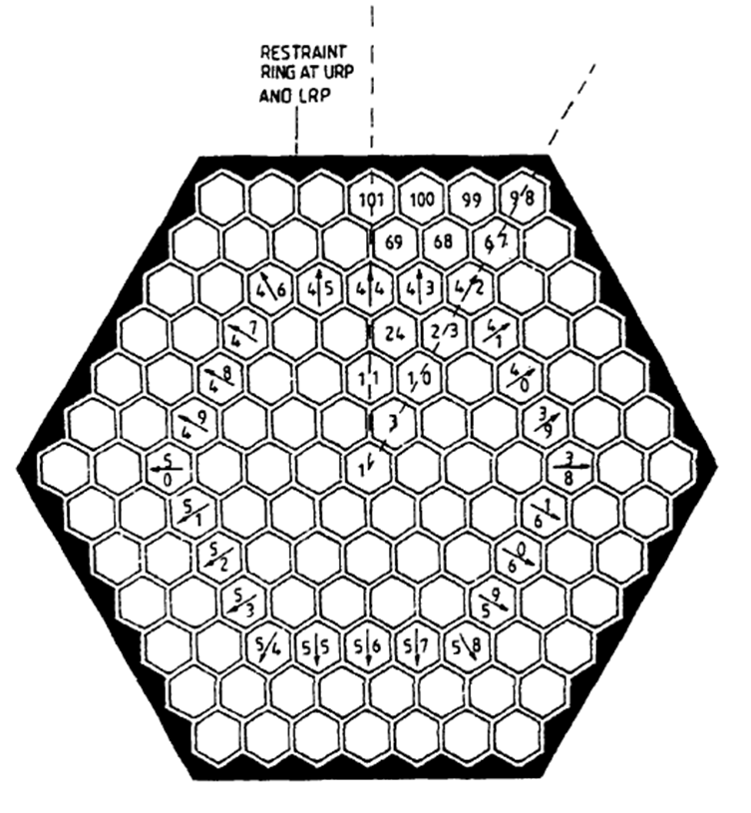
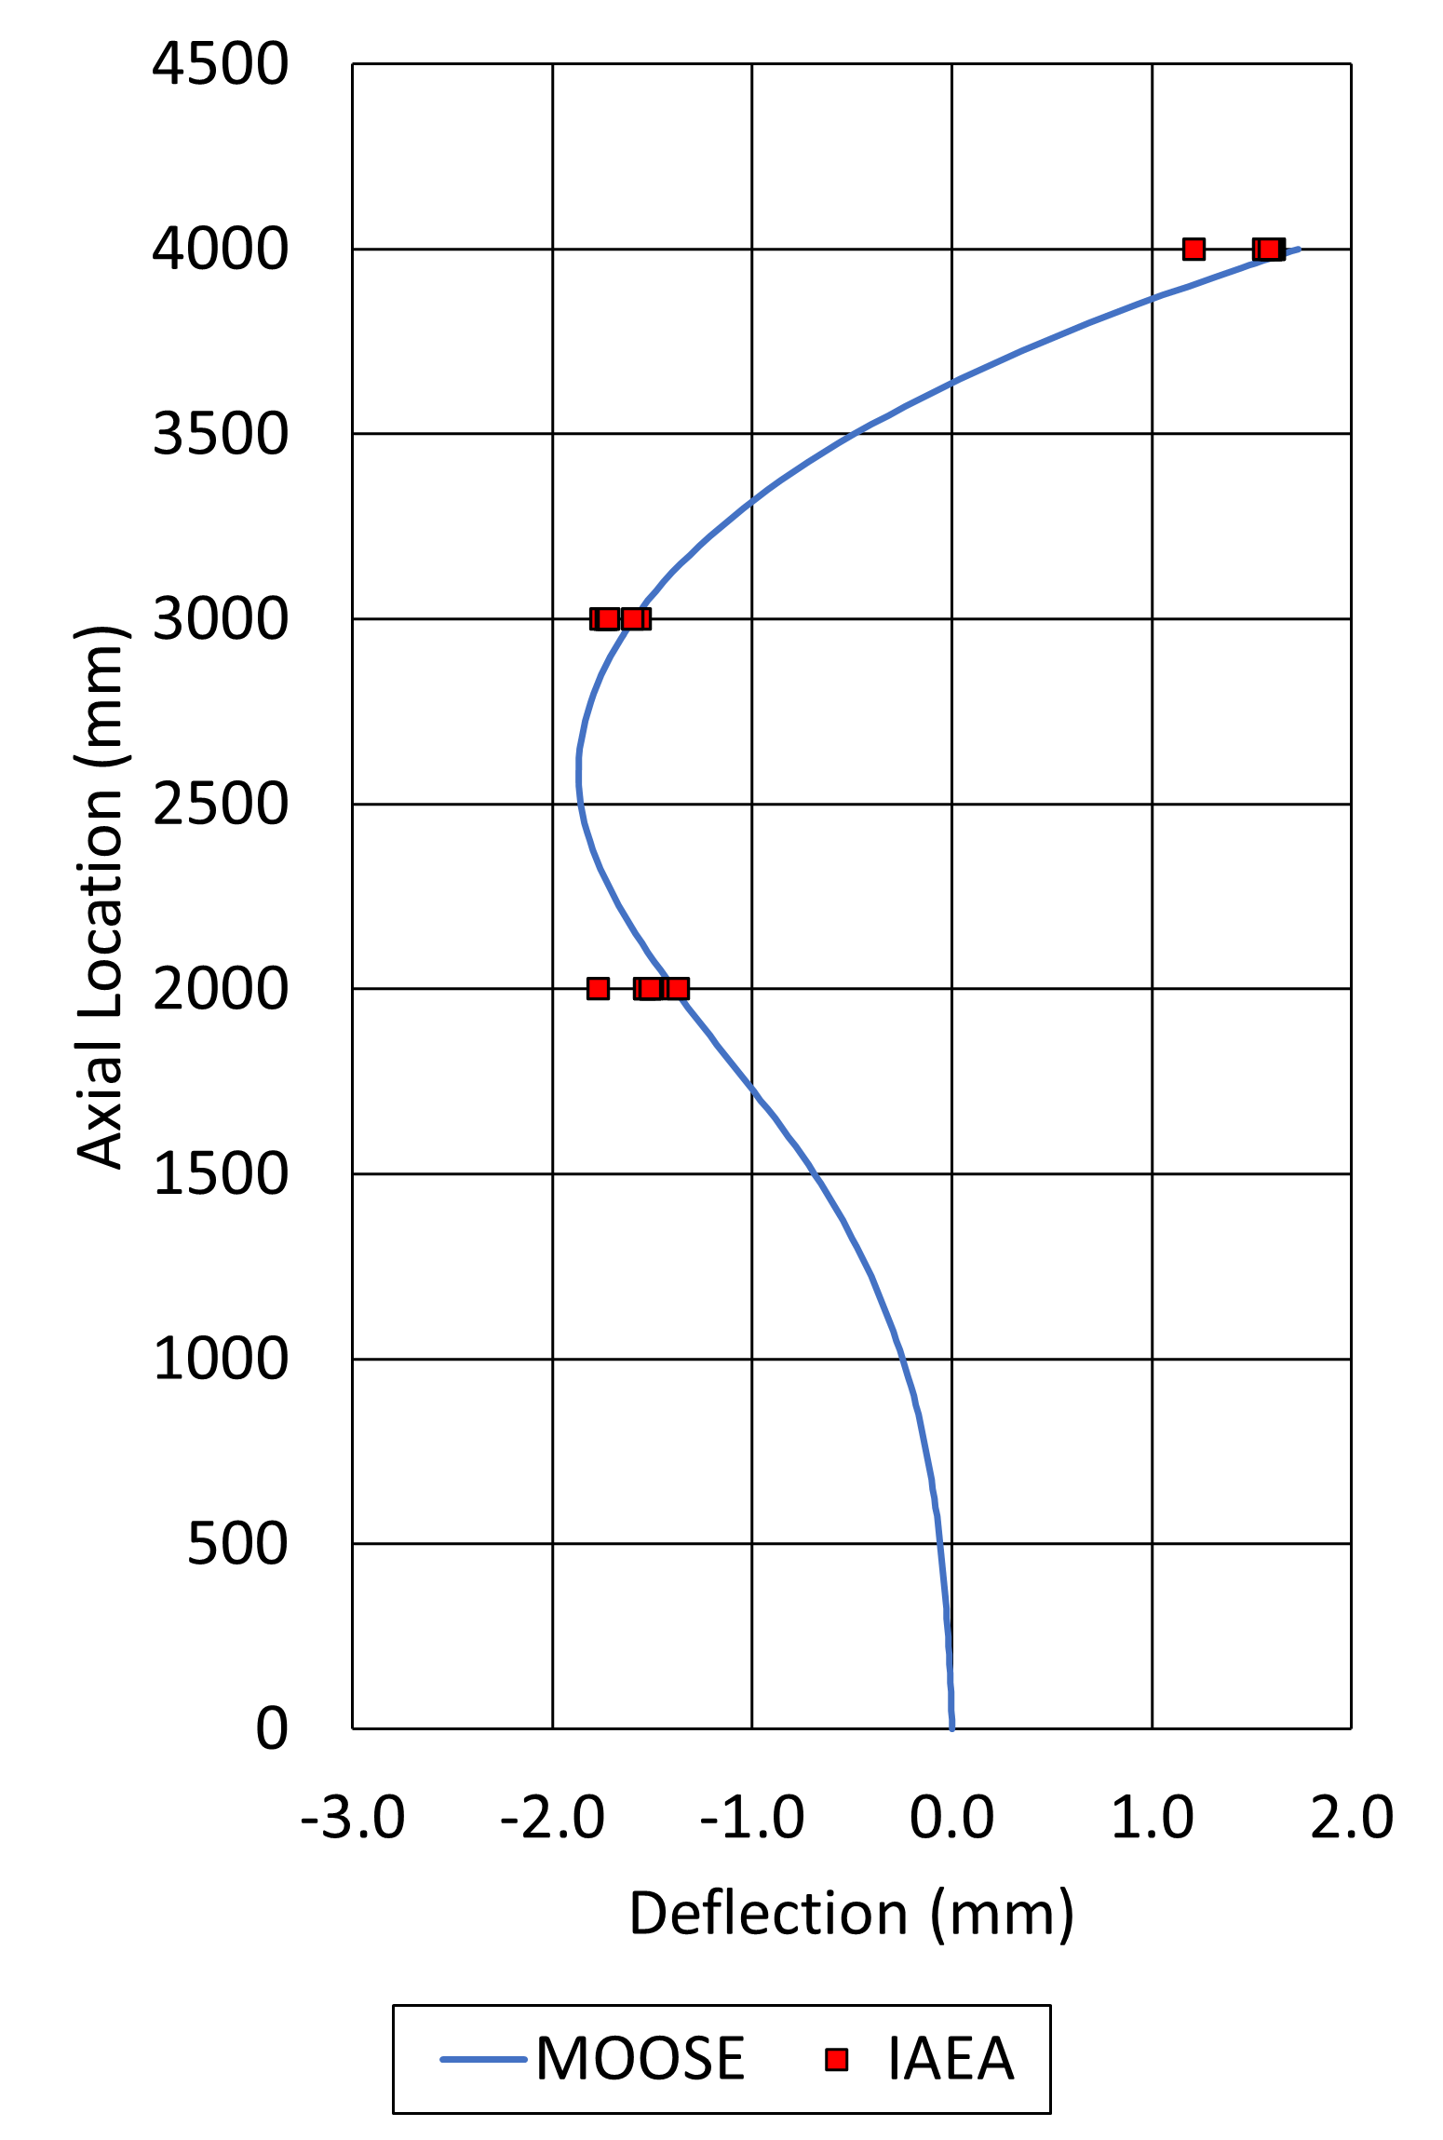
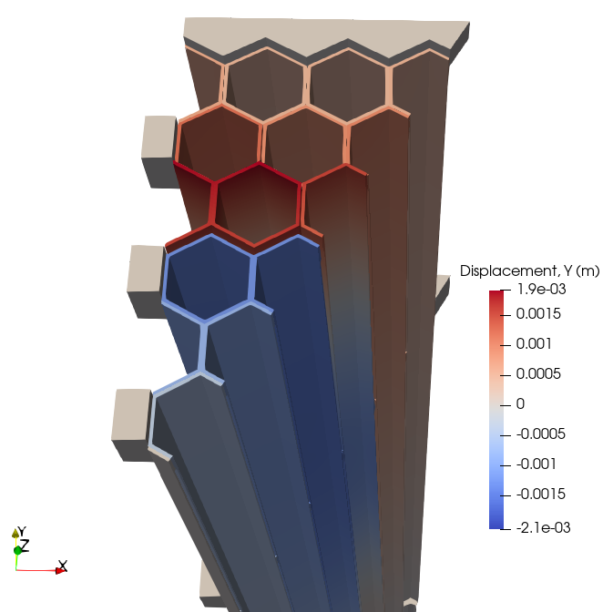
Solid Mechanics Assessment
Previous assessments used IAEA verification problems³ to verify thermo-mechanical behavior of duct bowing, load pad contacts, irradiation creep and swelling behavior
Explicitly modeled load pads and contact with penalty contact, node-on-face algorithm in MOOSE Contact Module
Current assessment focuses on more realistic limited free-bow design⁴
  Thermal gradient applied to 5th ring of ducts causing outward bowing
  S-shaped curve observed in agreement with study participant results
IAEA VP4 Thermo-mechanical model with symmetric sector bowing³ (© IAEA)
Duct 44 centerline displacement
Reactor sector displacement
3. “Verification and Validation of LMFBR Static Core Mechanics Codes Part I,” International Atomic Energy Agency, Vienna, IWGFR/75, 1990.
4. N. Wozniak, et al (2024). Demonstration and Verification of Thermo-Mechanical Bowing in a Limited Free-Bow SFR Concept Using MOOSE. Transactions of the American Nuclear Society, 131(1), 1010-1013.
Notes:
Mention complexity of modeling the duct, non-uniform expansion, bending, nozzle, contacts at load pads

Slide 6
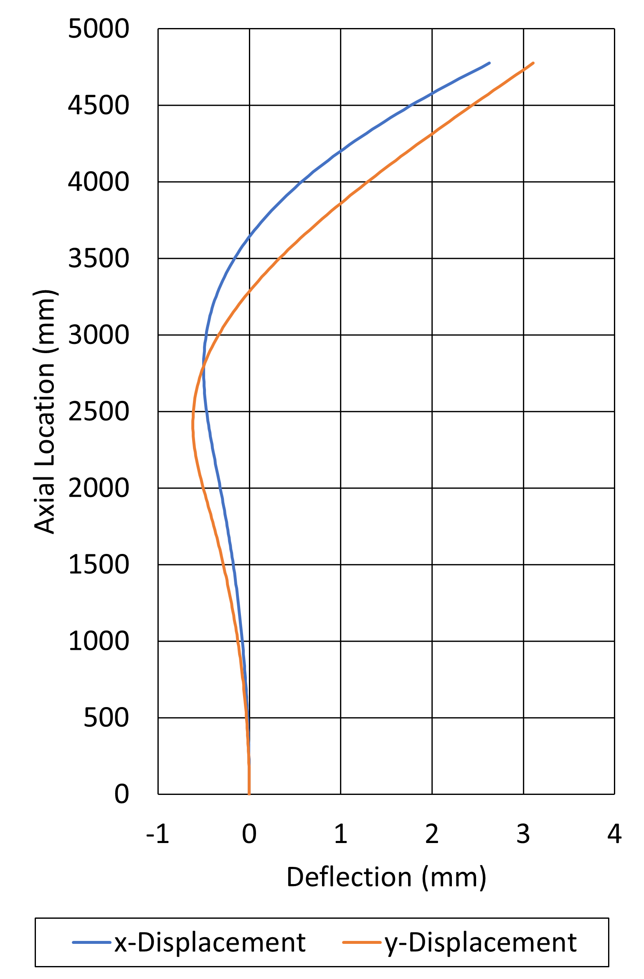
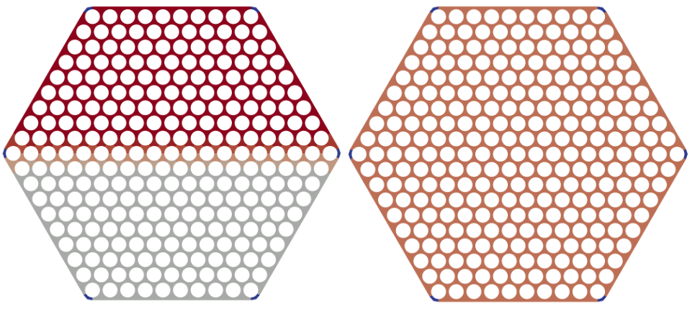
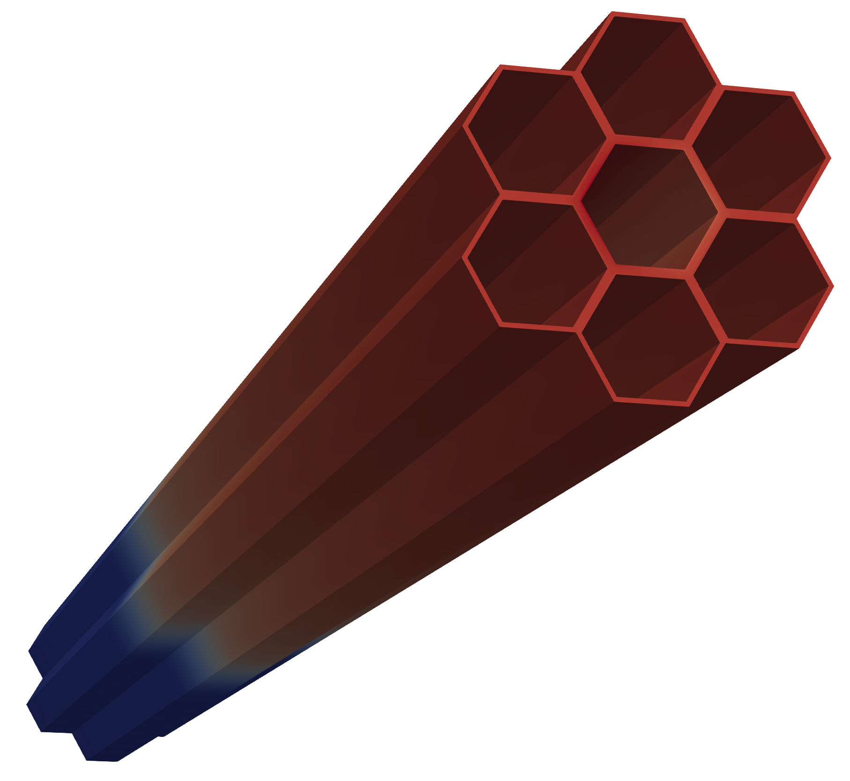
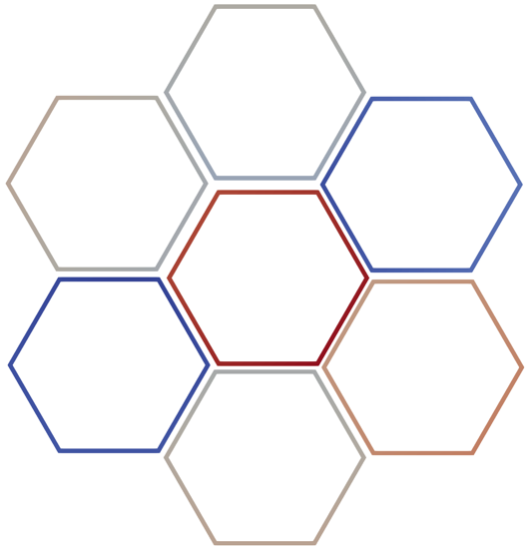
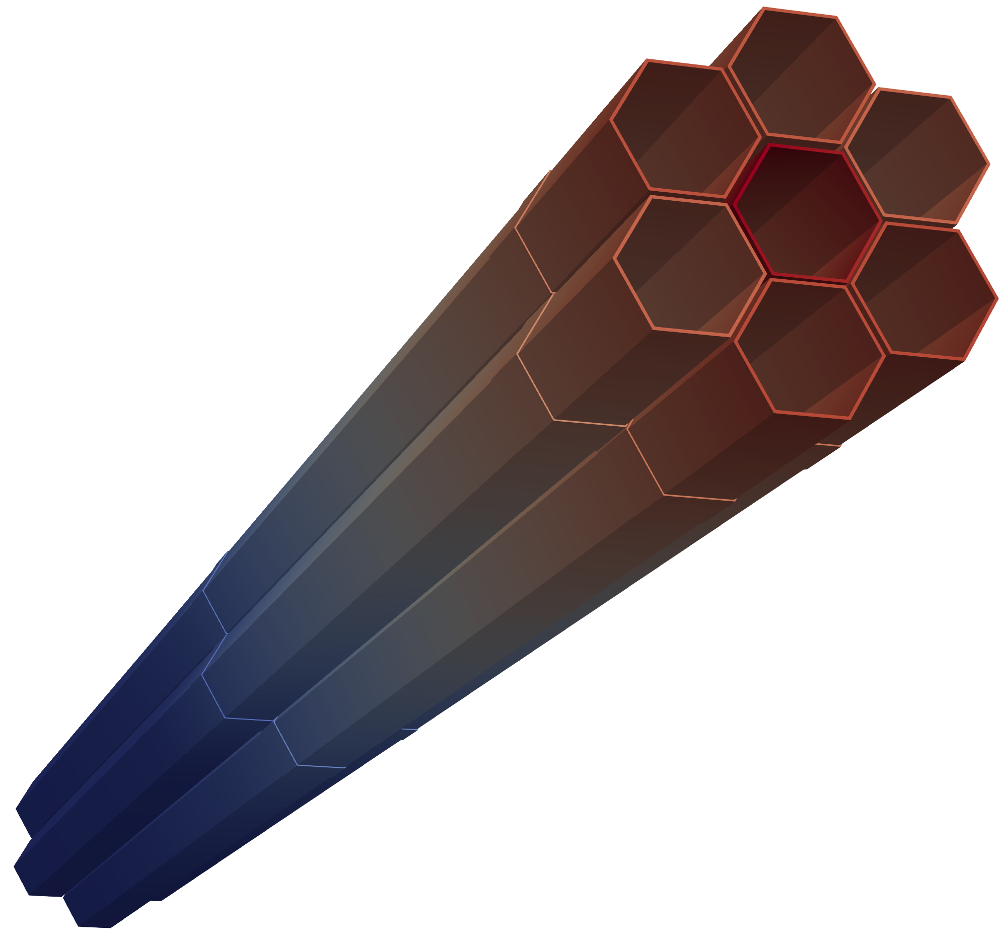
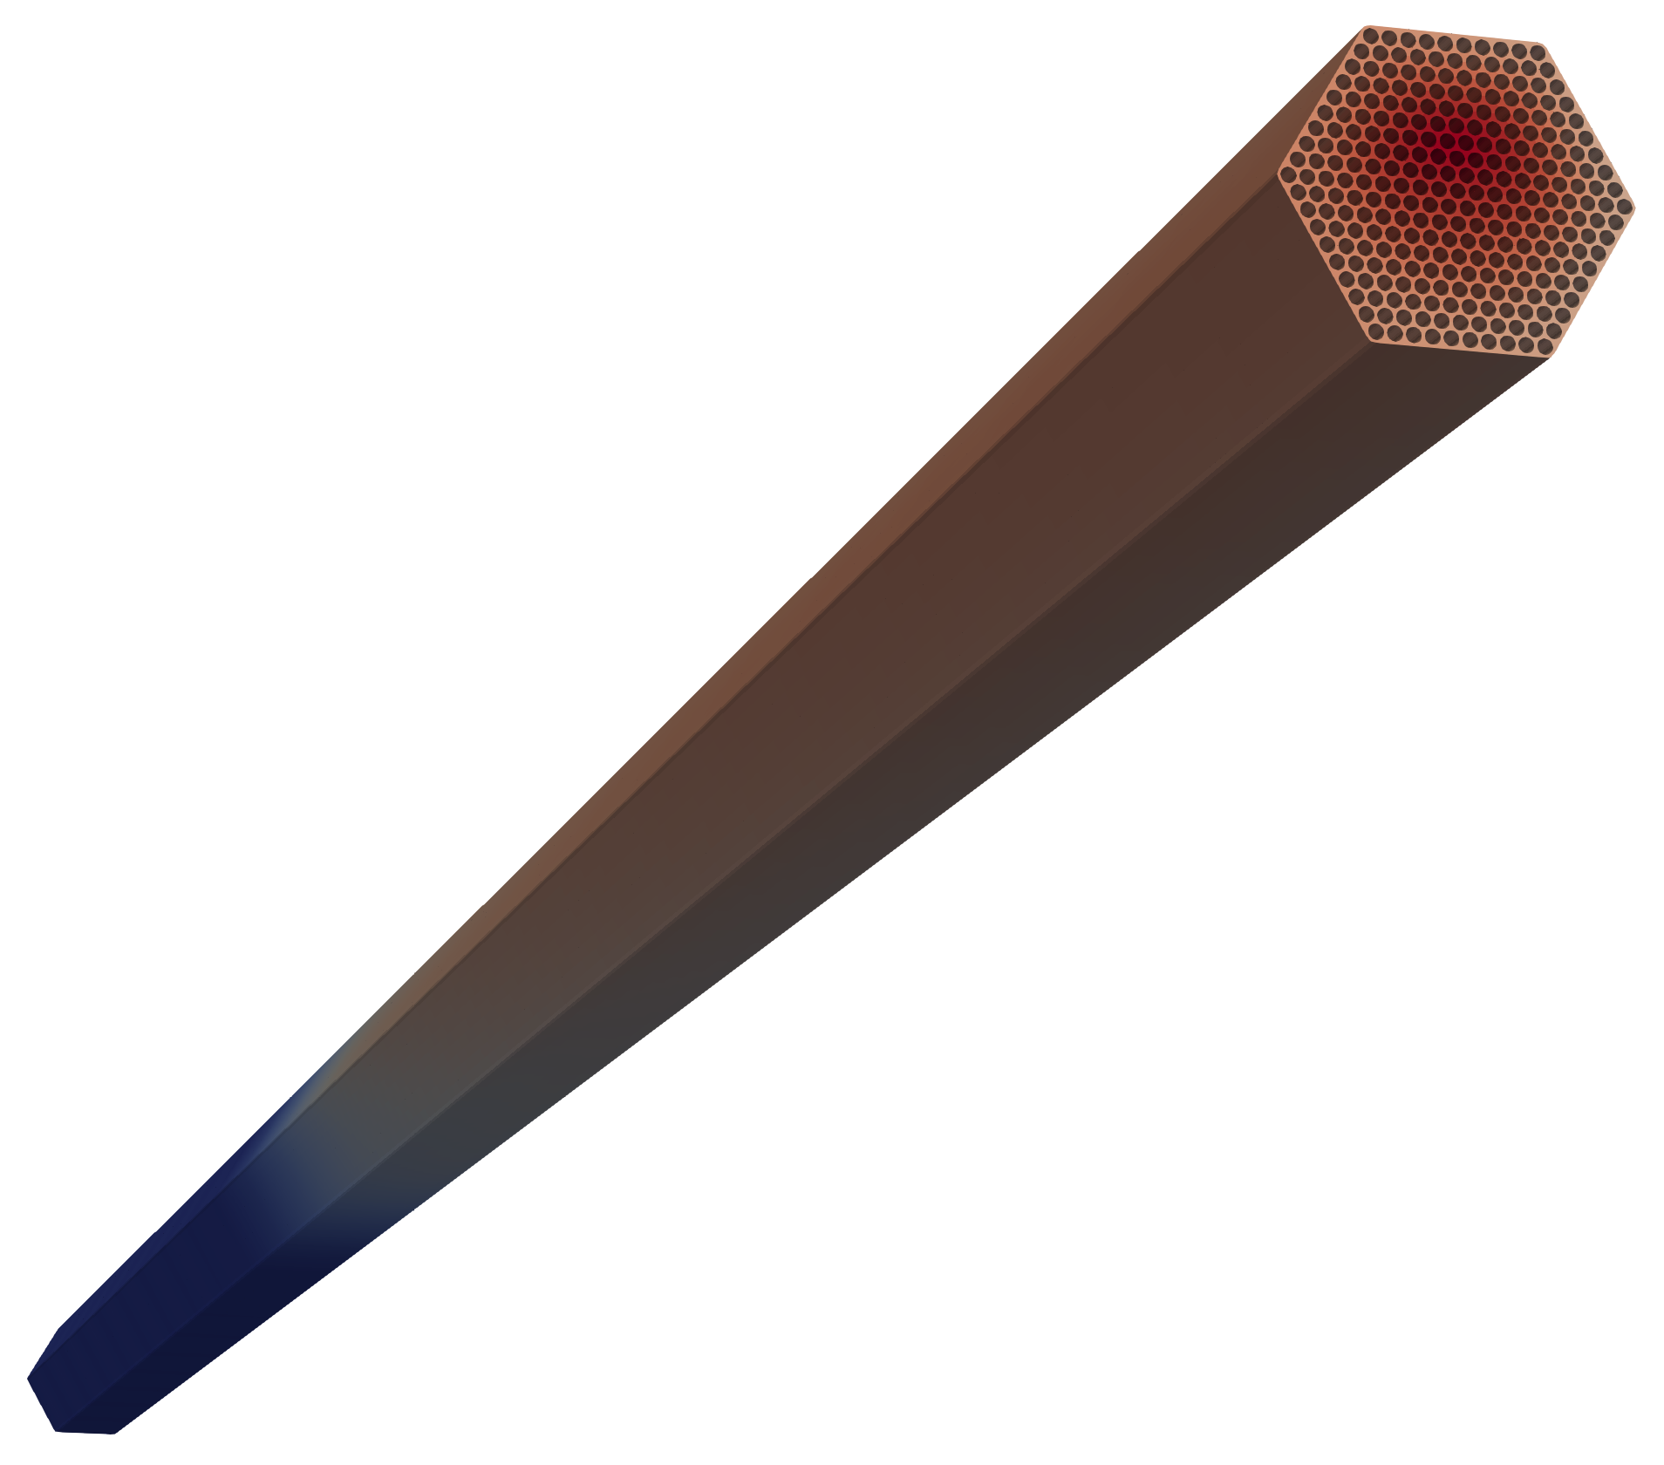
Thermal Fluids + Thermo-Mechanics Coupling Demo:
7 assembly
Seven ABR-1000 fuel assemblies, no restraint ring
Radial power gradient forced in center assembly to drive duct wall temperature gradient and bowing
Force asymmetric power profile in center assembly
Outward Bowing
TLP
Inward Bowing
ACLP
Computed duct-wall temperature and thermal displacement
MOOSE Heat Conduction
Heat Flux
Duct-wall Temperature
Temperature
3
4
2
1
5
7
MOOSE Solid Mechanics
Radial deflection of center assembly as a function of axial location⁵
MOOSE-SC
6
Coupled approach (without reactor physics)
5. G. Yang, et al (2024) Multiphysics Demonstration of Temperature-Driven Assembly Bowing in SFRs using MOOSE-Based Codes. Transactions of the American Nuclear Society, 131(1), 1006-1009.
Notes:
7-assembly model was developed using fuel assemblies from the ABR-1000 design, including load pads, in a hexagonal lattice of 2 rings4
The assembly total power is set to the average power of an ABR-1000 fuel assembly (5.56 MW).
Cosine power shape is assumed in the axial direction.
Center assembly: radially asymmetric power distribution (asymmetry drives temperature gradient across duct which drives asymmetrical expansion/bowing)
Peripheral assemblies: uniform radial power distribution
Swirl of wire-wrap, causes rotational deformation of duct at different axial levels

Slide 7
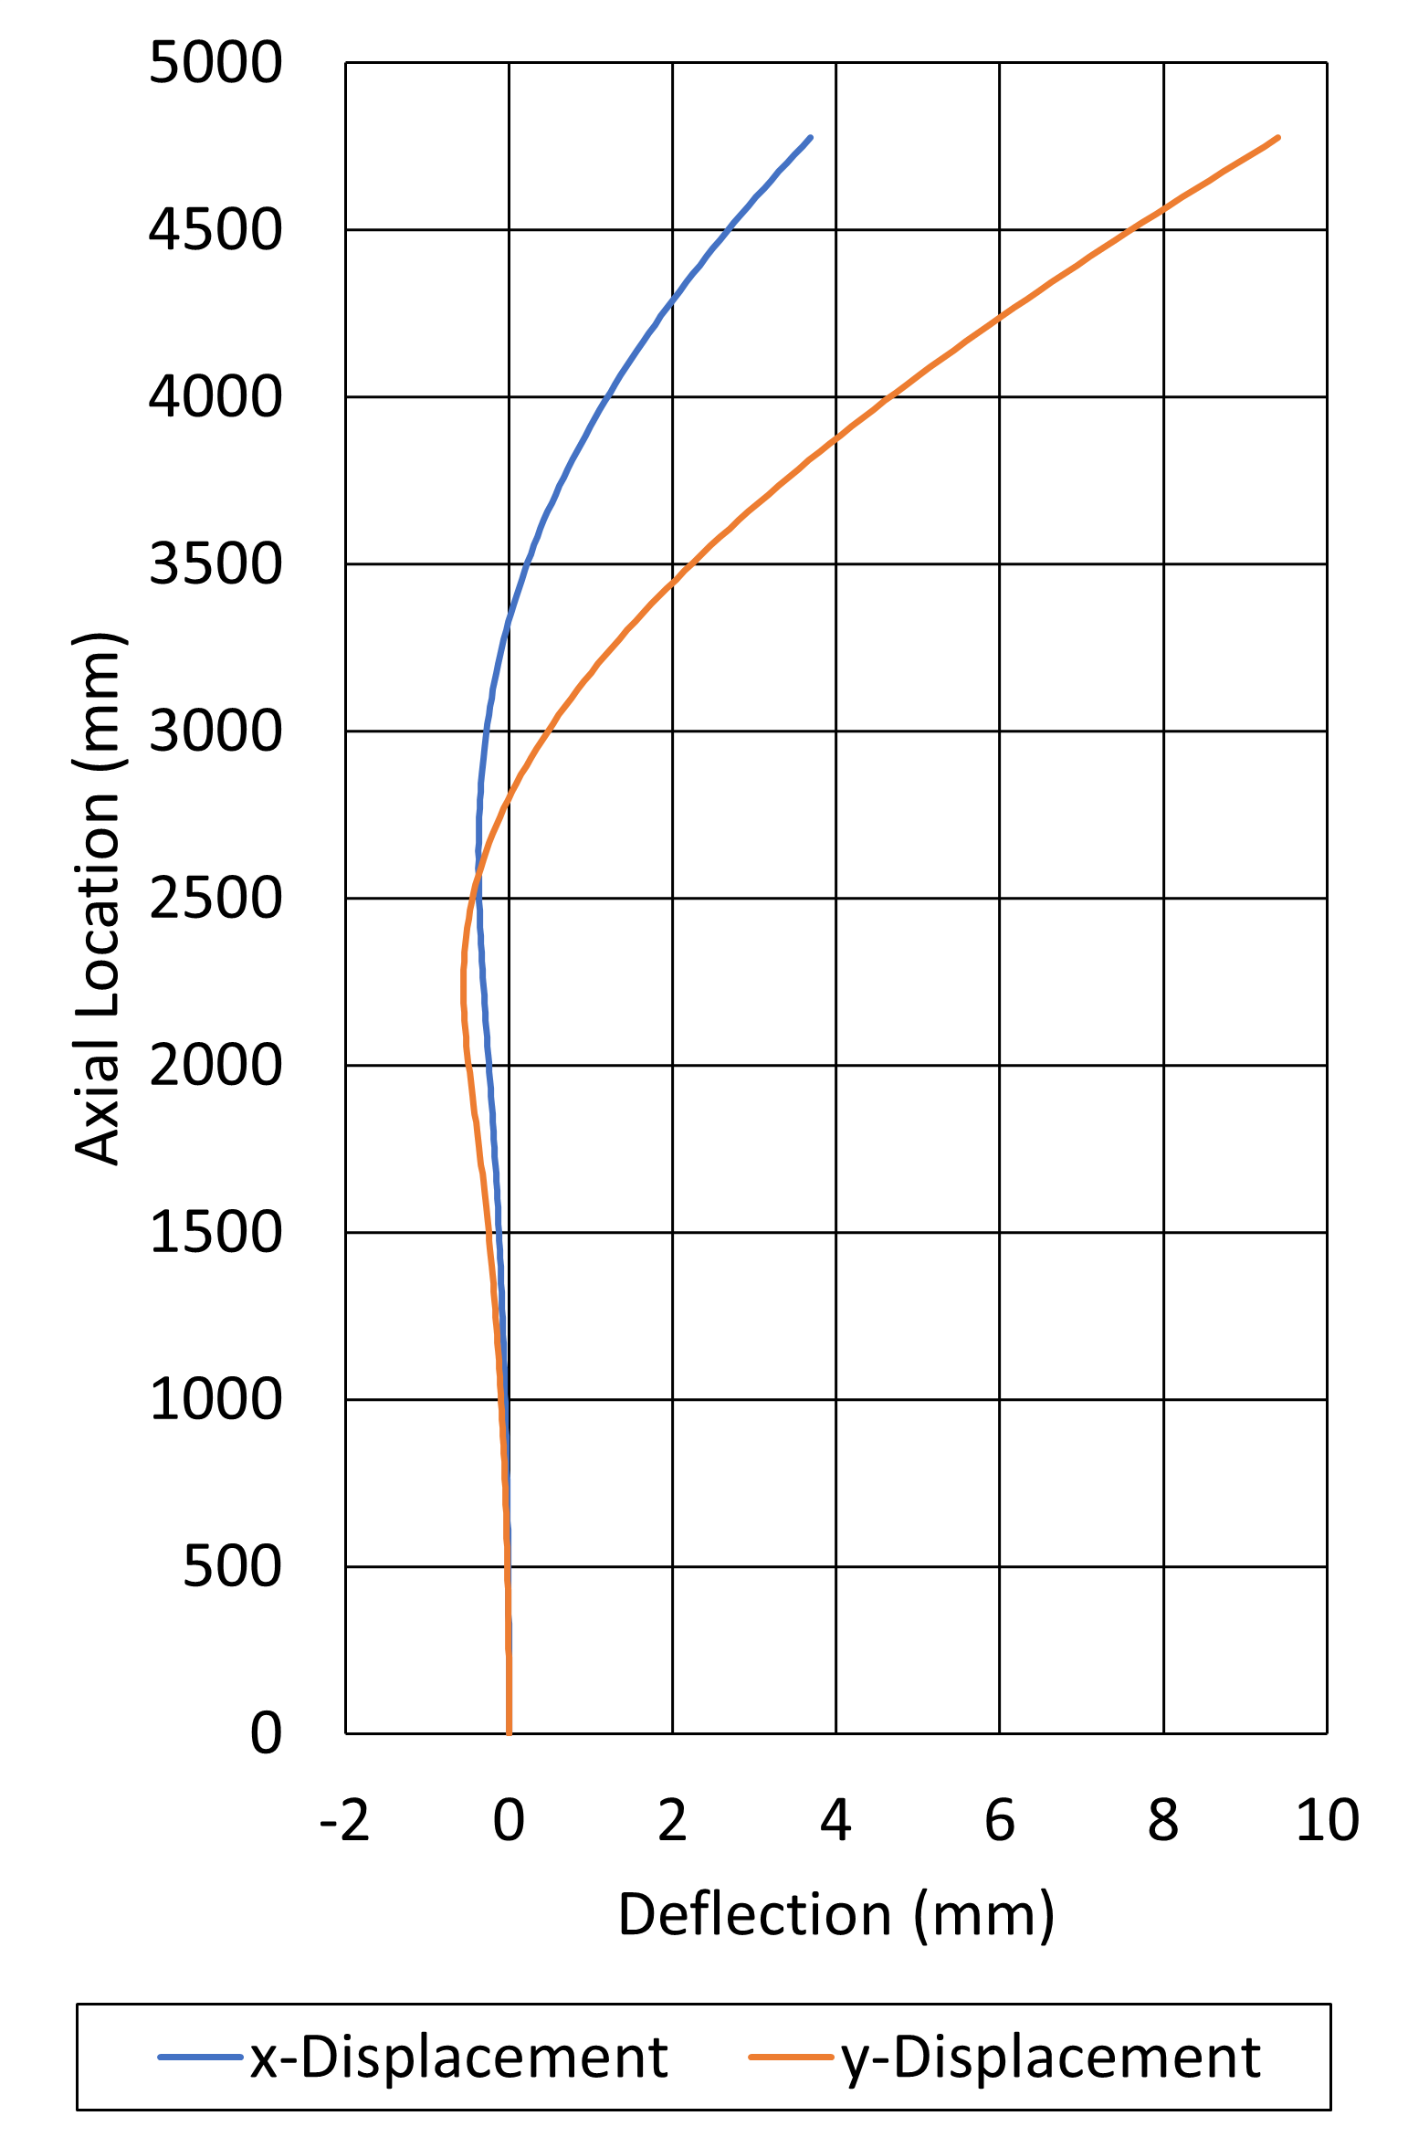
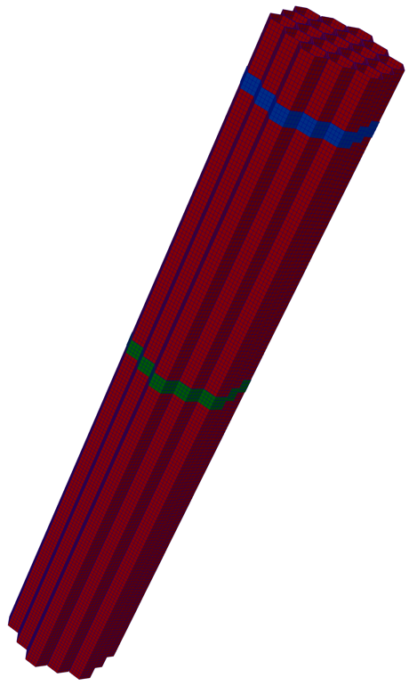
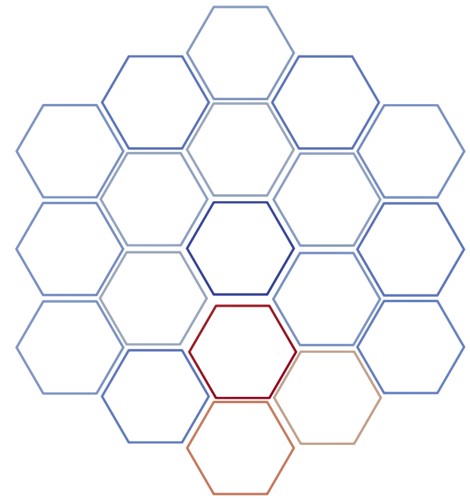
Thermal Fluids + Thermo-Mechanics Coupling Demo:
19 assembly
19 ABR-1000 fuel assemblies, no restraint ring
Radial power gradient forced in assembly 6 to drive duct wall temperature gradient and bowing
Force asymmetric power profile in assembly 6
Outward Bowing
TLP
Inward Bowing
Computed duct-wall temperature and thermal displacement
ACLP
10
Load Pad Locations
11
9
12
3
8
4
2
13
1
19
5
7
14
6
18
15
17
Radial deflection of assembly 6 as a function of axial location⁶
Solid Mechanics Mesh
16
6. N. Wozniak, et al, “MOOSE-Based Fast Reactor Core Bowing Capabilities: Coupled Structural Mechanics – Thermal Fluids Demonstration and Related Verification Efforts,” ANL/NEAMS--24/2, 2447921, 191719, Sep. 2024
Notes:
Best practices modeling contact

Slide 8
Thermal Fluids and Thermo-mechanics Coupling Findings
Coupled thermal fluids & thermal mechanics using MOOSE modules for calculating duct thermal bowing with reasonable prediction of bowing behavior and inter-assembly contact
MOOSE-SC can predict the detailed duct wall temperature distribution with asymmetric power profile, including impact of wire wrap on flow
Heat conduction model is used for inter-assembly gap heat transfer, but does not include inter-assembly flow modeling
Also performed SAM calculations for comparison
  Duct wall temperature prediction with SAM multichannel model agrees well with CFD and MOOSE-SC calculations. SAM may be a promising option for coupling with neutronics and solid mechanics modules for long term transient simulations.
  SAM Point Kinetics Model will be used as a low fidelity reference to compare with the integrated multiphysics approach.
Notes:
NEAMS TH Area is working on inter assembly flow modeling

Slide 9
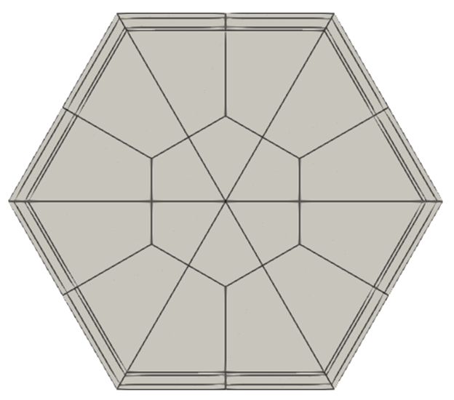
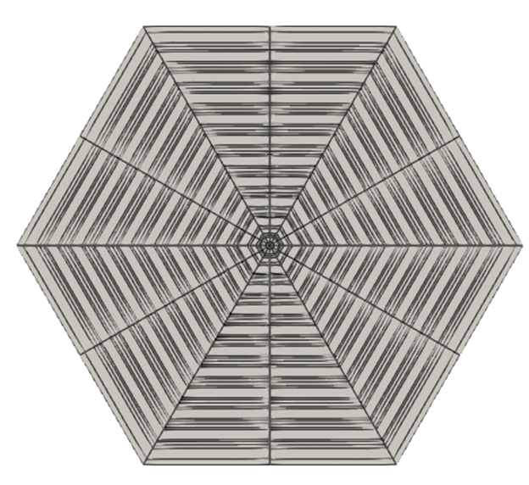
Current Year: Integration of Reactor Physics into Coupled Thermal Fluids + Thermal Mechanics Workflow
Duct and inter-assembly coolant gaps explicitly modeled to capture neutron leakage induced by core bowing
  Will utilize “duct-het” and “ring-het” representations available in Griffin (with automated fast reactor cross section workflows)
Pin powers will be reconstructed in Griffin and transferred to MOOSE-SC to solve for temperature distribution
Griffin’s mesh will be deformed to calculate new reactivity state
  Additional logic in Griffin will be required to “back-fill” sodium coolant with the correct density into homogenized regions
Since FY24, we participate in a joint reactor physics benchmark with JAEA under the US-Japan CNWG bilateral. Aim is to understand and compare reactor physics approaches to modeling fast reactor core deformation.
Notes:
Don’t want to throw Griffin under the bus
Just starting integration
We have a path we think will work, but haven’t done it yet, how next to proceed

Slide 10
Summary
Core bowing, guided by the core restraint system, is an important passive safety feature in LMFRs
We are developing an integrated multiphysics approach using the MOOSE framework to directly model reactivity feedback in LMFRs due to core bowing.
  The proposed approach will offer a high-fidelity reference solution capability – can benchmark faster running approaches as well as perform detailed analysis for restraint system performance
Completed: several thermo-mechanical benchmarks for core bowing behavior, thermal fluids/thermo-mechanical coupling small core demonstration problems (without restraint rings)
In progress: reactor physics & thermal fluids verification, reactor physics integration, modeling of restraint ring
Future: application of code suite to full core problems, start up, and transients. Working with ART FRP to identify and obtain suitable validation data.
Notes:
Why do we need high fidelity approach to core bowing and reactivity feedback, how to convince
Specific accident scenarios are important to more accurately calculate the core response

Slide 11
Acknowledgement
This research made use of the resources of the High Performance Computing Center at Idaho National Laboratory, which is supported by the Office of Nuclear Energy of the U.S. Department of Energy and the Nuclear Science User Facilities under Contract No. DE-AC07-05ID14517.

Slide 13
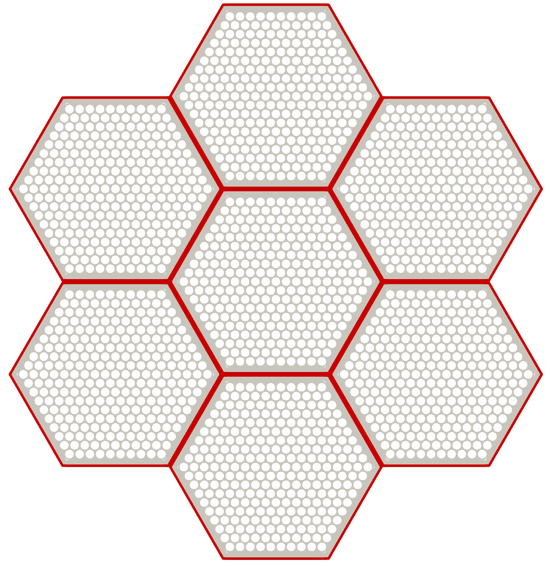
7-Assembly Coupled Model
7-assembly model was developed using fuel assemblies from the ABR-1000 design, including load pads, in a hexagonal lattice of 2 rings⁴
  The assembly total power is set to the average power of an ABR-1000 fuel assembly (5.56 MW).
  Cosine power shape is assumed in the axial direction.
  Center assembly: radially asymmetric power distribution (asymmetry drives temperature gradient across duct which drives asymmetrical expansion/bowing)
  Peripheral assemblies: uniform radial power distribution
7-assembly model configuration
4. Yang, G., Wozniak, N., Shemon, E., & Spencer, B. (2024). Multiphysics Demonstration of Temperature-Driven Assembly Bowing in SFRs using MOOSE-Based Codes. Transactions of the American Nuclear Society, 131(1), 1006-1009.

Slide 14
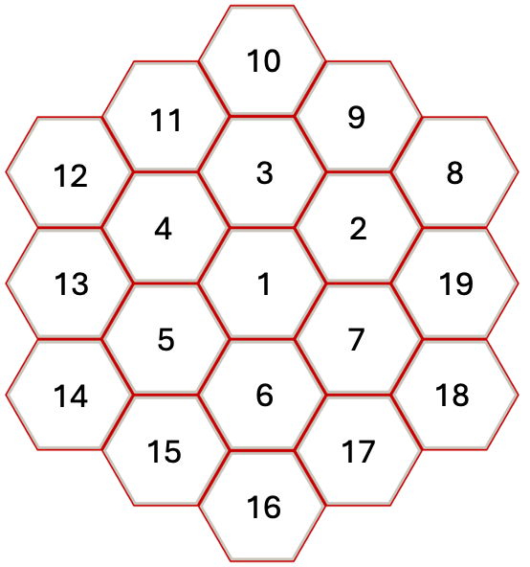
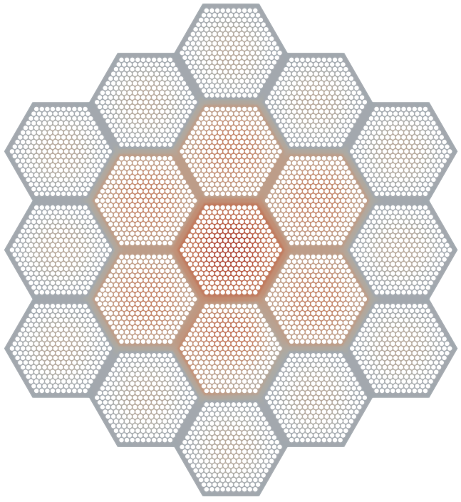
19-Assembly Coupled Model
19-assembly model was developed by extending the 7-assembly model with an outer ring of assemblies
  Assembly 1 is assigned the highest power (6.95 MW)
  Assemblies 2 – 7 are set to the average power of an ABR-1000 fuel assembly (5.56 MW).
  Outer ring is assigned a lower power (4.17 MW)
  Cosine power shape is assumed in the axial direction.
  Radially asymmetric power distribution assigned to assembly 6 (asymmetry drives temperature gradient across duct which drives asymmetrical expansion/bowing)
  Peripheral assemblies: uniform radial power distribution
19-assembly model configuration and temperature distribution at the top surface
N. Wozniak, G. Yang, E. Shemon, and A. Abdelhameed, “MOOSE-Based Fast Reactor Core Bowing Capabilities: Coupled Structural Mechanics – Thermal Fluids Demonstration and Related Verification Efforts,” ANL/NEAMS--24/2, 2447921, 191719, Sep. 2024

