Slide 1
Assessing the Impact of Uncertainties on Peak Temperatures using High Fidelity Multiphysics Simulation
Yiqi Yu¹, Hansol Park¹, Emily Shemon¹, April Novak^{1,2}
¹Argonne National Laboratory
²University of Illinois Urbana-Champaign
yyu@anl.gov
NEAMS Annual Review: Fast Reactors
May 29, 2025

Slide 2
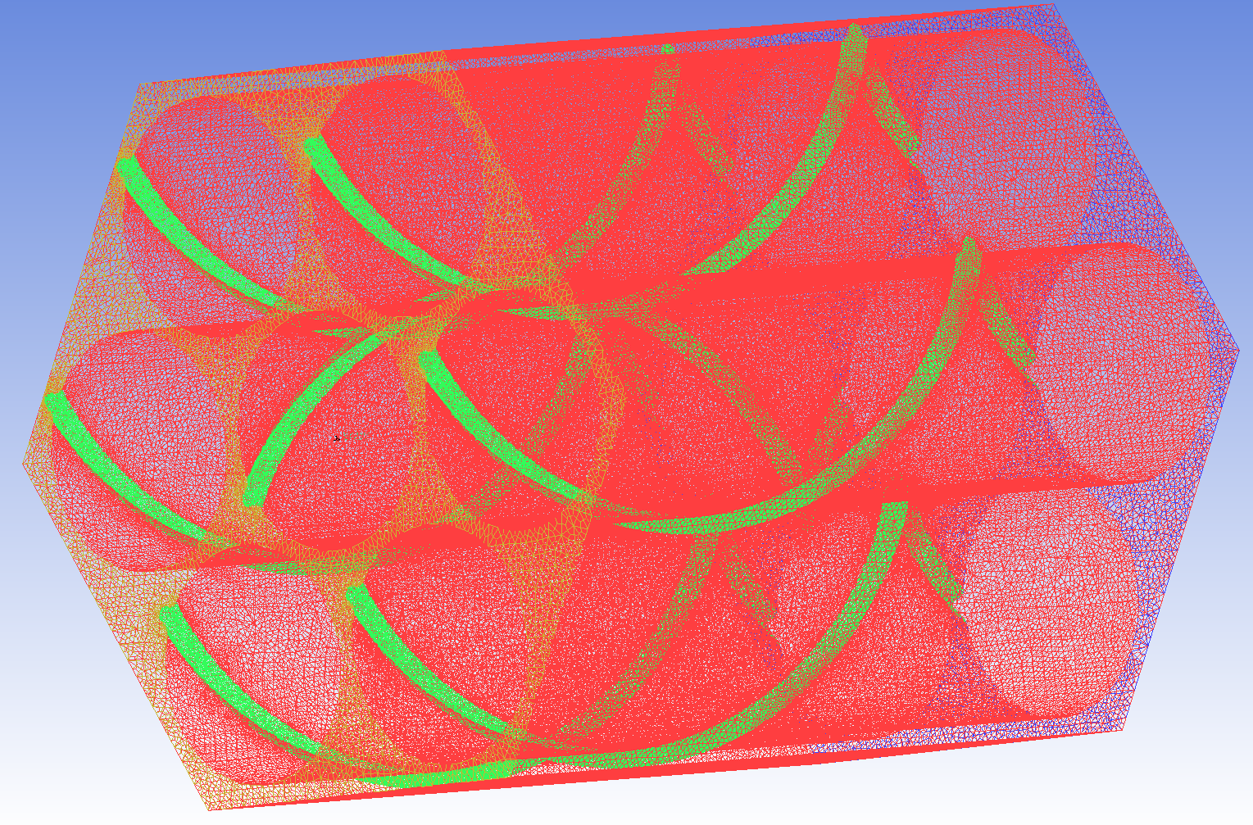
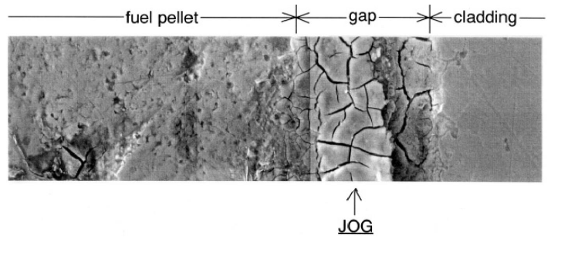
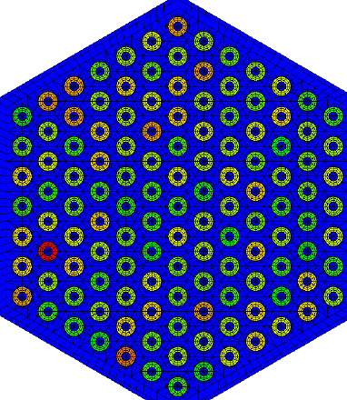
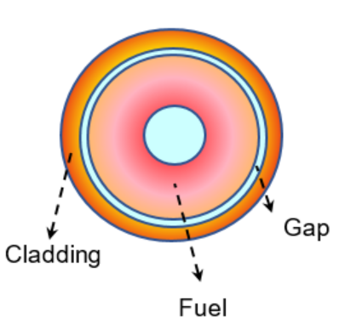
Introduction to Hot Channel Factors
What are HCF? Hot channel factors (HCF) are computed datasets that help quantify safety margins for reactor designs, accounting for uncertainties.
Challenges in Obtaining HCF:
Very few existing HCF datasets, which may not be applicable to your reactor design
Legacy methods to compute HCF have limitations
theoretical uncertainties
experimental uncertainties
instrumentation uncertainties
manufacturing tolerances
correlation uncertainties
Evaluate impact on peak temps using mod/sim
HCF dataset
Opportunity for advanced modeling & simulation!
Legacy methods simulate with low fidelity:
Legacy methods unable to simulate:
Uncertainty from Cladding Thickness
Uncertainty from Coolant Density
Uncertainty from Cladding Conductivity
Uncertainty from Fuel Conductivity
Uncertainty from Coolant Specific heat
Uncertainty from Coolant Density
Uncertainty from Joint Oxide Gain (JOG) formation
Uncertainty from Wire Orientation
Uncertainty from Fissile Content Maldistribution

Slide 3
Objective: Build an Automated Multiphysics Workflow for Hot Channel Factor Prediction
Objective: Build a high fidelity multiphysics workflow to automate, expand, and improve HCF calculation
Impact: High fidelity simulation can reduce conservatism & expand HCF dataset capability. This results in increased safety margin, potential economic gains.
theoretical uncertainties
experimental uncertainties
instrumentation uncertainties
manufacturing tolerances
correlation uncertainties
Perturbed Condition Accounting for Uncertainties
Nominal Condition
Potential Margin Recovery
Maximum Fuel temperature
Maximum Cladding temperature
HCF dataset
Maximum Coolant temperature
Legacy Method
High-fidelity Multiphysics Method
Inlet Coolant temperature

Slide 4
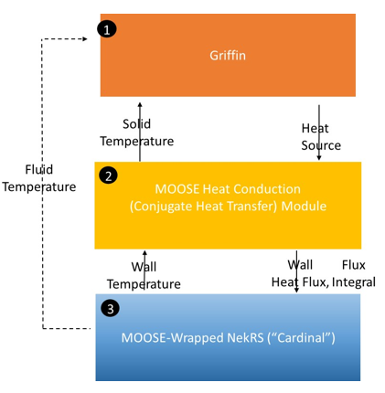
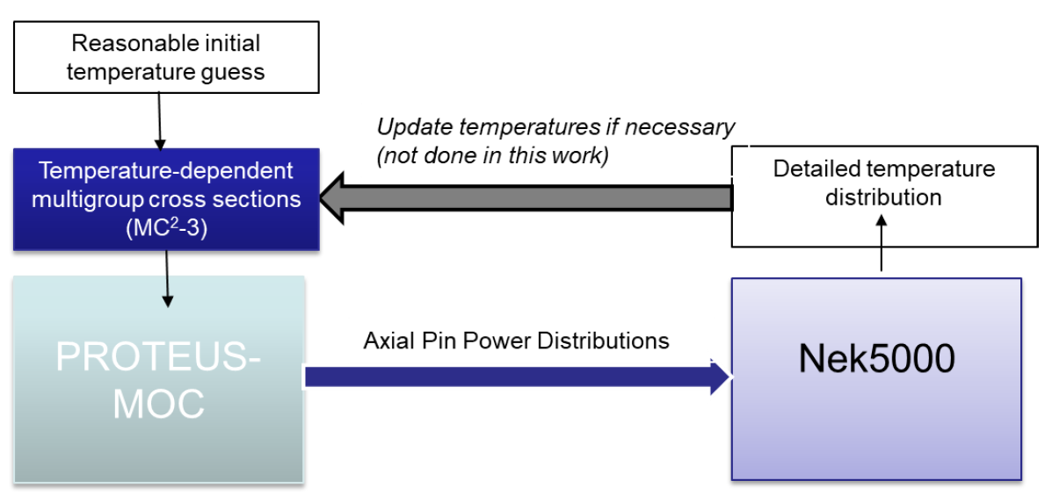
Development Roadmap
Today:
Stochastic online two-way coupled
Introduction of the MOOSE framework:
Online two-way coupled
(FOAK Griffin+NekRS)
MOOSE Stochastic Tools Module
Initial work:
Offline one-way coupled
Input parameter sampling
Collect results & stats

Slide 5
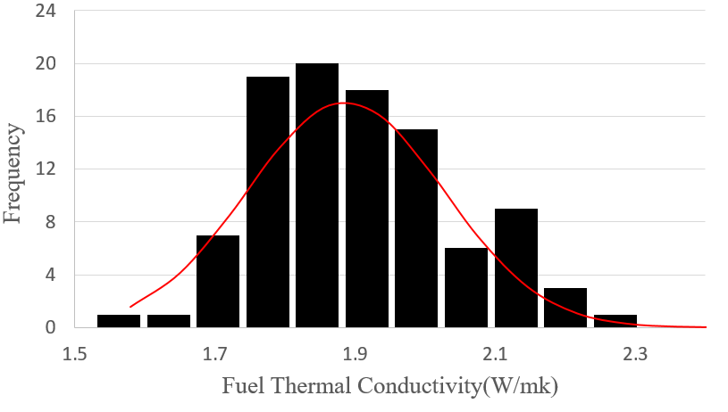
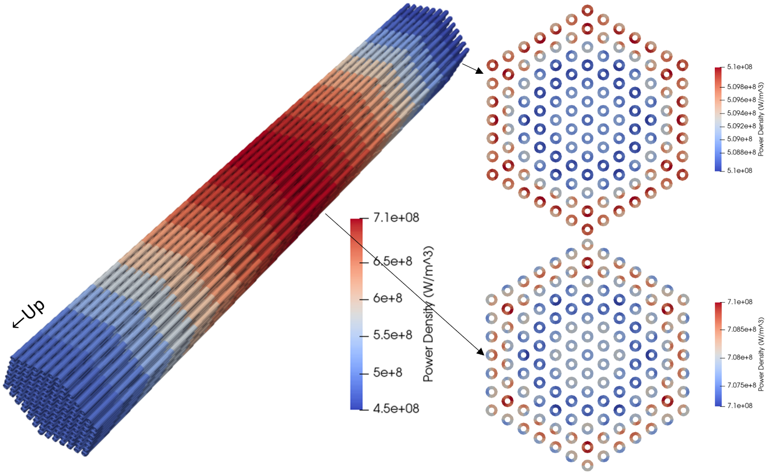
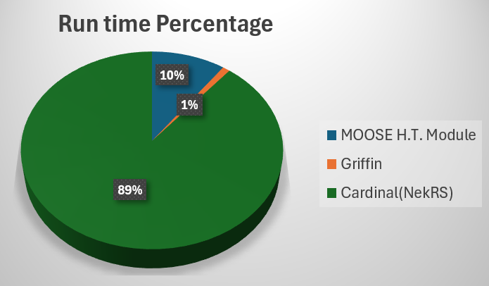
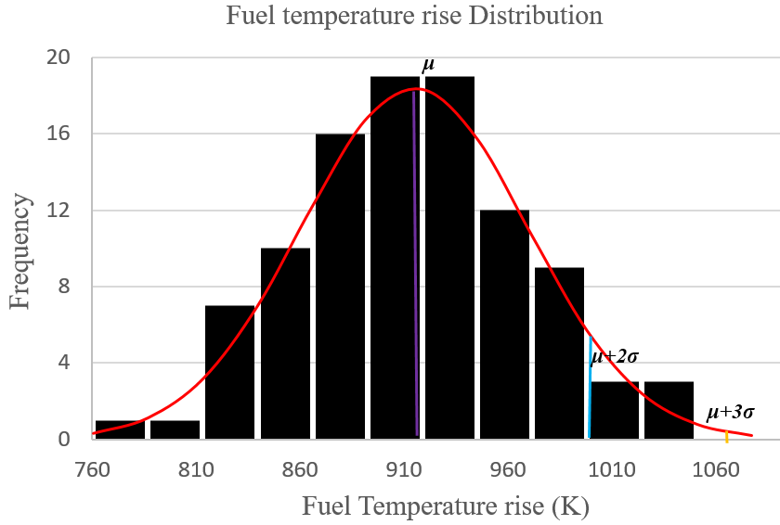
HCF Calculation: Fuel Conductivity
Question: How does uncertainty in MOX fuel conductivity affect peak fuel temperature?
Method: Assuming LFR U-Pu-O fuel conductivity = 1.882 W/m·K with physical uncertainty of 21.3% (source: WEC[1]), automate parameter sampling & multiphysics simulations, and collect data on peak fuel temperature.
Distribution of fuel conductivity samples
Distribution of max fuel temperature rise across pellet
The statistical approach HCF for fuel conductivity is 1.197, which is smaller than deterministic approach (1.236) and conventional analytical method (1.271)
[1] G. Grasso, A. Levinsky, F. Franceschini, P. Ferroni, “A MOX-fuel core configuration for the Westinghouse Lead Fast Reactor,” ICAPP 2019 – International Congress on Advances in Nuclear Power Plants, France, May 12-15 2019
Notes:
or the 3-sigma rule, To find a 95%~99.7% confidence interval

Slide 6
HCF Calculation: Comparing Methods
Statistical: Sample the material properties from a Gaussian (normal) distribution function. The statistical variations of the maximum fuel temperature are collected, and the 2-sigma/3-sigma rule is used to assess the HCF from the corresponding factors.
Deterministic: Apply the maximum material property uncertainty to the corresponding material properties to calculate the maximum temperature variation.
Analytical: Use the 1D Fourier law of heat conduction assumption.
Overall, the statistically-computed HCFs obtained with high fidelity tightly coupled calculations showed improvement (reduction) over legacy techniques and the deterministic multiphysics method.
Maximum fuel temperature rise and the corresponding HCF for fuel conductivity
Method | Maximum fuel temperature rise ΔT_{fuel} across annular pellet | HCF_{fuel}
NEAMS Statistical (100 samples) -3σ 99.7% CI | 1051.43 | 1.197
NEAMS Deterministic | 1085.03 | 1.236
Analytical method | - | 1.271
Account for distribution
Edge case
Fourier 1D HC

Slide 7
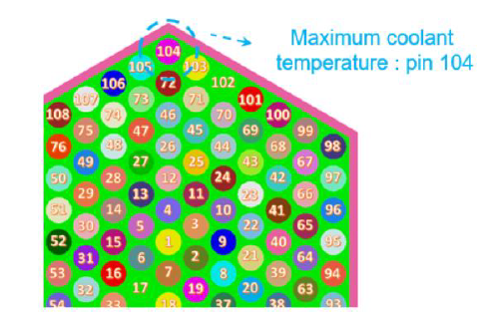
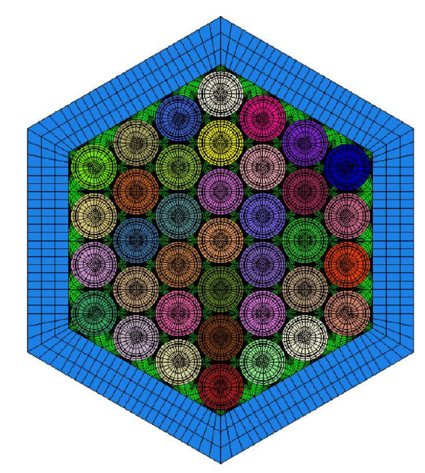
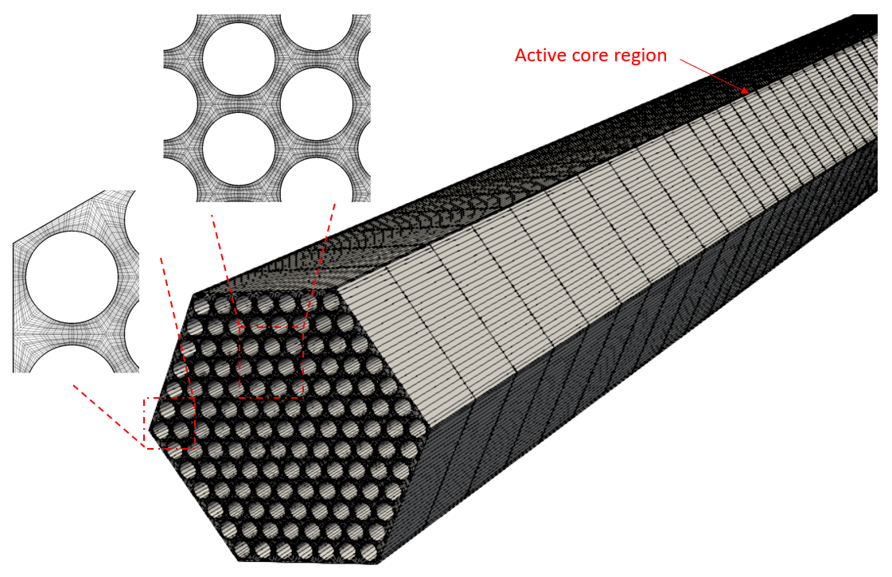
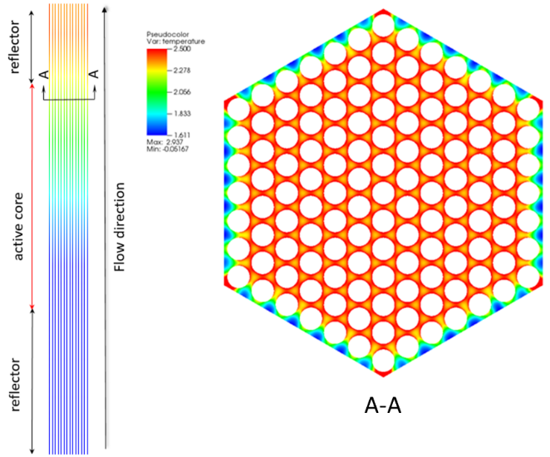
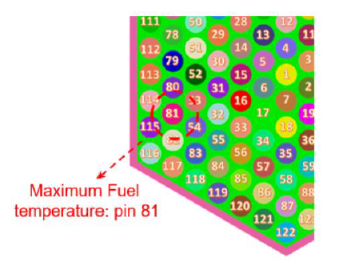
Advantages of the Developed Workflow
Fine tune and potentially reduce HCFs using high-fidelity multi-physics simulation
Generate substantial data to help designers better understand the mechanism of the impact from the uncertainties
Consider the impact of different sub-factors simultaneously (increase accuracy)
Provides a capability to predict high quality HCF that are applicable to the specific design of interest (LFR, SFR)
Fuel rod power
SFR control assembly
LFR fuel assembly
Fluid temperature
Maximum fuel and coolant temperature detected in different locations
Notes:
3-sigma rule

Slide 8
Summary
Demonstrated a high fidelity, first-of-a-kind coupling demonstration between NekRS(Cardinal) and Griffin
  Broadly useful for reactor configurations requiring both reactor physics & CFD
Demonstrated an automated workflow for sampling input parameters in high fidelity multiphysics simulations, and applied it to calculate hot channel factors in a lead-cooled fast reactor assembly
  Reductions in HCF (and thus increase in safety margin) were observed
  This capability provides a basis for computing HCFs for novel designs
  Limitations: high compute time; sampling some types of inputs are easier than others
  Parameter sampling for coupled reactor physics/CFD simulations is useful beyond the specific example of hot channel factor calculation (UQ, SA, DO, AI)
Recent journal paper: Yiqi Yu, Hansol Park, April Novak, Emily Shemon, High fidelity multiphysics tightly coupled model for a lead cooled fast reactor concept and application to statistical calculation of hot channel factors, Nuclear Engineering and Design Volume 435, 15, 2025, 113915
Notes:
A high-fidelity Multiphysics workflow for advanced reactor simulation.
More realistic, Less assumption, more accurate

Slide 9
Acknowledgement
This research made use of the resources of the High Performance Computing Center at Idaho National Laboratory, which is supported by the Office of Nuclear Energy of the U.S. Department of Energy and the Nuclear Science User Facilities under Contract No. DE-AC07-05ID14517.

