Slide 1
NEAMS Reactor Physics Microreactor Capabilities
Matthew Jessee
Olin Calvin
Tara Pandya
May 12, 2025

Slide 2
NEAMS Reactor Physics technical area develops and deploys codes for modeling neutral particle transport and nuclide depletion/decay
Neutral particle transport: Interaction of neutrons/gammas with reactor materials
Transmutation: Time evolution of isotope inventories due to irradiation and decay; and decay-induced neutron and gamma source
Coupled Transport and Transmutation: Time evolution of flux (power), isotopes, and decay source
Steady-state operation (days, months, years)
Transient scenarios (seconds, hours, days)
Spent fuel management (years)
Changes in geometry, temperature, and density influence change in reactor physics
Strategically prioritize, coordinate, and develop 3 codes: Griffin, Shift, and MPACT
MPACT is the direct whole-core reactor physics code integrated into VERA for high-fidelity light water reactor simulation
Griffin is a flexible MOOSE-based reactor physics application for multiphysics simulations of advanced reactor designs
Range of mesh-based MG deterministic solvers
On-the-fly cross section processing is integrated for both fast and thermal systems, including TRISO based systems
Depletion/decay using built-in depletion solver
Transient analysis using point kinetics, improved quasi static method, and spatial kinetics.
MOOSE framework enables ease-of-coupling to other MOOSE-based codes
Shift is a Monte Carlo radiation transport code designed to scale from supercomputers to laptops.
Continuous-energy nuclear data on exact geometry (CSG)
State-of-the-art methods for eigenvalue, shielding, depletion, and sensitivity/uncertainty on CPU/GPU systems
Shift provides MG cross sections for subsequent multiphysics simulations with Griffin for all non-LWR reactor systems
Notes:
Do not repeat what the Griffin and Shift stuff we will mention later

Slide 3
Overview of Griffin Capabilities
Deterministic Neutron Transport
Discrete Ordinates (S_{n})
Spherical Harmonics (P_{N})
Low-order super homogenization (SPH) method currently under development
Decay Heat Tracking
Explicit (using nuclide number densities)
Decay Heat Standard
Cross Sections
Online cross section generation
Load cross sections from Monte Carlo codes (Shift, Serpent, OpenMC)
Depletion
Control Rod/Drum Decusping

Slide 4
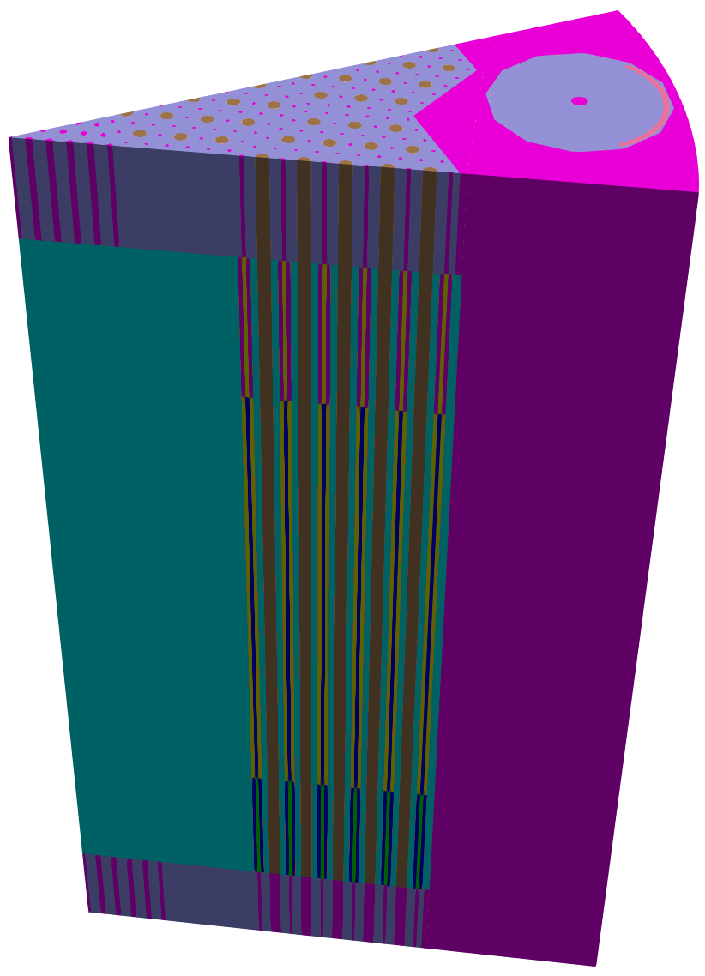
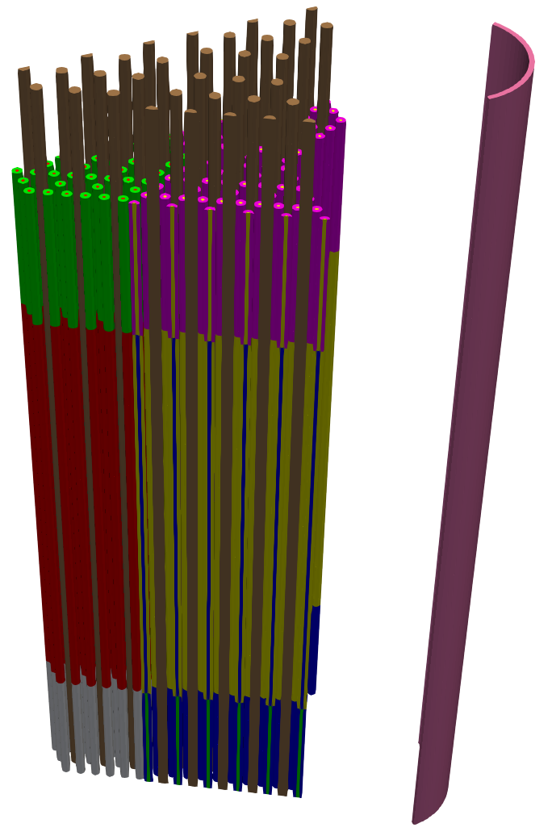
RHPMR Geometry
Reflector
Heat Pipes
Control Material
Monolith
Fuel

Slide 5
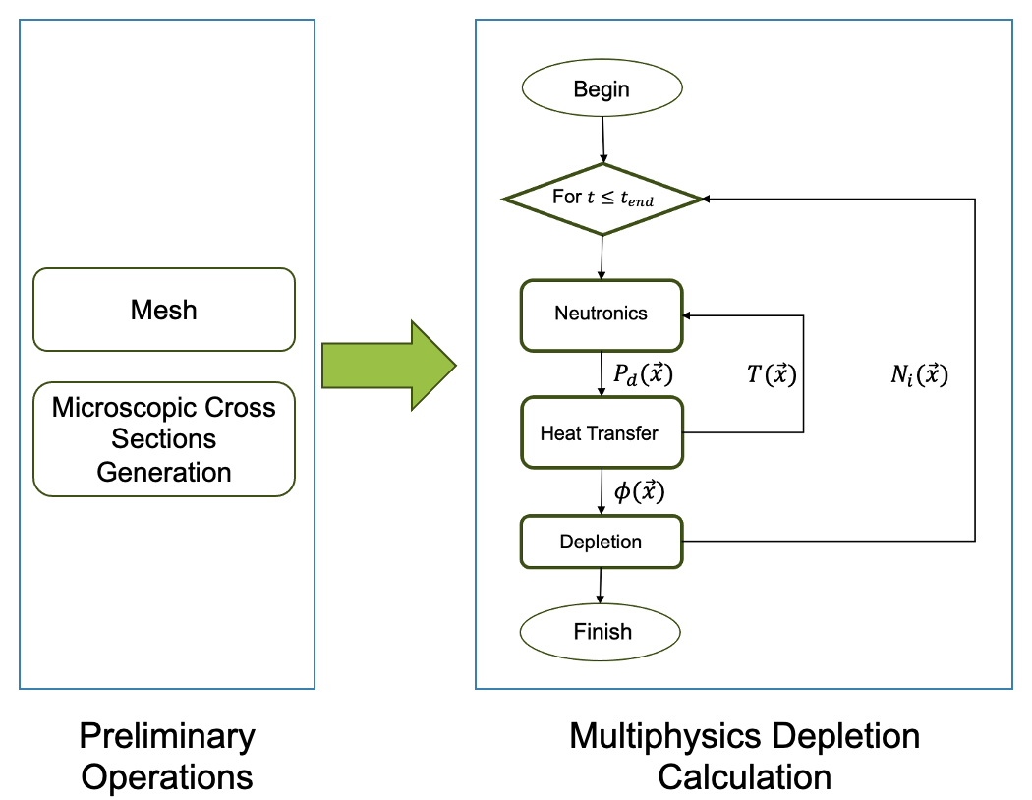
Microreactor (rHPMR) Analysis in Griffin
Temp. [K] | Monte Carlo (std.) | Griffin | Diff. [pcm]
700 | 1.07745(15) | 1.08158 | 413
800 | 1.07184(14) | 1.07563 | 379
900 | 1.06553(14) | 1.06943 | 390
1000 | 1.06038(15) | 1.06421 | 383
1100 | 1.05522(14) | 1.05892 | 370
1200 | 1.04983(14) | 1.05338 | 355
1300 | 1.04550(14) | 1.04925 | 375
1400 | 1.04128(14) | 1.04520 | 392

Slide 6
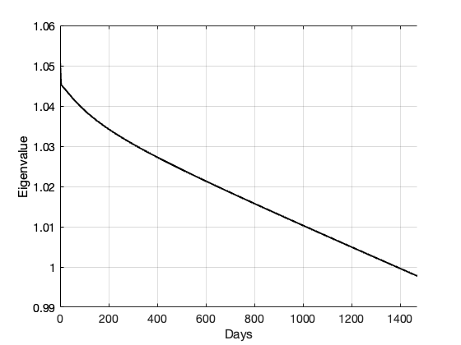
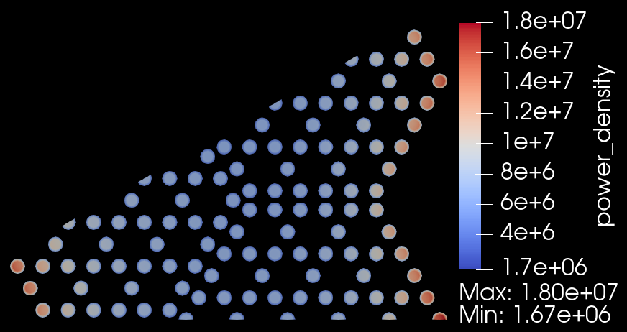
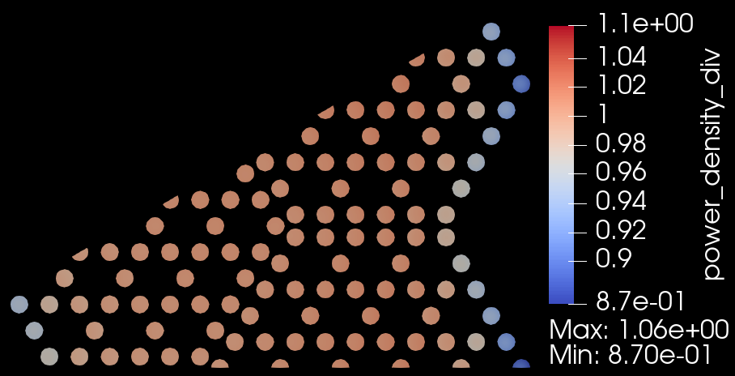
Microreactor (rHPMR) Analysis in Griffin (continued)
Initial power density of the midplane of the rHPMR Griffin model
Ratio between the final and initial power densities of the midplane of the rHPMR Griffin model
Eigenvalue calculated by Griffin during the entire depletion calculation
N. Choi et al., “Advancements in Multiphysics Microdepletion Analysis of an eVinciTM-like Microreactor Leveraging OpenMC-CRAB Workflow,” INL/RPT-24-77346 Rev:001 (2024).
Notes:
Top figure is power density at BOL and bottom is EOL

Slide 7
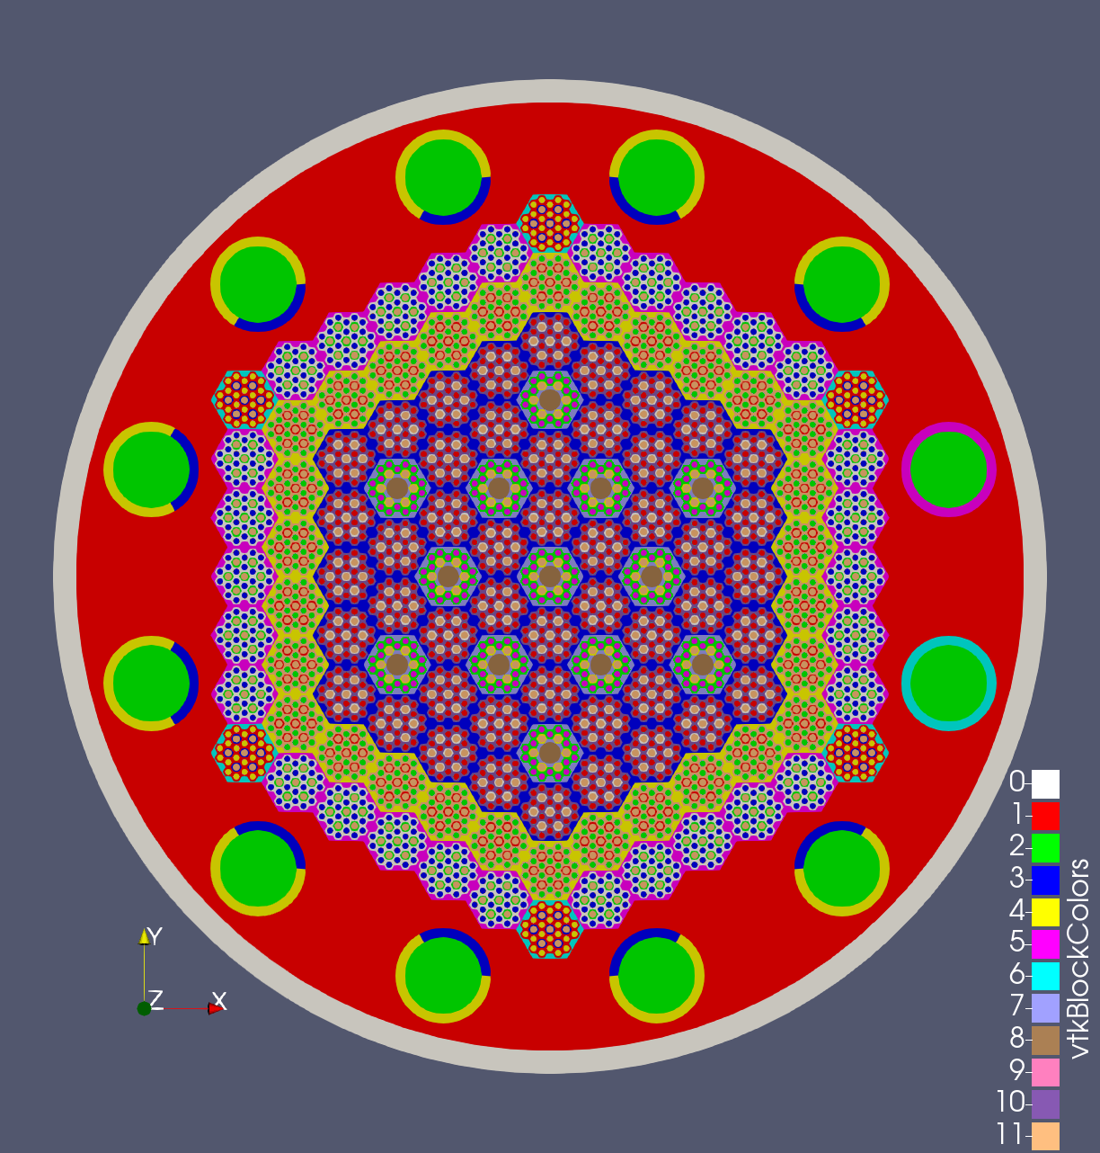
Microreactor (gHPMR) Analysis in Griffin
Movement of two control drums (i.e. one control drum bank)
Cross sections generated with Monte Carlo and transport results compared against a reference Monte Carlo solution
Fixed Control Drum
Fuel & HP Assembly
Vessel Wall
Movable Control Drum
Reflector

Slide 8
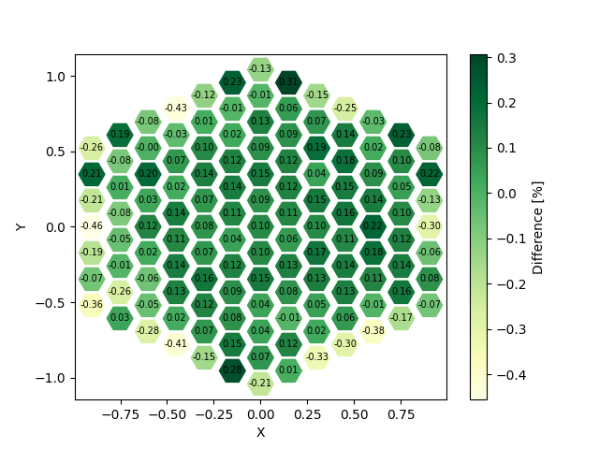
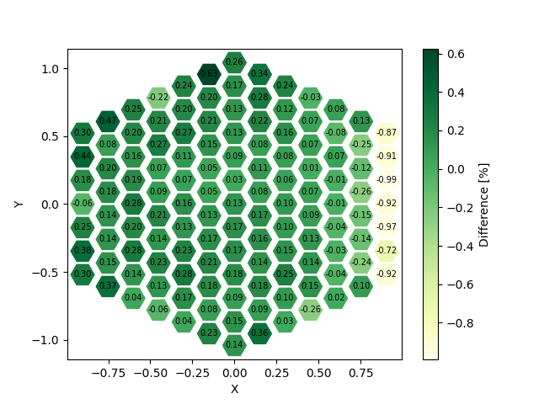
Microreactor (gHPMR) Analysis in Griffin
Assembly Power Comparison between Griffin and reference Monte Carlo solution
All drums fully inserted
All drums fully inserted except rightmost bank, which is fully withdrawn
Notes:
gHPMR Tfuel=1600 K, Tmod=1600 K, left control drums fully withdrawn, right control drums fully inserted (two drums in right bank only)

Slide 9
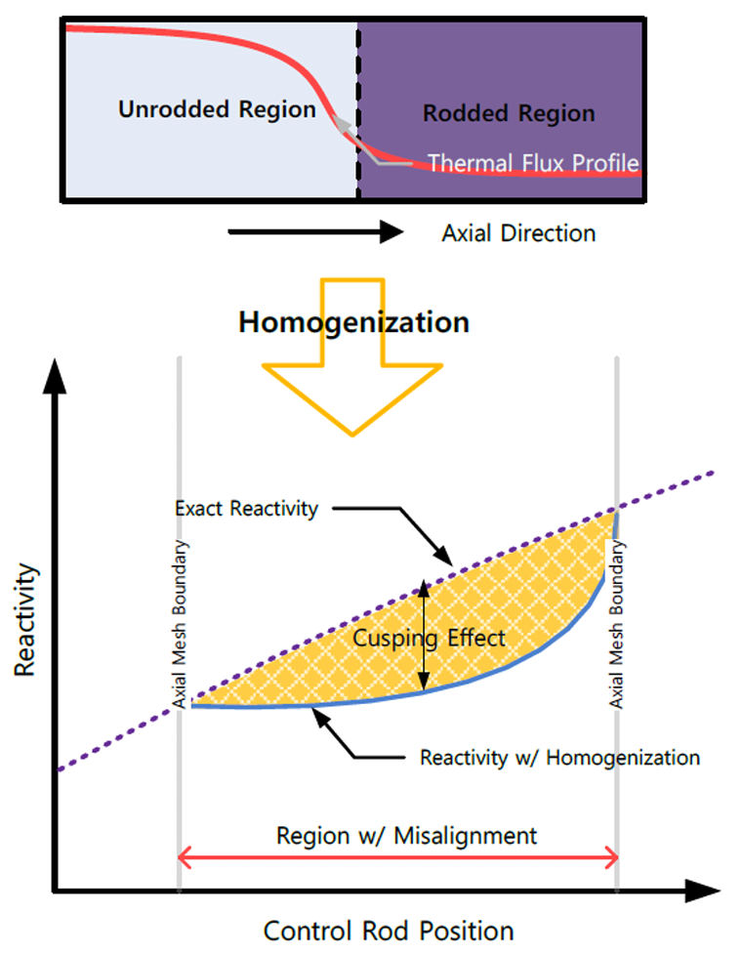
Control Rod/Drum Cusping Effect
Control rod/drum front can be located within a mesh element during computation, leading to the need for homogenization.
The thermal flux profile around the rod/drum front exhibits steep gradients, and thus high-order polynomials (typically 4th or above) are required to capture the flux profile.
Simple volume weighting or flux weighting with insufficient order of shape functions leads to large homogenization errors that appear as cusps.
Transport solvers typically employ first-order shape functions as high-order shape functions are expensive.
Decusping improvements have been implemented which allows for local increase to the flux shape function order in the rod/drum regions, improving results without significant runtime costs from applying higher-order solves to the entire system.
Decusping improvements implemented by Namjae Choi, Ph.D. (INL)
Y. S. Jung and H. G. Joo, ”Control Rod Decusping Treatment Based on Local 3-D CMFD Calculation for Direct Whole Core Transport Solvers,” International Congress on Advances in Nuclear Power Plants (ICAPP) (2014).

Slide 10
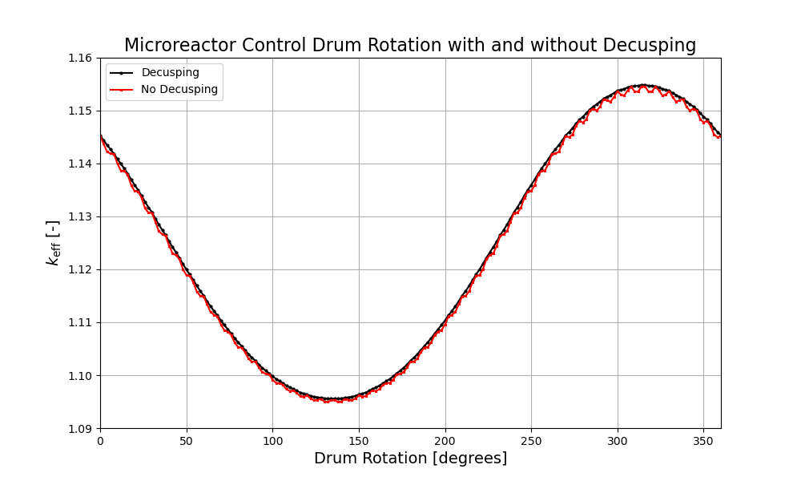
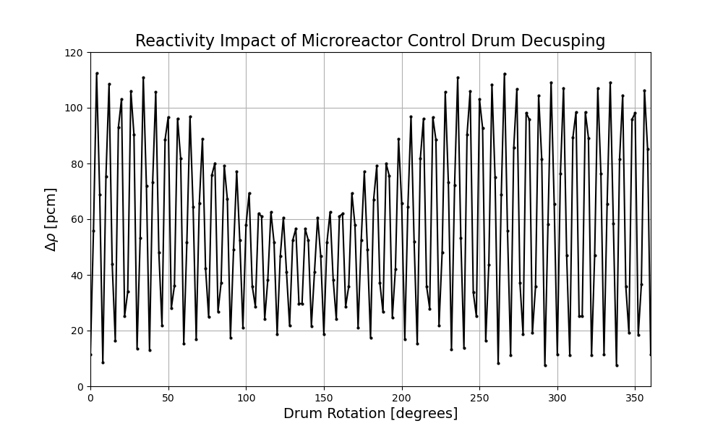
Control Rod/Drum Cusping Effect (continued)

Slide 11
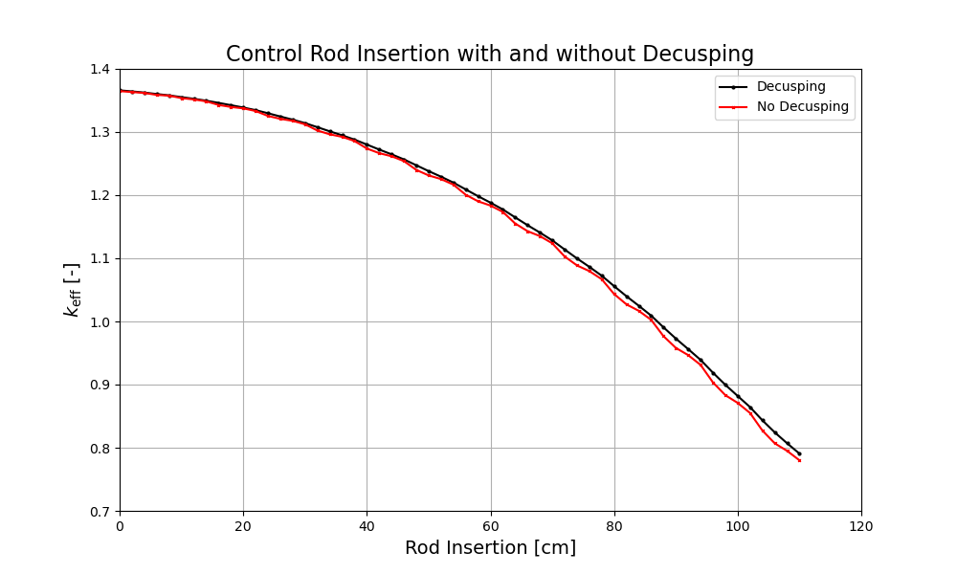
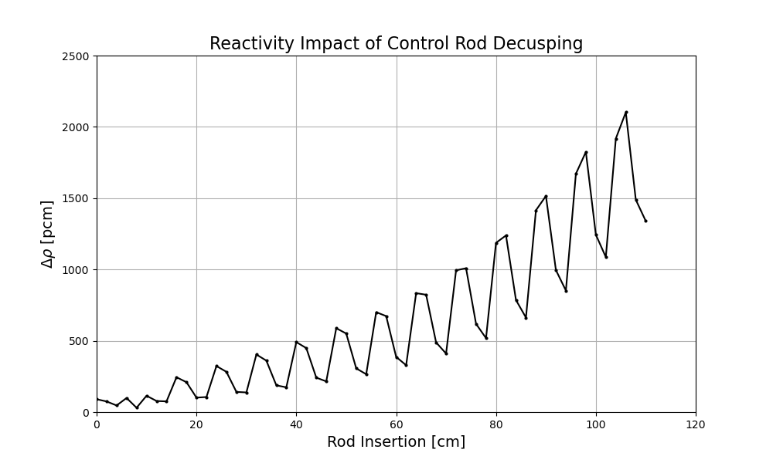
Control Rod/Drum Cusping Effect (continued)

Slide 12
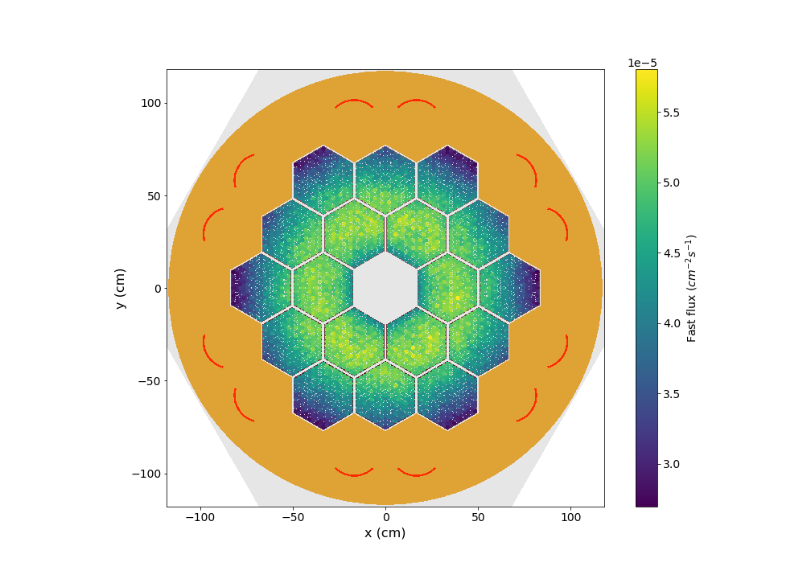
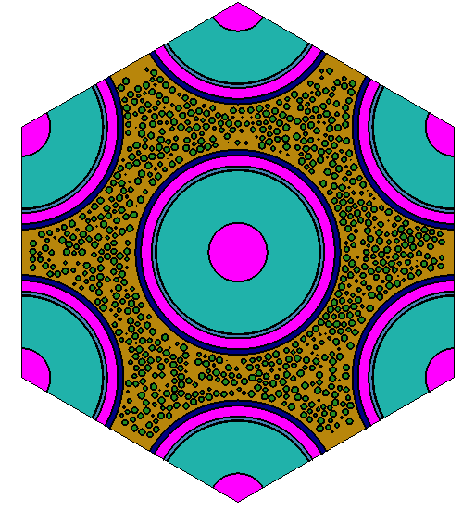
Shift is a Monte Carlo radiation transport code in SCALE
Empire Fast Flux Slice
Flexible high-performance radiation transport code designed to scale from supercomputers to laptops
State-of-the-art methods and algorithms
sensitivity/uncertainty
depletion via
ORIGEN
GPU/CPU
hybrid variance
reduction
TCR

Slide 13
Shift can serve as a reference solution for Griffin for verification
Why and How?
"Exact" physics
"Exact" geometry
Single snapshot calculation
all quantities of interest with uncertainty
Automated ISOXML library generation
Are there limitations?
Notes:
Shift directly computes core output QOIs: k-eff, power distributions, reactivity coefs, etc
These calculations are performed at core “snapshots”, i.e. known of fixed TH and operation conditions (control position)
“Reference” implies
Exact physics: Continuous energy cross sections and scattering kinematics
Exact geometry: No spatial mesh, or discrete angle discretization
Only limitation is Monte Carlo statistics. However calculation of QOI uncertainties is a feature, not a bug!
In addition to output QOI verification, Shift can provide cross section verification
Shift can automatically generate a Griffin ISOXML library for a given snapshot based on user selection of MG boundaries and cross section regions
Shift-generated ISOXMLs compared to Griffin-generated ISOXMLs provide qualitative insight on potential issues in cross section preparation methods
Qualitative to Quantitative:
On-going effort to implement sensitivity coefficient generator in Griffin based on perturbation theory
Sensitivity-coefficients quantify how much a cross section difference impacts an output QOI difference
NEAMS-funded Shift-ISOXML library data:
Macroscopic cross sections
Microscopic cross sections
Kinetics Parameters (beta, lambda, delayed-chi)
Energy-weighted cross sections for power normalization
Transport cross sections for diffusion coefficients
In development
Higher-order scattering matrices
Optimizations
Surface tallies

Slide 14
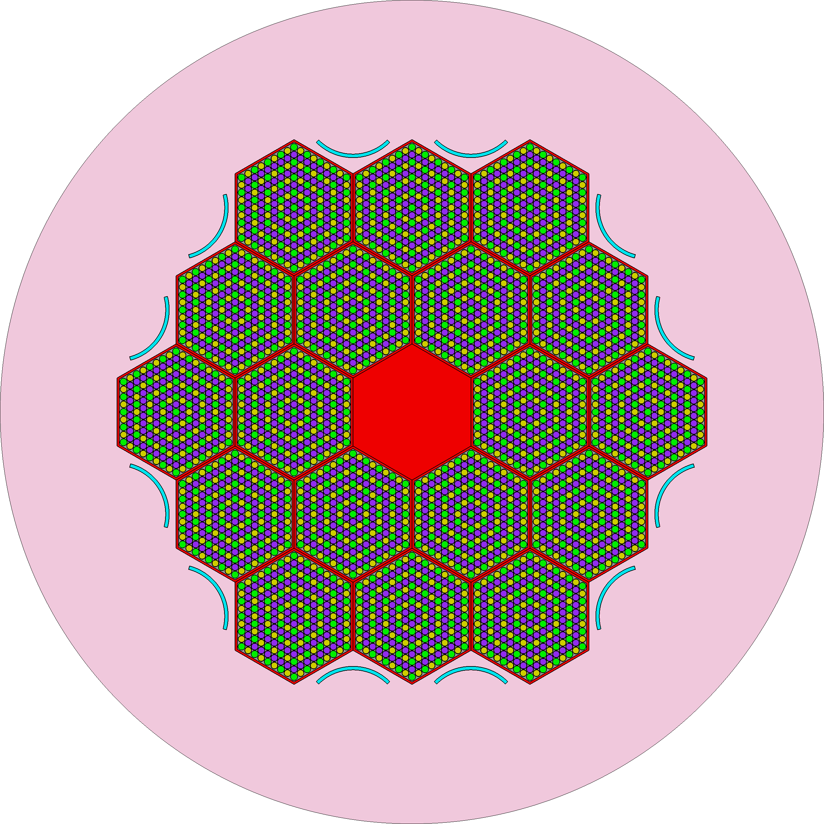
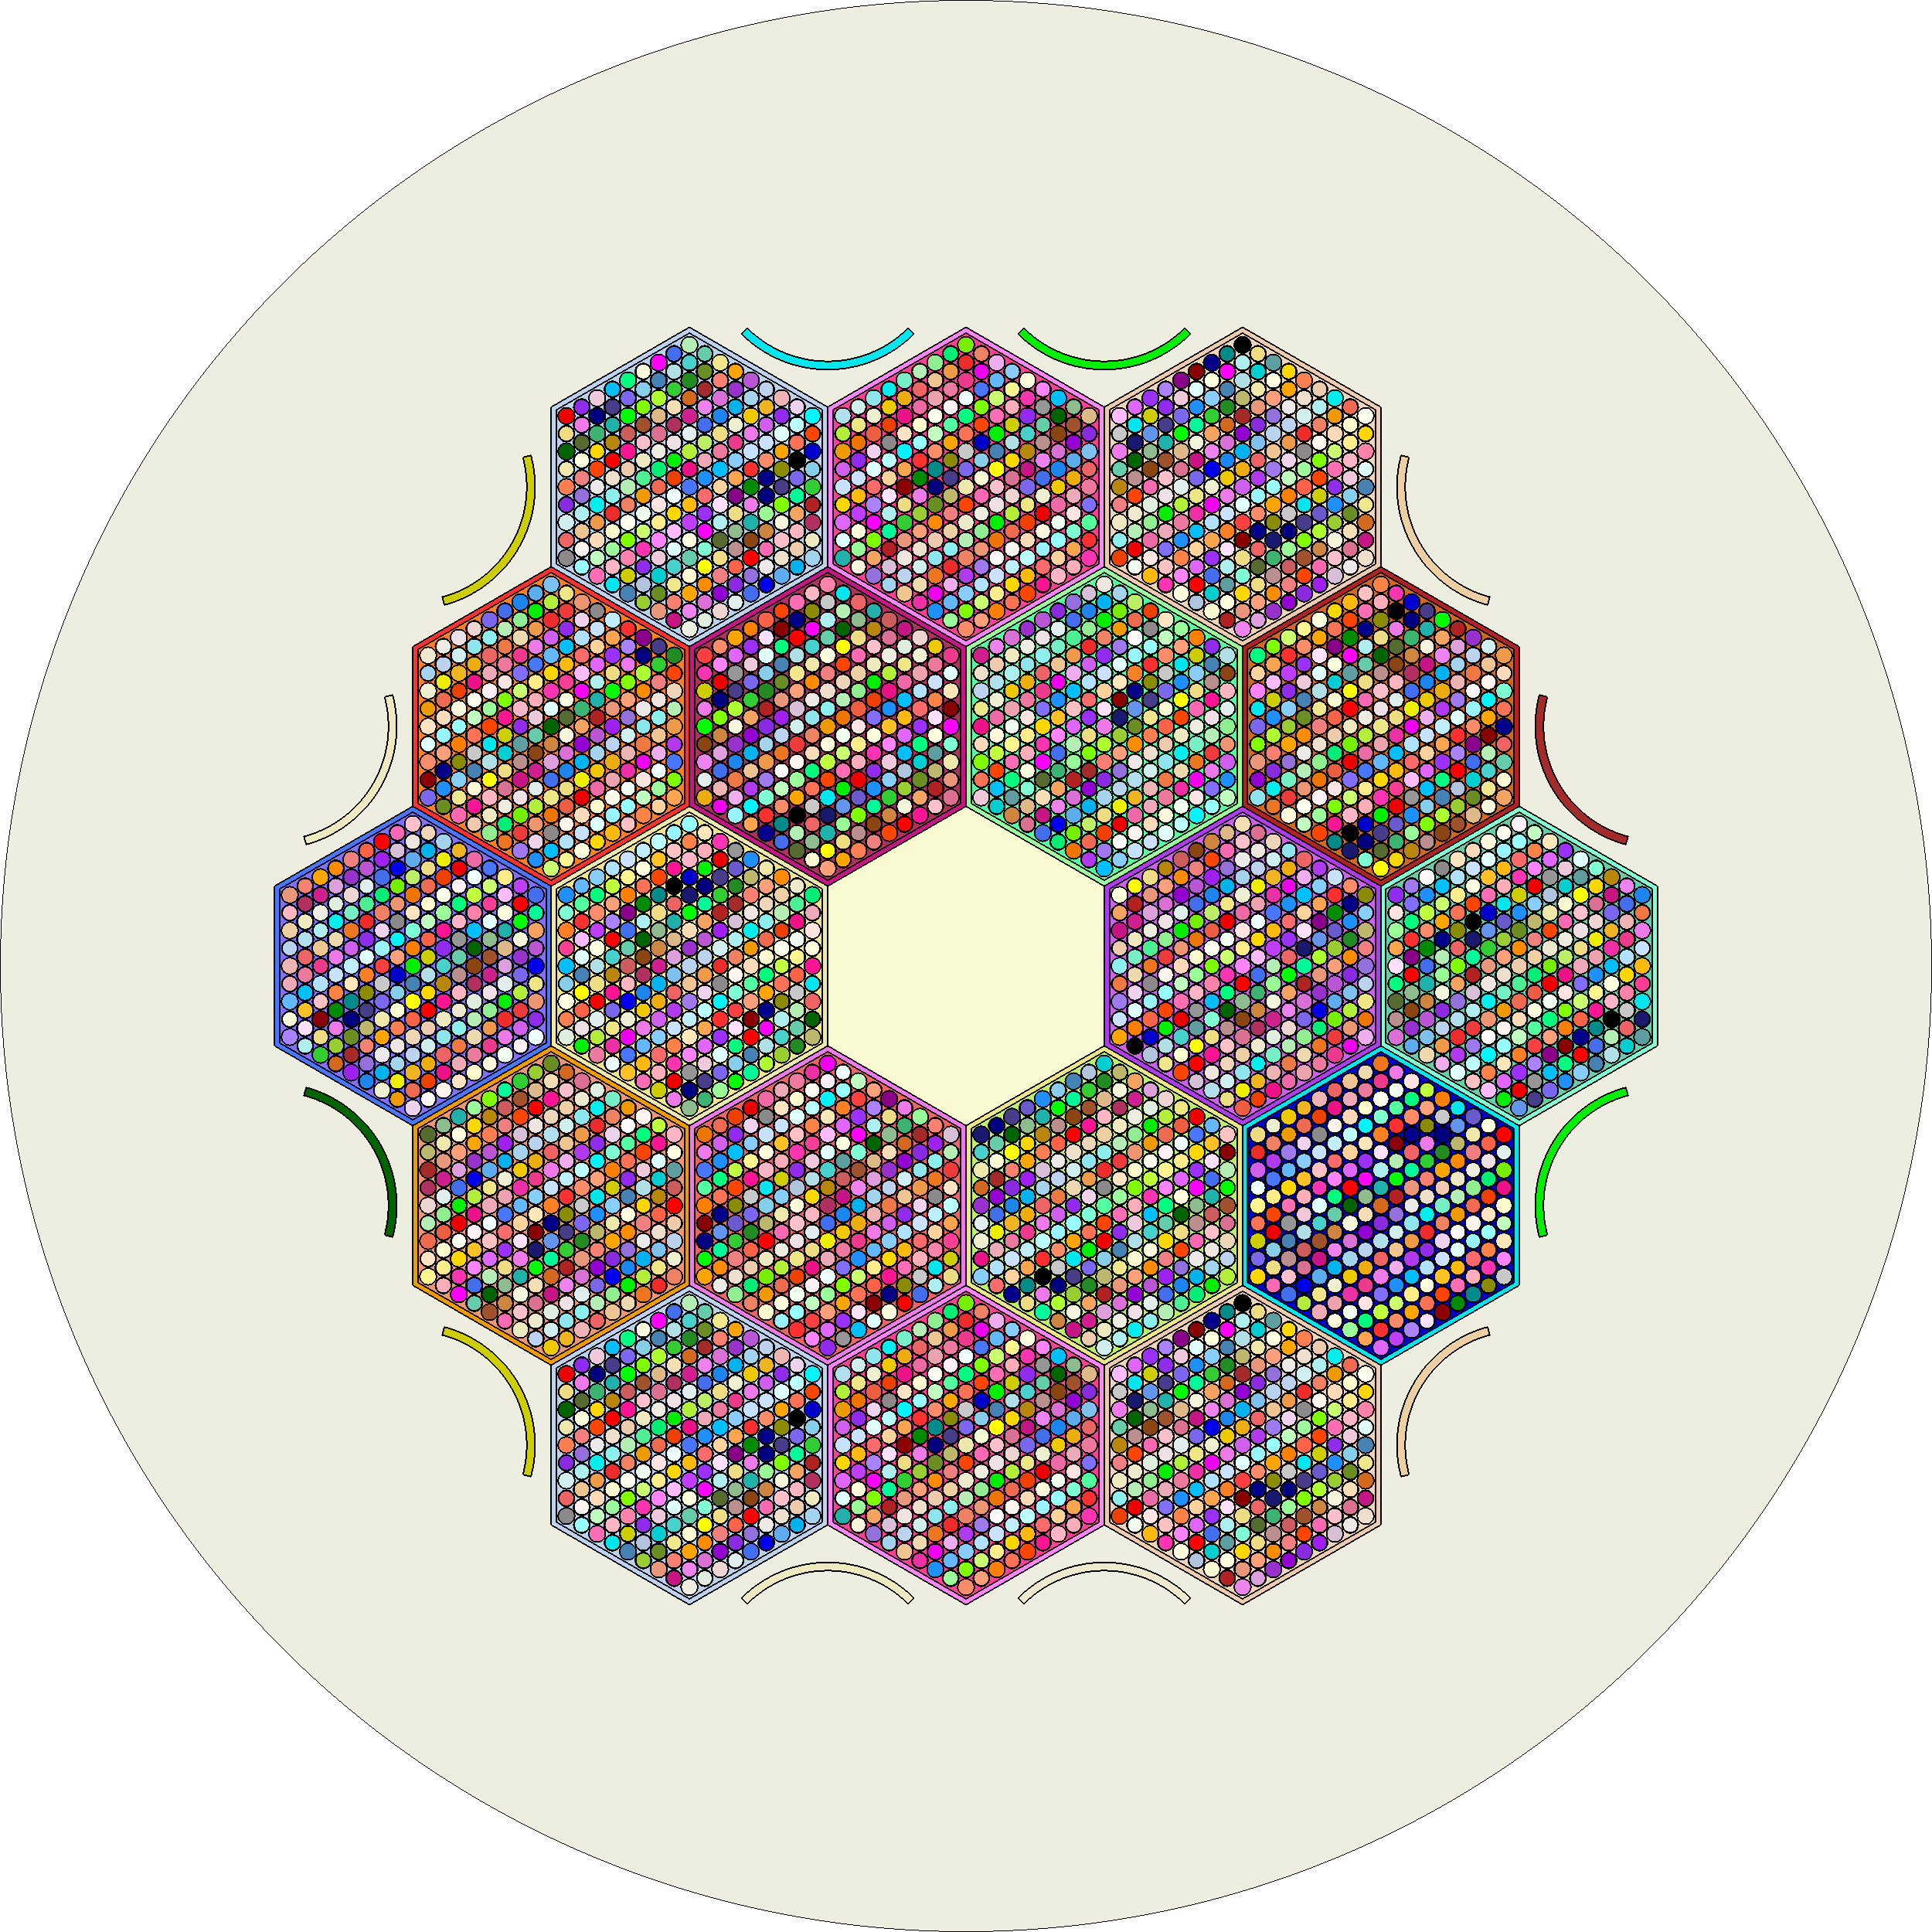
Titan is the reactor physics interface to Shift
NEAMS Workbench
Titan
Reduces modeling complexity
Shift
ORIGEN
reference
solution
multigroup cross sections
steady-state depletion
Notes:
Titan is an easy-to-use reactor model front-end that reduces modeling complexity that arises from unique material and unique tally regions
Titan utilizes other foundational components of SCALE (ORANGE, Shift, ORIGEN)
Titan offers Monte-Carlo cross-section generation (cell-union or overlay based) and steady-state depletion
Titan is integrated into the NEAMS Workbench (demonstrated at a July 2024 training at INL)
Goal is to be both a stand-alone reactor physics capability, and Internal API for client codes
Reducing code maintenance of multiple geometry packages
Extending the geometry capabilities for both codes
Enable snapshot verification with Shift
Future work:
GPU support
New shapes (involutes, triply periodic shapes, etc)
Fixed-source shielding and depletion
Autocomplete and other LSP capabilities for Workbench and VS Code
Automated ISOXML generation (instead of two-step process with provided python script)
Current Work:
Branch calculations (easy temperature and geometry changes)
Automated sphere packing in complex geometries
Higher packing fraction support (>60%)
Other:
Titan training in July 2024 provided the opportunity to address a lot of feedback and a couple bugs in the beta!
We have an up-to-date Titan install on sawtooth for anyone with SCALE beta access

Slide 15
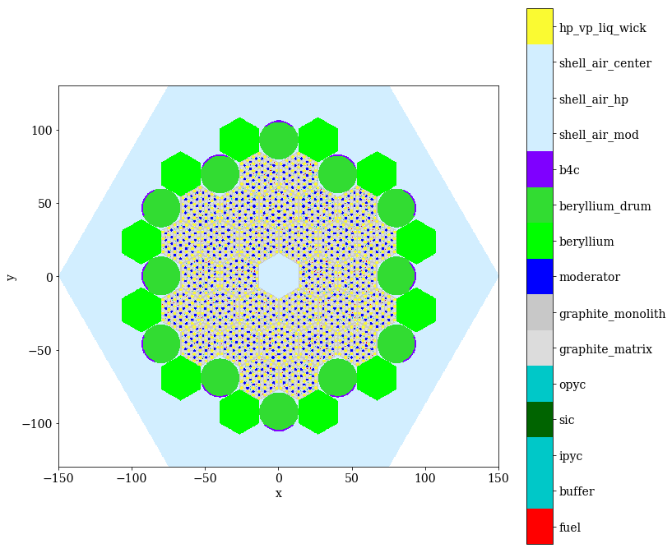
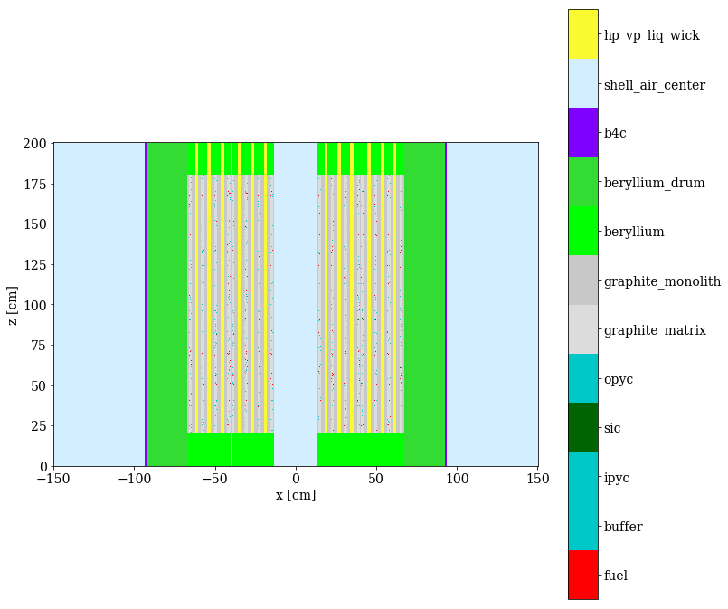
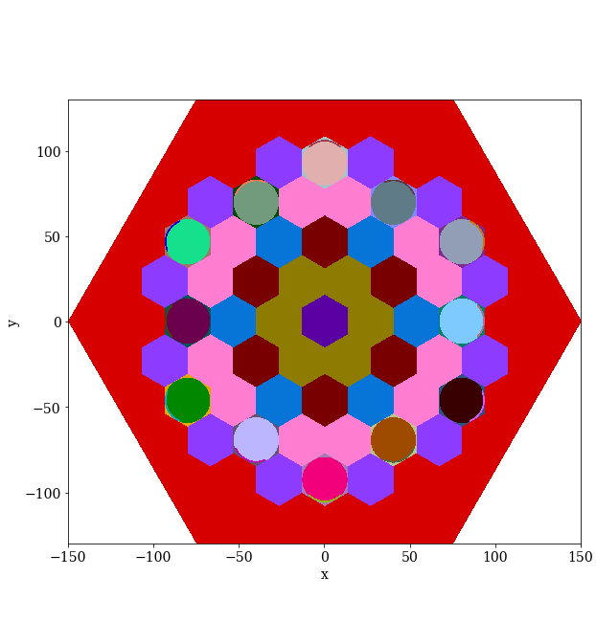
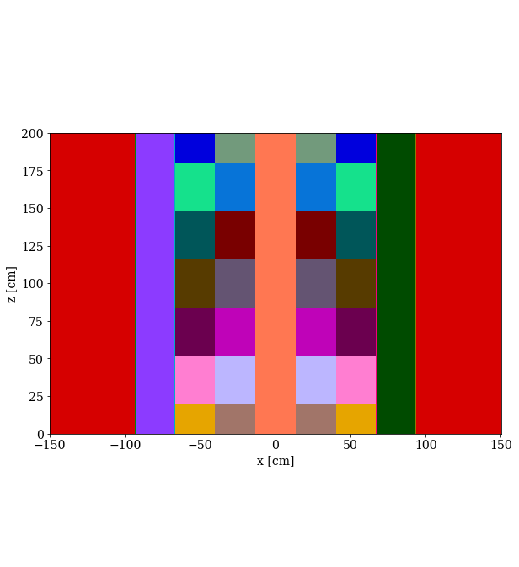
Overlay CSG cross section tally capability in Shift enables easier multigroup cross section generation
Combinatorial solid geometry
Homogenization use cases:
Pebble bed reactors (random pebbles)
Hexagonal lattices
Complex structures
Currently supported:
Macroscopic XS
ORANGE overlay geometry
Automated ISOXML generation
XY-slice at Z=100 cm
XZ-slice at Y=0 cm
Notes:
CSG = combinatorial solid geometry
ORANGE = internal CSG in SCALE
ISOXML = format for Griffin data
Random distribution of the pebbles + conical regions are easily captured
triangular meshes are usually used on hex lattices
Mechanics of the tally: The overlay tally is performed by simultaneously tracking individual MC particles on both the detailed/original problem geometry and the overlay tally geometry. This might incur a small performance overhead, but this cost is almost always small compared to CE xs lookup and the overlay geometry is usually much simplified
We exercised the overlay capability on a TRISO-HPMR with 28 homogenized regions
* 11 group energy structure
In FY25 we plan to extend this to include microscopic cross section library generation. Planned GPU integration?

Slide 16
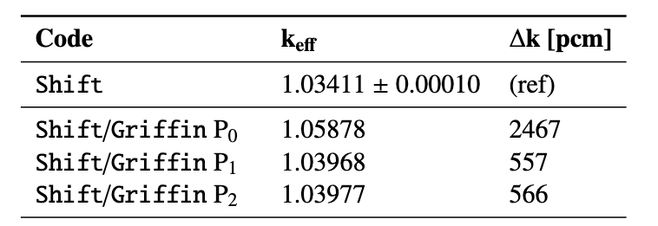
We exercised the overlay CSG cross section tally capability by performing two-step neutronics calculations with Shift and Griffin
Notes:
DFEM SN calculations using macroscopic multigroup library generated by Shift
Griffin mesh shows homogenized regions (upper reflector is hidden)
Flux plot showing energy boundaries produced with Shift
Results are meh

Slide 17

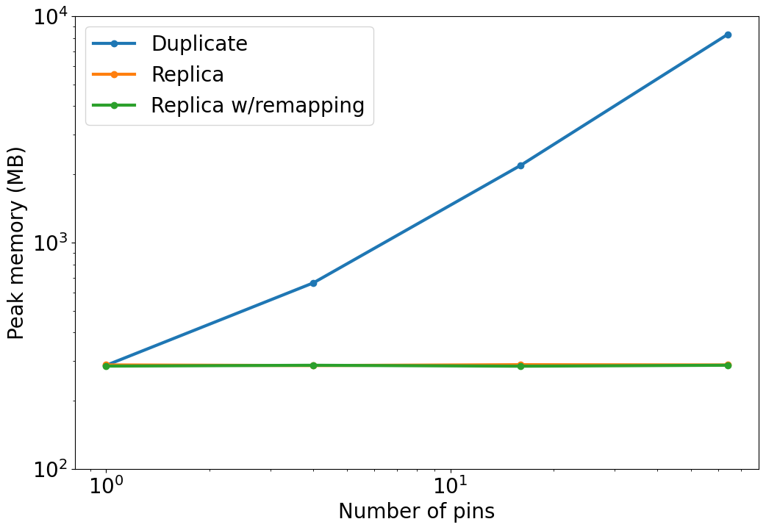
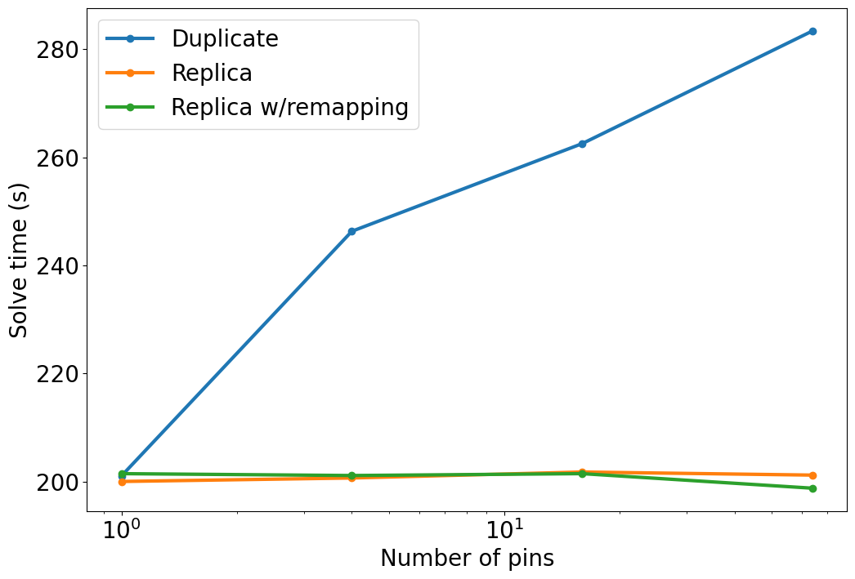
Reduced memory usage for TRISO problems by taking advantage of material remapping
Example: Fuel pin with TRISO pellets
TRISO distribution can be reused for each pin
Remapping materials allows each pin to be tallied/depleted independently
Remap Memory Usage
Remap Solve Time
Notes:
This capability is targeted at TRISO-based problems (arrays and pebble bed)
The existing "replica" capability saves memory but must use same material
Replica w/remapping (unique materials) uses same amount of memory as a single material (replica) without much of an increase in solve time

Slide 18
Current and future work on microreactor reactor physics modeling
Griffin and Shift have robust capabilities for modeling microreactors
NEAMS tools enable ease of multiphysics integration with a single input
Integration of Shift in this framework is ongoing
Focus on shielding simulations
Notes:
Griffin capabilities highlighted: Robust depletion, account for rod cusping (rods and drums)
Shift capabilities highlighted: Reference solutions (verification of Griffin), multigroup cross section generation, shielding (ex-core dose)
Current/future work: Integration of Shift into MOOSE framework; shielding capability in Griffin? Griffin + Shift for shielding and ex-core dose where Griffin provides adjoint/forward + fission source

