Slide 1
NEAMS Reactor Physics Fast Reactor Capabilities
Dr. Matthew Jessee (ORNL)
Dr. Shikhar Kumar (ANL)
Dr. Friederike Bostelmann (ORNL)
May 29, 2025

Slide 2
NEAMS Reactor Physics technical area develops and deploys codes for modeling neutral particle transport and nuclide depletion/decay
Neutral particle transport: Interaction of neutrons/gammas with reactor materials
Transmutation: Time evolution of isotope inventories due to irradiation and decay; and decay-induced neutron and gamma source
Coupled Transport and Transmutation: Time evolution of flux (power), isotopes, and decay source
Steady-state operation (days, months, years)
Transient scenarios (seconds, hours, days)
Spent fuel management (years)
Changes in geometry, temperature, and density influence change in reactor physics
Strategically prioritize, coordinate, and develop 3 codes: Griffin, Shift, and MPACT
MPACT is the direct whole-core reactor physics code integrated into VERA for high-fidelity light water reactor simulation
Griffin is a flexible MOOSE-based reactor physics application for multiphysics simulations of advanced reactor designs
Range of mesh-based MG deterministic solvers
On-the-fly cross section processing is integrated for both fast and thermal systems, including TRISO based systems
Depletion/decay using built-in depletion solver
Transient analysis using point kinetics, improved quasi static method, and spatial kinetics.
MOOSE framework enables ease-of-coupling to other MOOSE-based codes
Shift is a Monte Carlo radiation transport code designed to scale from supercomputers to laptops.
Continuous-energy nuclear data on exact geometry (CSG)
State-of-the-art methods for eigenvalue, shielding, depletion, and sensitivity/uncertainty on CPU/GPU systems
Shift provides MG cross sections for subsequent multiphysics simulations with Griffin for all non-LWR reactor systems

Slide 3
Overview of Griffin R&D Activities for Fast Reactor Systems
Dr. Shikhar Kumar (ANL)

Slide 4
Introduction
Overview of Cross Section Generation Workflow
Implementation Details for Fast Reactor Analysis
Mesh Generation
Pin Power Reconstruction
Fuel Cycle Management
Status of SFR Workflow Activities
Verification
External Stakeholders
Presentations, Workshops, and Applications
Conclusion

Slide 5
Overview of SFR Cross Section Workflow
Goal – Generate broad group (33 energy groups) cross section library for fast reactor core, for use in downstream full-core calculation
FR Core Design
XS Generation
Core Analysis
Fuel Cycle Analysis
Automated Workflow
DFEM-SN / HFEM-PN Solver
Pin Power Reconstruction
Multi-cycle Depletion
Equilibrium Core Depletion

Slide 6
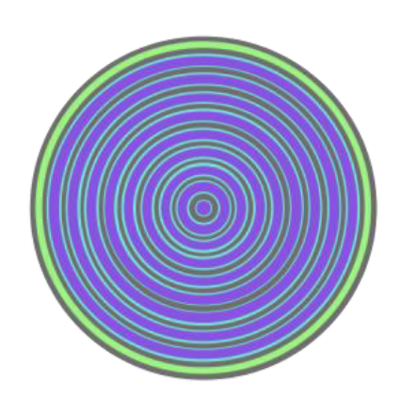
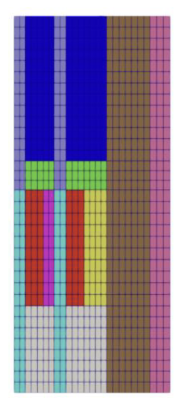
Overview of SFR Cross Section Workflow
Goal – Generate broad group (33 energy groups) cross section library for fast reactor core, for use in downstream full-core calculation
FR Core Design
XS Generation
Core Analysis
Fuel Cycle Analysis
Automated Workflow
DFEM-SN / HFEM-PN Solver
Pin Power Reconstruction
Multi-cycle Depletion
Equilibrium Core Depletion
MC²-3 1D CPM calculation to generate 33g XS from full-core spectrum (fuel / control)
MC²-3 0D hom. calculation to generate 1041g XS for each unique subassembly region
Griffin R-Z S_{N} transport to solve full-core 1041g flux
MC²-3 0D calculation to generate 33g XS from full-core spectrum (non-fuel / non-control)

Slide 7
Execution of SFR Cross Section Workflow
Core input skeleton will automatically set up the Griffin analysis problem with appropriate homogenized compositions, materials, and geometry
33-group cross section library for each unique subassembly region in homogenized full-core geometry
Supports generation of additional data libraries for use in downstream analysis
Delayed neutron data library
Gamma data library
Tabulation of neutron data as a function of core operating temperature
Griffin XS Generation Input File
Heterogeneous core geometry
Heterogeneous core compositions
Control options related to:
MC²-3 execution
Griffin R-Z full-core calculation
Auto-generated skeleton for running full-core eigenvalue problem with Griffin-generated cross sections
Updated by user to facilitate homogeneous full-core analysis
Steady-state eigenvalue calculation
Pin power reconstruction
Fast reactor transient
Fuel cycle management

Slide 8
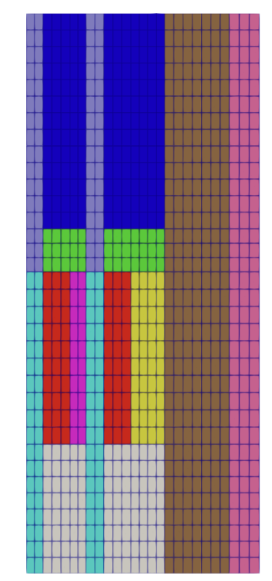



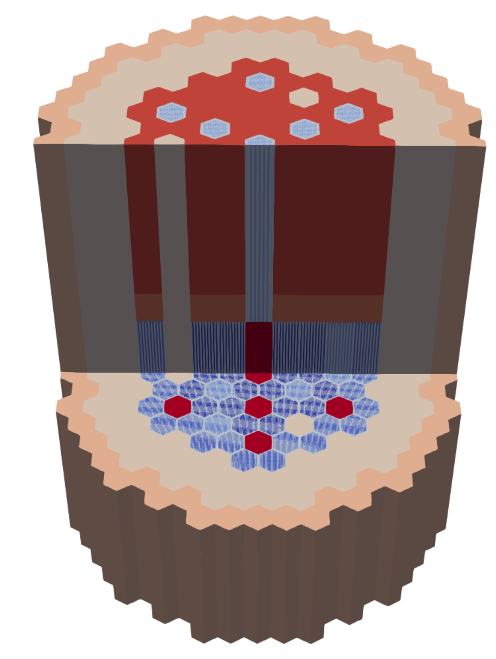




Mesh Generation
SFR workflow relies on the Reactor Geometry Mesh Builder (RGMB) system and Griffin’s EquivalentCoreMeshGenerator to generate various mesh representations
RGMB produces input heterogeneous core mesh
EquivalentCoreMeshGenerator produces equivalent core mesh
RZ Core Mesh for Cross Section Generation
target_geometry = rz
Constituent pins
Constituent assemblies
Heterogeneous core
Homogenized / Partially Homogenized Core Mesh for Full Core Analysis
full_hom
target_geometry = duct_het
ring_het

Slide 9
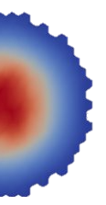
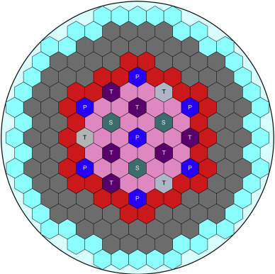

Pin Power Reconstruction
Fast reactor core analysis is typically performed for a homogenized-assembly configuration
Requires a transport solver like HFEM-PN or DFEM-SN to account for pronounced streaming effects
Core analysis can be conducted on ring-heterogeneous or duct-heterogeneous mesh representations as well
Pin-power reconstruction capability can provide pin-wise power distributions
Integral fission rates are computed from the homogeneous flux distribution for each pin volume defined on an overlaid pin lattice​
SFR designs do not exhibit strong local heterogeneous flux effects, so form functions do not need to be computed
Pin power reconstruction is integrated with MOOSE multiphysics solvers
Added support for ring-heterogeneous and duct-heterogeneous mesh representations
Homogenized Core Flux Distribution
Reconstructed Pin Power

Slide 10
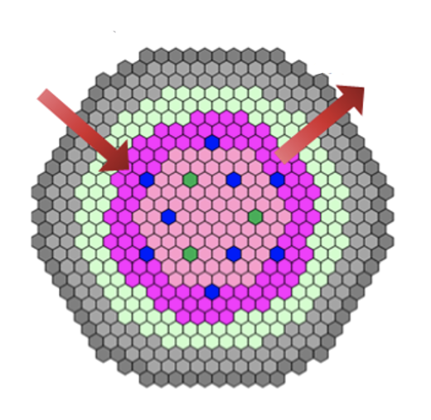
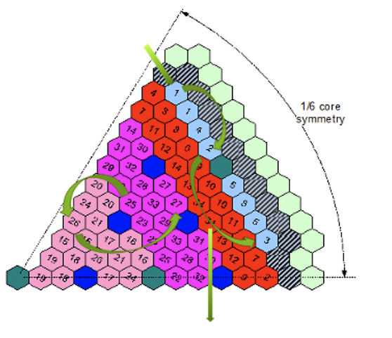
Fuel Cycle Management
Fresh / reprocessed
fuel loading
Discharged fuel
at each cycle
Fuel management in fast reactors involves a series of operations to achieve targeted performance objectives
Multi-objective optimization to improve reactor performance, increase fuel utilization, reduce waste production, and enhance safety
In-core schemes: Fuel loading, shuffling, and fuel depletion
Ex-core schemes: Cooling spent fuel in ex-vessel storage tanks, fuel reprocessing, and fuel re-fabrication
Griffin supports fuel management capabilities using the [FuelManagement] block
Multi-cycle depletion: Explicit cycle-by-cycle or non-equilibrium cycle operation of a reactor under a specified periodic or non-periodic fuel management scheme
Equilibrium core depletion: Characterization of equilibrium core conditions of a reactor operating under a periodic fuel management scheme
Enrichment and cycle length search: Adjust fuel enrichment and/or cycle length to satisfy equilibrium core constraints
External fuel management: All ex-core schemes including fuel re-processing, re-fabrication, and external feeds (in progress)
Fresh fuel
loading
Discharged fuel

Slide 11
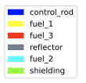
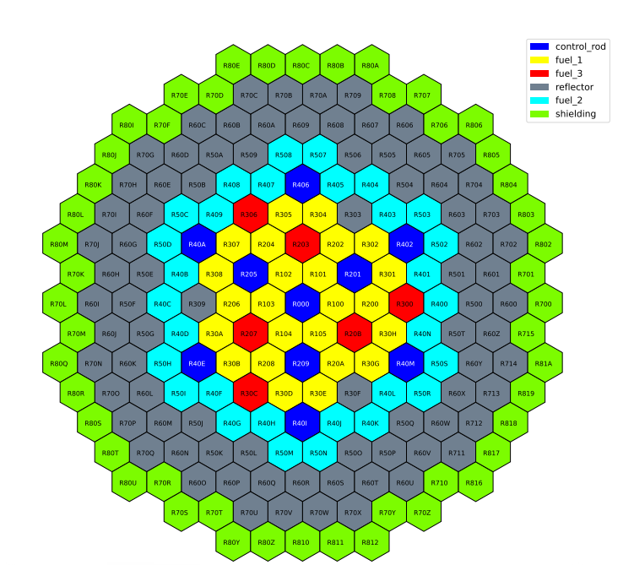
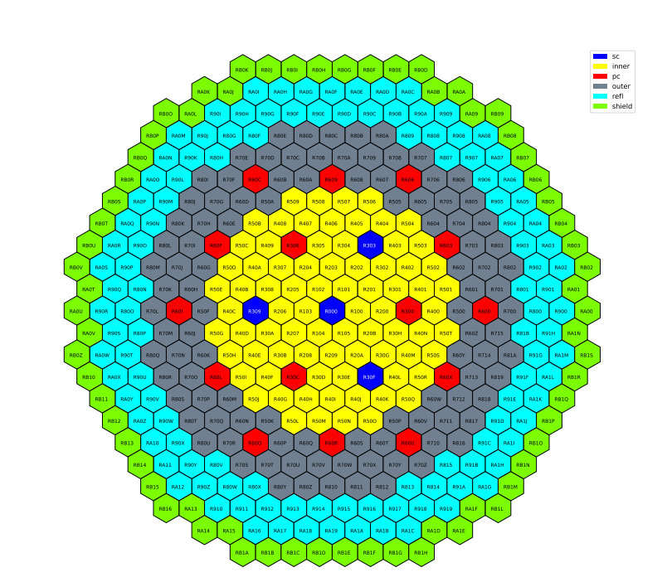

Verification Efforts
Griffin SFR Workflow has been verified against ABTR and ABR-1000 cores
Eigenvalue Comparison
Reactor | Parameter | Monte Carlo* | Difference
 |  |  | DIF3D | Griffin DFEM-SN | Griffin HFEM-PN
ABTR | k-eff | 1.08188 | -32 pcm | -85 pcm | -135 pcm
 | CR worth | 13,054 | -1.21 % | 0.31 % | -0.69 %
ABR- 1000 | k-eff | 1.01707 | 211 pcm | -2 pcm | -11 pcm
1000 | CR worth | 9,811 | -0.45 % | 1.35 % | 0.46 %
ABR-1000 Core
* Standard deviation ≤ 0.00004
ABTR Core
Assembly and Power Comparison
Reactor | Power | % Difference**
 |  | DIF3D |  | Griffin DFEM-SN |  | Griffin HFEM-PN
 |  | RMS | Max | RMS | Max | RMS | Max
ABTR | Assembly | 0.58 | 0.93 | 0.37 | 0.72 | 0.44 | 0.66
 | Pin | 0.93 | 4.72 | 0.75 | 4.98 | 0.73 | 5.01
ABR- 1000 | Assembly | 1.38 | 2.19 | 0.85 | 1.65 | 0.90 | 1.86
1000 | Pin | 1.46 | 5.40 | 1.12 | 6.82 | 1.15 | 6.34
** Difference compared against Monte Carlo solution
Notes:
Pc = primary control
Sc = secondary control

Slide 12
Current Status of FR Workflow Activities
External Stakeholders
ANL – Coupling of Neutronics, Thermal Fluids, and Structural Mechanics for Cores based on ABR-1000
NCSU – Neutronics Analysis of a Lead-cooled Fast Reactor Using Griffin
Presentations, Workshops, and Applications
Griffin team led hands-on workshop for Griffin Fast Reactor Workflow at ANS 2024 Annual Meeting and M&C 2025 Conference, with an upcoming training at ANS 2025 Annual Meeting.
Griffin team organized a 3-day workshop for NRC in December 2024 to explain set up of various reactor models in Griffin. As part of this training, SFR workflow and pin power reconstruction were covered in detail
ABTR model for SFR cross section generation and analysis workflow has been uploaded to VTB to familiarize users with input file structure

Slide 13
Overview of Shift R&D Activities for Fast Reactor Systems
Dr. Friederike Bostelmann (ORNL)

Slide 14
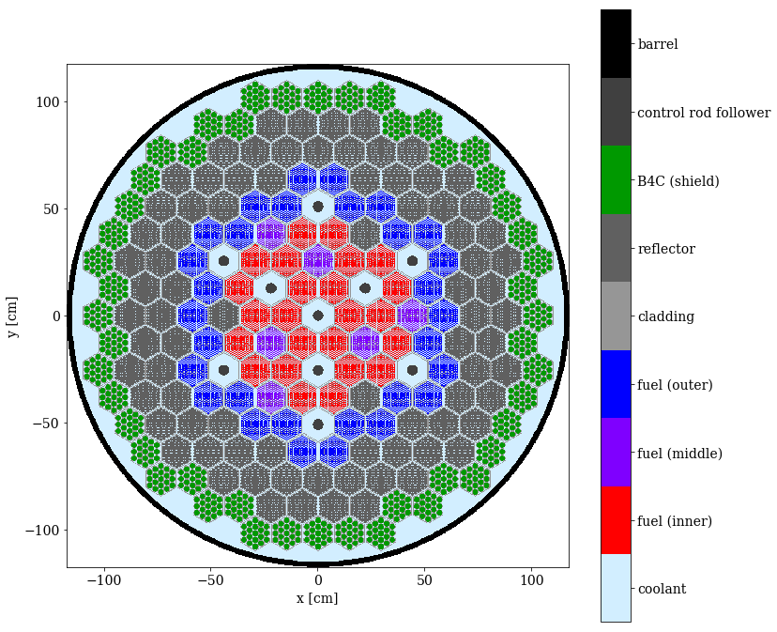
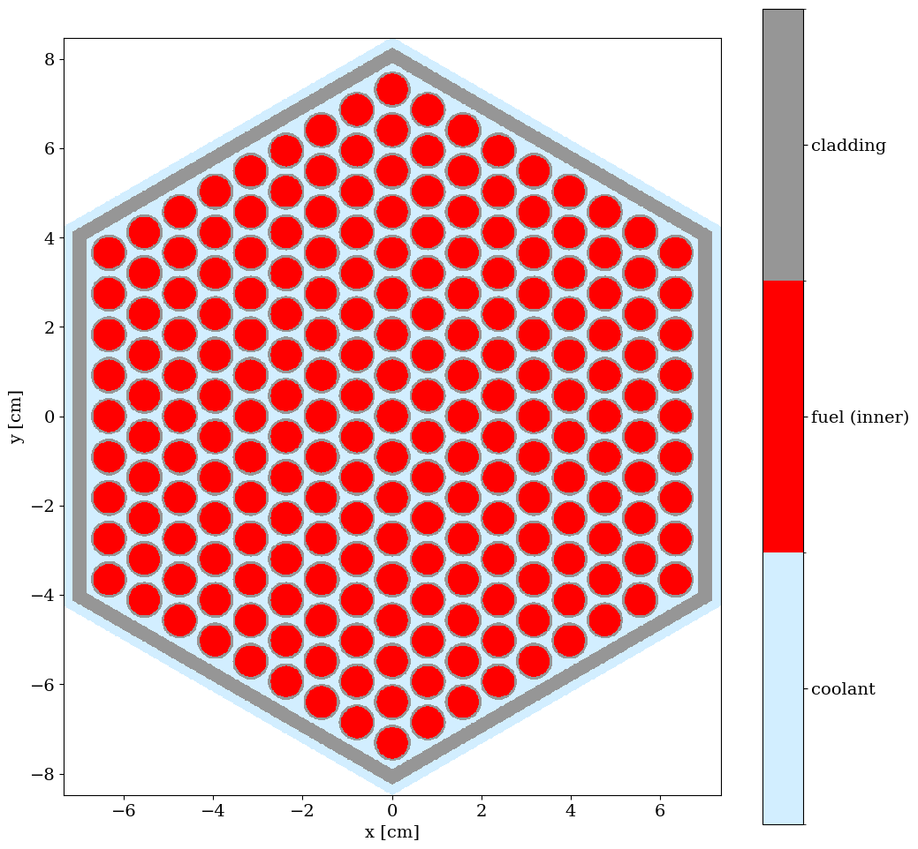
Shift is a Monte Carlo radiation transport code in SCALE
Flexible high-performance radiation transport code designed to scale from supercomputers to laptops
State-of-the-art methods and algorithms
sensitivity/uncertainty
depletion via
ORIGEN
GPU/CPU
hybrid variance
reduction

Slide 15
Shift can serve as a reference solution for Griffin for verification
Why and How?
"Exact" physics
"Exact" geometry
Single snapshot calculation
all quantities of interest with uncertainty
Automated ISOXML library generation
Are there limitations?
Notes:
Shift directly computes core output QOIs: k-eff, power distributions, reactivity coefs, etc
These calculations are performed at core “snapshots”, i.e. known of fixed TH and operation conditions (control position)
“Reference” implies
Exact physics: Continuous energy cross sections and scattering kinematics
Exact geometry: No spatial mesh, or discrete angle discretization
Only limitation is Monte Carlo statistics. However calculation of QOI uncertainties is a feature, not a bug!
In addition to output QOI verification, Shift can provide cross section verification
Shift can automatically generate a Griffin ISOXML library for a given snapshot based on user selection of MG boundaries and cross section regions
Shift-generated ISOXMLs compared to Griffin-generated ISOXMLs provide qualitative insight on potential issues in cross section preparation methods
Qualitative to Quantitative:
On-going effort to implement sensitivity coefficient generator in Griffin based on perturbation theory
Sensitivity-coefficients quantify how much a cross section difference impacts an output QOI difference
NEAMS-funded Shift-ISOXML library data:
Macroscopic cross sections
Microscopic cross sections
Kinetics Parameters (beta, lambda, delayed-chi)
Energy-weighted cross sections for power normalization
Transport cross sections for diffusion coefficients
In development
Higher-order scattering matrices
Optimizations
Surface tallies

Slide 16
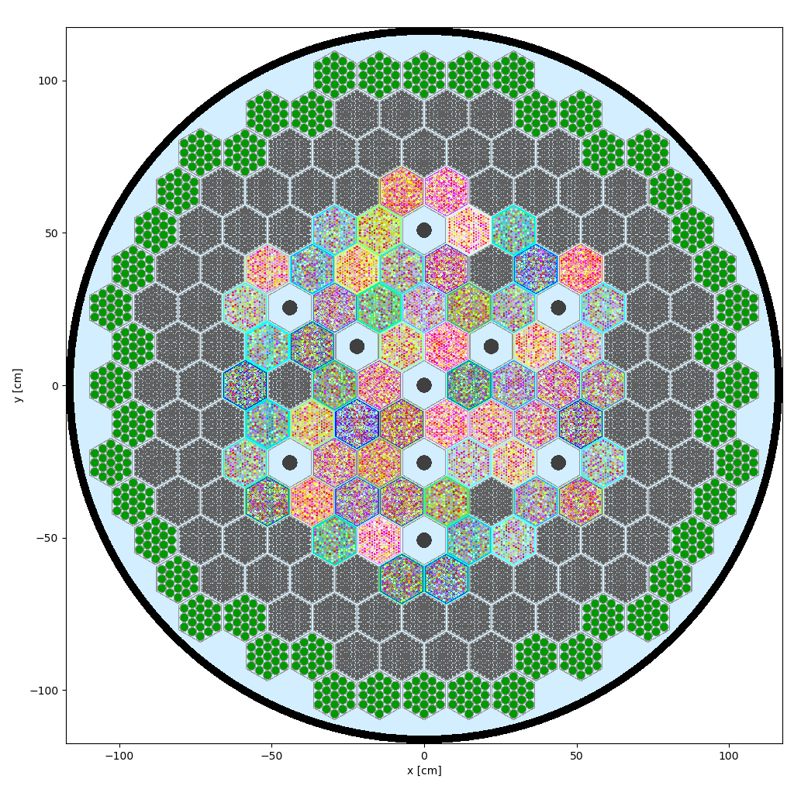
Titan is the reactor physics interface to Shift
NEAMS Workbench
Titan
Reduces modeling complexity
Shift
ORIGEN
reference
solution
multigroup cross sections
steady-state depletion
Notes:
Titan is an easy-to-use reactor model front-end that reduces modeling complexity that arises from unique material and unique tally regions
Titan utilizes other foundational components of SCALE (ORANGE, Shift, ORIGEN)
Titan offers Monte-Carlo cross-section generation (cell-union or overlay based) and steady-state depletion
Titan is integrated into the NEAMS Workbench (demonstrated at a July 2024 training at INL)
Goal is to be both a stand-alone reactor physics capability, and Internal API for client codes
Reducing code maintenance of multiple geometry packages
Extending the geometry capabilities for both codes
Enable snapshot verification with Shift
Future work:
GPU support
New shapes (involutes, triply periodic shapes, etc)
Fixed-source shielding and depletion
Autocomplete and other LSP capabilities for Workbench and VS Code
Automated ISOXML generation (instead of two-step process with provided python script)
Current Work:
Improvement of statistics in scattering matrices
Other:
Titan training in July 2024 provided the opportunity to address a lot of feedback and a couple bugs in the beta!
We have an up-to-date Titan install on sawtooth for anyone with SCALE beta access

Slide 17
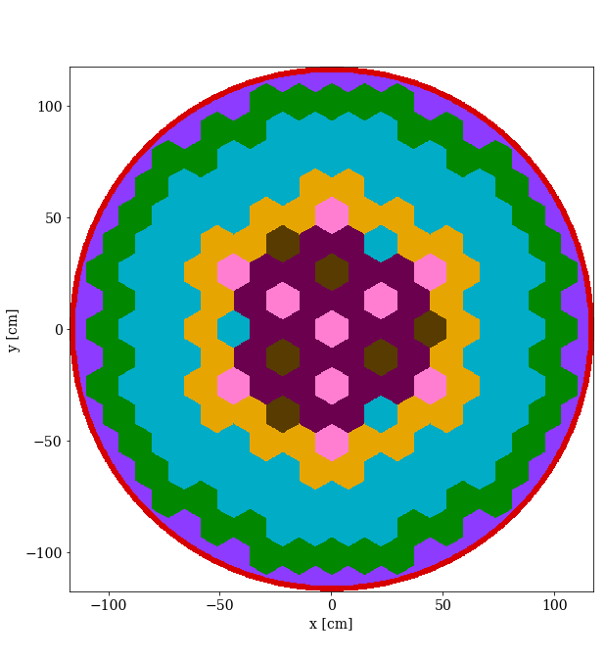
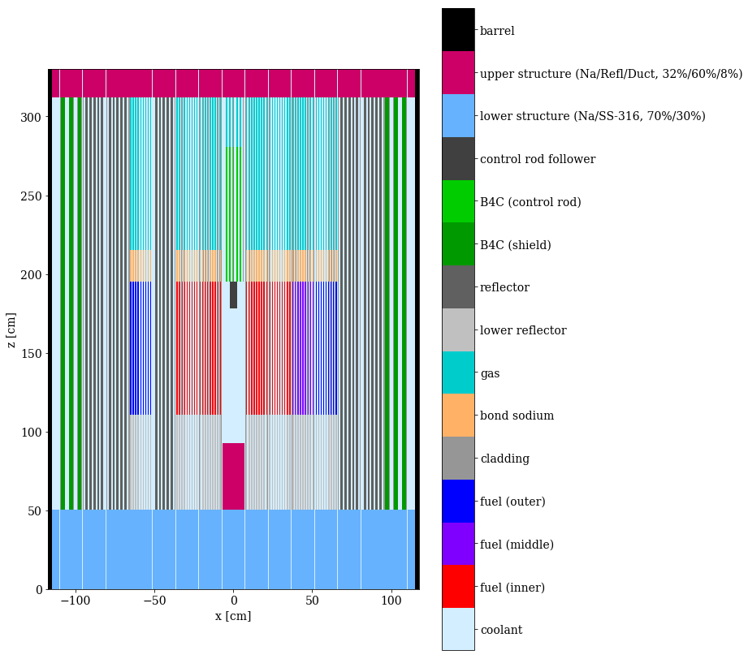
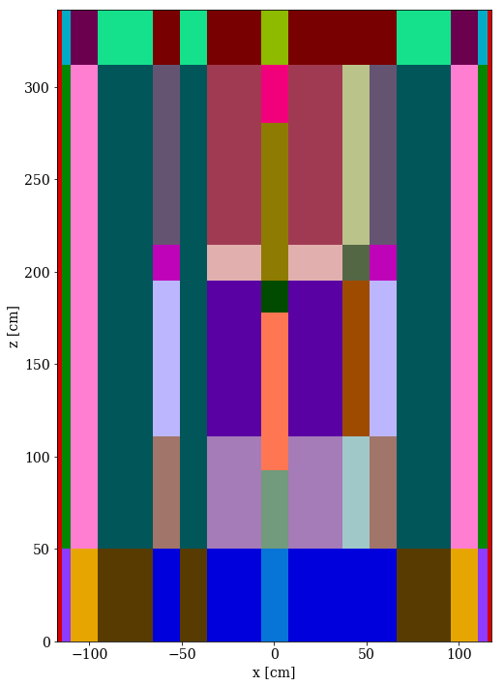
Overlay CSG cross section tally capability in Shift enables easier multigroup cross section generation
Constructive solid geometry
Homogenization use cases:
Pebble bed reactors (random pebbles)
Hexagonal lattices
Complex structures
Currently supported:
Macroscopic XS
ORANGE overlay geometry
Automated ISOXML generation
XY-slice at Z=180 cm
XZ-slice at Y=0 cm
Notes:
CSG = constructive solid geometry
ORANGE = internal CSG in SCALE
ISOXML = format for Griffin data
triangular meshes are usually used on hex lattices
Mechanics of the tally: The overlay tally is performed by simultaneously tracking individual MC particles on both the detailed/original problem geometry and the overlay tally geometry. This might incur a small performance overhead, but this cost is almost always small compared to CE xs lookup and the overlay geometry is usually much simplified
We exercised the overlay capability on a TRISO-HPMR with 22 homogenized regions
33 group energy structure

Slide 18
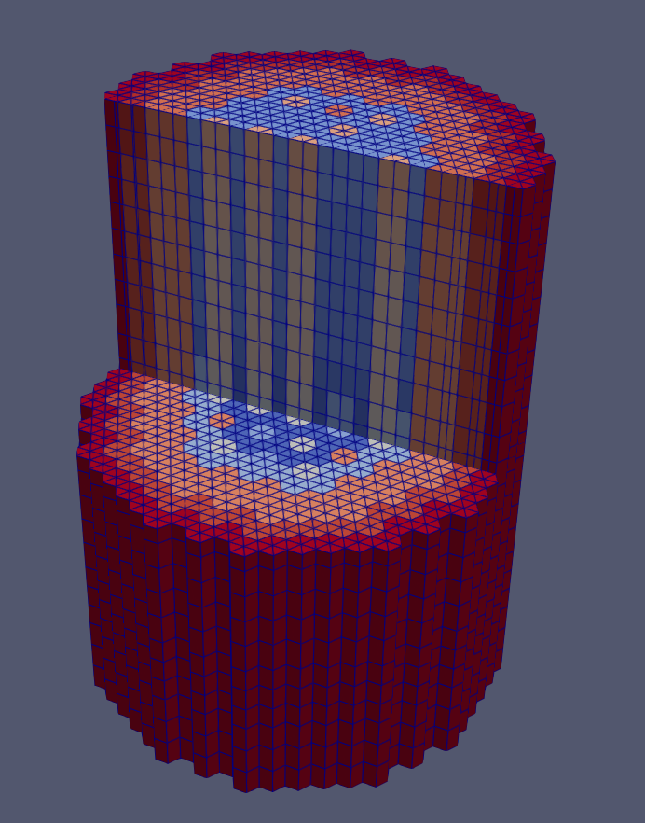
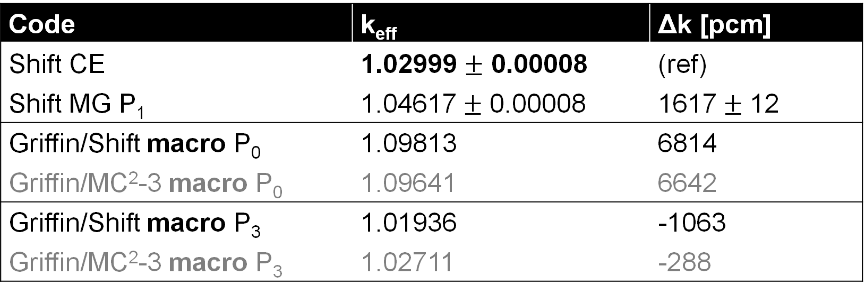
We exercised the overlay CSG cross section tally capability by performing two-step neutronics calculations with Shift and Griffin
Code | k_{eff} | Δk [pcm]
Shift CE | 1.02999 $±$ 0.00008 | (ref)
Shift MG P₁ | 1.04617$±$ 0.00008 | 1617
Griffin/Shift macro P₀ | 1.09813 | 6814
Griffin/MC²-3 macro P₀ | 1.09641 | 6642
Griffin/Shift macro P₃ | 1.01936 | -1063
Griffin/MC²-3 macro P₃ | 1.02711 | -288
Flux tallied in 1041 groups
Notes:
33-group macro XS calculation
Griffin mesh shows homogenized regions
Flux plot based on flux in 1041 groups
Flux plot showing energy boundaries for MG XS tallies
Results are not yet excellent

Slide 19
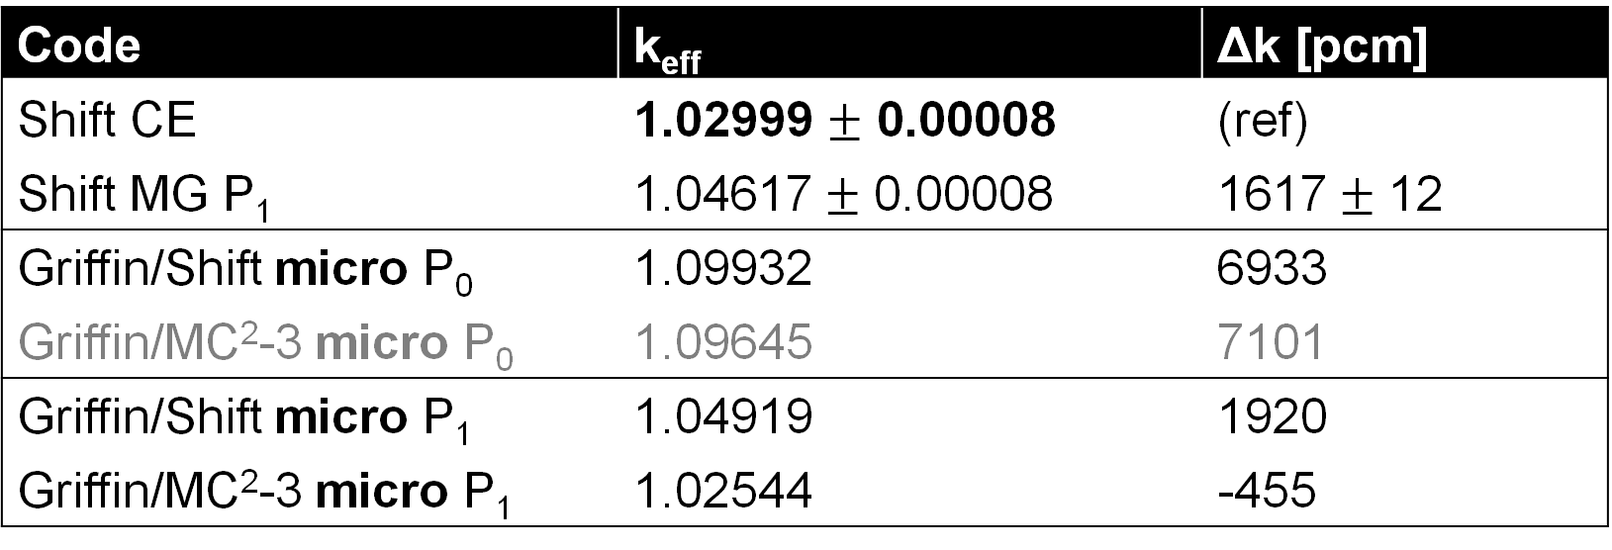
We added a new capability to generate microscopic few-group cross sections with Shift for use with Griffin
Code | k_{eff} | Δk [pcm]
Shift CE | 1.02999 $±$ 0.00008 | (ref)
Shift MG P₁ | 1.04617$±$ 0.00008 | 1617
Griffin/Shift micro P₀ | 1.09932 | 6933
Griffin/MC²-3 micro P₀ | 1.09645 | 7101
Griffin/Shift micro P₁ | 1.04919 | 1920
Griffin/MC²-3 micro P₁ | 1.02544 | -455
Notes:
Currently supported micro XS generation:
Cell-based
Coarse-group path-length reaction rate tallies
Fine-group path-length reaction rate tallies for transport
Collision-based scattering matrix probability
Automated ISOXML generation
Not yet, but soon: micros on overlay
The MC23 XS were generated using the standard approach of region-wise fine group flux solution obtained from an RZ model followed by the coarse-group XS gen using a heterogeneous model
These are just 2 example XS sets for the inner fuel
Note the discrepancy in the nu-fission which is due to a known issue with the generated MC23 library where the fission cross section small
Scattering matrix and its moments show large difference in the off-diagonal terms and for lower energy groups due to low scores → we are working on improving scattering matrices through virtual collision

Slide 20
Accomplished and future work on fast reactor physics modeling
SFR workflow has been established within Griffin to facilitate cross section generation, core analysis, pin power reconstruction, and fuel cycle management
Pin-wise and assembly-wise Griffin SFR solutions have been verified against DIF3D and Monte Carlo codes
Work is planned to extend fuel cycle management to support external cycle calculations
Work is planned to implement sodium backfill capability to support multiphysics simulations involving thermal expansion
Shift enables user-friendly generation of macroscopic and microscopic cross sections as well as provides reference solutions for Griffin
Work is in progress to improve statistical uncertainty of scattering matrices

