Slide 1
NEAMS Reactor Physics MSR Capabilities
Matthew Jessee
Changho Lee
Namjae Choi
May 28, 2025

Slide 2
NEAMS Reactor Physics technical area develops and deploys codes for modeling neutral particle transport and nuclide depletion/decay
Neutral particle transport: Interaction of neutrons/gammas with reactor materials
Transmutation: Time evolution of isotope inventories due to irradiation and decay; and decay-induced neutron and gamma source
Coupled Transport and Transmutation: Time evolution of flux (power), isotopes, and decay source
  Steady-state operation (days, months, years)
  Transient scenarios (seconds, hours, days)
  Spent fuel management (years)
Changes in geometry, temperature, and density influence change in reactor physics
Strategically prioritize, coordinate, and develop 3 codes: Griffin, Shift, and MPACT
MPACT is the direct whole-core reactor physics code integrated into VERA for high-fidelity light water reactor simulation
Griffin is a flexible MOOSE-based reactor physics application for multiphysics simulations of advanced reactor designs
  Range of mesh-based MG deterministic solvers
  On-the-fly cross section processing is integrated for both fast and thermal systems, including TRISO based systems
  Depletion/decay using built-in depletion solver
  Transient analysis using point kinetics, improved quasi static method, and spatial kinetics.
  MOOSE framework enables ease-of-coupling to other MOOSE-based codes
Shift is a Monte Carlo radiation transport code designed to scale from supercomputers to laptops.
  Continuous-energy nuclear data on exact geometry (CSG)
  State-of-the-art methods for eigenvalue, shielding, depletion, and sensitivity/uncertainty on CPU/GPU systems
  Shift provides MG cross sections for subsequent multiphysics simulations with Griffin for all non-LWR reactor systems

Slide 3
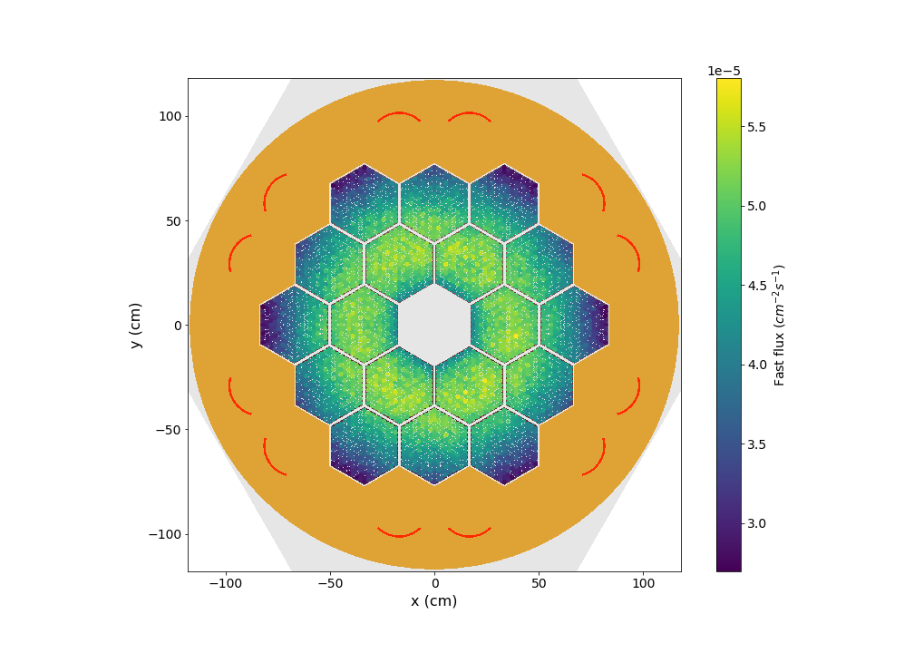

Shift is a Monte Carlo radiation transport code in SCALE
Empire Fast Flux Slice
Flexible high-performance radiation transport code designed to scale from supercomputers to laptops
State-of-the-art methods and algorithms
sensitivity/uncertainty
depletion via
ORIGEN
GPU/CPU
hybrid variance
reduction
TCR

Slide 4
Shift can serve as a reference solution for Griffin for verification
Why and How?
"Exact" physics
"Exact" geometry
Single snapshot calculation
all quantities of interest with uncertainty
Automated ISOXML library generation
Are there limitations?
Notes:
Shift directly computes core output QOIs: k-eff, power distributions, reactivity coefs, etc
These calculations are performed at core “snapshots”, i.e. known of fixed TH and operation conditions (control position)
“Reference” implies
Exact physics: Continuous energy cross sections and scattering kinematics
Exact geometry: No spatial mesh, or discrete angle discretization
Only limitation is Monte Carlo statistics. However calculation of QOI uncertainties is a feature, not a bug!
In addition to output QOI verification, Shift can provide cross section verification
Shift can automatically generate a Griffin ISOXML library for a given snapshot based on user selection of MG boundaries and cross section regions
Shift-generated ISOXMLs compared to Griffin-generated ISOXMLs provide qualitative insight on potential issues in cross section preparation methods
Qualitative to Quantitative:
On-going effort to implement sensitivity coefficient generator in Griffin based on perturbation theory
Sensitivity-coefficients quantify how much a cross section difference impacts an output QOI difference
NEAMS-funded Shift-ISOXML library data:
Macroscopic cross sections
Microscopic cross sections
Kinetics Parameters (beta, lambda, delayed-chi)
Energy-weighted cross sections for power normalization
Transport cross sections for diffusion coefficients
In development
Higher-order scattering matrices
Optimizations
Surface tallies

Slide 5

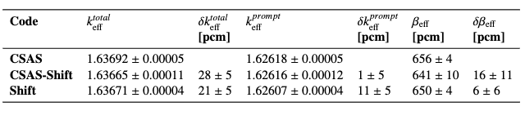

MSRE 2D pincell prompt eigenvalue and β_{eff} verified with Shift
Shift β_{eff} generated from multigroup cross section tallies = 651 pcm
2D MSRE pincell
Notes:
Why does this matter: One of the main MSR-specific implementations thus far into Shift is the ability to compute k_prompt. Which provides an estimate for beta_eff using the k_prompt method. This provides an upper bound on beta_eff if there was no delayed neutron drift.
Verification of prompt eigenvalue calculations of Shift and the kinetics parameter tallies were performed using a 2D MSRE pincell
3 calculations: 1) CSAS (using KENO) which is a Monte Carlo sequence in SCALE; 2) CSAS using Shift; 3) Shift by itself (run through Omnibus) in which we also tallied macroscopic cross sections to generate the tallied beta-eff
Agreement between all!

Slide 6
Overview of Griffin R&D Activities for MSR systems
Dr. Changho Lee (ANL)

Slide 7
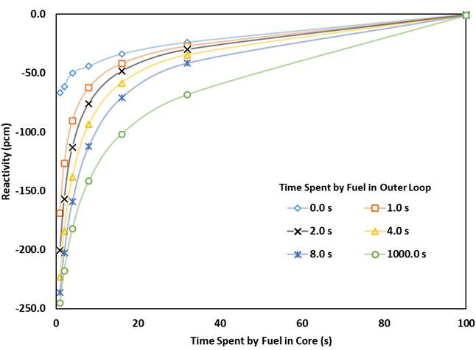
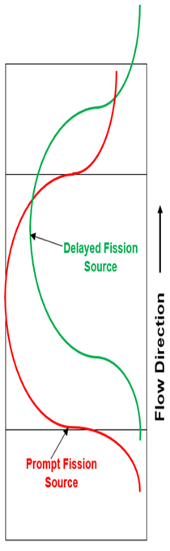
Flowing Fuel Simulation Using Griffin
Capabilities
  Steady-state, transient simulation
  Delayed neutron precursor drifting
  Depletion (needs updates)
  Decay heat (fission product drifting) (needs updates)
  Multiphysics simulation support
Cross sections
  Online cross sections using SSAPI for thermal spectrum cores (needs verification)
  MC²-3 for fast spectrum cores (needs workflow)
  Use of external codes (OpenMC, Shift, …)
(fast)
(slow)
Short-lived DNP
Long-lived DNP

Slide 8
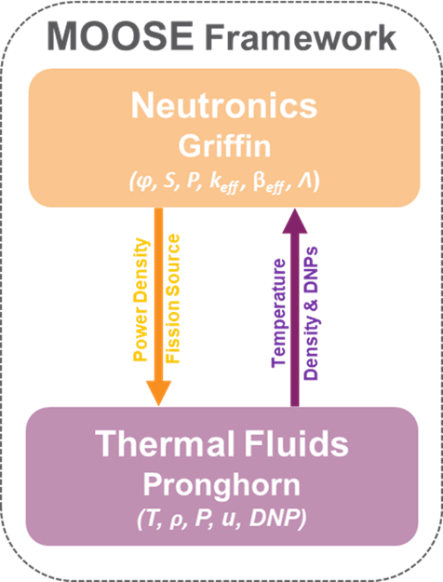
Multiphysics Simulation with SAM or Pronghorn
Griffin-SAM or Griffin-Pronghorn coupled models were developed for Multiphysics simulations (e.g., pump startup and coast-down transient)
MultiApp and Transfer systems are used to transfer information between SAM or Pronghorn and Griffin.
Power profile is transferred from Griffin to SAM or Pronghorn, and temperature and DNP profiles are transferred from SAM or Pronghorn to Griffin
Coupled Griffin and SAM

Slide 9
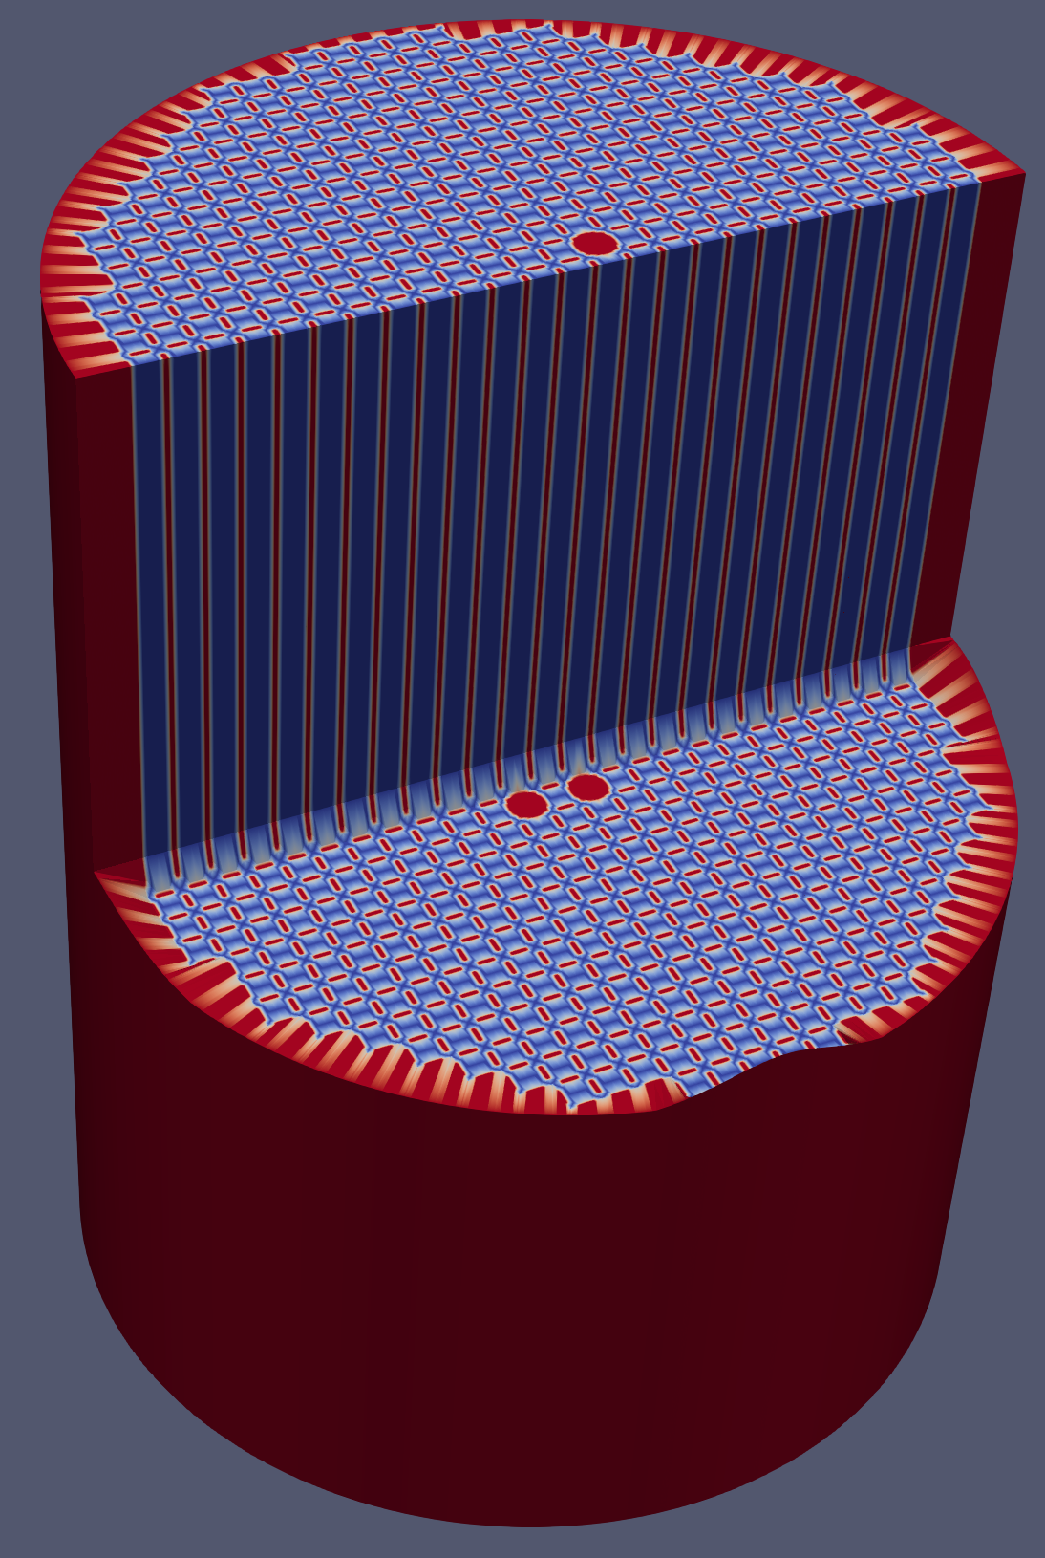
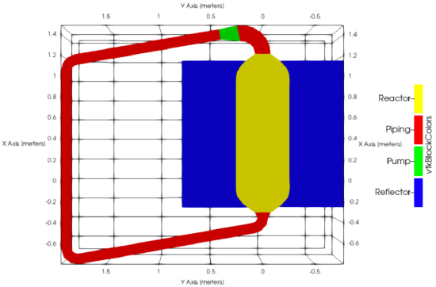
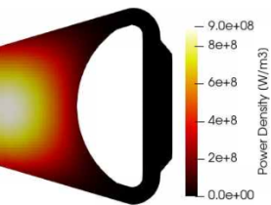
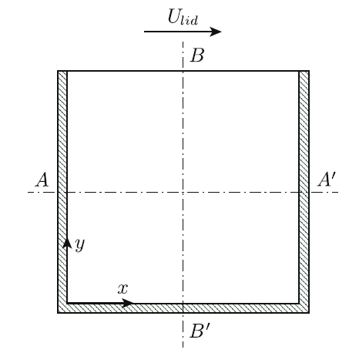
Verification & Validation Tests
MSRE
Lotus-MSR
MSFR
CNRS
10 MWth
908-936K
LiF-BeF₂-ZrF₄-UF₄
33 w/o
25 KWth
900K
NaCl–UCl₃
93 w/o
3 GWth
973K
LiF-ThF₃-UF₄
900K
LiF-BeF₂-UF₄

Slide 10
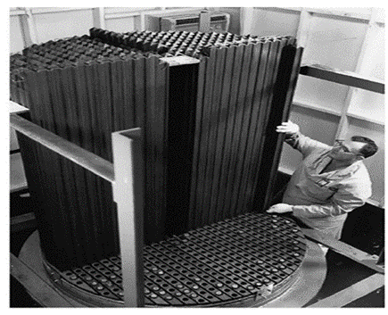
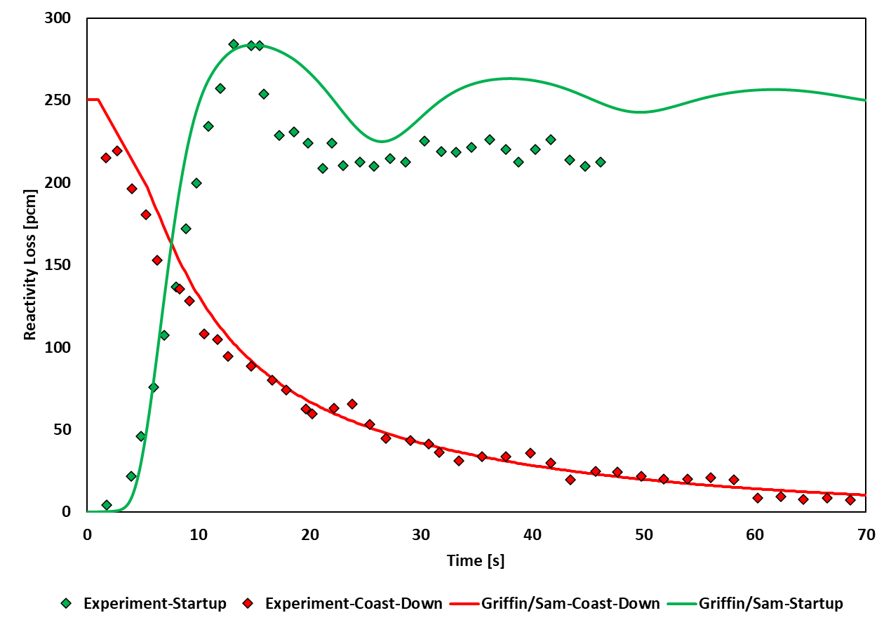

Validation Tests: Homogeneous Modeling of MSRE
Griffin-Pronghorn simulation
  Cross section generation by OpenMC
  Homogenized fuel region
Transient conditions during the zero-power experiment
  Initial equilibrium conditions were established with minimal flow rate.
  DNP losses (Fuel Salt Velocity) is only feedback mechanism.
  Criticality was maintained at zero power by adjusting control rod positions.
  Reactivity inserted by control rods compensates reactivity changes due to redistribution of the DNPs in the core region.
Performed multiphysics transient simulations
  Initial equilibrium conditions were established.
  Minimal flow (0.01% Nominal Value).
  Zero power state (0.01% Full Power).
  Both pump transient scenarios were performed with the same simulation.
  Mass flow rate was adjusted similar to the measured values.
M. Jaradat et al., “Thermal spectrum molten salt-fueled reactor reference plant model, Idaho National Laboratory,” INL/RPT-23-72875, 2023.

Slide 11
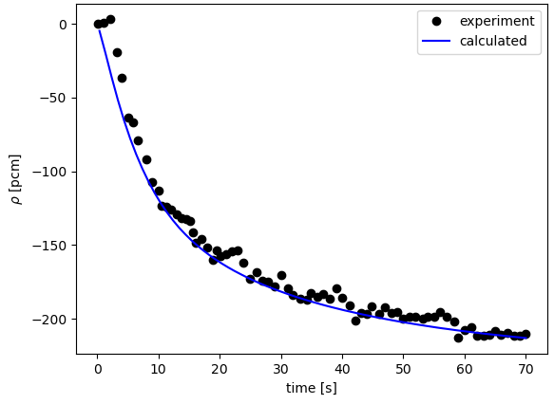
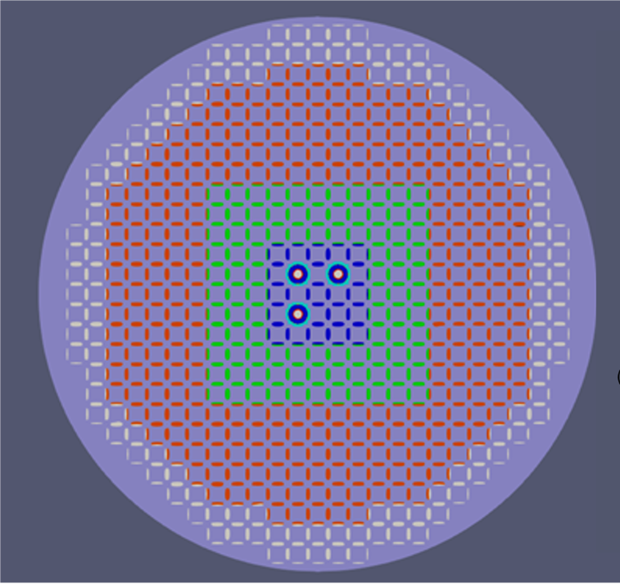
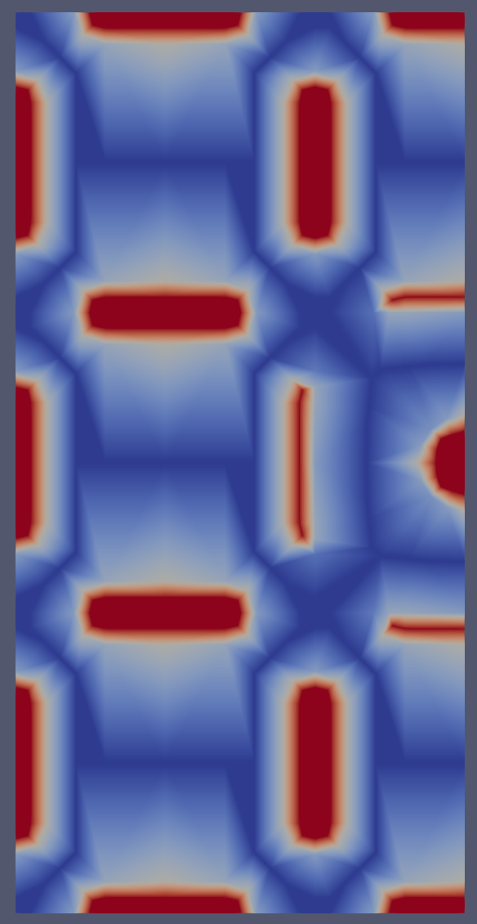
Validation Tests: Heterogeneous Modeling of MSRE
Cross sections were generated using OpenMC
Meshes were generated using the MOOSE Reactor Module
Heterogeneous modeling of MSRE using Griffin
SAM is the main app that drives Griffin eigenvalue calculation at each time step
Single-/multi-channel approach in SAM
Pump Coast-down
T. Fei et al., "Validation of NEAMS Tools Using MSRE Data," Argonne National Laboratory, ANL/NSE-22/48, August 2022

Slide 12
Application of Griffin for CNRS benchmark
Dr. Namjae Choi (INL)

Slide 13
Benchmarking of Griffin for MSRs – CNRS Benchmark
Developed by LPSC/CNRS-Grenoble.
  M. Tiberga et al., “Results from a multi-physics numerical benchmark for codes dedicated to molten salt fast reactors,” Annals of Nuclear Energy 142, 107428 (2020).
A simple 2m x 2m lid-driven cavity problem filled with molten salt.
Benchmark analysis results independently produced and submitted by CNRS, PoliMi, PSI, and TUD for cross comparison.
Chosen for code-to-code verification due to simplicity and the existence of multiple independent results.

Slide 14
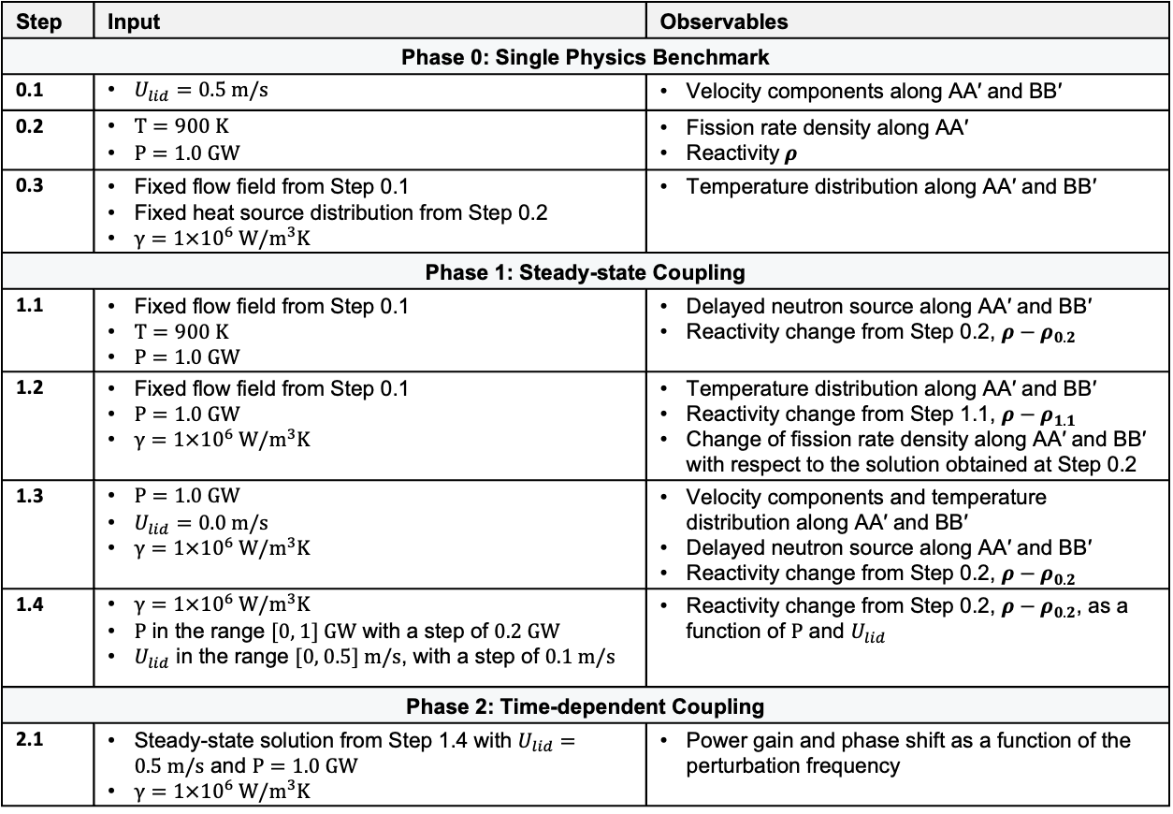
Benchmarking of Griffin for MSRs – CNRS Benchmark
Performed in three phases with progressively increasing complexity by gradually adding more coupling terms.
Encompasses single and multiphysics and steady-state and transient conditions, capturing important physics of MSRs.
Step | Input | Observables
Phase 0: Single Physics Benchmark
0.1 | $U_{lid}=0.5 m/s$ | Velocity components along AA′ and BB′
0.2 | $T=900 K$ $P=1.0 GW$ | Fission rate density along AA′ Reactivity $ρ$
0.3 | Fixed flow field from Step 0.1 Fixed heat source distribution from Step 0.2 $γ=1×{10}^{6} W/m^{3}K$ | Temperature distribution along AA′ and BB′
Phase 1: Steady-state Coupling
1.1 | Fixed flow field from Step 0.1 $T=900 K$ $P=1.0 GW$ | Delayed neutron source along AA′ and BB′ Reactivity change from Step 0.2, $ρ−ρ_{0.2}$
1.2 | Fixed flow field from Step 0.1 $P=1.0 GW$ $γ=1×{10}^{6} W/m^{3}K$ | Temperature distribution along AA′ and BB′ Reactivity change from Step 1.1, $ρ−ρ_{1.1 }$ Change of fission rate density along AA′ and BB′ with respect to the solution obtained at Step 0.2
1.3 | $P=1.0 GW$ $U_{lid}=0.0 m/s$ $γ=1×{10}^{6} W/m^{3}K$ | Velocity components and temperature distribution along AA′ and BB′ Delayed neutron source along AA′ and BB′ Reactivity change from Step 0.2, $ρ−ρ_{0.2}$
1.4 | $γ=1×{10}^{6} W/m^{3}K$ $P$ in the range [0, 1] GW with a step of 0.2 GW $U_{lid}$ in the range [0, 0.5] m/s, with a step of 0.1 m/s | Reactivity change from Step 0.2, $ρ−ρ_{0.2}$, as a function of $P$ and $U_{lid}$
Phase 2: Time-dependent Coupling
2.1 | Steady-state solution from Step 1.4 with $U_{lid}=0.5 m/s$ and $P=1.0 GW$ $γ=1×{10}^{6} W/m^{3}K$ | Power gain and phase shift as a function of the perturbation frequency

Slide 15
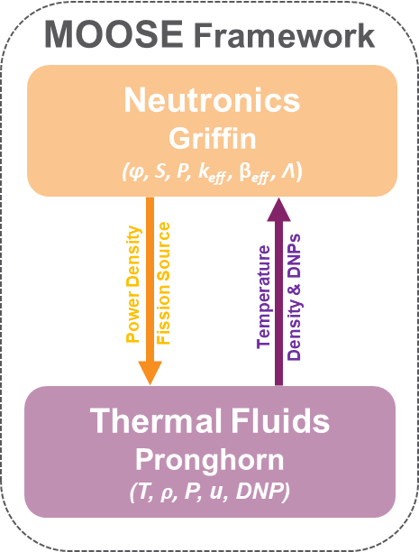
Griffin – Pronghorn Multiphysics Coupling for MSRs
Griffin provides the power density and fission source to Pronghorn.
Pronghorn computes the temperature, density, velocity, and pressure fields and the DNP distribution.
The density field is transferred to Griffin to update multigroup cross sections for incorporating thermal feedback.
The DNP distribution is used to construct the total fission source to obtain the neutron flux solution and corresponding power density.

Slide 16
Key Results – Step 1.4: Full Coupling
Expected physics of DNP drift are captured properly.
The DNPs with longer half-lives are more dispersed following the flow field.
The impact of forced convection on the DNP distributions can be observed.
Flow Speed and DNP Distributions
Notes:
Changho – font too small
Namjae – to work on perhaps improve on plot and narrative

Slide 17
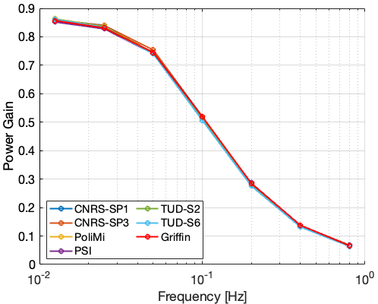
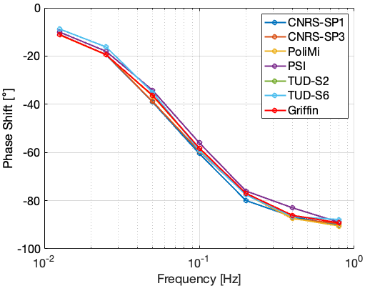
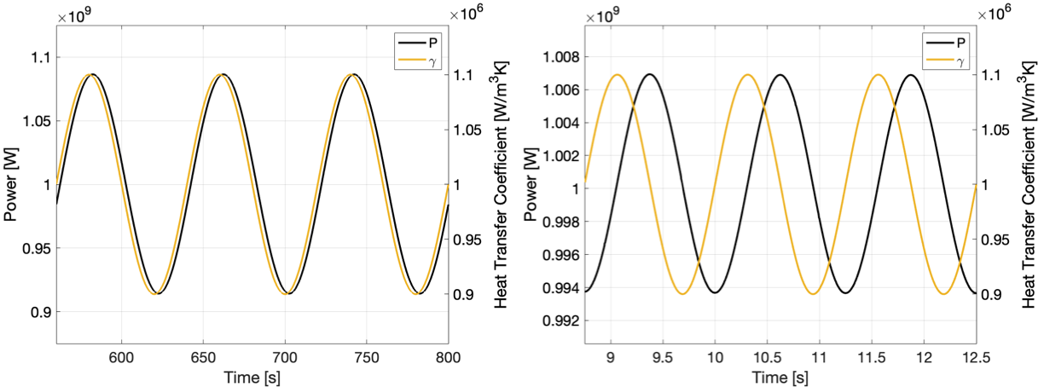
Key Results – Step 2.1: Forced Convection Transient
Power Gain
Phase Shift
Expected system dynamic responses by the sinusoidal perturbation of heat transfer coefficient are captured properly.
Power gain is reduced as the frequency gets higher due to delayed neutrons.
Phase shift approaches 90 degrees as the frequency gets higher due to temperature time-derivative term dominating convective and diffusive terms.
Power and Heat Transfer Coefficient Waves
0.0125 Hz
0.8 Hz

Slide 18
Summary and Future Work
Griffin is capable of simulating MSRs with flowing fuel and performing multiphysics simulations with Pronghorn or SAM for steady-state and transient conditions.
Griffin – Pronghorn or SAM has demonstrated very good agreement with reference solutions in benchmark cases, including MSRE, CNRS, MSFR, etc.
Griffin will address advanced depletion modeling for flowing fuel, removal of FPs, workflows for cross section generation, and extended verification and validation of single- and multi-physics simulations for key phenomena in various MSR types.
Shift will support for ex-core dose calculations over MSR lifetime to incorporate depletion, activation of materials; Support for generation of MSR multigroup macro/micro cross sections accounting for feed, removal, and temperature changes; support for automation of these workflows

