Slide 1
NEAMS RP Light Water Reactor Capabilities
Matthew Jessee (ORNL)
Javier Ortensi (INL)

Slide 2
NEAMS Reactor Physics technical area develops and deploys codes for modeling neutral particle transport and nuclide depletion/decay
Neutral particle transport: Interaction of neutrons/gammas with reactor materials
Transmutation: Time evolution of isotope inventories due to irradiation and decay; and decay-induced neutron and gamma source
Coupled Transport and Transmutation: Time evolution of flux (power), isotopes, and decay source
Steady-state operation (days, months, years)
Transient scenarios (seconds, hours, days)
Spent fuel management (years)
Changes in geometry, temperature, and density influence change in reactor physics
Strategically prioritize, coordinate, and develop 3 codes: Griffin, Shift, and MPACT
MPACT is the direct whole-core reactor physics code integrated into VERA for high-fidelity light water reactor simulation
Griffin is a flexible MOOSE-based reactor physics application for multiphysics simulations of advanced reactor designs
Range of mesh-based MG deterministic solvers
On-the-fly cross section processing is integrated for both fast and thermal systems, including TRISO based systems
Depletion/decay using built-in depletion solver
Transient analysis using point kinetics, improved quasi static method, and spatial kinetics.
MOOSE framework enables ease-of-coupling to other MOOSE-based codes
Shift is a Monte Carlo radiation transport code designed to scale from supercomputers to laptops.
Continuous-energy nuclear data on exact geometry (CSG)
State-of-the-art methods for eigenvalue, shielding, depletion, and sensitivity/uncertainty on CPU/GPU systems
Shift provides MG cross sections for subsequent multiphysics simulations with Griffin for all non-LWR reactor systems

Slide 3
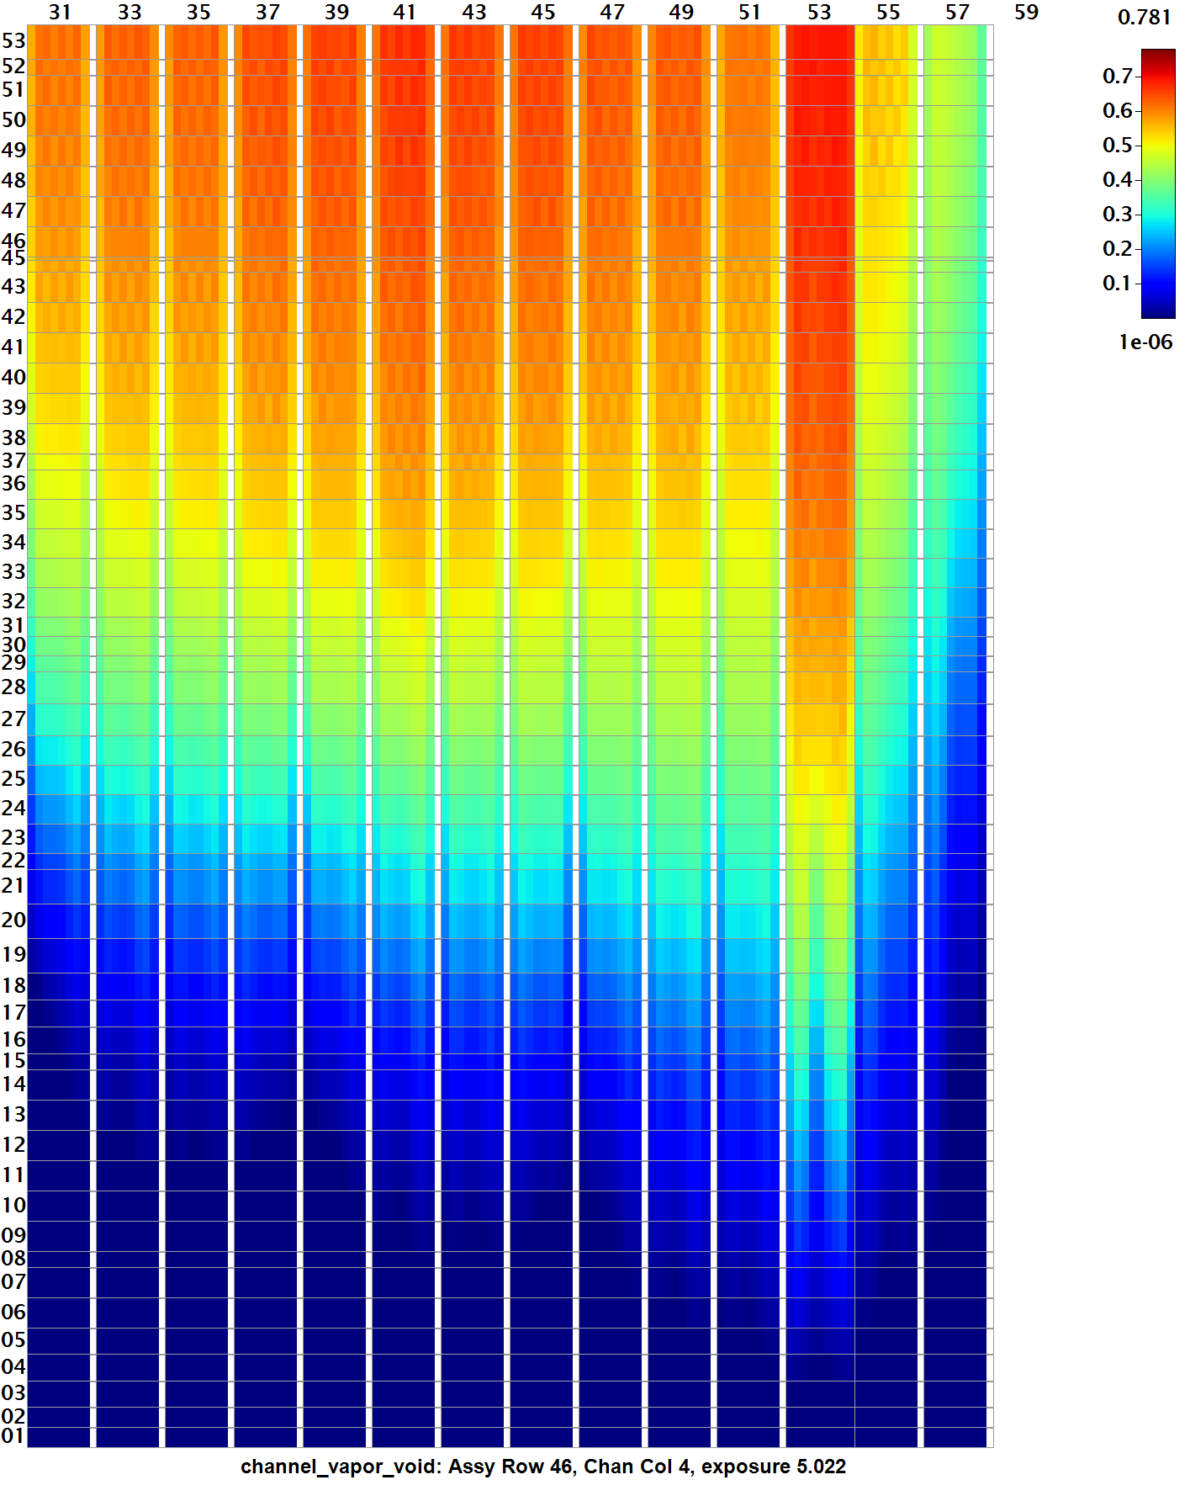
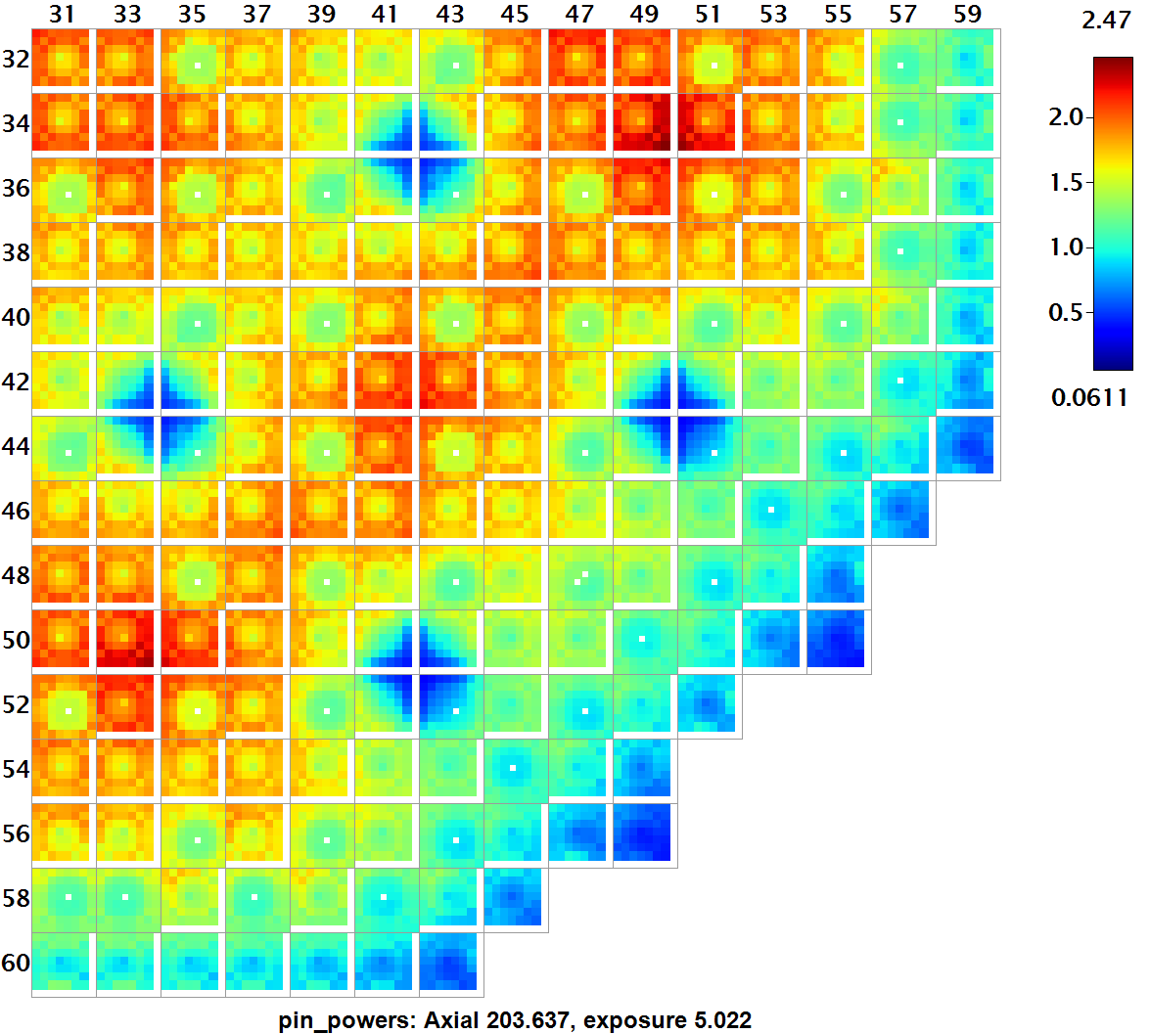
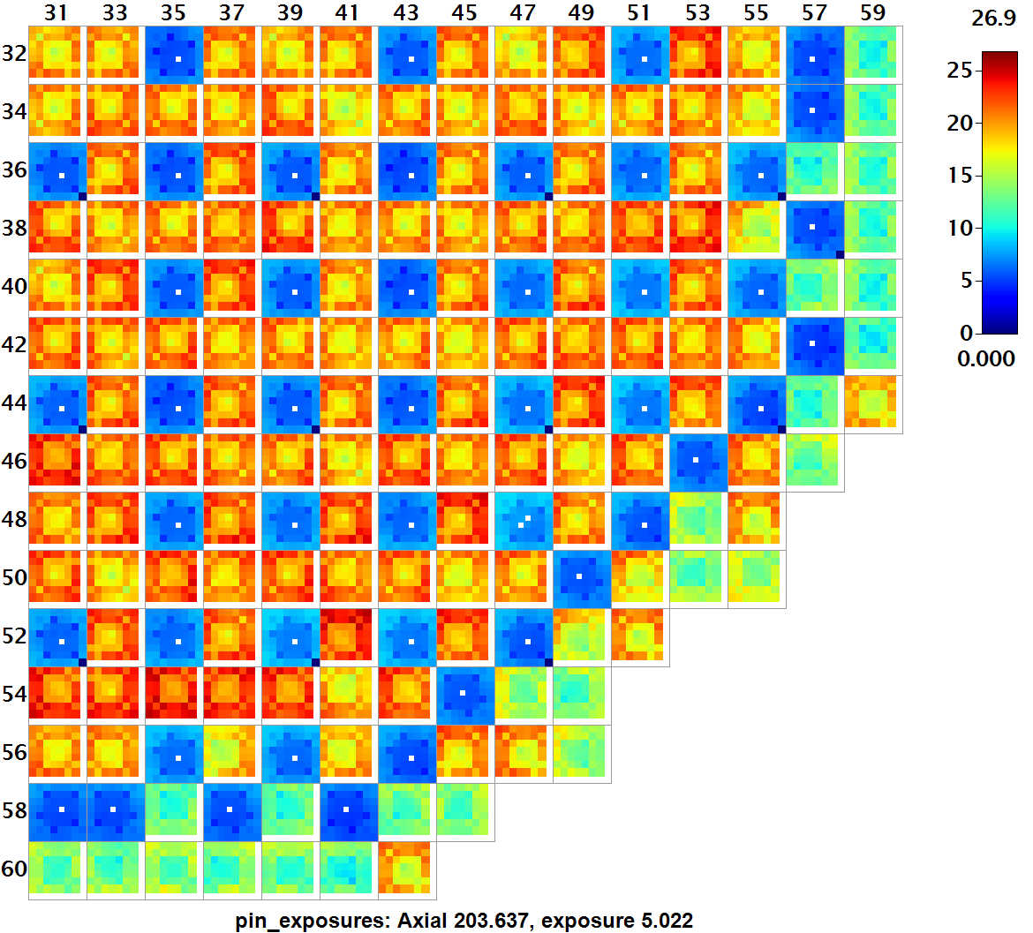
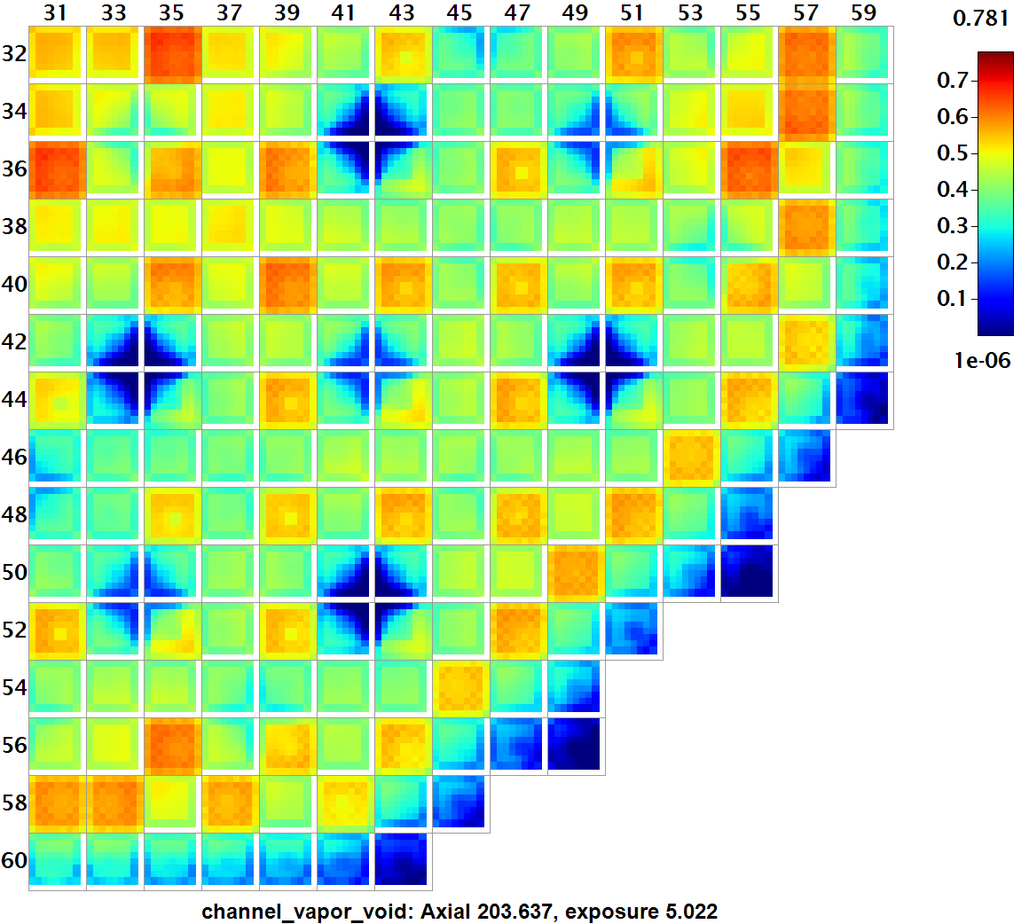
VERA Model Description
Whole-core 3D neutron transport
51 energy groups using subgroup method and P2 scattering
Explicit pin-by-pin powers with intra-pin distributions
Explicit 3D reflector geometry​​
Explicit pin-by-pin depletion at local conditions​
Explicit isotopic decay
TH moderator and fuel temperature feedback​ using VERA’s Simplified TH model for depletion and CTF for transient
Pin powers at EOC (radial slice)
Coolant void at EOC (axial and radial slices)
Pin exposures at EOC (radial slice)

Slide 4
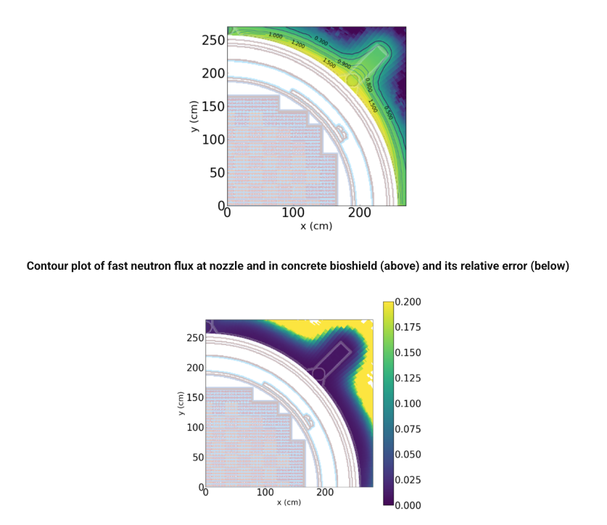
VERA
Other features:
Inline Shift excore-dose capability
ORIGEN depletion
Coupling to CTF MAMBA and BISON
Access
VERA is controlled under Part 810 of Title 10 of the U.S. Code of Federal Regulations (10 CFR 810)
Individual VERA 4.3 license available through RSICC https://rsicc.ornl.gov
Commercial licensing: Email vera-support@ornl.gov
VERA 4.3 is available on INL NCRC through government use agreements, email vera-support@ornl.gov

