Slide 1
Development of Graphite Thermal and Mechanical Modeling Capabilities in Grizzly
Parikshit Bajpai, Veerappan Prithivirajan, Gyanender Singh, Lynn Munday, Benjamin Spencer
Idaho National Laboratory

Slide 2
Graphite in Nuclear Reactors
Graphite used extensively as a moderator and reflector
Prominent historical or operational reactors
US: CP-1, MSRE, Peach Bottom 1, Fort Saint Vrain,
International: Magnox (UK), AGR (UK), RBMK (Soviet).
In consideration for advanced reactor designs
HTGR, MSR, FHR.
Environmental effects
Irradiation: shrinkage, swelling, creep, thermal expansion coefficient, thermal conductivity,
Oxidation: mass loss, property degradation.
Operational/safety concerns from graphite degradation
Changes in coolant flow patterns (e.g., bypass flow),
Interference with reactor control mechanisms.
Need for simulation tools to predict lifetime performance of graphite components.
Typical prismatic graphite fuel block (left) and reflector block (right).
From Windes et al., INL/EXT-14-31720
Notes:
Graphite is widely used in nuclear reactors both as moderator and reflector. There are several prominent reactors all around the world which have used or are currently using graphite and several upcoming designs also expect to use graphite. These include high temperature gas reactors, molten salt reactors and fluoride salt-cooled high-temperature reactors. However, nuclear graphite degrades due to various factors like irradiation, oxidation, and temperature changes, ultimately affecting its structural integrity and performance. Irradiation, especially from neutrons, causes atomic displacements leading to lattice distortions and microstructural changes. Oxidation, particularly at high temperatures, leads to weight loss and a reduction in strength and durability. Modeling and analysis tools are crucial for predicting and mitigating graphite degradation in nuclear reactors, ensuring core stability and safe operation

Slide 3

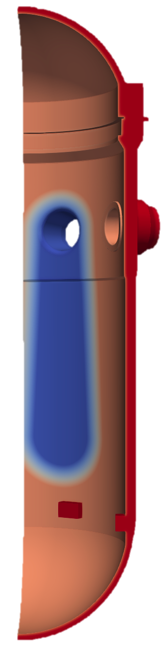
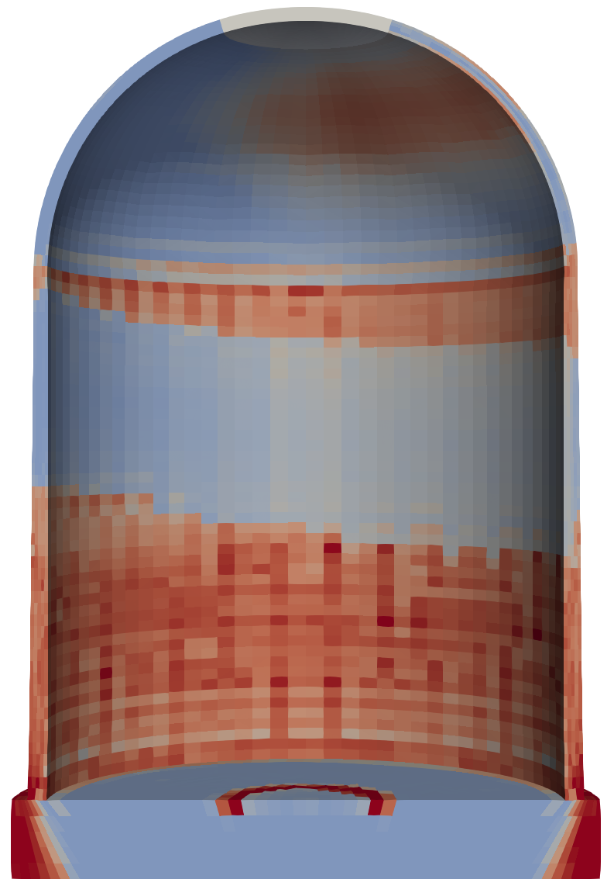
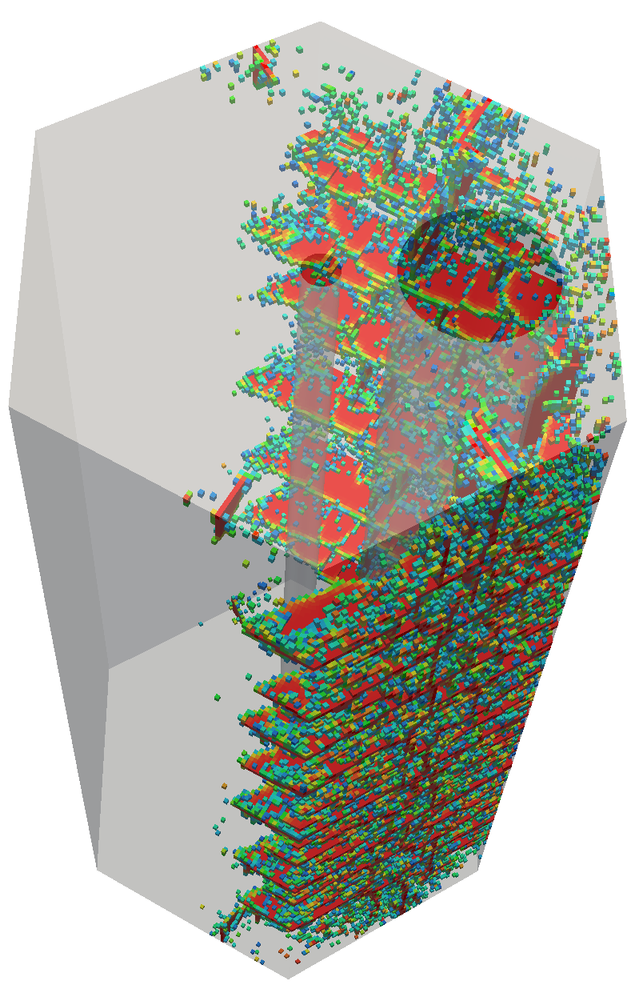
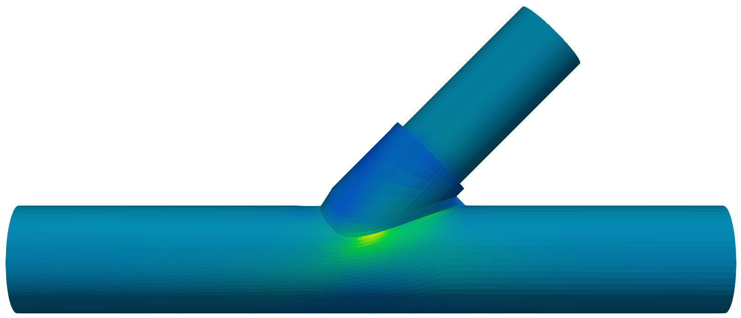
Grizzly & BlackBear: Component Degradation Codes
Multiphysics simulation of the progression and effects of degradation
Light Water Reactor Pressure Vessel Fracture
Reinforced Concrete Degradation
High-Temperature Alloy Creep
Graphite Deformation and Fracture
Notes:
Grizzly and BlackBear are MOOSE-based application for modeling degradation phenomena in structural materials and predicting the response of those structures to the loading conditions that they are expected to safely withstand. As was mentioned by Ben in the overview, these codes have been used for modeling of phenomena such as Reactor Pressure Vessel fracture in LWRs, degradation of reinforced concrete containments, and high-temperature alloy creep. Over the last couple of years, there has been an effort under NEAMS to develop capabilities to enable deformation and fracture modleing in graphite components.

Slide 4
Graphite Thermomechanical Modeling
Reactor conditions initiate several degradation mechanisms in graphite
Non-uniform volumetric strains induced by irradiation and thermal expansion.
Stresses can compromise the performance of graphite components.
Robust modeling and simulation tools required for predicting
Stress and strain fields.
Fracture initiation and propagation.
Require material properties to inform the thermomechanical models.
Material Properties
Oxidation Rates
Component Geometry & Environment
Thermomechanical Models
Oxidation
Model
Stress Distribution
Structural Reliability Class
ASME
Assessment
Material Strength
Schematic for assessing a graphite component based on the ASME BPVC.
From Bass, INL/EXT-21-65240
Notes:
Graphite is a polycrystalline material and reactor environment activates several degradation mechanisms which can compromise the performance of graphite components. Graphite component assessments are performed following the guidelines in ASME BPVC and needs robust modeling and simulation tools for predicting stress and strain fields as well as fracture initiation and propagation. All these models require material properties, and we have been working of both these aspects.

Slide 5
Thermomechanical Property Models
Temperature and dose dependent thermal and mechanical properties needed:
Thermal: Thermal conductivity, specific heat, coefficient of thermal expansion.
Mechanical: Elastic modulus, Poisson’s ratio, strength, creep coefficient, irradiation induced dimensional change (IIDC).
Parametrized expressions for IIDC and irradiation creep calibrated from Advanced Graphite Creep (AGC) data.
Models added for IG-110, NBG-18 and H-451 graphite grades.
Bajpai et al., INL/RPT-24-78905, 2024.
Notes:
Regarding thermomechanical properties, temperature and dose dependent expressions are needed for properties like elastic modulus, strength, creep, thermal conductivity, etc. Many of these properties have been measured under the AGC campaign but often we don’t have expressions that capture both temperature and dose dependence of these properties. Therefore, as part of this work we have been working on calibrating parametrized expressions for several properties using the AGC data. We primarily focused on the development of IIDC and creep models for graphite grades IG-110, NBG-18. and H-451. These models inform the Grizzly component simulations.

Slide 6
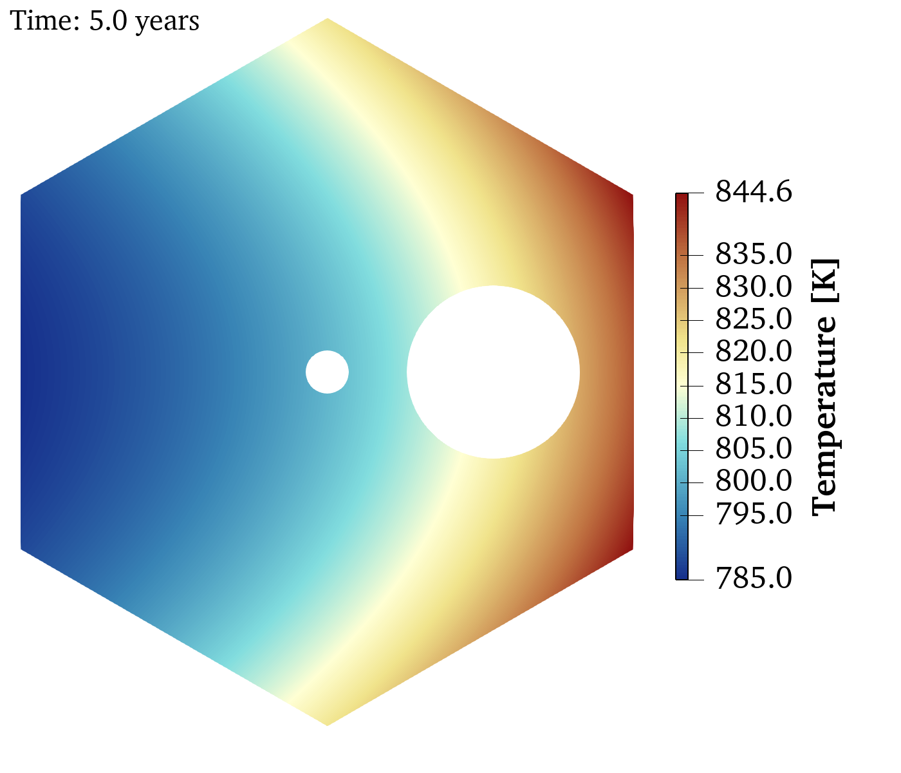
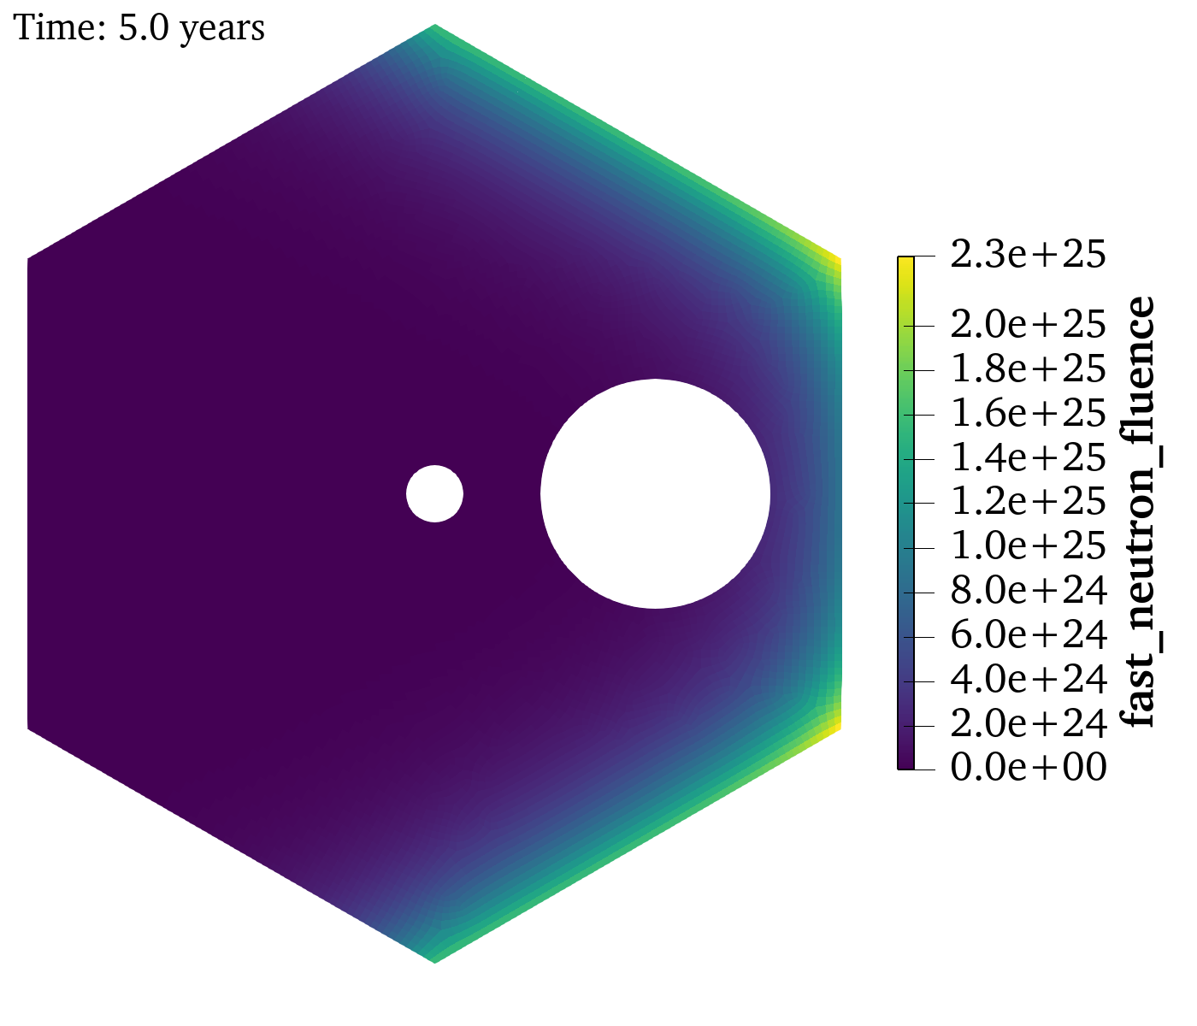
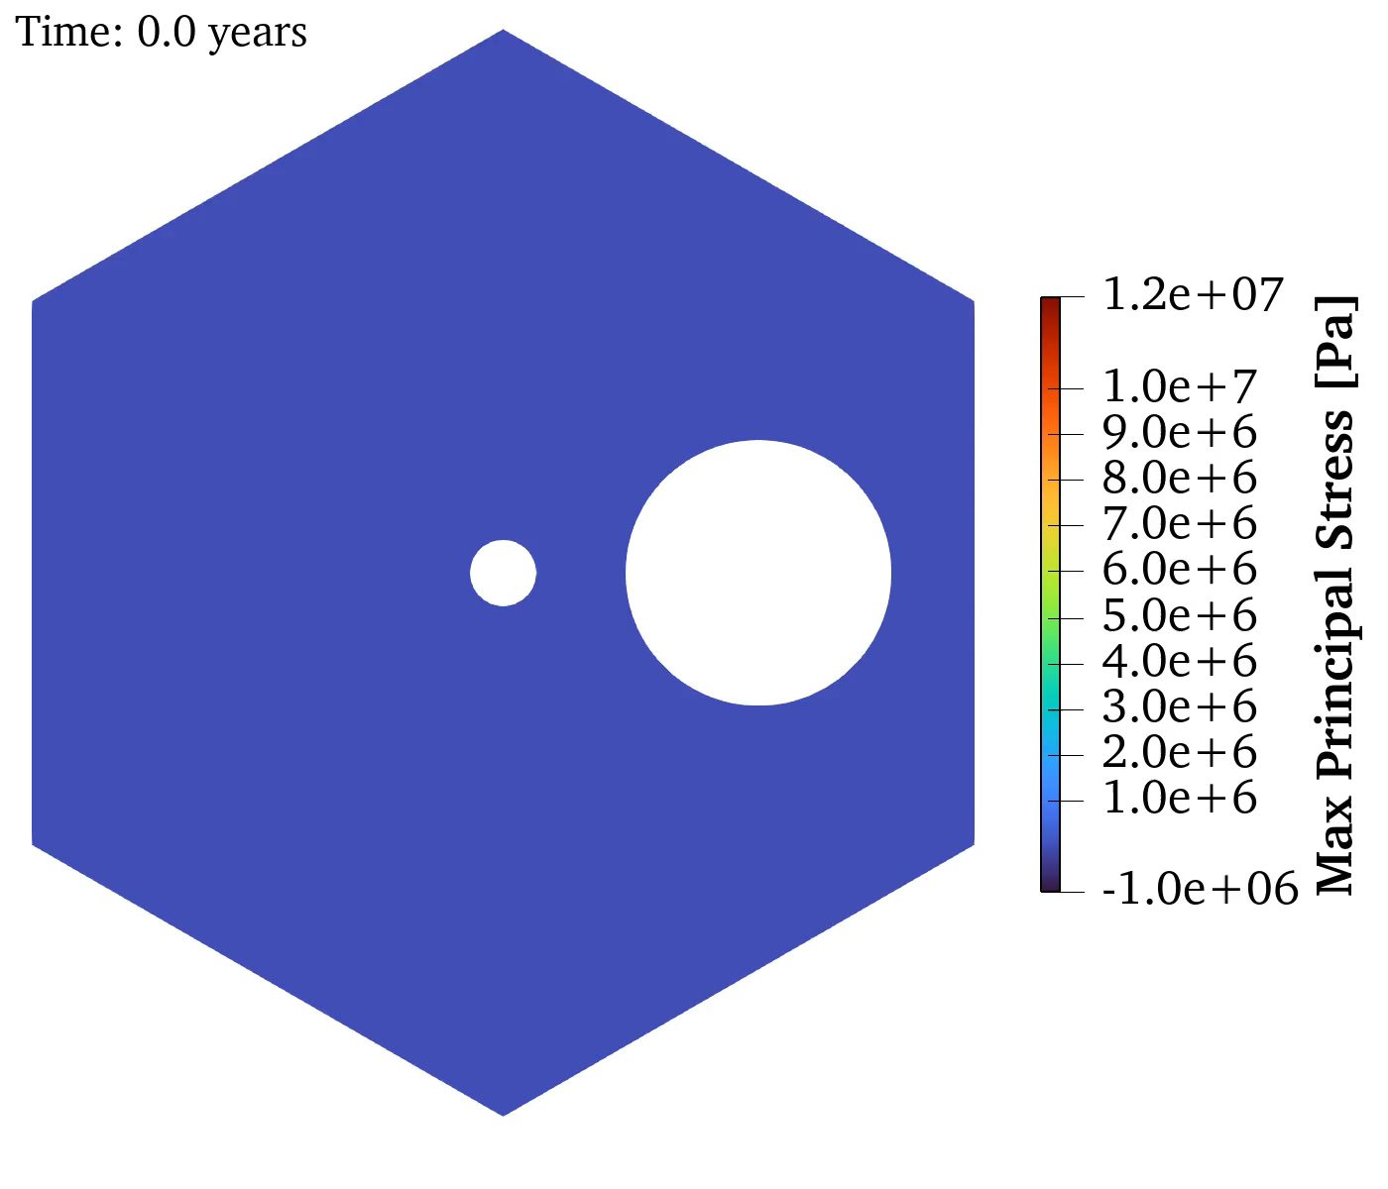
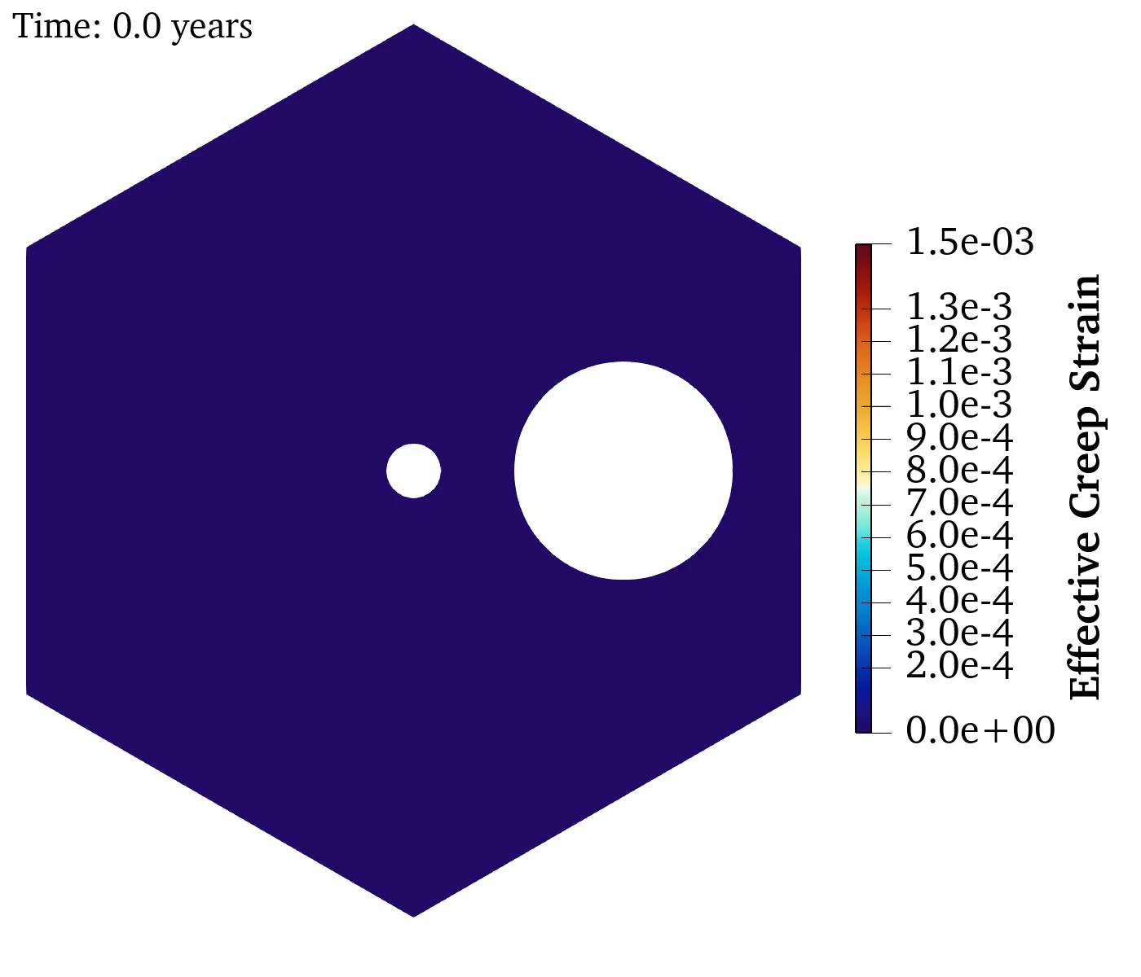
Component Modeling
Predict the thermomechanical response of a representative reflector brick for a very high temperature reactor (VHTR).
A 2D cross-section model simulated with generalized plane strain assumptions.
Loads placed on the brick due thermal expansion, irradiation creep.
A 2D mesh-based cutter object to track XFEM crack propagation
Crack nucleation on surfaces,
Crack nucleation in bulk,
Stress based crack growth.
Fast Neutron Fluence [neutrons m⁻²]
Bajpai et al., INL/RPT-24-78905, 2024.
Spencer et al., INL/RPT-23-74062, 2023.
Notes:
To demonstrate the capabilities of Grizzly, we simulated the thermomechanical response of a representative reflector brick of a VHTR. A 2D cross-section model was simulated with generalized plane strain assumptions. Representative temperature and flux gradient were prescribed with the temperature kept constant while the fluence was linearly ramped with respect to time. The bottom two figures show the stress and creep strain predicted by the model. Thermal expansion and irradiation creep resulted in the stress and strain field shown here. To model the cracking, we used the MOOSE XFEM capabilities which were improved to better model crack nucleation and the stress-based crack growth and we see the component fracture initiation and progression towards the top right in the figures.

Slide 7
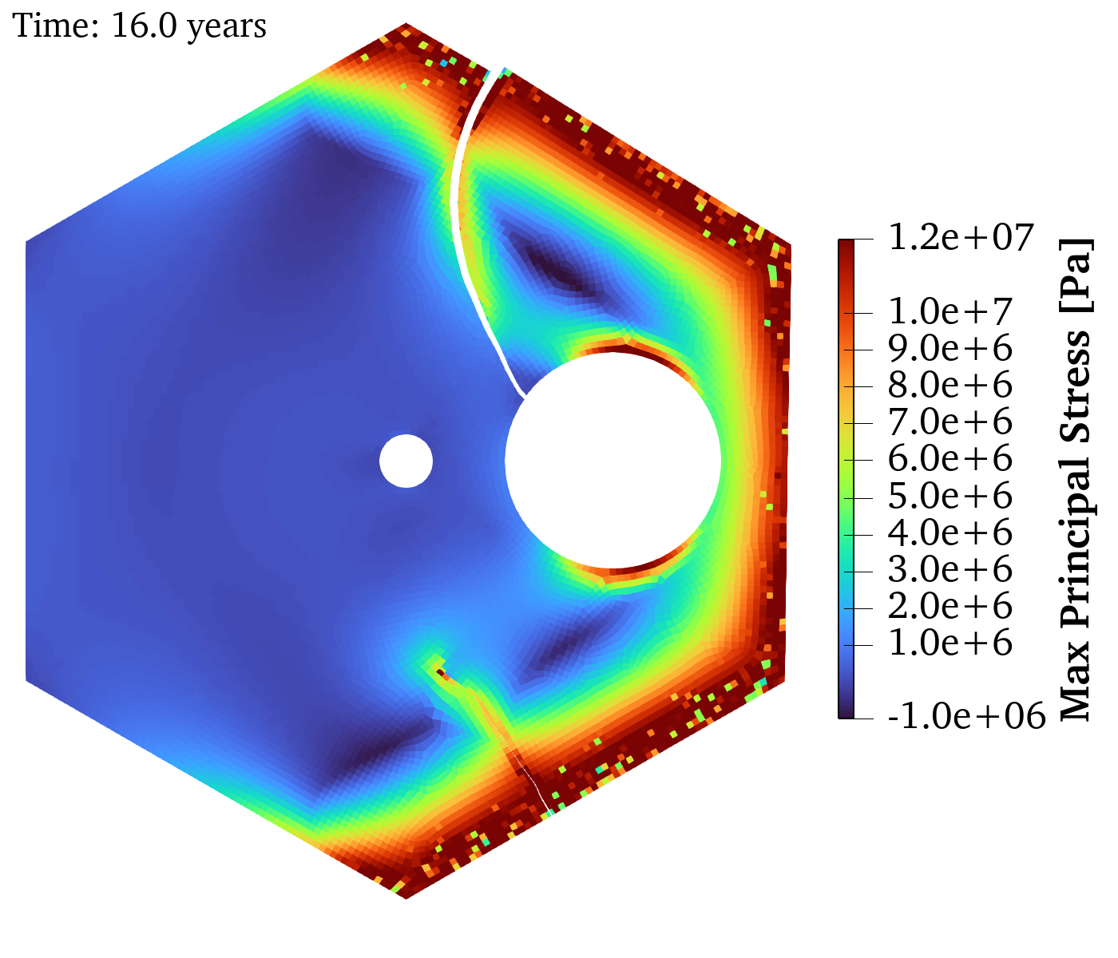
Summary and Future Work
Irradiation induced dimensional change and irradiation induced creep models for IG-110 and NBG-18 calibrated from experimental data obtained in AGC campaign.
Continued development of XFEM capabilities and nonlinear models for quasibrittle materials in Grizzly / BlackBear.
Future work will expand capabilities
Uncertainty quantified models for IG-110, NBG-18, NBG-17, PCEA and 2114 graphite grades,
Multiphysics modeling of graphite using the above thermomechanical properties,
Uncertainty propagation to component level modeling.
Parikshit Bajpai (Parikshit.Bajpai@inl.gov), Benjamin W. Spencer (Benjamin.Spencer@inl.gov)
Notes:
To summarize, we developed IIDC and creep models for IG-110 and NBG-18 from experimental data obtained in the AGC campaign and added have demonstrated their use in predicting the response of graphite

