Slide 1


MSTDB-TP and MSTDB-TC Development
Anthony Birri, Theodore M. Besmann, Juliano Shorne Pinto, Ryan Chesser, Nicholas Termini, Jorge Paz Soldan Palma, Shane Henderson, Brett Smith, Vanda Glezakou

Slide 2
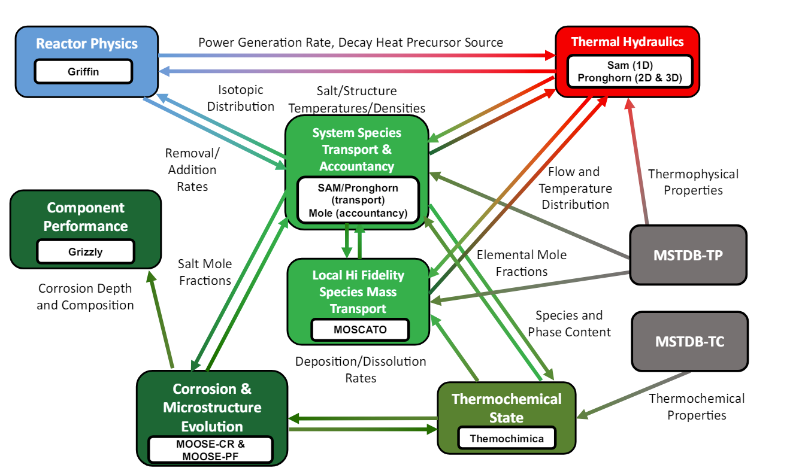

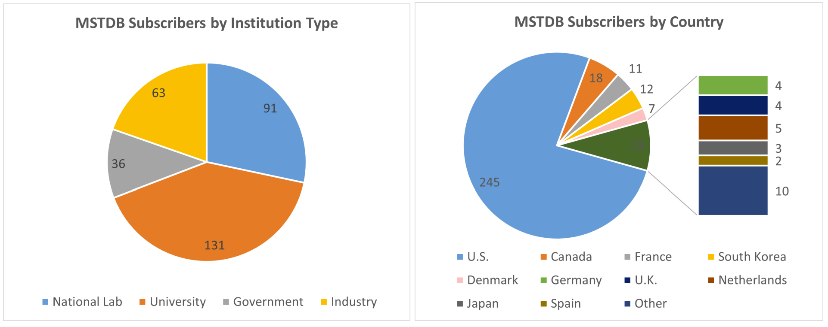
What is MSTDB?
The Molten Salt Thermal Properties Database–Thermochemical (MSTDB-TC) and Molten Salt Thermal Properties Database–Thermophysical (MSTDB-TP) databases are available via the ORNL/ITSD Gitlab Server.
MSTDB-TC contains Gibbs energy models and values for molten salt components and related systems of interest with respect to molten salt reactor technology. (MSR Campaign funded)
MSTDB-TP consists of tabulated thermophysical properties and relations for computing properties as a function of temperature or composition. (NEAMS funded)
MSTDB has >320 users currently
Measurements made by the MSR Campaign support the databases
[1]
[2]
[1] INL/RPT-22-70694
[2] ORNL/TM-2024/3575

Slide 3
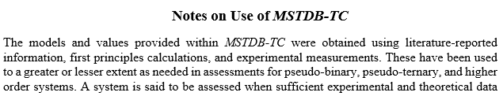
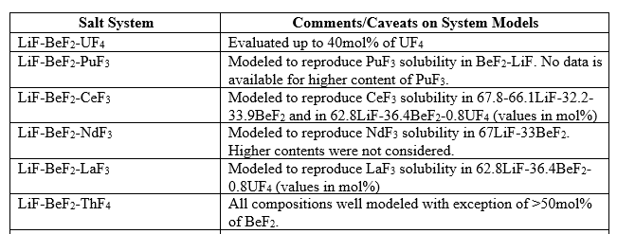
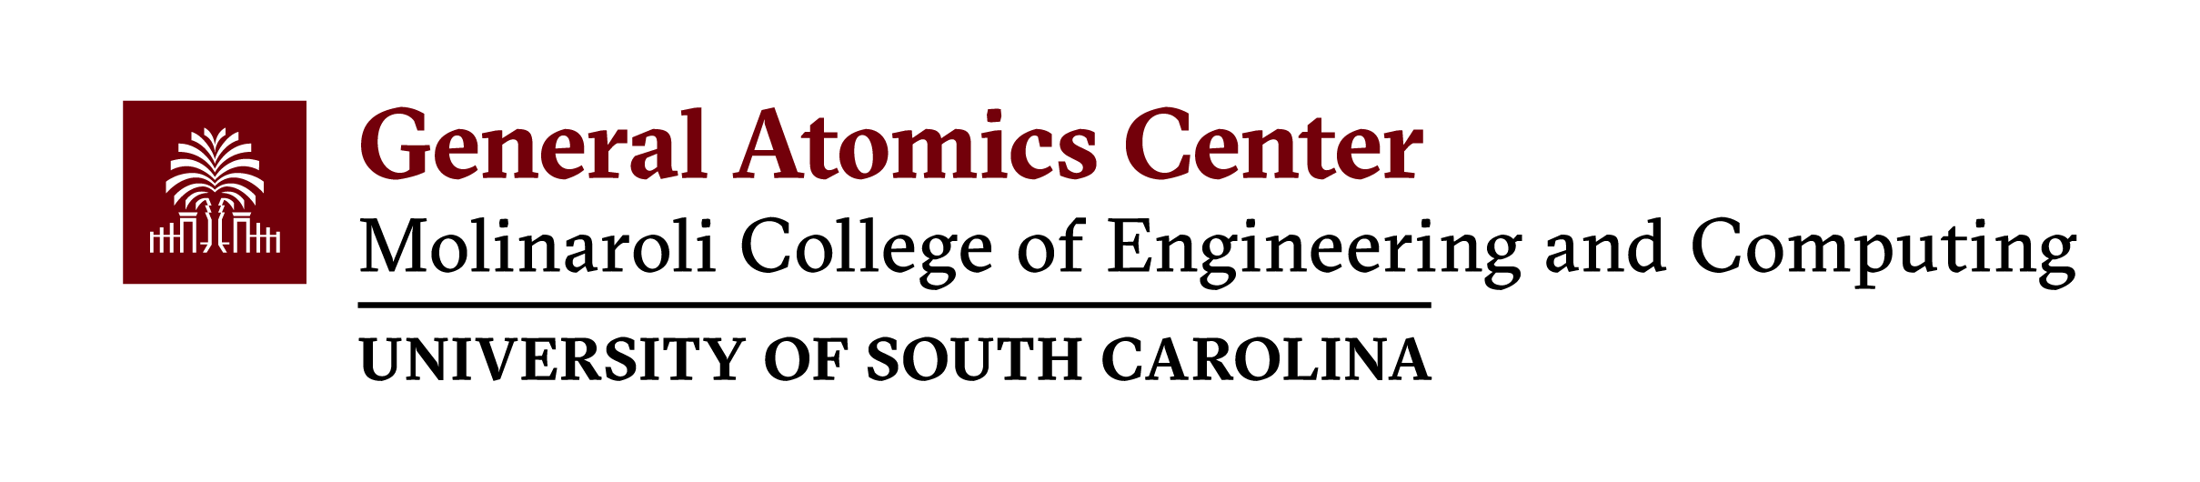
MSTDB-TC Format and Supporting Documentation
FactSage .dat file format
Thermodynamic database usable by FactSage™, and the open-source codes Thermochimica and pycalphad
As systems are validated as they are added to database and new versions made available
Documentation is provided that provides data sources and information regarding system model use issues, such as limited accuracy in certain phase regions

Slide 4
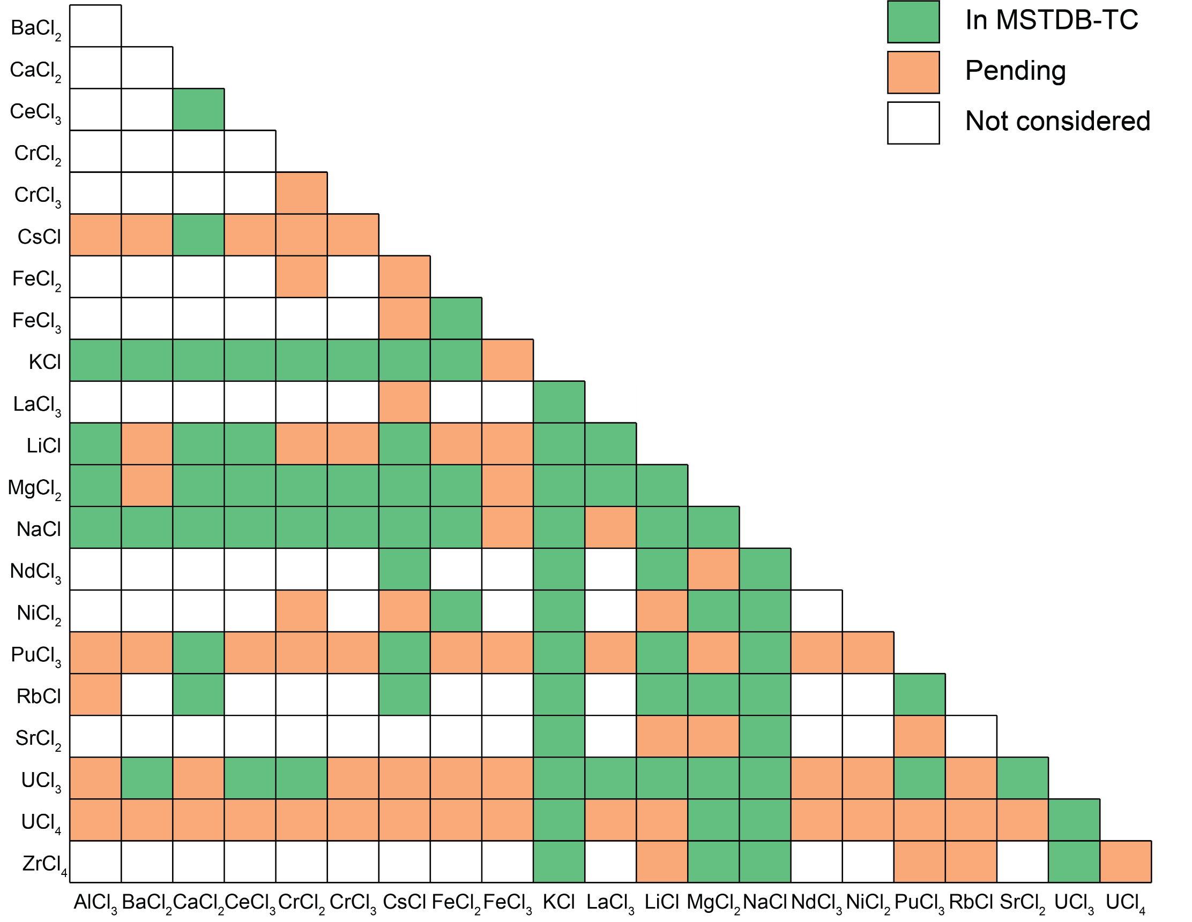
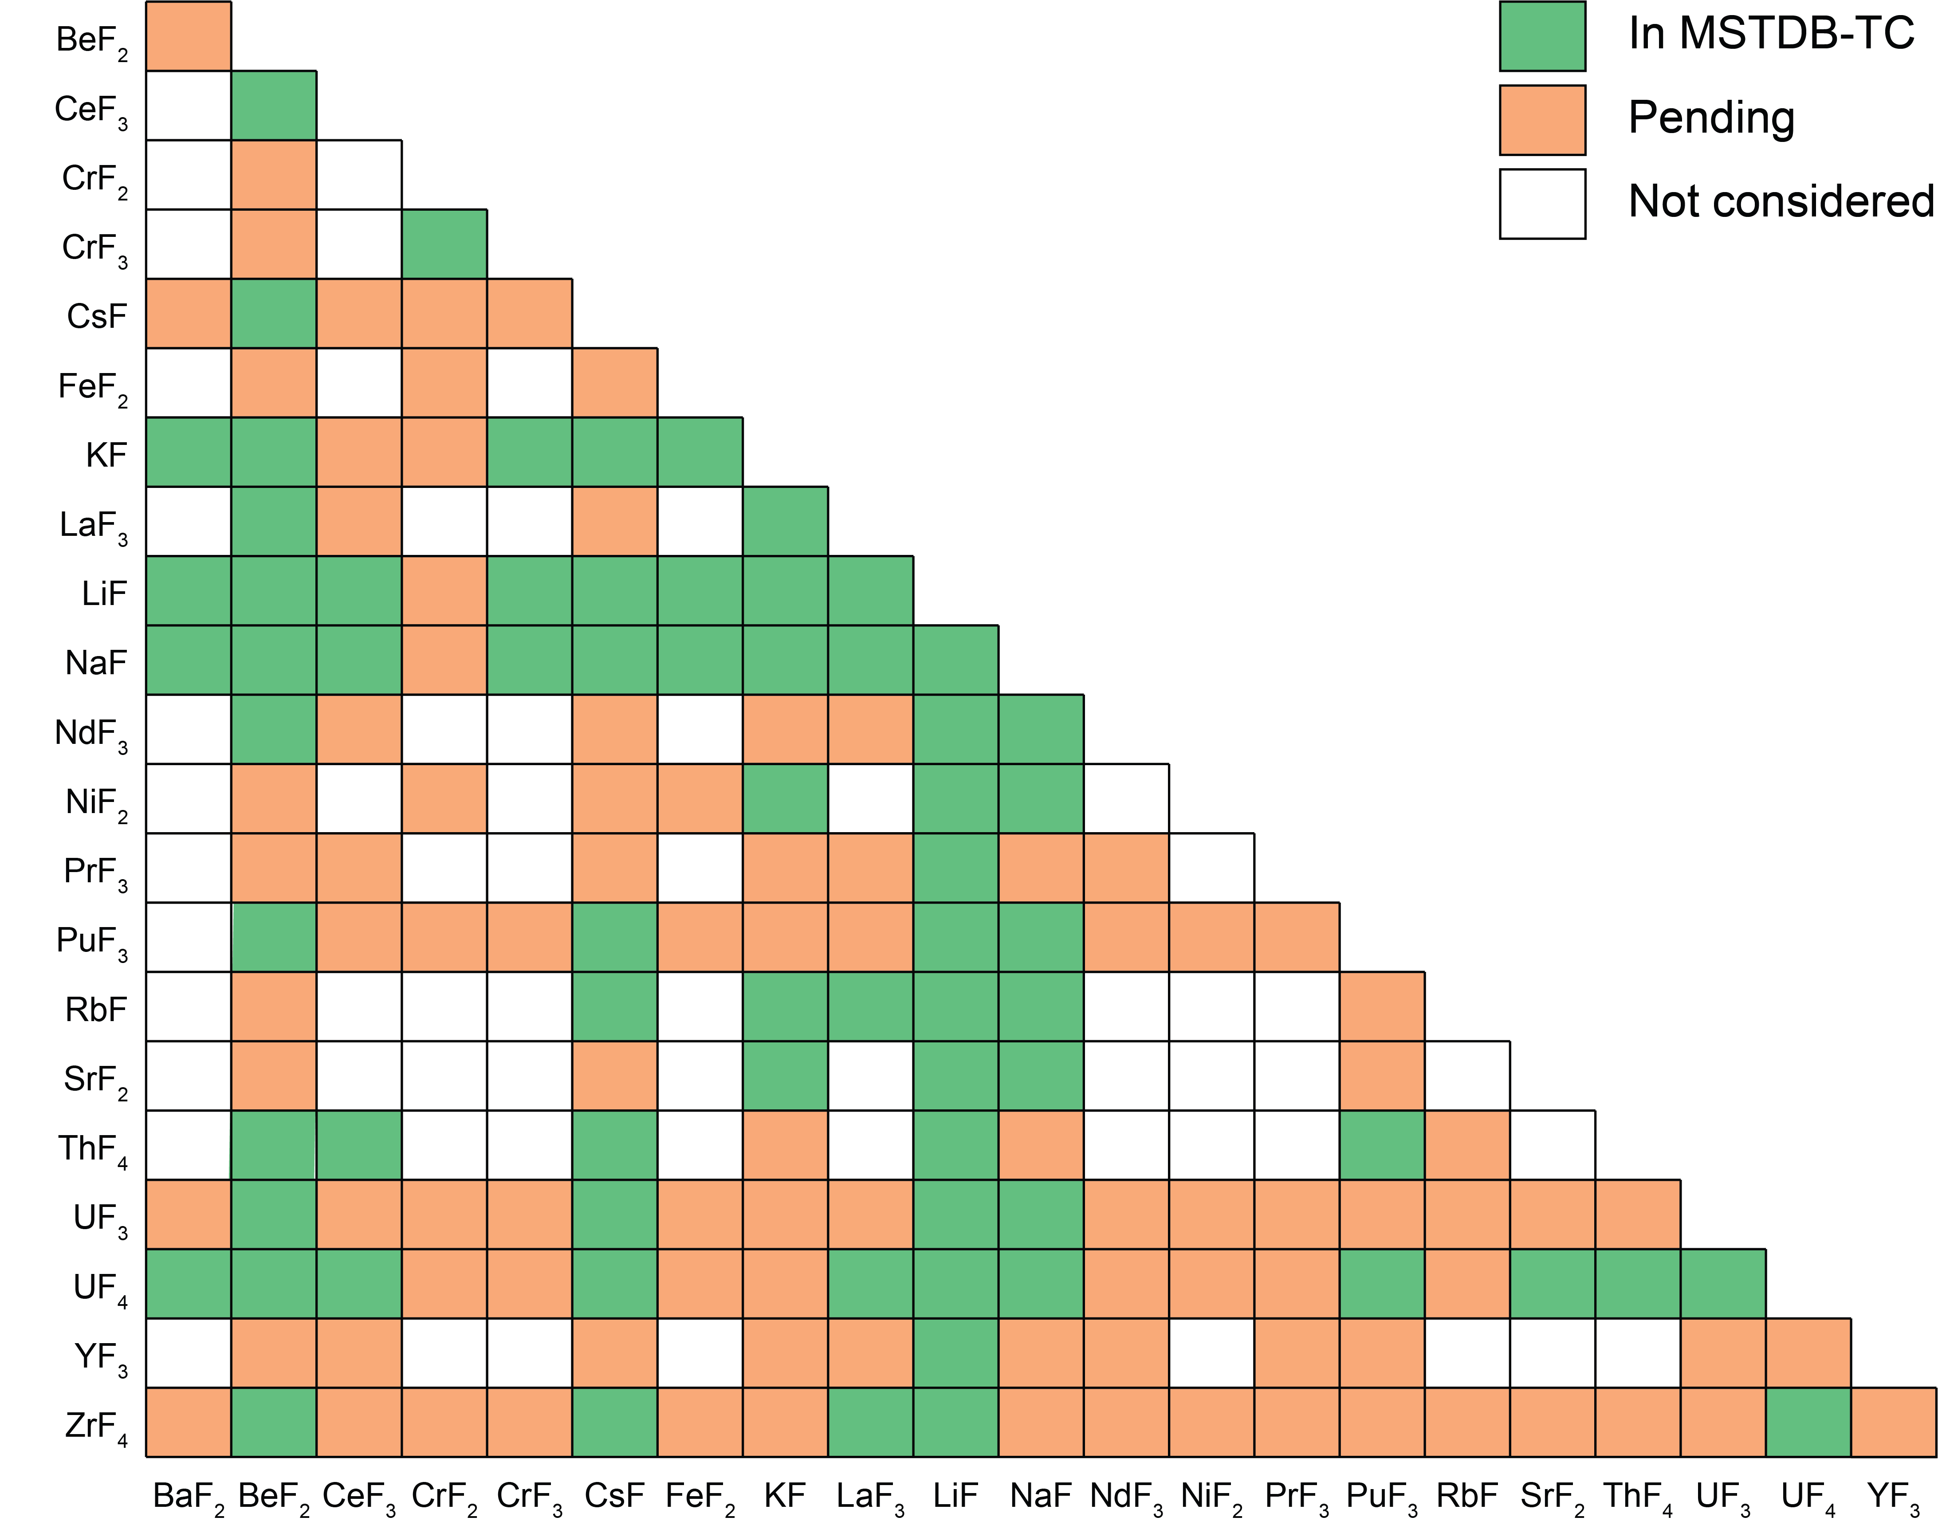
Content of MSTDB-TC Ver. 4.0
Pseudo-binary System Content Matrices
Extensive compositional space
175 pseudo-binary systems
61 pseudo-ternary systems
12 reciprocal systems that include iodine as anion
Added new models that consider ZrCl₄, BaCl₂, SrCl₂, BaF₂, SrF₂, LaCl₃
NaCl-MgCl₂ refined based on new experimental data
Improved reciprocal systems with iodine
Pseudo-binary System Content Matrices
Higher Order Systems
LiF-LiI-CsI
LiF-LiI-NaI
LiF-LiI-KI
LiF-CsF-CsI
LiF-KF-KI
LiF-NaF-NaI
LiF-NaF-NaI
NaI-NaF-KF
KF-KI-NaF
NaF-NaI-KF
LiF-NaF-CsI
LiF-KF-CsI
LiF-KF-CsI
NaF-KF-CsI
LiF-KF-CsF-CsI
CsI-LiF-NaF-KF
MgCl₂-NaCl-UCl_{3,4}
MgCl₂-KCl-UCl_{3,4}
Chloride Systems
Fluoride Systems

Slide 5
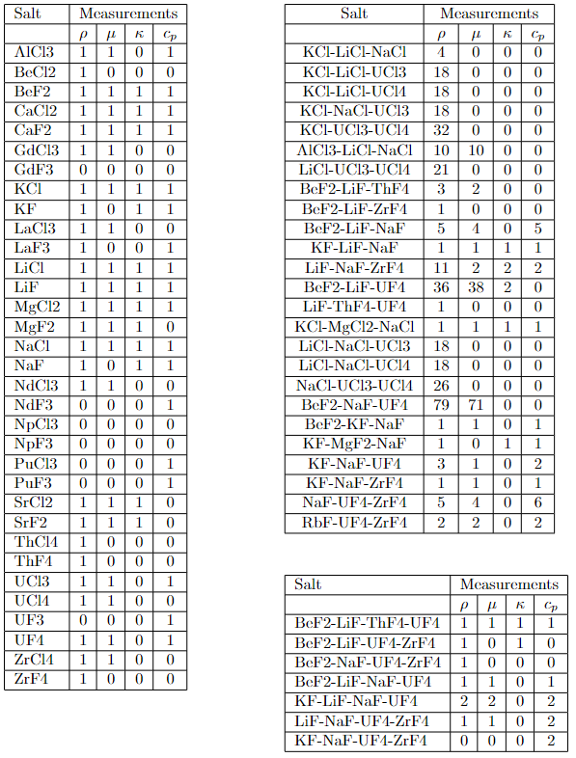
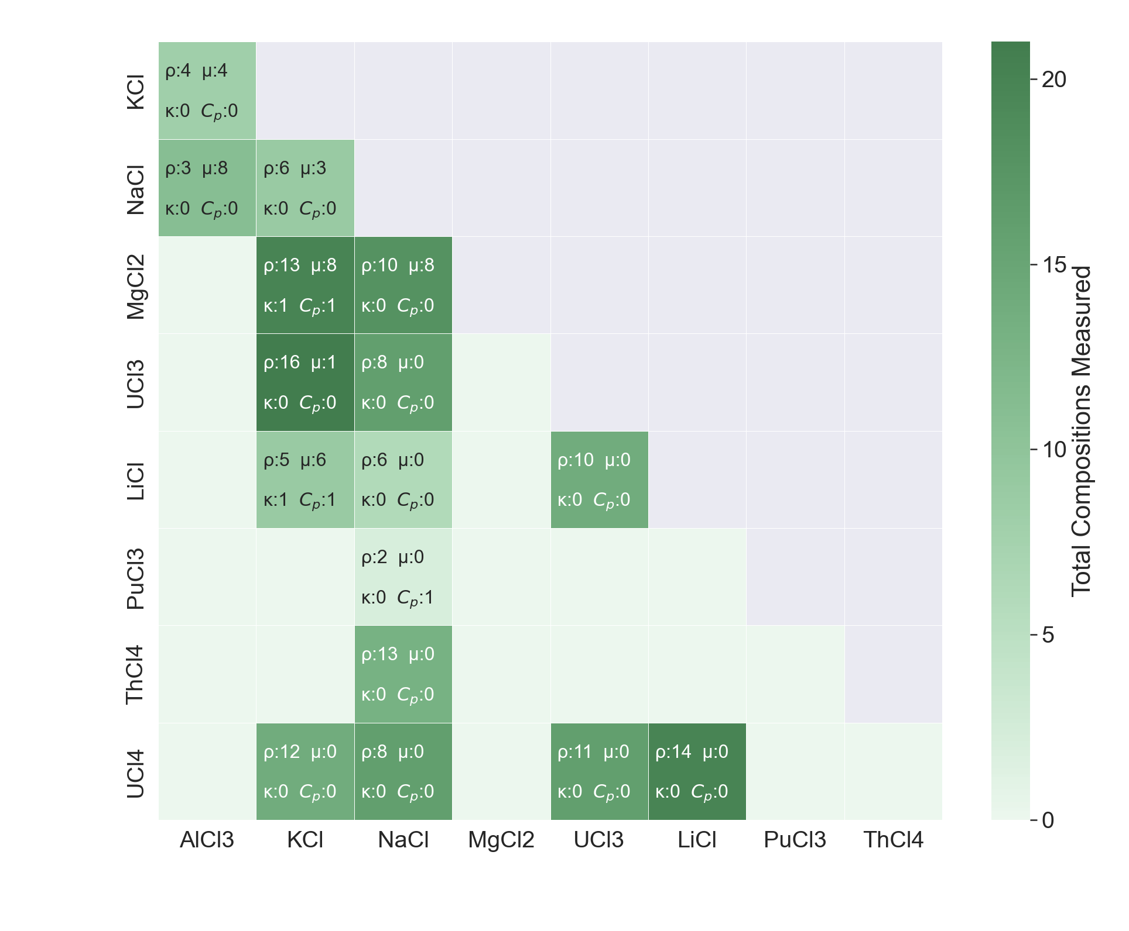
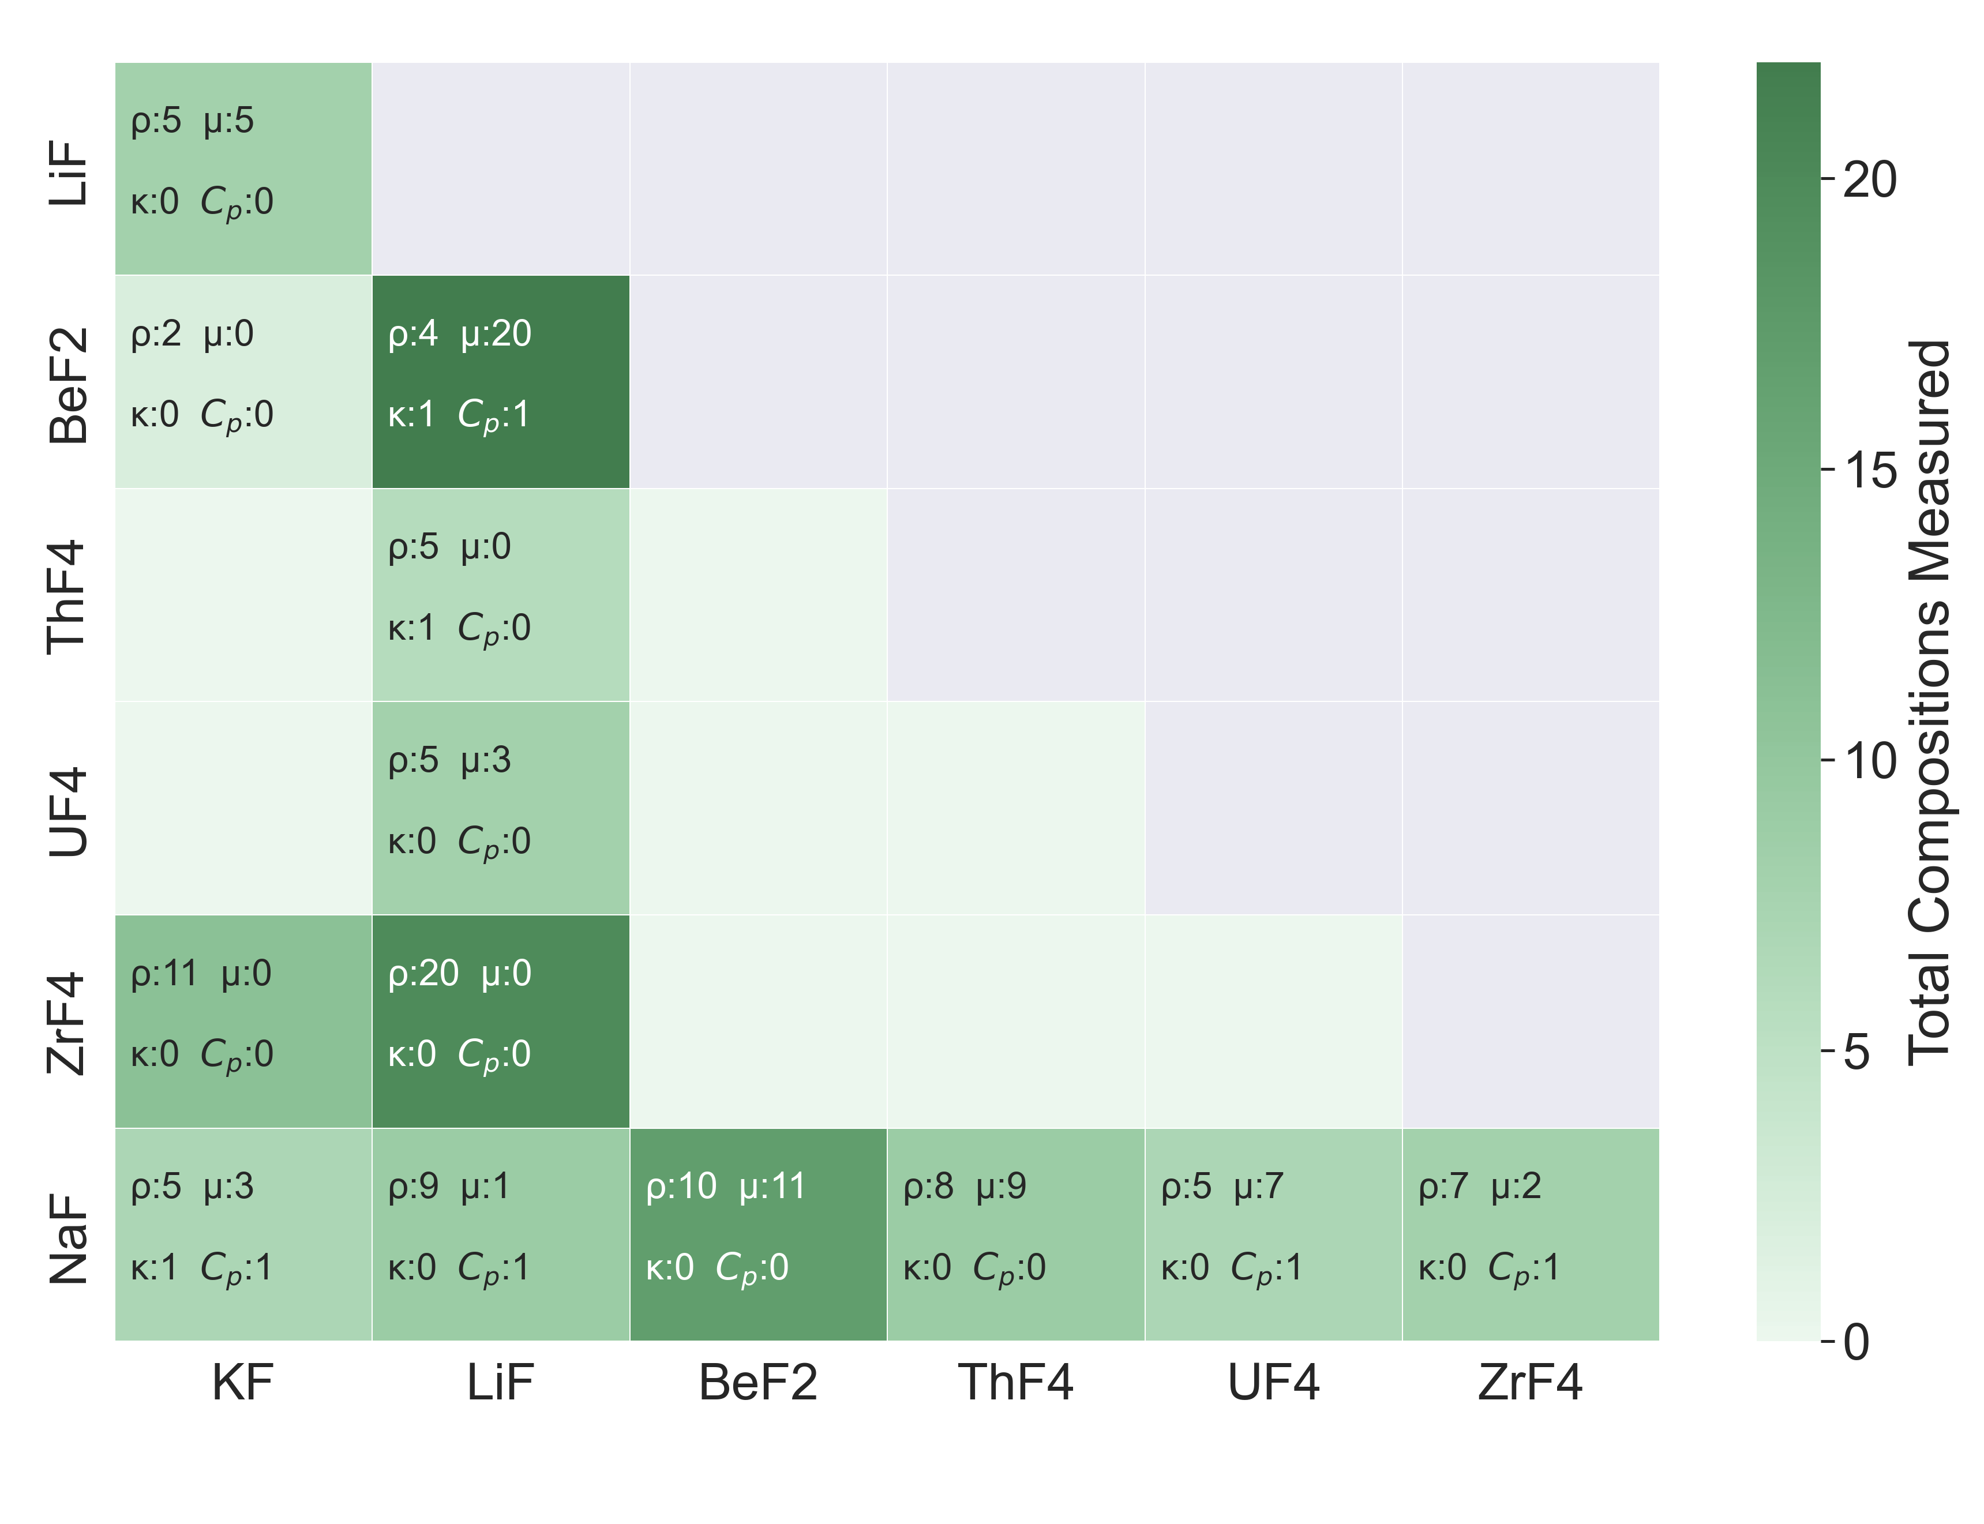
Current State of MSTDB-TP
Pure Compounds
Ternaries
As per the current version release (3.1) There are 820 entries, including:
33 pure compounds
380 pseudo-binaries
395 pseudo-ternaries
12 pseudo-quaternaries
Each property entry in the database includes a margin of experimental error
This list is constantly expanding. The data is based on the outputs of 180+ independent experimental studies in literature.
Surface Tension will be included for fluorides and chlorides in the next major release
[1]
[1]
Chloride Binaries
Fluoride Binaries
Quaternaries
[1] ORNL/TM-2024/3575

Slide 6
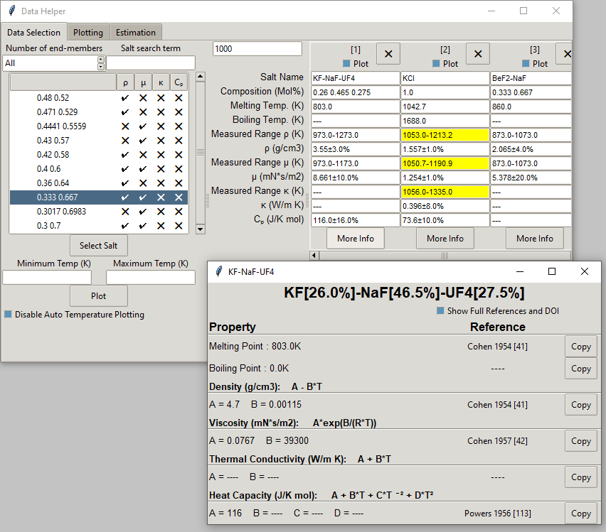
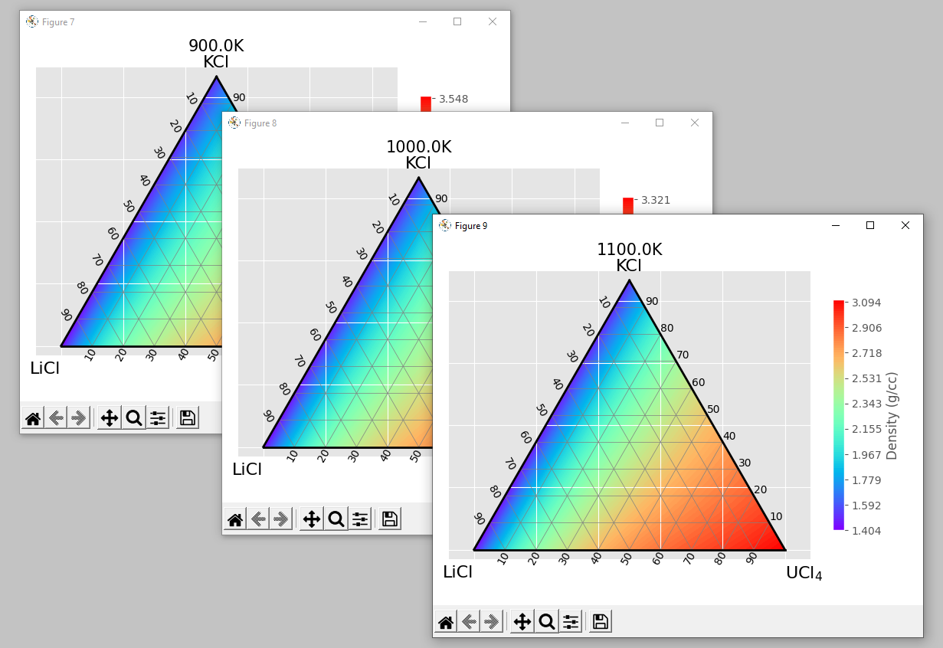
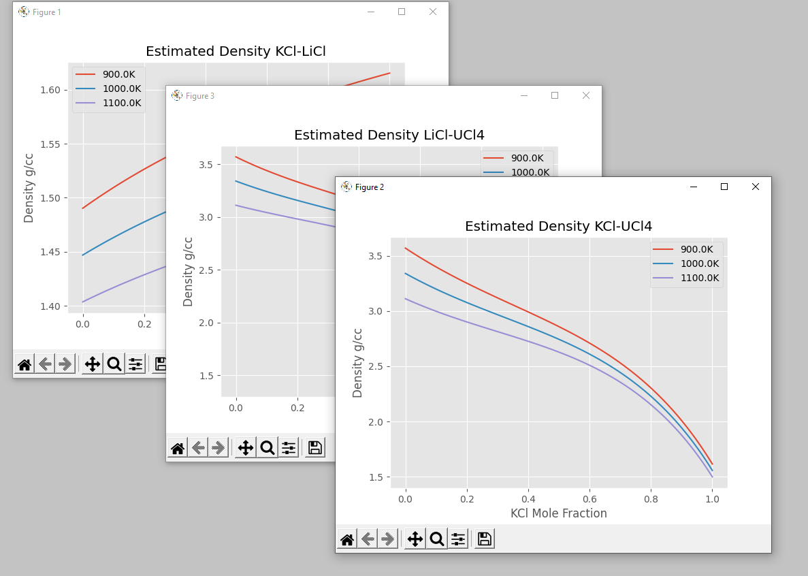
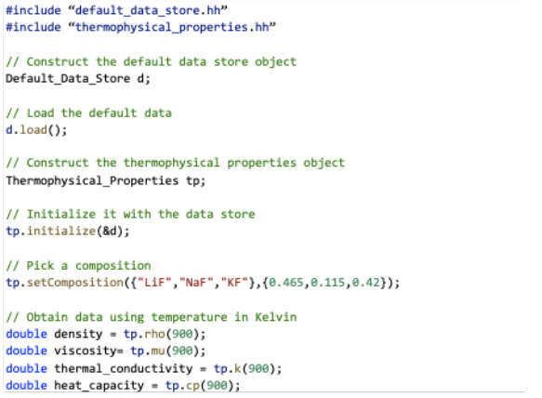
MSTDB-TP User Interfaces
Saline is the MSTDB-TP API
Provides a stable C++ interface for obtaining supported properties (density, viscosity, heat capacity, and thermal conductivity)
Designed for integration with other NEAMS codes
There are two different classes which serve as data models
Default: allows for the extraction thermophysical data for compositions in database
RK: allows for arbitrary salt mixtures to be estimated
We also have a GUI which is backed by Saline for more easy access to data
GUI Screenshots
Saline API
[1] ORNL/TM-2021/2239

Slide 7
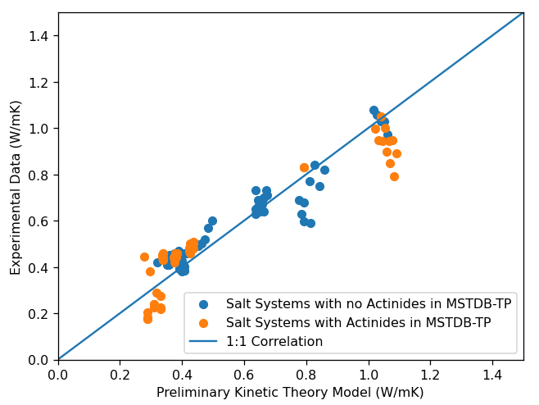
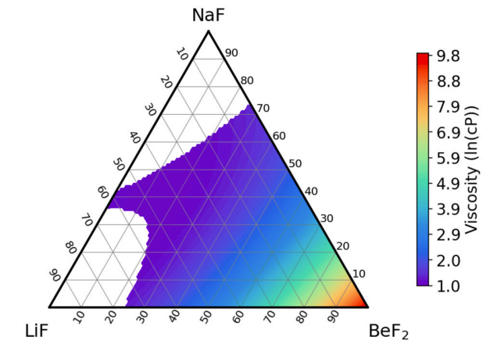
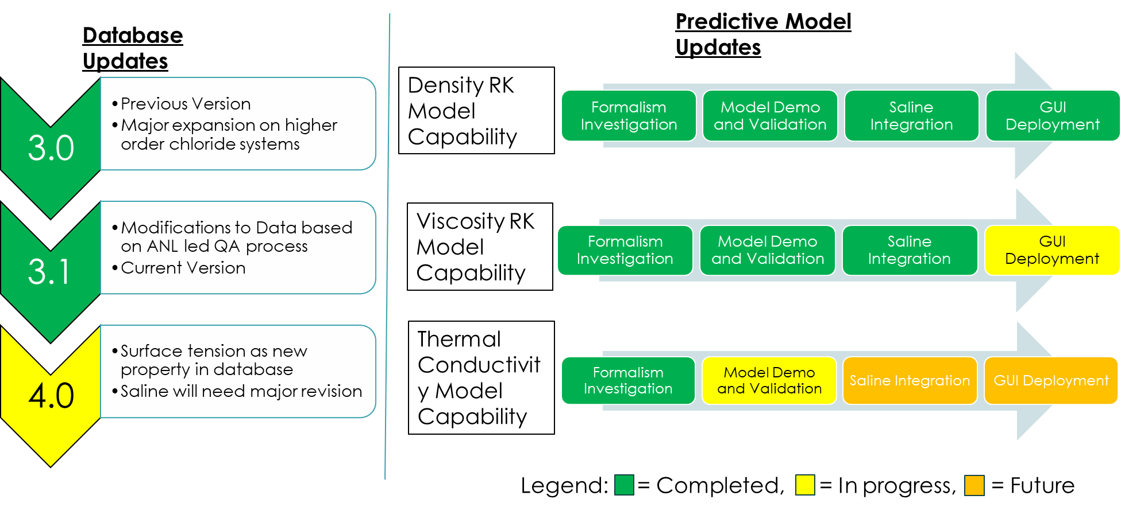
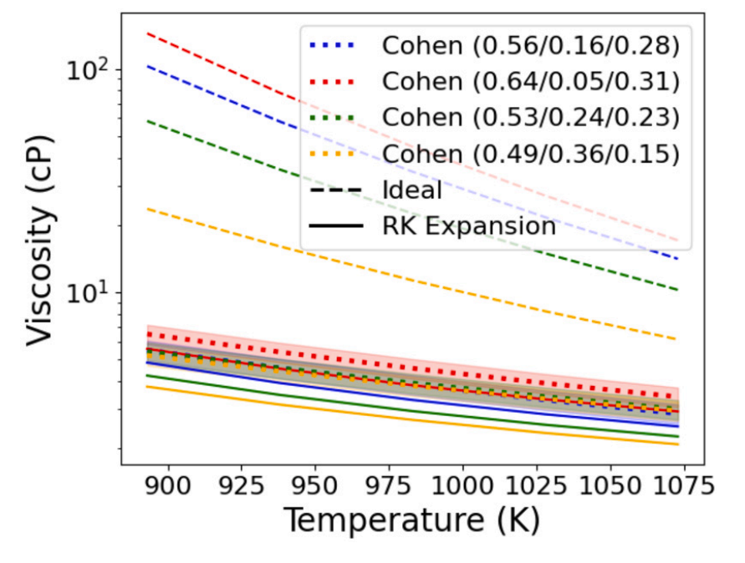
Predictive Modeling
In order to address gaps in the database, we use the RK methodology and/or AIMD/ML simulations to yield estimates
This method has been developed for density and viscosity [1,2,3,4]
Both Saline and the GUI have estimation tools built into them
We need a more fundamental model for thermal conductivity prediction
Working to modify existing kinetic theory models [5] and molecular simulations
Preliminary Kinetic Theory Model Results
RK Viscosity Prediction
Experimental Validation
Viscosity prediction
RK method
[1] Birri, A., Termini, N., & Ezell, N. D. B. (2024). Chem. Eng. Sci., 298, 120391.
[2] Agca, C., & McMurray, J. W. (2022). Chem. Eng. Sci., 247, 117086
[3] Birri, A., Gallagher, R., Agca, C., McMurray, J., & Ezell, N. D. B. (2022). Chem. Eng. Sci., 260, 117954.
[4] Nguyen et al., ACS Appl. Mater. Interfaces, 2021
[5] Gheribi, A. E. & Chartrand, P. (2016). J. Chem. Phys., 144(8)
AIMD/ML

Slide 8
Acknowledgements
Melissa Rose at ANL for quality rankings collaboration
Vanda Glezakou and Brett Smith for collaboration regarding AIMD generated data
Jacob Numbers and Troy Munro at BYU for collaboration on thermal conductivity prediction
MD modeling efforts of LANL/INL under NEAMS (POCs: Gaoxue Wang, Chao Jiang)
This work is directly funded by the Molten Salt Reactor Campaign and the Nuclear Energy Advanced Modeling and Simulation Program under the Department of Energy, Office of Nuclear Energy.
Please feel free to email us at mstdb@ornl.gov or check out our websites:
https://mstdb.ornl.gov/
https://gacenterusc.org/

