Slide 1
Incorporating irradiation effects in predictive models of Grade 91 alloy
V. Vivekanandan, J. Joy, A. Talapatra, L. Capolungo

Slide 2
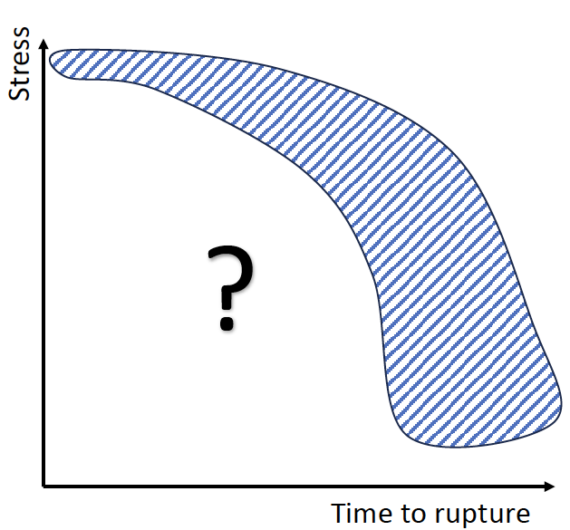
NEAMS developed ready to use capabilities to predict the post-irradiation and in situ response of Ferritic Martensitic steel
Effect of microstructure on mechanical performance?
Response of material under irradiation?
Takeway message:
We can predict the performance envelope of Grade 91 during tensile and creep loads.
How we can relate the mechanical performance of RAFMs to their microstructure (including the loss of high temperature strength).
Predict the post irradiation response of Ferritic/Martensitic steels.
Predict the in-pile response of Ferritic Martensitic steels.
Time to critical strain

Slide 3
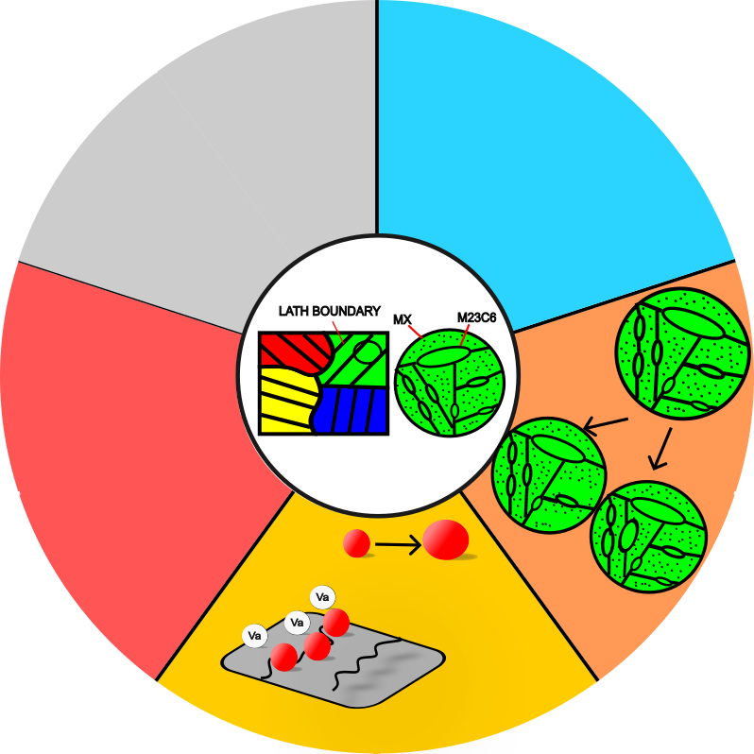
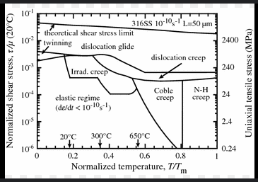
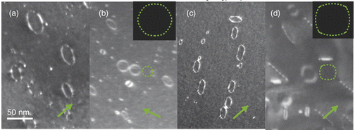
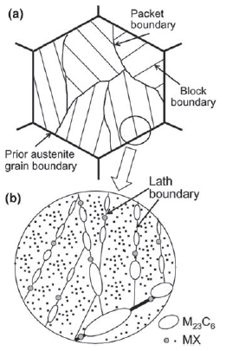
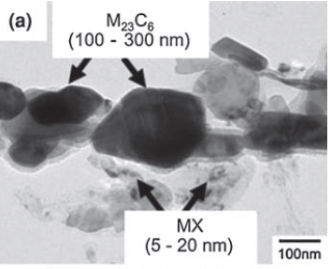
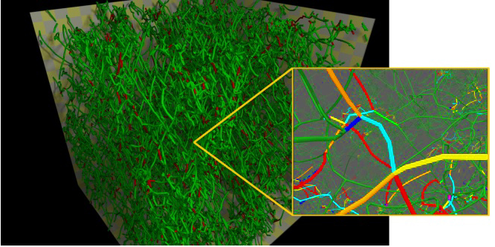
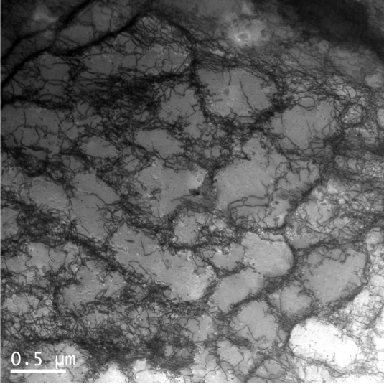
Objective: develop models to (i) extrapolate the mechanical response and failure of materials under extreme environments, (ii) quantify how micvrostructure affect behavior.
Composition:
9Cr, 1Mo, VNb
FM steel are strengthened by lat boundaries, solutes and precipitates. Hoe can we quantify the efficacy of each strengthener ads a function of temperature and irradiation damage?
*F. ABE, Advanced Steels, Chapter 11, 2011
Example of a ferritic-martensitic microstructure
*Similar approaches are pursued to study HT9, 316H, additively manufactured steels, superaloys, Zircaloys.

Slide 4
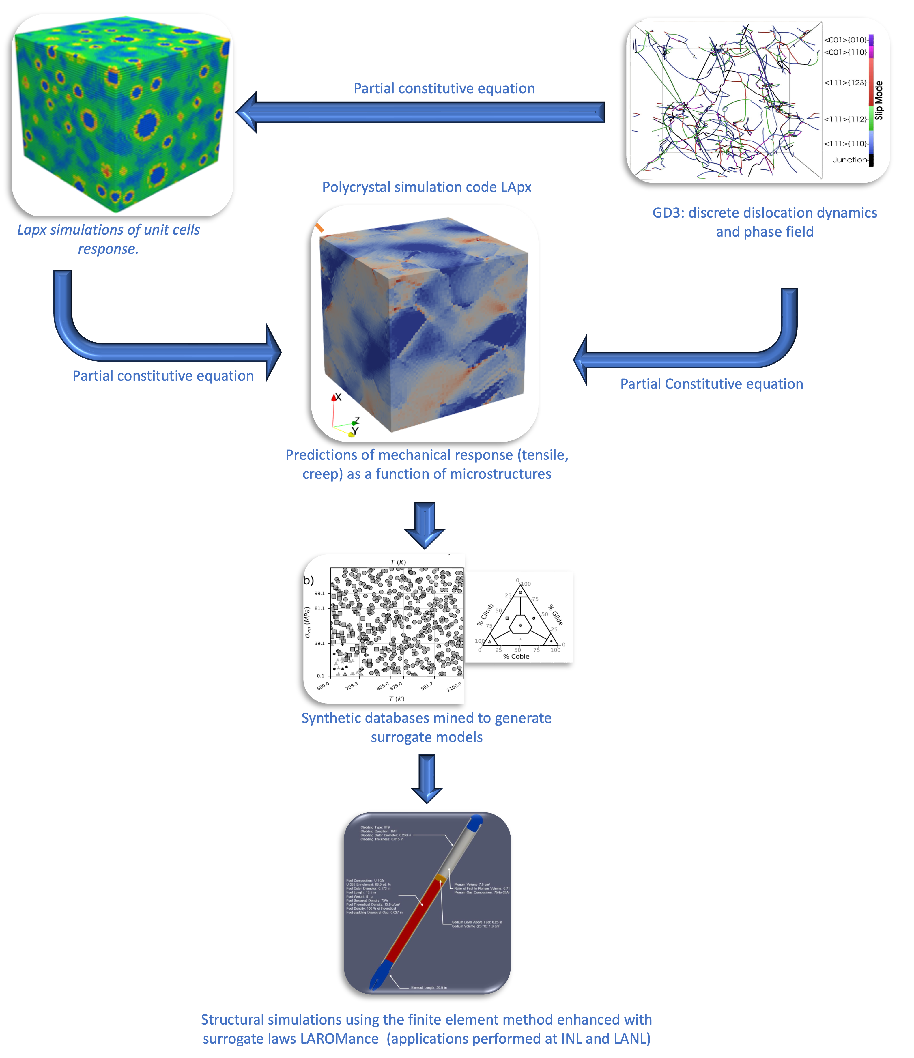
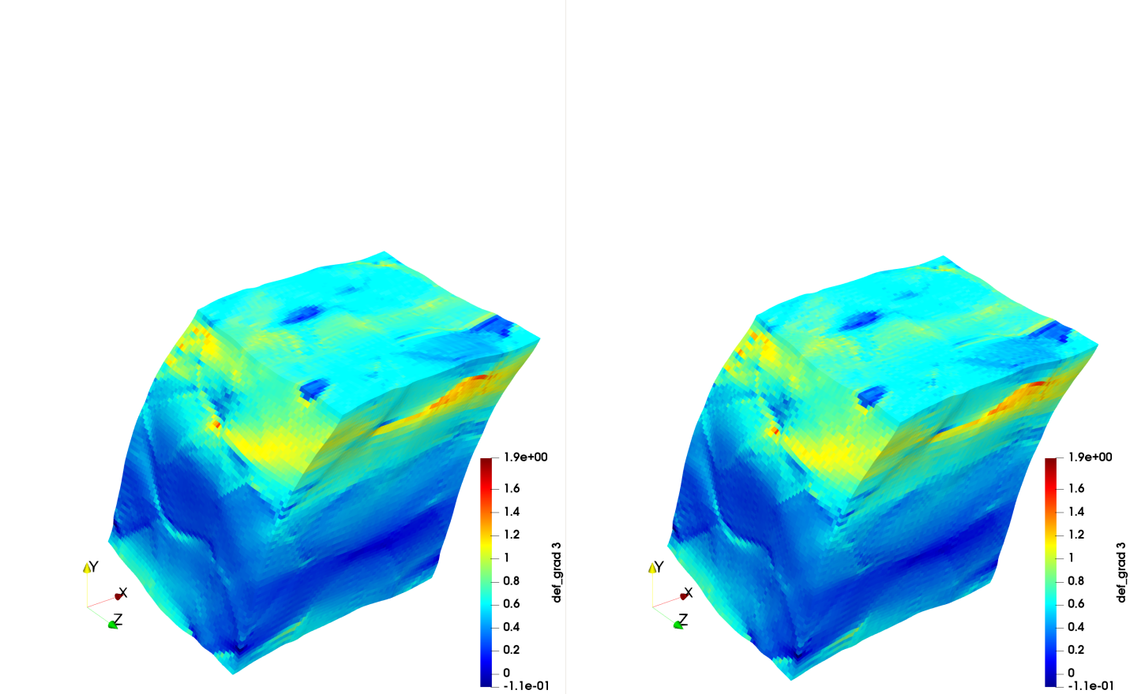
Idea: Use a multiscale modeling approach to capture how each deformation mechanism is affected by microstructure and constraints
Applicability of the models
Creep
Fatigue
Complex Loadings
Chemo-mechanical solver
Cyclic load
Dislocation glide
(Cross slip, DSA)
Damage nucleation growth coalescence
Vacancy diffusion mediated plasticity
Ageing
(thermal irradiation)
Zecevic, Lebensohn, Capolungo, MoM, 2022
*Caveat: in all future slides, the lath size, precipitate content and irradiation induced defects content are not evolving dynamically

Slide 5
A universal model for the effects of temperature on the tensile and creep response of Gr91
glide
climb
diffusion
LApx captures anomalous temperature effects on yield and ultimate strength of Gr91 and the creep response simultaneously over a wide range of stresses and temperatures

Slide 6


How microstructure affects mechanical performance of Gr91 under thermal conditions: assessment of performance variability
Our model can blindly predict the variability in creep response (minimum creep rate) induced by variability in initial microstructure.
The effect of microstructure (i.e. lath size, precipitate content, dislocation density) on performance variability depend on stress and temperature.
We reveal that the loss of strength at high temperatures is due to a mechanisms of bypass of precipitates by dislocations
Quantification of the effect of microstructure on Variability in performance of Gr91.
$$r_{o}$$
After climb
$${\overline{r}}_{P}$$
A new postulate: Coupling between dislocation climb and can lead to loss of creep strength in alloys strengthened by small precipitate

Slide 7
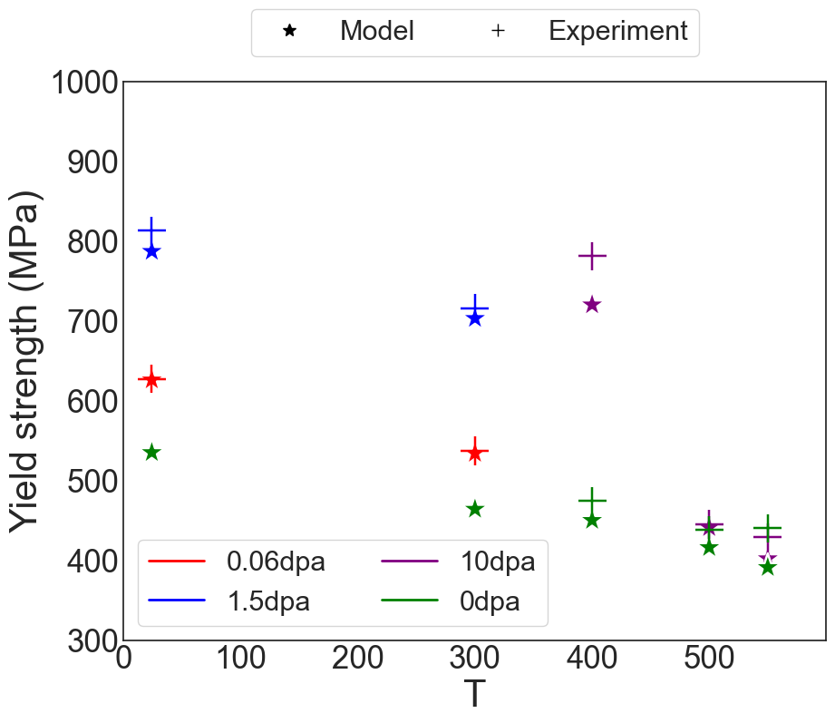
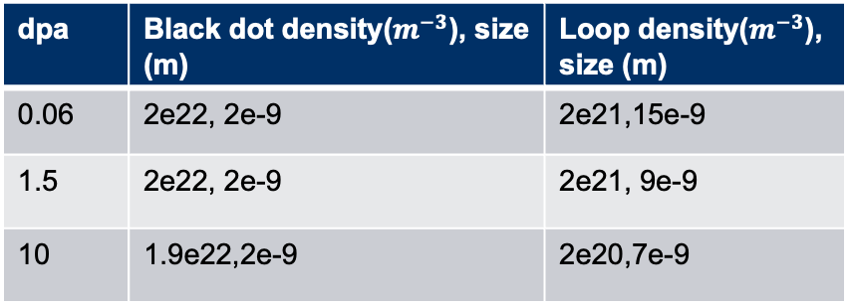
LApx can predict the post irradiation response of T91 as a function of dose
dpa | Black dot density($m^{−3}$), size (m) | Loop density($m^{−3}$), size (m)
0.06 | 2e22, 2e-9 | 2e21,15e-9
1.5 | 2e22, 2e-9 | 2e21, 9e-9
10 | 1.9e22,2e-9 | 2e20,7e-9
*Ongoing work aims at dynamically predicting the evolution of microstructure induced by damage. The microstructure is taken as an input for now

Slide 8
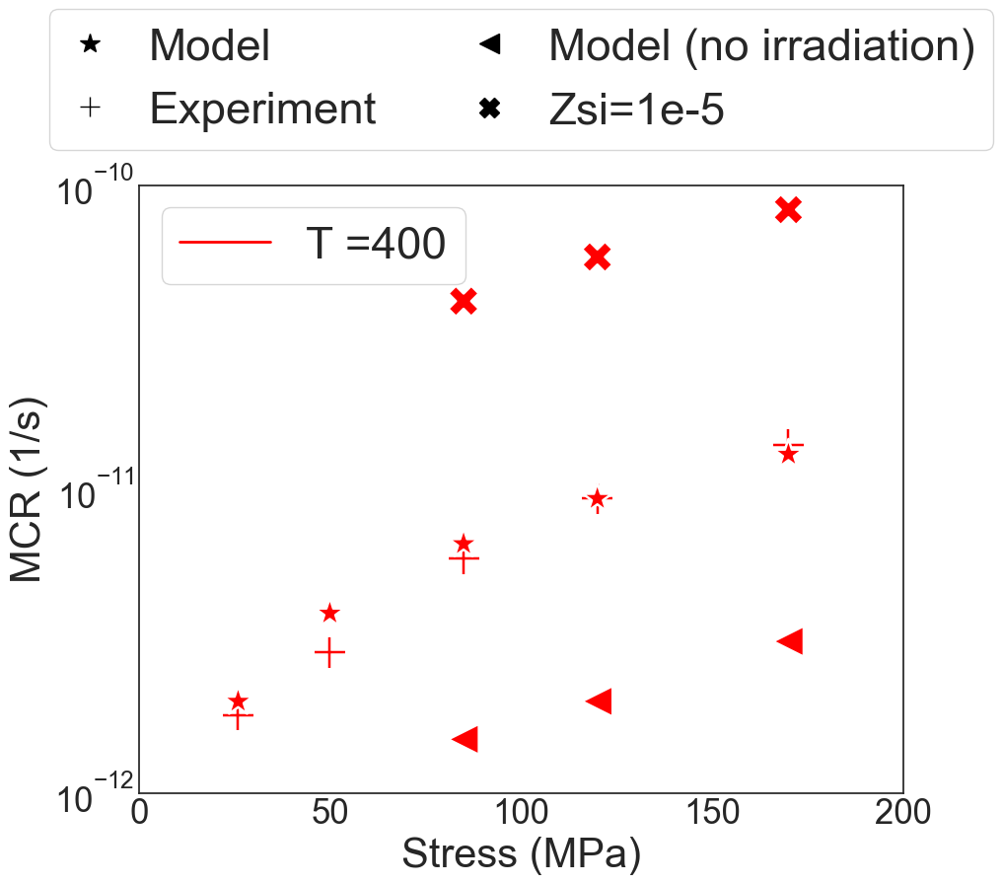
LApx can predict the post irradiation response of T91 as a function of dose
Out of pile
In pile

Slide 9
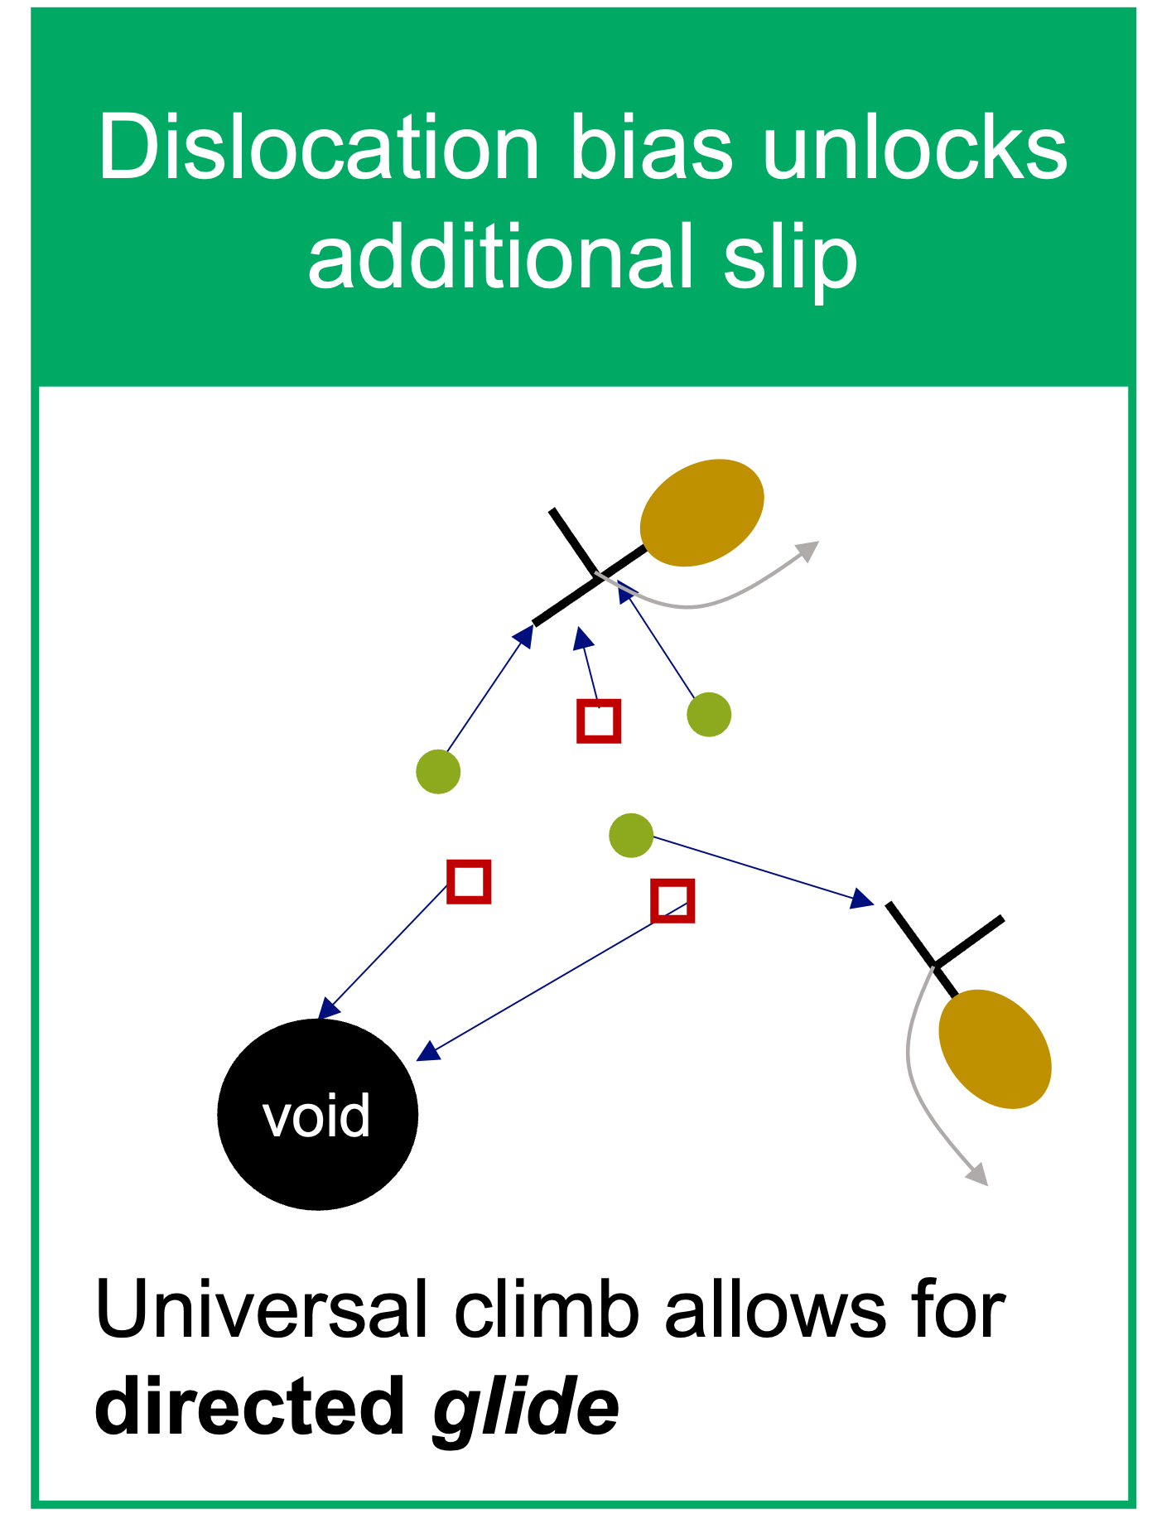


We identified the mechanism leading to creep acceleration under irradiation
$$r_{o}$$
After climb
$${\overline{r}}_{P}$$

Slide 10
NEAMS developed ready to use capabilities to predict the post-irradiation and in situ response of Ferritic Martensitic steel
Takeway message:
We can predict the performance envelope of Grade 91 during tensile and creep loads.
How we can relate the mechanical performance of RAFMs to their microstructure (including the loss of high temperature strength).
Predict the post irradiation response of Ferritic/Martensitic steels.
Predict the in-pile response of Ferritic Martensitic steels.

Slide 11
laurent@lanl.gov

