Slide 1
Release of NEML2 A High-Performance Constitutive Modeling Library
Gary Hu, ANL, thu@anl.gov
Mark Messner, ANL, messner@anl.gov

Slide 2
Motivation
Challenge #1
High-fidelity material models help ensure long-term structural integrity of reactor designs
Plasticity, viscoplasticity, creep, etc.
Multiscale reduced-order models
Data-driven models
Fidelity Cost
Challenge #2
Most computing power in newly built HPCs are provided by GPUs.
This trend mostly aligns with the rise of AI/ML.
Can we use GPUs for tasks other than AI/ML, e.g., nuclear reactor simulations?
Yes!
Supercomputer | Year | Performance | GPU Contribution (%)
Tianhe-1A | 2010 | 4.701 petaflops | ~60–70%
Titan | 2012 | 17.59 petaflops | ~85–90%
Summit | 2018 | 148.6 petaflops | ~95%
Sierra | 2018 | 125.7 petaflops | ~95%
ABCI | 2018 | 19.88 petaflops | ~90%
Perlmutter | 2021 | 70.9 petaflops (Phase 1) | ~90–95% (GPU nodes)
Aurora | 2024 | ~2 exaflops (projected) | ~90%+
El Capitan | 2024 | ~2+ exaflops (projected) | ~95%

Slide 3
NEML2
Publicly released: https://applied-material-modeling.github.io/neml2/
Feature highlights:
A rich collection of extensible common material models for structural assessment of reactors
Drop-in replacement for native material models in MOOSE
Models are fast and scalable, and can run on both CPU and GPU
Automated material model calibration/tuning against data
A Python wrapper that is fully interoperable with PyTorch models

Slide 4
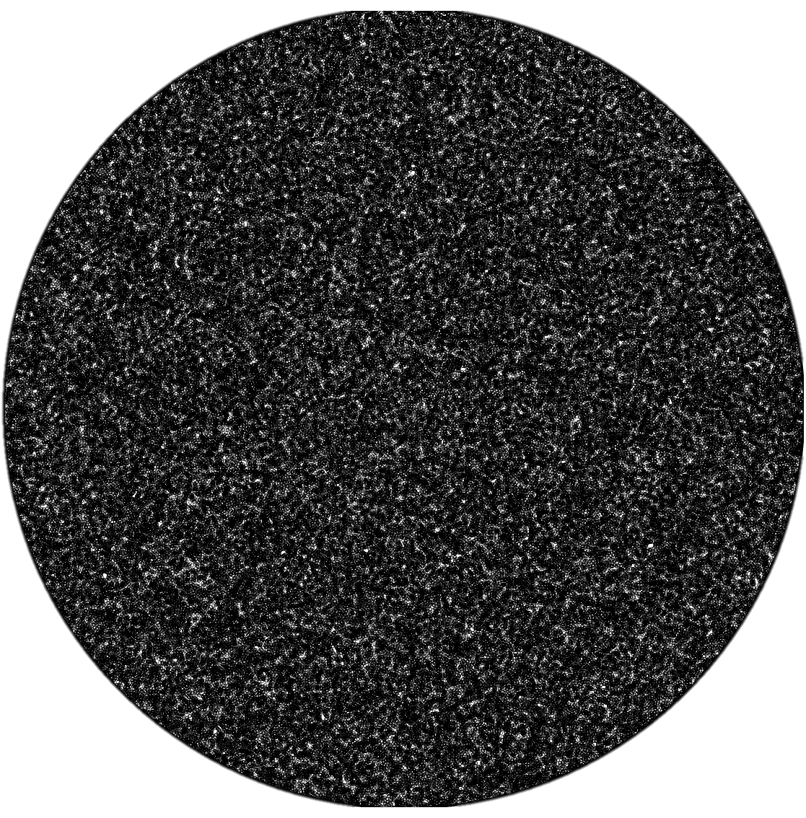
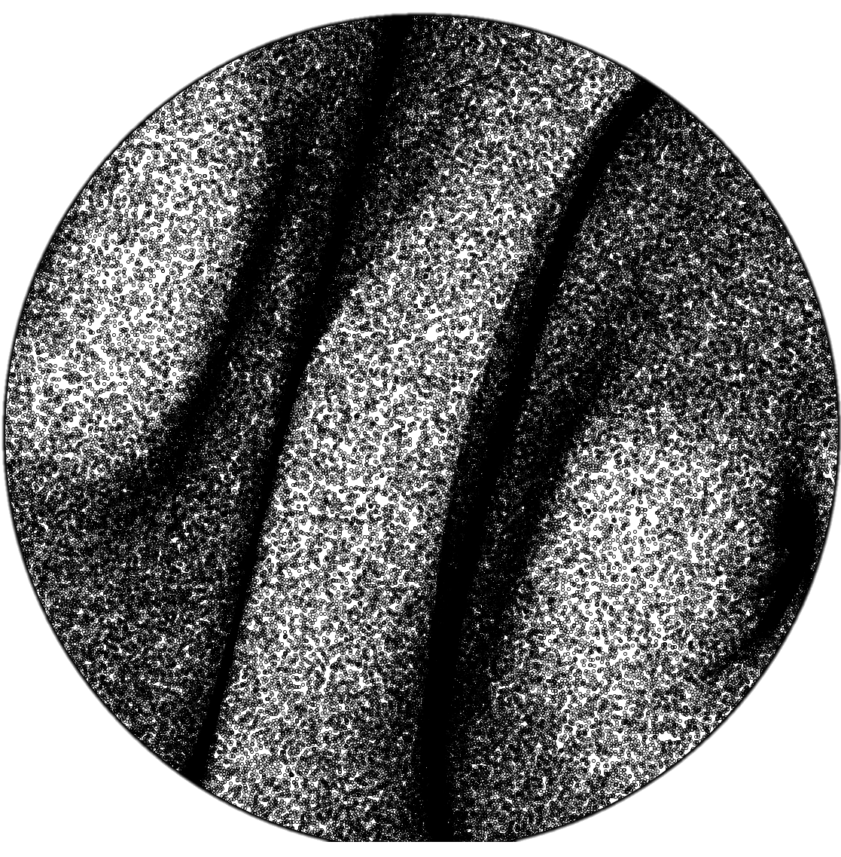
Timing Results: NEML2
Crystal plasticity
50,000 grains
250 steps
111 pole figures

Slide 5
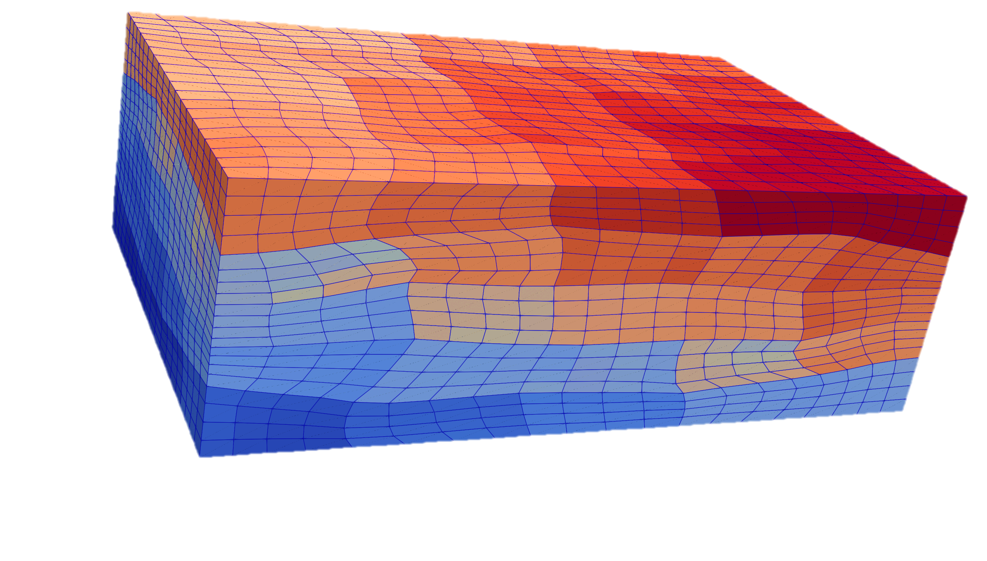
Timing Results: NEML2 + MOOSE
100 steps
64,000 constitutive updates per step

Slide 6
Automated Material Model Calibration
Exercise: Calibrate a universal material model for various metallic alloys of interest.
Completed: 316H, Grade 91, A800H, A617, Alloy 709
In progress: 304H, Grade 22, ...
Technical report ANL-ART-284

Slide 7
Conclusion and Future Work
Publicly released: https://applied-material-modeling.github.io/neml2/
Feature highlights:
A rich collection of extensible common material models for structural assessment of reactors
Drop-in replacement for native material models in MOOSE
Models are fast and scalable, and can run on both CPU and GPU
Automated material model calibration/tuning against data
A Python wrapper that is fully interoperable with PyTorch models
Future work
Implement work dispatchers for hybrid computing environments
Explore the possibility of supporting Abaqus UMAT/VUMAT
Gary Hu thu@anl.gov
Mark Messner messner@anl.gov

