Slide 1
Longterm stress relaxation modeling of Alloy 709 for accelerated qualification
Mark Messner
Shahmeer Baweja
Gary Hu
Argonne National Laboratory

Slide 2
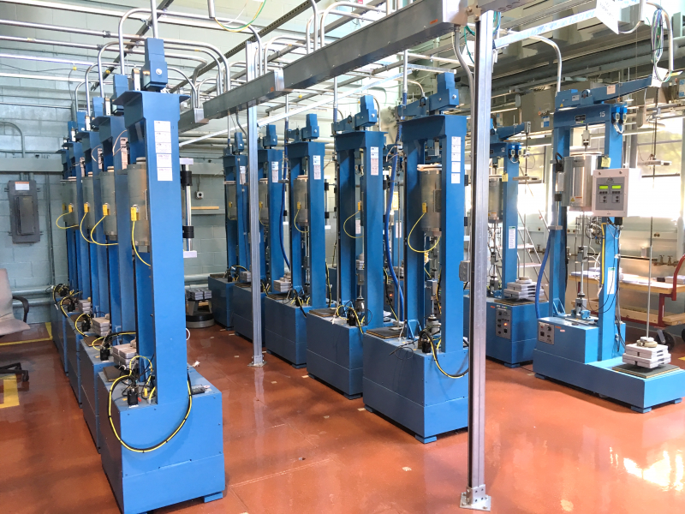
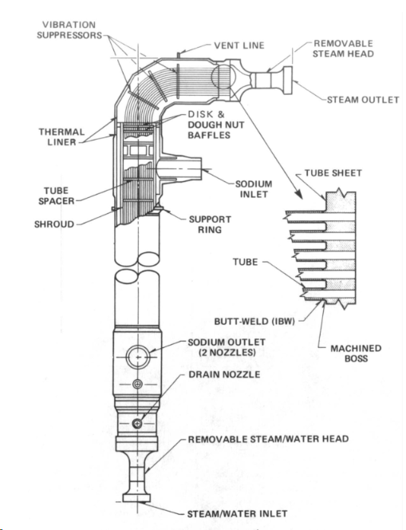
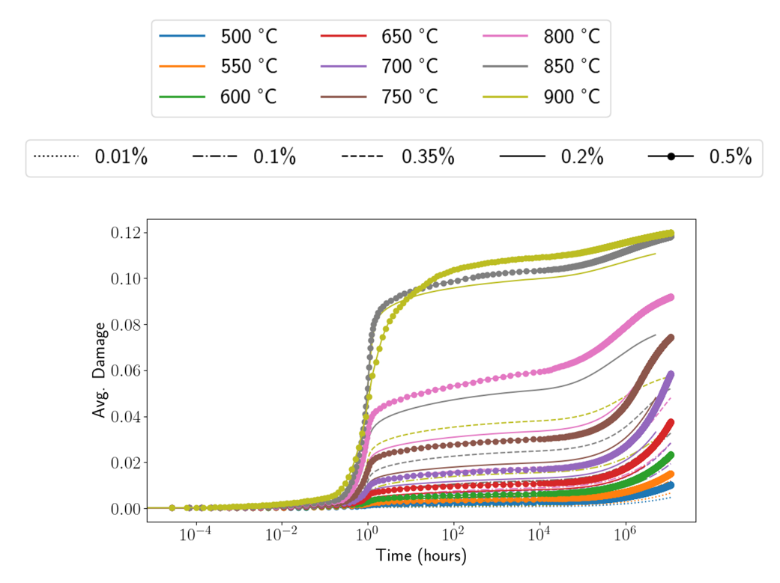
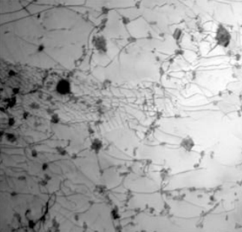
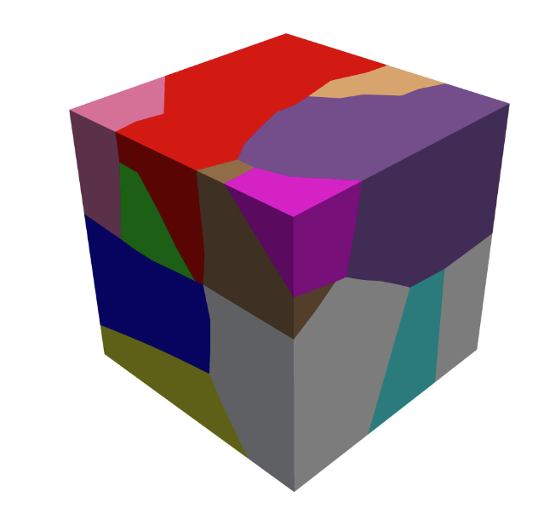

Simulation can accelerate material qualification
How can NEAMS help?
Provide insight on long-term behavior (creep and stress relaxation)
Supplement test data with “simulated tests”
  Long-term (100k + hours)
  Difficult conditions (multiaxial stress, environmental effects…)
Alloy 709
ART/FR aiming to qualify for use with Section III, Division 5 of the ASME Boiler Code
  Rules governing design of high temperature reactor components
“Advanced” austenitic stainless steel
Originally developed by Nippon Steel for boiler tubes
Goal: better high temperature performance than 316H without (much) additional cost
Uniaxial stress
M₂₃C₆ carbide (like 316)
Fine carbo-nitride (not like 316)
Multiaxial stress

Slide 3
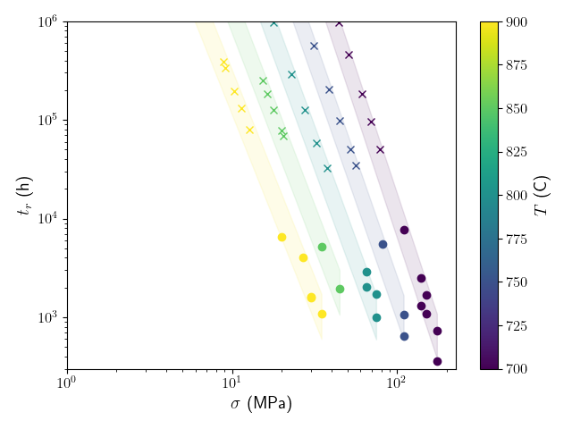
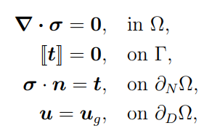
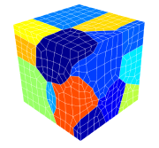

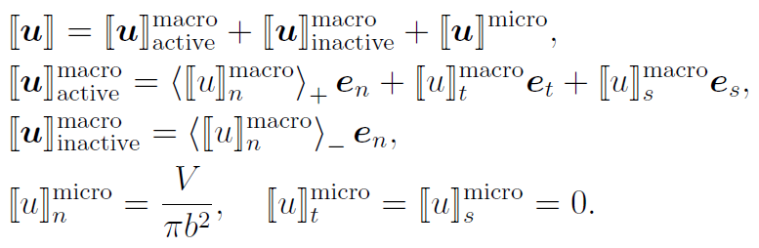
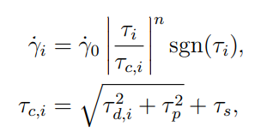
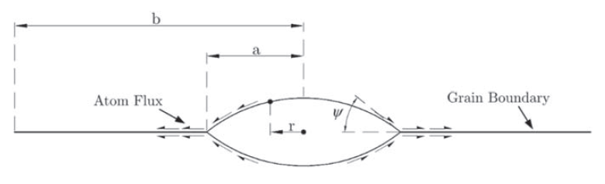
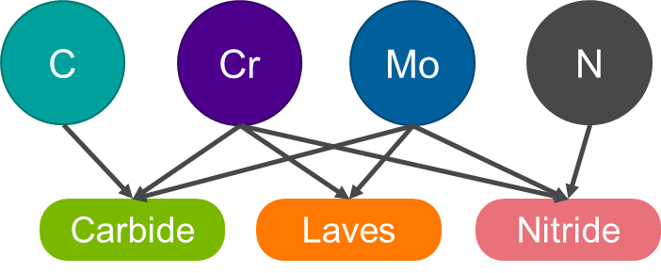
Quick overview of the model
The framework of crystal plasticity finite element (CPFE)
  Balance of linear momentum
  Traction continuity at grain boundaries
Constitutive model (bulk): The Hu-Cocks precipitation model
  Dislocation forest hardening
  Precipitation hardening
  Solid solution hardening
Constitutive model (grain boundary): The Sham-Needleman cavitation model
  Cavity nucleation, growth, and diffusion
  Softening due to grain boundary cavitation
Data and model predictions
Experimental data
Simulation predictions

Slide 4

NEAMS simulation studies for Alloy 709
Type of test
Challenge
Key questions
Creep
Long-term creep
Waiting for data…
How will the material behave at 30 or 60 years?
Dead load
Stress
Stress
relaxation
Long-term stress relaxation
Running the test (servo hydraulic machine)
Waiting for data…
Is the ASME damage model accurate?
Does the material have a threshold stress?
$$ΔT$$
??
Multiaxial creep
Running the test (limited capabilities, even at labs)
Waiting for data…
How to best correlate multiaxial to uniaxial failure?
How accurate is the ASME model for 304/316 for 709?
Time

Slide 5
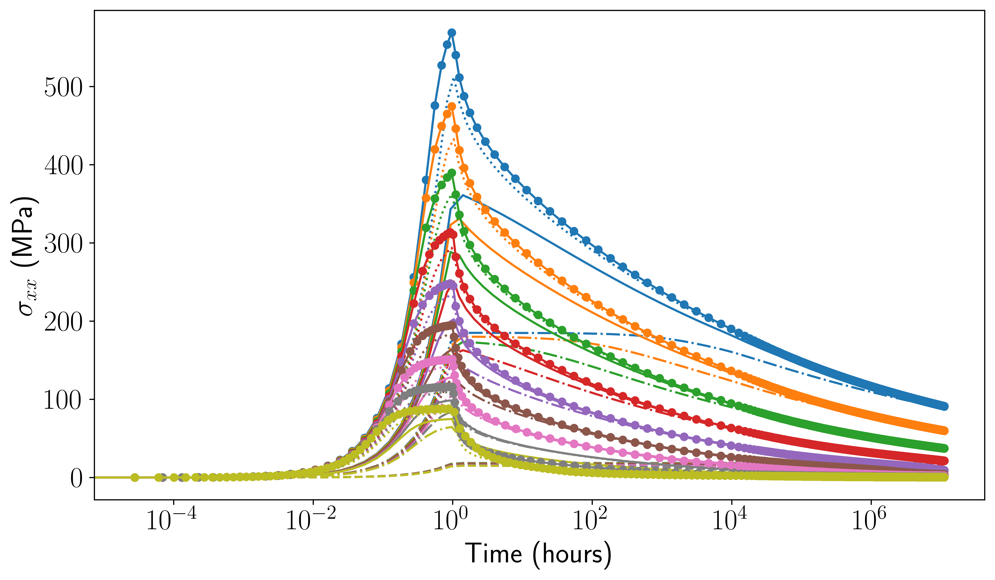
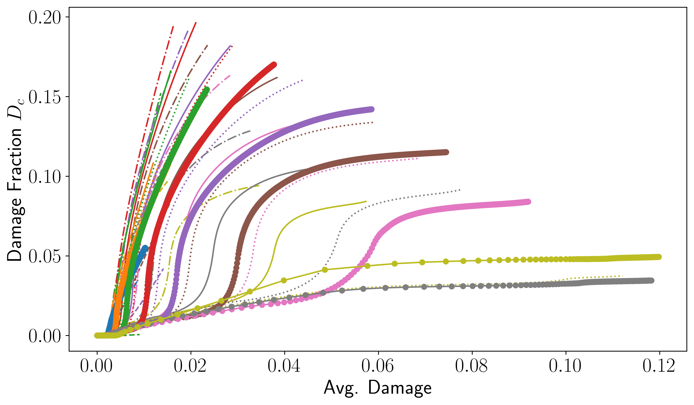
Long-term stress relaxation (FY24)
Stress (MPa)
ASME damage
Time (hours)
Simulated damage
Line style: different initial values of strain
Colors: different temperatures (550°to 900°C)
Key conclusions: (1) there is no threshold stress and (2) ASME time fraction damage is conservative, but could be much more accurate for pure relaxation conditions

Slide 6
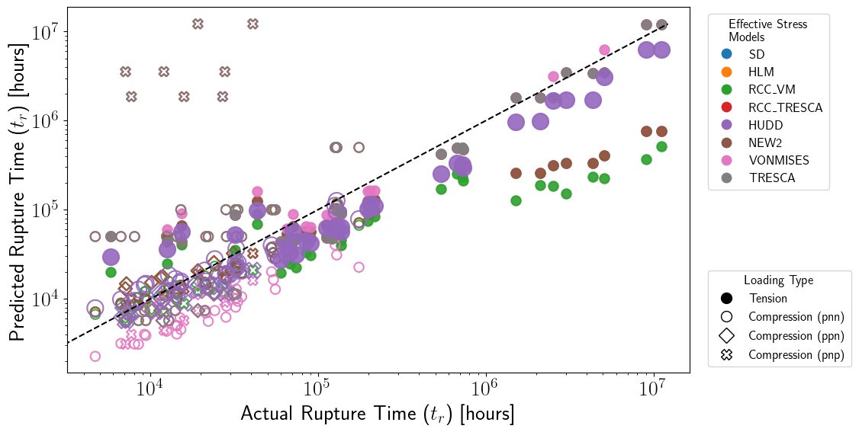





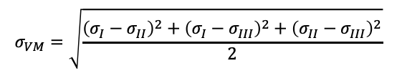

Multiaxial creep (FY25 carryover, completed)
Effective Stress Models
$$σ_{Tresca}=σ_{I}−σ_{III}$$
$$σ_{VM}=\sqrt{\frac{{\left(σ_{I}−σ_{II}\right)}^{2}+{\left(σ_{I}−σ_{III}\right)}^{2}+{\left(σ_{II}−σ_{III}\right)}^{2}}{2}}$$
$$σ_{Sd}\left(α\right)=α\left\langle σ_{I}\right\rangle +\left(1−α\right)σ_{VM}$$
Predicted with effective stress (hr)
$$σ_{Hudd}\left(β\right)=σ_{VM}\exp\left[β\left(\frac{I_{1}}{SS}−1\right)\right]$$
$$σ_{RCC_{\text{Tresca} }}\left(β\right)=\left(1−β\right)σ_{\text{Tresca} }+βI_{1}$$
$$σ_{RCC_{VM}}\left(β\right)=\left(1−β\right)σ_{VM}+βI_{1}$$
$$σ_{NEW^{1}}\left(α,β\right)=σ_{Sd}\left(α\right)\exp\left[β\left(\frac{I_{1}}{SS}−1\right)\right]$$
$$σ_{NEW^{2}}\left(α,β\right)=σ_{Sd}\left(α\right)\exp\left[β\left(\frac{I_{1}}{σ_{Sd}\left(α\right)}−1\right)\right]$$
Simulated rupture time (hr)
Key conclusions: (1) Huddleston model best fits the data, (2) Huddleston coefficient (0.22) very close to ASME value for 304/316 stainless steel (0.24)
ART/ASME will probably stop here

Slide 7
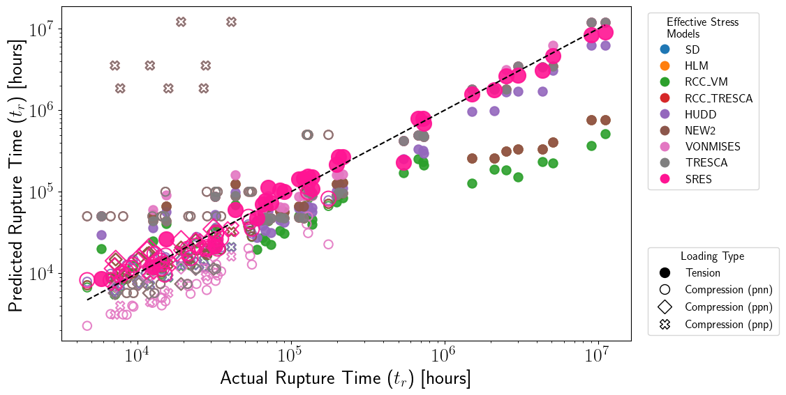
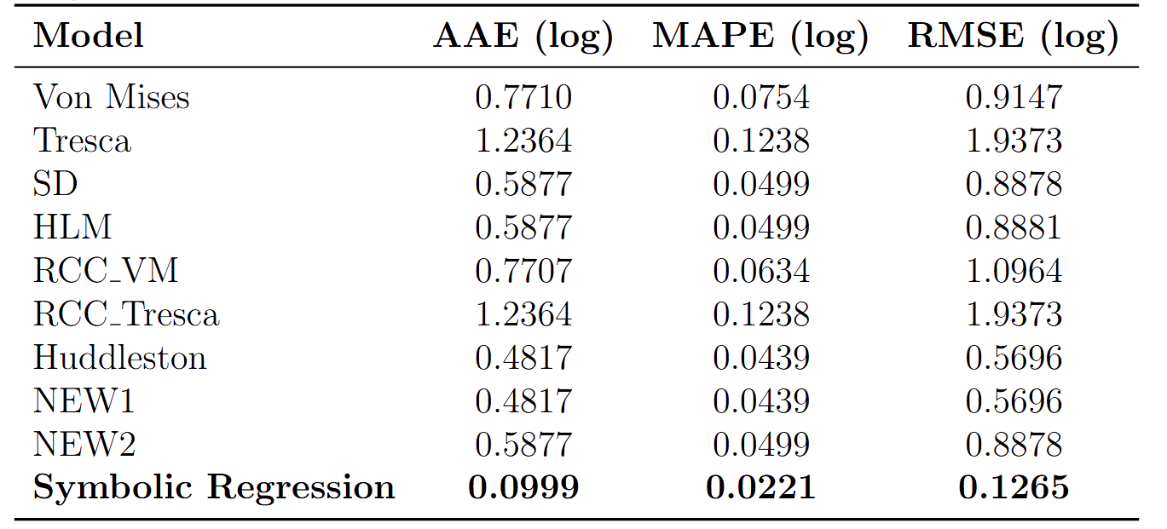
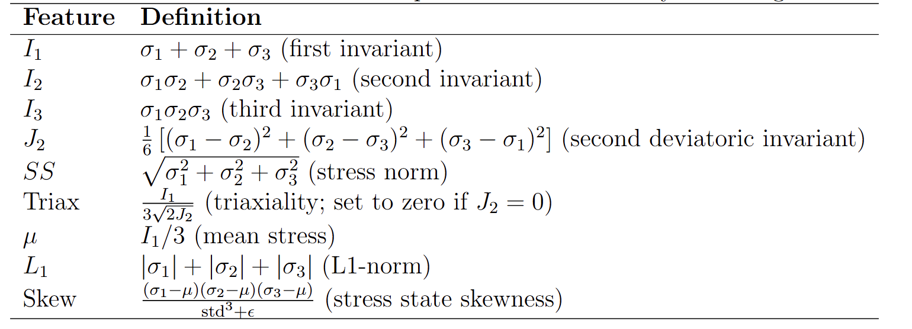
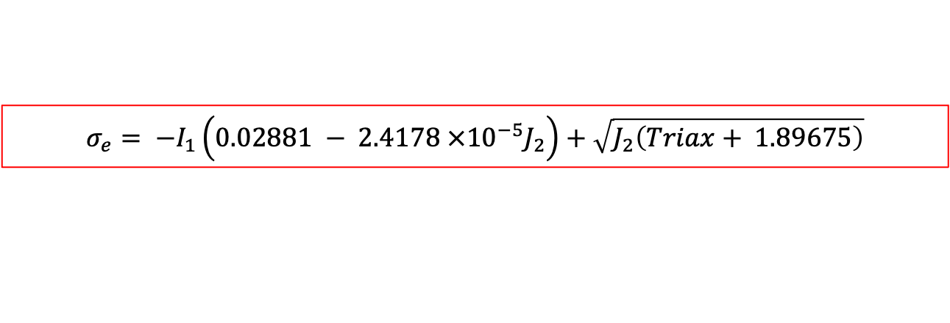
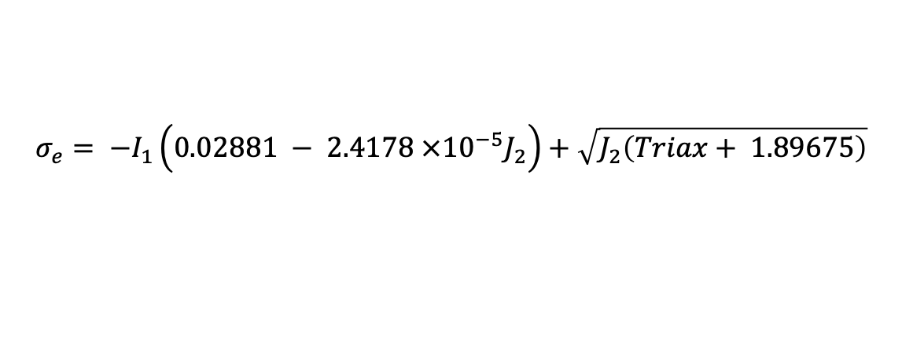
Symbolic regression for effective stress measures
$$σ_{e}= −I_{1}\left.\left(0.02881 − 2.4178 ×{10}^{−5}J_{2}\right.\right)+\sqrt{J_{2}\left(Triax+ 1.89675\right)}$$
Error comparison
Using Symbolic Regression with stress invariants as input features
The Symbolic Regression Effective Stress (SRES) model outperformed all other models, achieving:
79% reduction in absolute average error compared to Huddleston
77% reduction in RMSE compared to Huddleston
6–9× lower error metrics compared to classical models like von Mises and Tresca
Predicted with effective stress (hr)
Simulated rupture time (hr)
Input features (invariants)
Most interesting part (to me):
$$σ_{e}= −I_{1}\left.\left(0.02881 − 2.4178 ×{10}^{−5}J_{2}\right.\right)+\sqrt{J_{2}\left(Triax+ 1.89675\right)}$$

Slide 8
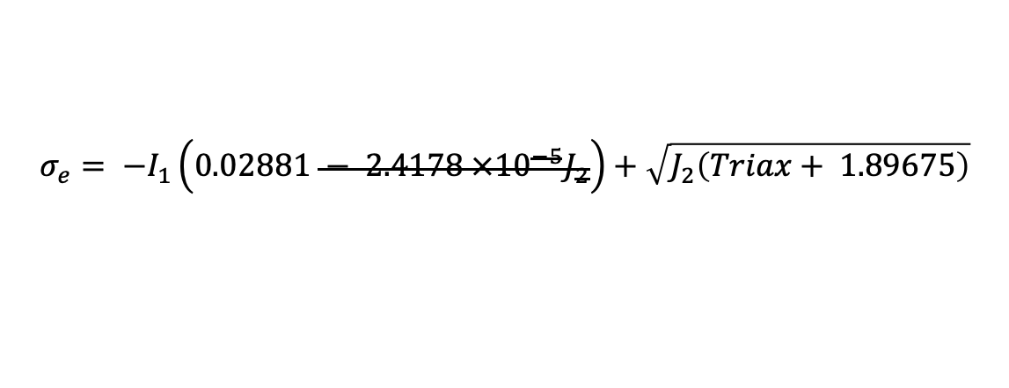
Symbolic regression for effective stress measures
$$σ_{e}= −I_{1}\left.\left(0.02881 − 2.4178 ×{10}^{−5}J_{2}\right.\right)+\sqrt{J_{2}\left(Triax+ 1.89675\right)}$$
Error comparison
Using Symbolic Regression with stress invariants as input features
The Symbolic Regression Effective Stress (SRES) model outperformed all other models, achieving:
79% reduction in absolute average error compared to Huddleston
77% reduction in RMSE compared to Huddleston
6–9× lower error metrics compared to classical models like von Mises and Tresca
Predicted with effective stress (hr)
Simulated rupture time (hr)
Input features (invariants)
Most interesting part (to me):
$$σ_{e}= −I_{1}\left.\left(0.02881 − 2.4178 ×{10}^{−5}J_{2}\right.\right)+\sqrt{J_{2}\left(Triax+ 1.89675\right)}$$

Slide 9
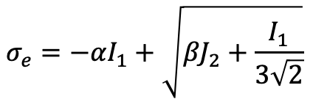
Symbolic regression for effective stress measures
$$σ_{e}= −I_{1}\left.\left(0.02881 − 2.4178 ×{10}^{−5}J_{2}\right.\right)+\sqrt{J_{2}\left(Triax+ 1.89675\right)}$$
Error comparison
Using Symbolic Regression with stress invariants as input features
The Symbolic Regression Effective Stress (SRES) model outperformed all other models, achieving:
79% reduction in absolute average error compared to Huddleston
77% reduction in RMSE compared to Huddleston
6–9× lower error metrics compared to classical models like von Mises and Tresca
Predicted with effective stress (hr)
Simulated rupture time (hr)
Input features (invariants)
Most interesting part (to me):
$$σ_{e}=−αI_{1}+\sqrt{{βJ}_{2}+\frac{I_{1}}{3\sqrt{2}}}$$
Modified Drucker-Prager…

Slide 10
Conclusions/continuing work
ART program is wrapping up Alloy 709 qualification
  Presented long-term creep and relaxation work in the past
  Presented on multiaxial creep work at the May ASME Code Week
AMMT program continues material qualification work
  Will coordinate with them to determine what’s most helpful
  Will validate/update 709 models as long-term data become available
  Similar work will continue with Alloy 625 and other materials

