Slide 1
Structural Materials and Chemistry Technical Area Overview: Light Water Reactors
Benjamin Spencer¹ and Ted Besmann²
¹Idaho National Laboratory
²University of South Carolina
Contact: Benjamin.Spencer@inl.gov

Slide 2
Technical Area Overview
Nuclear reactors contain numerous structural components, the integrity of which is essential for their safe and reliable operation
The Structural Materials & Chemistry Technical Area is developing computational tools for two main applications:
Ensuring the integrity of structural components in current and advanced reactors
Chemistry modeling in molten-salts, including speciation, depletion, corrosion, and plating.
The tools being developed are designed to integrate with the other tools being developed by the NEAMS program for seamless multiphysics coupling

Slide 3
Research Topics and Codes
Structural Material Performance
Molten-Salt Chemistry
Databases MSTDB-TP
MSTDB-TC³
Gibbs Energy Minimizer Thermochimica/
MOOSE
High-Temperature Alloy Creep¹
LAROMANCE/LApx NEML2 Grizzly/BlackBear
Fast-Reactor Core Duct Deformation
MOOSE
Graphite Components² Grizzly
Ab-initio Salt Property Prediction
AIMD, MD, MD with ML potentials
Transport Codes Mole
Pronghorn MOSCATO
Reinforced Concrete Degradation Grizzly/BlackBear
LWR Reactor Pressure Vessel Integrity Grizzly
Metal Hydride Moderators SWIFT
¹Coordination with AMMT program
²Data from ART program
³Developed by MSR program

Slide 4
Research Topics and Codes (Presentation Topics Indicated)
Structural Material Performance
Molten-Salt Chemistry
Databases MSTDB-TP
MSTDB-TC³
Gibbs Energy Minimizer Thermochimica/
MOOSE
High-Temperature Alloy Creep¹
LAROMANCE/LApx NEML2 Grizzly/BlackBear
Fast-Reactor Core Duct Deformation
MOOSE
Graphite Components² Grizzly
Ab-initio Salt Property Prediction
AIMD, MD, MD with ML potentials
Transport Codes Mole
Pronghorn MOSCATO
Reinforced Concrete Degradation Grizzly/BlackBear
LWR Reactor Pressure Vessel Integrity Grizzly
Metal Hydride Moderators SWIFT
¹Coordination with AMMT program
²Data from ART program
³Developed by MSR program

Slide 5
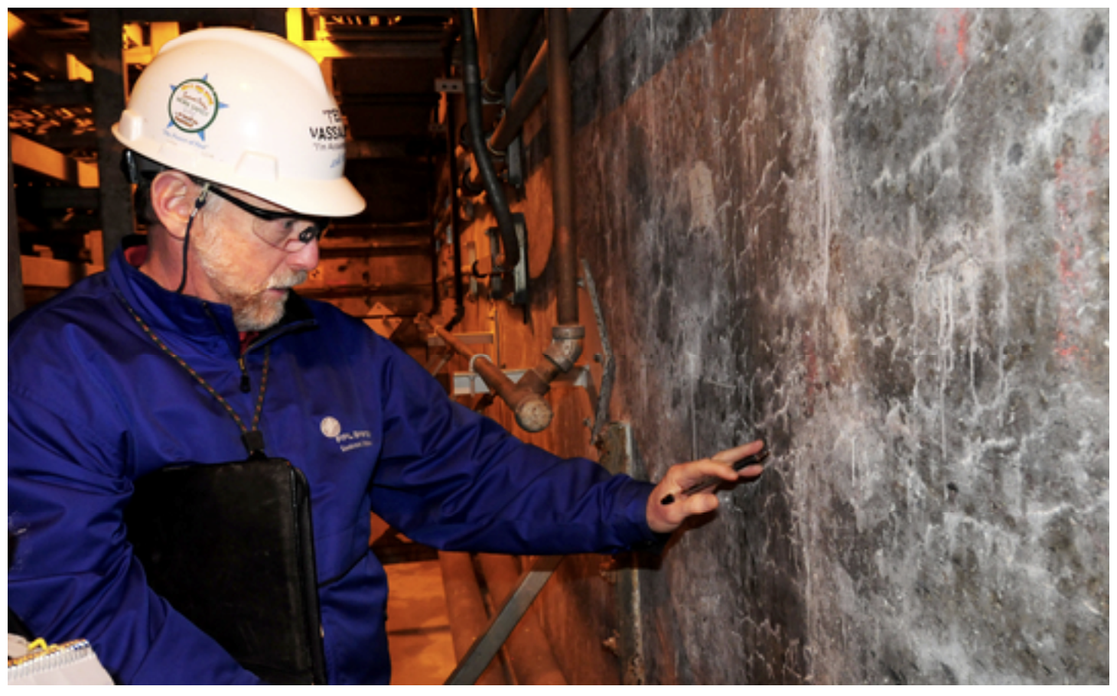
Reinforced Concrete Degradation
Reinforced concrete (RC) structures play a key role in LWR safety and are a major capital investment
Important mechanisms in nuclear structures:
Creep
Alkali-silica reaction (ASR)
Radiation-induced volumetric expansion (RIVE)
NEAMS Modeling tools:
BlackBear (open source): foundational capabilities
Grizzly: Everything in BlackBear, plus RIVE
Fracture in concrete containment vessel cut for repair (Image from Progress Energy, NRC ML09320292)
Cracking due to ASR in a concrete containment vessel (Image from NRC, ML12199A300)

Slide 6
Processes Affecting Alkali-Silica Reaction
ASR modeling starts with the underlying processes:
Temperature
Moisture
Mechanical Deformation
Coupled-physics models for evolution and interaction of these processes
Model predicts deformation and degradation due to ASR
Initial state for capacity assessment
Temperature
ASR & Associated Expansion/Damage
Moisture
Mechanical Deformation

Slide 7
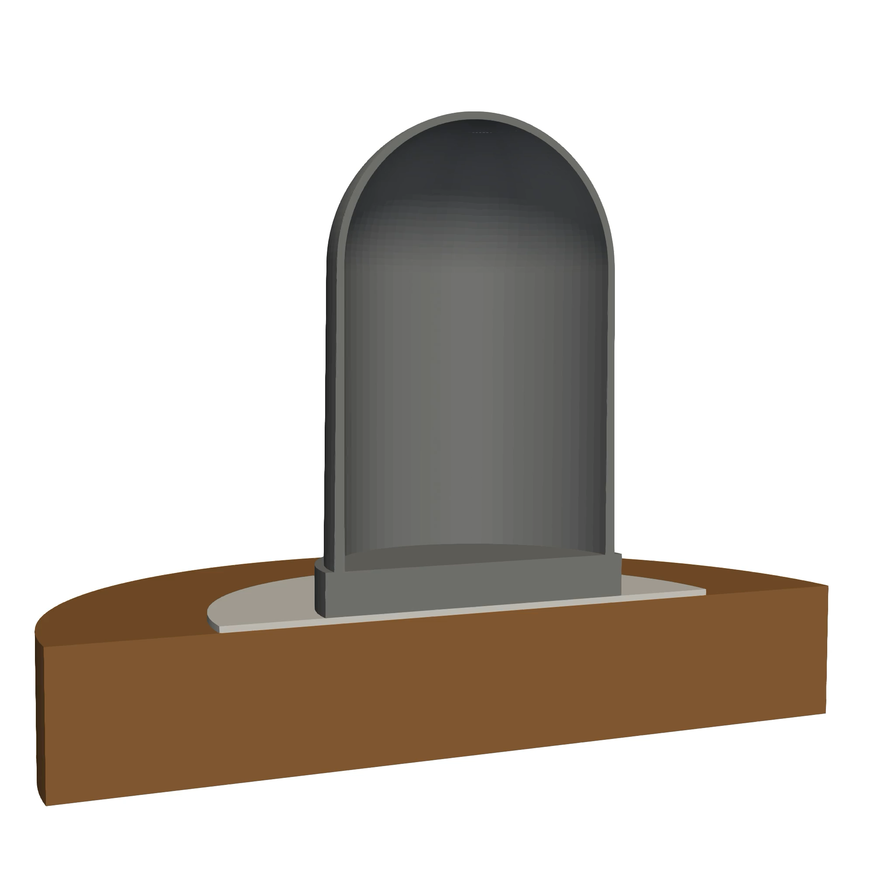
Simulated ASR Effect on LWR RC Containment Vessel
Recent DOE Nuclear Safety R&D project used NEAMS tools to assess effects of ASR on seismic capacity
Unified modeling approach
Model of prototypical LWR RC containment vessel with individual rebars represented
Coupled-physics model for long-term progression of ASR and resulting damage
Seismic response modeled following ASR
Probabilistic analyses on hundreds of samples for seismic fragilities

Slide 8
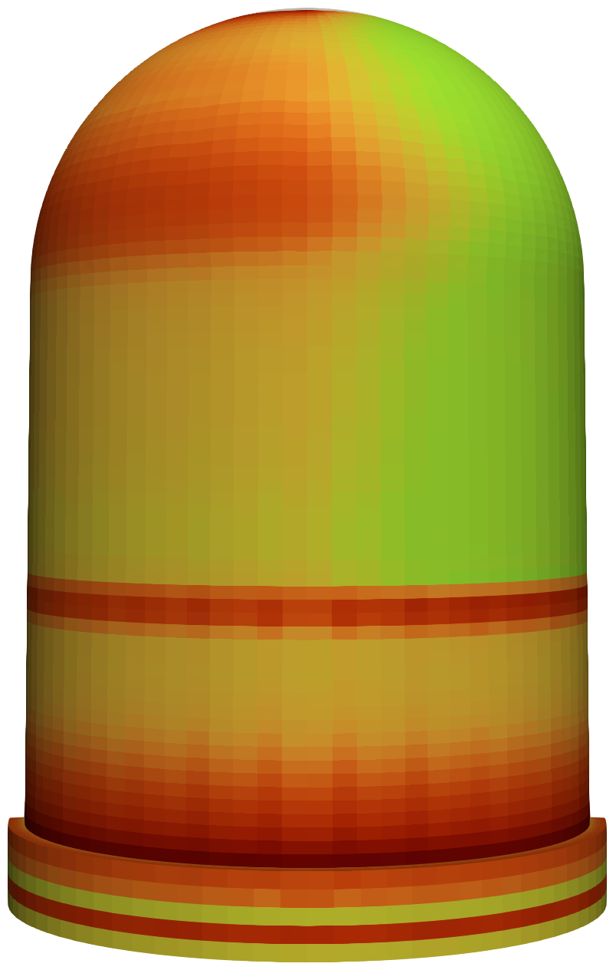
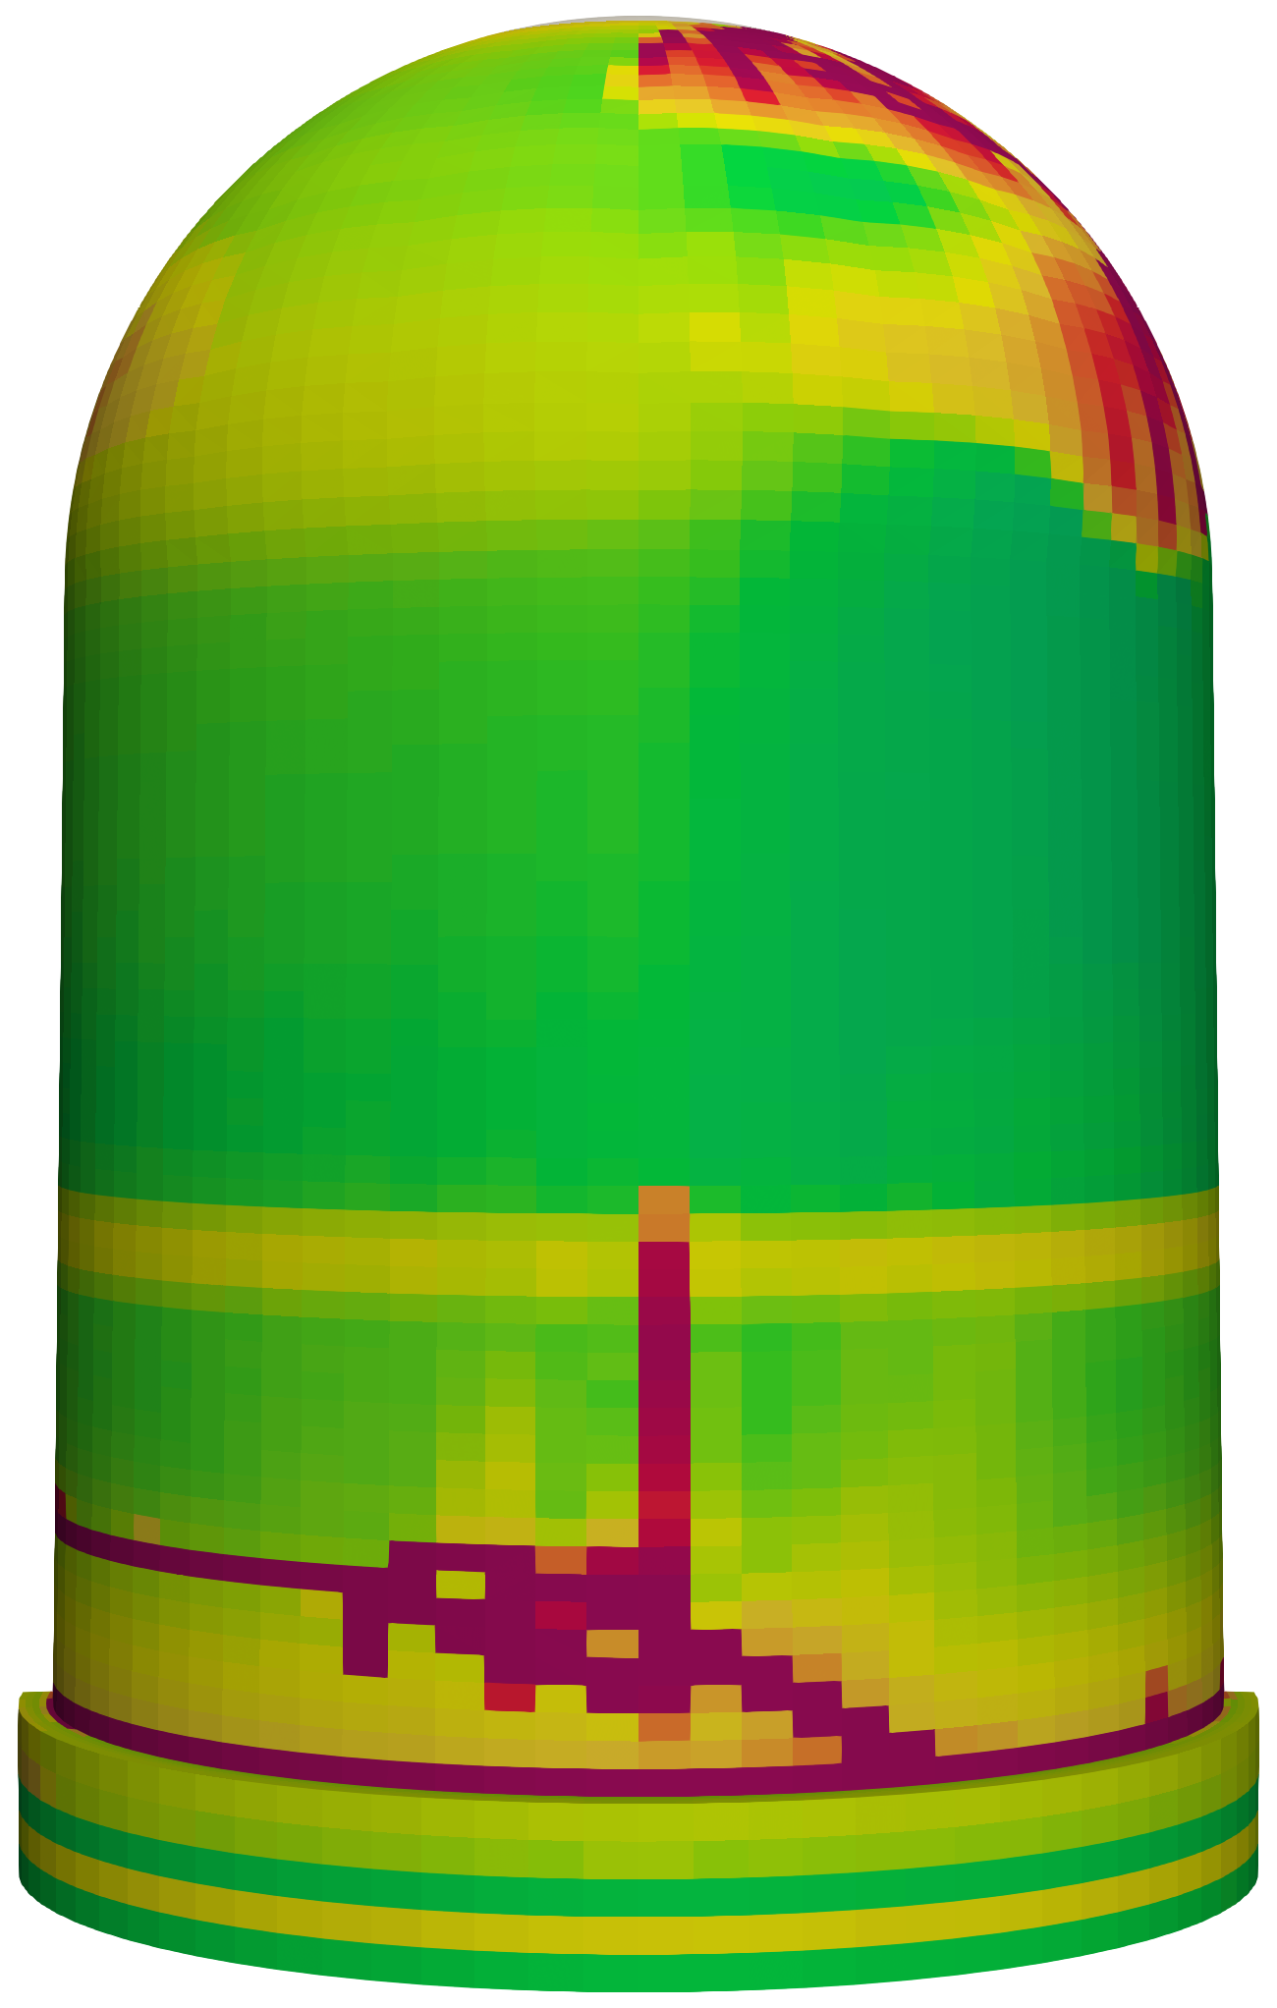
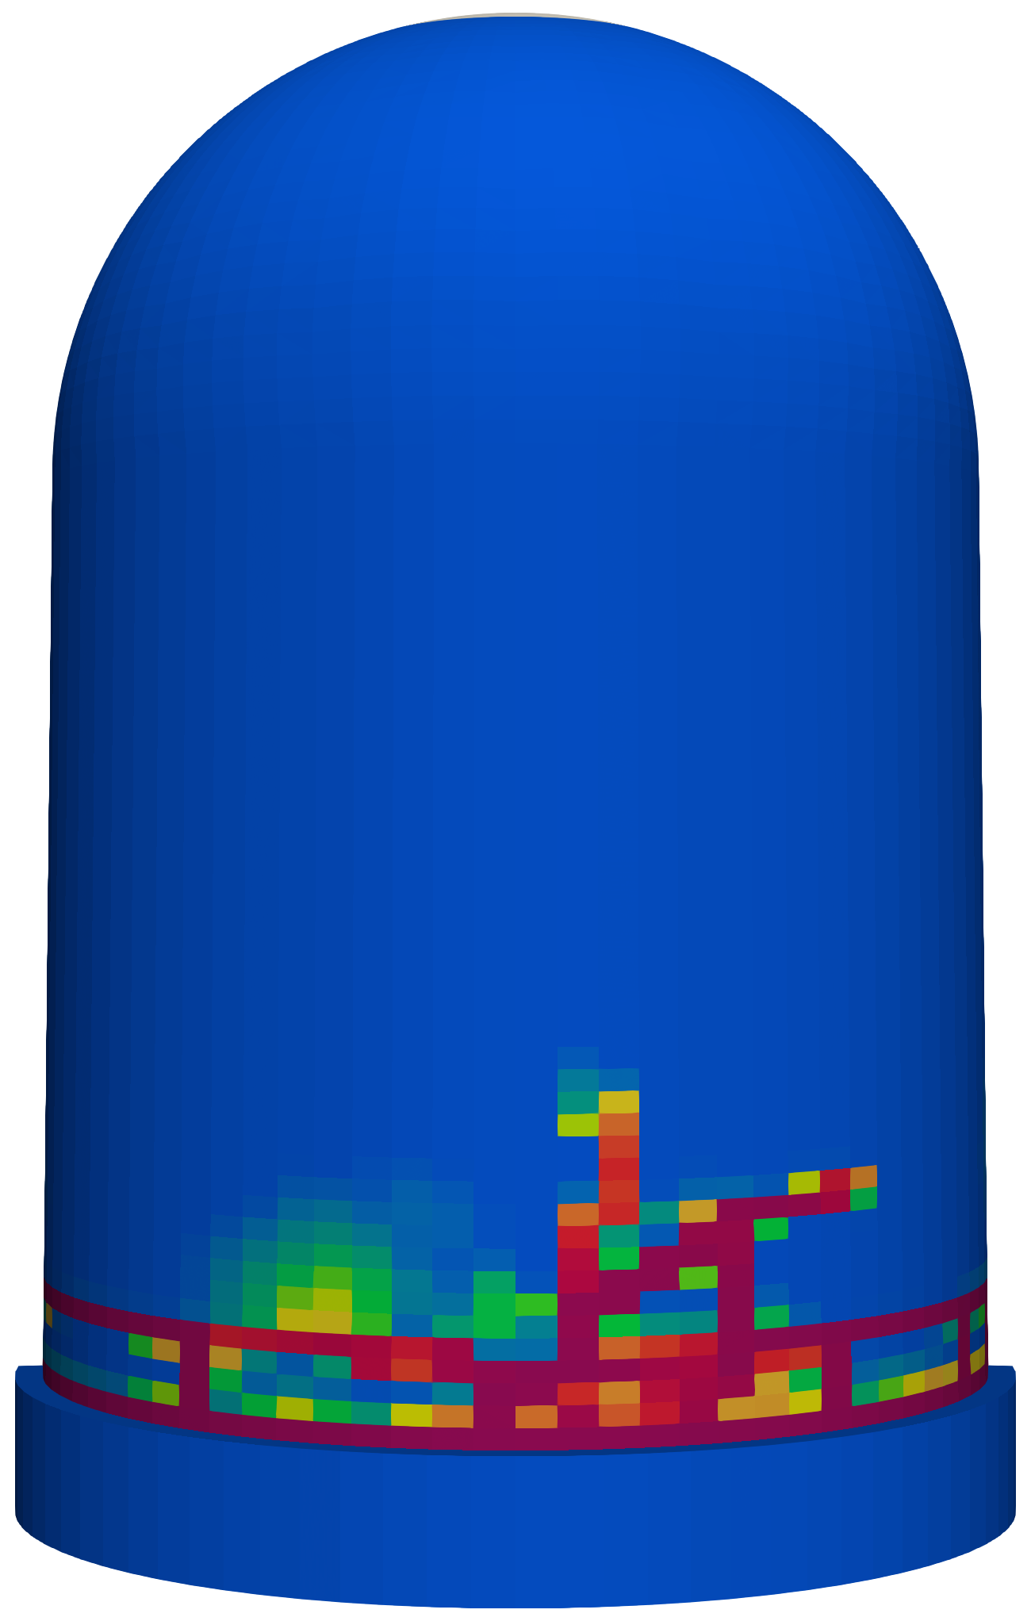
ASR Effect on Seismic Capacity
ASR Effect
Long-term alkali-silica-reaction (ASR) damage to containment vessel
Damage after seismic loading (left) with ASR and
(right) without ASR
ASR effect on seismic fragility under multiple limit states
A. Dahal, B. W. Spencer, S. L. Dhulipala, A. Jain, and L. F. Ibarra. Coupled alkali-silica-reaction/seismic simulation of nuclear containment vessels. International Journal of Mechanical Sciences, 110185, Apr. 2025.

Slide 9
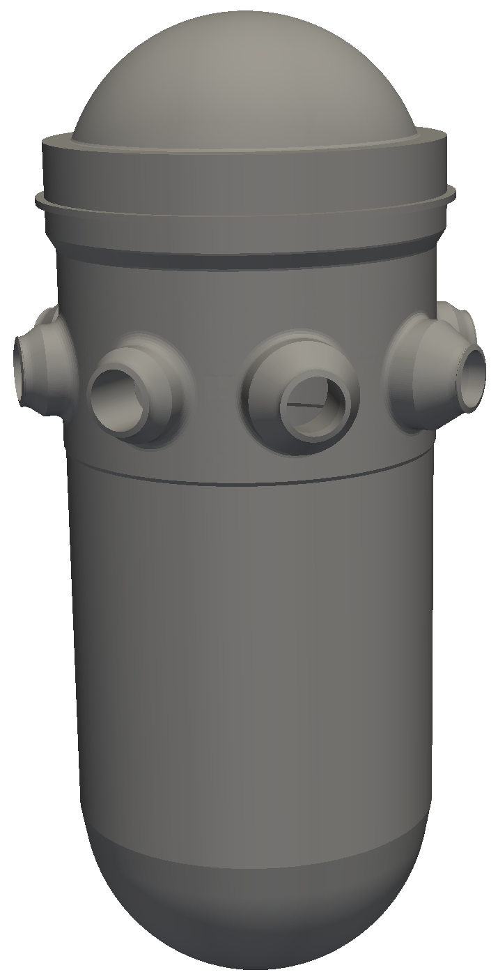
LWR Reactor Pressure Vessel Integrity
Reactor pressure vessels (RPVs) can contain large numbers of manufacturing flaws
Most of the flaws are inconsequential
Flaws can serve as fracture initiation sites
Rapid-cooling transients can challenge RPV integrity
Elevated tensile stress
Decreased toughness
Exposure to neutron irradiation embrittles the RPV steel
Increased susceptibility to fracture over time
RPVs are considered life-limiting reactor components
Grizzly capabilities for RPV fracture
3D probabilistic assessment of sampled populations of flaws

Slide 10
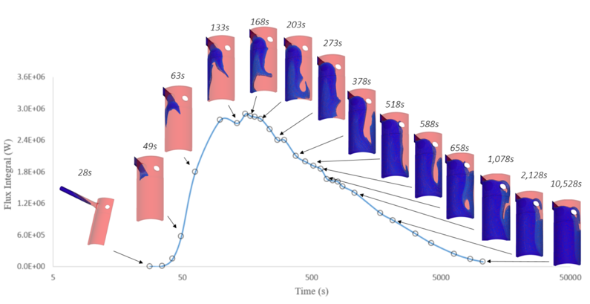
Assessing Spatially Nonuniform Cooling Using Coupled Fluid Dynamics and Fracture Mechanics
Cooling during transients can be highly spatially nonuniform
Most RPV probabilistic fracture mechanics models assume spatially uniform cooling
NEAMS effort coupled codes to simulate nonuniform cooling:
NekRS: Computational fluid dynamics model of coolant within RPV
Cardinal: Thermal coupling between coolant and RPV wall
Grizzly: Probabilistic fracture of RPV
Computational fluid dynamics simulation of RPV wall temperatures during medium break loss of cooling accident (MBLOCA)

Slide 11
Grizzly Probabilistic Fracture Model Shows Significant Effects from Nonuniform Cooling
Three scenarios considered:
Average coolant temperature uniformly applied (non-conservative, current practice)
Spatially varying temperature (most accurate)
Minimum coolant temperature uniformly applied (highly conservative)
Time history of maximum conditional probability of fracture initiation (CPI)
Flaws with nonzero CPI from 100,000 realizations shown on 90º RPV rollout. Critical flaws in regions with rapid cooling.

Slide 12
Ongoing & Potential Future Efforts for RPV & Concrete
Both RPV and concrete simulation tools now have most major features
Concrete capability gap: models for rebar/concrete bond
Current FY25 effort is adding bond-slip capability
Other potential areas for future research & development, depending on interest:
Concrete:
More sophisticated damage models (being developed for graphite modeling efforts)
Other degradation mechanisms (e.g., chemical attack)
Validation against experiments with combined ASR and mechanical loading
RPV:
Assessing relative importance of the various factors influencing fracture initiation in 3D plume model
Models for predicting probability of full through-wall cracking, rather than initiation

Slide 13
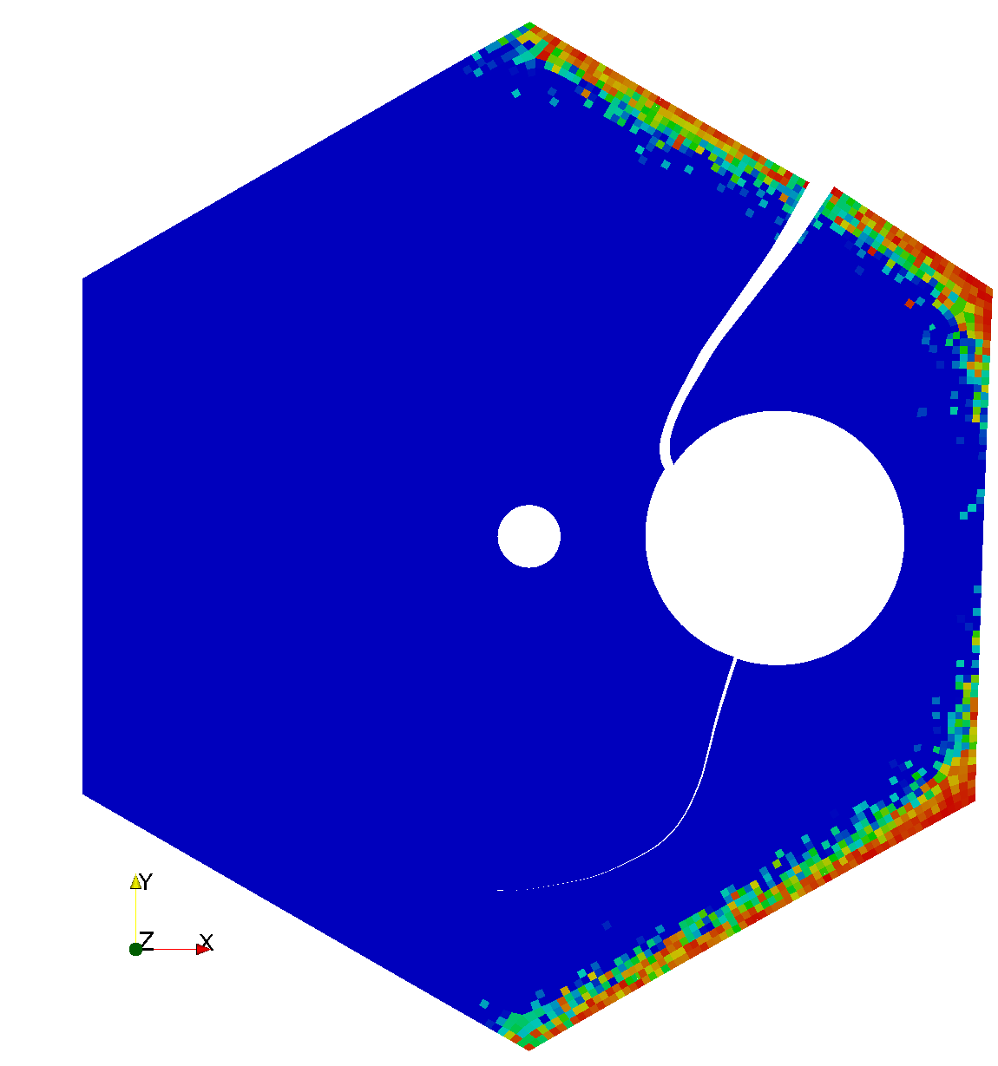
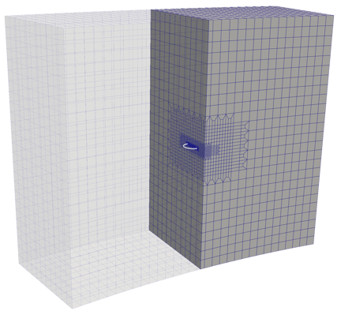
LWR-Relevant Fracture Modeling
Environmentally assisted fracture is important for LWR structural integrity
Fractures in welds around penetrations in RPV head
Stress-corrosion cracking in core internal components
Identified need for more robust tools for 3D fracture propagation into complex components
Ongoing development to address needs:
Modeling methodology for residual stress development during welding processes
Improve extended finite element method (XFEM) for both 2D and 3D mesh-independent fracture propagation into regions with residual stresses
Prior 2D and 3D applications of XFEM in MOOSE

