Slide 1
Structural Materials and Chemistry Technical Area Overview:
Microreactors
Benjamin Spencer¹ and Ted Besmann²
¹Idaho National Laboratory
²University of South Carolina
Contact: Benjamin.Spencer@inl.gov

Slide 2
Technical Area Overview
Nuclear reactors contain numerous structural components, the integrity of which is essential for their safe and reliable operation
The Structural Materials & Chemistry Technical Area is developing computational tools for two main applications:
  Ensuring the integrity of structural components in current and advanced reactors
  Chemistry modeling in molten-salts, including speciation, depletion, corrosion, and plating.
The tools being developed are designed to integrate with the other tools being developed by the NEAMS program for seamless multiphysics coupling

Slide 3
Research Topics and Codes
Structural Material Performance
Molten-Salt Chemistry
Databases
MSTDB-TP
MSTDB-TC³
Gibbs Energy Minimizer
Thermochimica/
MOOSE
High-Temperature Alloy Creep¹
LAROMANCE/LApx
NEML2
Grizzly/BlackBear
Fast-Reactor Core Duct Deformation
MOOSE
Graphite Components²
Grizzly
Ab-initio Salt Property Prediction
AIMD, MD, MD with ML potentials
Transport Codes
Mole
Pronghorn
MOSCATO
Reinforced Concrete Degradation
Grizzly/BlackBear
LWR Reactor Pressure Vessel Integrity
Grizzly
Other Chemistry
Metal Hydride Moderators
SWIFT
¹Coordination with AMMT program
²Data from ART program
³Developed by MSR program

Slide 4
Research Topics and Codes (Presentation Topics Indicated)
Structural Material Performance
Molten-Salt Chemistry
Databases
MSTDB-TP
MSTDB-TC³
Gibbs Energy Minimizer
Thermochimica/
MOOSE
High-Temperature Alloy Creep¹
LAROMANCE/LApx
NEML2
Grizzly/BlackBear
Fast-Reactor Core Duct Deformation
MOOSE
Graphite Components²
Grizzly
Ab-initio Salt Property Prediction
AIMD, MD, MD with ML potentials
Transport Codes
Mole
Pronghorn
MOSCATO
Reinforced Concrete Degradation
Grizzly/BlackBear
LWR Reactor Pressure Vessel Integrity
Grizzly
Other Chemistry
Metal Hydride Moderators
SWIFT
¹Coordination with AMMT program
²Data from ART program
³Developed by MSR program

Slide 5
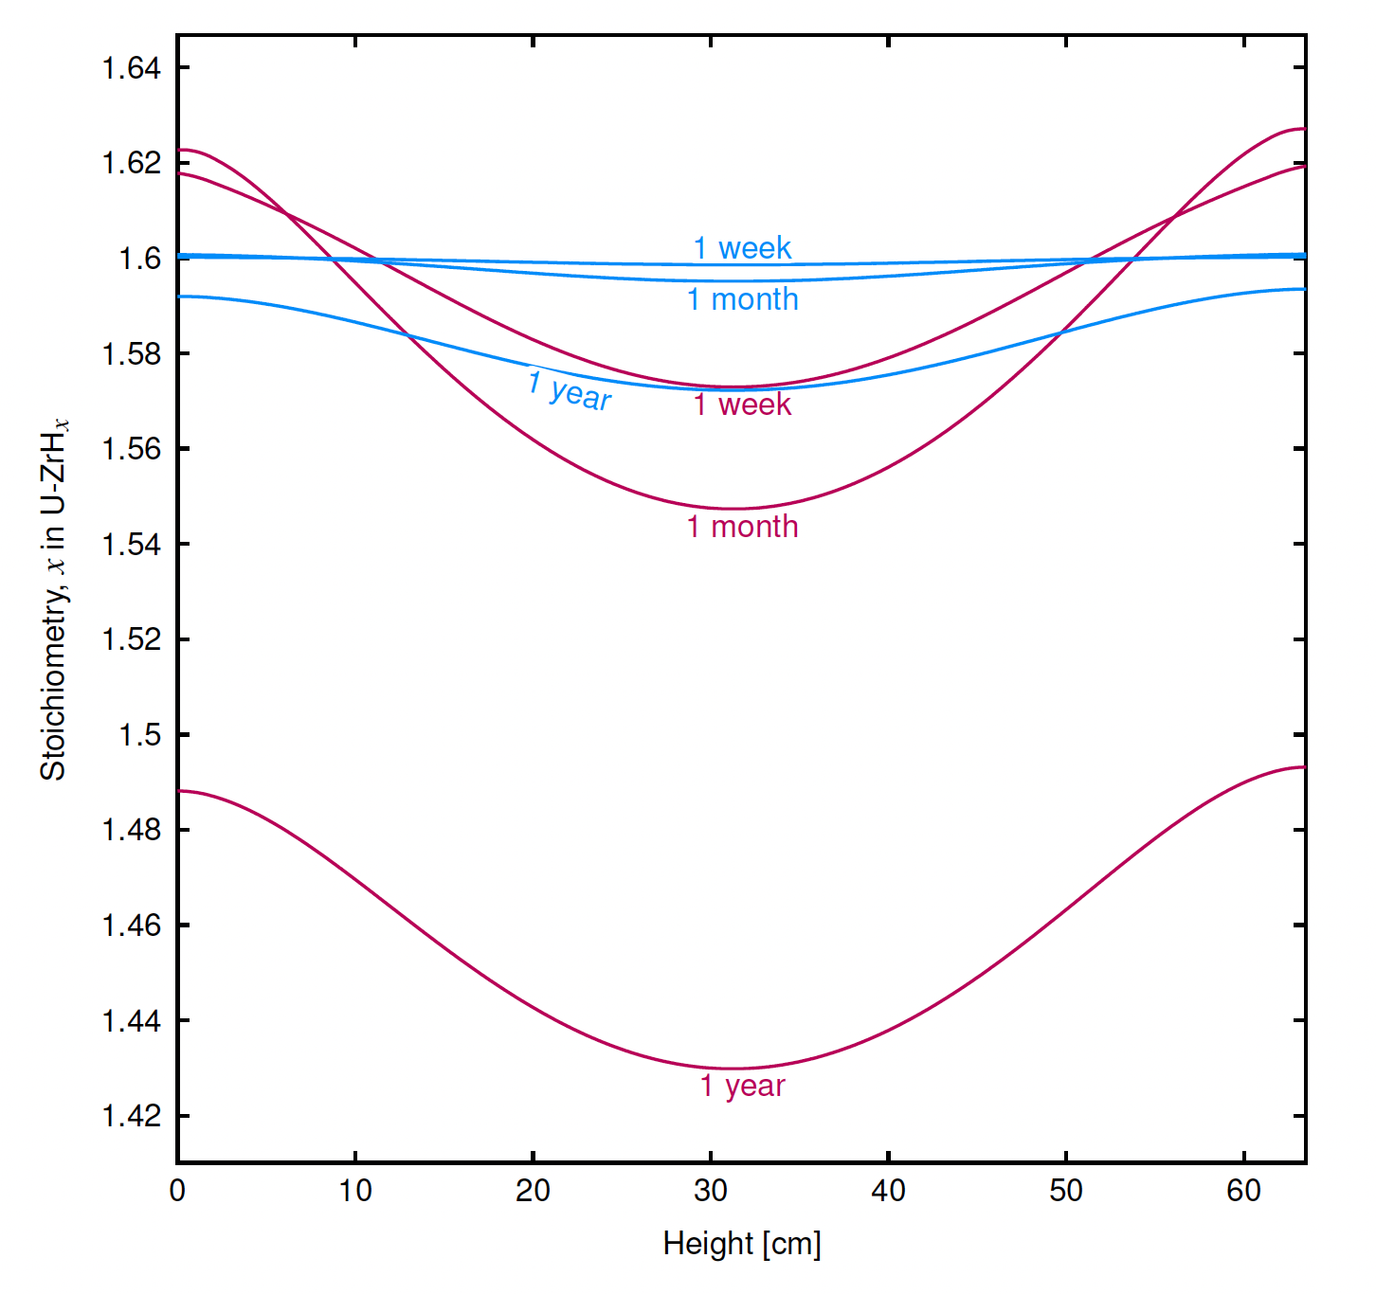
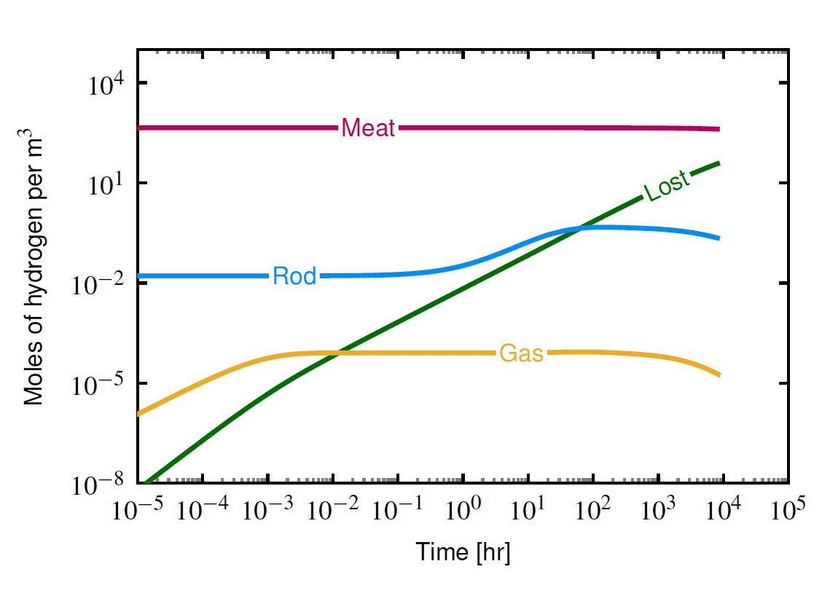
SWIFT: A thermo-chemistry tool for metal hydride moderators
SWIFT tracks the non-linear behavior of hydrogen in a metal hydride due to surface reactions, diffusion, and permeation
Can provide insight into critical performance criteria, including:
  On what timescale is hydrogen lost to the gas?
  To what extent is the fuel-cladding gas gap pressurized?
  How non-uniform is hydrogen concentration in the solid phase?
Hydrogen content vs time
Hydrogen content vs position
Blue = cold temperatures
Red = hot temperatures
SWIFT is ready for use by external users
Upcoming work: 1) baseline capability paper, 2) material properties improvements, 3) lower-length scale advancements
Contact: Topher Matthews, cmatthews@lanl.gov

