Slide 1
Pronghorn-Thermochimica Integration for Full-Core MSR Simulations
Mauricio Tano*, Parikshit Bajpai, Chaitanya Bhave, Samuel Walker, Ramiro Freile, Daniel Schwen
Idaho National Laboratory
May 28, 2025
NEAMS Annual Review: Molten Salt Reactors

Slide 2
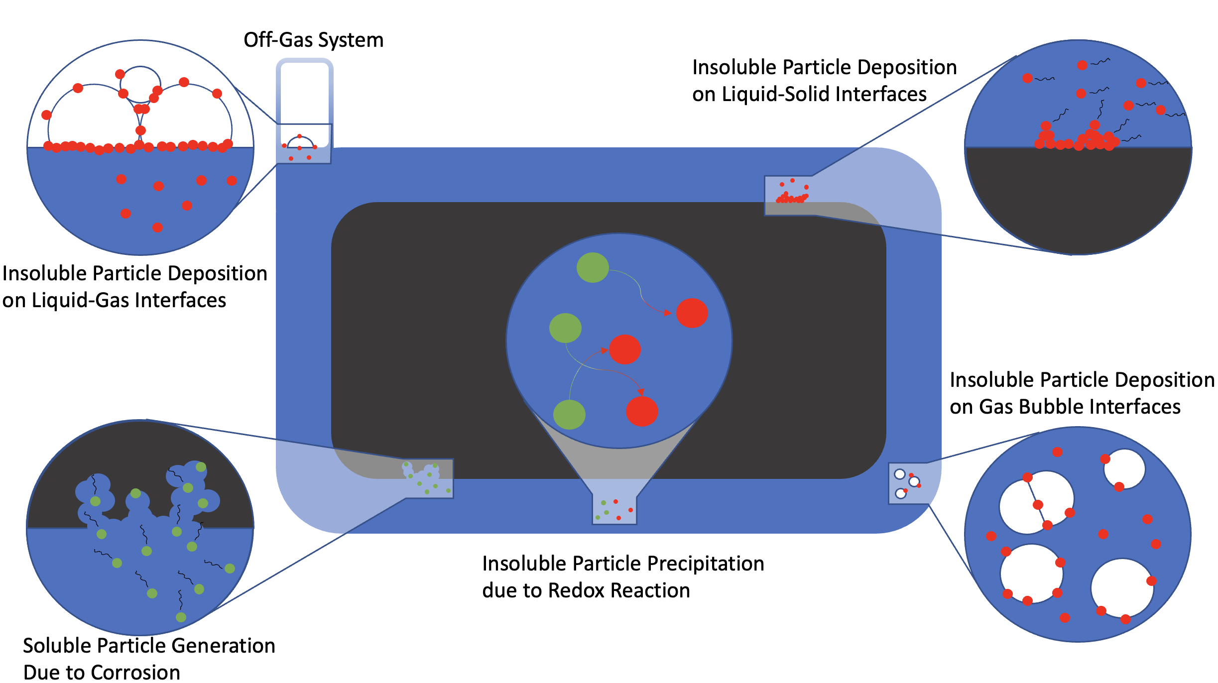
Motivation: MSR Chemistry

Slide 3
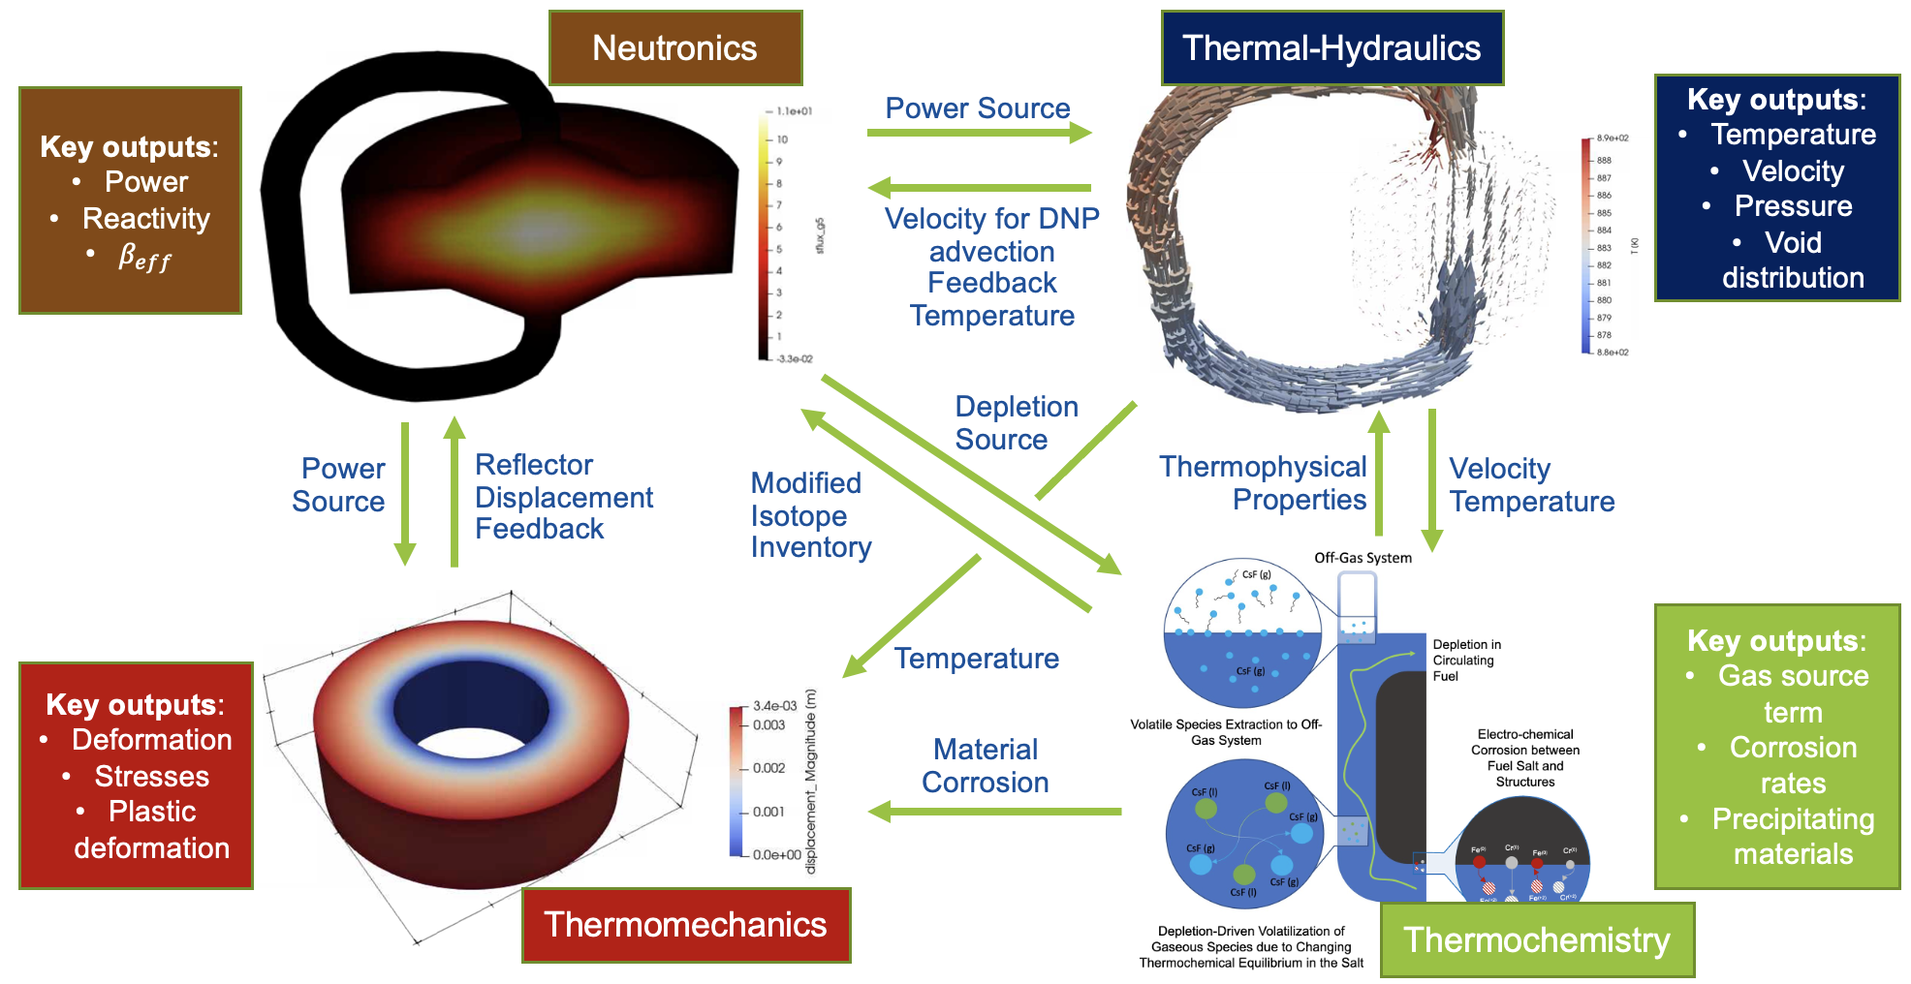
Where this works fits in the multiphysics framework?
MSTDB-TP
MSTDB-TC

Slide 4
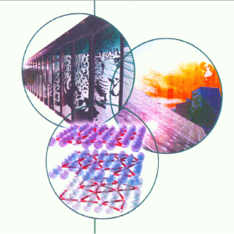
Thermochimica
Thermochimica is a computational library for chemical thermodynamics.
It determines a unique combination of phases and their compositions for a prescribed chemical composition, temperature and pressure.
The solver and the underlying thermodynamic models can be used to estimate the chemical state and various constitutive and transport properties necessary for modeling of materials and processes.
The original Thermochimica source package is developed in FORTRAN.
We have recently developed a MOOSE-based wrapper that allows us to run Thermochimica on the MOOSE computational mesh and makes its results readily available and able to be coupled via MultiApps

Slide 5
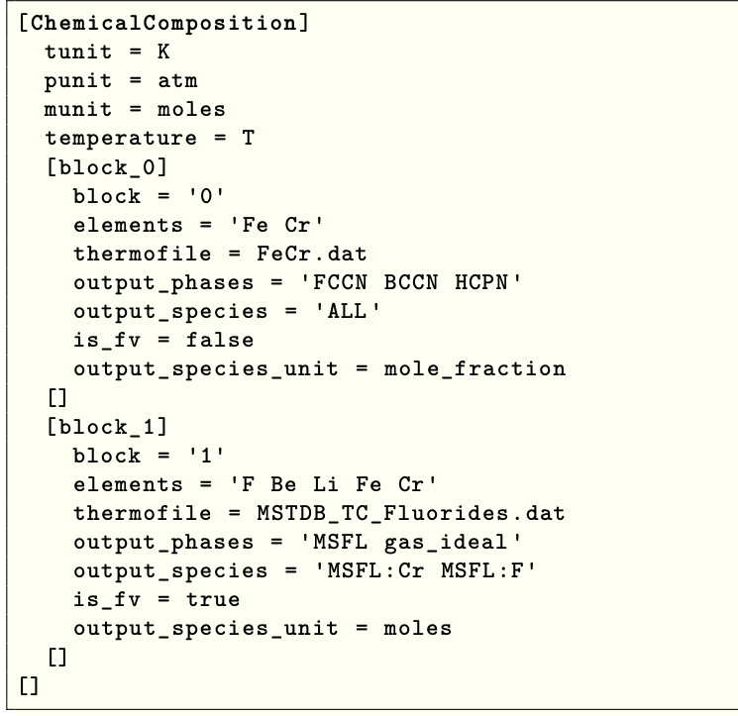
Thermochimica Integration into MOOSE
Application usage via ChemicalComposition UO:
Block restricted
User defines temperature and pressure fields and units for these fields
Per block, user defines:
Element concentration/distribution fields
Thermochemical file
Required output phases
Required output species
The is_fv flag: to create auxiliary fields for coupled species and phases
Units of for the output species
ChemicalComposition then outputs the equilibrium phases and species within those phases as AuxVariables

Slide 6
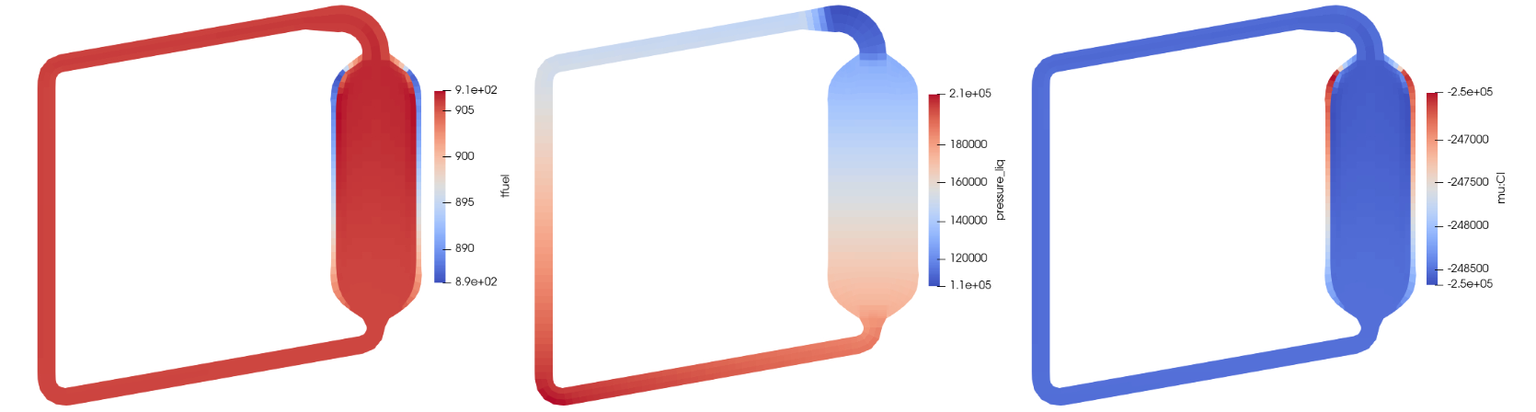
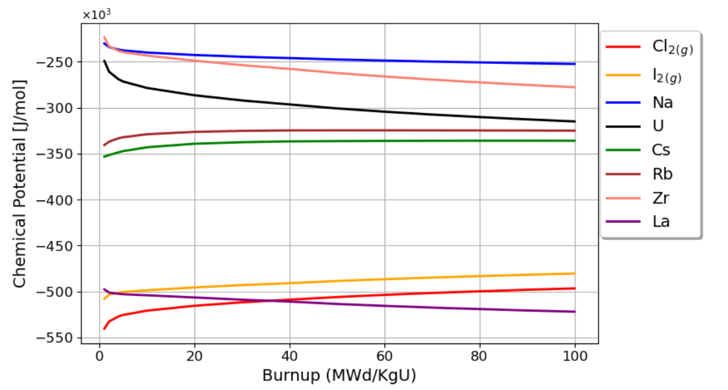
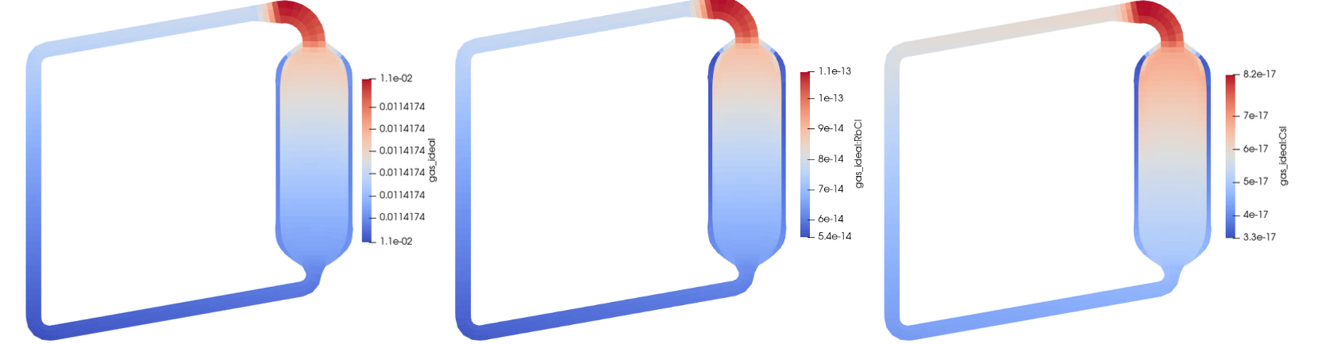
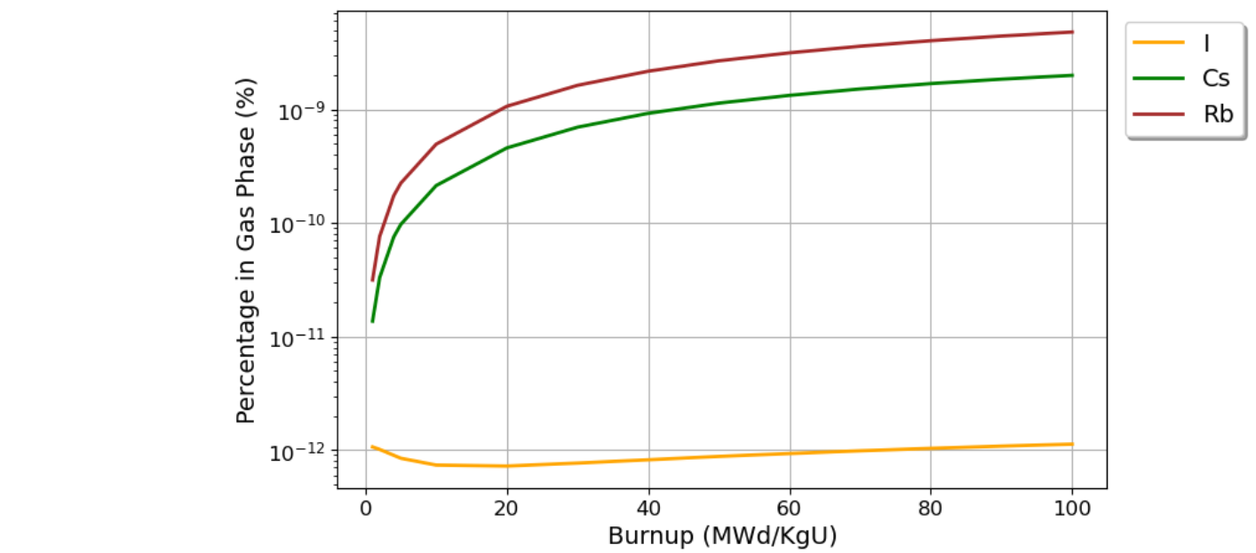
Example 1: Chemical Potential Evolution in L-MSR
Temperature [K]
Pressure [Pa]
Chlorine Chemical Potential (Cl⁻)
Evolution in chemical potential of fuel salt with burnup
Ideal Gas Phase [mol/m³]
RbCl gas [mol/m³]
CsI gas [mol/m³]
Volatilization of chemical species due to depletion

Slide 7
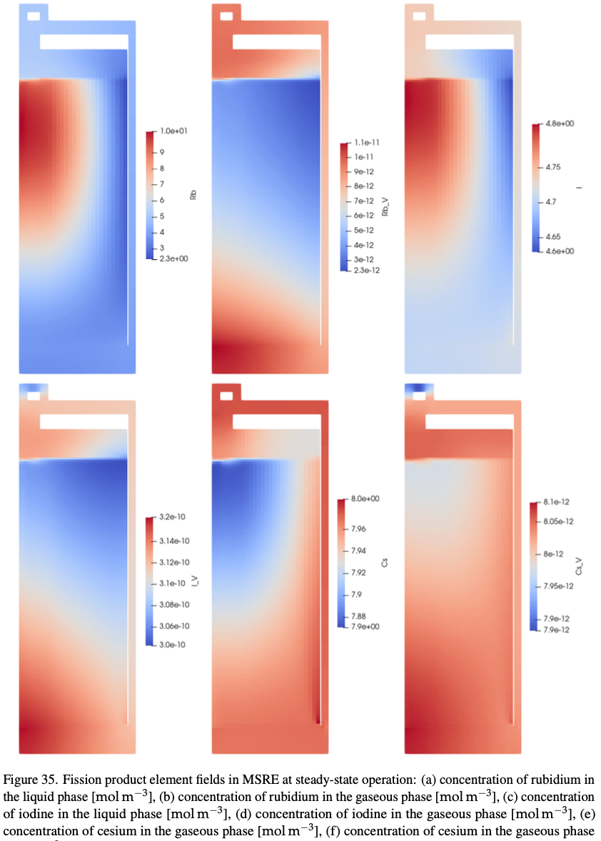
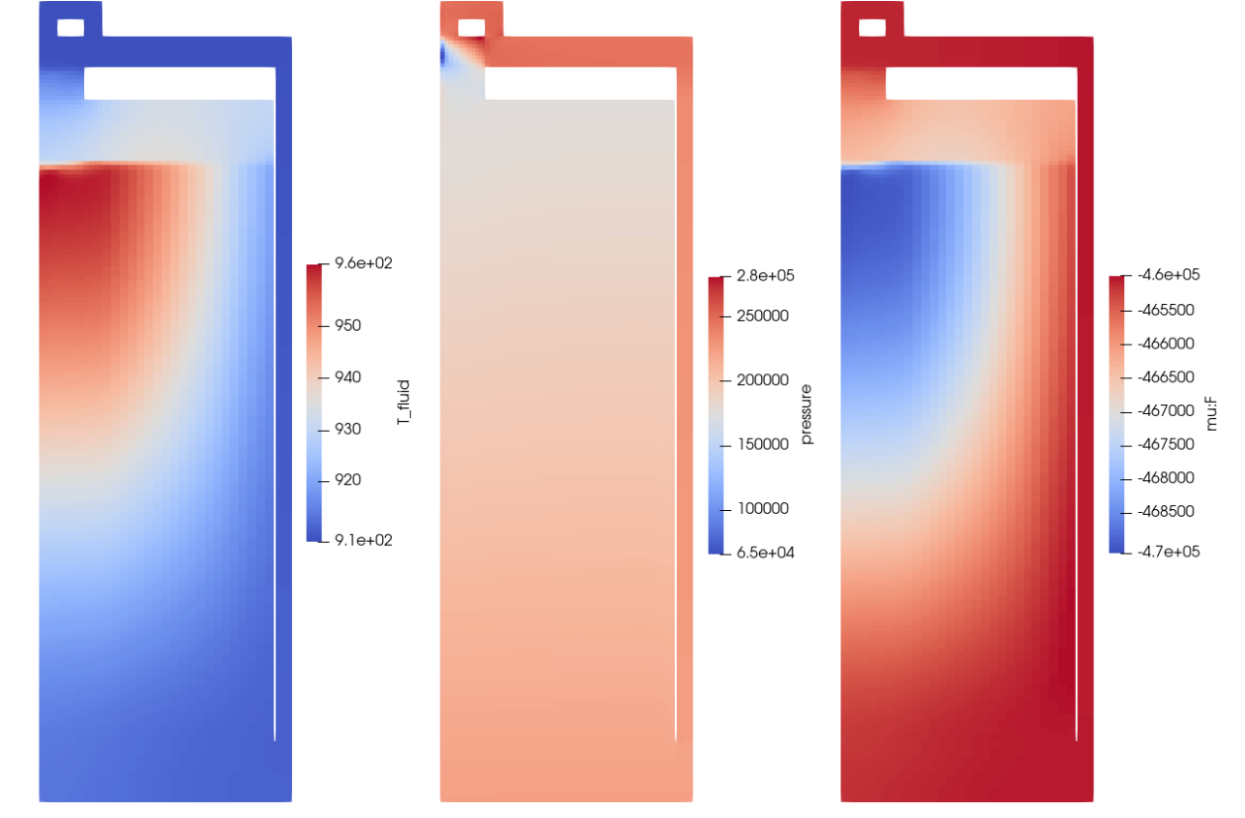
Example 2: Volatilization in MSRE
Liquid Rb [mol/m³]
Gas Rb [mol/m³]
Liquid I [mol/m³]
Temperature [K]
Pressure [Pa]
Fluorine Chemical Potential (F⁻)
Gas I [mol/m³]
Liquid Cs [mol/m³]
Gas Cs [mol/m³]

Slide 8
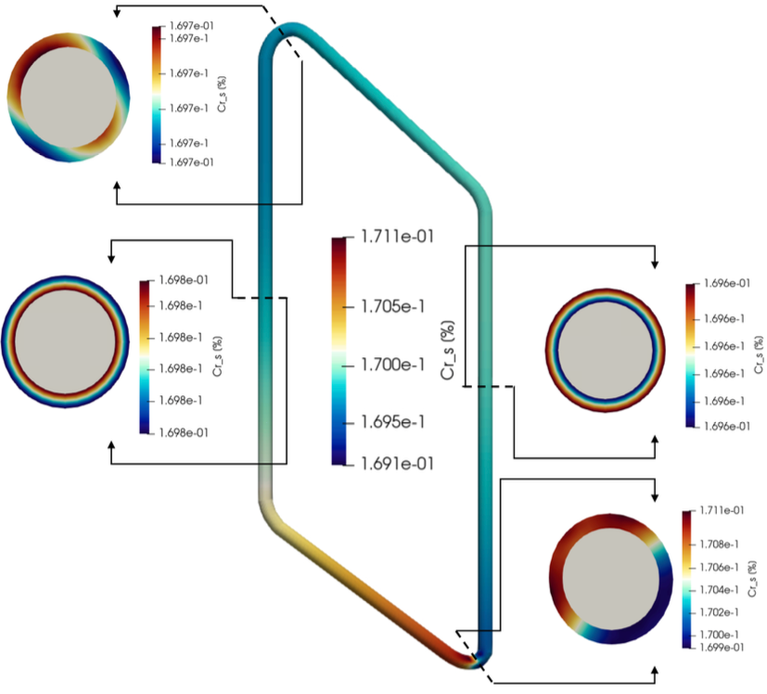
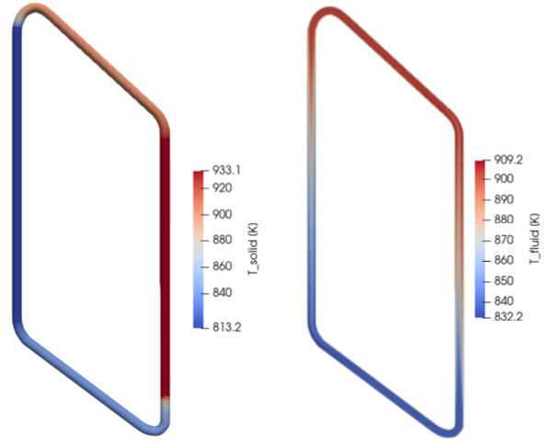
Example 3: 3D Corrosion in Molten Salt Loop
Parameter | Value
Molten Salt | Eutectic FLiNaK
Pipe | Stainless Steel 316H
Pipe Composition | Fe (71%) – Cr (17%) – Ni (12%)
Heated Wall Temperature | 933.1 K (right wall)
Cooled Wall Temperature | 813.2 K (left wall)
Operation Time | 100 days
Solid Temperature [K]
Salt Temperature [K]
Cr Profiles

Slide 9
Summary and Next Steps
Accomplishment Summary:
Developed and demonstrated the coupling between Thermochimica and Pronghorn (+ Griffin) for multiphysics assessments of MSRs → Collaboration with MSR Program
The toolkit allows us to track redox potential and speciation across MSRs
Next Steps:
Although the corrosion models have been verified and partially validated, they will need further validation for routine usage to support MSR industry
Developing more accurate models for interface corrosion currents (coupling with phase field)
For two-phase flow modeling, we need data for element-dependent mass transfer rate between liquid and gas phases (integration with Mole)
Some specific MSR components, e.g., heat exchangers, elbows, etc., may require more fidelity than the one that could be achieved in Pronghorn-Thermochimica (coupling with MOSCATO)
Developing improved models for the non-electrochemical deposition of species into reactor structures
Contact: Mauricio.TanoRetamales@inl.gov

Slide 11
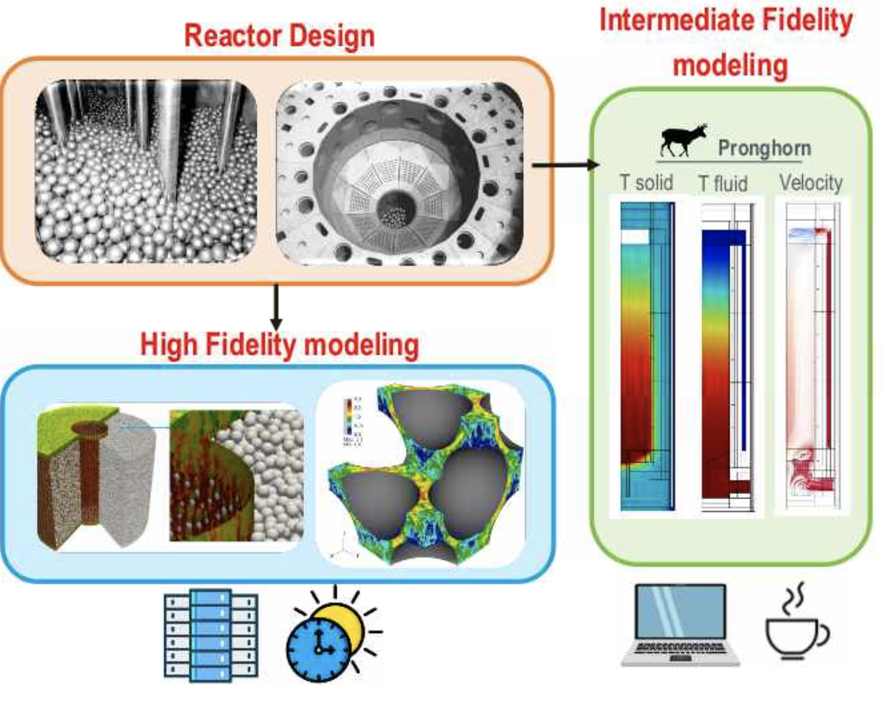
Pronghorn
Engineering-scale porous media code solving for the conservation of mass, momentum, and energy in one or multiple phases with conjugated heat transfer between fluid and solids
Implements porous media closures, involving correlations for:
Flow Friction
Heat and Mass Transfer Coefficients
Radiative Transfer

