Slide 1
Modeling the MARVEL Microreactor Using NEAMS Tools
NEAMS Annual Review: Micro-Reactors
May 12th, 2025
Lise Charlot¹, Stefano Terlizzi^{1,2}, Vasileios Kyriakopoulos¹
¹ Idaho National Laboratory, ² Pennsylvania State University

Slide 2
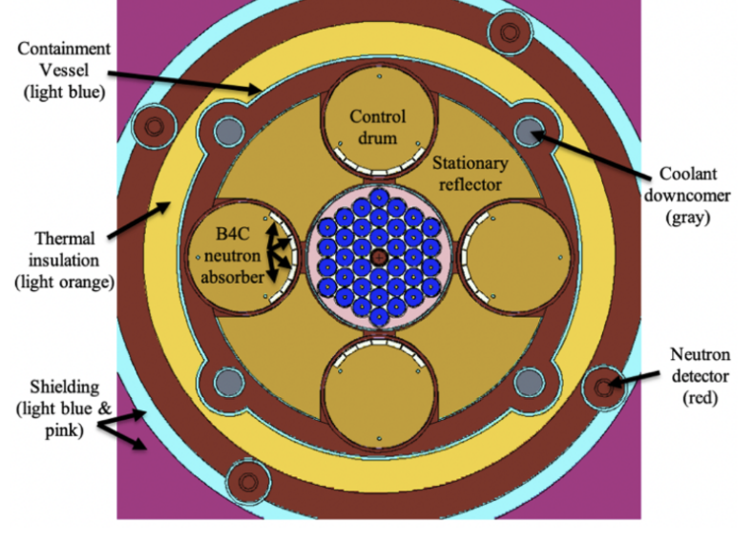
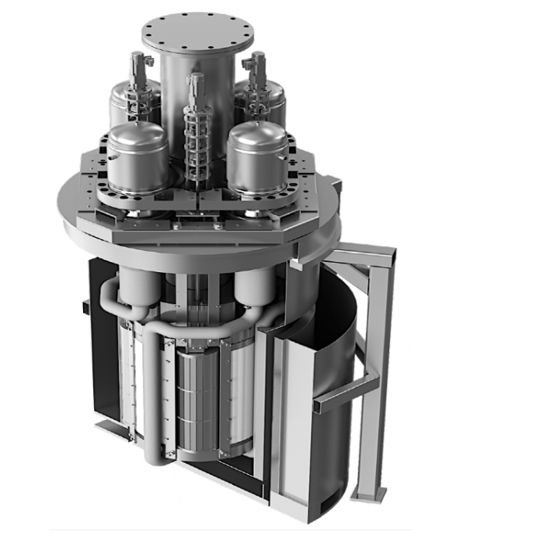
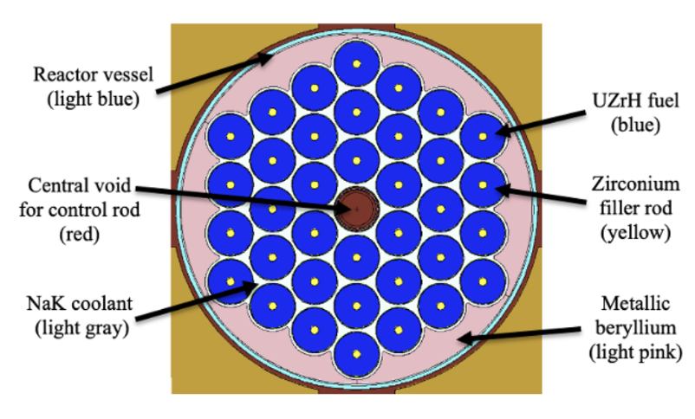
MARVEL Microreactor
85 kWth microreactor developed by the US DOE Microreactor Program
Uranium Zirconium Hydride (UZrH) fuel
Four boron carbide (B4C) control drums for reactivity control
Cooled by NaK through natural circulation (no pump)
Beryllium and graphite reflected
Goal: Build a high-fidelity multiphysics model of the MARVEL microreactor to validate the NEAMS tools with the experimental data generated by MARVEL when available
MARVEL isometric view [1]
MARVEL core cross section [2]
[1] D. Gerstner, Y. Arafat, J. Andrus, and J. Parry, (2022) “Safety design strategy for the microreactor applications research validation and evaluation (MARVEL) project,” in ANS Transactions, vol. 127, pp. 1078–1081, 11.
[2]Lange, T., Wagner, A., Parisi, C., & Arafat, Y. (2022). MARVEL Core Design and Neutronic Characteristics. In ANS Transactions, 127(1), 1078-1081.

Slide 3
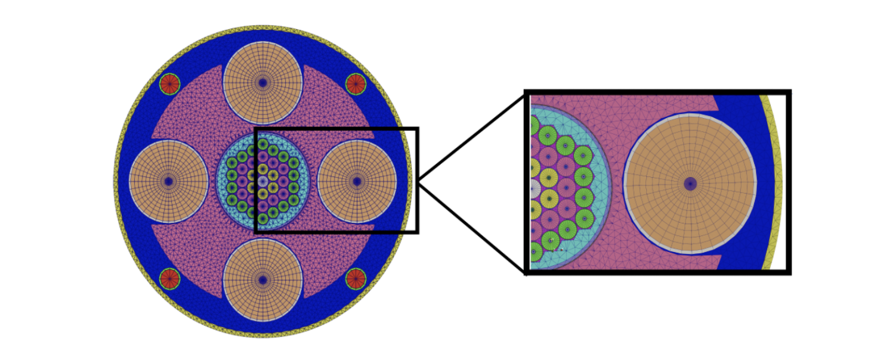
Multiphysics model
Cross section generation using Serpent
Mesh generated with MOOSE reactor module
Neutronics solved using Griffin (DFEM-SN)
Heat transfer in the fuel pin, reflectors and ex-core structures using BISON
Thermal-hydraulics in the core, primary and secondary loops using SAM
Cross sections
(Serpent)
Mesh
(MOOSE)
Fluid temperature, density,
heat transfer coefficient
Neutronics
(Griffin)
Solid temperature
Power density
Power density, fluid temperature, heat transfer coefficient
Thermal fluids
(SAM)
Heat Transfer
(BISON)
View of the mesh at core mid-plane
Terlizzi, Stefano and Charlot, Lise. (2024) "Towards a NEAMS-based high-fidelity model of the MARVEL reactor."

Slide 4
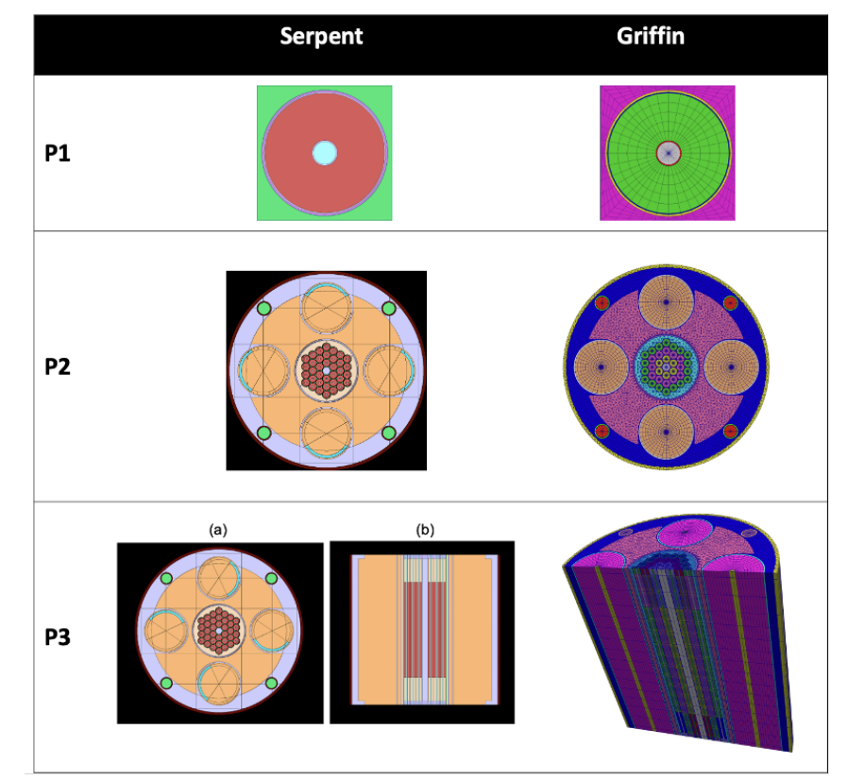
Cross section generation and neutronics
Serpent (v. 2.2) used to compute the macroscopic cross sections on a 13-group energy structure
Energy structure based on previous work on hydride moderated microreactors.
Multigroup cross sections used in DFEM-SN solver in Griffin
Griffin neutronics model verified for unit cell, 2D core and full 3D core problems

Slide 5
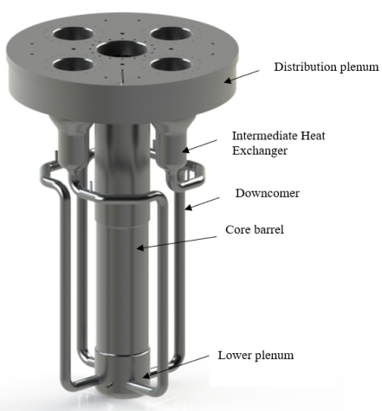
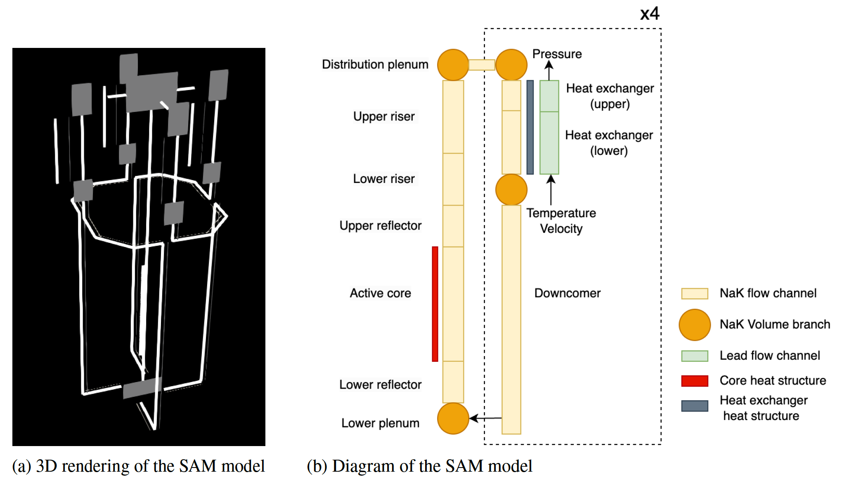
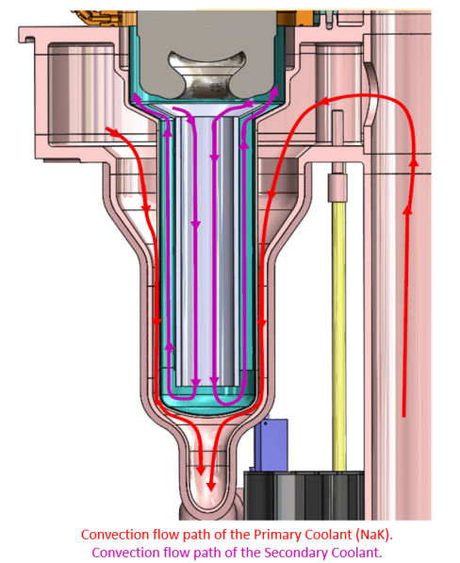
Primary coolant system model
3D rendering of the SAM model
Diagram of the SAM model
View of the primary coolant system [1]
[1] MARVEL 90% Final Design Report, Sept 2023, INL/RPT-23-74280

Slide 6
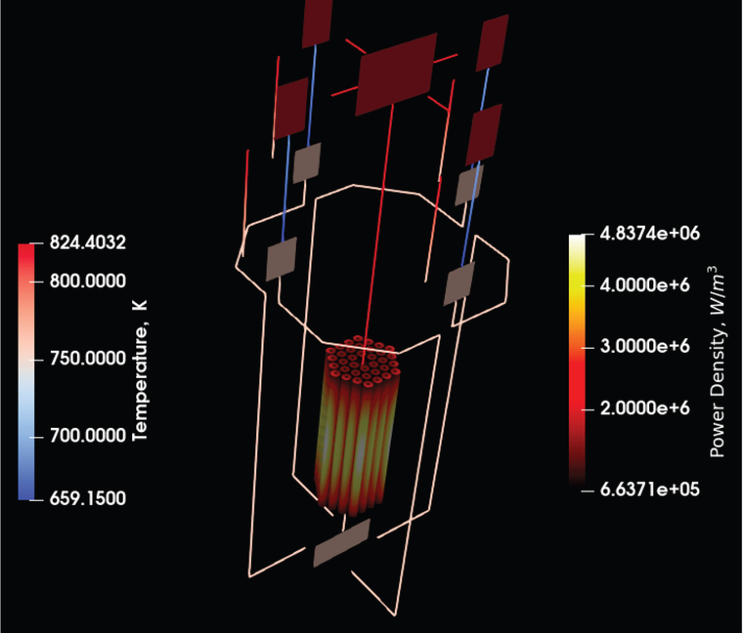
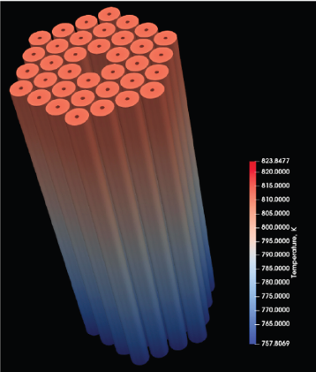
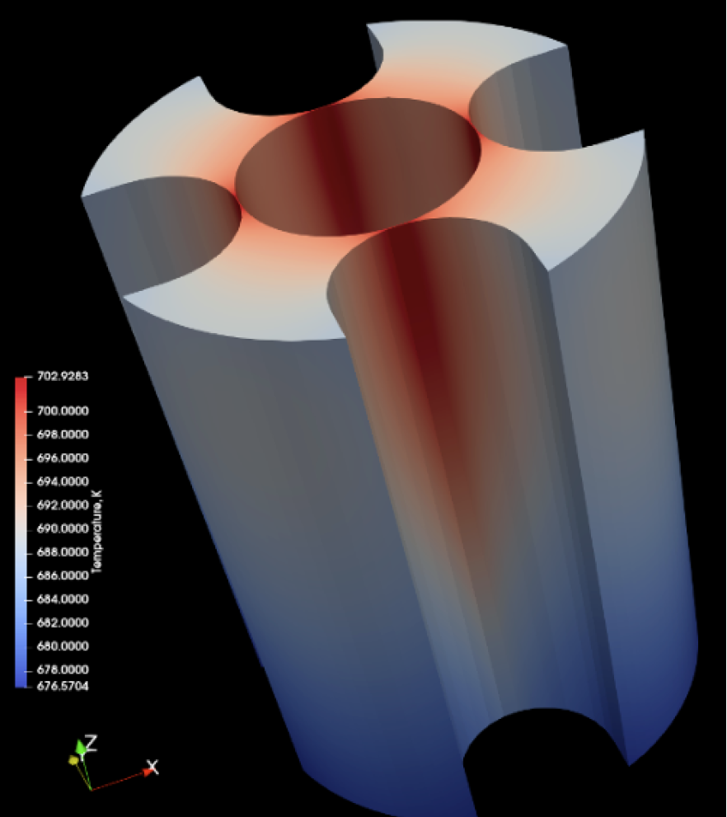

Coupled results
Fluid temperature and mass flow rate similar to those obtained with RELAP5-3D
Griffin high resolution method capture local gradients in fuel pins (see external ring)
Fuel pin temperature
Outer reflector temperature
Power density
Power Density distribution in the fuel and coolant temperature
Notes:
This highlights the potential of using a high-resolution
method, such as DFEM-SN in Griffin, which can capture local gradients that would be difficult or impossible
to capture with legacy nodal codes or Monte Carlo methods.

Slide 7
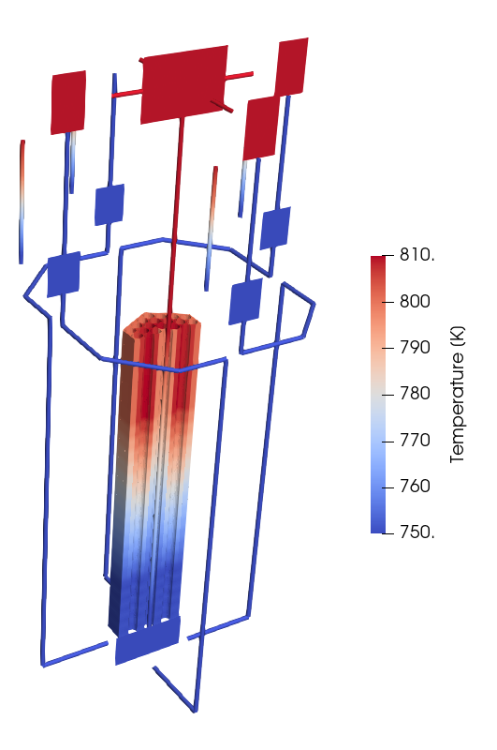
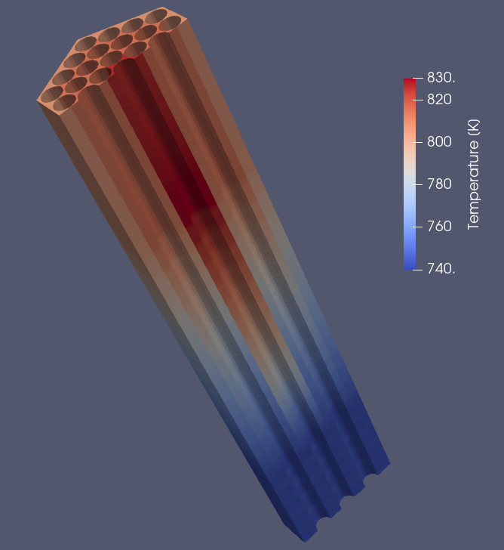
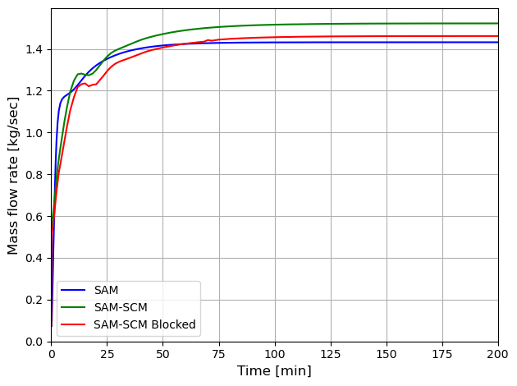
Improving the thermal hydraulic model
Coupled MOOSE Subchannel module (SCM) with SAM :
SCM used for the core
SAM used for loop
Coupling using domain overlapping strategy: SAM provides BCs for SCM, and SCM provides friction factors to SAM
Performed startup transient with and without flow blockage
MARVEL SAM/SCM blocked core simulation
(80% area reduction and a form loss of 2
_{around center pin)}
Comparison of the mass flow rate in the primary loop
MARVEL SAM/SCM coupled simulation.
_{Unblocked core}

Slide 8
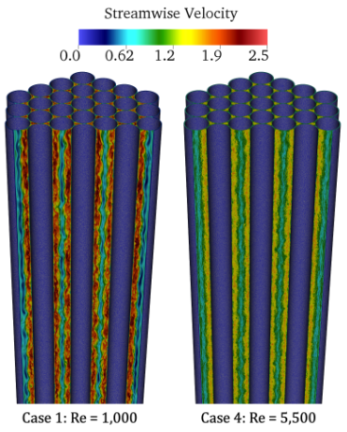
Conclusion and Future work
Developed a cutting-edge multiphysics model of the MARVEL microreactor
Future work:
Integrate the SAM/Subchannel thermal hydraulics model into the multiphysics model
Perform code-to-code comparisons with models developed by the Microreactor program
Implement friction factors and heat transfer coefficients in SCM derived from high fidelity simulations (NekRS/Nek5000)
Validate the T/H model with PCAT data when available
Validate the multiphysics model with MARVEL data when available
LES simulation of MARVEL core using NekRS

