Slide 1

Heat Pipe Modeling Capabilities in Sockeye
Joshua Hansel Idaho National Laboratory

Slide 2
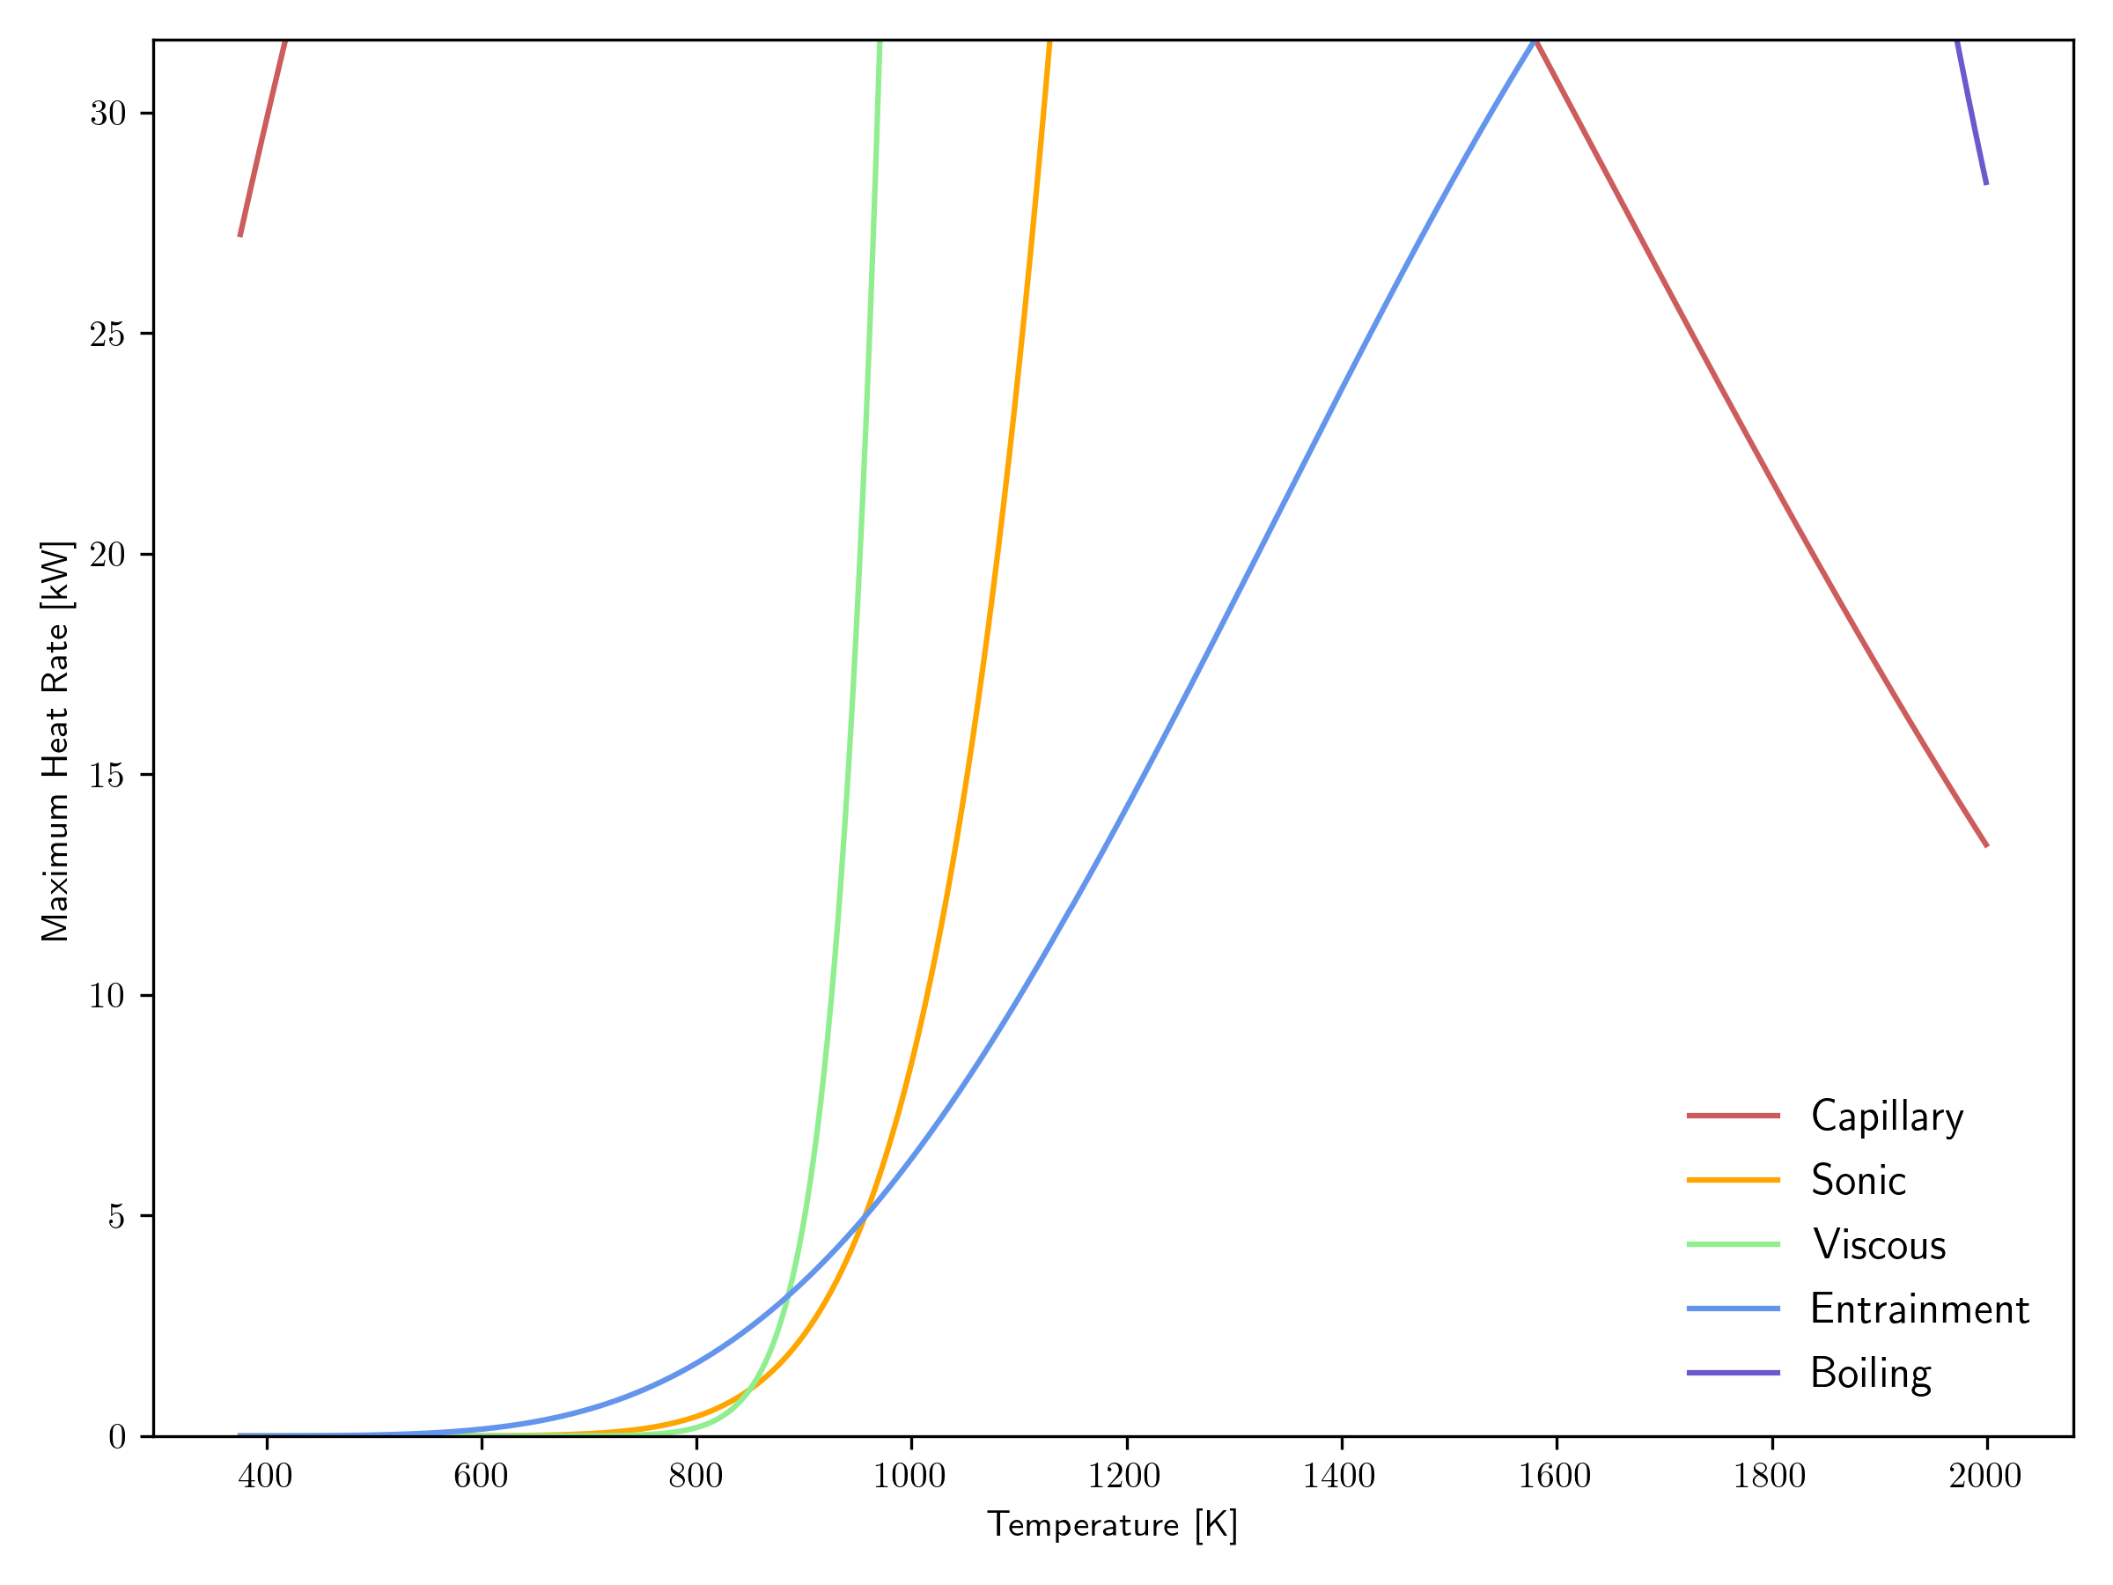
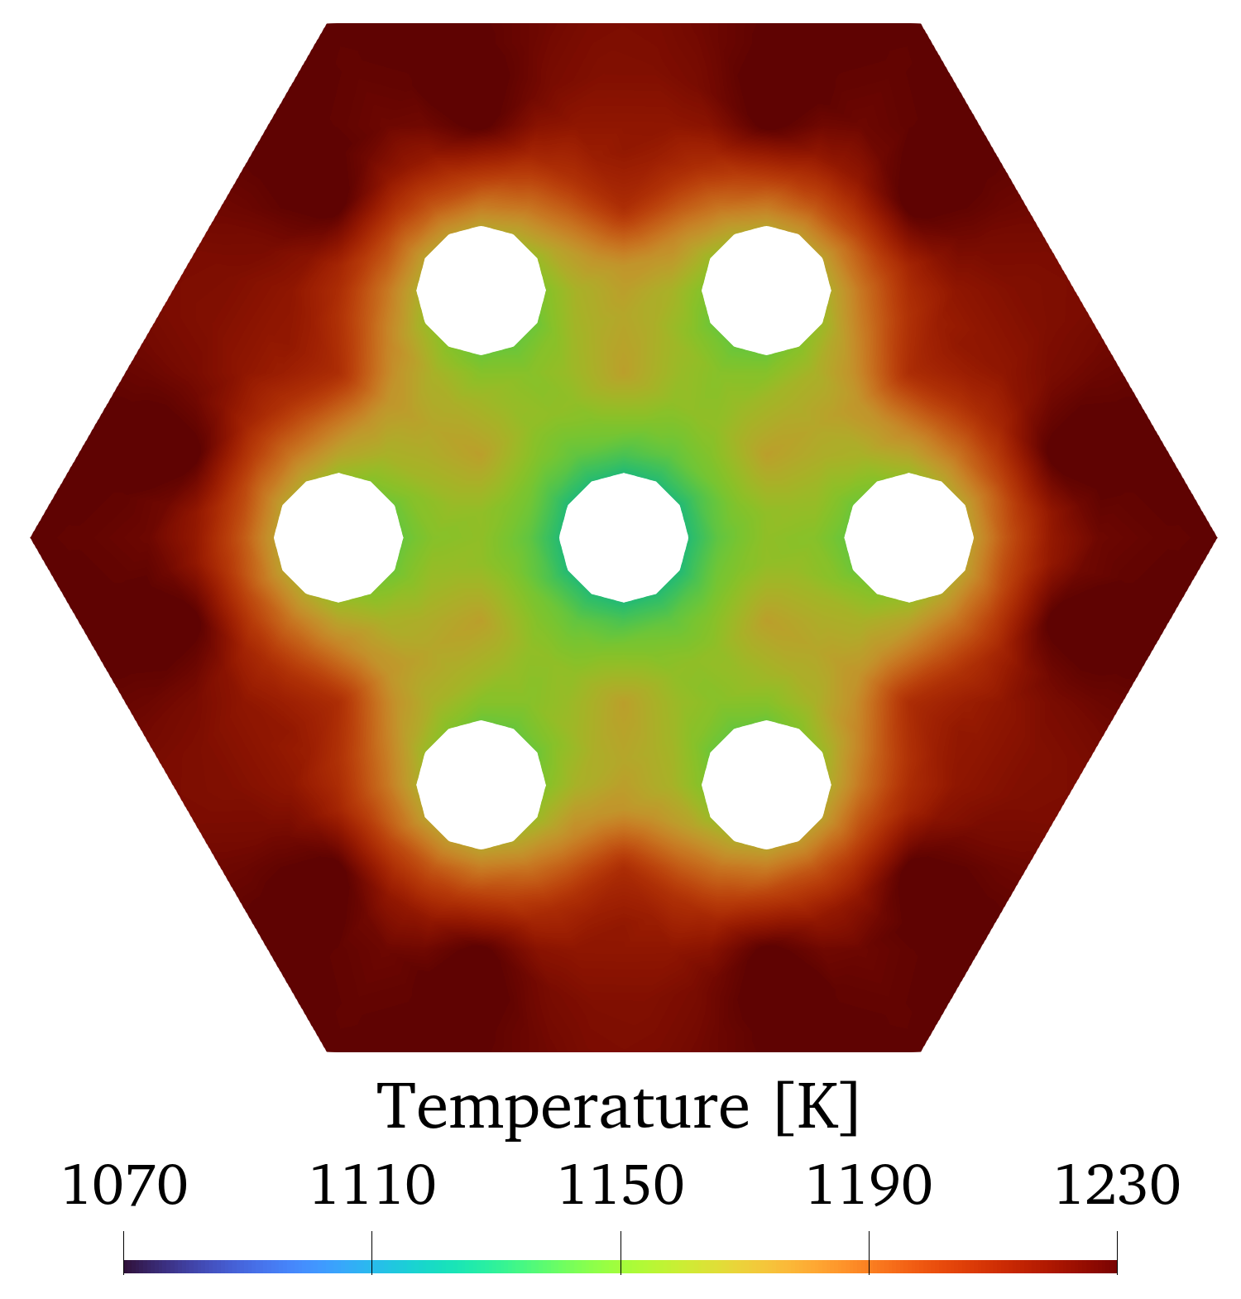
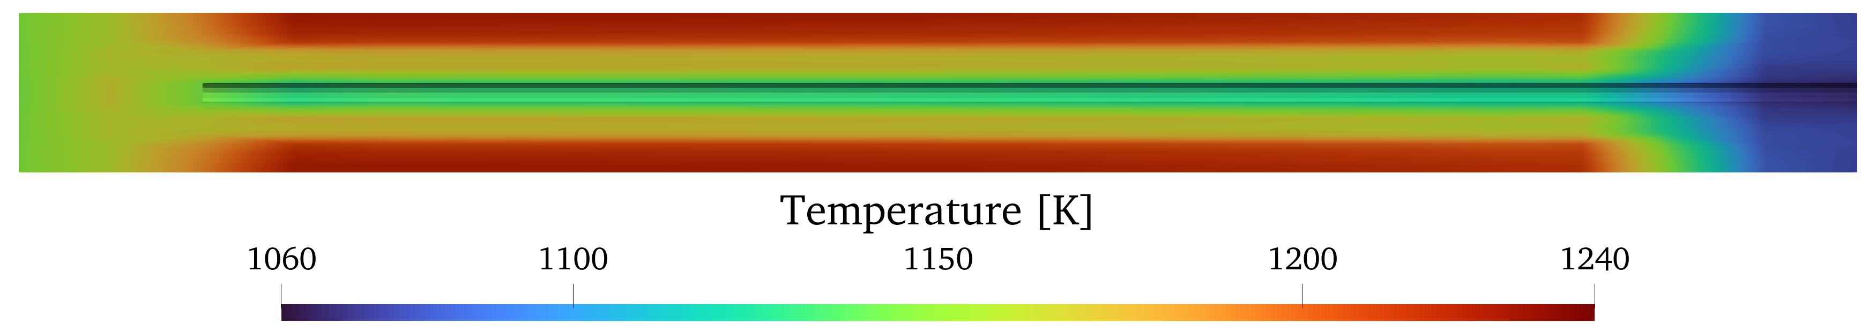
Sockeye Overview
Engineering-scale heat pipe application based on MOOSE framework
Use cases:
Heat pipe design studies
Prediction of heat pipe performance limits
Prediction of heat pipe transient response
Prediction of heat pipe thermal resistance
Simulations may be standalone or multiphysics:
Heat pipe microreactors

Slide 3
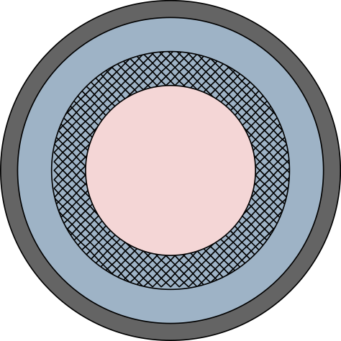
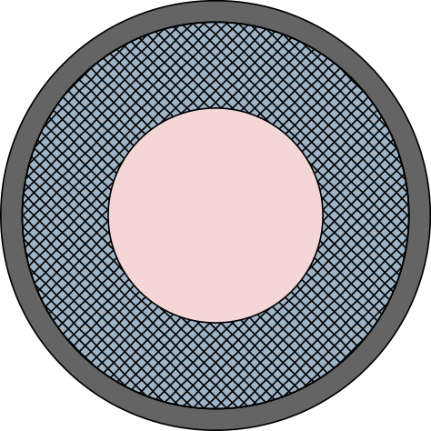
Supported Heat Pipes
Supported wick designs:
Conventional heat pipes with mesh screen wicks, with or without gap
Not yet supported: wickless heat pipes, i.e., thermosyphons
Supported working fluids:
Sodium
Potassium
Water
Screen wick with gap
Screen wick without gap
Vapor Wick Gap Wall

Slide 4
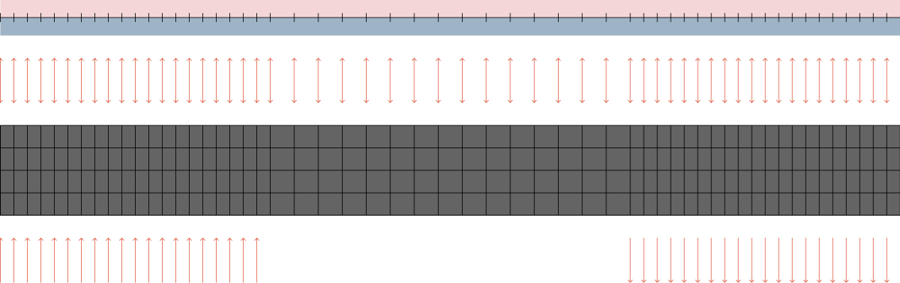
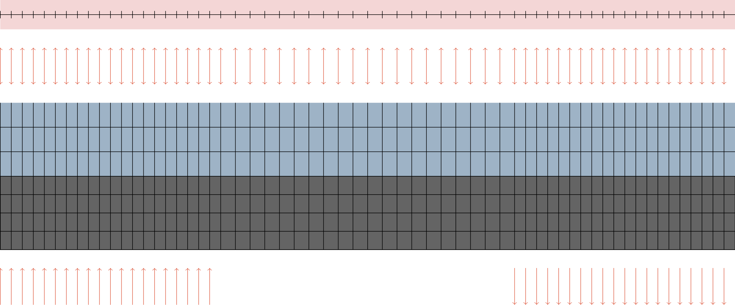
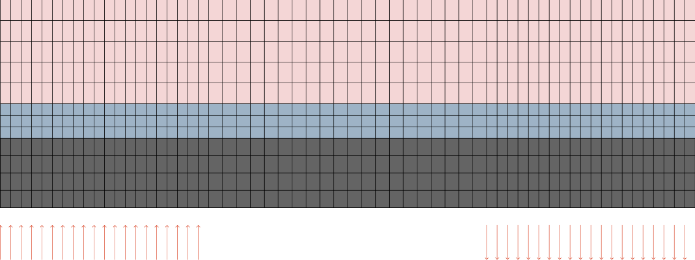
Available Models
Two-phase flow model
Liquid-conduction, Vapor-flow (LCVF) model
Conduction model
Vapor: 1D flow Liquid/wick: 1D flow
Wall: 2D heat conduction
Vapor: 1D flow Liquid/wick: 2D heat conduction
Wall: 2D heat conduction
Vapor: 2D heat conduction Liquid/wick: 2D heat conduction
Wall: 2D heat conduction
1D, two-phase, compressible flow:
Baer-Nunziato equations
Not robust in single-phase regimes:
Condenser pool
Dryout
1D, single-phase, compressible flow for vapor phase:
Euler equations of gas dynamics
Rarefied gas flow treatment during startup
2D heat conduction used for liquid
Supports non-condensable gases
Thermally expanding condenser pool
Fairly robust
2D heat conduction in all regions
Uses analytic heat pipe limits
Controls vapor core thermal conductivity to enforce limits
Extremely robust

Slide 5
Limits Support
Limit | Two-Phase Model | LCVF Model | Conduction Model | Notes
Capillary | Mechanistic | Mechanistic vapor, analytic liquid | Analytic
Sonic | Mechanistic | Mechanistic | Analytic
Viscous | Mechanistic | Mechanistic | Analytic
Entrainment | Not considered | Not considered | Analytic | Believed not to be a concern for high-temperature HPs.
Boiling | Not considered | Not considered | Analytic | Requires very high radial heat flux; not highest priority

Slide 6
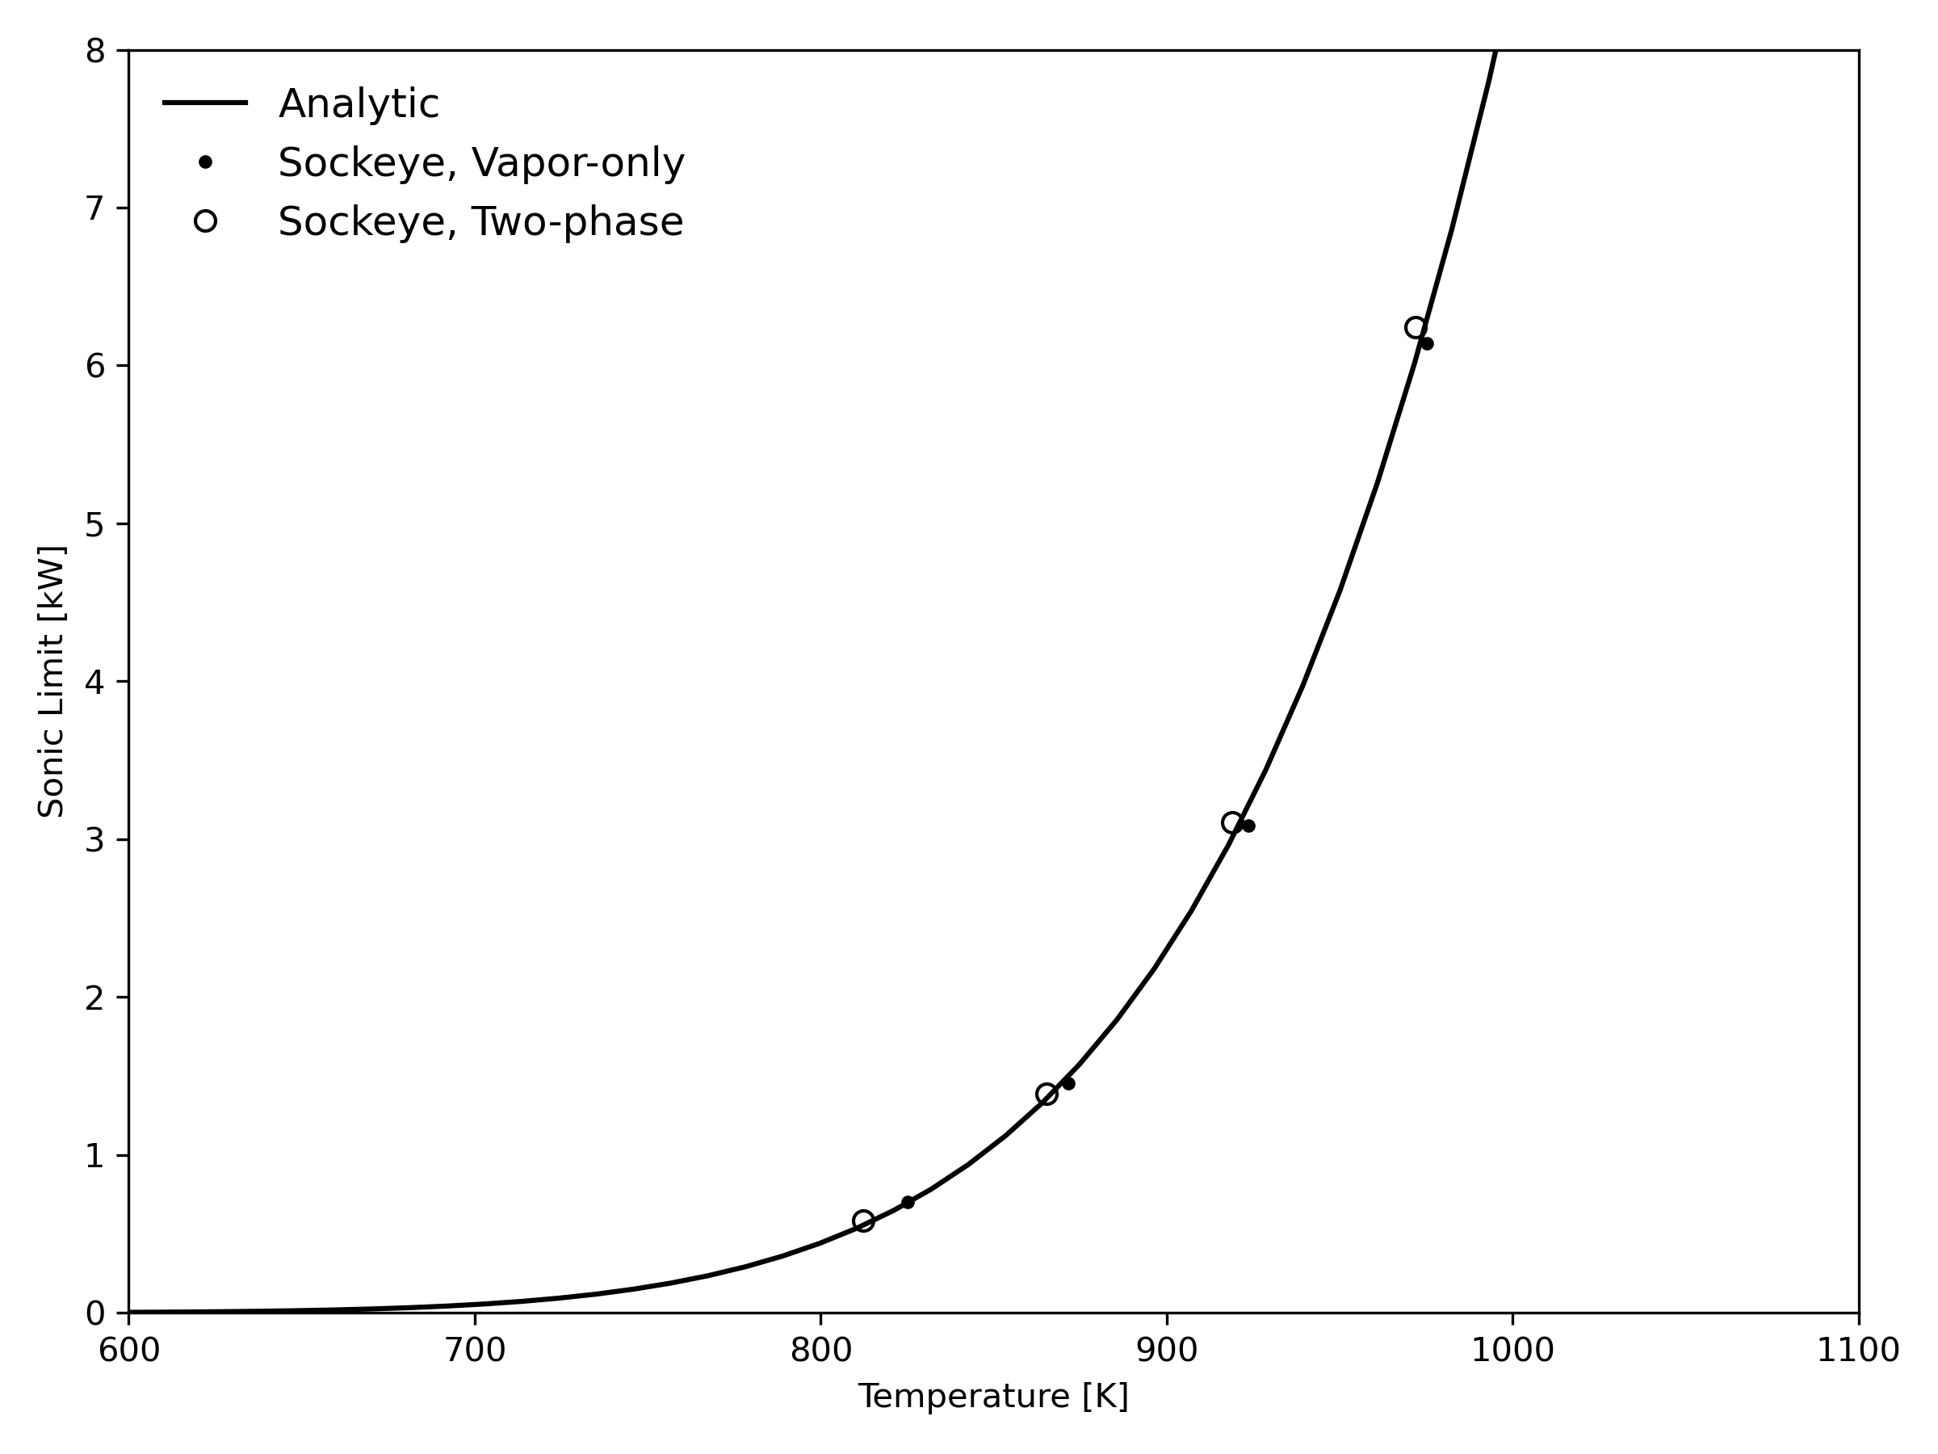
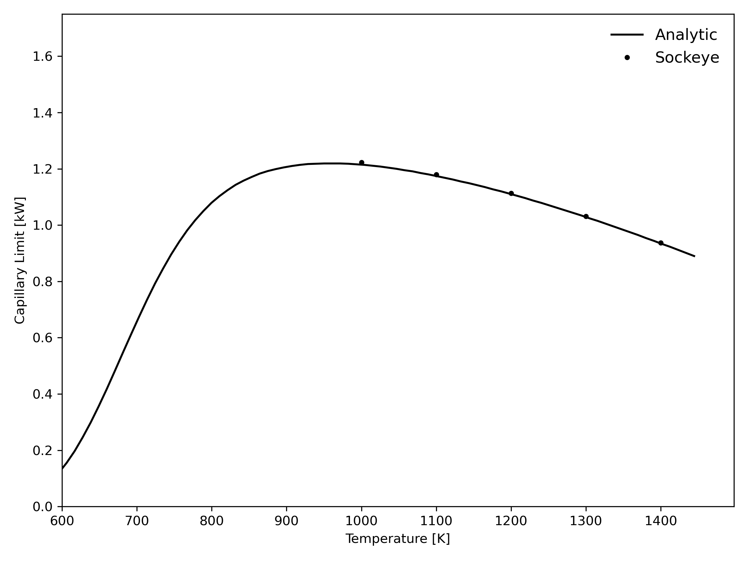
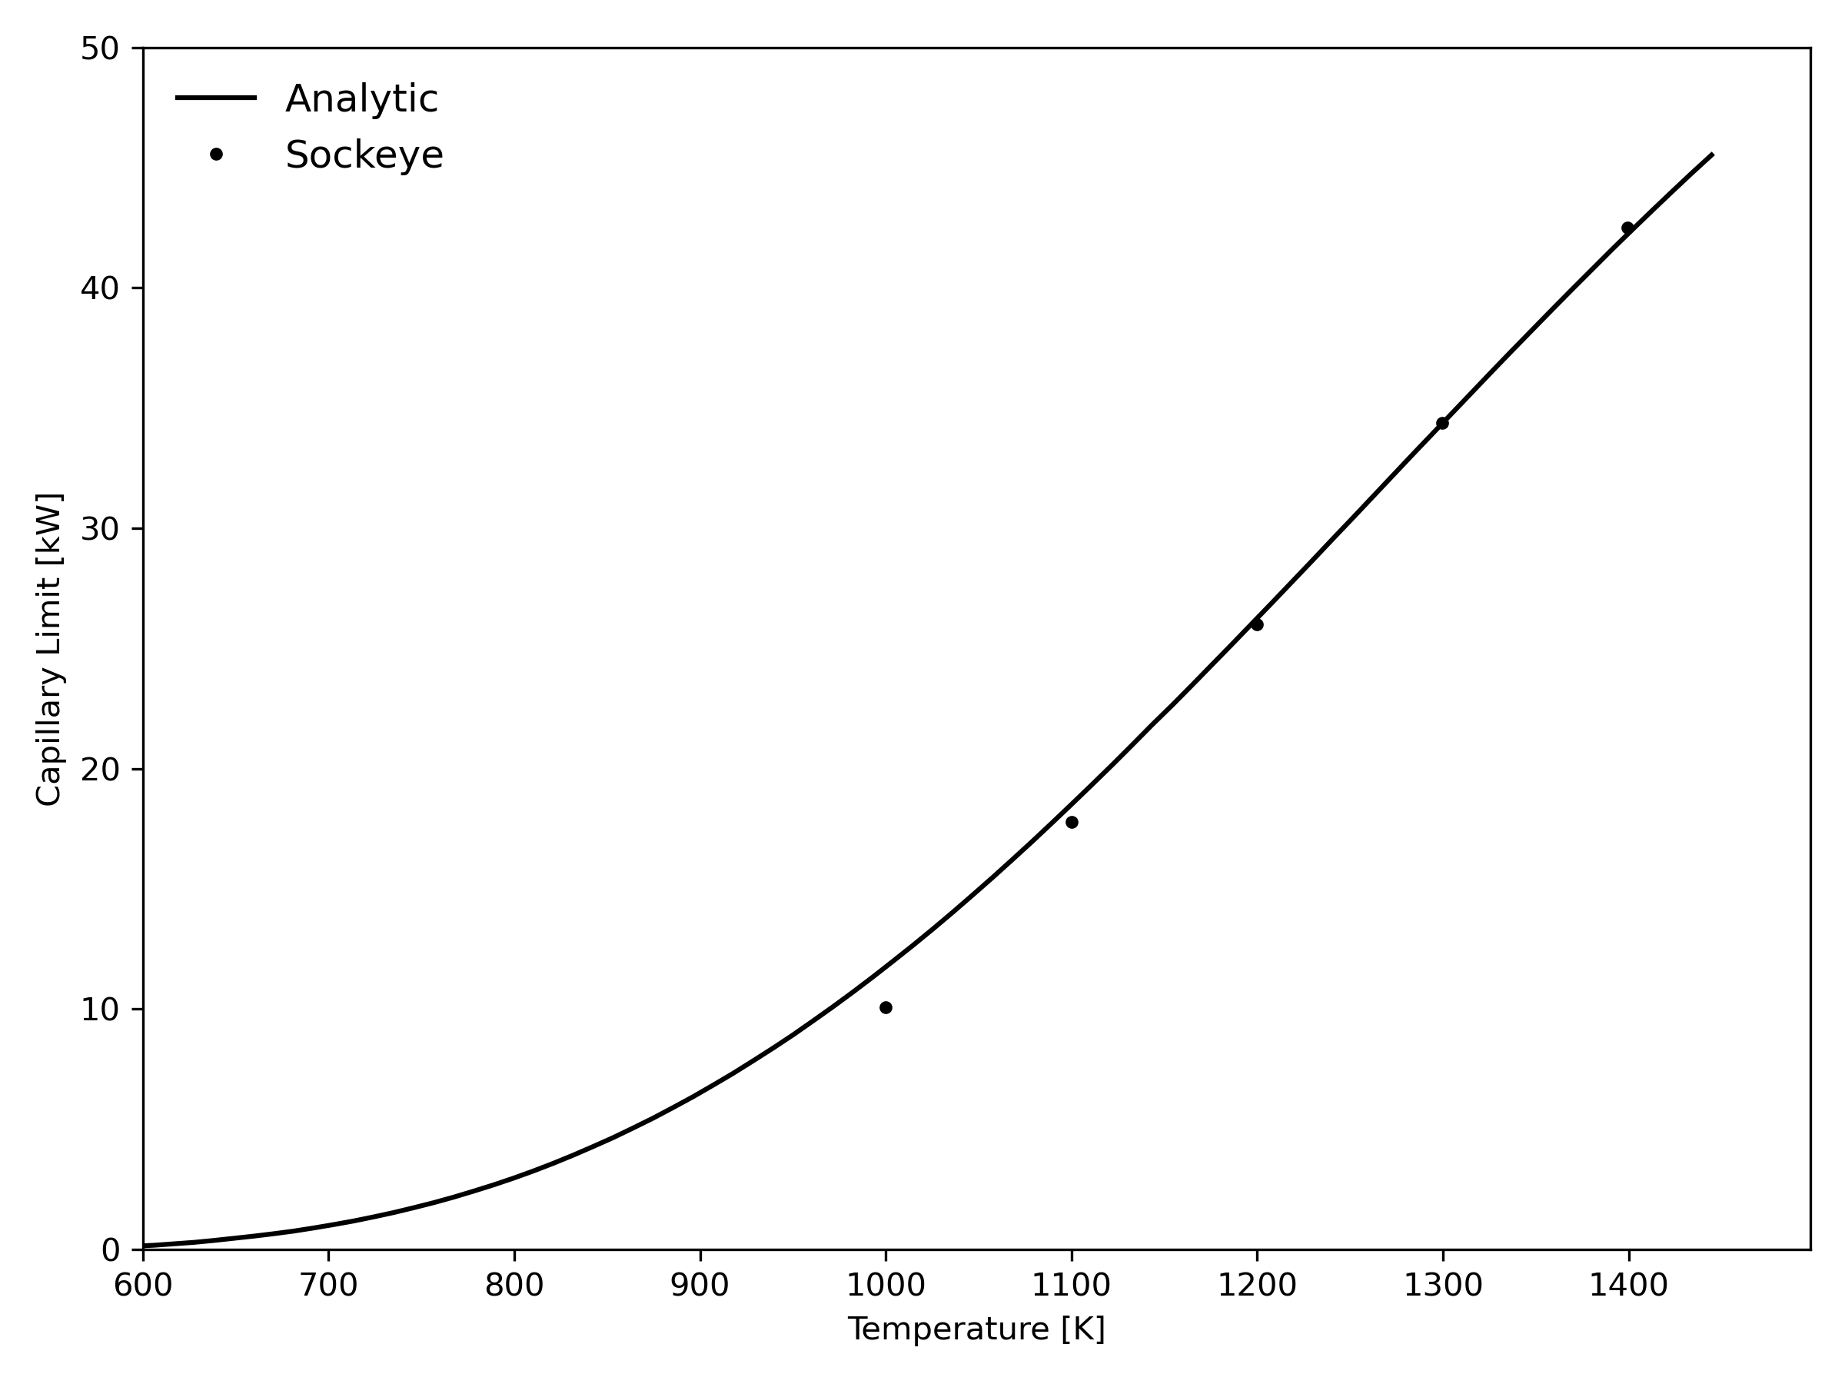
Verification
Capillary Limit Without Wick Gap
Sonic Limit
Capillary Limit With Wick Gap

Slide 7
Validation Summary
Experiment | Fluid | Wick(s) | Cooling | Angle | Measurements | Status
RPI | H₂O | Thermosyphon, Screen | Water HX | 90 | Fiber optics, TCs, Pressure, film thickness | O
SAFE-30 | Na | Screen | Radiation | 0 | TCs | C
SPHERE (2021) | Na | Screen | Radiation | 0 | Thermowell TCs, cooling rate | C
SPHERE (2023) | Na | Screen | Water HX | 0 | TCs, cooling rate | C
SPHERE (2024) | Na | Screen | Radiation to water HX | 0 | TCs, cooling rate | C
Texas A&M | H₂O | Screen | Water HX | 0 | Fiber optics, TCs | O
U. Michigan | Na | Screen | Water+air HX | 0 | TCs, cooling rate | C
U. W-Madison | Na | Screen | Gas HX | 0 | Fiber optics, TCs, x-ray | P
Status: C = Complete, O = Ongoing, P = Planned

Slide 8
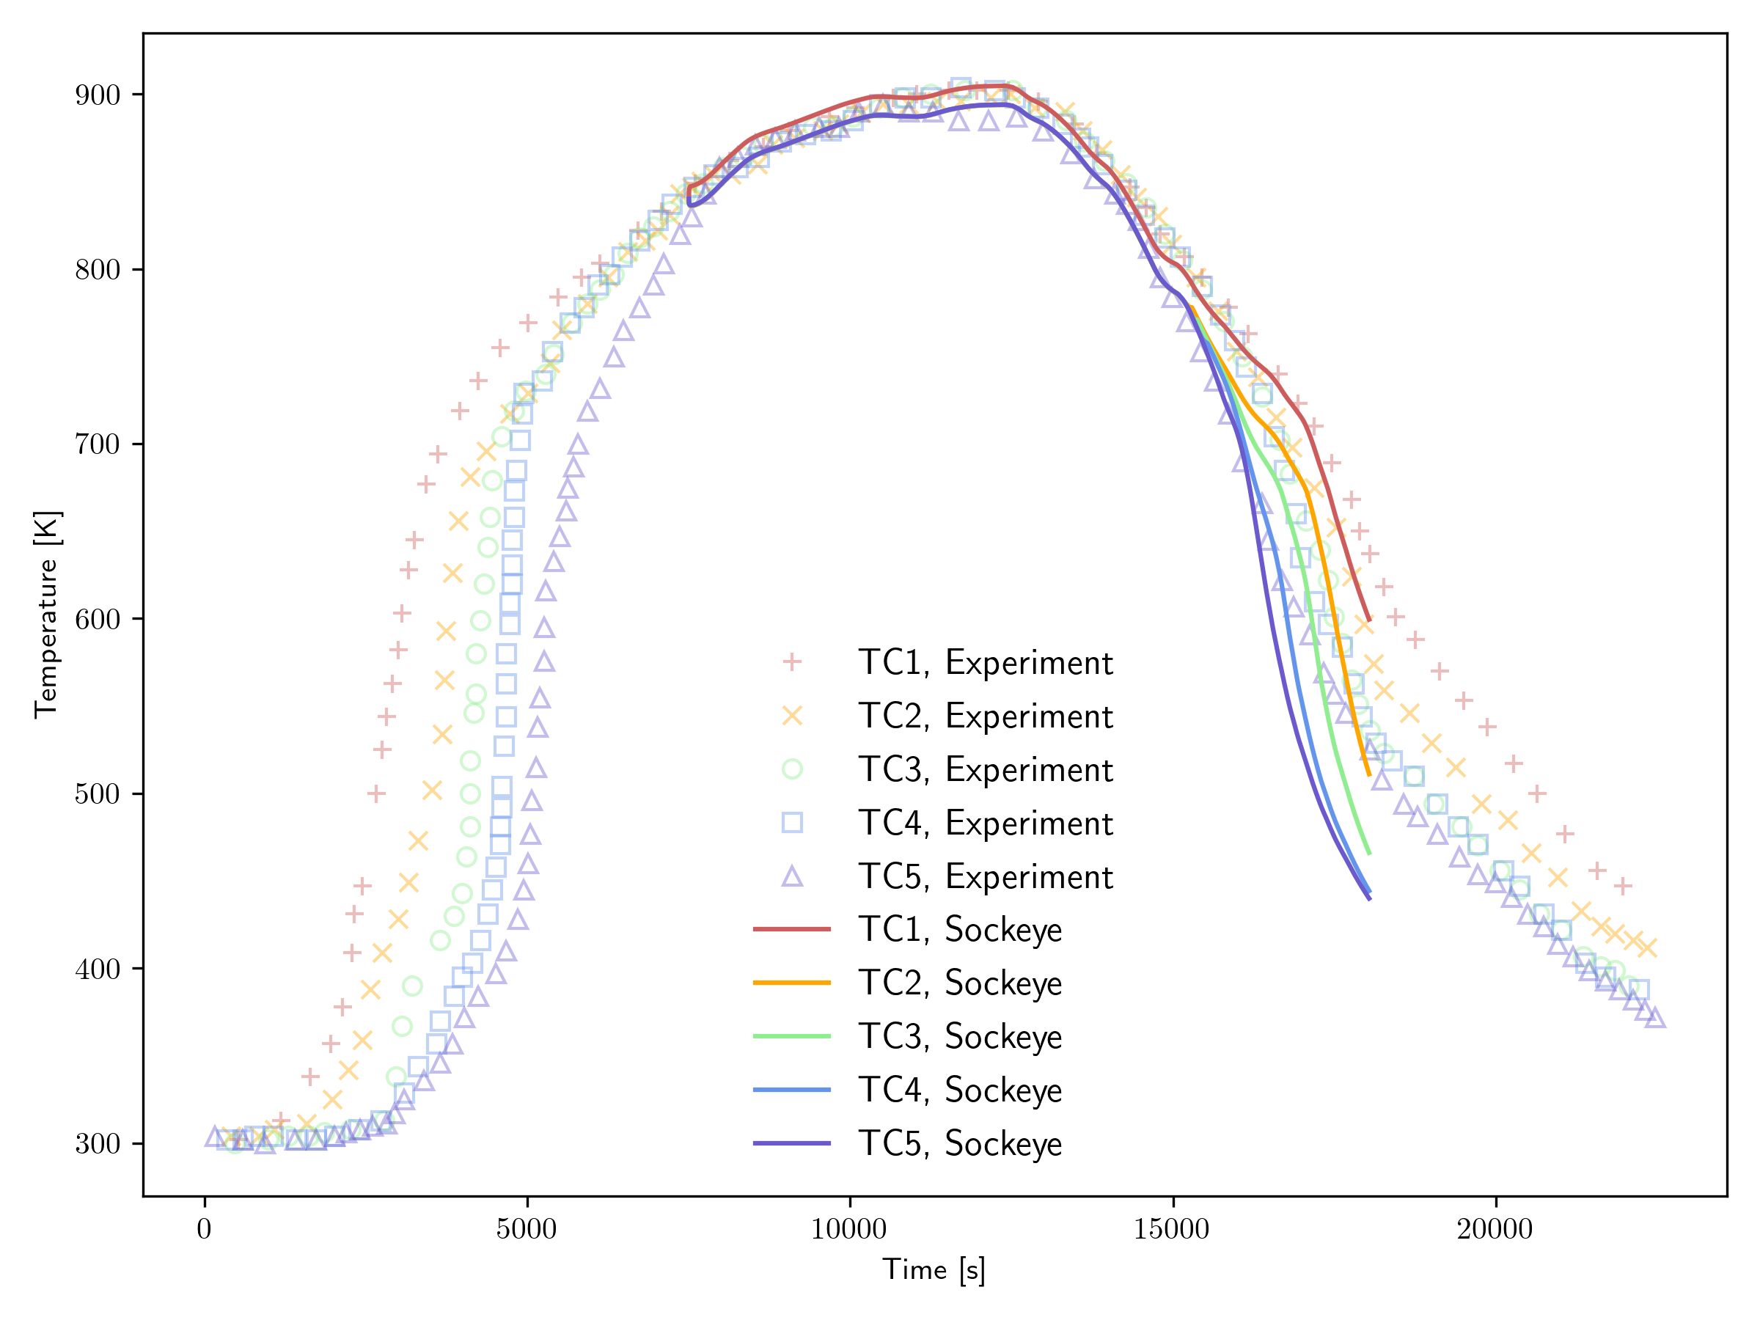
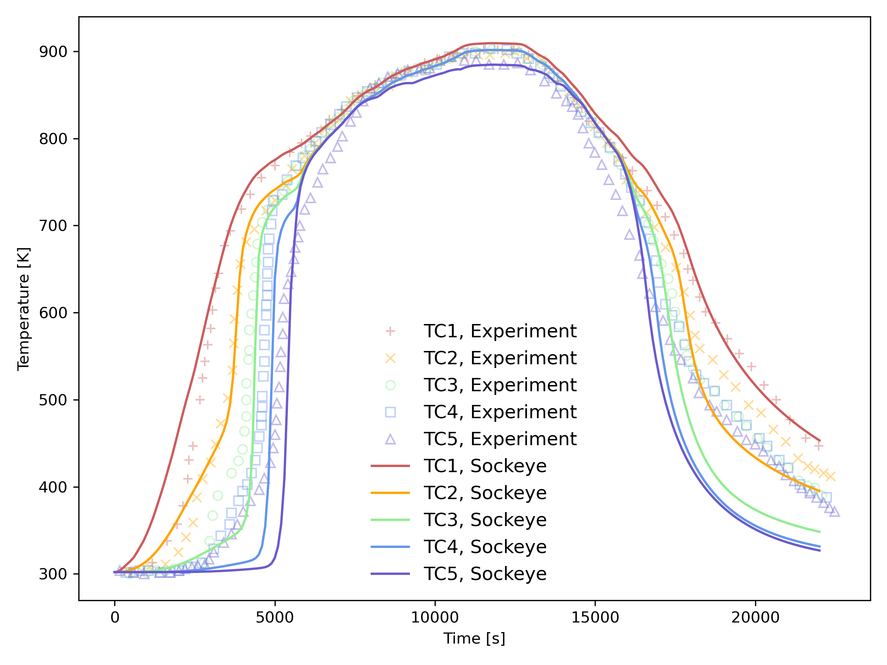
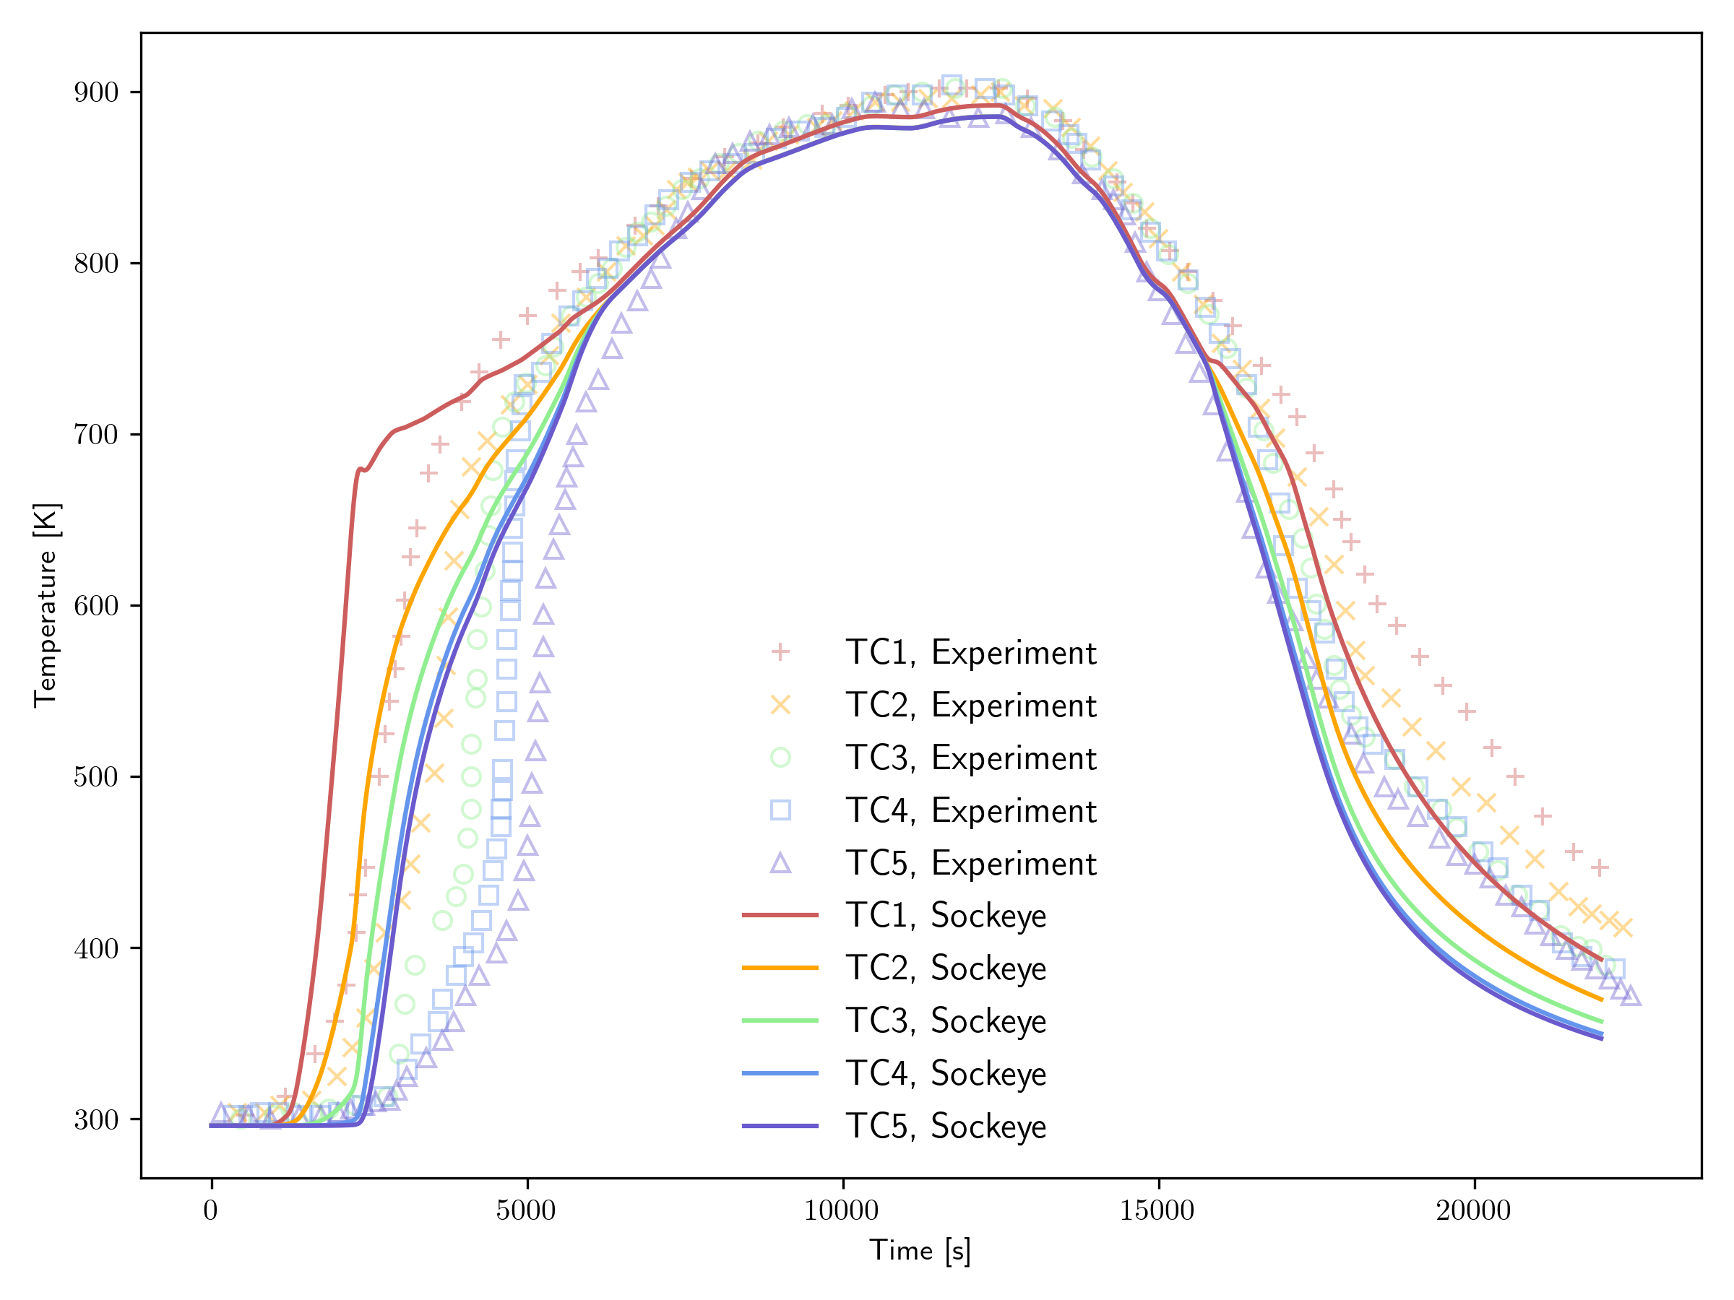
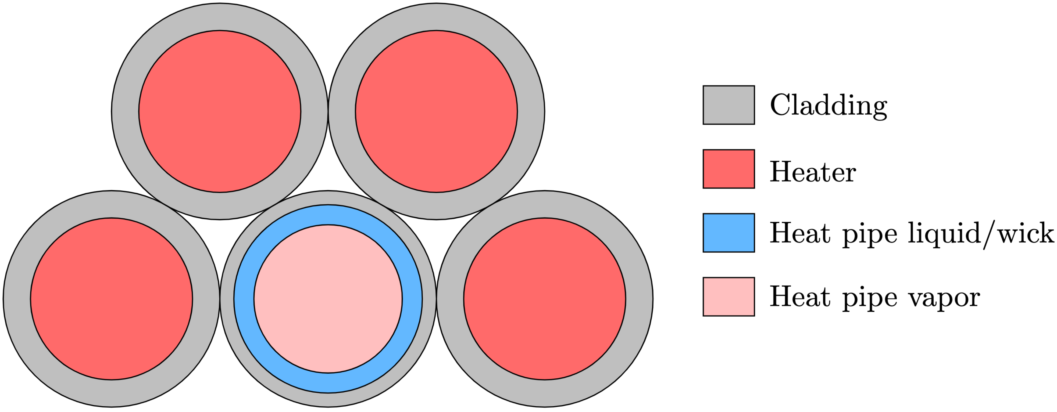
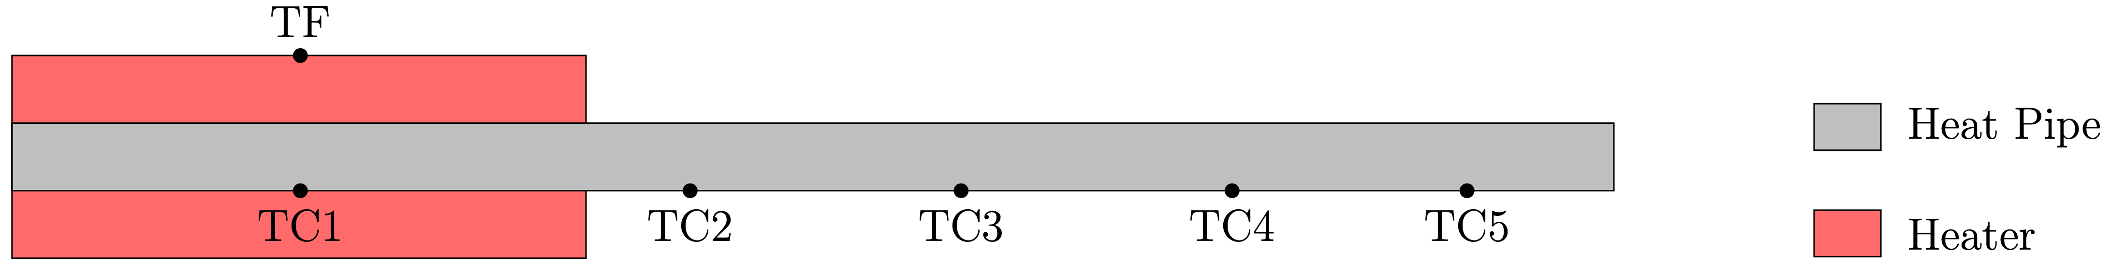
Validation Case: SAFE-30
Two-phase model
LCVF model
Conduction model

Slide 9
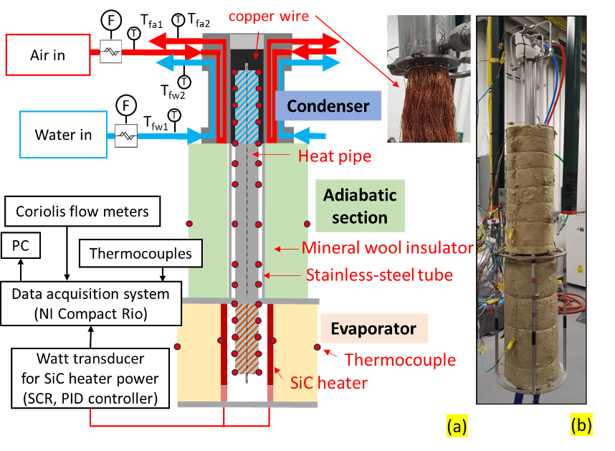
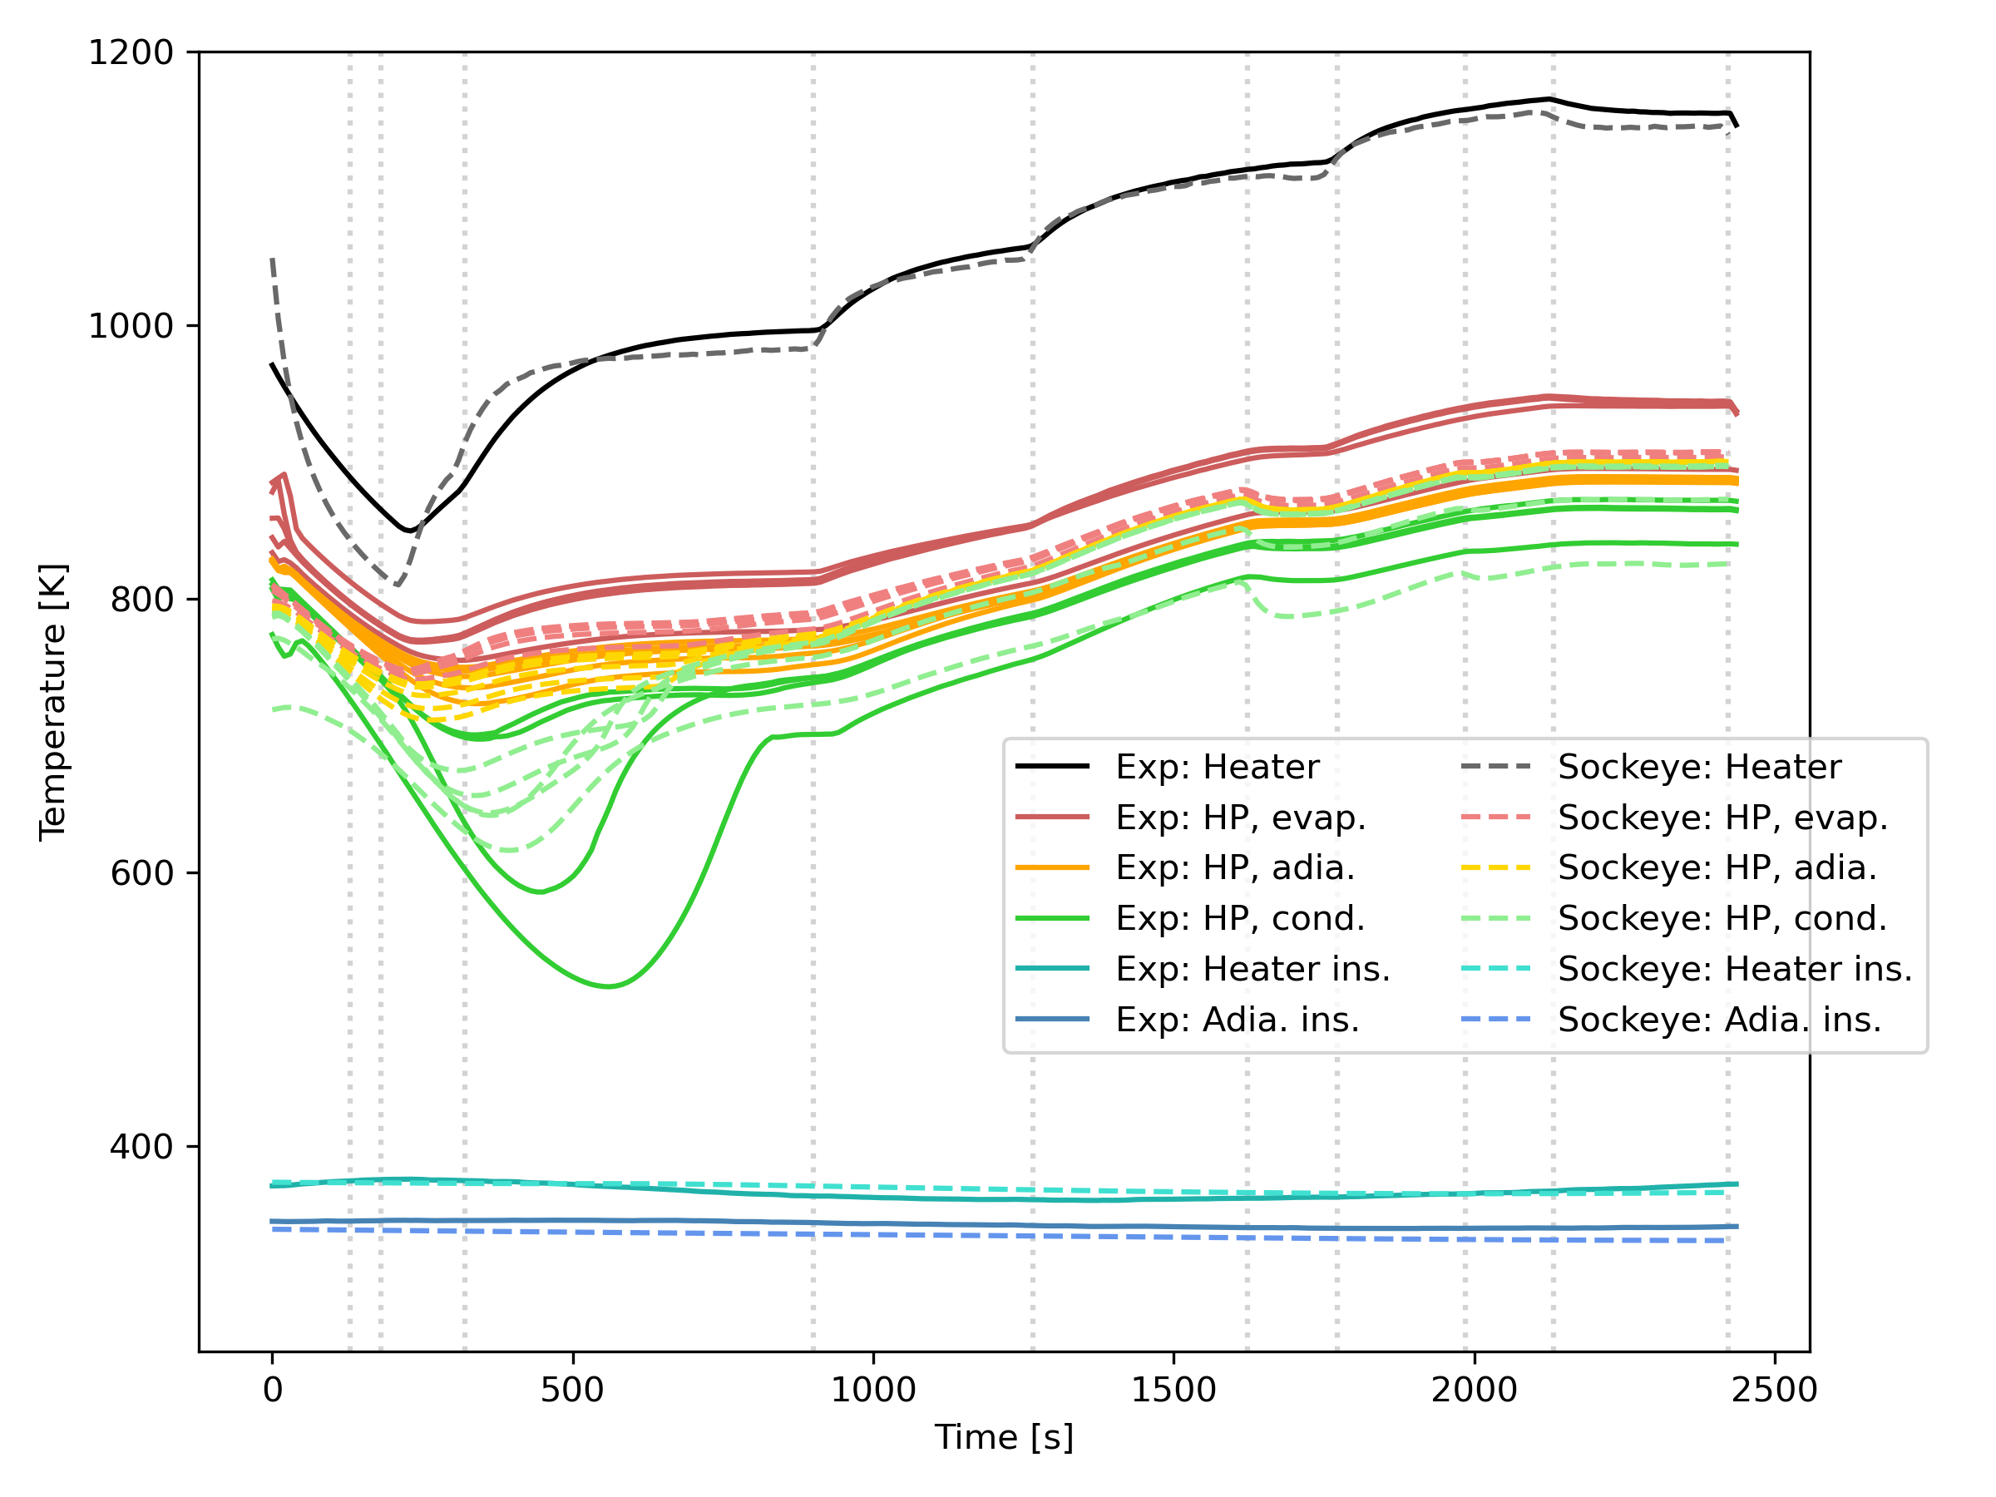
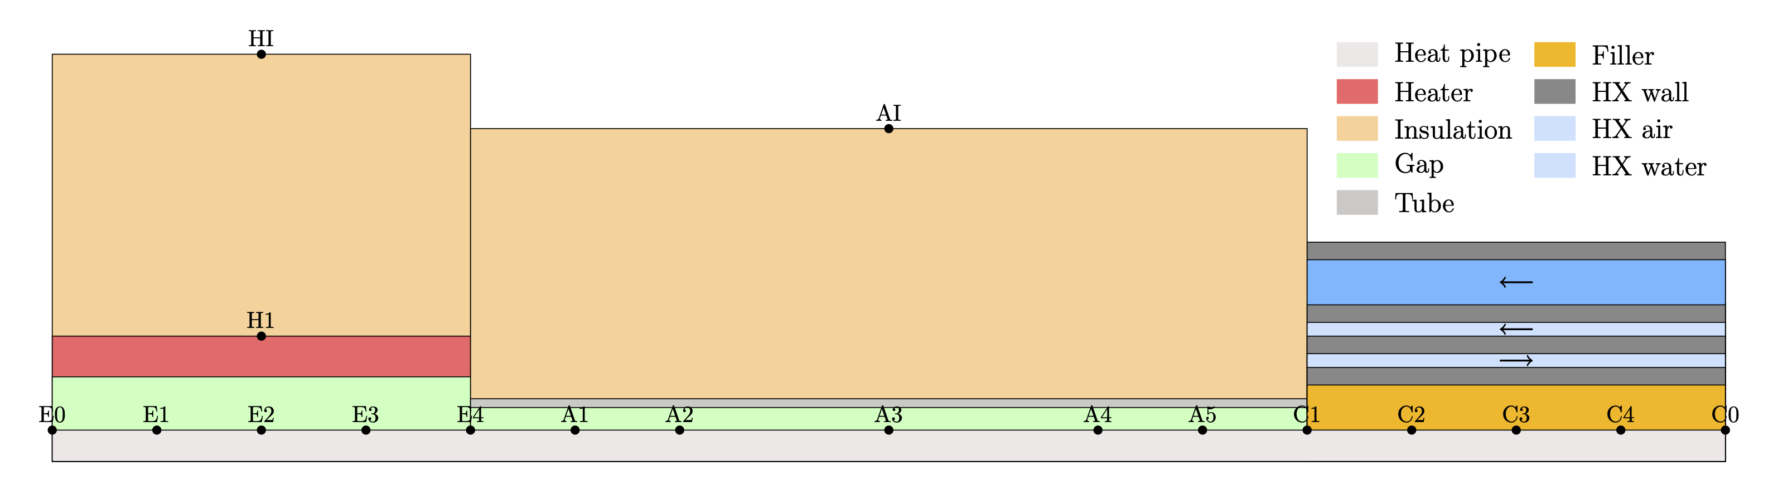
Validation Case: University of Michigan

Slide 10
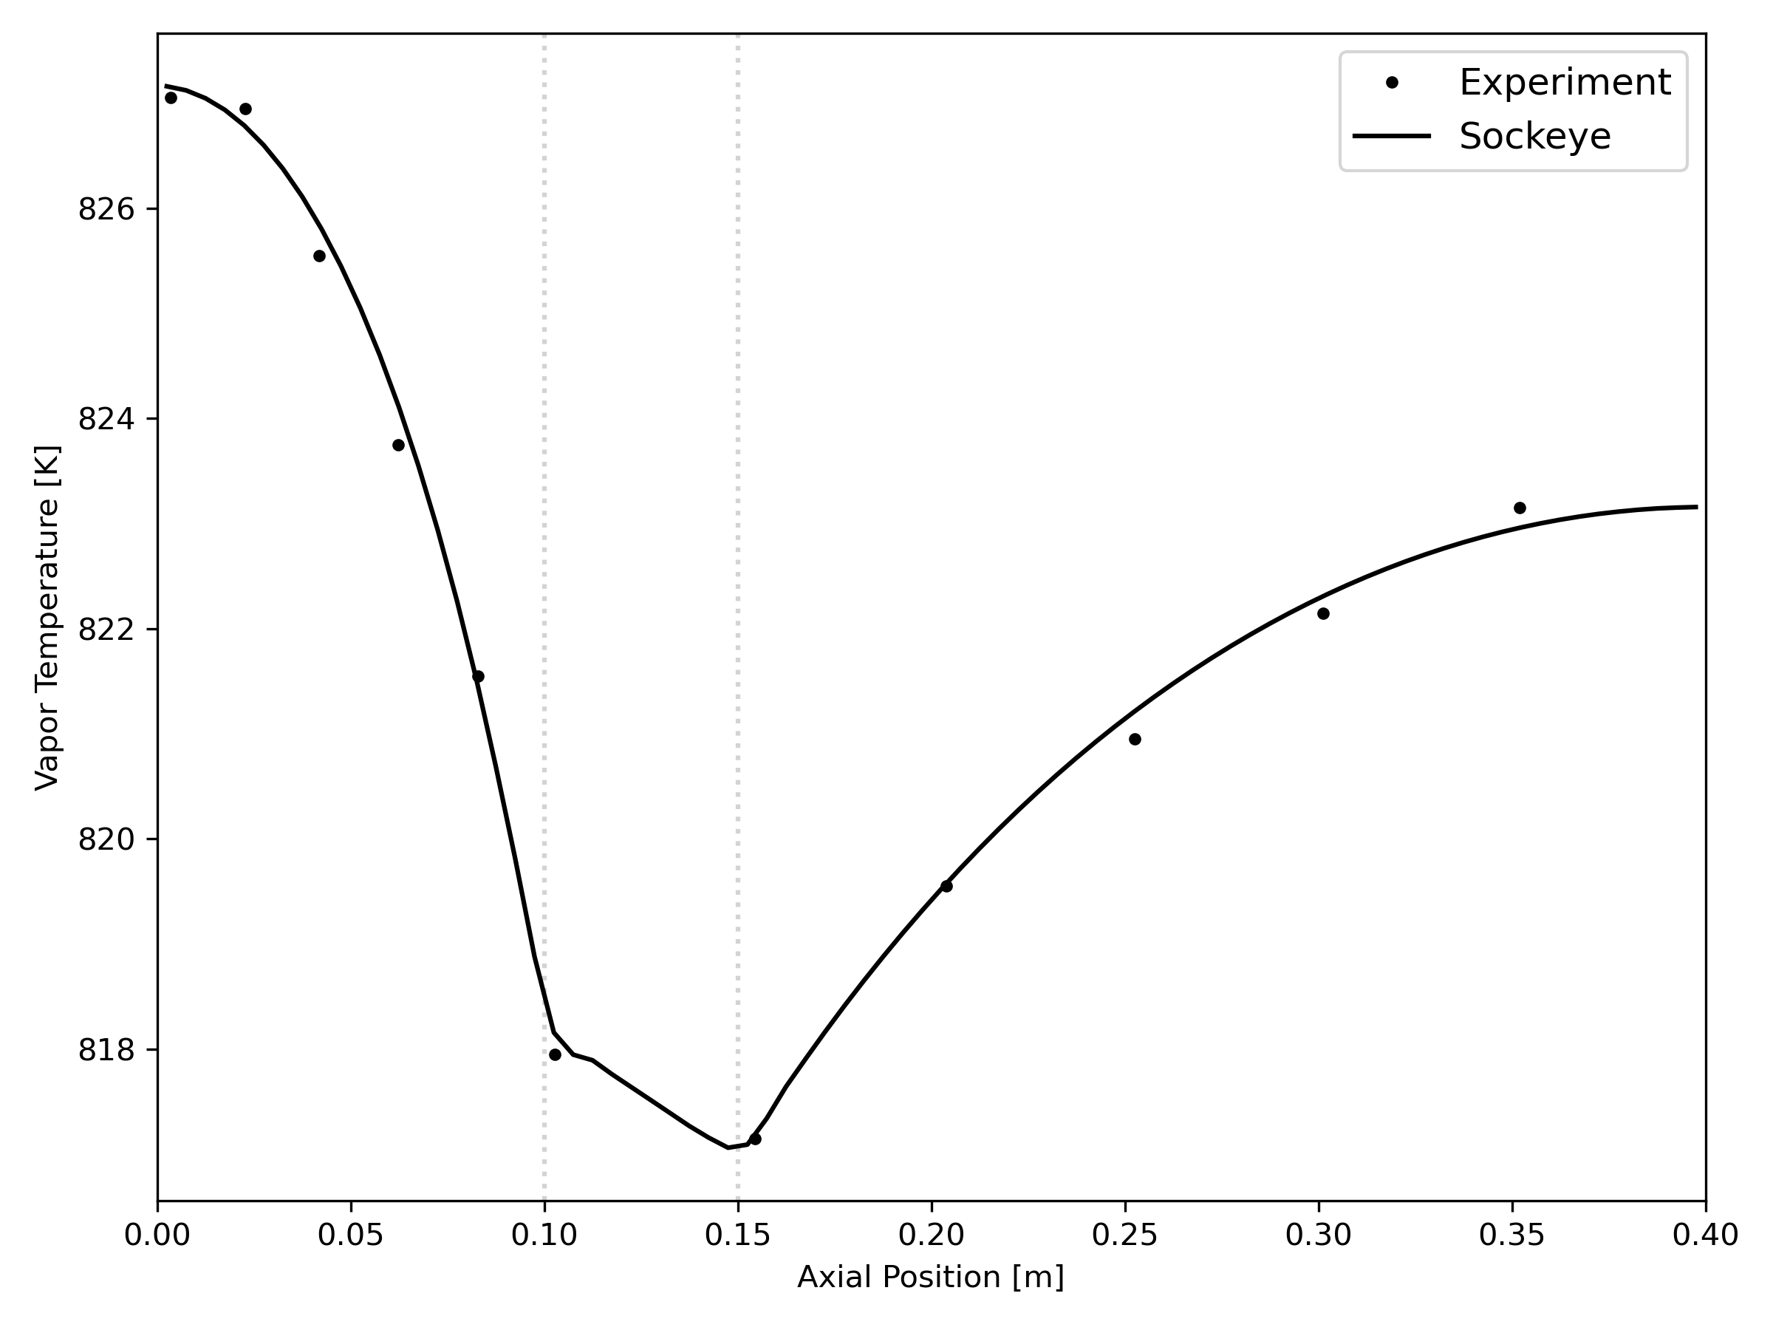
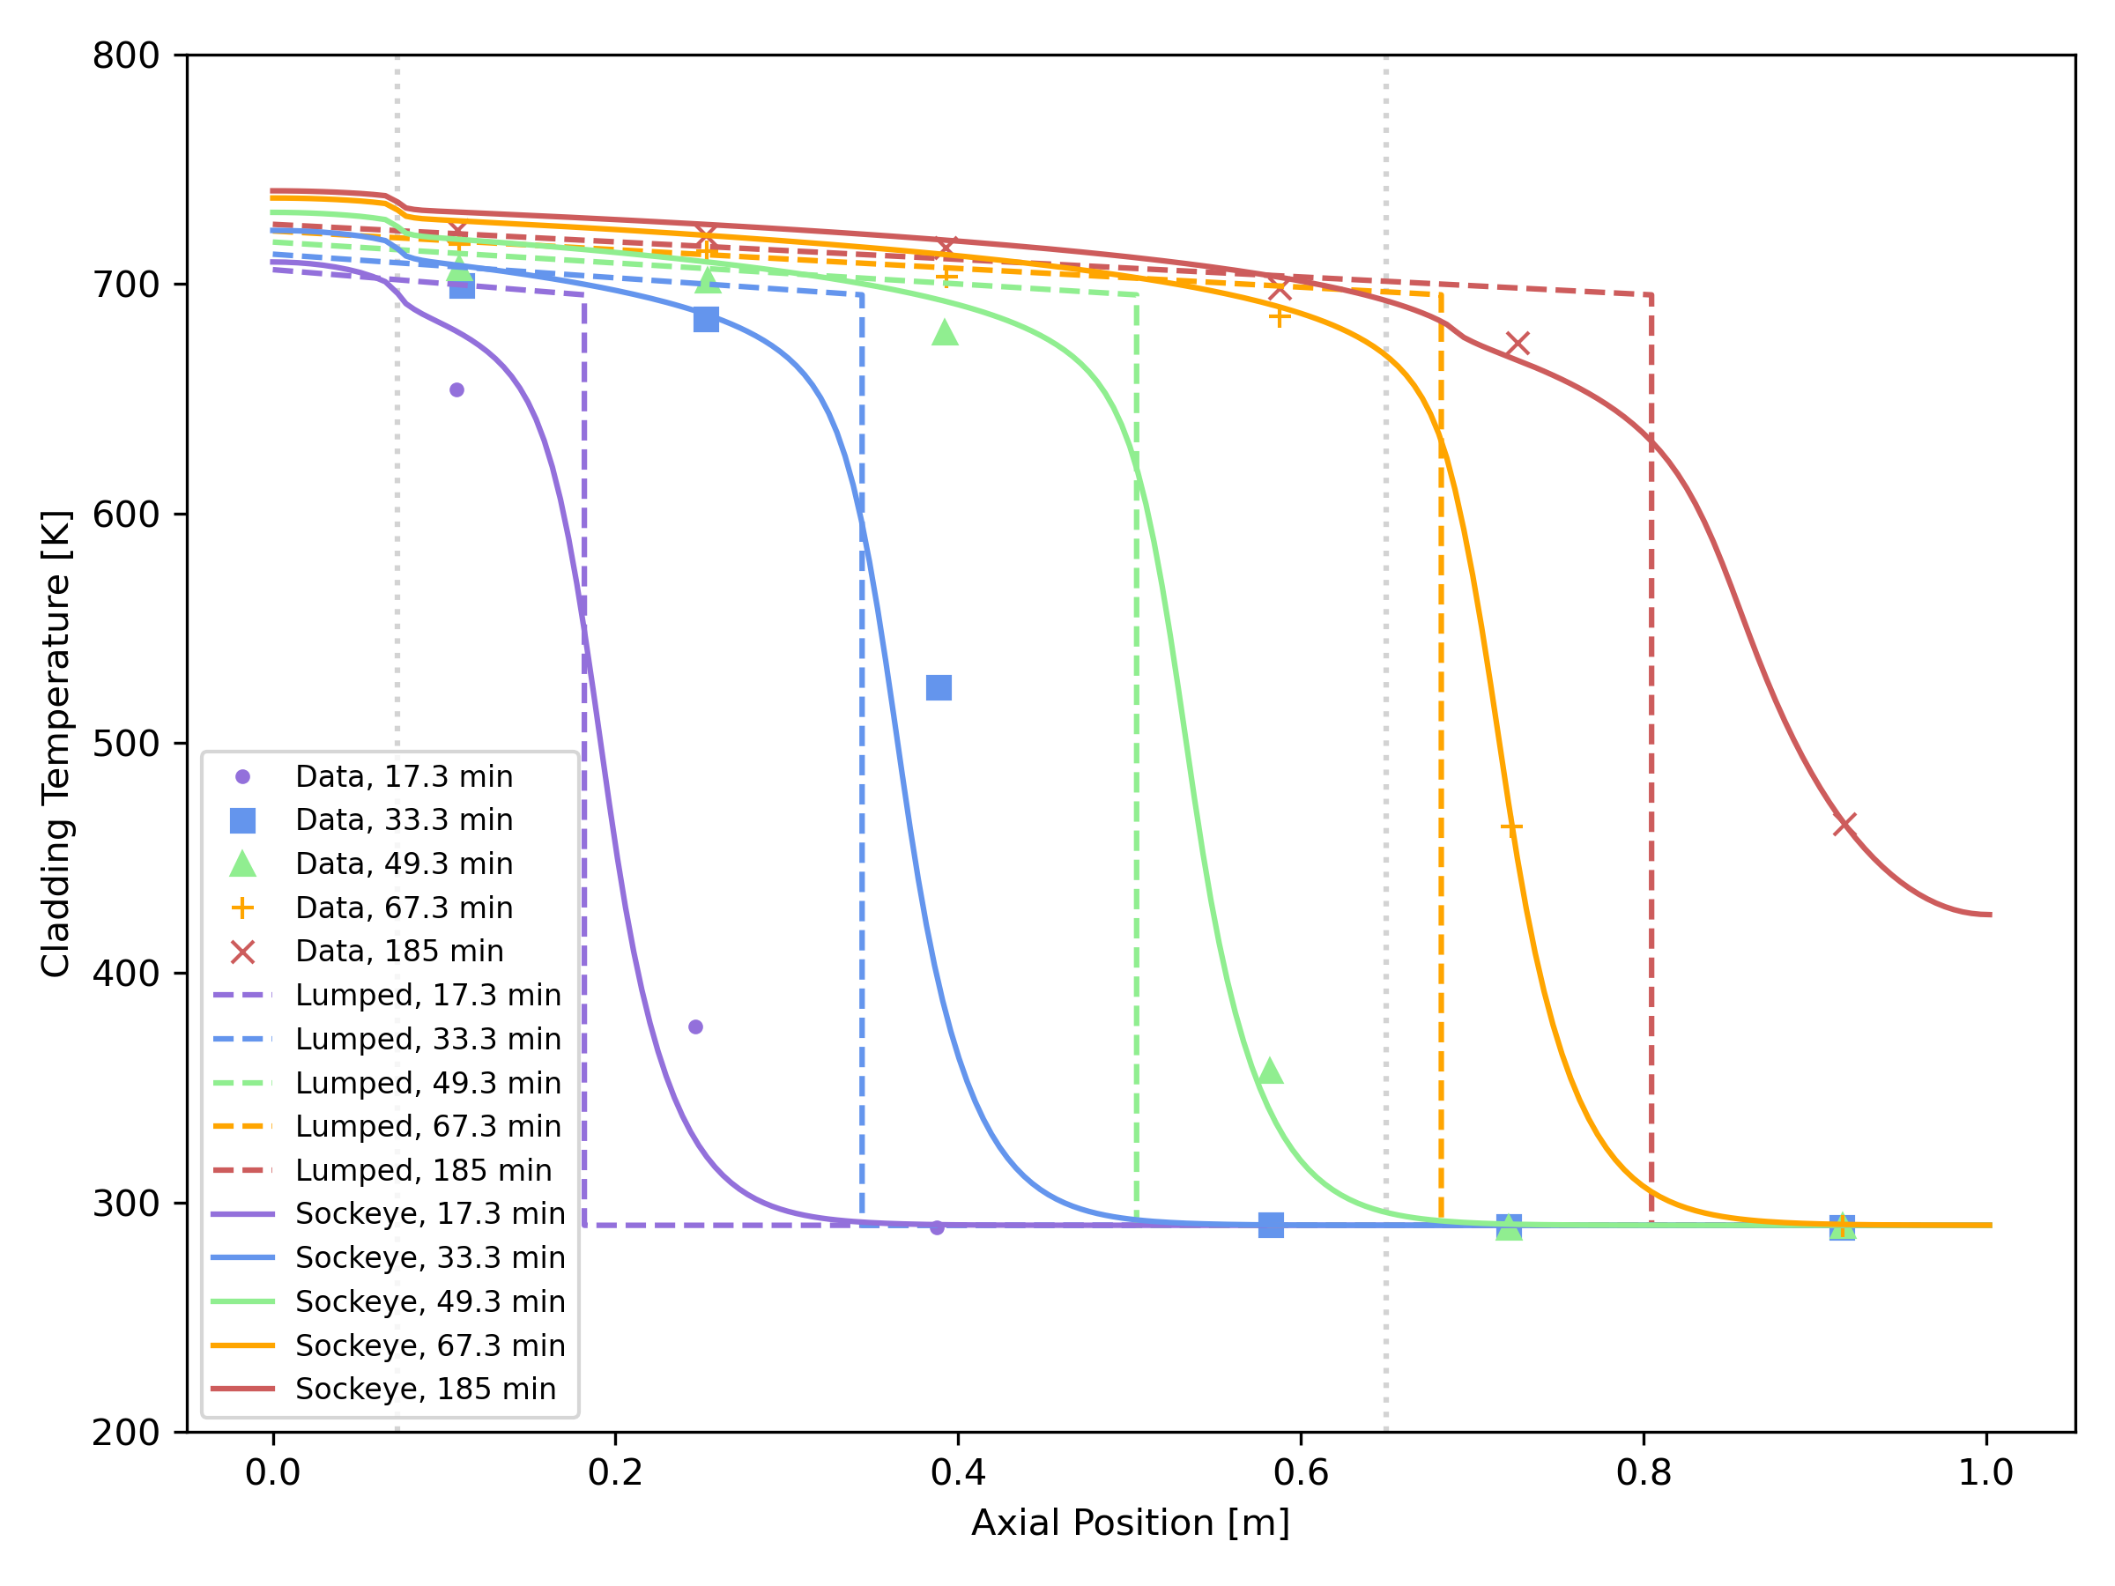
Some Other Validation
Ivanovskii
Faghri

Slide 11
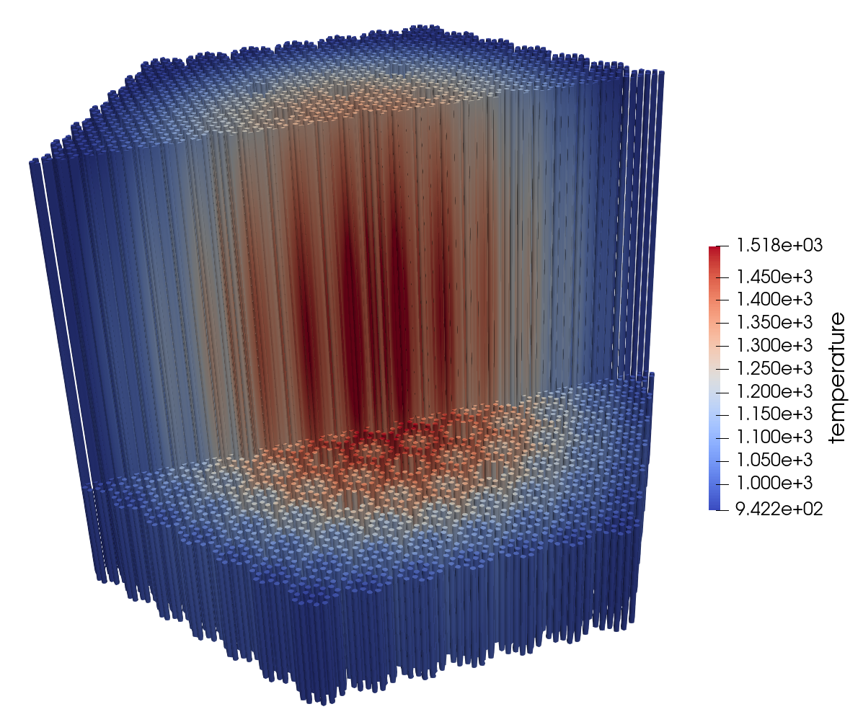
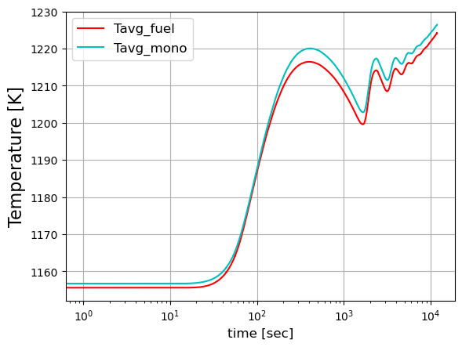
Multiphysics Demonstration
Demonstrated coupling of heat pipe models to microreactor block monolith
General-purpose heat pipe microreactor: 20 MWth with 876 heat pipes
Steady core temperature
Loss of heat sink transient

Slide 12
Conclusions and Possible Future Work
Conclusions:
Sockeye is a flexible, engineering-scale tool for the design and analysis of heat pipes, used in
Single heat pipe studies
Multiphysics simulations of heat-pipe-cooled microreactors
The LCVF model is recommended for most applications due to its robustness and accuracy
Possible future work:
Addressing phase disappearance in two-phase heat pipe model
Supporting additional heat pipe types, e.g., thermosyphons
Support for entrainment and boiling limits in flow models
Continued validation, including additional experiments by the Microreactor Program

