Slide 1
Simulation of the Peach Bottom 2 Turbine Trip Benchmark with VERA
Nick Herring & Bob Salko & Mehdi Asgari
Oak Ridge National Laboratory
Oak Ridge, Tennessee

Slide 2
Introduction
Motivation
The US nuclear industry is investigating a clad-performance-based safety (time-at-temperature) that would allow for power uprates of the current fleet
Modeling & simulation techniques must be developed and qualified for this application
Identification of important phenomena and qualification of model accuracy/uncertainty will be needed
Objectives
Application of high-fidelity, multiphysics modeling & simulation for limiting LWR transients
Perform validation and uncertainty quantification of modeling approach
Begin with BWR conditions and then move to PWR
FY25: Utilize Peach Bottom Turbine Trip Benchmark for VERA assessment and demonstration
Overview of NEAMS/AFC activities for time-at-temperature

Slide 3
Peach Bottom Unit 2 Description
GE 4 BWR Reactor
764 Fuel Assemblies
102.5 Mlb/hr rated flow rate
3293 MWt rated power
Operated intermittently from January 1974
Turbine trip transient of interest occurred on April 28, 1977
VERA model¹ based on Core Design and Operating Data for Cycles 1 and 2 of Peach Bottom 2² and Boiling Water Reactor Turbine Trip (TT) Benchmark³
S. Choi, et al., “Preliminary Simulation Results of Peach Bottom Unit 2 Cycles 1 and 2 with MPACT”, PHYSOR, 2022, https://doi.org/10.13182/PHYSOR22-37699
N. Larsen, “Core Design and Operating Data for Cycles 1 and 2 of Peach Bottom 2”, EPRI, 1978, https://doi.org/10.2172/6561294
J. Solis, et al., “Boiling Water Reactor Turbine Trip (TT) Benchmark Volume 1: Final Specifications”, Nuclear Energy Agency, NEA/NSC/DOC(2001)1, 2001

Slide 4
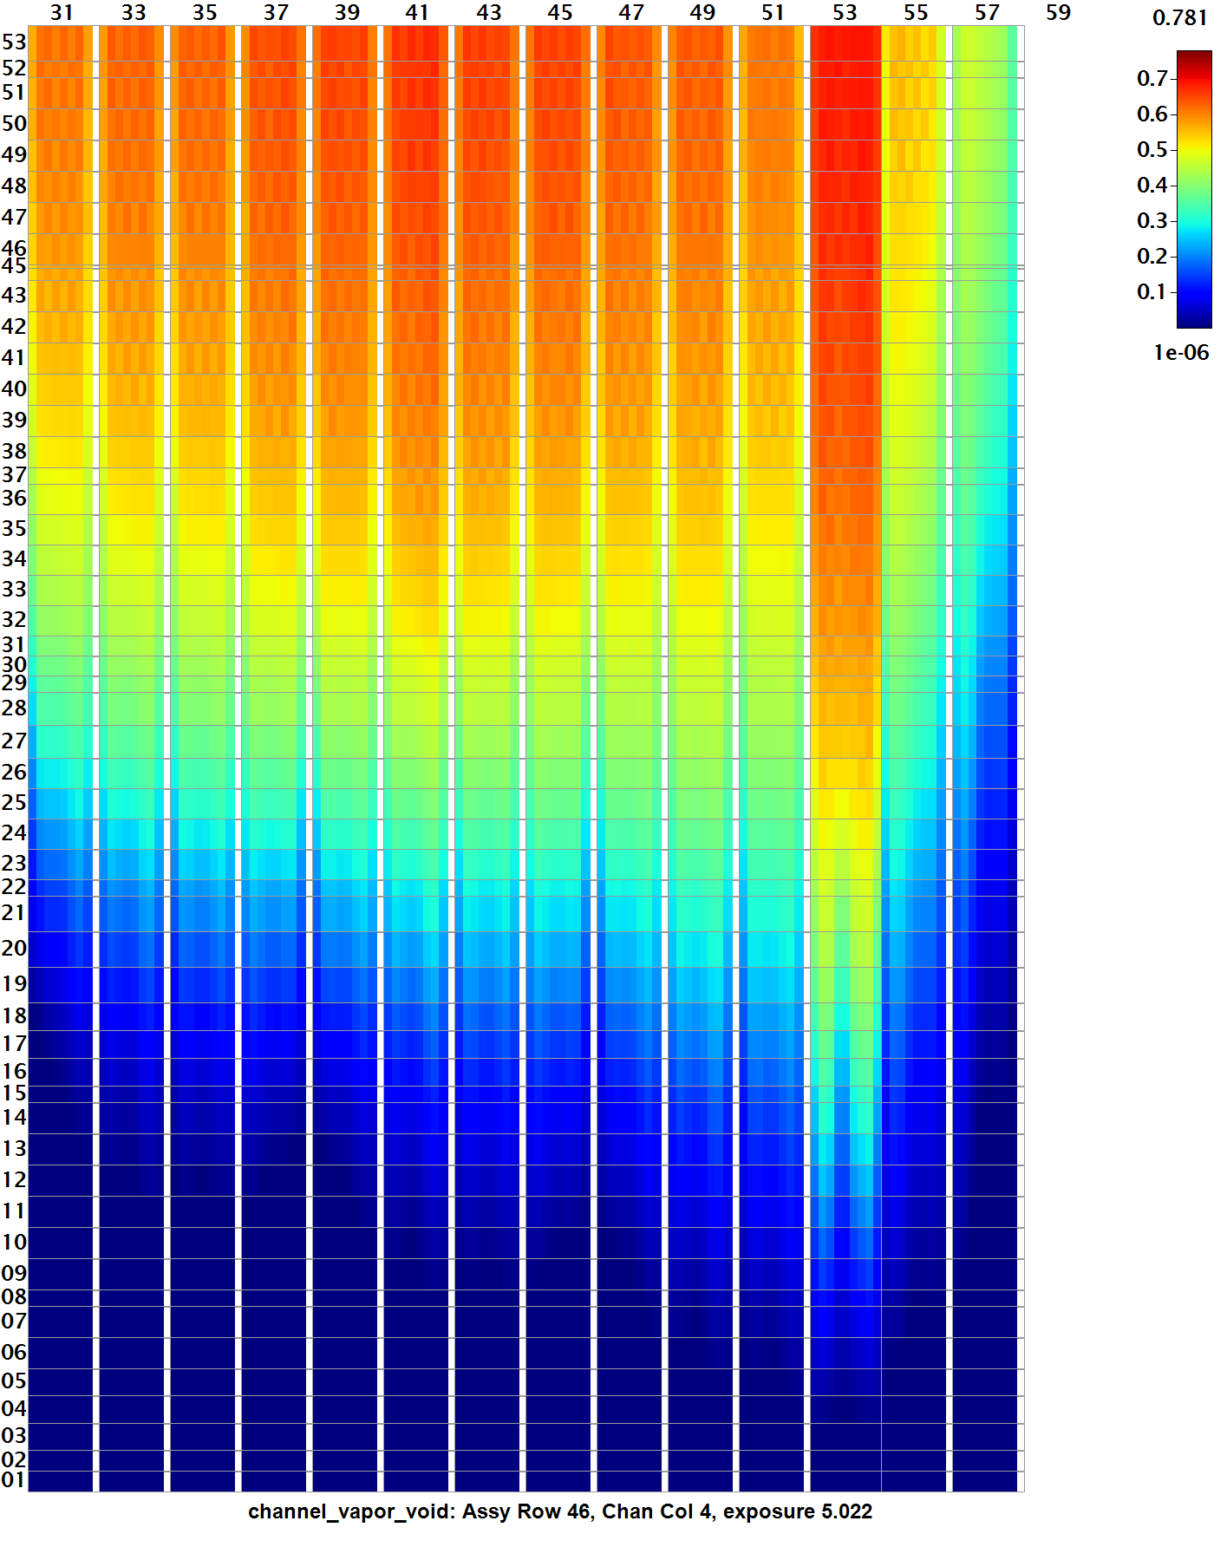
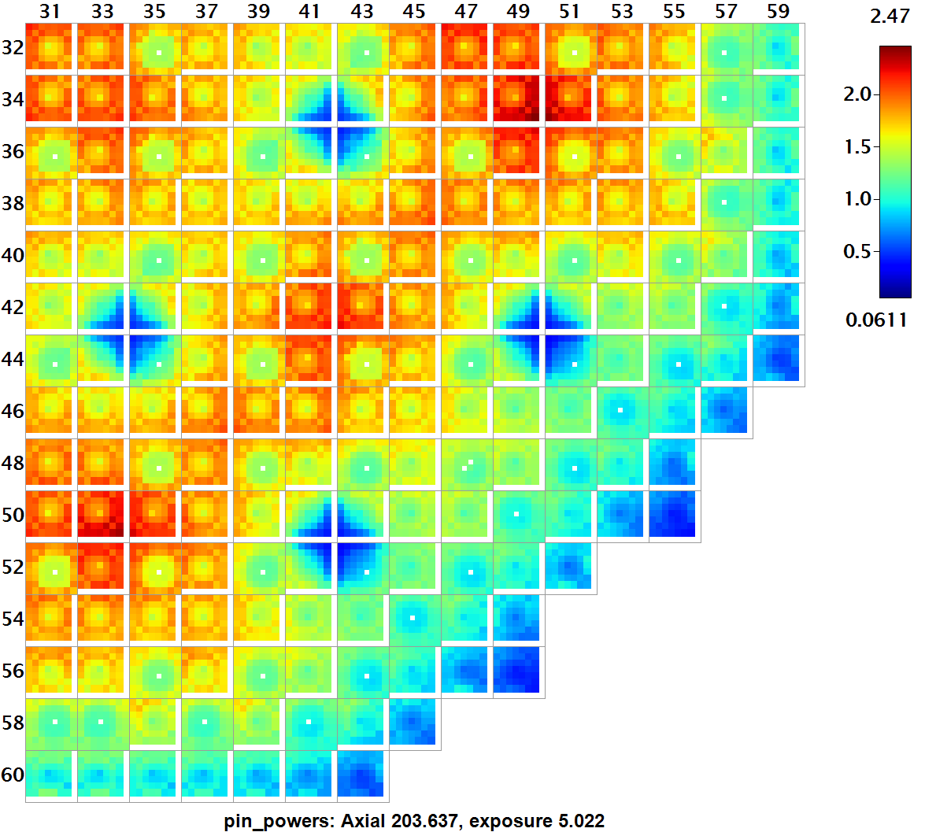
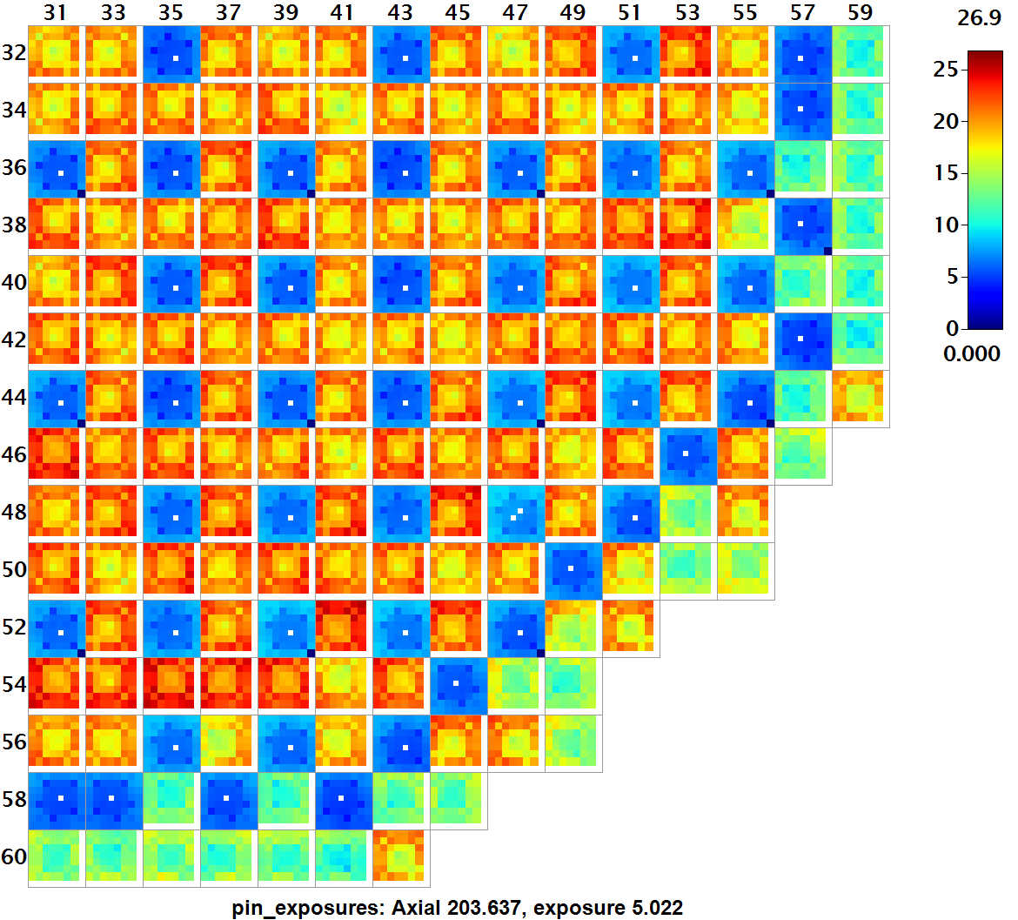
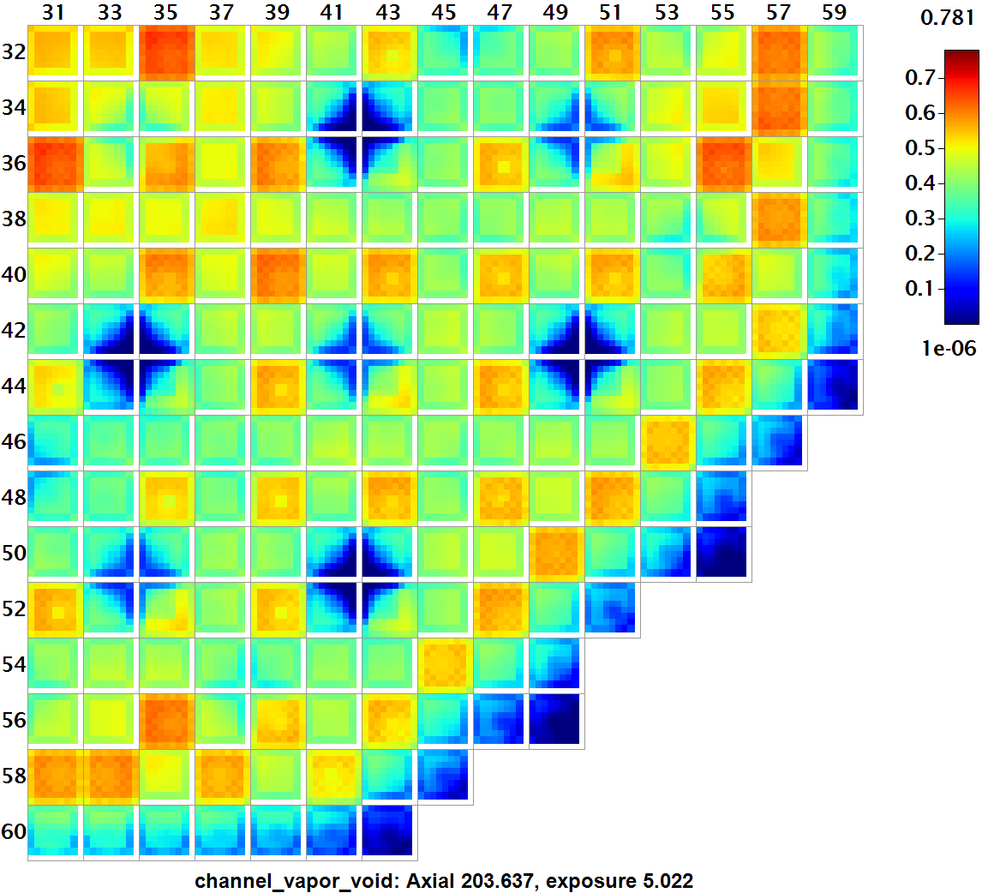
VERA Model Description
Whole-core 3D neutron transport
51 energy groups using subgroup method and P2 scattering
Explicit pin-by-pin powers with intra-pin distributions
Explicit 3D reflector geometry​​
Explicit pin-by-pin depletion at local conditions​
Explicit isotopic decay
TH moderator and fuel temperature feedback​ using VERA’s Simplified TH model for depletion and CTF for transient
Pin powers at EOC (radial slice)
Coolant void at EOC (axial and radial slices)
Pin exposures at EOC (radial slice)

Slide 5
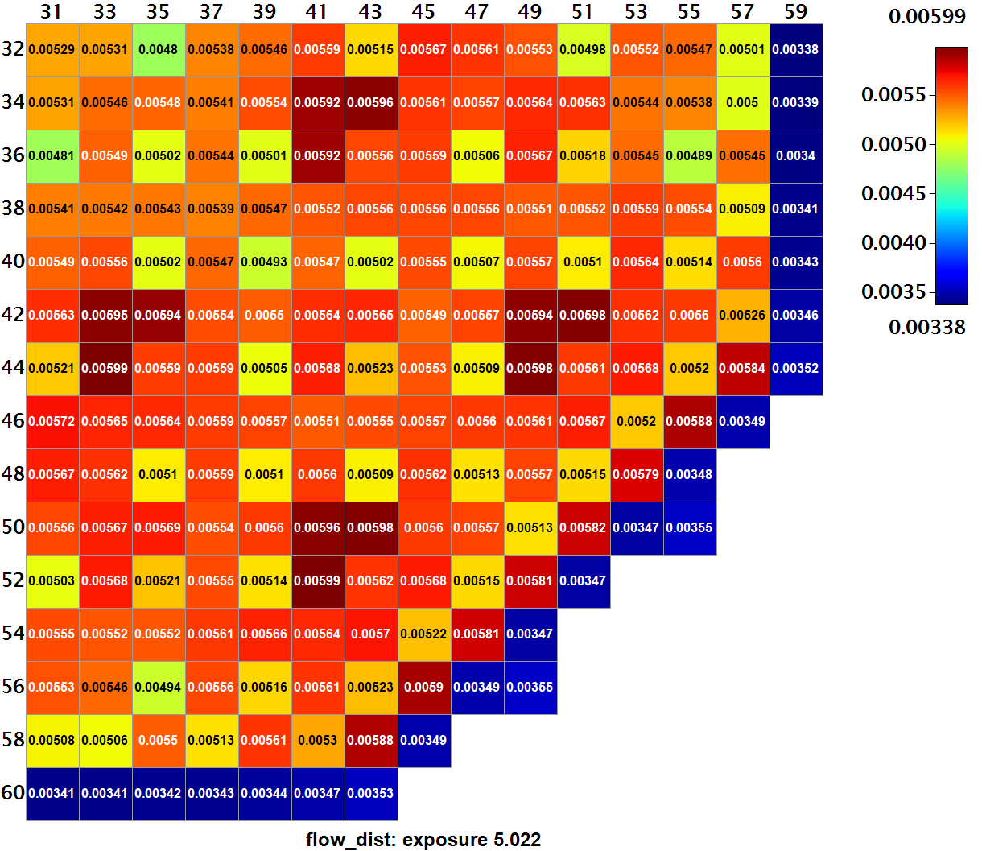
Benchmark Being Considered
Model depletion of the Peach Bottom 2 core Cycles 1 & 2 up to the steady state conditions prior to the transient
Exercise 2 of the benchmark selected: Benchmark organizers provide core boundary condition behavior and participants model in-core behavior only
The first portion of Exercise 2 is the Hot Power model (initial conditions of TT2)
Restart from Cycle 1 & 2 depletion using custom VERA cross sections
Organizer-provided core boundary conditions for outlet pressure, inlet mass flow rate, bypass fraction, assembly flow distribution, and inlet temperature distribution
Inlet pressure predicted by CTF and compared to organizer values
Flow distribution at EOC (radial slice)

Slide 6
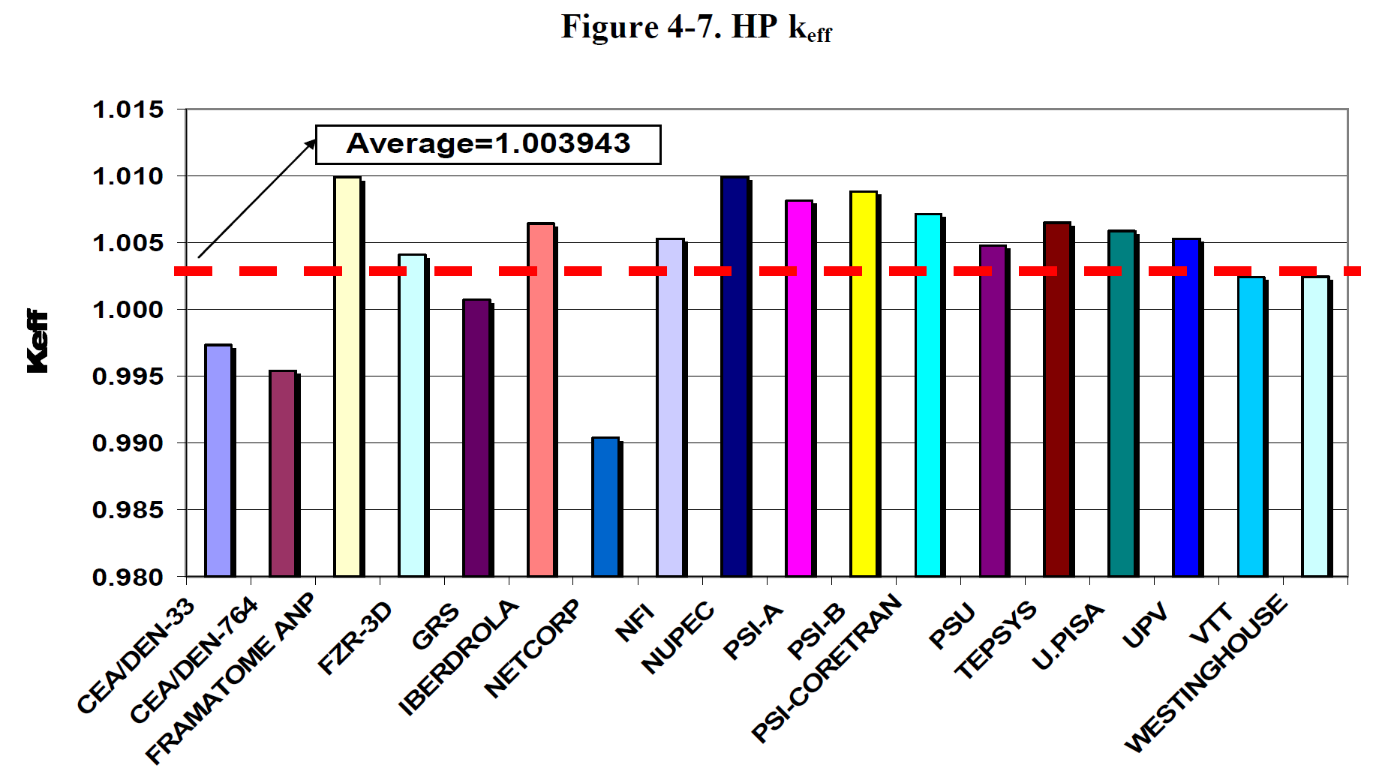
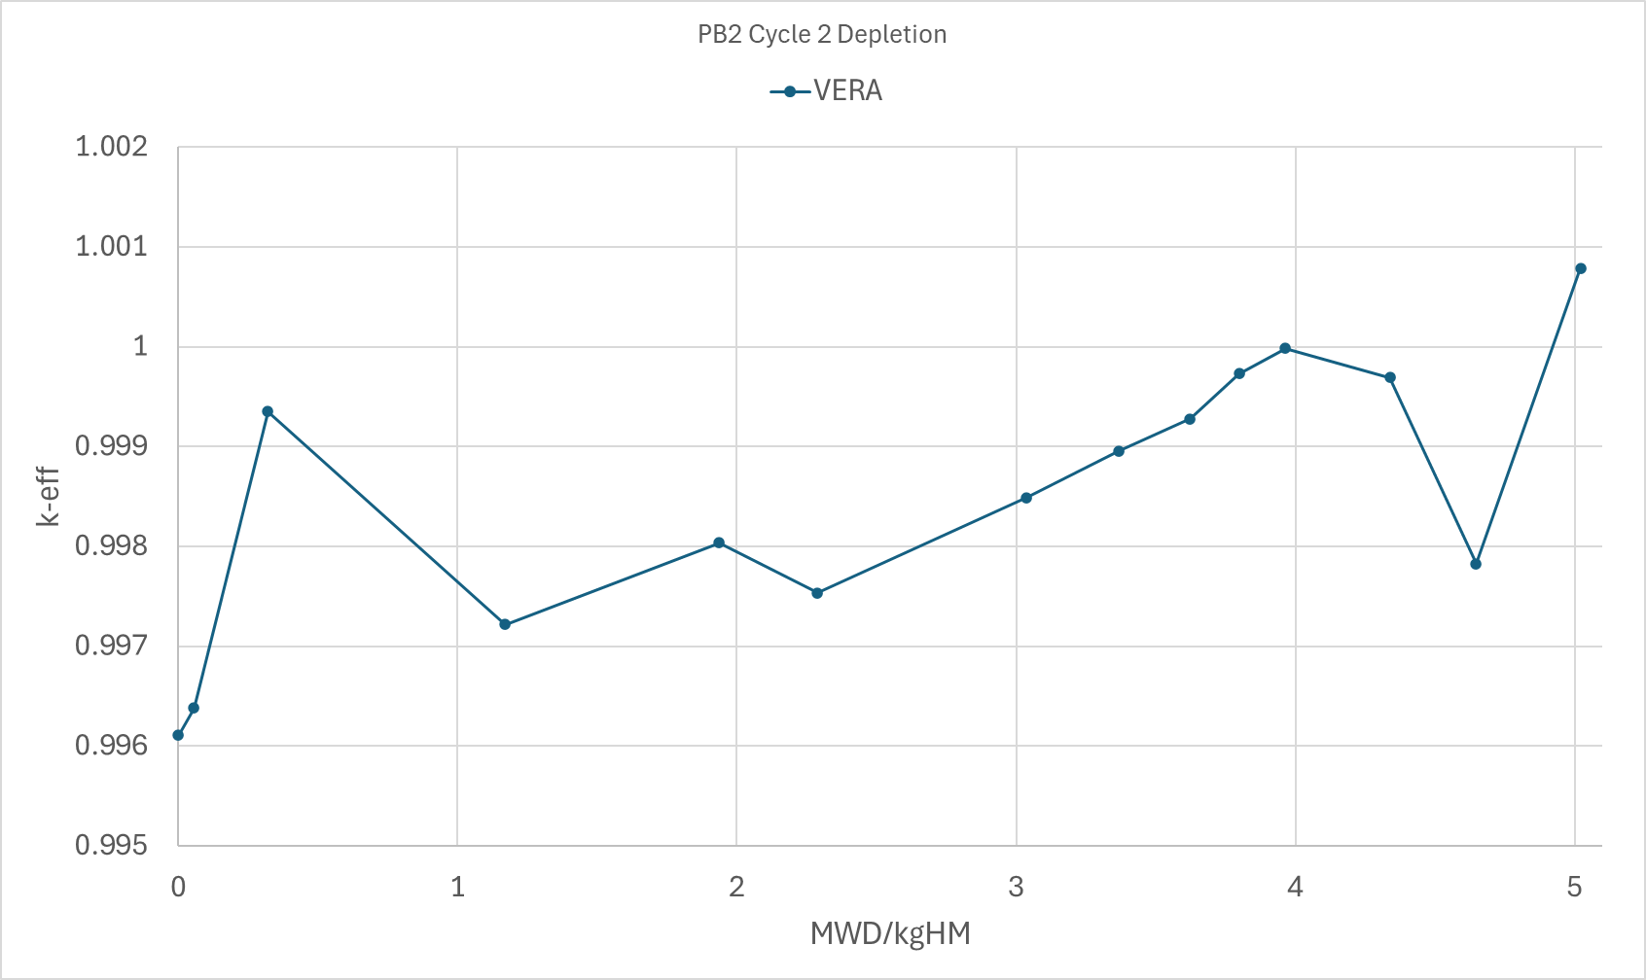
Peach Bottom 2 Depletion
Cycle 2 depletion was within 400 pcm of critical throughout the depletion
VERA k_{eff} was 0.99490 at EOC
Figure 4-7 from BOILING WATER REACTOR TURBINE TRIP (TT) BENCHMARK Volume III: Summary Results of Exercise 2, Bedirhan Akdeniz and Kostadin N. Ivanov

Slide 7
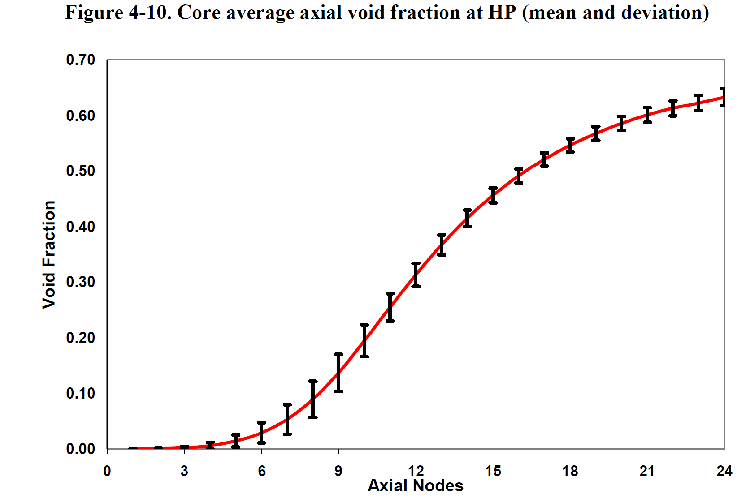
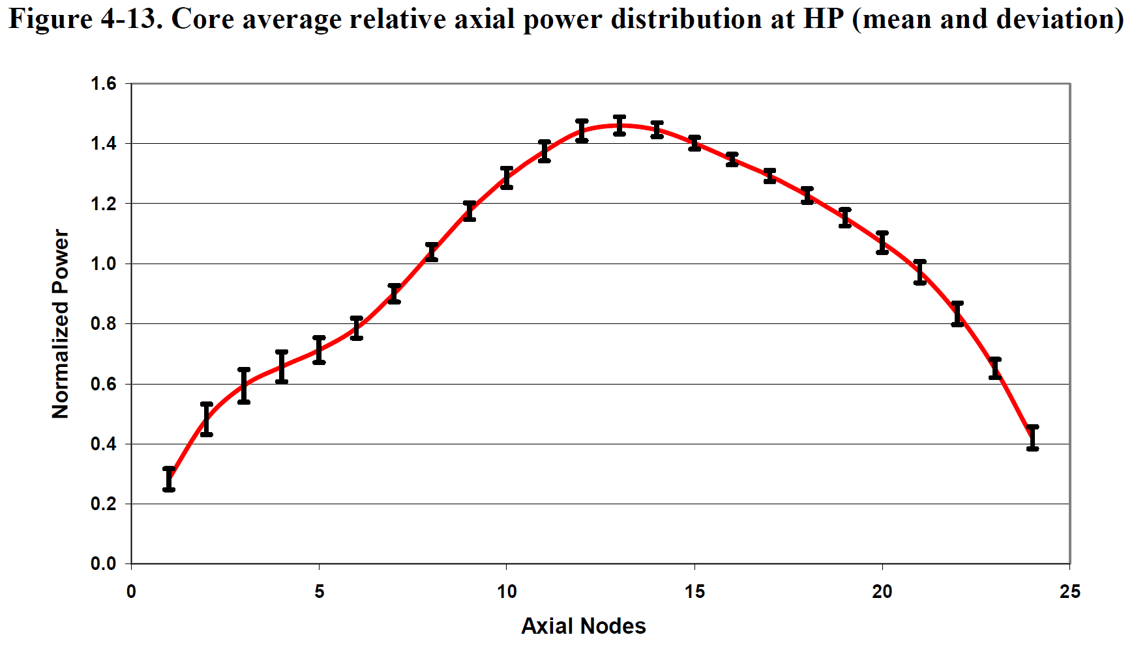
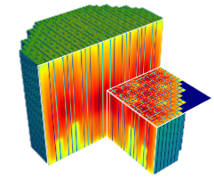
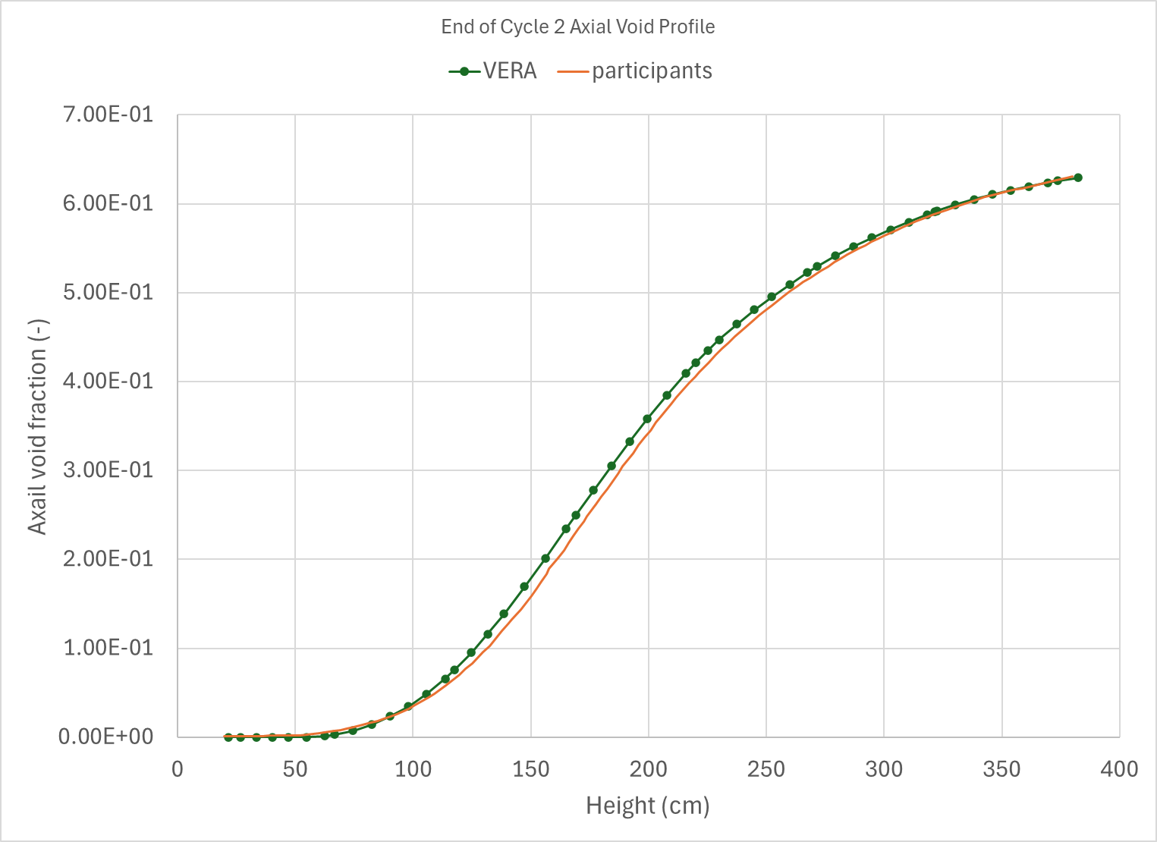
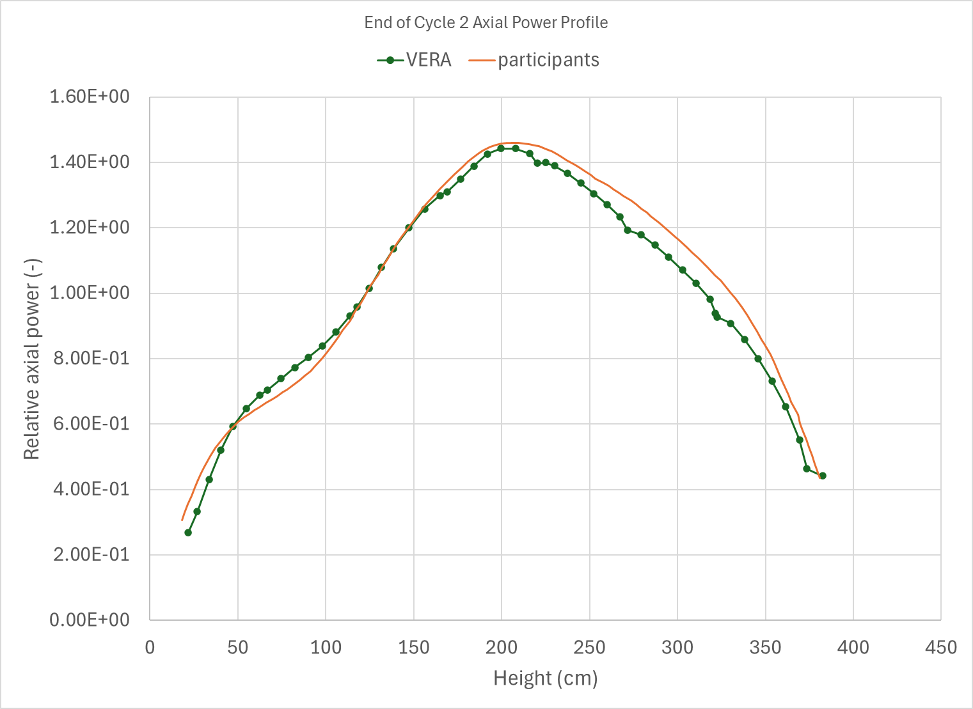
Peach Bottom 2 End of Cycle 2 Hot Power Results
Axial void profile EOC
Axial power profile EOC
Pin Fuel Temperatures at EOC
Figure 4-10 and 4-13 from BOILING WATER REACTOR TURBINE TRIP (TT) BENCHMARK Volume III: Summary Results of Exercise 2, Bedirhan Akdeniz and Kostadin N. Ivanov

Slide 8
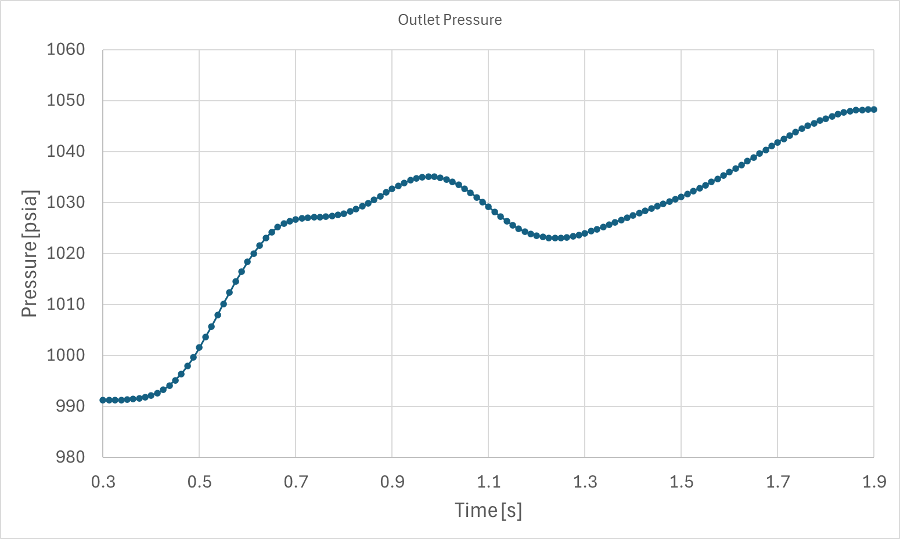
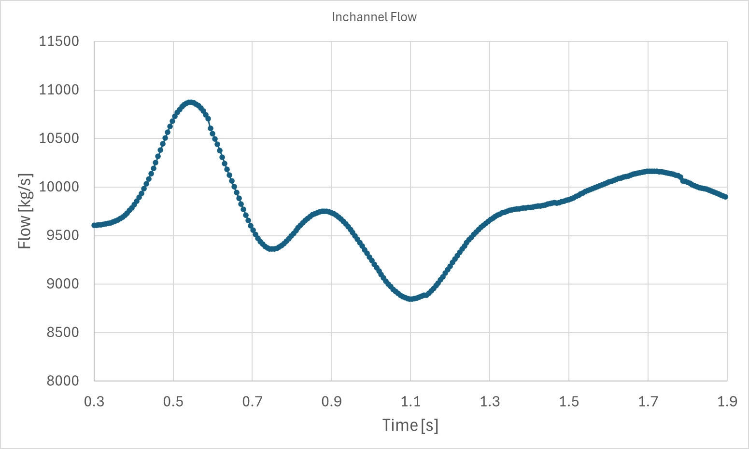
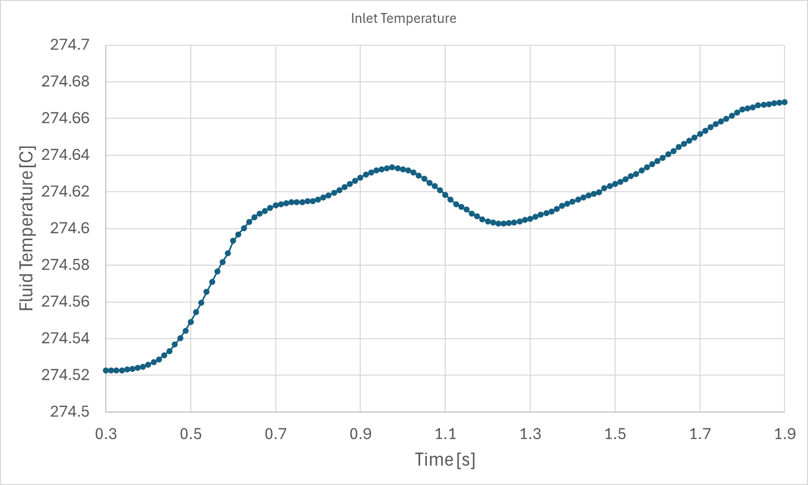
Benchmark Being Considered
The second portion of Exercise 2 is the turbine trip transient (TT2) at the end of cycle 2
Utilized organizer-specified boundary condition ramps for CTF using the outlet pressure, inlet mass flow rate, bypass fraction, and inlet temperature specified
Significant changes start after 0.3 seconds and scram occurs at 0.75 seconds
Reactivity insertion is primarily a result of void collapse due to pressure increase from turbine trip
Inchannel Flow Rate Boundary Condition
Outlet Pressure Boundary Condition
Inlet Temperature Boundary Condition

Slide 9
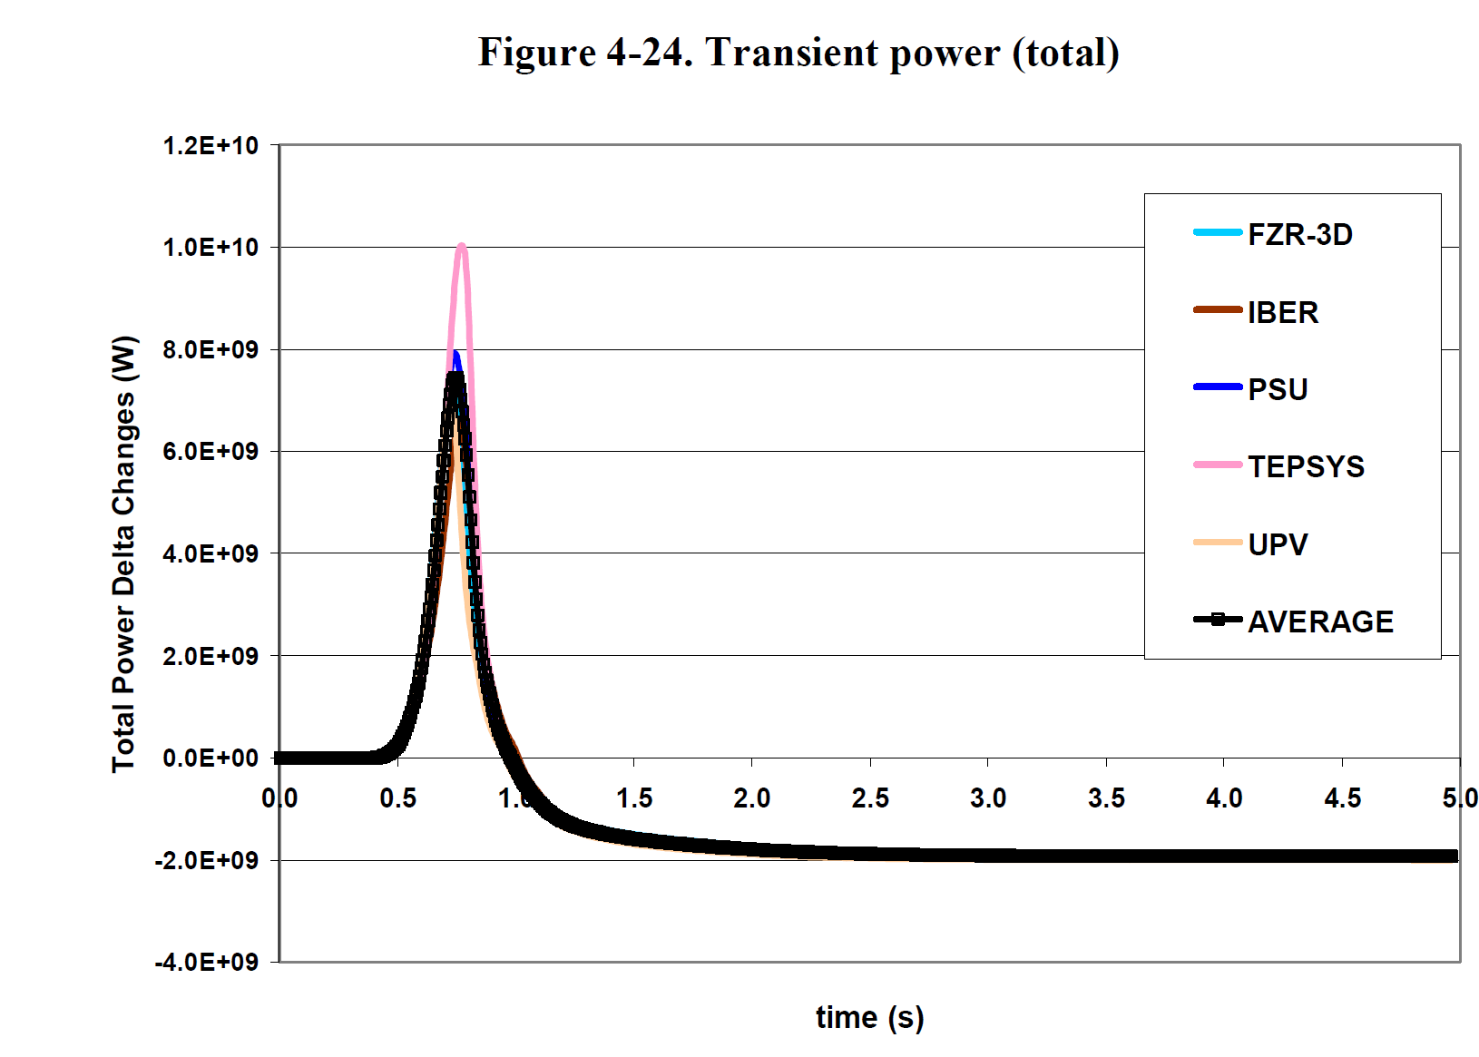
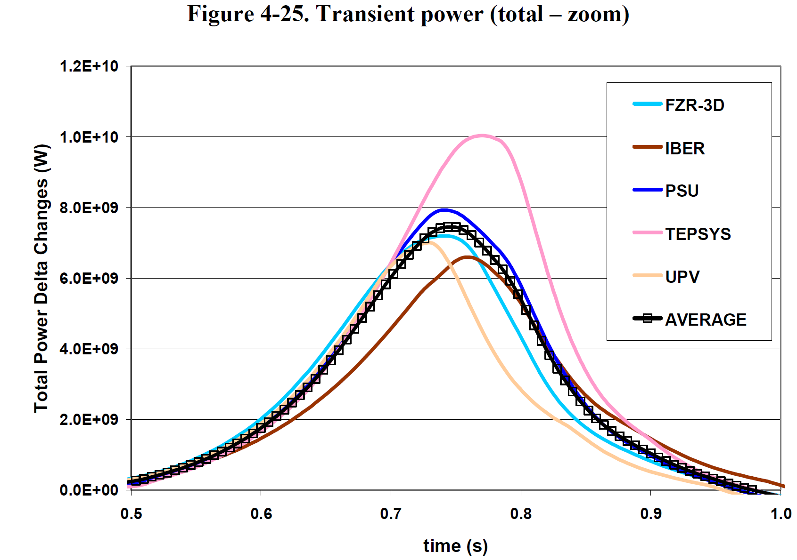
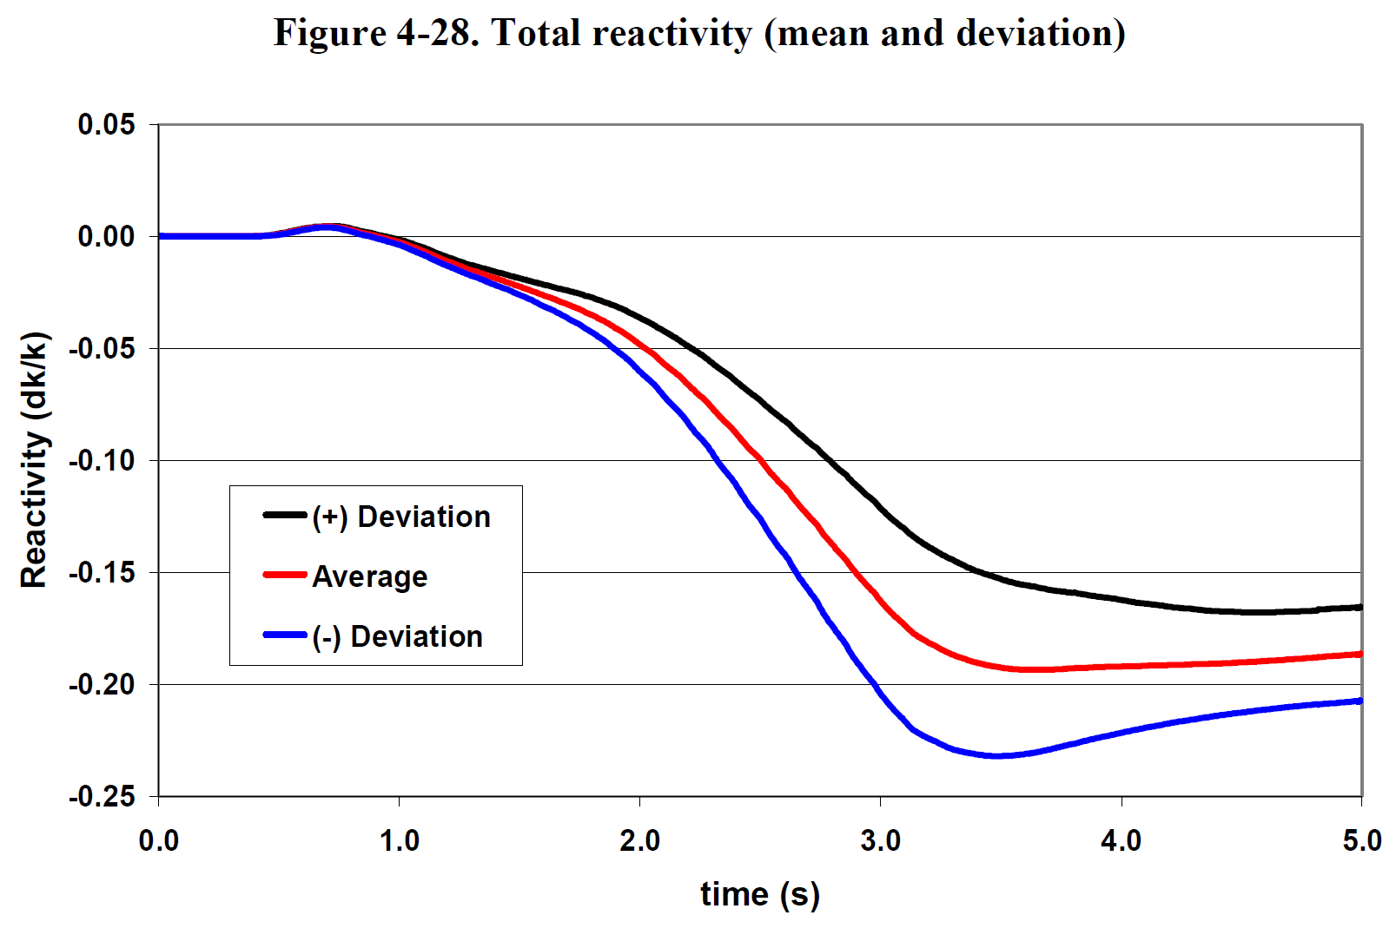
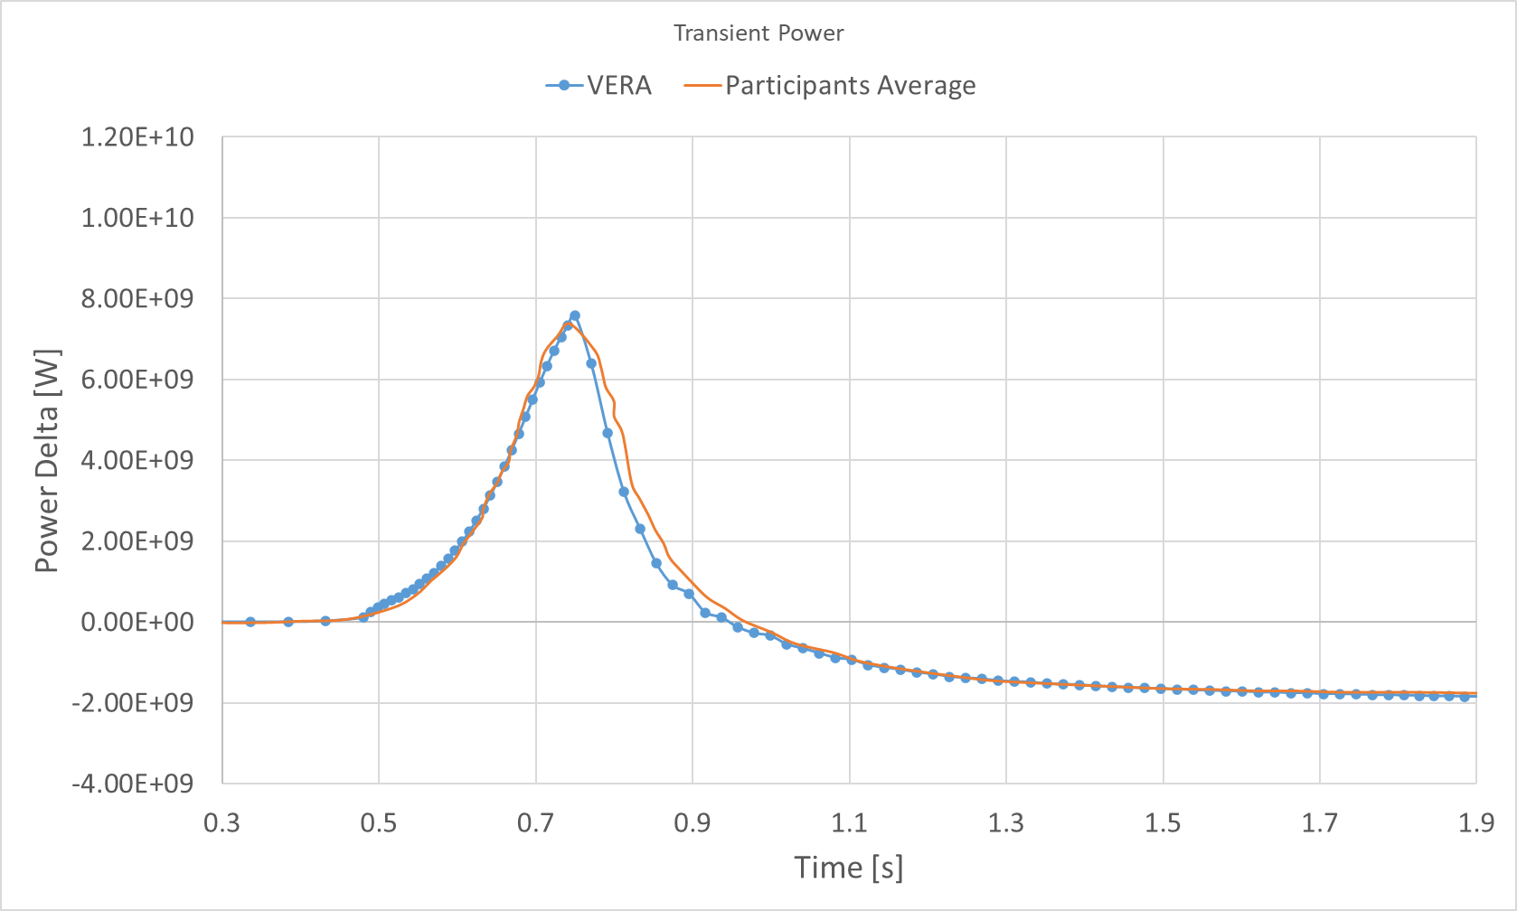
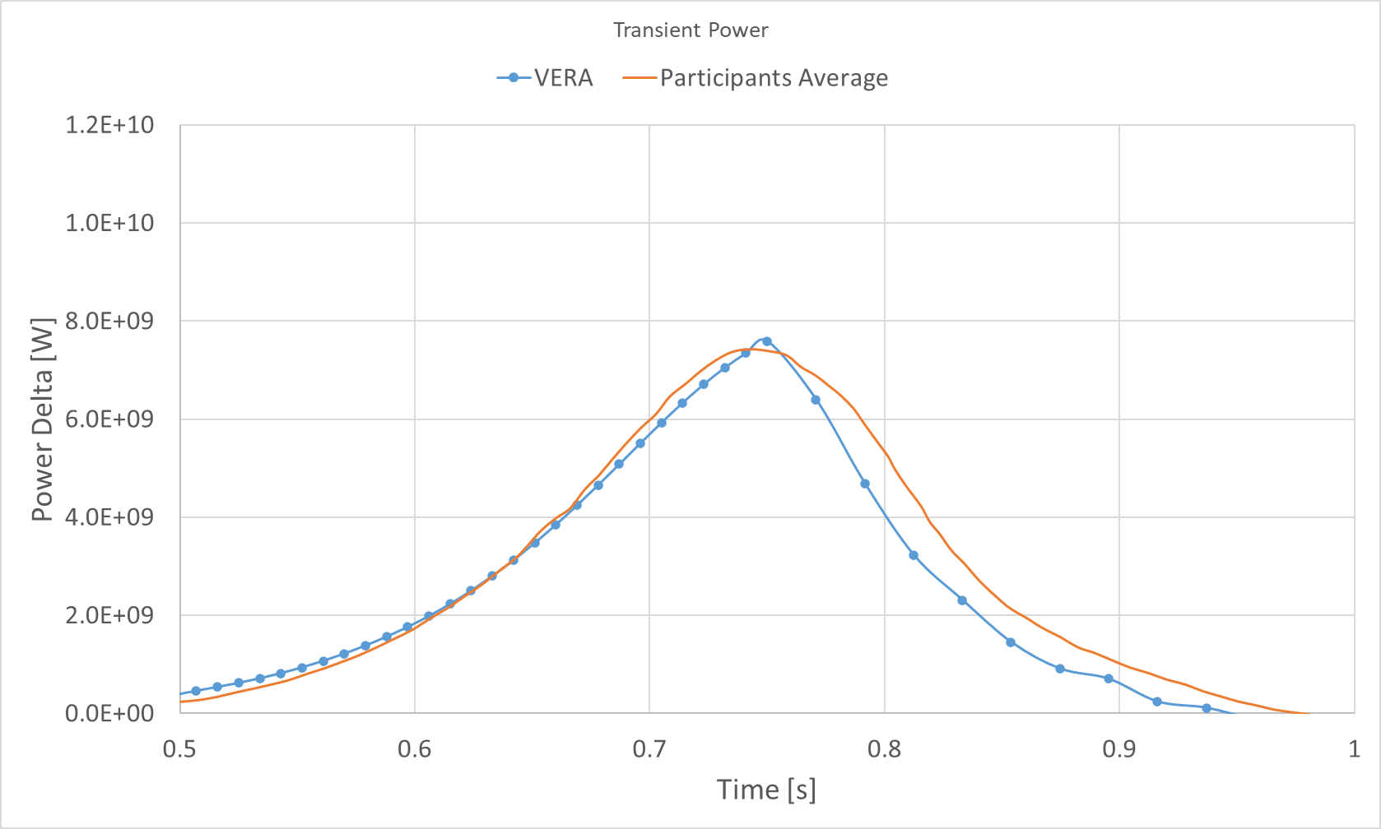
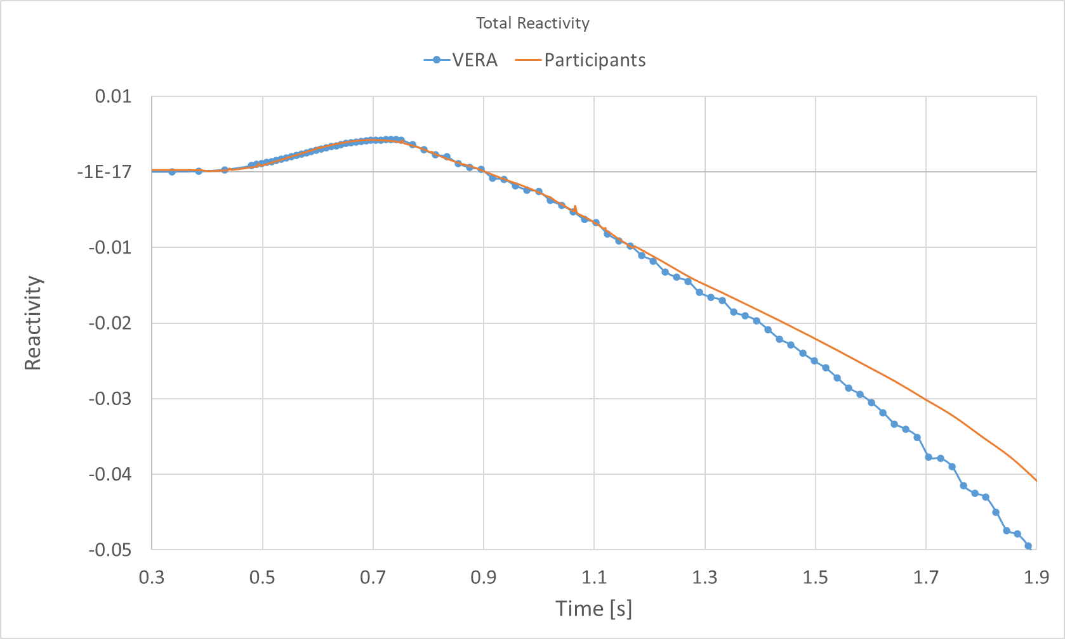
Peach Bottom 2 Turbine Trip Transient
Time of maximum power is 0.75 s, average of participants is 0.742 s
Transient Power
Transient Power (zoomed)
Transient Reactivity
Figure 4-24, 4-25, and 4-28 from BOILING WATER REACTOR TURBINE TRIP (TT) BENCHMARK Volume III: Summary Results of Exercise 2, Bedirhan Akdeniz and Kostadin N. Ivanov

Slide 10
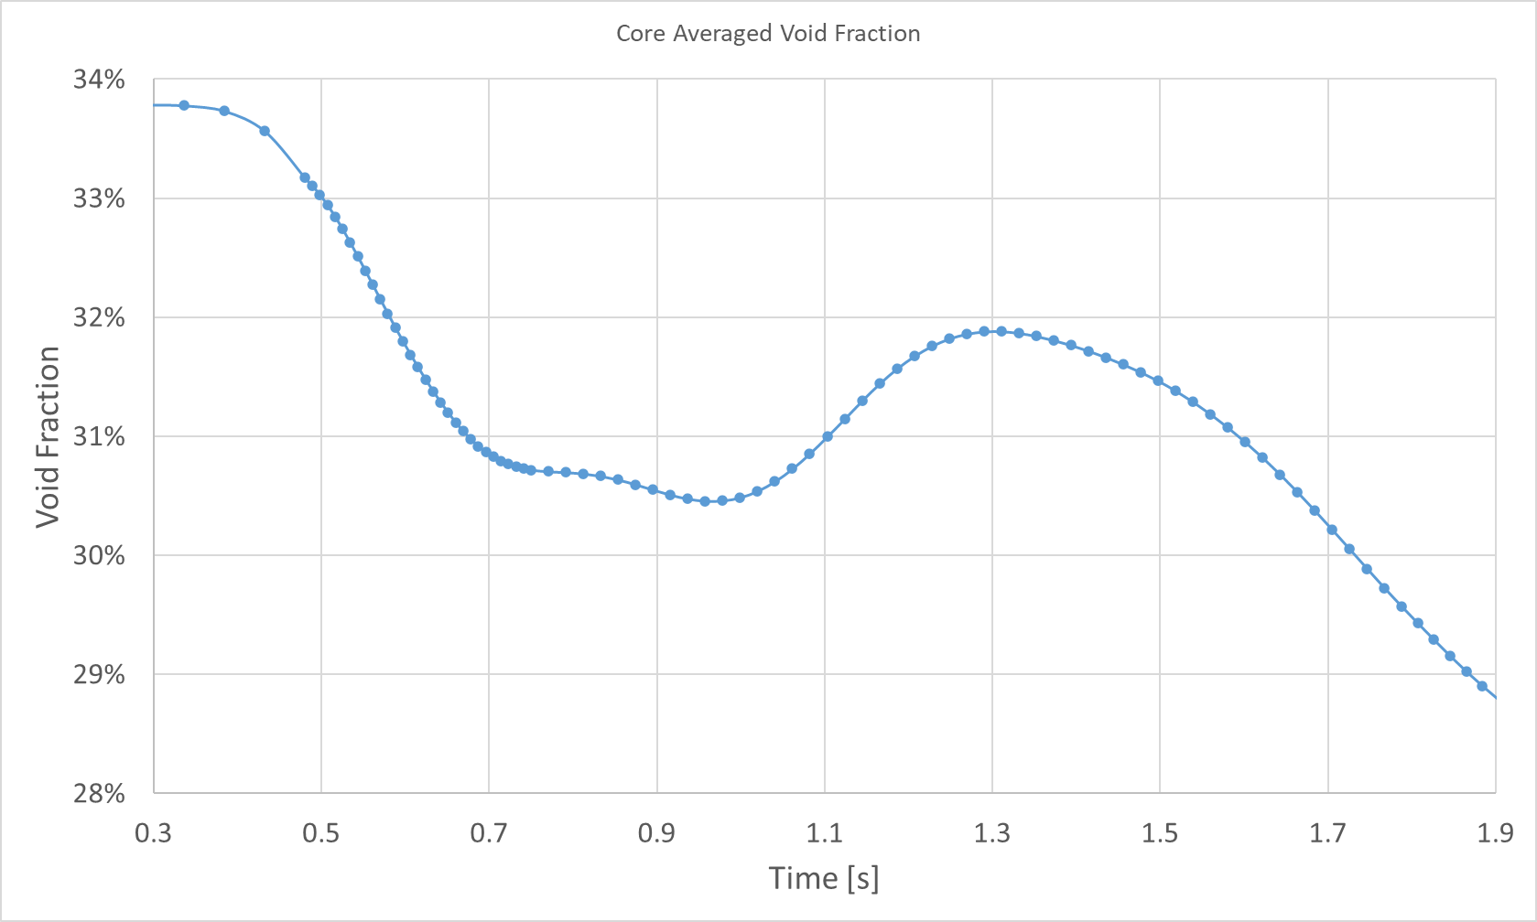
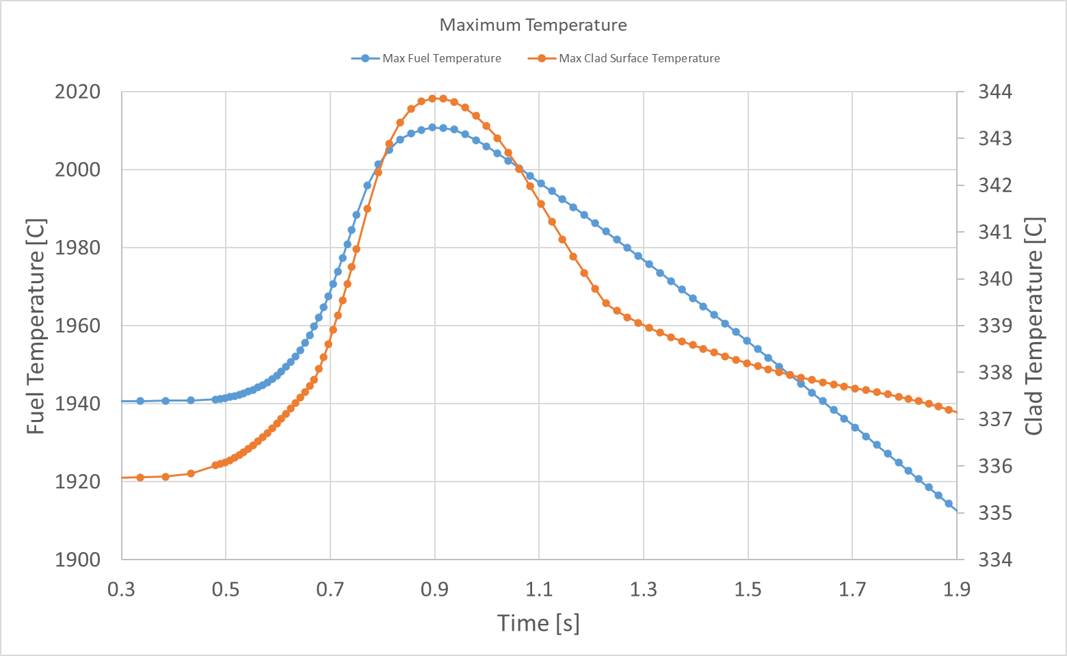
Peach Bottom 2 Turbine Trip Transient
Core Averaged Void Collapse
Maximum Fuel and Clad Surface Temperatures

Slide 11
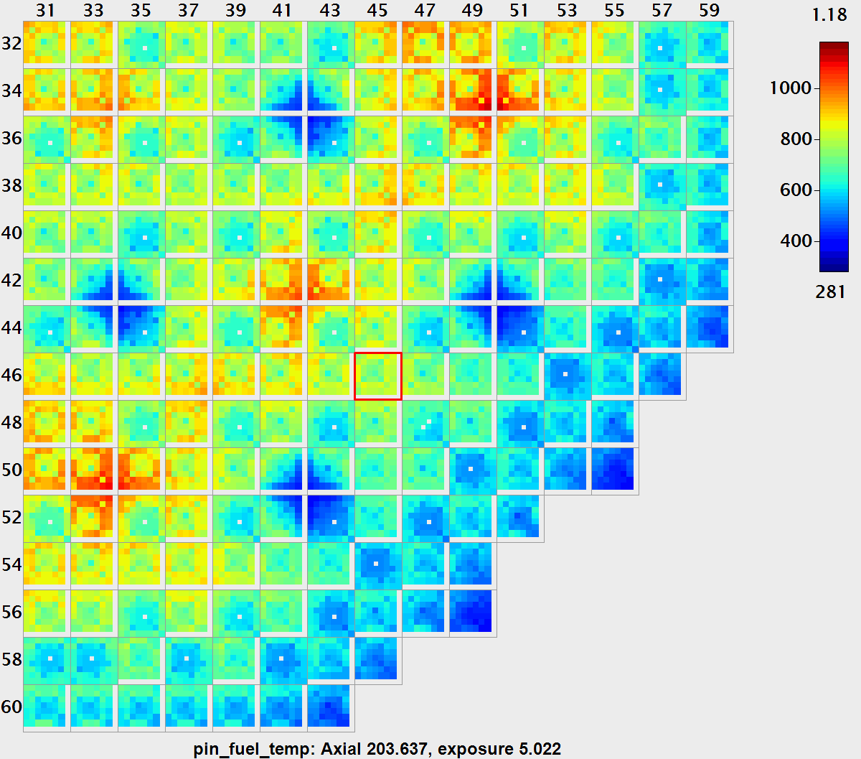
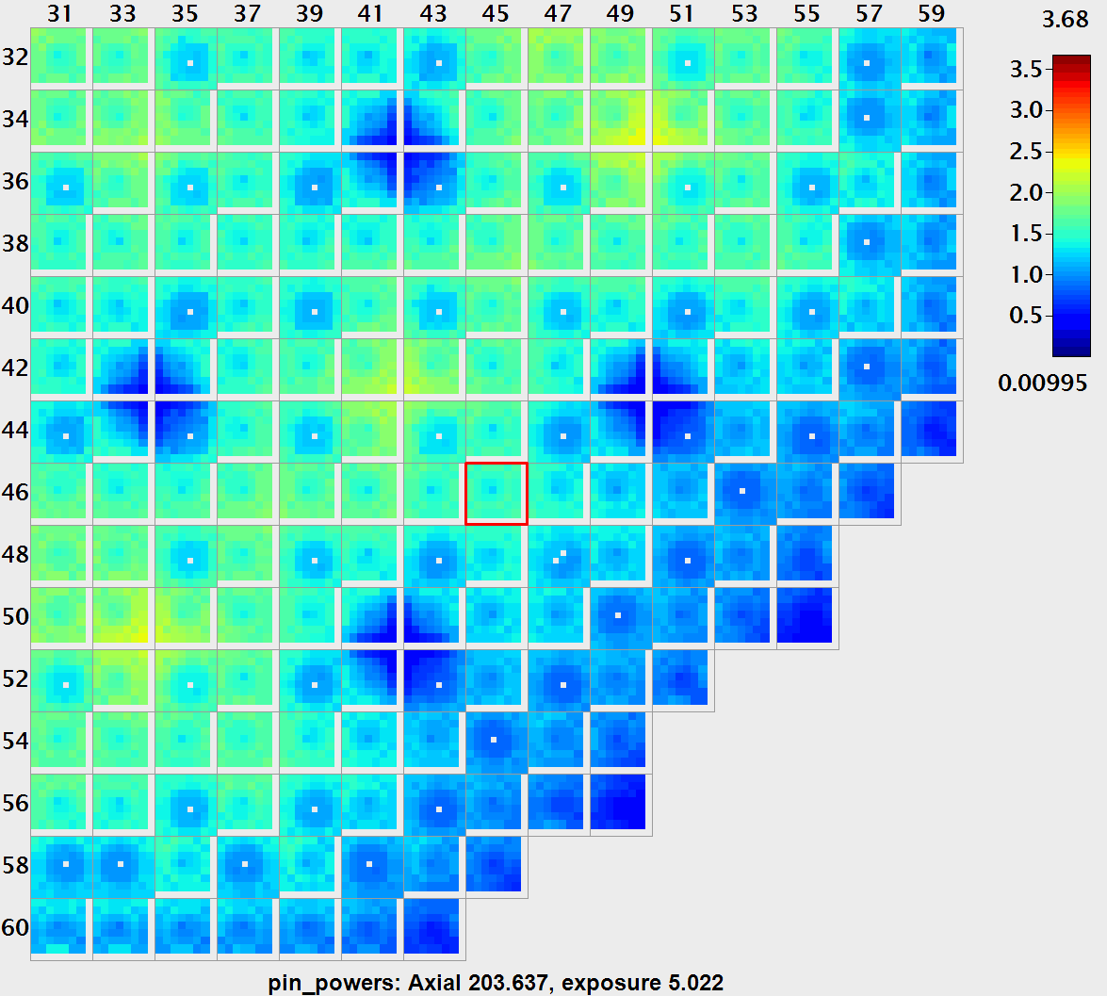
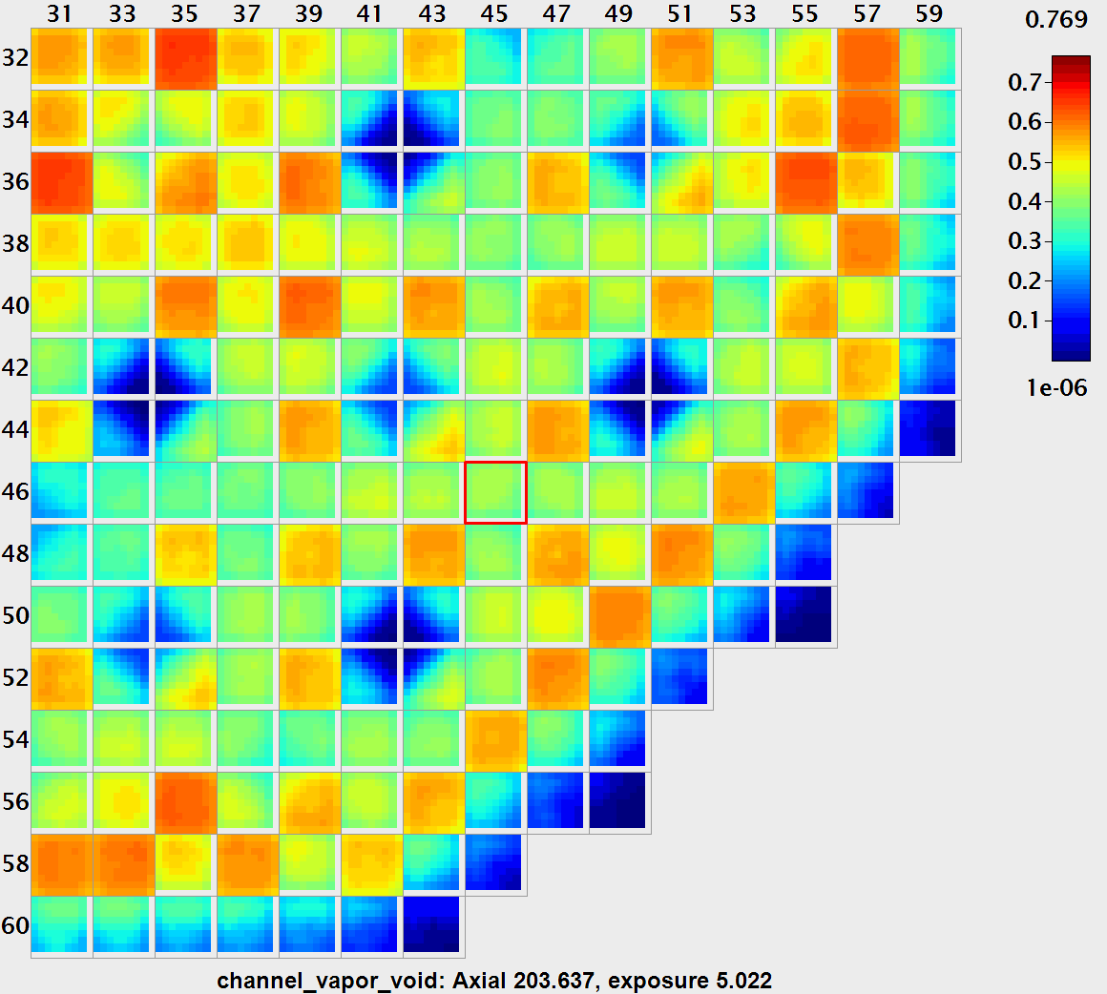
Peach Bottom 2 Turbine Trip Transient
Pinwise Fuel Temperature
Channelwise Void Fraction
Pin Powers

Slide 12
Summary
VERA was used to simulate a high-fidelity model of Peach Bottom 2 leading up to and including the turbine trip transient
Depletion models kept within 400 pcm of criticality for cycle 2
Steady state calculations prior to the turbine trip matched well with reported results from participant simulations in the benchmark
Turbine trip transient power excursion and total reactivity matched well with average participant simulation results

Slide 13
Upcoming Work
FY25 Objectives
Modify Peach Bottom 2 turbine trip to create dryout and rewet conditions
Model similar turbine trip on Limerick Cycle 18 to achieve dryout
Analyze fuel performance using BISON
FY26 Objectives
Perform sensitivity and uncertainty analysis on fuel performance for time at temperature due to dryout

