Slide 1
Validation and sensitivity analysis of T/H capabilities for modeling of transient dry out and re-wet
Vineet Kumar, Bob Salko, and Will Gurecky
NEAMS ANNUAL REVIEW LWR
May 7, 2025

Slide 2
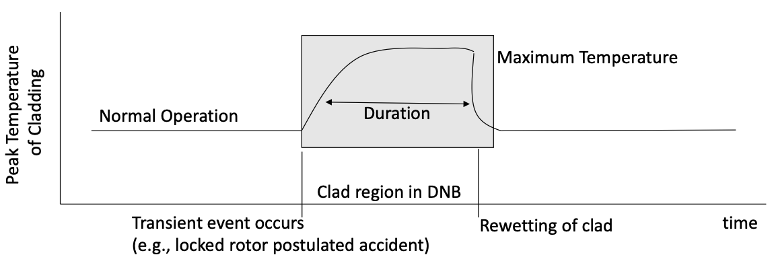
Introduction
The T/H technical area seeks to support improved economics of the current LWR fleet by improving modeling accuracy, fidelity, and uncertainty
US nuclear industry is pursuing time-at-temperature strategy, allowing for limited fuel dryout during LWR transients
Power uprates, operational flexibility, cost savings
T/H modeling improvements are needed
Cladding behavior during dryout/re-wet event
Overview of NEAMS strategy for time-at-temperature

Slide 3
T/H Assessment Strategy
Identify relevant experimental data
Perform validation
Identify high impact models through sensitivity analysis
Quantify model uncertainty
Improve models as needed
How can NEAMS support stakeholders in t@T deployment?
Formal identification and ranking of phenomena importance
Quantify accuracy and uncertainty of available models
Develop new models for high uncertainty, high impact phenomena
Develop high-fidelity, multiphysics reference solutions with uncertainty

Slide 4
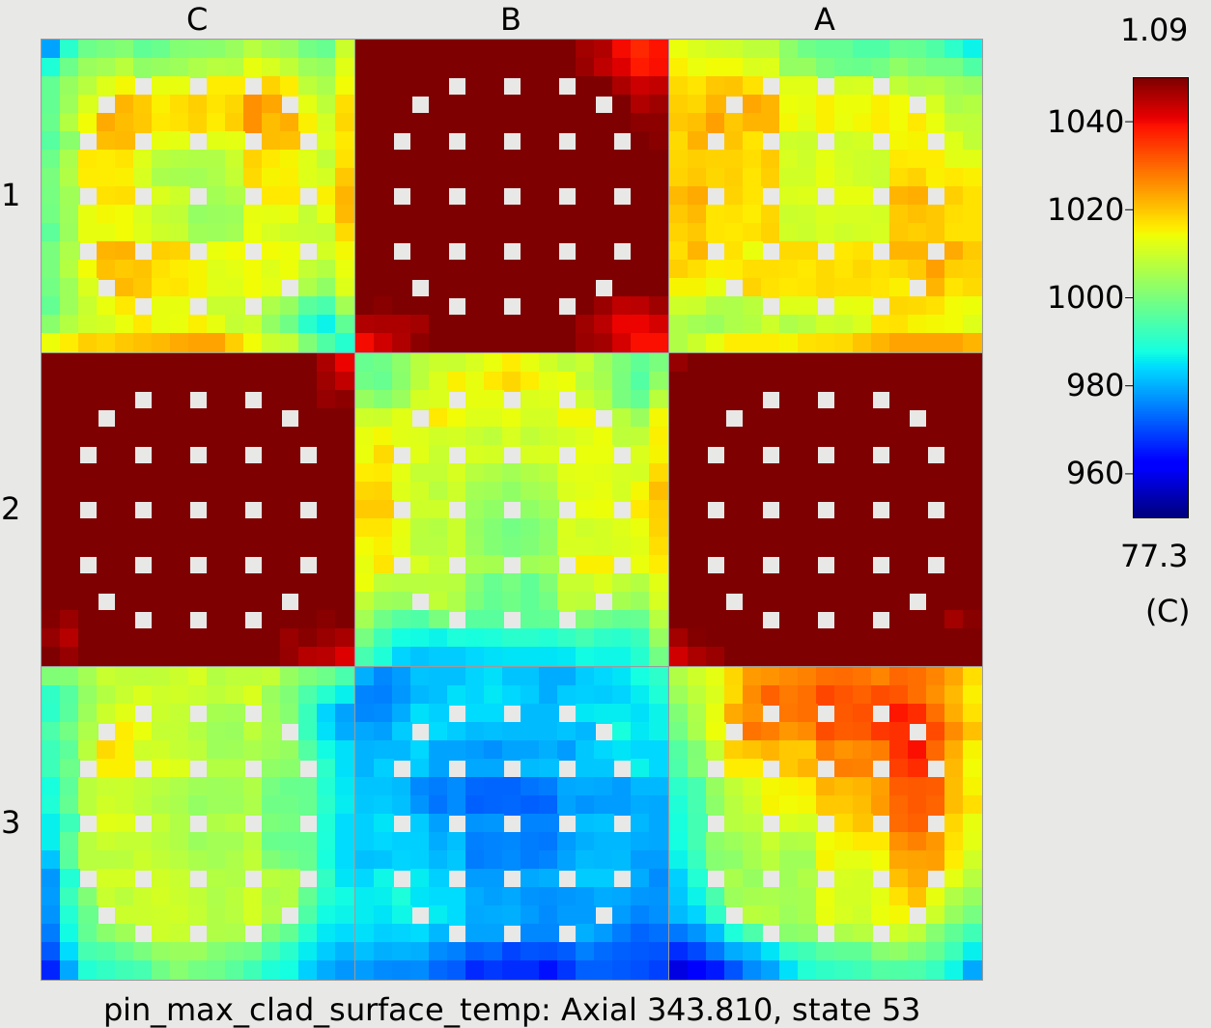
CTF
CTF is a three-field, two-fluid subchannel code derived from COBRA-TF
Validation matrix to support modeling of several applications:
Depletion in PWRs and BWRs
PWR RIA
PWR LBLOCA reflood
Time-at-temperature requires new assessment campaign
Validation for dryout and re-wet
Identify high-impact phenomena/models
Quantify model uncertainty

Slide 5
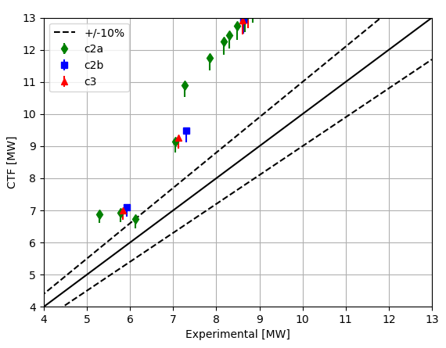
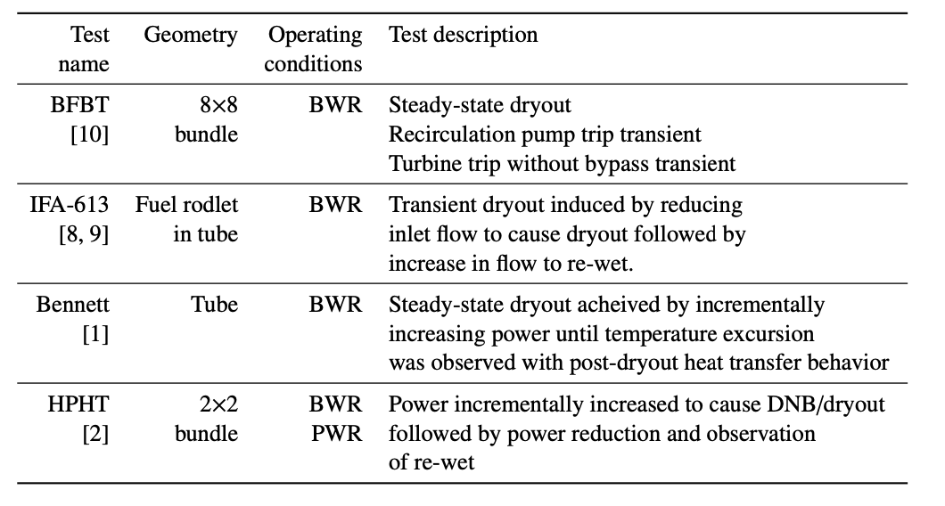
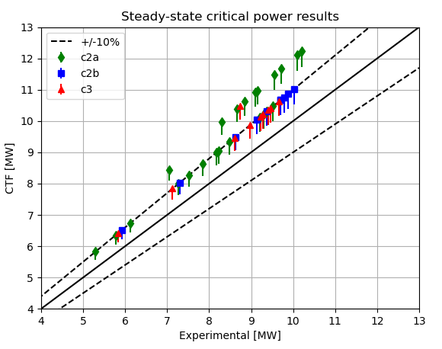
Addition of new validation tests
CTF legacy post-CHF model
Implementation of new post-CHF package improves prediction of BFBT critical power
Summary of current tests being considered for validation
Data is critical to model UQ and new data sources are being pursued
COBRA/TRAC post-CHF model

Slide 6
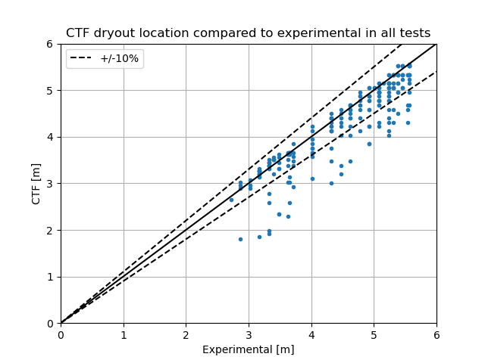
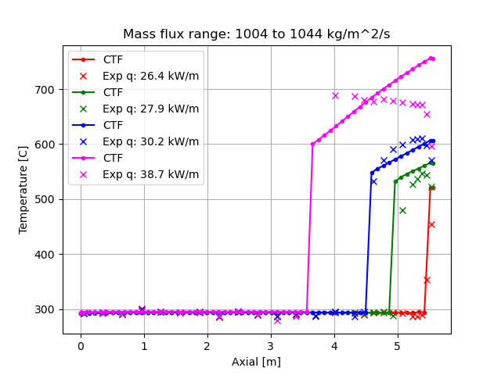
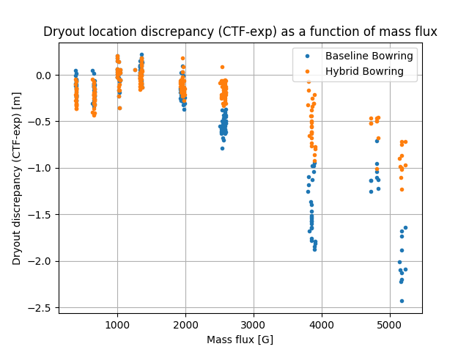
Addition of new validation tests
Harwell tests
Dryout and post-CHF heat transfer in tube geometry with uniform heating
Measurement of axial temperature profile
Dryout prediction improved with COBRA/TRAC heat transfer package
Reasonable dryout prediction for nominal BWR conditions
Development of ML CHF model improves prediction¹
Axial temperature profile prediction
1. Physics-informed machine learning model developed by A. Furlong at NCSU in university collaboration leads to improved dryout prediction

Slide 7
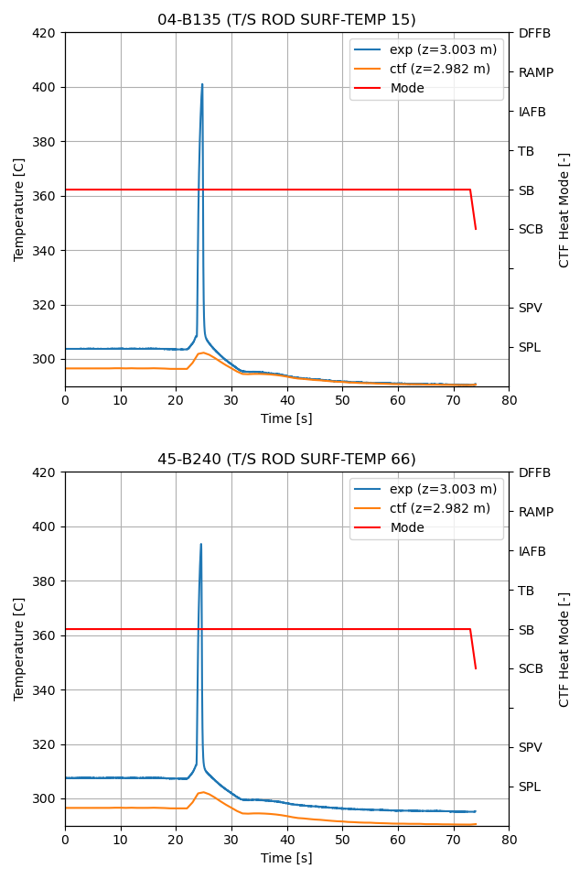
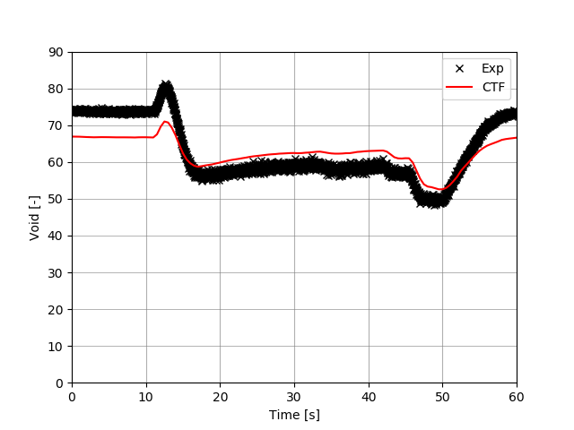
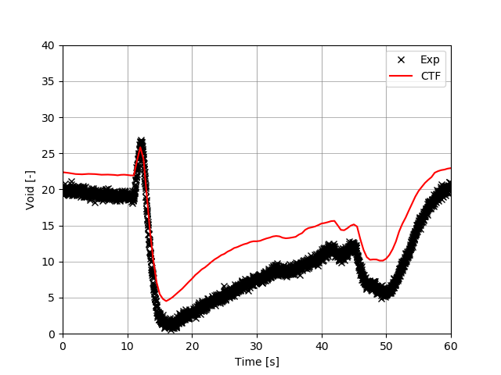
Validation testing: BFBT Turbine Trip
BFBT turbine trip simulates void collapse and power excursion
Reasonable prediction of void behavior
Failure to predict dryout
Consistent with bundle test behavior
CTF does not predict transition boiling
682 mm
1. Physics-informed machine learning model developed by A. Furlong at NCSU in university collaboration leads to improved dryout prediction

Slide 8
Sensitivity analysis
CTF models for dryout behavior
Dryout and rewet requires complex interaction of several phenomena
Uncertainty of clad temperature behavior is needed
Most impactful phenomena and underlying models must be determined
Uncertainty quantification can be determined utilizing inverse UQ
Feed forward UQ will be performed for AOOs of interest using these findings

Slide 9
Sensitivity analysis
CTF sensitivity parameters used
First high-level, then low-level
Sobol method and Gradient Boosted Regression used to determine importance
Interfacial heat transfer
Entrainment
Heat transfer (liquid)
CHF
x
Interfacial drag
Heat transfer (boiling)
x
Heat transfer (vapor)
High level
Low level
Small bubble
Nucleate boiling
Annular film
Slug
Inverted annular film boiling
Quench front
CHF
Dispersed
Droplet impingement
Hot film
Annular film
Droplet radiative
Bubbly
Annular drop
Vapor convection

Slide 10
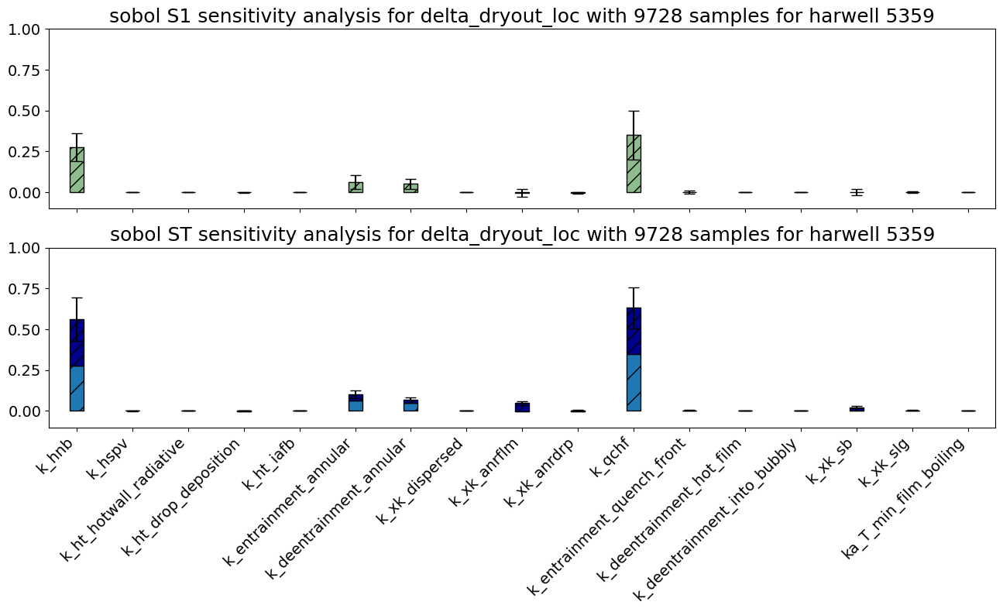
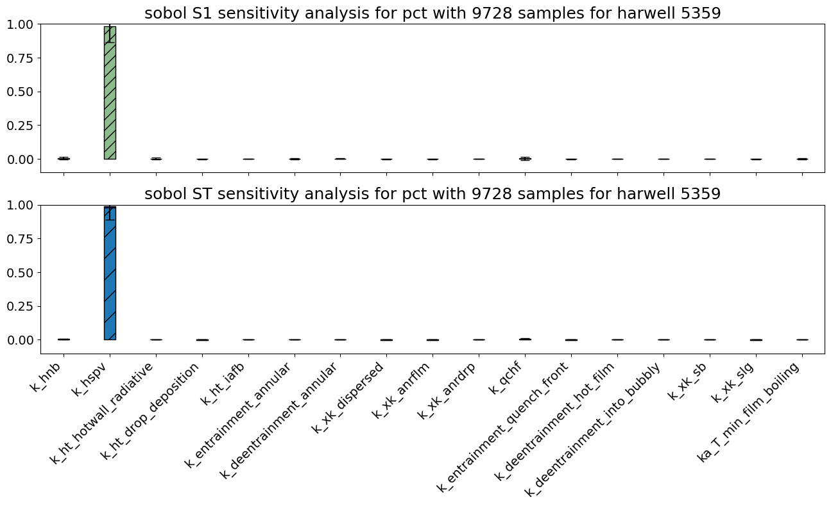
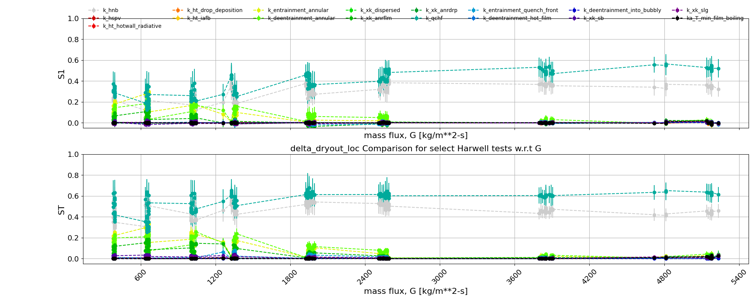
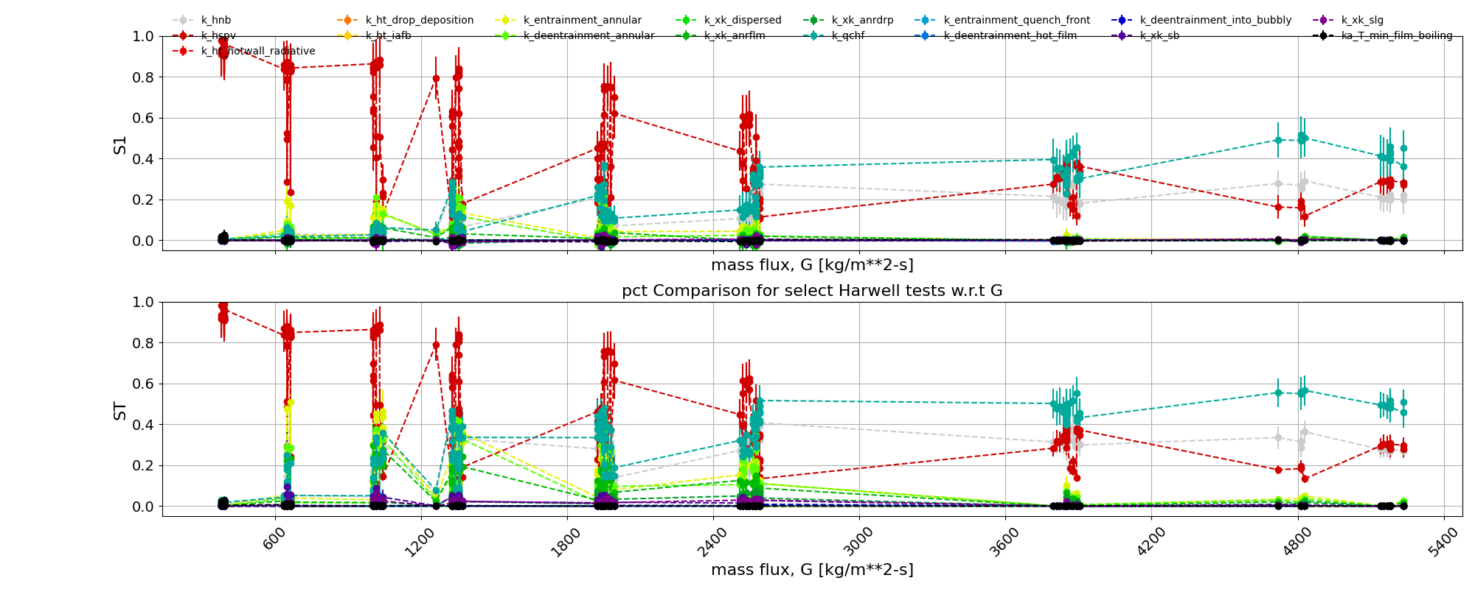
Steady-state CHF: Harwell
FOM: Dryout location
FOM: PCT
High level analysis can eliminate parameters from consideration
Parameters of importance change based on flow conditions.
High level analysis can eliminate parameters from consideration
Boiling heat transfer
CHF model
Vapor heat transfer
CHF model
Vapor heat transfer
Boiling heat transfer

Slide 11
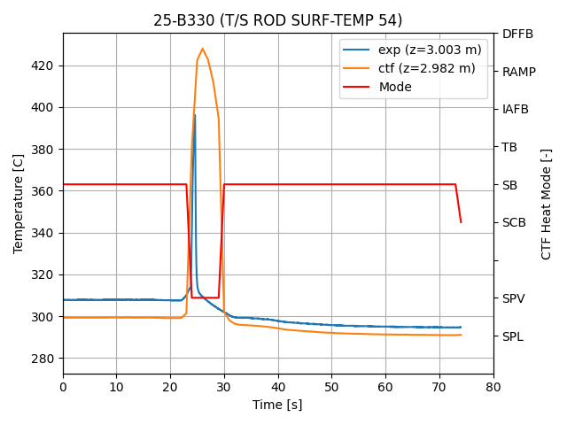
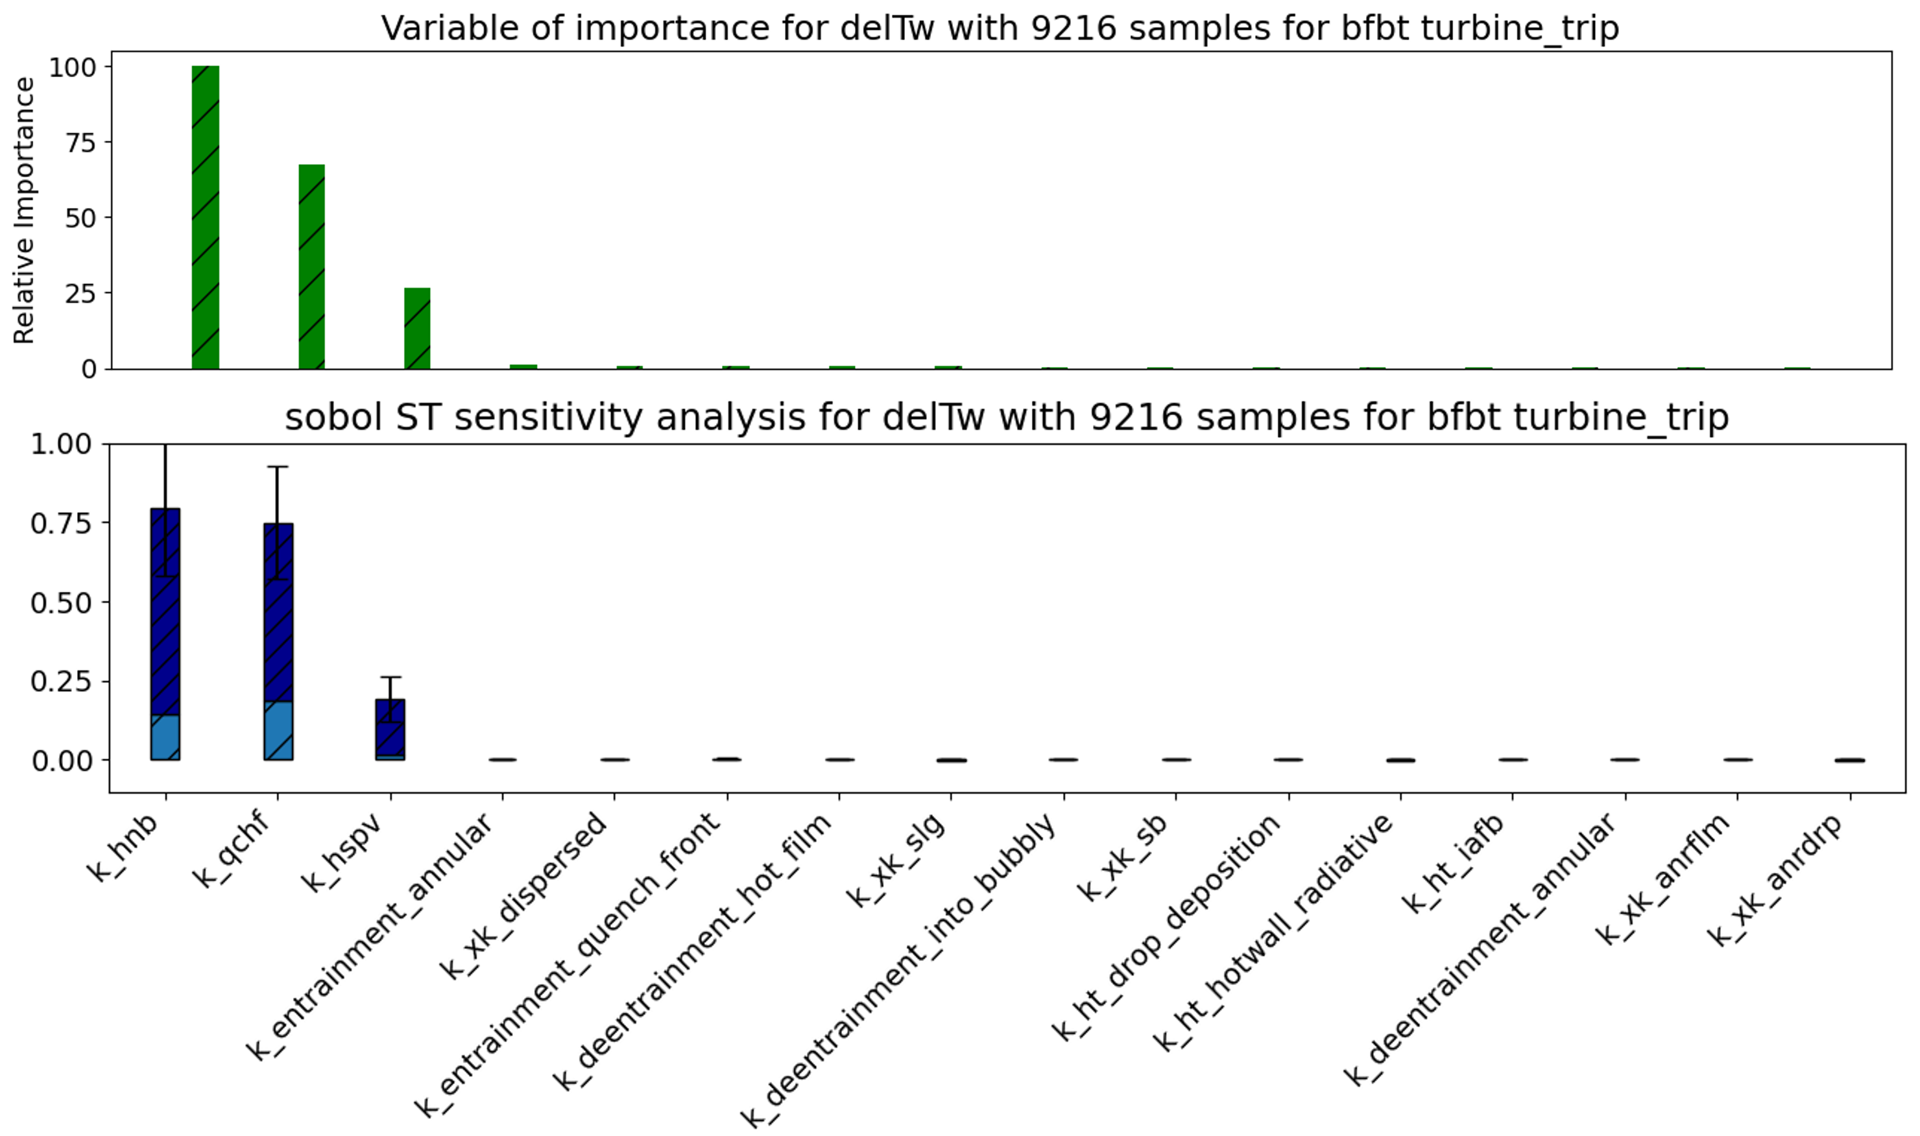
BFBT Turbine Trip
Boiling heat transfer and CHF, set dryout criteria
FOM: ∆T_{w,rmse}
Vapor convection heat transfer dominates PCT prediction
Cases with lower boiling heat transfer, higher CHF, and higher vapor heat transfer leads to better agreement
This highlights model in need of improvement, and the magnitude of changes needed
Similar phenomena rankings determined for BFBT and Harwell

Slide 12
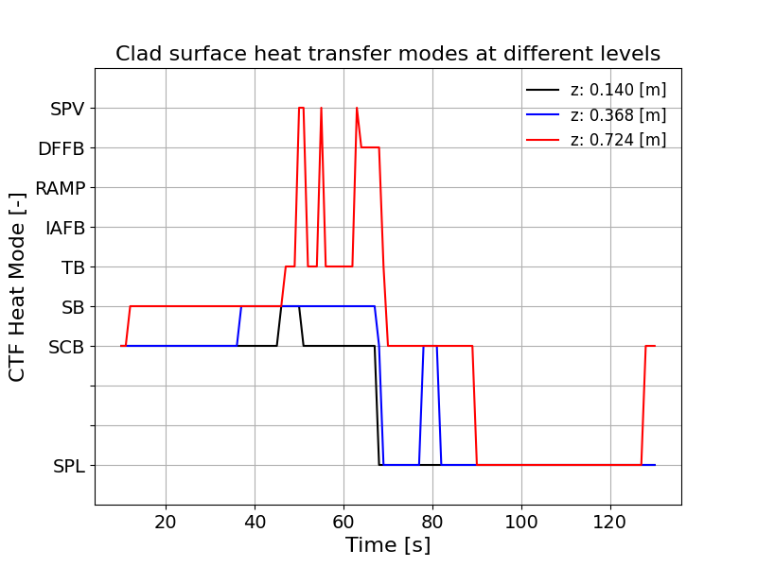
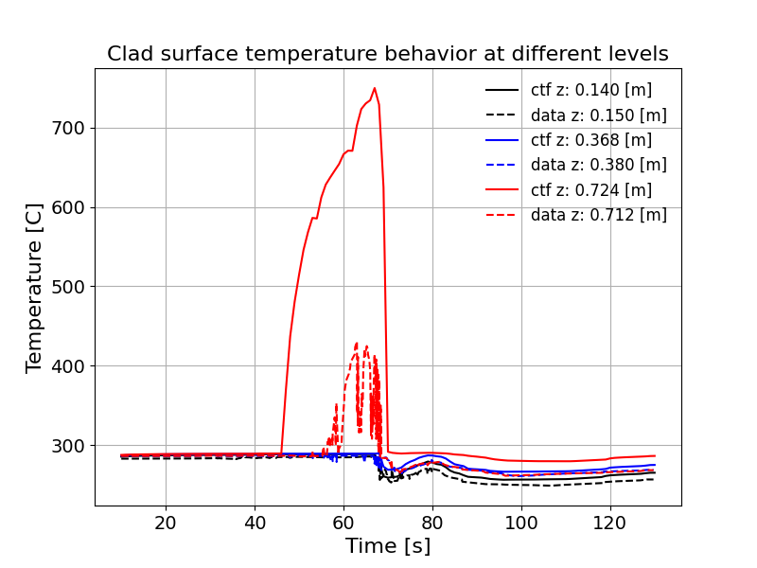
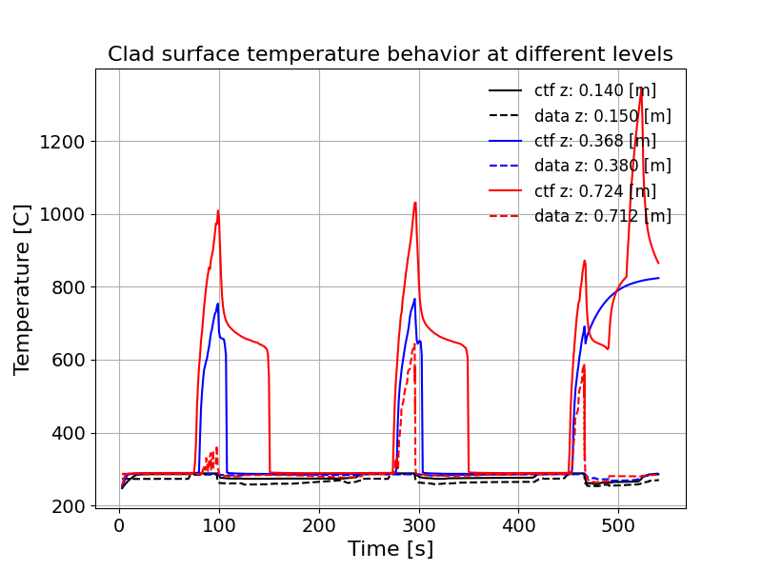
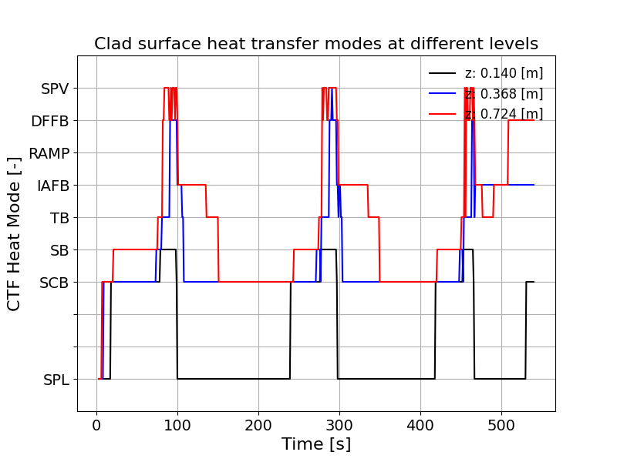
IFA613^{1,2}
Instrumented fuel rodlets in Halden test rig with very low flow
Vary flow to cause transient dryout and re-wet in 26 different tests
CTF now over-predicts PCT and duration
Opposite trend of BFBT TT highlights the importance of test conditions
Case 6
Case | LHGR [kW/m] | Subcooling [K] | DO time [s]
6 | 13.6 | 51 | 3
11 | 7.0 | 55 | 47
Case 11
M. Limback and R. Ianiri, “Dryout Fuel Behavior Tests in IFA-613.1”, OECD Halden Reactor Project, HWR-493, 1997.
Y. Broy, W. Wolfgang and L. A. Moen. “The OECD Halden Reactor Project-international research on safety and reliability of nuclear power generation.”, 2001.

Slide 13
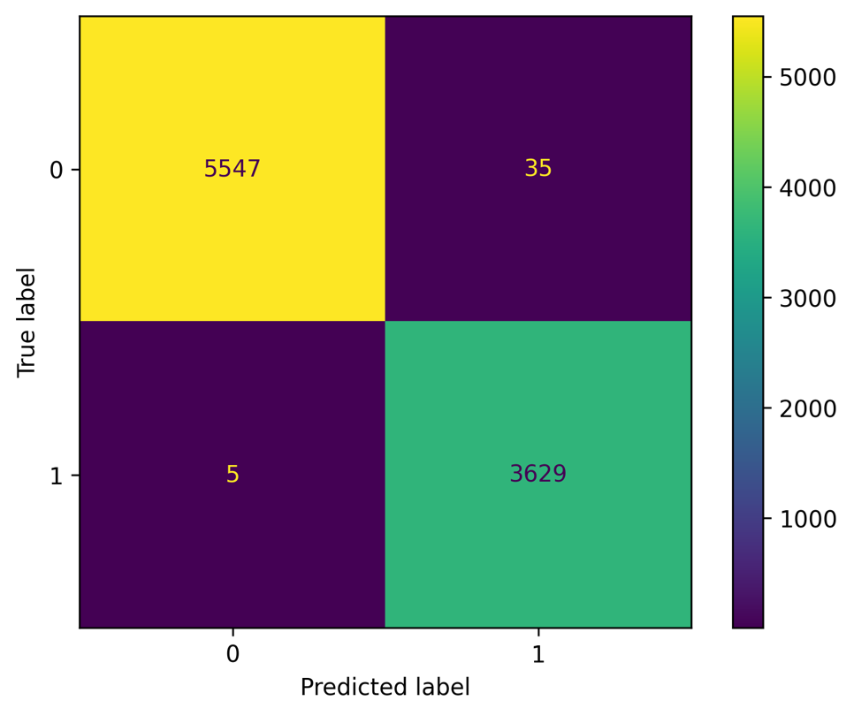
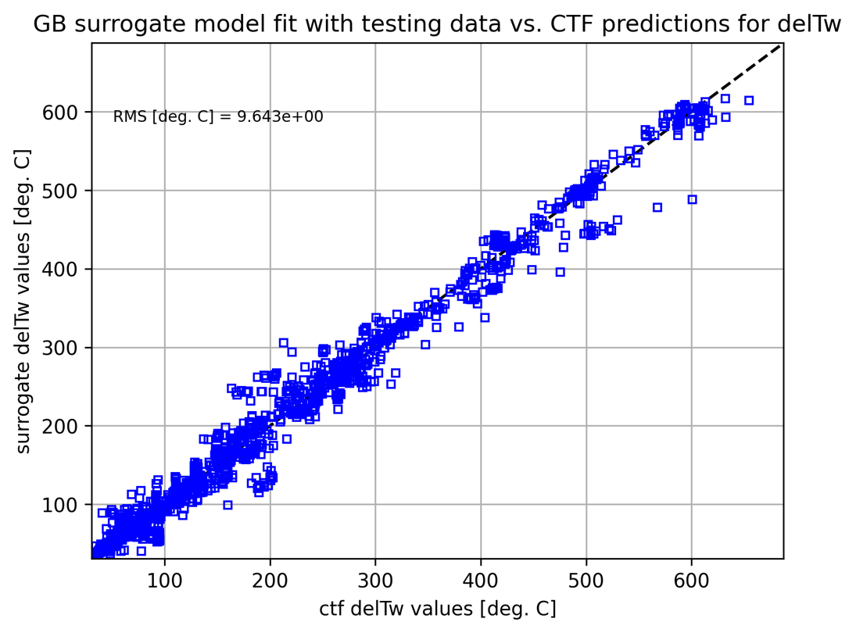
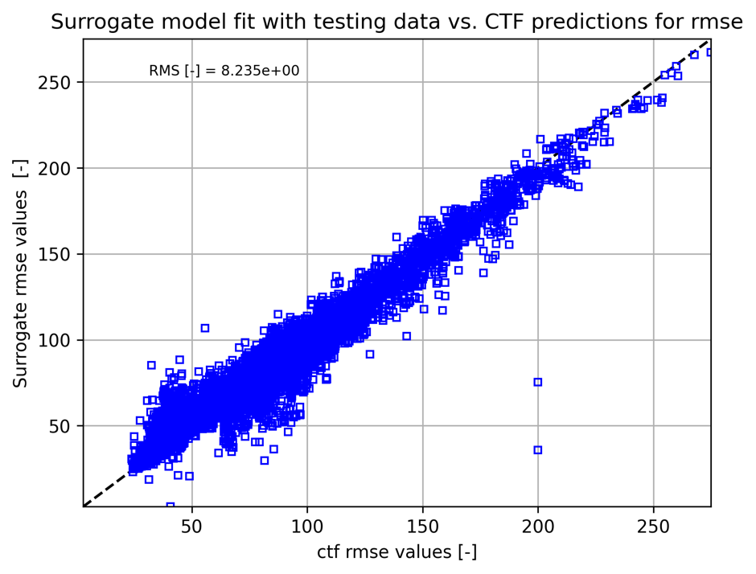
Surrogate building
Use Bayesian inference to formally quantify model uncertainties using experimental data
Requires huge number of simulations O(100k)
Generating code surrogates may be needed to ensure reasonable turnaround time
Testing building surrogates for BFBT, Harwell, IFA613
BFBT prediction of dryout occurrence
Harwell
BFBT turbine trip

Slide 14
Conclusions
NEAMS is employing a strategy to support t@T deployment
Using advanced sensitivity and UQ techniques to quantify phenomena importance and model uncertainty
Performing validation to assess model accuracy
Improving on high uncertainty, high impact models
Supporting high-fidelity, multiphysics modeling of relevant transients for t@T
Preliminary sensitivity analysis and validation has been performed to assess model accuracy and determine important models
Phenomena of high importance are beginning to emerge, but further consideration of the range of testing conditions is needed

Slide 15
Future activities
Expand sensitivity analysis
Cover all conditions of interest in Harwell
Perform sensitivity analysis for BFBT pump trip test
Perform refined analysis for all test cases
Expand validation
BFBT pump trip, IFA613, UW HPHT tests
JAERI 4x4 bundle tests and upcoming UW transient dryout tests are promising
More data is always needed
Develop matrix of test conditions and model importance
Demonstrate the model UQ framework

