Slide 1
Thermal-fluid Area Overview
NEAMS Annual Review: Molten Salt Reactors
May 28th, 2025
Elia Merzari, Rui Hu

Slide 2
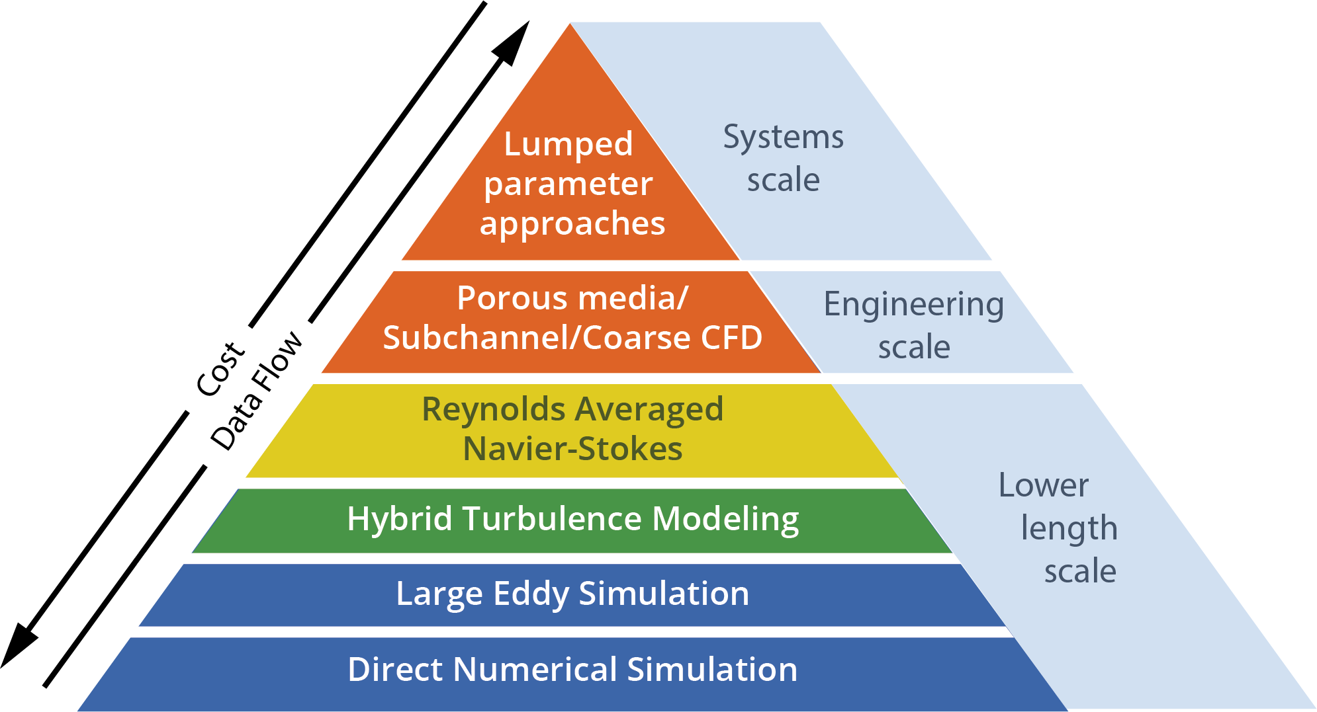
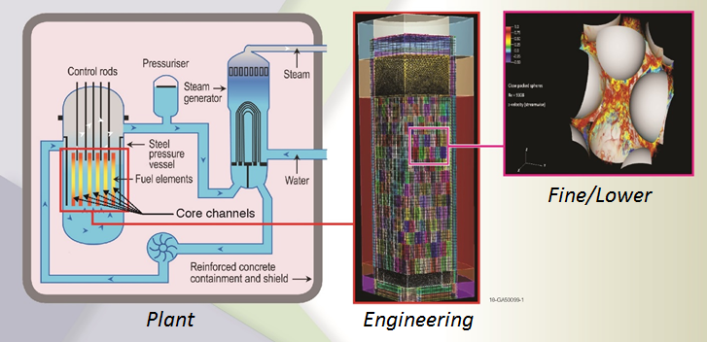
Thermal-hydraulics modeling in NEAMS - I
The thermal-hydraulic technical advances the state of the art of thermal-hydraulic simulations by researching novel new solution strategies for challenging real-world heat and fluid flow issues that affect advanced reactor designs or still affect the current fleet of deployed Light Water Reactor nuclear reactors.
The economics of most advanced reactor designs relies on achieving higher temperatures that the current fleet.
This poses severe challenges in terms of materials and puts an onus on thermal-hydraulic models to provide accurate assessment of hot spots.
A reduction of uncertainty on thermal-hydraulic prediction has potential for a substantial economic benefit and to ultimately accelerate deployment.
Thermal and Fluid Flow phenomena involve a wide range of length and time scales
Resolving all scales for a realistic engineering system of interest is often computationally not feasible.
On the other hand, if scales are not resolved, closures need to be provided to ensure reasonable accuracy, as all scales contribute to the dynamics.
Multiscale/multi-resolution simulation hierarchy

Slide 3
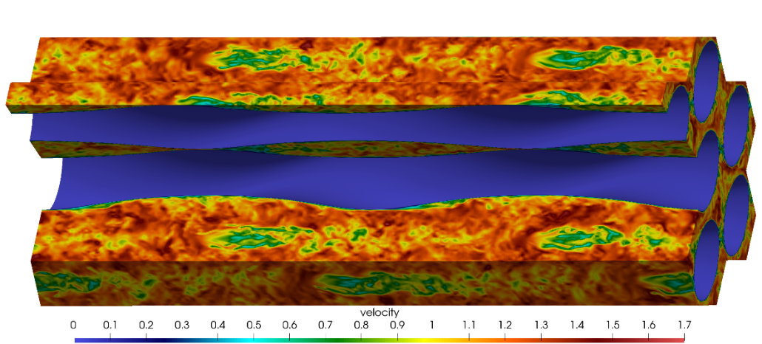
Thermal-hydraulics modeling in NEAMS - II
SAM
Trustworthy and practical plant-level system analysis tool for advanced reactors
Advances in software environments and design, numerical methods, and physical models thanks to MOOSE.
Pronghorn
Engineering scale environment build on MOOSE
Coarse CFD, subchannel and distributed resistance
Nek5000/NekRS/Cardinal
Open Source, Spectral element high-fidelity code
Proven scalability beyond a million MPI ranks (Gordon Bell prize). Now GPU-capable (NekRS).
Extensive code verification and validation
Couples to MOOSE and OpenMC through Cardinal
Sockeye
Engineering scale heat-pipe heat transfer code.
Relies on THM module of MOOSE.
CTF
LWR subchannel code.
Part of VERA.
Flow in a twisted tube HX.
Plant
Scales
Engineering Scales
Fine
Scales
System
Codes
Sub-channel
Reduced-order models
Porous
media
modeling
Momentum
Sources
(Coarse CFD)
RANS
CFD
Hybrid
CFD
LES
/DNS
System Analysis Module
(SAM)
Pronghorn
Nek5000

Slide 4
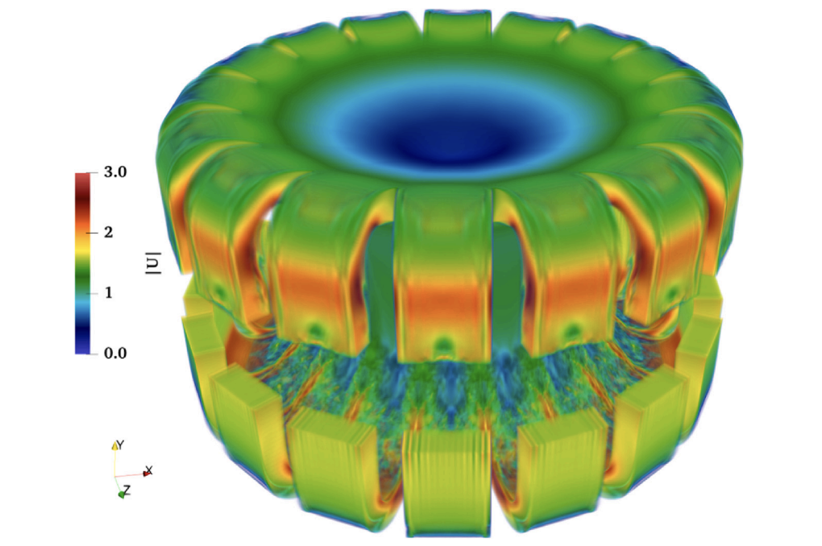
Unique Capability
CFD modeling capability for MSR cores at high fidelity
Example: MSFR
Comparisons against available data and correlations.
Can be used to assess applicability of correlations, turbulence models and improvements to both (see presentation today)
Excellent scaling and performance on leadership class computing architectures (Aurora, Frontier).
Flow in a MSFR core (Large Eddy SImulation).

Slide 5
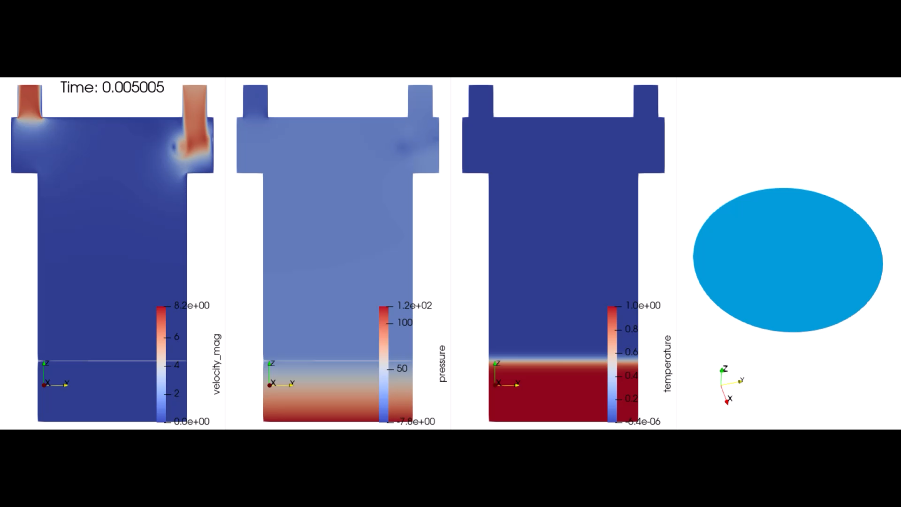
Thermal-fluids presentations today
Enhancement on Species Transport Modeling in SAM and Coupling to Saline and Mole (Bob Salko)
Improvements in Pronghorn for MSR modeling, including overlapping domain coupling with SAM for multiscale modeling (Mauricio Tano)
For questions contact me at ebm5351@psu.edu
CFD Simulation of Air-jet impaction on molten-salt surface. Subsequent application: O₂ ingression in molten-salt

Slide 6
Enhancement on Species Transport Modeling in SAM and Coupling to Saline and Mole
NEAMS Annual Review: Molten Salt Reactors
May 28th, 2025
Bob Salko, Travis Mui, Rui Hu

Slide 7
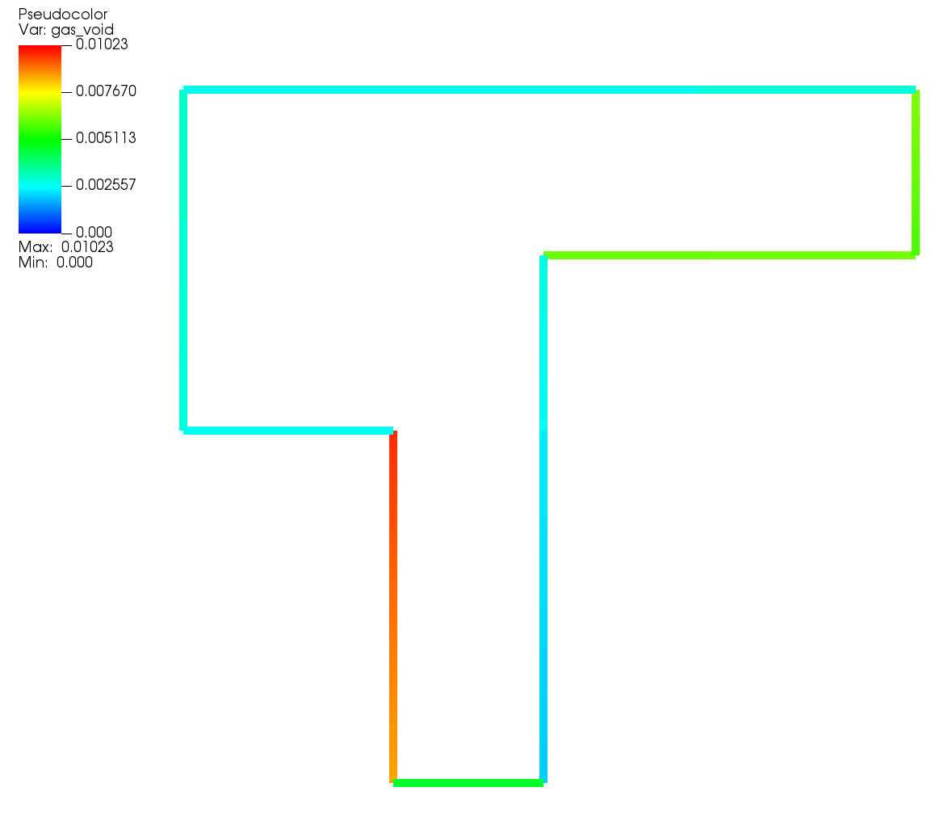
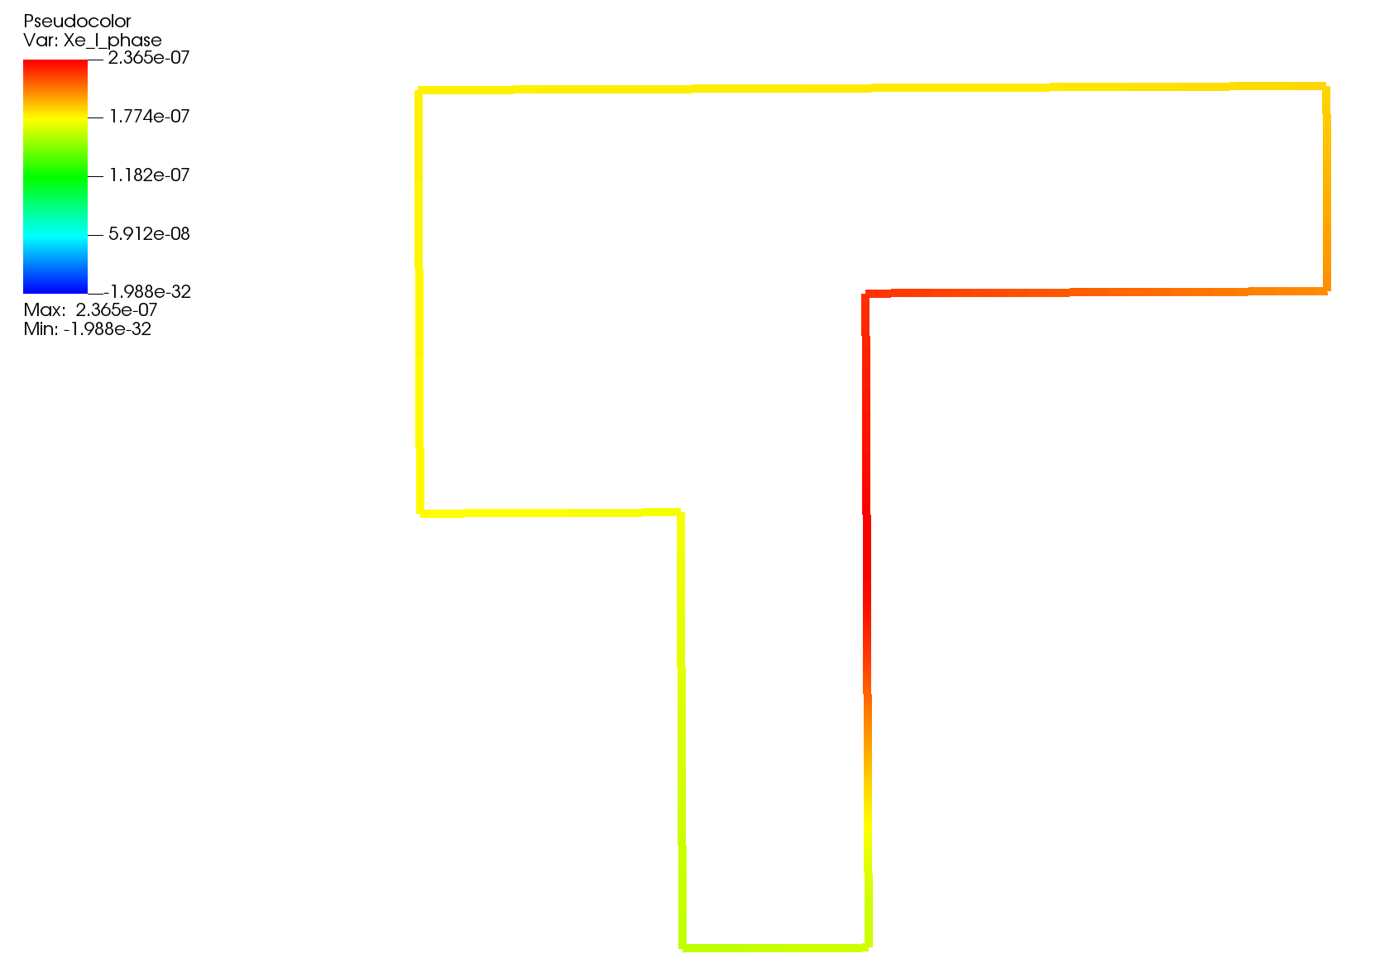
Introduction
A modern system analysis code for advanced non-LWR safety analysis
Covers almost all non-LWR concepts
Ongoing efforts to develop SAM for MSR applications
Salt thermophysical properties
Salt freezing
Species tracking for delayed neutron precursors and fission products in both salt and sparge gas
Species decay and decay heat
Species phase transfer
Modeling of non-condensable gas transport
Validation using MSRE, MSR Campaign data, and open two-phase data
Prediction of void distribution (top) and salt xe-135 distribution (right) in MSRE¹
1. T. Mui, et al. “SAM Code Improvements for Molten Salt Reactor Transient and Species Transport Modeling”, ANL/NSE-24/73, 2024.

Slide 8
Species Tracking in SAM
Generic species (passive scalar) transport originally implemented in SAM to model flowing delayed neutron precursors in MSRs
Framework expanded to simulate transport pathways of tritium in FHRs and MSRs
Ongoing work to consider additional applications:
Oxidation-corrosion in lead-cooled reactors
Redox corrosion in salt-cooled reactors
Noble gas/metal transport in MSR
Species transport pathways modeled in SAM

Slide 9
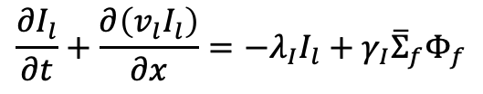
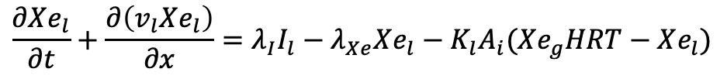
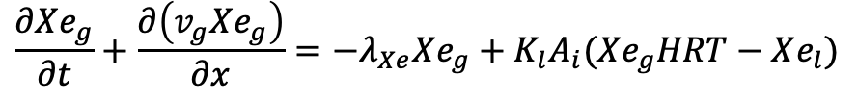
Enhancements to Species Tracking
Fission source from Griffin
Species can now exist in the gas phase
Transported by gas velocity
Phase transfer using Henry’s Law for high-volatile gas
Henry and mass transfer coefficient calculated by Mole
Interfacial area and gas velocity by SAM
Capture decay between species
$$\frac{∂I_{l}}{∂t}+\frac{∂\left(v_{l}I_{l}\right)}{∂x}=−λ_{I}I_{l}+γ_{I}{\overline{Σ}}_{f}Φ_{f}$$
Track decay from one species to another
$$\frac{∂Xe_{l}}{∂t}+\frac{∂\left(v_{l}Xe_{l}\right)}{∂x}=λ_{I}I_{l}−λ_{Xe}Xe_{l}−K_{l}A_{i}(Xe_{g}HRT−Xe_{l})$$
Mass transfer data from Mole
Added phase transfer term
$$\frac{∂Xe_{g}}{∂t}+\frac{∂\left(v_{g}Xe_{g}\right)}{∂x}=−λ_{Xe}Xe_{g}+K_{l}A_{i}(Xe_{g}HRT−Xe_{l})$$
Species can exist in gas phase
Bubble behavior predicted by SAM
v_{g}
a_{i}
c_{g}
Phase transfer
c_{l}

Slide 10
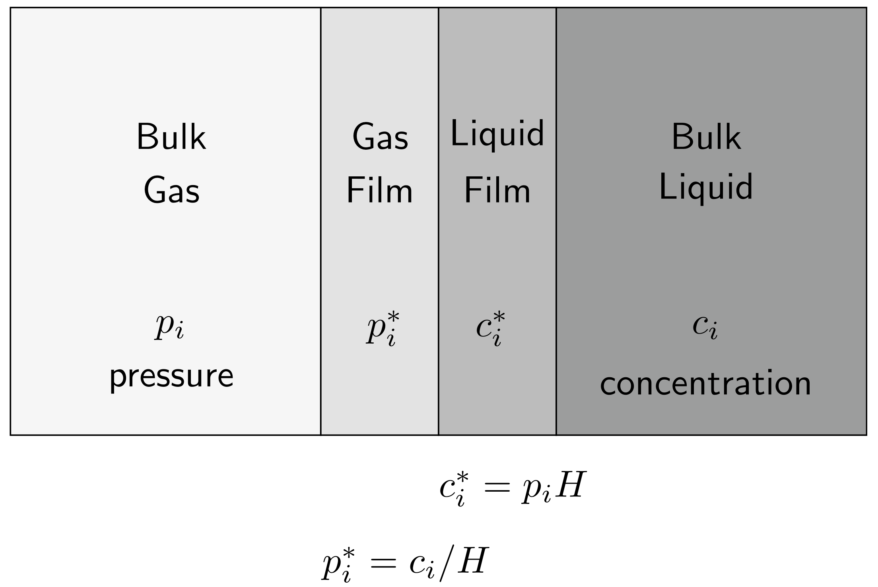
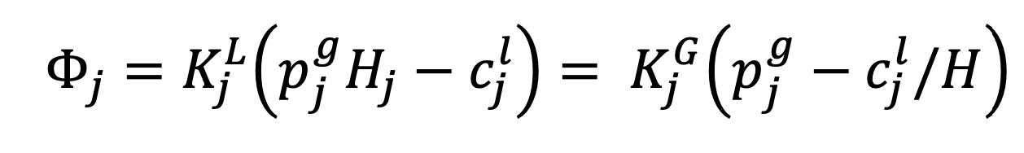
Coupling to Saline and Mole
Mole provides modeling of high-volatile species phase transfer¹
Utilizes two-film theory
Provides Henry coefficients for FLiNaK and FLiBe salts and several noble gases
Mass transfer coefficient determined using Wilke-Chang or Stokes-Einstein¹
Saline is a C++/Fortran/Python interface to MSTDB-TP
Integrated into MOOSE and SAM
Provides thermophysical properties of many common salts and salt compositions
Gas liquid interface modeled using two-film theory
Interface concentrations determined using Henry’s Law
1. K. Lee, W. Williams, J. McFarlane, D. Kropaczek, and D. de Wet, “Semi-empirical model for Henry’s Law Constant of Noble Gases in Molten Salts”, Nature Portfolio, 14:12847, 2024, https://doi.org/10.1038/s41598-024-60006-9.

Slide 11
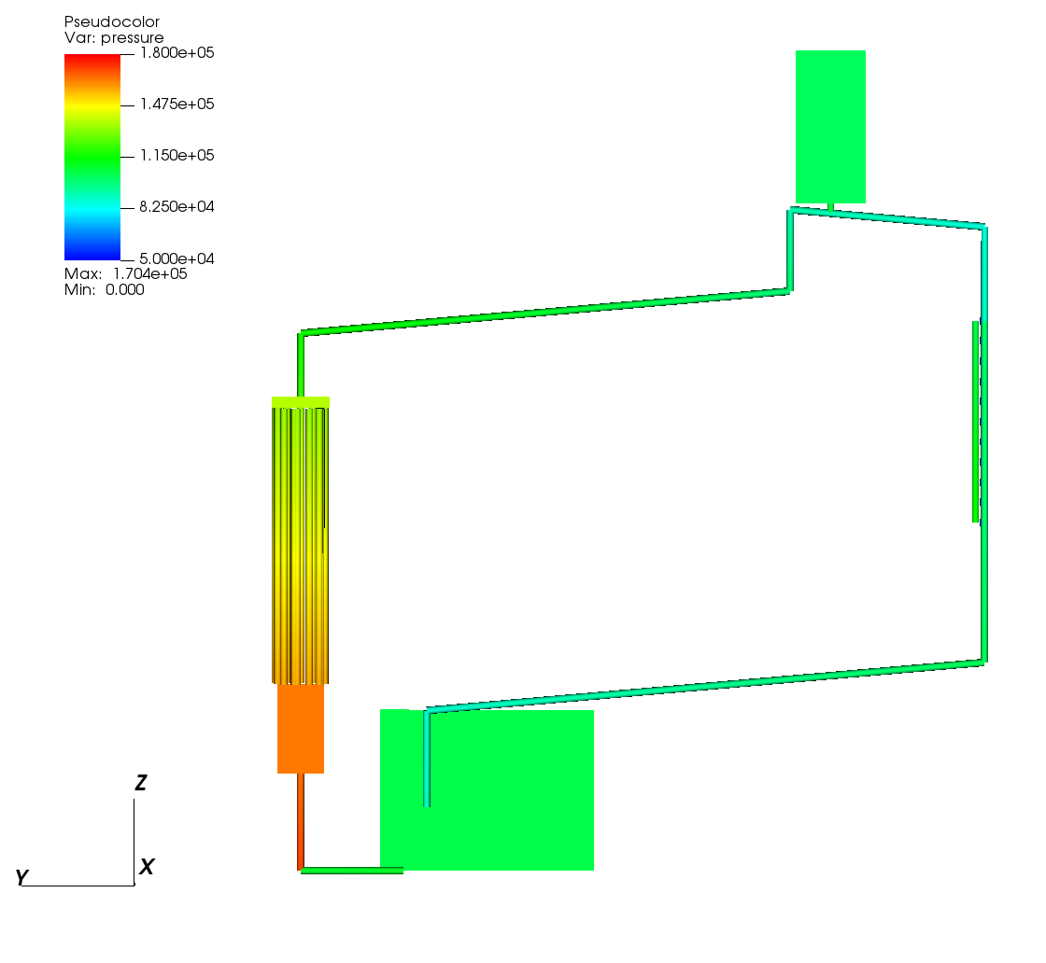
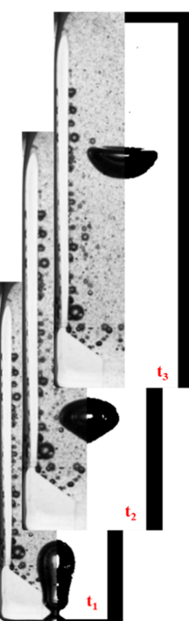
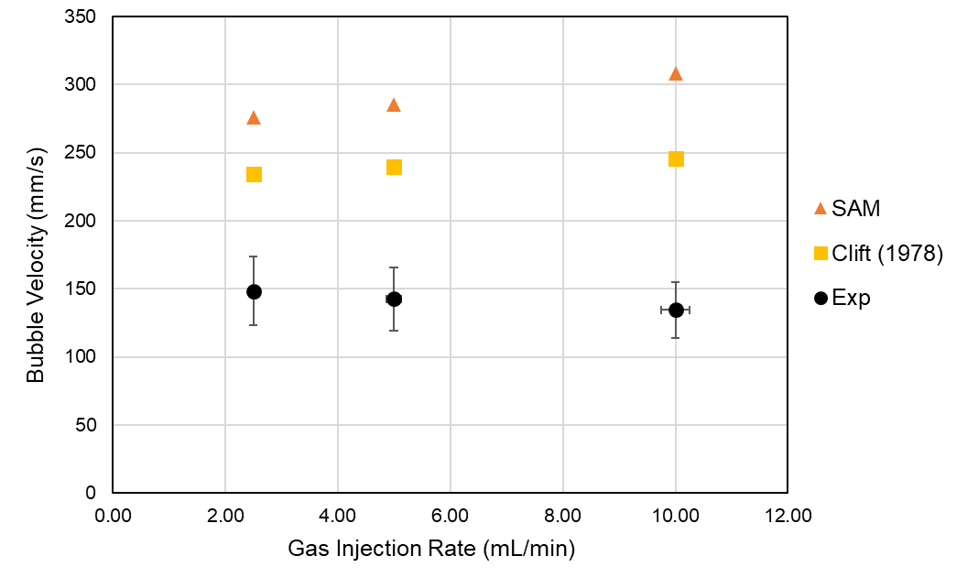
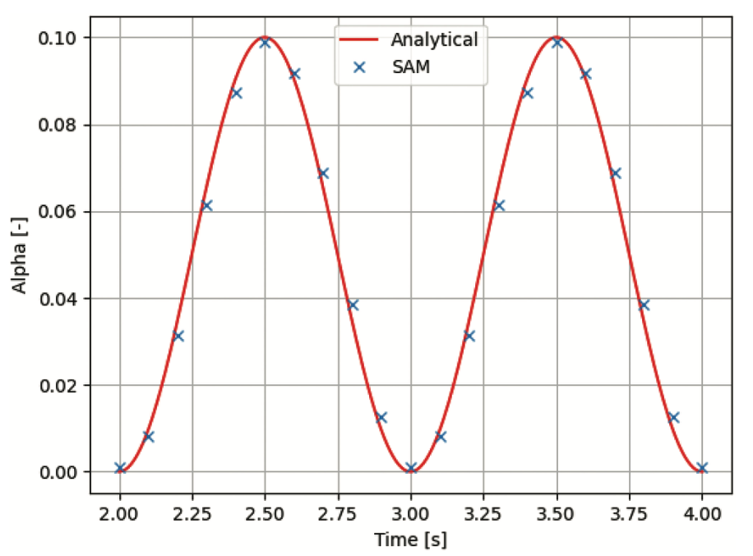
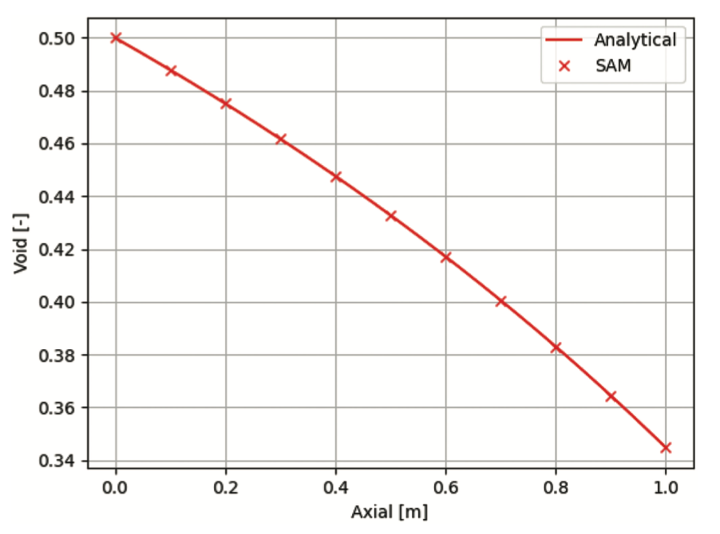
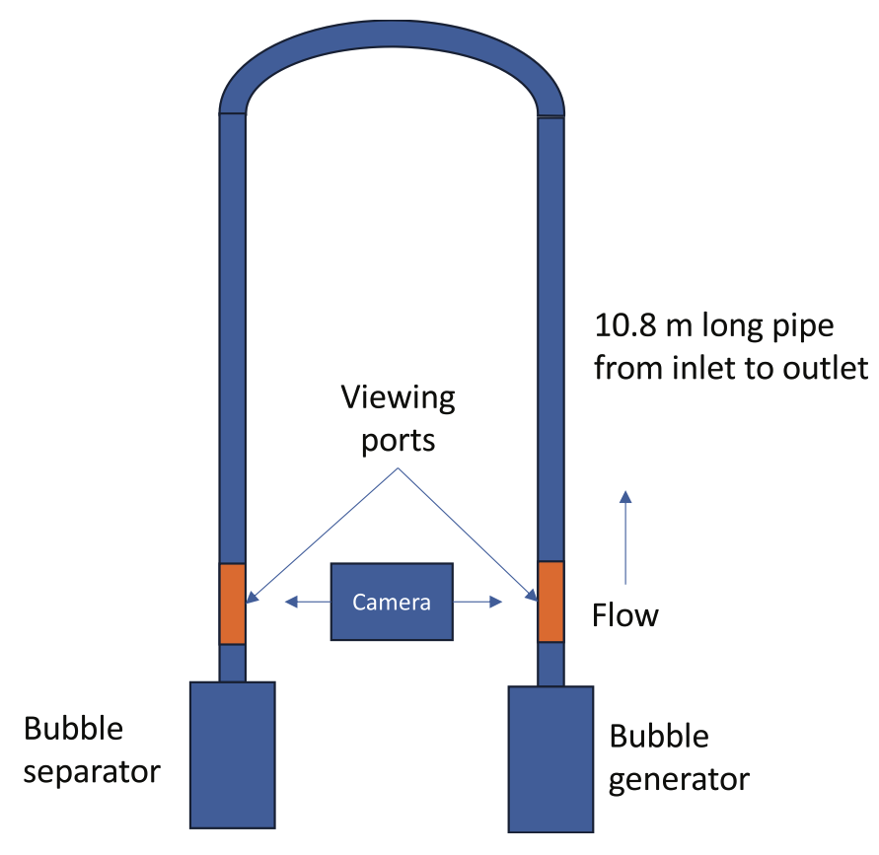
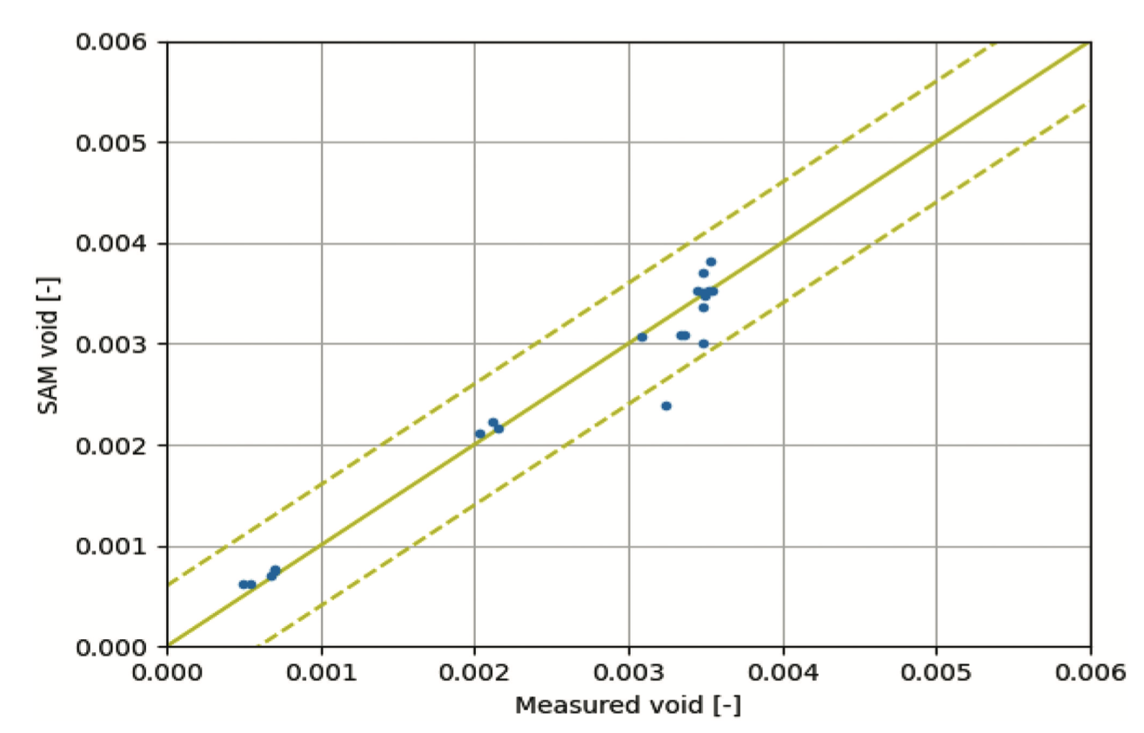
Validation activities
t₃
t₂
Modeling of experiments of bubbles rising in molten salt¹
t₁
Modeling of void fraction in Kress experiment³
Development of verification test suite for gas transport model³
Modeling of pressure drop in LSTL²
McFarlane, J., et al. “Design of Instrumentation for Noble Gas Transport in LSTL Needed for Model Development” Report. ORNL TM-2023-3138 (2023).
Yoder, G., et al. “Development of a forced-convection liquid-fluoride-salt test loop”, Proceedings of HTR, 2010
Salko, R, et al. “Implementation of a Drift Flux Model into SAM with Development of a Verification and Validation Test Suite for Modeling of Noncondensable Gas Mixtures”, Nuclear Technology, 2024

Slide 12
Modeling of Off-Gas System
Model pool-type MSR
Bubble generation due to xenon creation and phase transfer
Species and bubble transport affects fission gas concentration in pool region
Bubble buoyancy leads to escape at pool surface
Depletion determines fission product inventory
Coupled system being utilized for prediction of off-gas of fission products plus uncertainty

Slide 13
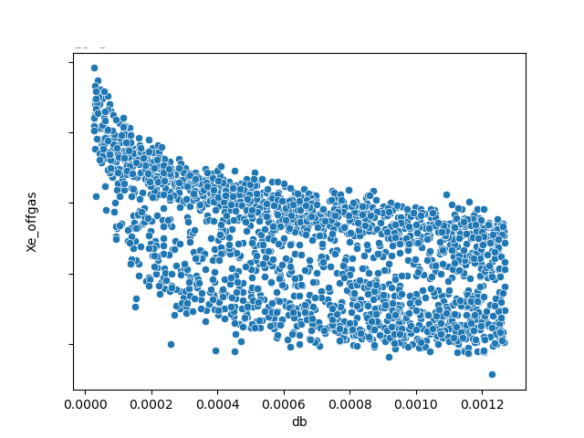
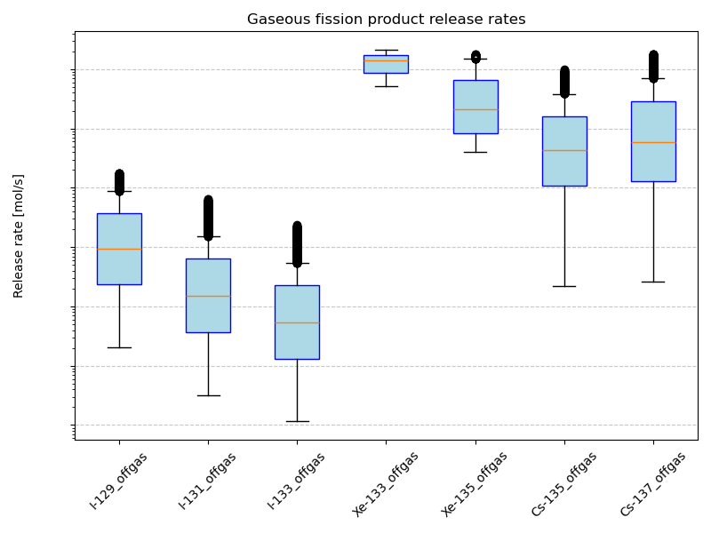
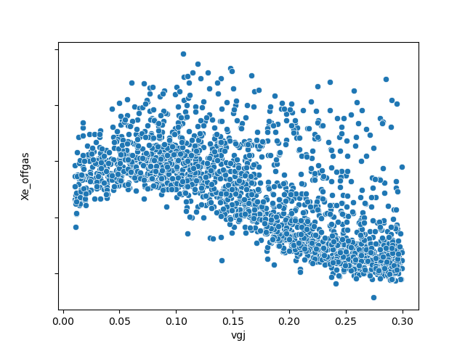
Uncertainty Quantification of Offgas
Forward UQ analysis of off-gas modeling
Variation of 15 input parameters
Nuclear data, thermophysical fluid properties, mass transfer data, bubble behavior
Xenon, cesium, and iodine off-gas rate are figures of merit (FOM)
5,000 evaluations of coupled analysis lead to convergence of FOMs
Bubble velocity uncertainty obtained from MSR Campaign data¹
Spread in off-gas release rates due to input uncertainties
Bubble terminal velocity, bubble diameter, and thermochemical data found to be potentially high importance
Relationship between input parameters and off-gas rates
1. D. Orea, K. Robb, J. McFarlane, Optical Measurements of Gas Bubble Rise Velocity in Molten LiCl-KCl, in press., 2025

Slide 14
Summary
Species and gas transport modeling capabilities expanded in SAM for modeling of MSRs
Ability to track gaseous species using drift flux
Ability model phase transfer, decay between species, and bubble release
Demonstration of capabilities shown by performing fission gas release uncertainty analysis
Model will be expanded including coupling with Thermochimica, bubble modeling improvements based on MSR Campaign data, graphite xenon absorption, and improved coupling for depletion

Slide 15
Acknowledgements
Demonstration of NEAMS tools for MSR UQ analysis has been funded by a US DOE iFOA project in collaboration with Terrestrial Energy, USA

Slide 16
Improvements in Pronghorn for MSR modeling, including overlapping domain coupling with SAM for multiscale modeling
NEAMS Annual Review: Molten Salt Reactors
May 28th, 2025
Mauricio Tano, Ramiro Freile, Mengnan Li, Victor Coppe Leite, Peter German, Joshua Hansel, Lise Charlot

Slide 17
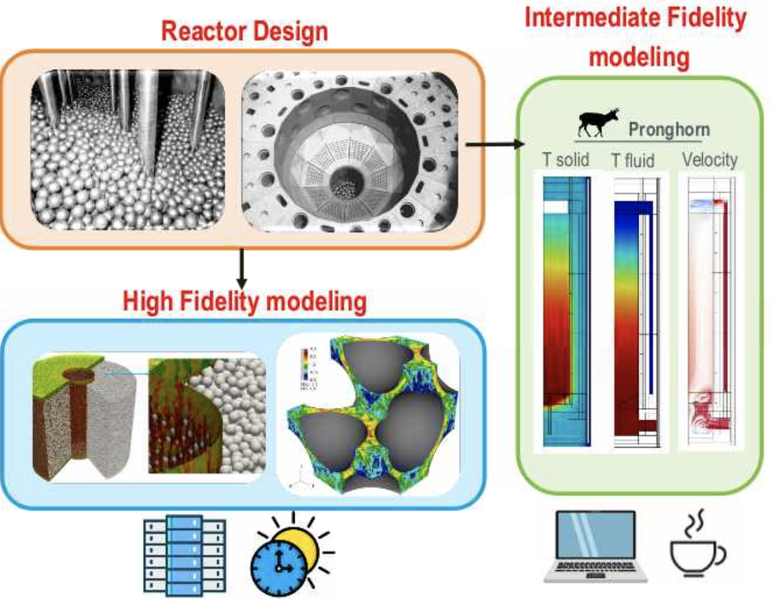
Pronghorn
Pronghorn: Intermediate-fidelity multidimensional coarse-mesh CFD code
Capabilities:
Coarse-mesh CFD with finite volume discretization
Incompressible or weakly compressible flows
Porous flow modeling with a wide range of correlations
RANS turbulence modeling with several turbulence models
Two-phase flow modeling
Straightforward coupling to neutronics and other physics within the MOOSE framework
Level of resolution appropriate for full core modeling

Slide 18
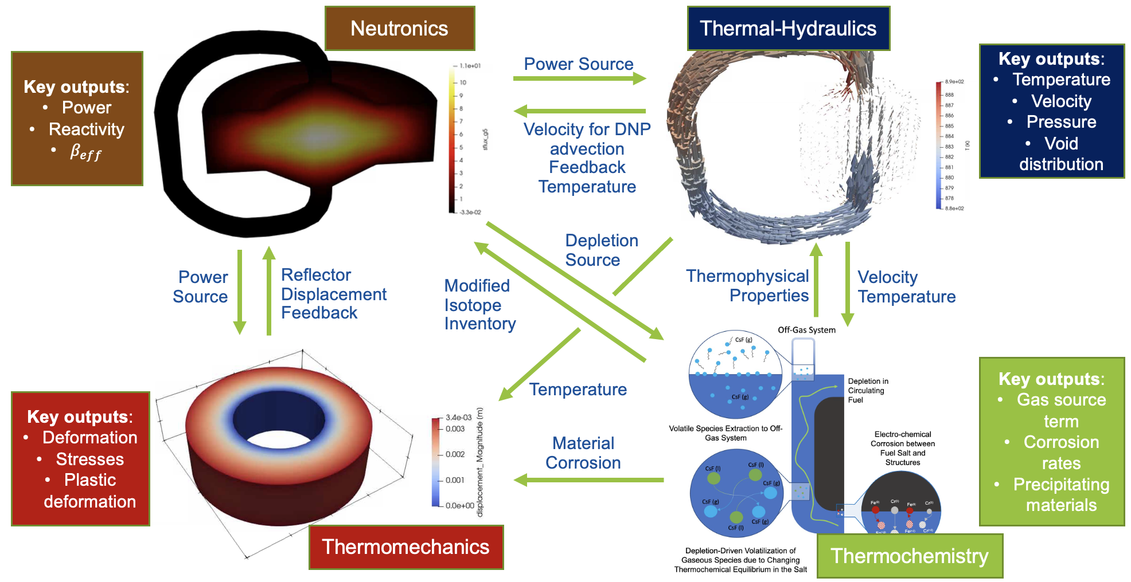
Pronghorn’s Role in MSR Multiphysics Framework
Pronghorn
SAM
Nek5000/NekRS

Slide 19
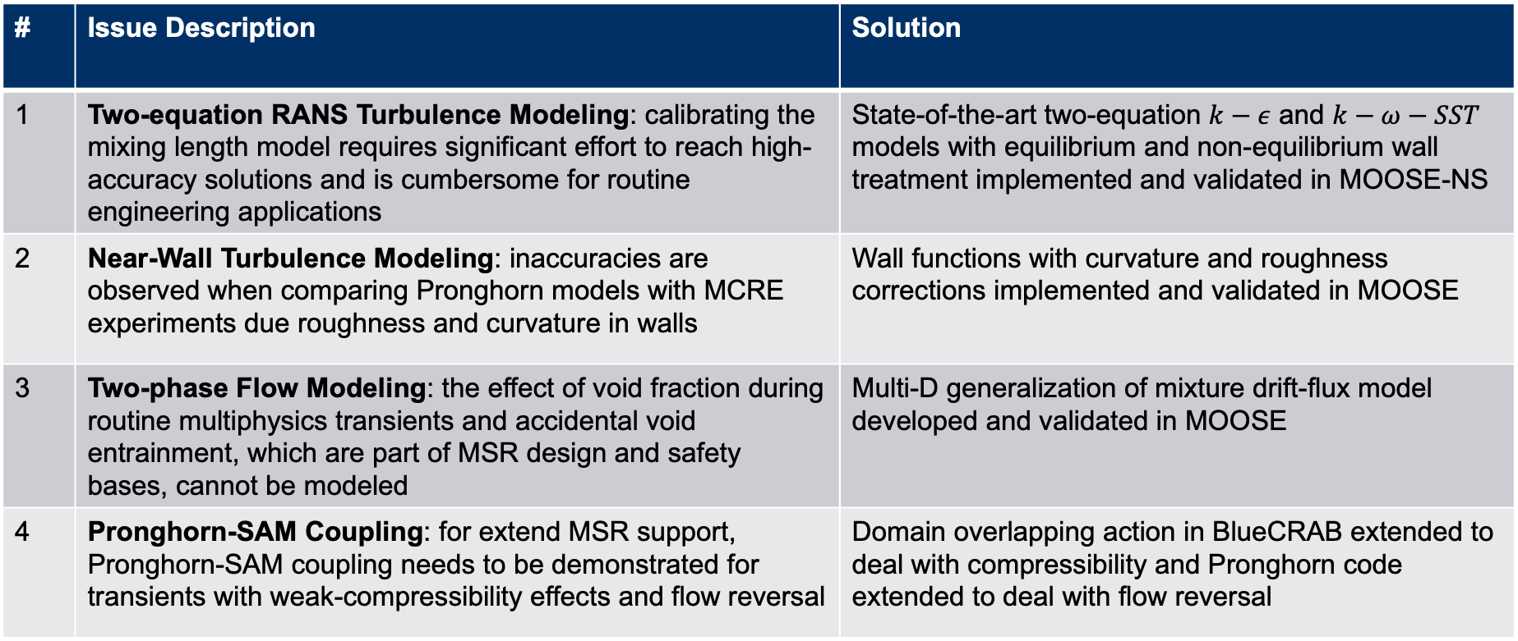
Key TH Improvements in Pronghorn for MSR Modeling
# | Issue Description | Solution
1 | Two-equation RANS Turbulence Modeling: calibrating the mixing length model requires significant effort to reach high-accuracy solutions and is cumbersome for routine engineering applications | State-of-the-art two-equation $k−ε$ and $k−ω−SST$ models with equilibrium and non-equilibrium wall treatment implemented and validated in MOOSE-NS
2 | Near-Wall Turbulence Modeling: inaccuracies are observed when comparing Pronghorn models with MCRE experiments due roughness and curvature in walls | Wall functions with curvature and roughness corrections implemented and validated in MOOSE
3 | Two-phase Flow Modeling: the effect of void fraction during routine multiphysics transients and accidental void entrainment, which are part of MSR design and safety bases, cannot be modeled | Multi-D generalization of mixture drift-flux model developed and validated in MOOSE
4 | Pronghorn-SAM Coupling: for extend MSR support, Pronghorn-SAM coupling needs to be demonstrated for transients with weak-compressibility effects and flow reversal | Domain overlapping action in BlueCRAB extended to deal with compressibility and Pronghorn code extended to deal with flow reversal

Slide 20
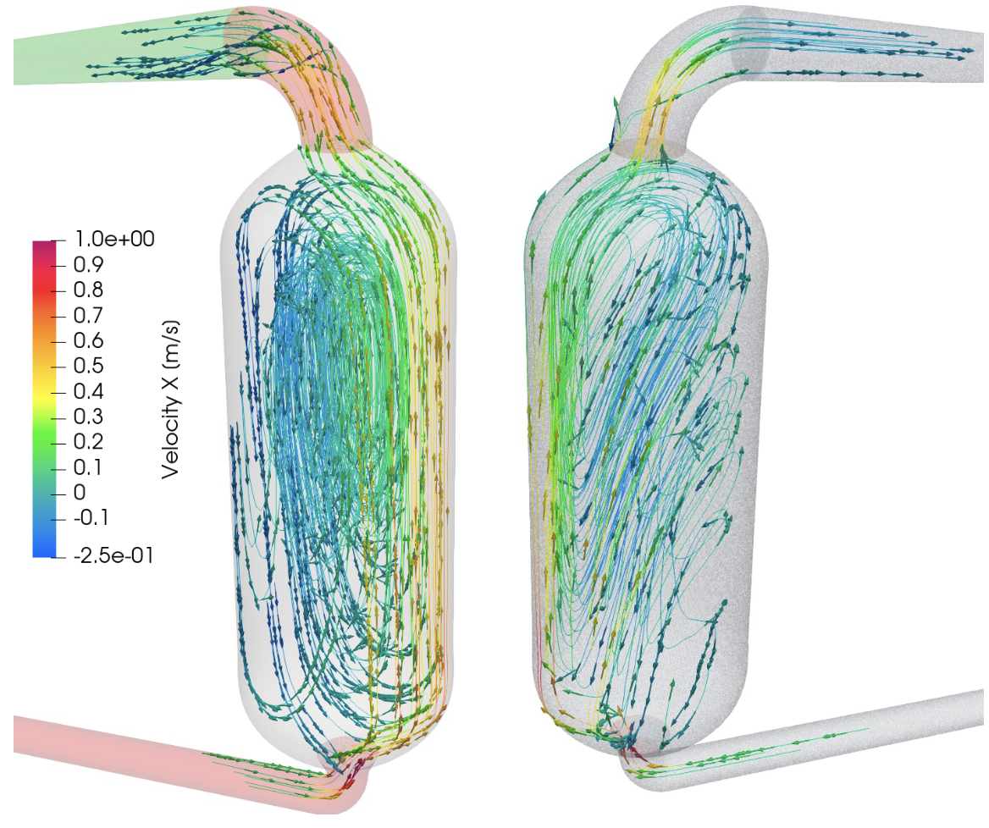
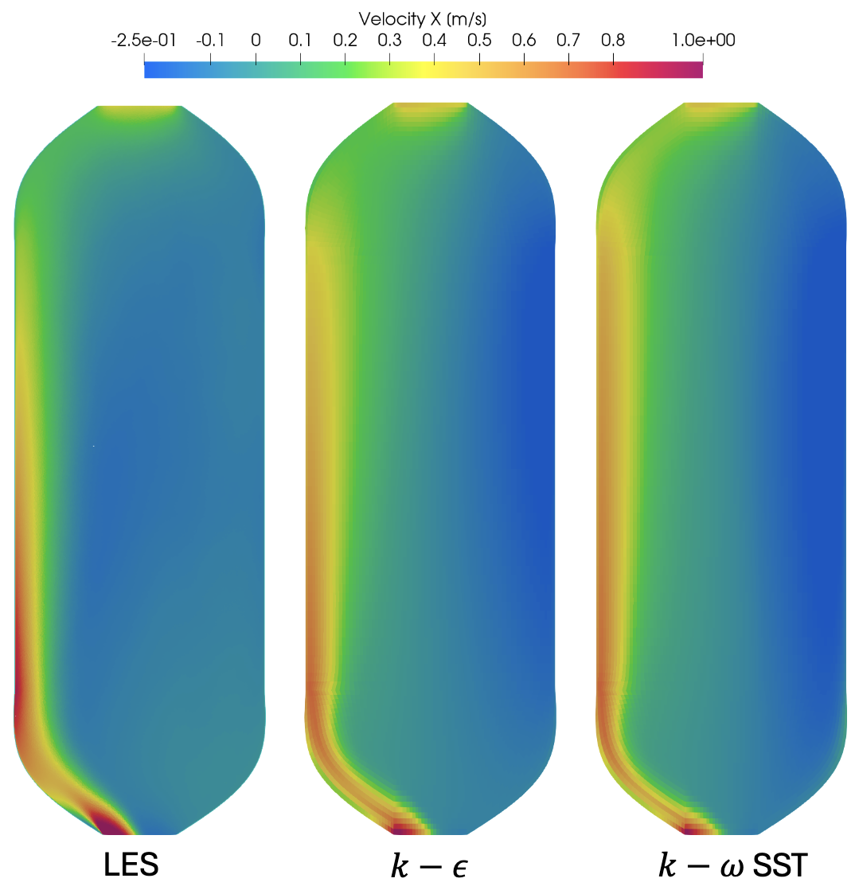
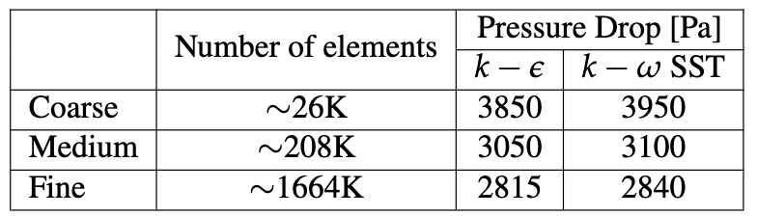
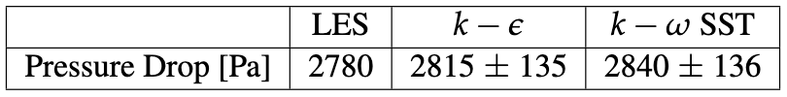
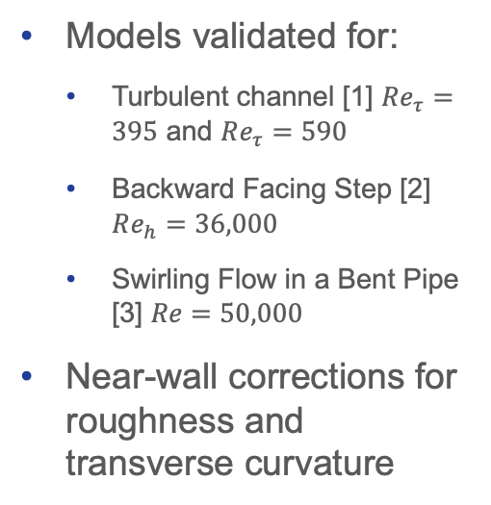
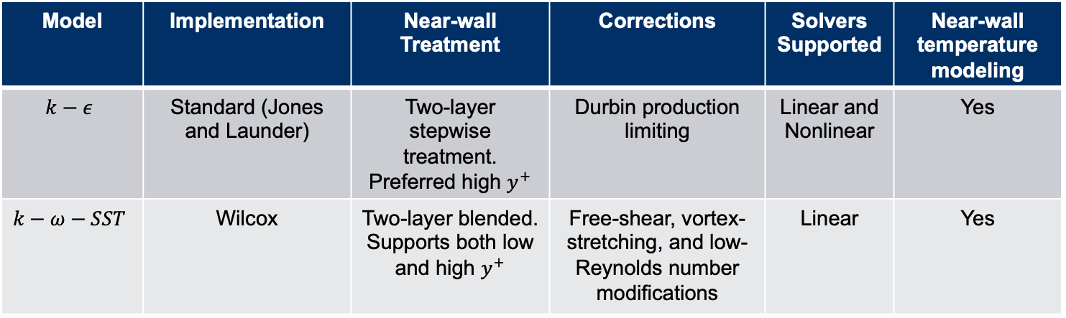

Two-equations RANS Turbulence Modeling
Model | Implementation | Near-wall Treatment | Corrections | Solvers Supported | Near-wall temperature modeling
$$k−ε$$ | Standard (Jones and Launder) | Two-layer stepwise treatment. Preferred high $y^{+}$ | Durbin production limiting | Linear and Nonlinear | Yes
$$k−ω−SST$$ | Wilcox | Two-layer blended. Supports both low and high $y^{+}$ | Free-shear, vortex-stretching, and low-Reynolds number modifications | Linear | Yes
Models validated for:
Turbulent channel [1] $Re_{τ}=395$ and $Re_{τ}=590$
Backward Facing Step [2] $Re_{h}=36,000$
Swirling Flow in a Bent Pipe [3] $Re=50,000$
Near-wall corrections for roughness and transverse curvature
.
RANS
$$k−ω−SST$$
LES
Application to L-MSR (open source MCRE)
1. Mansour, N.N., Kim, J., Moin, P. (1988). Reynolds-stress and dissipation-rate budgets in a turbulent channel flow. J. Fluid Mech., Vol. 194, pp. 15-44
2. Le, H., Moin, P., Kim, J. (1997). Direct numerical simulation of turbulent flow over a backward-facing step. J. Fluid Mech., Vol. 330, pp. 349-374.
3. So, R.M.C., Anwer, M. (1993). Swirling turbulent flow through a curved pipe. Part 2: Recovery from swirl and bend curvature. Exp. Fluids, Vol. 14, pp. 169-177.

Slide 21
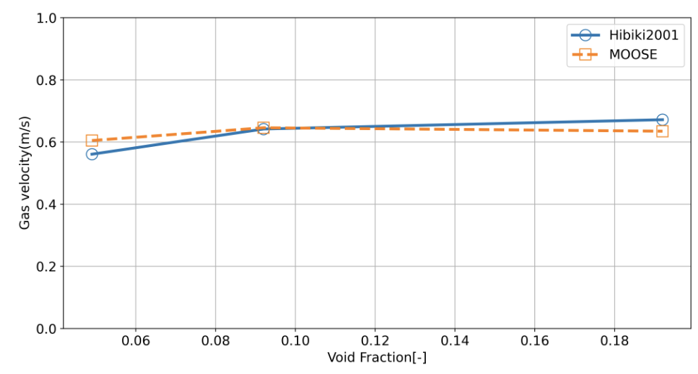
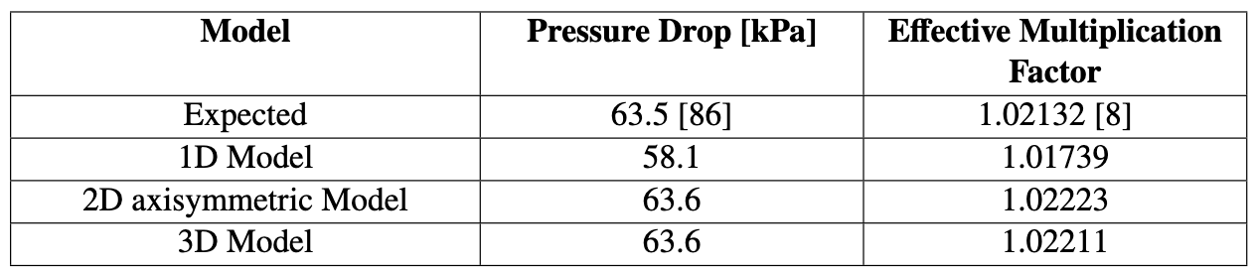
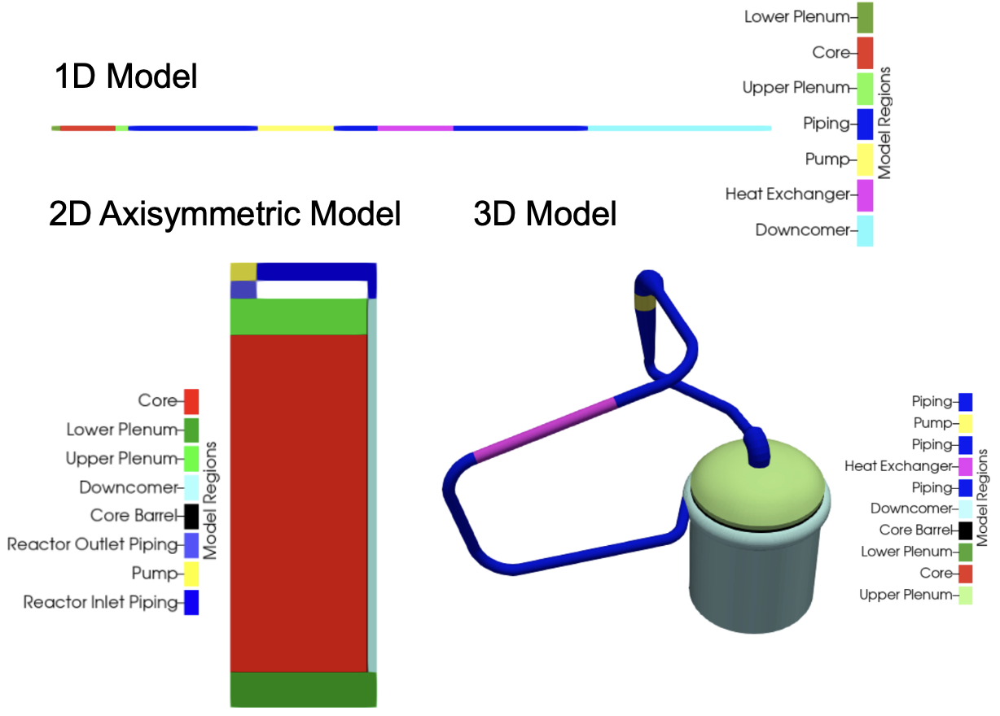
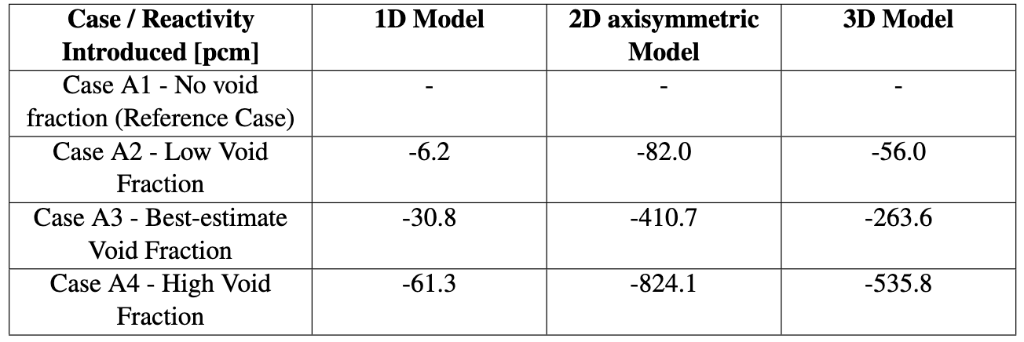
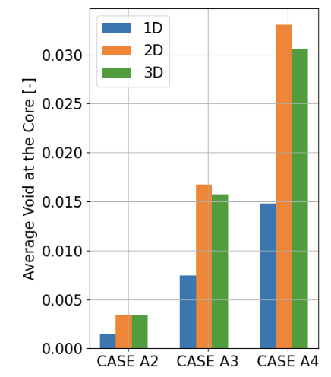
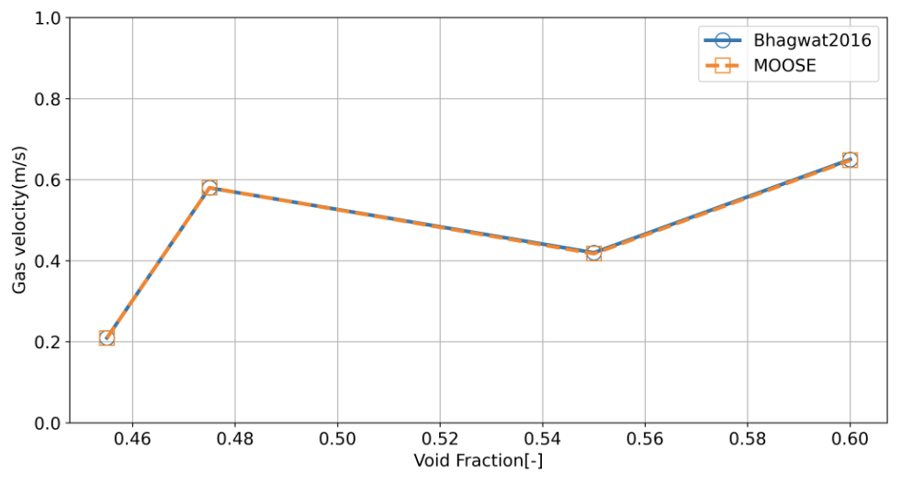
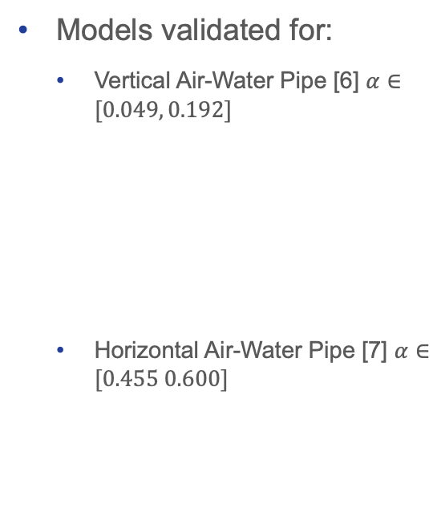
Two-Phase Flow Modeling
Model | Modifications | Solvers Supported | Compatible with wall functions
Drift flux model in porous media formulation | - Generalization to multi-D flows - Porous media support | Linear and Nonlinear | Yes
Models validated for:
Vertical Air-Water Pipe [6] $α∈[0.049, 0.192]$
Horizontal Air-Water Pipe [7] $α∈[0.455 0.600]$
Application to MSRE
6. Ishii, M., & Hibiki, T. (2010). Thermo-fluid dynamics of two-phase flow. Springer Science & Business Media.
7. Hibiki, T., Ishii, M., & Xiao, Z. (2001). Axial interfacial area transport of vertical bubbly flows. International Journal of Heat and Mass Transfer, 44(10), 1869-1888.

Slide 22
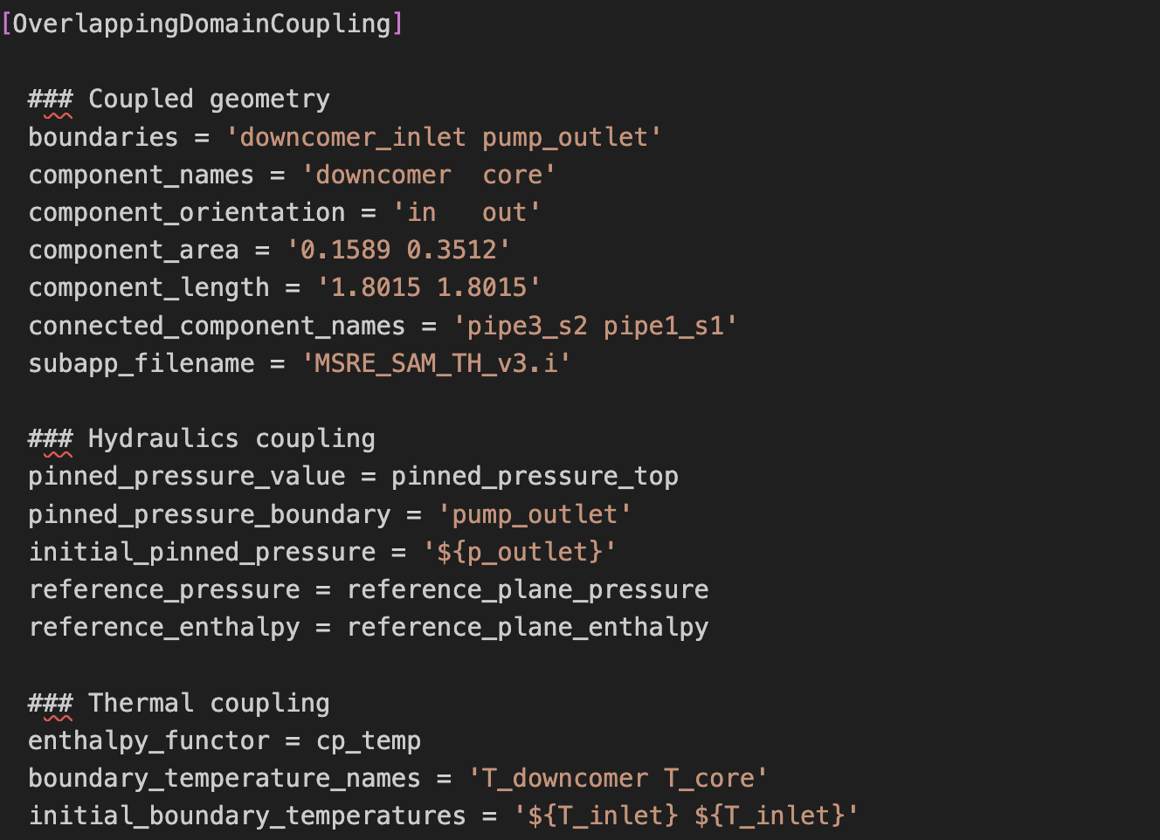
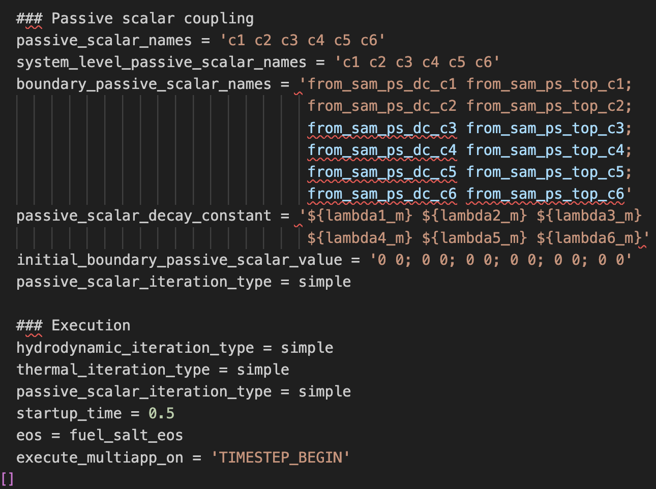
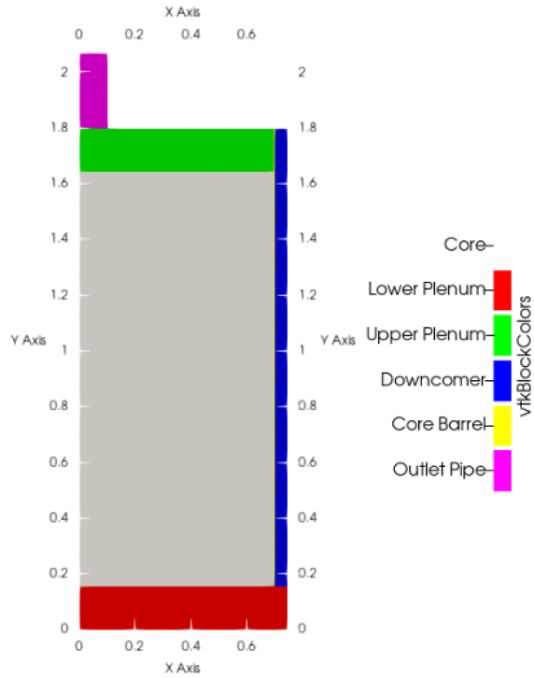
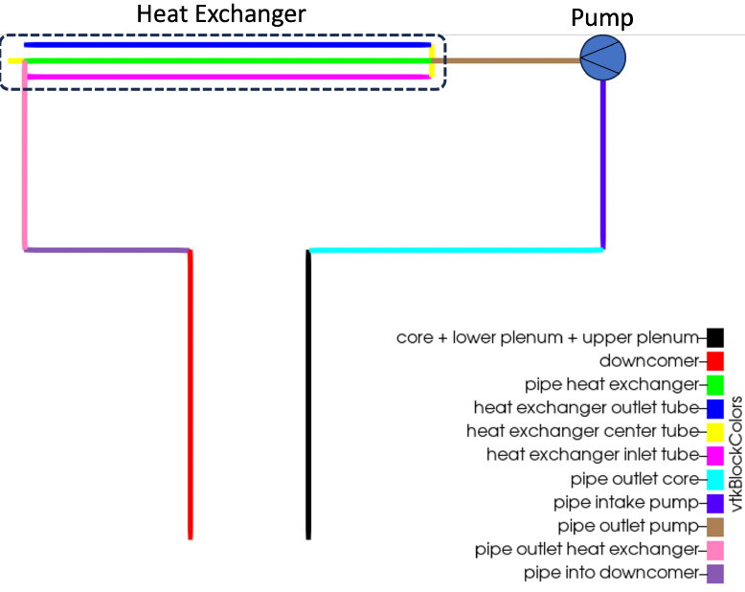
Pronghorn-SAM Domain-Overlapping Coupling 1/2
Example of Domain Overlapping Coupling Action for MSRE
MOOSE Action developed to couple Pronghorn and SAM*
The key principle is to automatically generate pipe components in SAM that represent the overlapped Pronghorn component and to match Pronghorn calculated values in SAM:
Match pressure drop → Friction factors set in SAM
Match enthalpy/temperature rise → heat source set in SAM
Adjust passive scalar concentration → volume source set in SAM
The main components of the coupling action are
Geometric description of the coupled boundaries and their area and length
Boundary where Pronghorn pressure is pinned
Enthalpy function for temperature coupling
Passive scalar decay constants
Execution parameters, including solution method, coupling start time, and equations of state
MSRE Model
Pronghorn Model
SAM Model**
*) Schunert, S., Tano, M. E., & Mohammad Jaradat, M. K. (2023). Overlapping Domain Coupling of Multidimensional and System Codes in NEAMS-Pronghorn and SAM (No. INL/RPT-23-72874-Rev000). Idaho National Laboratory (INL), Idaho Falls, ID (United States).
**) Model developed by Jun Fang and Tingzhou Fei (ANL)

Slide 23
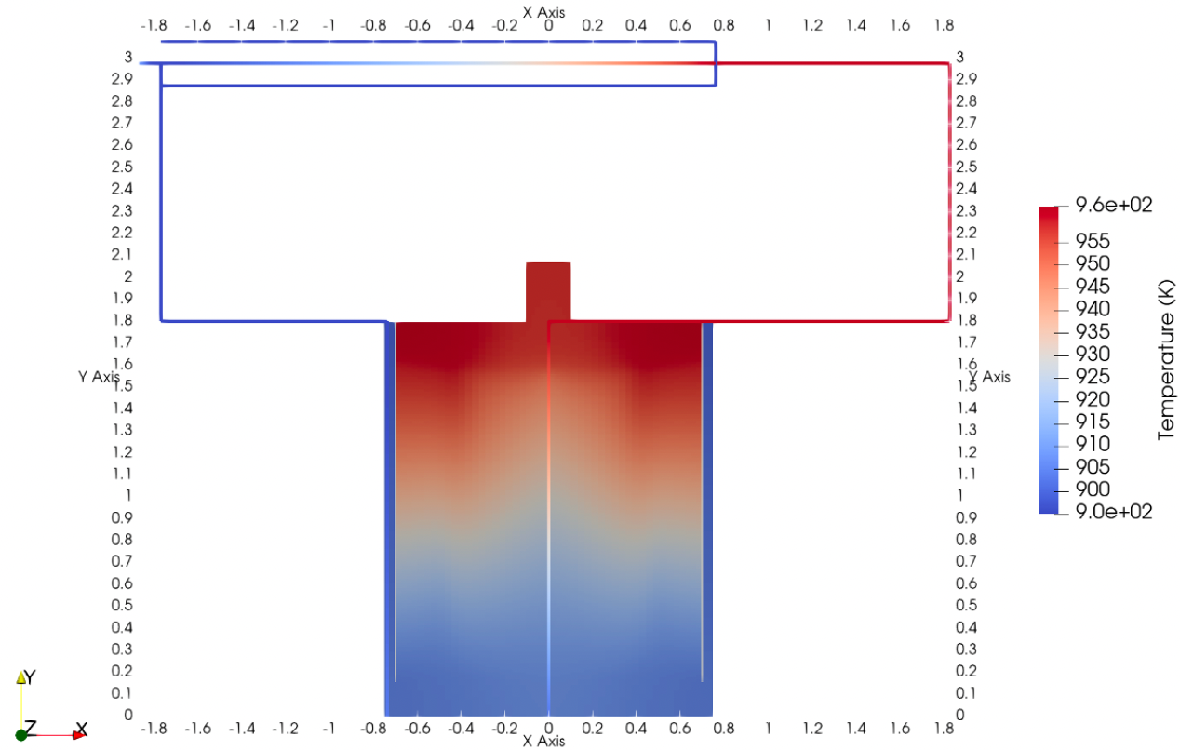
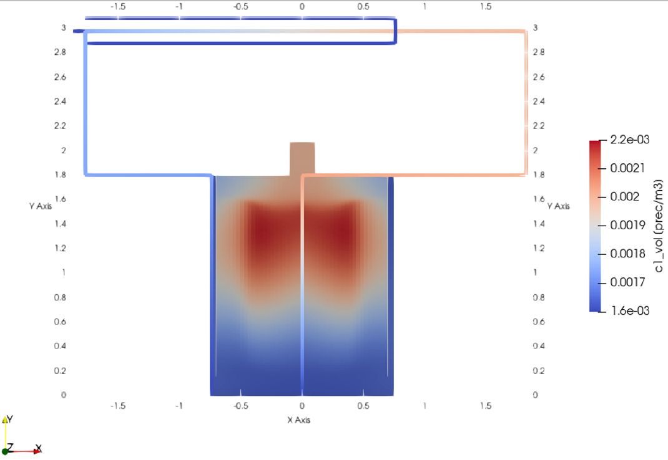
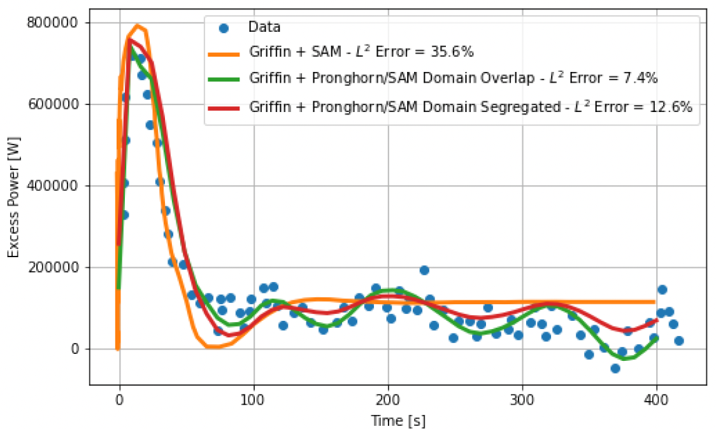

Pronghorn-SAM Domain-Overlapping Coupling 2/2
Demonstration:
Pronghorn-SAM coupling demonstrated for MSRE
For steady-state operation, the coupling methodology has been demonstrated and verified for the full reactor model.
Key limitation:
1D to multiD boundary condition in Pronghorn imposed from SAM models where flow assumptions must be made.
The user must still carefully select the boundary where the coupling is performed to avoid the effects of these boundary conditions.
Coupling validation:
The transient model has been validated for reactivity insertion transients in MSRE.
Pronghorn SAM results showed improved performance due to the higher resolution of the Pronghorn model.
Delayed neutron precursor concentration for group 1 ($λ_{1}=1.3336×{10}^{−2}1/s$)
Temperature Field
Reactivity Insertion Transient at 5MW of thermal power

Slide 24
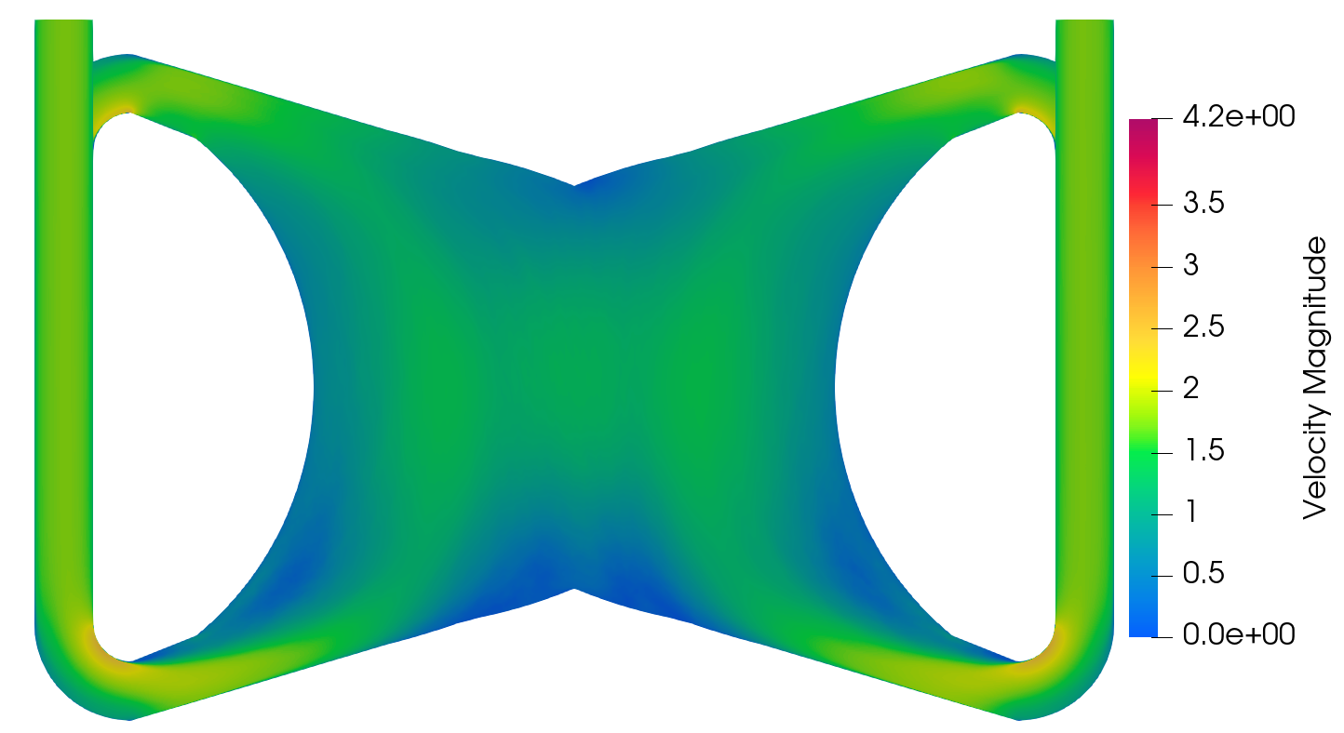
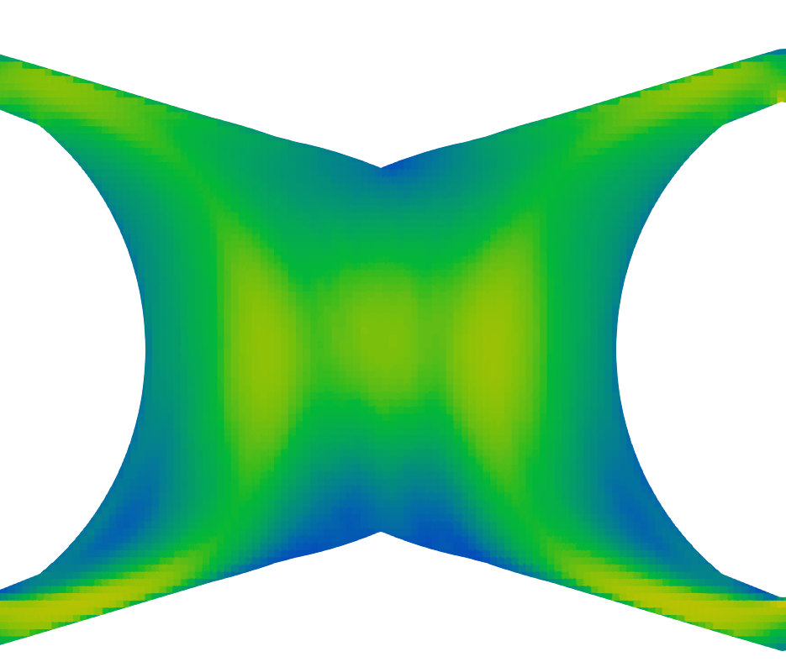
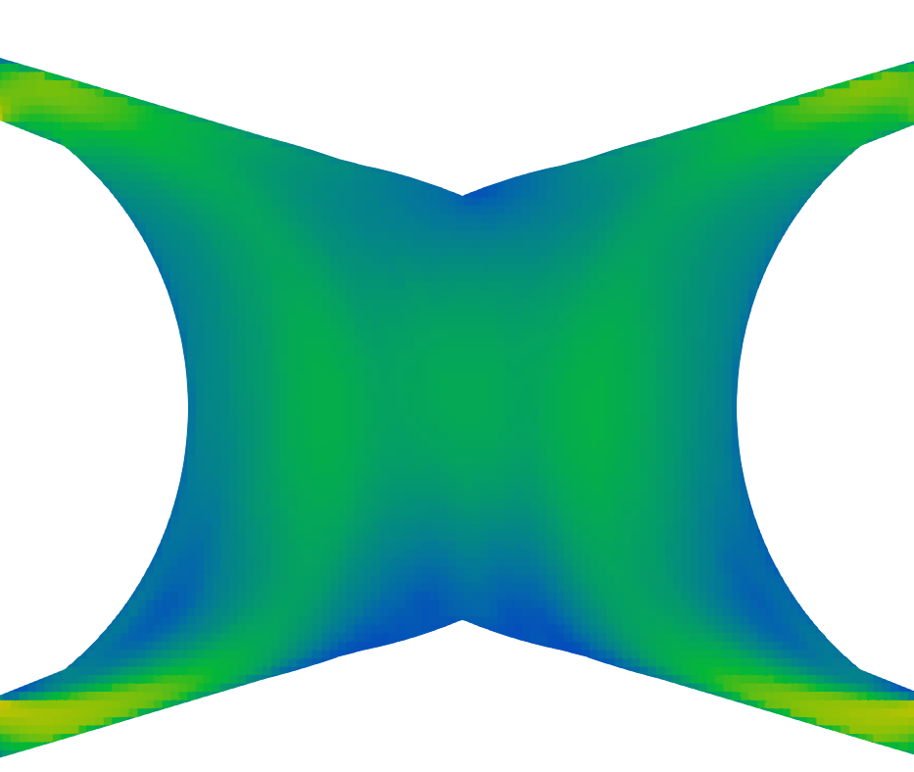
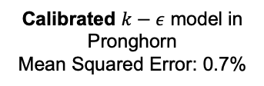
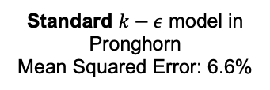
Pronghorn-Nek High-to-Low (HOLO) Coupling
Standard $k−ε$ model in Pronghorn
Mean Squared Error: 6.6%
Calibrated $k−ε$ model in Pronghorn
Mean Squared Error: 0.7%
Time-averaged NekRS LES
Pronghorn RANS turbulent closures implemented as Functors, which allows for a simple calibration from higher-fidelity models
Pronghorn implements an inverse Kalman filter for advection, allowing to obtain good performance advection in coarse meshes
Example for the Molten Salt Fast Reactor (MSFR) core in the right figures
Tano, M., Walker, S., Abou-Jaoude, A., Fang, J., & Shaver, D. (2023). Nek5000-Pronghorn-SAM multiscale modeling of pool-type Molten Salt Reactors. In 20th International Topical Meeting on Nuclear Reactor Thermal Hydraulics, NURETH 2023 (pp. 478-491). American Nuclear Society.

Slide 25

Summary
Pronghorn has been extended to model pool-like MSRs with coarse-mesh for engineering-scale modeling
Additions included:
Two-equations $k−ε$ and $k−ω−SST$ RANS turbulence models
Near wall modeling for rough walls and swirling flow
Two-phase, drift-flux, multi-dimensional modeling
Domain-overlapping coupling with SAM
Current work is targeting:
Coarser computational meshes
Coupling with Saline for modeling molten salt flows with diverse composition due to varying burnup
Improving near-wall solute wall functions for corrosion modeling (coupling with PNP model)
Two-phase Euler-Euler modeling for accounting for sloshing and larger void fraction transport
Continue improving domain-overlapping for cases with large body forces, weak-compressibility, and porosity jumps

Slide 27




Near-Wall Turbulence Modeling
Correction | Implementation
Roughness correction | Moody-adapted Colebrook and Asymptotic corrections
Transverse curvature correction | Quadratic aggregation of shear velocity
Models validated for:
Roughness Corrections in Moody Chart $Re∈[65,000, 650,000]$
Rough Channel Experiment [4] $Re=65,000$
Swirling Flow in Axial Expansion [5] $Re=206,000$
Application to L-MSR
Impact of Wall Function Corrections
Difference in Temperature
Difference in Velocities for plane ad mid axial height
Difference in Turbulent Viscosity
4. Fujita, H., Hirota, M., Yokosawa, H., Hasegawa, M., Gotoh, I. (1990). Fully developed turbulent flows through Rectangular Ducts with One Roughened Wall. JSME Int. J., Vol. 33, pp. 692-701.
5. Stieglmeier, M., Tropea, C., Weiser, N., Nitsche, W. (1989). Experimental investigation of the flow through axisymmetric expansions. J. Fluids Engineering, Vol. 111, pp. 464-471.

