Slide 1
Thermal-fluid Area Overview
Elia Merzari, Rui Hu
Argonne National Laboratory
May 12th, 2025

Slide 2
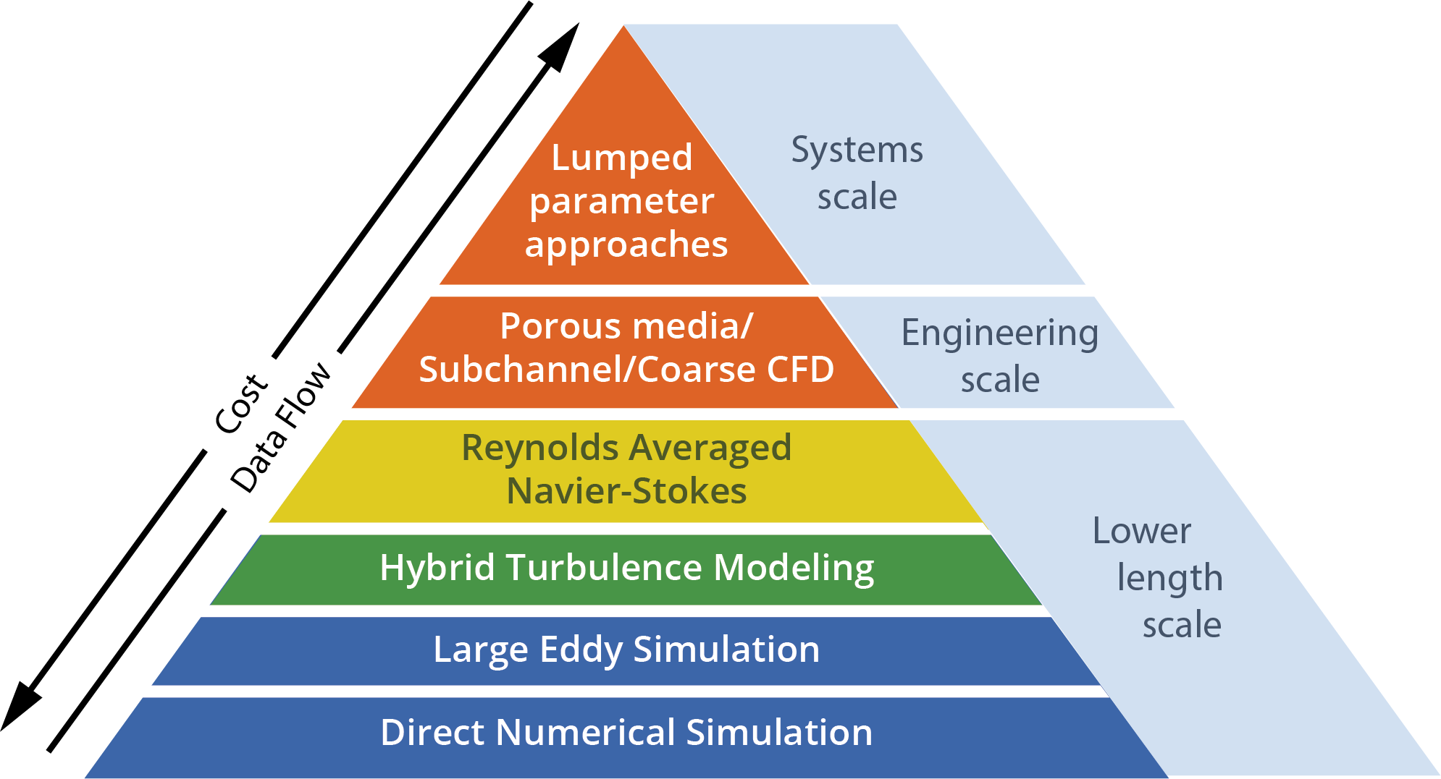
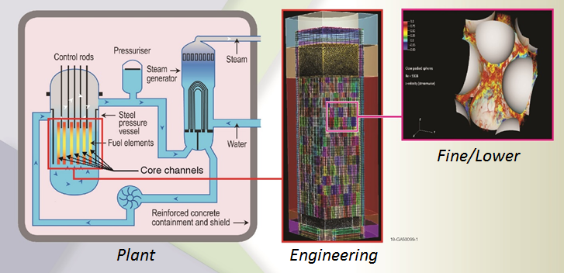
Thermal-hydraulics modeling in NEAMS - I
The thermal-hydraulic technical advances the state of the art of thermal-hydraulic simulations by researching novel new solution strategies for challenging real-world heat and fluid flow issues that affect advanced reactor designs or still affect the current fleet of deployed Light Water Reactor nuclear reactors.
The economics of most advanced reactor designs relies on achieving higher temperatures that the current fleet.
This poses severe challenges in terms of materials and puts an onus on thermal-hydraulic models to provide accurate assessment of hot spots.
A reduction of uncertainty on thermal-hydraulic prediction has potential for a substantial economic benefit and to ultimately accelerate deployment.
Thermal and Fluid Flow phenomena involve a wide range of length and time scales
Resolving all scales for a realistic engineering system of interest is often computationally not feasible.
On the other hand, if scales are not resolved, closures need to be provided to ensure reasonable accuracy, as all scales contribute to the dynamics.
Multiscale/multi-resolution simulation hierarchy

Slide 3
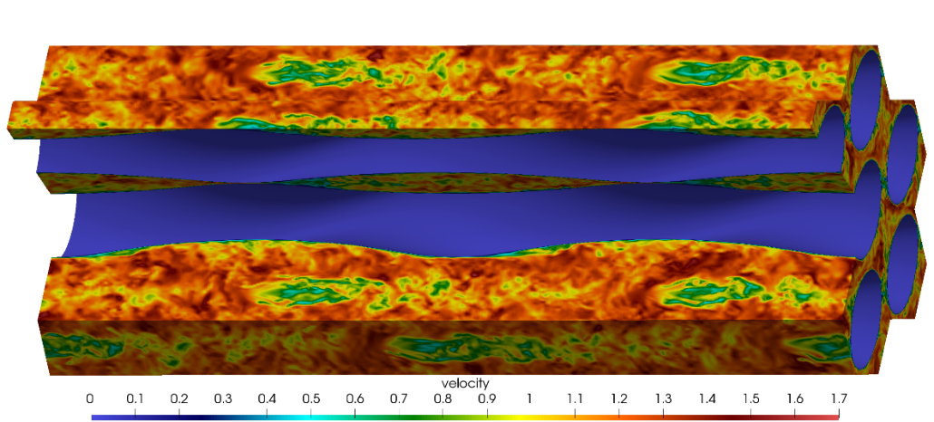
Thermal-hydraulics modeling in NEAMS - II
SAM
Trustworthy and practical plant-level system analysis tool for advanced reactors
Advances in software environments and design, numerical methods, and physical models thanks to MOOSE.
Pronghorn
Engineering scale environment build on MOOSE
Coarse CFD, subchannel and distributed resistance
Nek5000/NekRS/Cardinal
Open Source, Spectral element high-fidelity code
Proven scalability beyond a million MPI ranks (Gordon Bell prize). Now GPU-capable (NekRS).
Extensive code verification and validation
Couples to MOOSE and OpenMC through Cardinal
Sockeye
Engineering scale heat-pipe heat transfer code.
Relies on THM module of MOOSE.
CTF
LWR subchannel code.
Part of VERA.
Flow in a twisted tube HX.
Plant
Scales
Engineering Scales
Fine
Scales
System
Codes
Sub-channel
Reduced-order models
Porous
media
modeling
Momentum
Sources
(Coarse CFD)
RANS
CFD
Hybrid
CFD
LES
/DNS
System Analysis Module
(SAM)
Pronghorn
Nek5000

Slide 4
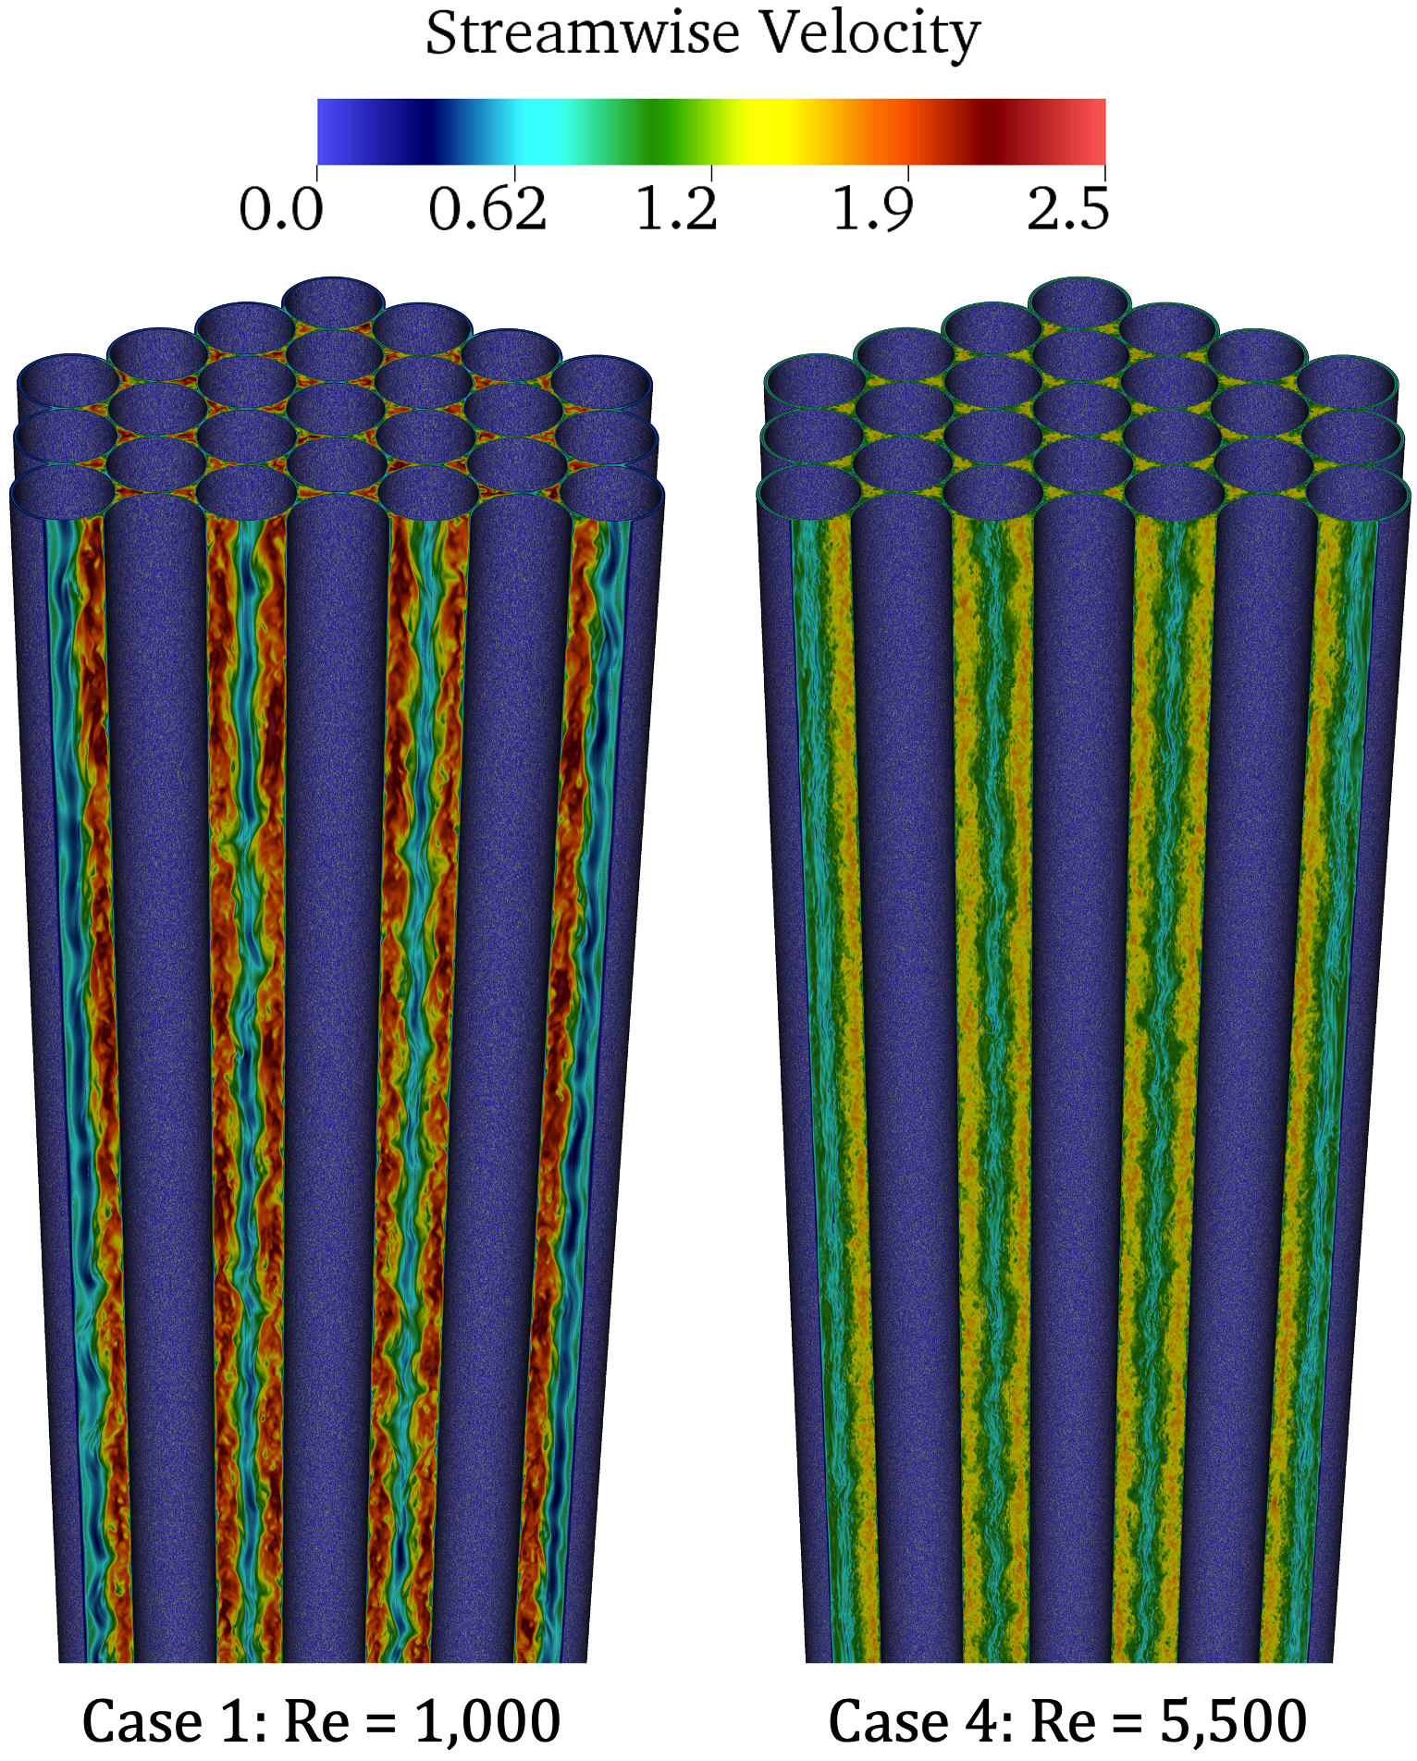
Unique Capability
CFD modeling capability for full microreactor cores at high fidelity
SNAP10A model
Comparisons against available data and correlations
Can be used to assess applicability of correlations to modified geometries or even develop new correlations
Excellent scaling on leadership class computing architectures
Flow in a microreactor core, showcasing typical tight lattice patterns

Slide 5
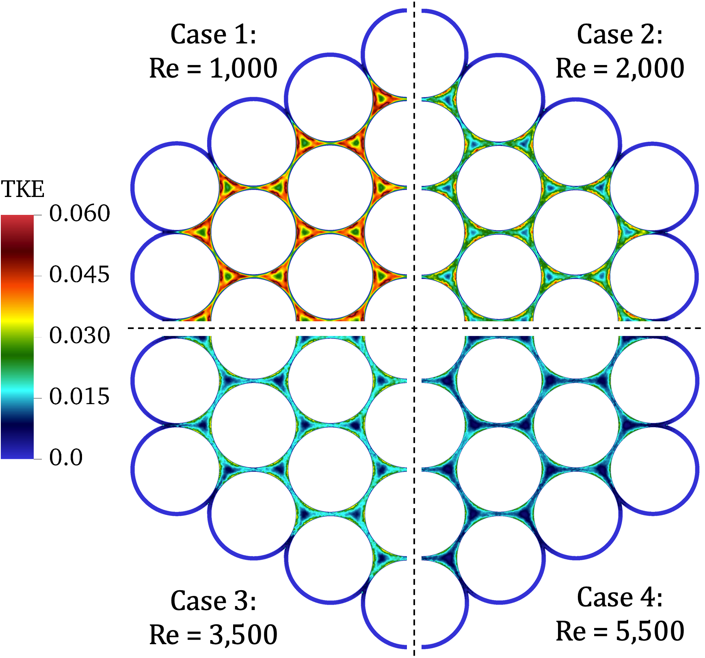
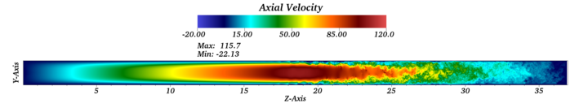
Thermal-fluids presentations today
Heat Pipe Modeling Capabilities in Sockeye (Joshua Hansel)
Modeling the MARVEL Microreactor Using NEAMS Tools (Lise Charlot)
CFD prediction of the flow in the vapor core of a heat pipe
Top view of TKE in a microreactor core at different Reynolds numbers.

