Slide 1
Thermal-fluid Area Overview
Elia Merzari, Rui Hu
Argonne National Laboratory
May 7, 2025

Slide 2
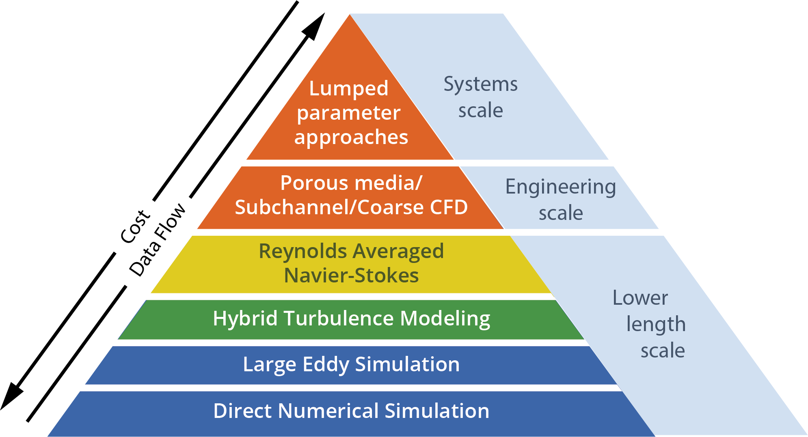
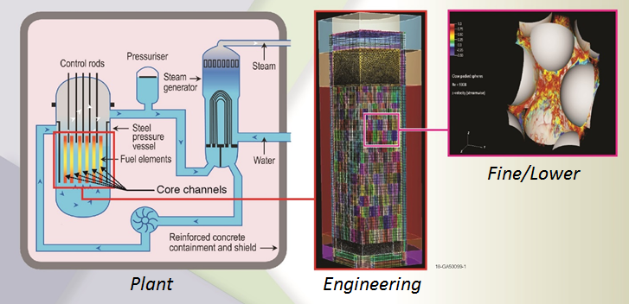
Thermal-hydraulics modeling in NEAMS - I
The thermal-hydraulic technical advances the state of the art of thermal-hydraulic simulations by researching novel new solution strategies for challenging real-world heat and fluid flow issues that affect advanced reactor designs or still affect the current fleet of deployed Light Water Reactor nuclear reactors.
  The economics of most advanced reactor designs relies on achieving higher temperatures that the current fleet.
  This poses severe challenges in terms of materials and puts an onus on thermal-hydraulic models to provide accurate assessment of hot spots.
  A reduction of uncertainty on thermal-hydraulic prediction has potential for a substantial economic benefit and to ultimately accelerate deployment.
Thermal and Fluid Flow phenomena involve a wide range of length and time scales
  Resolving all scales for a realistic engineering system of interest is often computationally not feasible.
  On the other hand, if scales are not resolved, closures need to be provided to ensure reasonable accuracy, as all scales contribute to the dynamics.
  Multiscale/multi-resolution simulation hierarchy

Slide 3
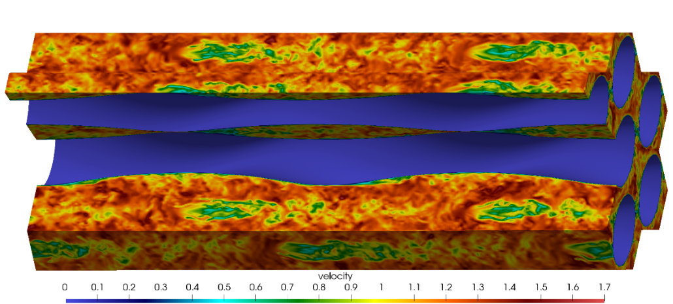
Thermal-hydraulics modeling in NEAMS - II
SAM
    Trustworthy and practical plant-level system analysis tool for advanced reactors
    Advances in software environments and design, numerical methods, and physical models thanks to MOOSE.
Pronghorn
    Engineering scale environment build on MOOSE
    Coarse CFD, subchannel and distributed resistance
Nek5000/NekRS/Cardinal
    Open Source, Spectral element high-fidelity code
    Proven scalability beyond a million MPI ranks (Gordon Bell prize). Now GPU-capable (NekRS).
    Extensive code verification and validation
    Couples to MOOSE and OpenMC through Cardinal
Sockeye
    Engineering scale heat-pipe heat transfer code.
    Relies on THM module of MOOSE.
CTF
    LWR subchannel code.
    Part of VERA.
Flow in a twisted tube HX.
Plant
Scales
Engineering Scales
Fine
Scales
System
Codes
Sub-channel
Reduced-order models
Porous
media
modeling
Momentum
Sources
(Coarse CFD)
RANS
CFD
Hybrid
CFD
LES
/DNS
System Analysis Module
(SAM)
Pronghorn
Nek5000

Slide 4
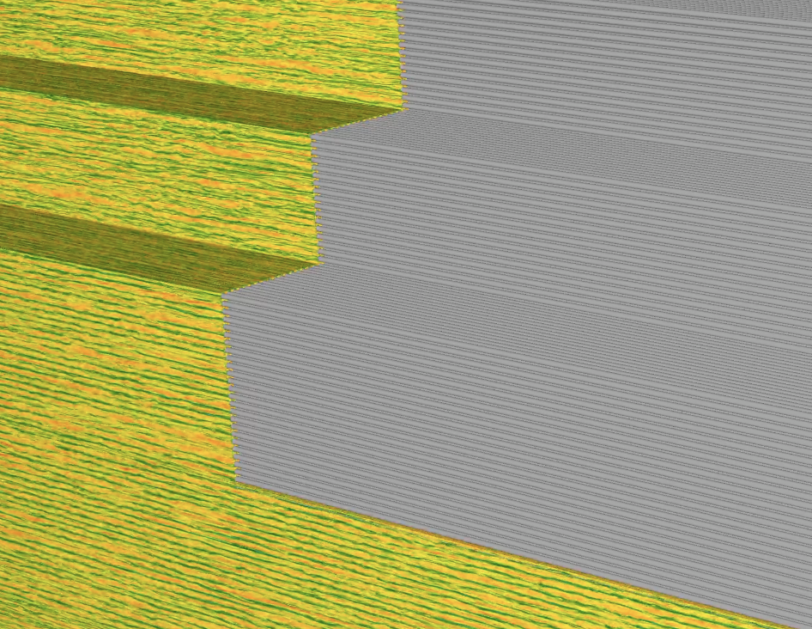
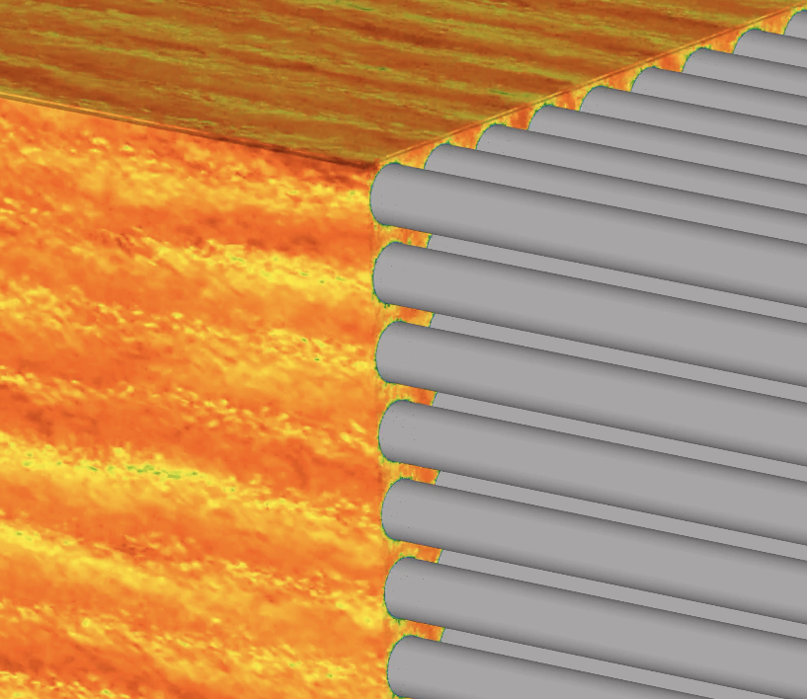
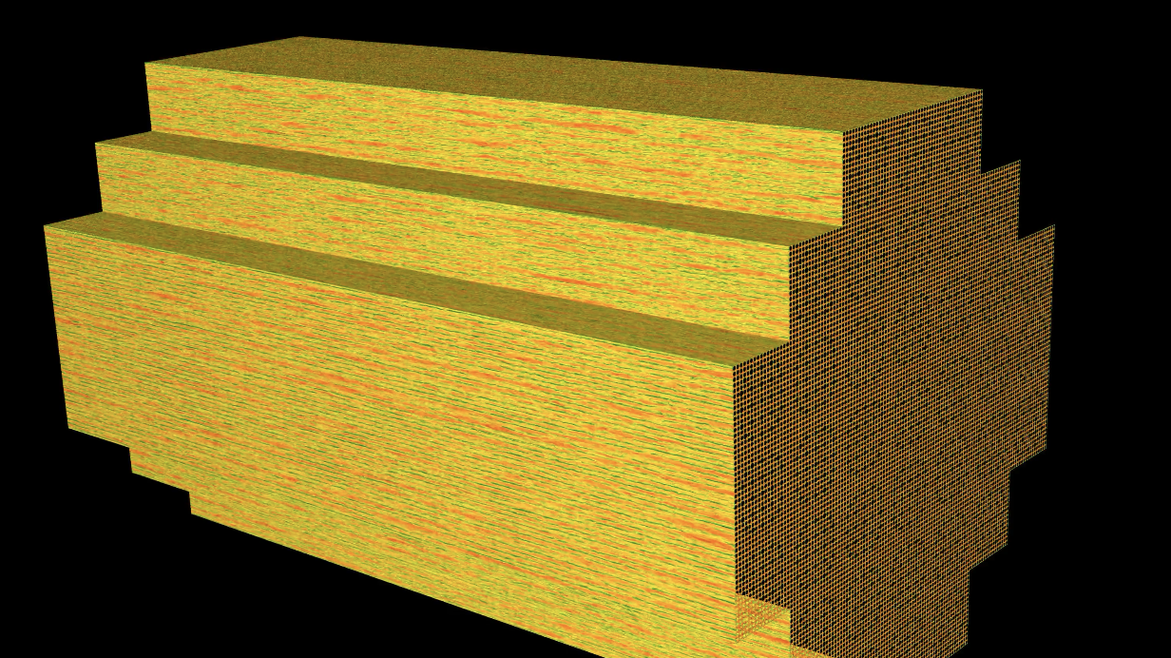
Unique Capability
Capability to model full SMR core at high-fidelity. We look at an SMR the reactor core with 37 assemblies.
  The reactor is buoyancy driven (no pump).
  Standalone runs were also conducted with 6.03x10¹¹ grid points. Some of largest runs ever conducted. Highly scalable CFD on DOE supercomputers
  Coupled runs with MC (Shift) also conducted.
Full core turbulence resolving
CFD simulation, with details.

Slide 5
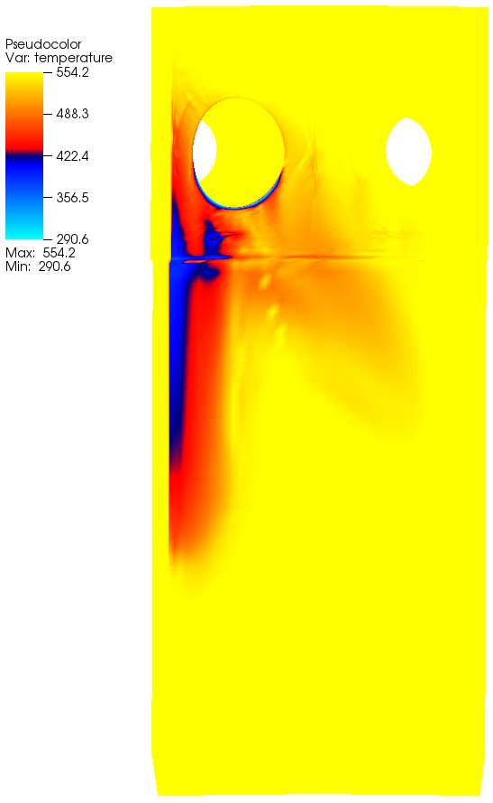
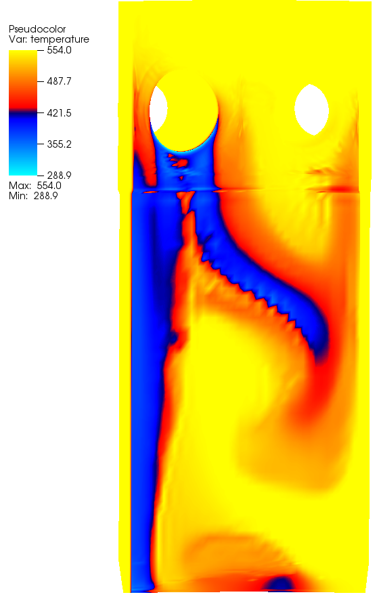
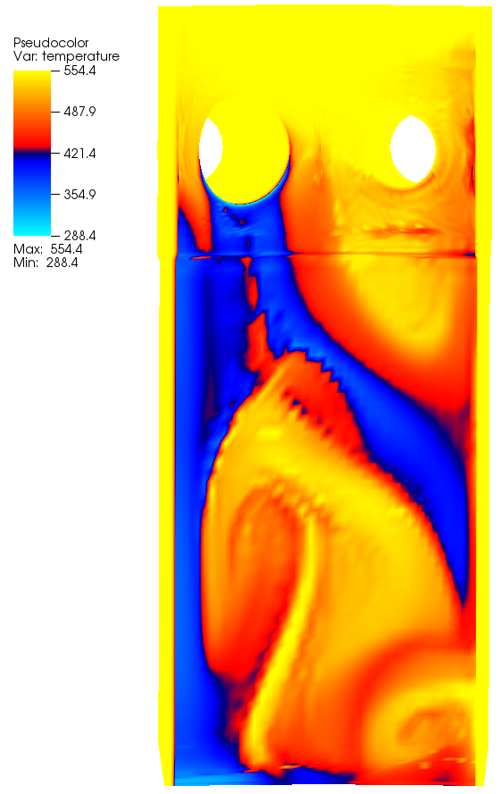
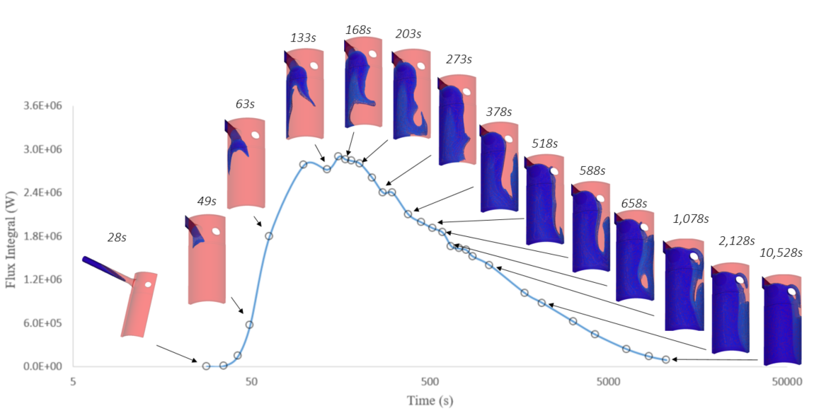
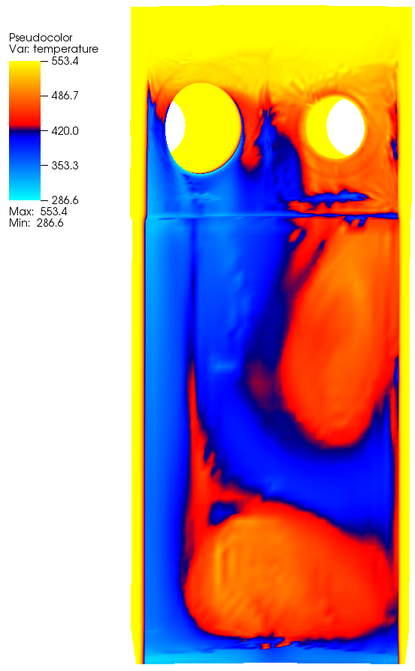
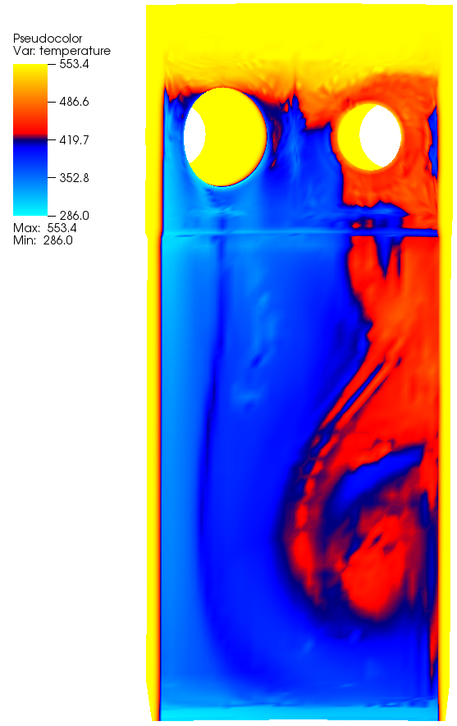
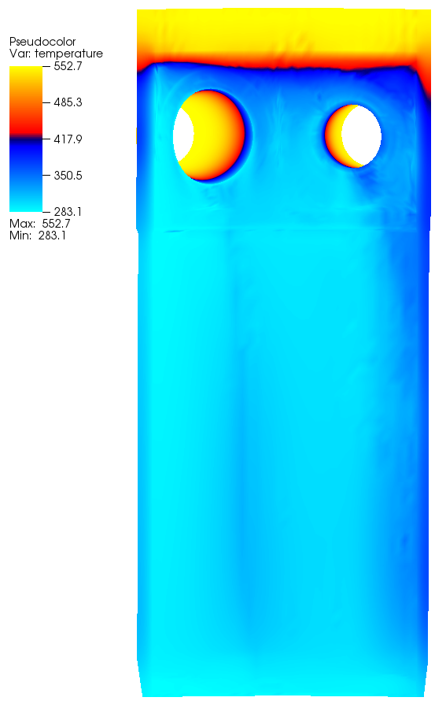
Thermal-Hydraulic Analyses (LOCA) to Vessel aging studies
We have demonstrated the CFD modeling of flow and the temperature distribution in the downcomer region, as well as the vessel during a LOCA (different break sizes). The temperatures have then been used to assess the impact of vessel aging in multi-physics simulations (Grizzly).
Solid Temperature
56 s
81 s
98 s
Fluid Temperature
168 s
238 s
10528 s
Temperature evolution on the RPV
inner wall under MBLOCA
Temperature evolution in the flow channel under MBLOCA
5

Slide 6
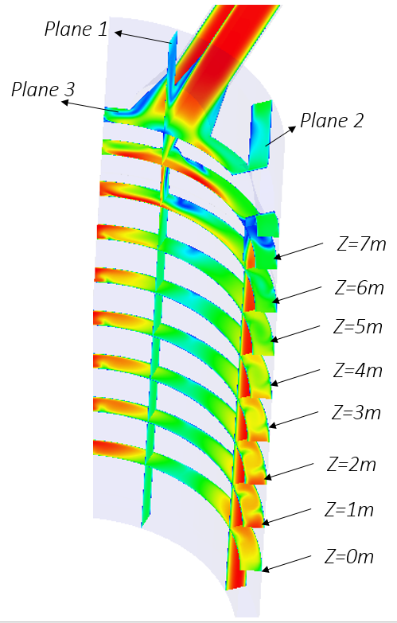
Thermal-fluids presentations today
Validation and sensitivity analysis of T/H capabilities for modeling of transient dry out and re-wet (Vineet Kumar & Bob Salko)
CFD prediction of cross-flow in 7x7 LWR pin bundle for evaluation of FIV, performed in collaboration with Framatome
Flow in the downcomer during LOCA

