Slide 1
Enhancement on Species Transport Modeling in SAM and Coupling to Saline and Mole
Bob Salko, Travis Mui, Rui Hu
NEAMS ANNUAL REVIEW MSR
May 28, 2025

Slide 2
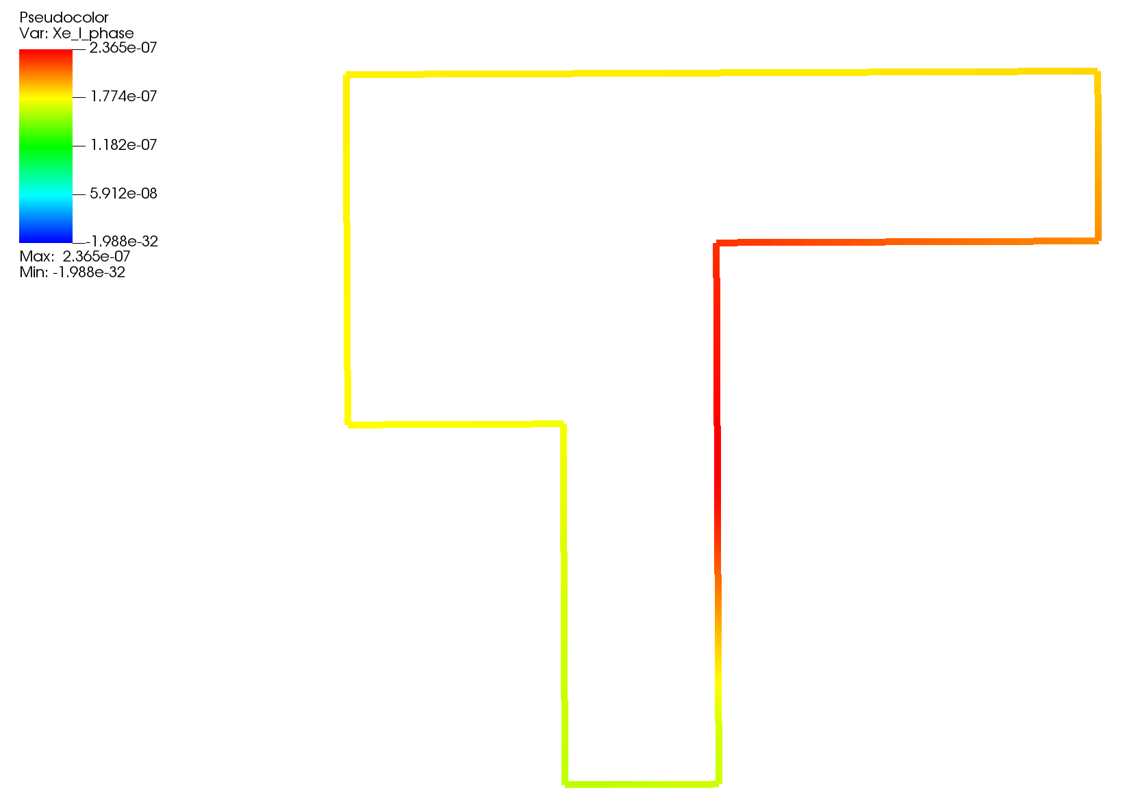
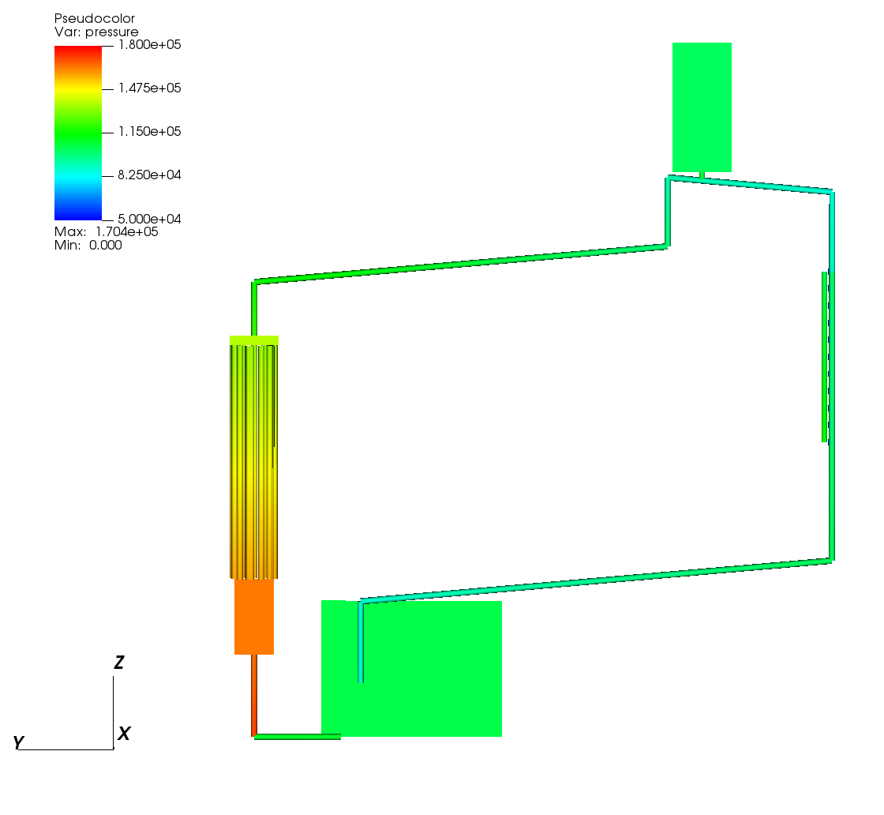
Introduction
  A modern system analysis code for advanced non-LWR safety analysis
  Covers almost all non-LWR concepts
Ongoing efforts to develop SAM for MSR applications
  Salt thermophysical properties
  Salt freezing
  Species tracking for delayed neutron precursors and fission products in both salt and sparge gas
  Species decay and decay heat
  Species phase transfer
  Modeling of non-condensable gas transport
Validation using MSRE, MSR Campaign data, and open two-phase data
Prediction of salt xe-135 distribution in MSRE¹
Prediction of pressure distribution in LSTL²
T. Mui, et al. “SAM Code Improvements for Molten Salt Reactor Transient and Species Transport Modeling”, ANL/NSE-24/73, 2024.
Yoder, G., et al. “Development of a forced-convection liquid-fluoride-salt test loop”, Proceedings of HTR, 2010

Slide 3
Species Tracking in SAM
Generic species (passive scalar) transport originally implemented in SAM to model flowing delayed neutron precursors in MSRs
Framework expanded to simulate transport pathways of tritium in FHRs and MSRs
Ongoing work to consider additional applications:
  Oxidation-corrosion in lead-cooled reactors
  Redox corrosion in salt-cooled reactors
  Noble gas/metal transport in MSR
Species transport pathways
modeled in SAM

Slide 4

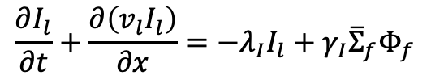
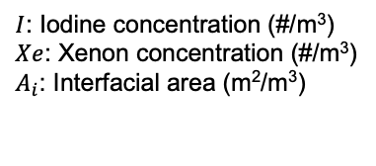
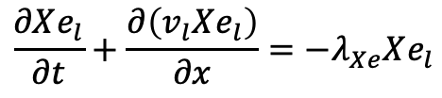
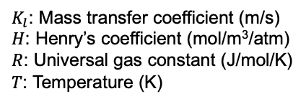
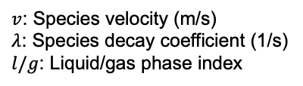

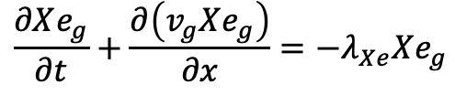

Enhancements to Species Tracking
Iodine transport in liquid
Species can now exist in the gas phase
  Transported by gas velocity
Phase transfer using Henry’s Law for high-volatile gas
  Henry and mass transfer coefficient calculated by Mole
  Interfacial area and gas velocity by SAM
Capture decay between species
$$\frac{∂I_{l}}{∂t}+\frac{∂\left(v_{l}I_{l}\right)}{∂x}=−λ_{I}I_{l}+γ_{I}{\overline{Σ}}_{f}Φ_{f}$$
Track decay from one species to another
Xenon transport in liquid
Mass transfer data from Mole
$$\frac{∂Xe_{l}}{∂t}+\frac{∂\left(v_{l}Xe_{l}\right)}{∂x}=−λ_{Xe}Xe_{l}$$
$$+λ_{l}I_{l}$$
$$−K_{l}A_{i}(Xe_{g}HRT−Xe_{l})$$
Added phase transfer term
Xenon transport in gas
Gas/bubble behavior predicted by SAM
$$\frac{∂Xe_{g}}{∂t}+\frac{∂\left(v_{g}Xe_{g}\right)}{∂x}=−λ_{Xe}Xe_{g}$$
$$+K_{l}A_{i}(Xe_{g}HRT−Xe_{l})$$
Species can exist in gas phase
v_{g}
a_{i}
c_{g}
Phase transfer
$v$: Species velocity (m/s)
$λ$: Species decay coefficient (1/s)
$l/g$: Liquid/gas phase index
$I$: Iodine concentration (#/m³)
$Xe$: Xenon concentration (#/m³)
$A_{i}$: Interfacial area (m²/m³)
$K_{l}$: Mass transfer coefficient (m/s)
$H$: Henry’s coefficient (mol/m³/atm)
$R$: Universal gas constant (J/mol/K)
$T$: Temperature (K)
c_{l}

Slide 5
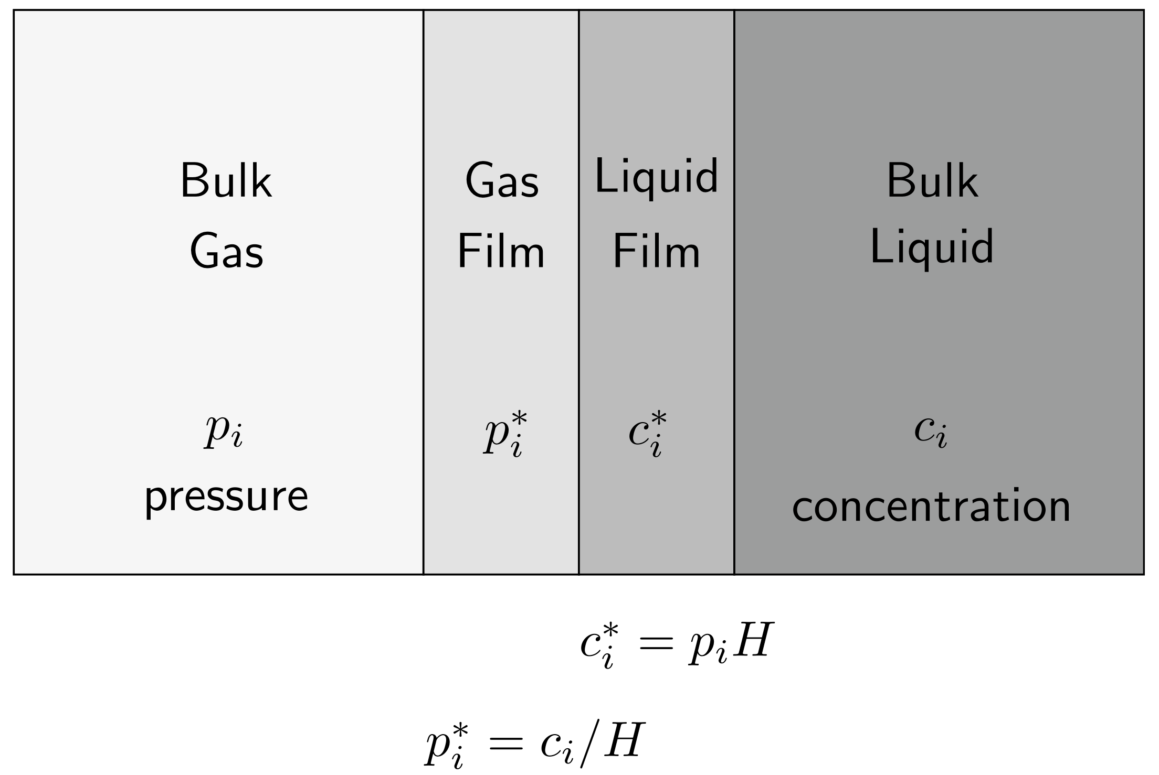
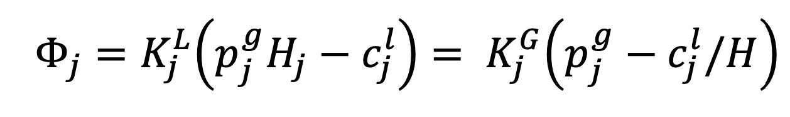
Coupling to Saline and Mole
Mole provides modeling of high-volatile species phase transfer¹
  Utilizes two-film theory
  Provides Henry coefficients for FLiNaK and FLiBe salts and several noble gases
  Mass transfer coefficient determined using Wilke-Chang or Stokes-Einstein¹
Saline is a C++/Fortran/Python interface to MSTDB-TP
  Integrated into MOOSE and SAM
  Provides thermophysical properties of many common salts and salt compositions
Gas liquid interface modeled using two-film theory
Interface concentrations determined using Henry’s Law
1. K. Lee, W. Williams, J. McFarlane, D. Kropaczek, and D. de Wet, “Semi-empirical model for Henry’s Law Constant of Noble Gases in Molten Salts”, Nature Portfolio, 14:12847, 2024, https://doi.org/10.1038/s41598-024-60006-9.

Slide 6
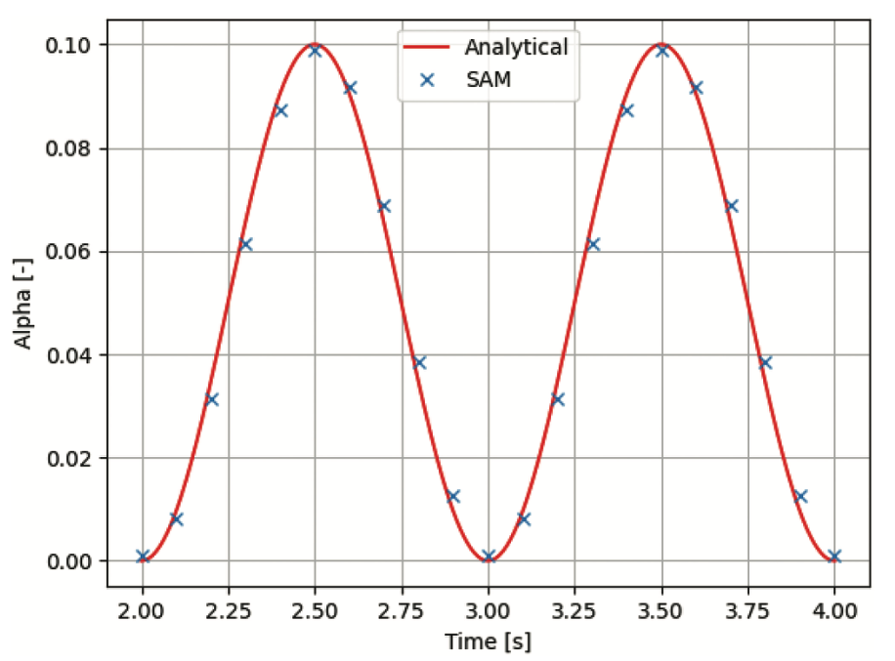
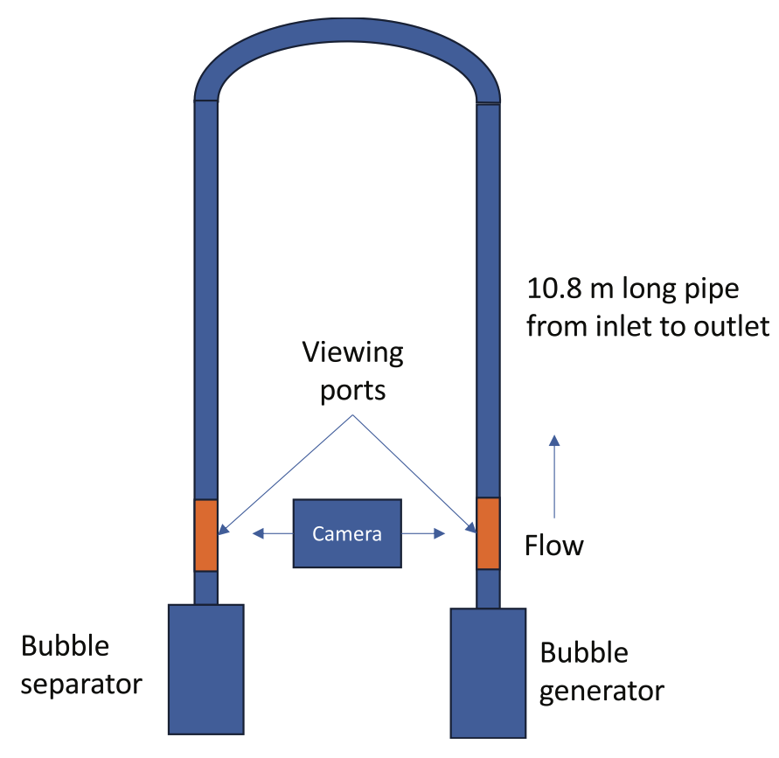
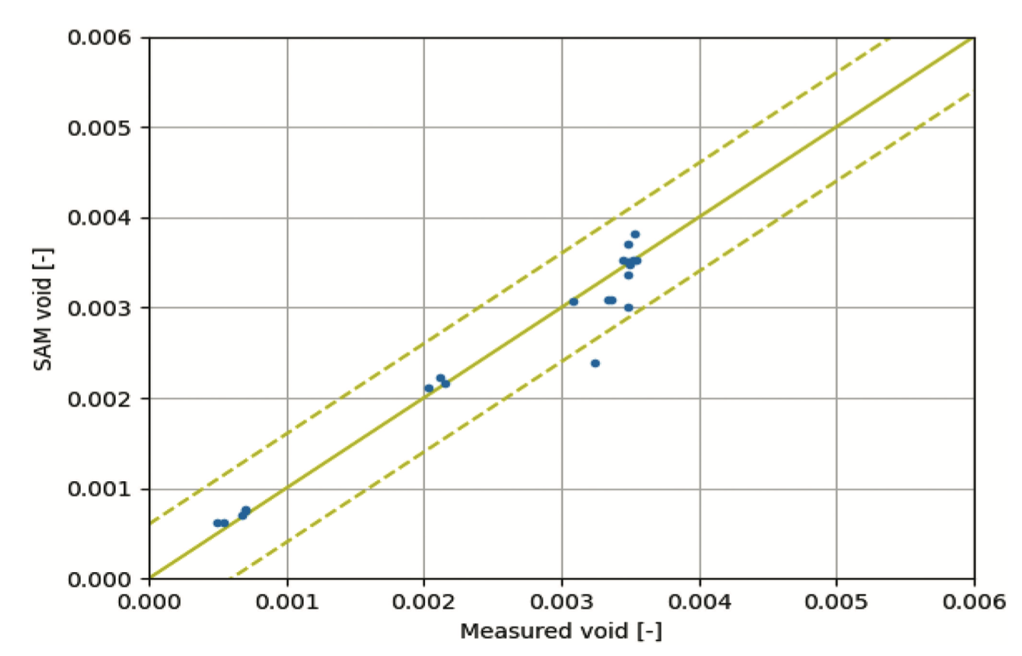
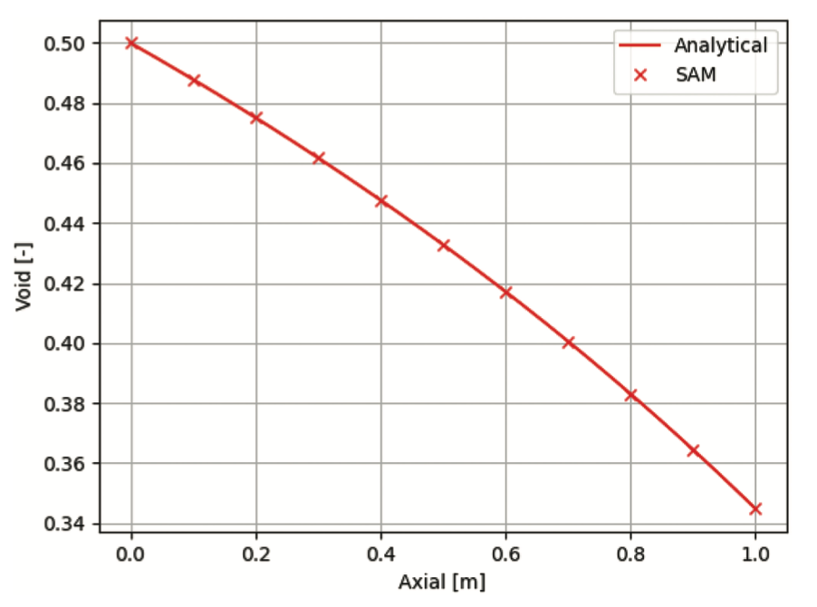
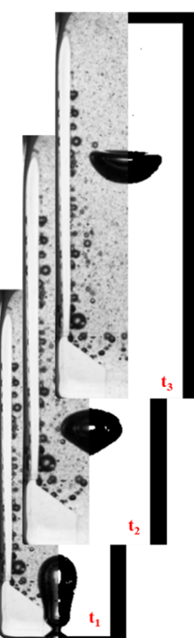
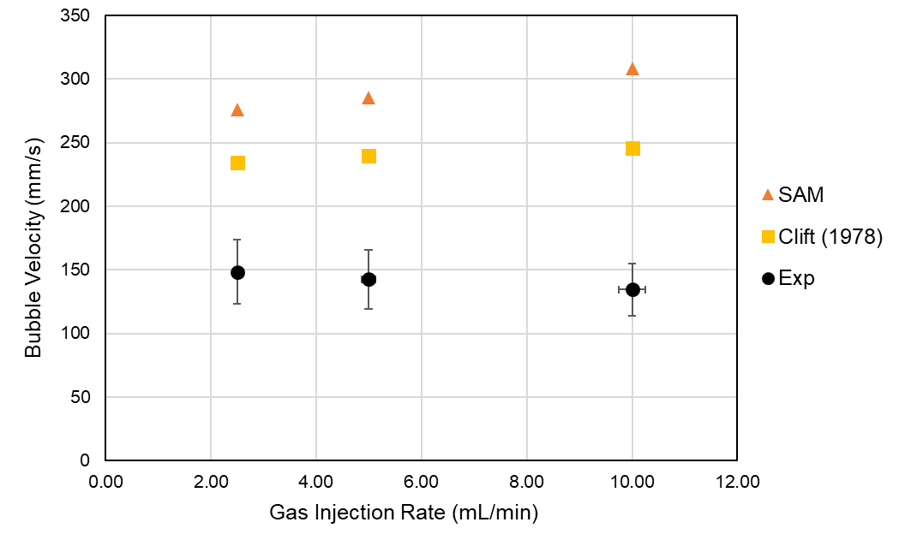
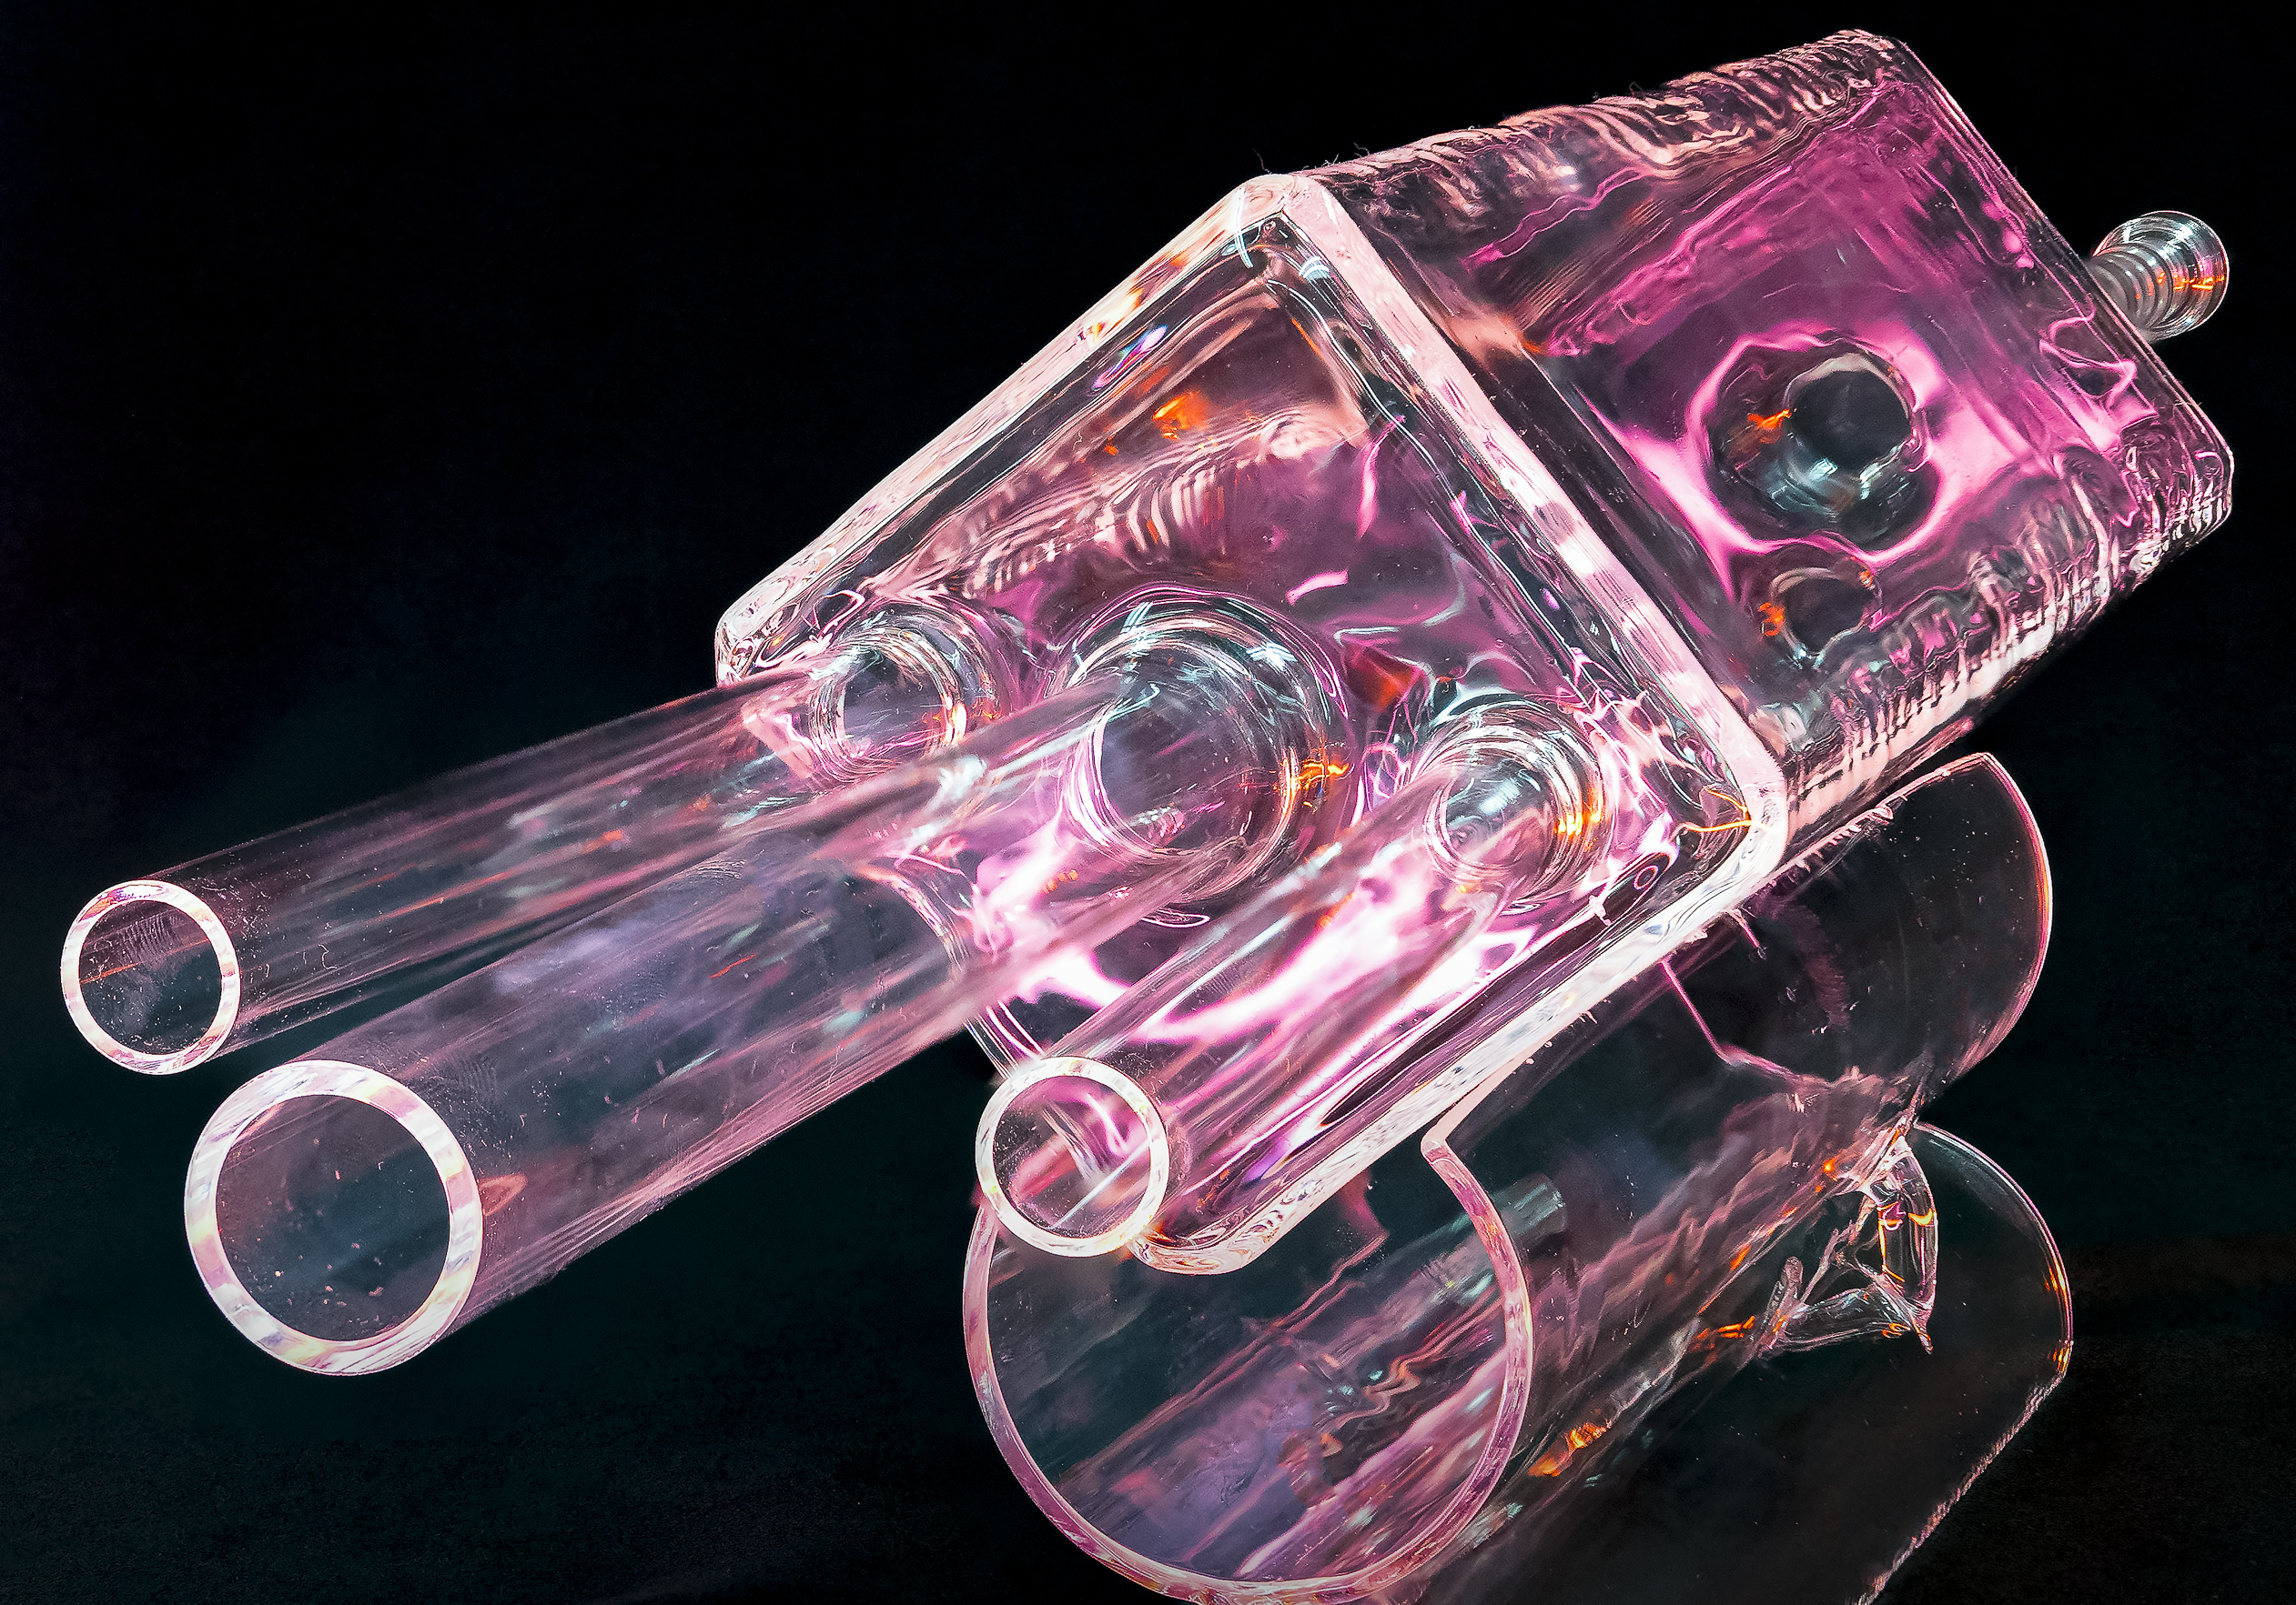
Verification and Validation Activities
Modeling of void fraction in Kress experiment³
Modeling of experiments of bubbles rising in molten salt¹
Development of verification test suite for gas transport model³
Modeling of pressure drop in LSTL²
McFarlane, J., et al. “Design of Instrumentation for Noble Gas Transport in LSTL Needed for Model Development” Report. ORNL TM-2023-3138 (2023).
Yoder, G., et al. “Development of a forced-convection liquid-fluoride-salt test loop”, Proceedings of HTR, 2010
Salko, R, et al. “Implementation of a Drift Flux Model into SAM with Development of a Verification and Validation Test Suite for Modeling of Noncondensable Gas Mixtures”, Nuclear Technology, 2024

Slide 7
Modeling of Off-Gas System
Model pool-type MSR
  Bubble generation due to xenon creation and phase transfer
  Species and bubble transport affects fission gas concentration in pool region
  Bubble buoyancy leads to escape at pool surface
Depletion determines fission product inventory
Coupled system being utilized for prediction of off-gas of fission products plus uncertainty¹
DOE iFOA project in collaboration with Terrestrial Energy, USA

Slide 8
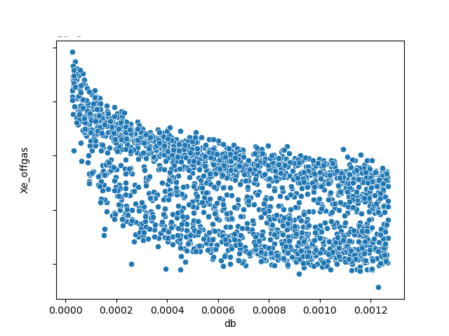
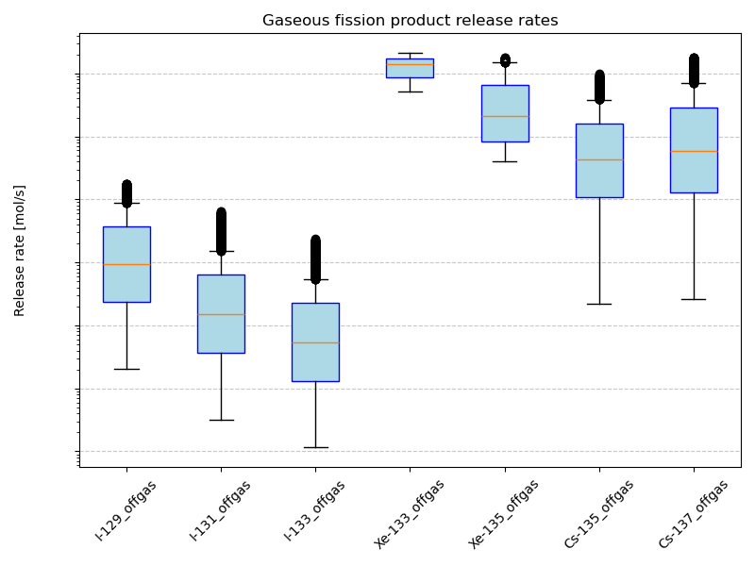
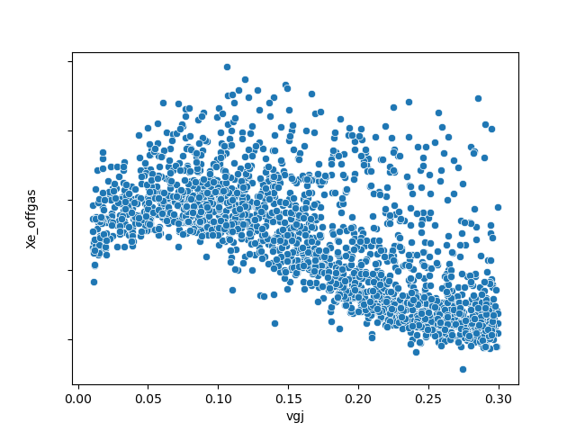
Uncertainty Quantification of Offgas
Forward UQ analysis of off-gas modeling
  Variation of 15 input parameters
  Nuclear data, thermophysical fluid properties, mass transfer data, bubble behavior
  Xenon, cesium, and iodine off-gas rate are figures of merit (FOM)
  5,000 evaluations of coupled analysis lead to convergence of FOMs
Bubble velocity uncertainty obtained from MSR Campaign data¹
Spread in off-gas release rates due to input uncertainties
Bubble terminal velocity, bubble diameter, and thermochemical data found to be potentially high importance
Relationship between input parameters and off-gas rates
D. Orea, K. Robb, J. McFarlane, “Comparative Study Between Experimental Measurements and Model Predictions of Bubble Rise Velocity in Molten LiCl-KCl”, in press., 2025

Slide 9
Summary
Species and gas transport modeling capabilities expanded in SAM for modeling of MSRs
  Ability to track gaseous species using drift flux
  Ability model phase transfer, decay between species, and bubble release
Demonstration of capabilities shown by performing fission gas release uncertainty analysis
Model will be expanded including coupling with Thermochimica, bubble modeling improvements based on MSR Campaign data, graphite xenon absorption, and improved coupling for depletion

