Slide 1
Improvements in Pronghorn for MSR modeling, including overlapping domain coupling with SAM for multiscale modeling
NEAMS Annual Review: Molten Salt Reactors
May 28th, 2025
Mauricio Tano, Ramiro Freile, Mengnan Li, Victor Coppe Leite, Peter German, Joshua Hansel, Lise Charlot

Slide 2
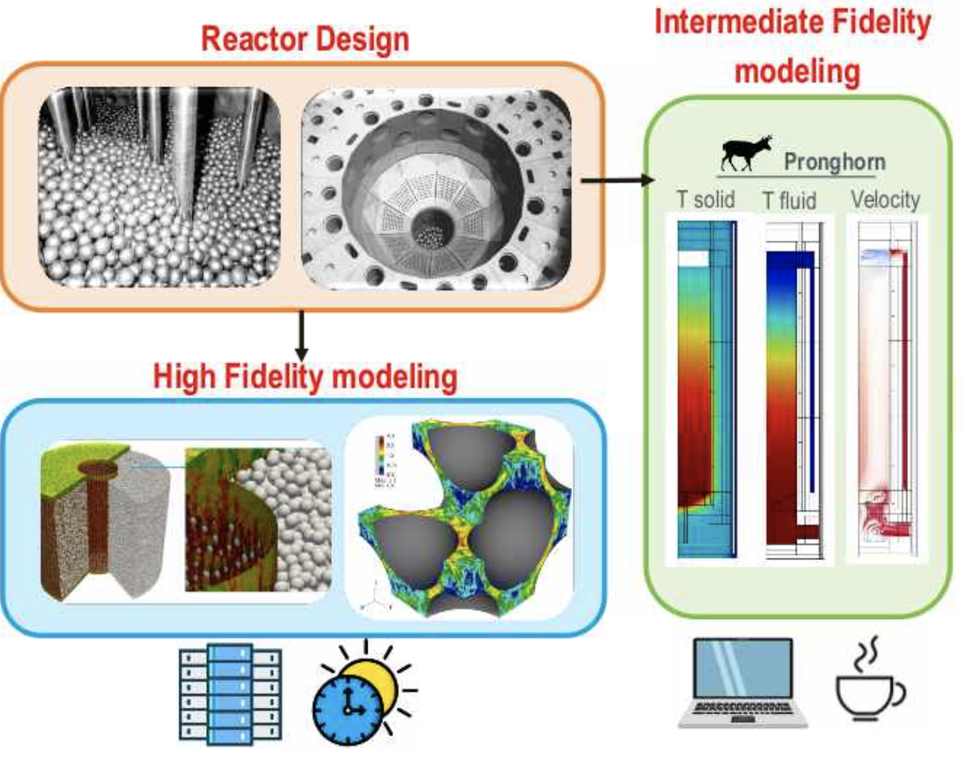
Pronghorn
Pronghorn: Intermediate-fidelity multidimensional coarse-mesh CFD code
Capabilities:
Coarse-mesh CFD with finite volume discretization
Incompressible or weakly compressible flows
Porous flow modeling with a wide range of correlations
RANS turbulence modeling with several turbulence models
Two-phase flow modeling
Straightforward coupling to neutronics and other physics within the MOOSE framework
Level of resolution appropriate for full core modeling

Slide 3
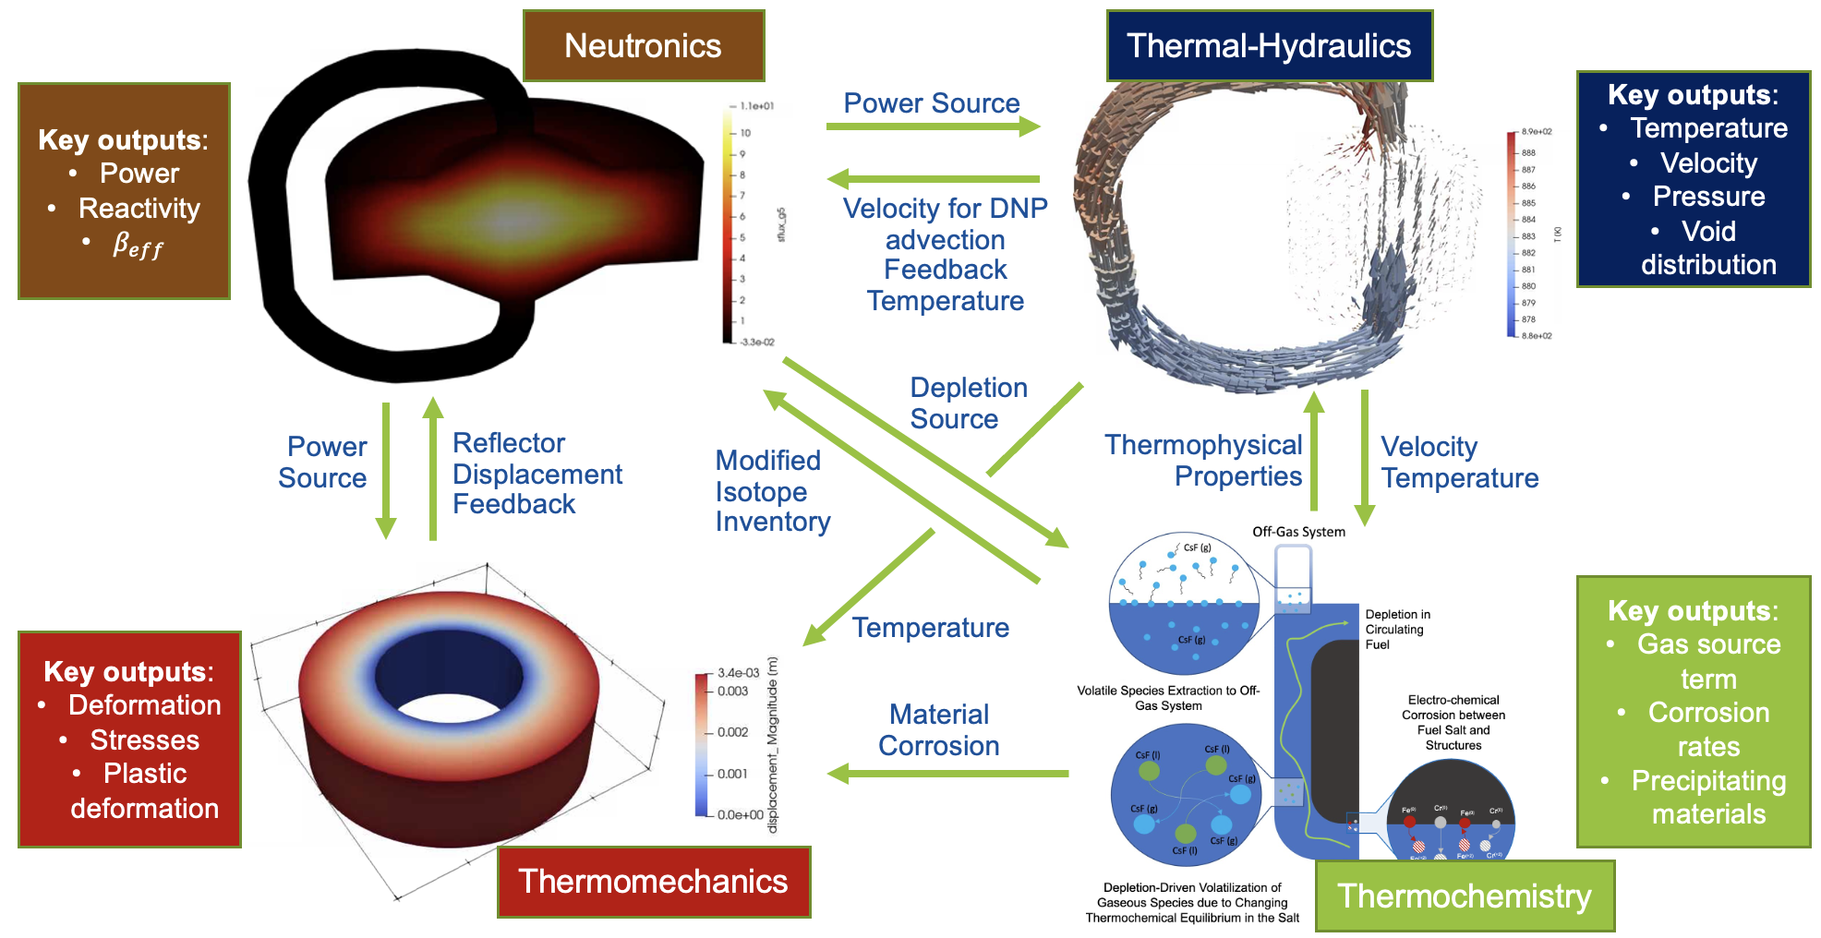
Pronghorn’s Role in MSR Multiphysics Framework
Pronghorn
SAM
Nek5000/NekRS

Slide 4
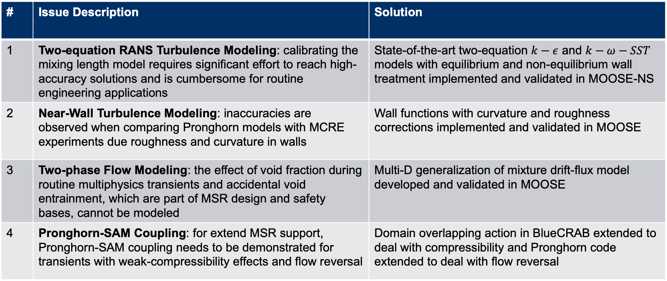
Key TH Improvements in Pronghorn for MSR Modeling
# | Issue Description | Solution
1 | Two-equation RANS Turbulence Modeling: calibrating the mixing length model requires significant effort to reach high-accuracy solutions and is cumbersome for routine engineering applications | State-of-the-art two-equation $k−ε$ and $k−ω−SST$ models with equilibrium and non-equilibrium wall treatment implemented and validated in MOOSE-NS
2 | Near-Wall Turbulence Modeling: inaccuracies are observed when comparing Pronghorn models with MCRE experiments due roughness and curvature in walls | Wall functions with curvature and roughness corrections implemented and validated in MOOSE
3 | Two-phase Flow Modeling: the effect of void fraction during routine multiphysics transients and accidental void entrainment, which are part of MSR design and safety bases, cannot be modeled | Multi-D generalization of mixture drift-flux model developed and validated in MOOSE
4 | Pronghorn-SAM Coupling: for extend MSR support, Pronghorn-SAM coupling needs to be demonstrated for transients with weak-compressibility effects and flow reversal | Domain overlapping action in BlueCRAB extended to deal with compressibility and Pronghorn code extended to deal with flow reversal

Slide 5
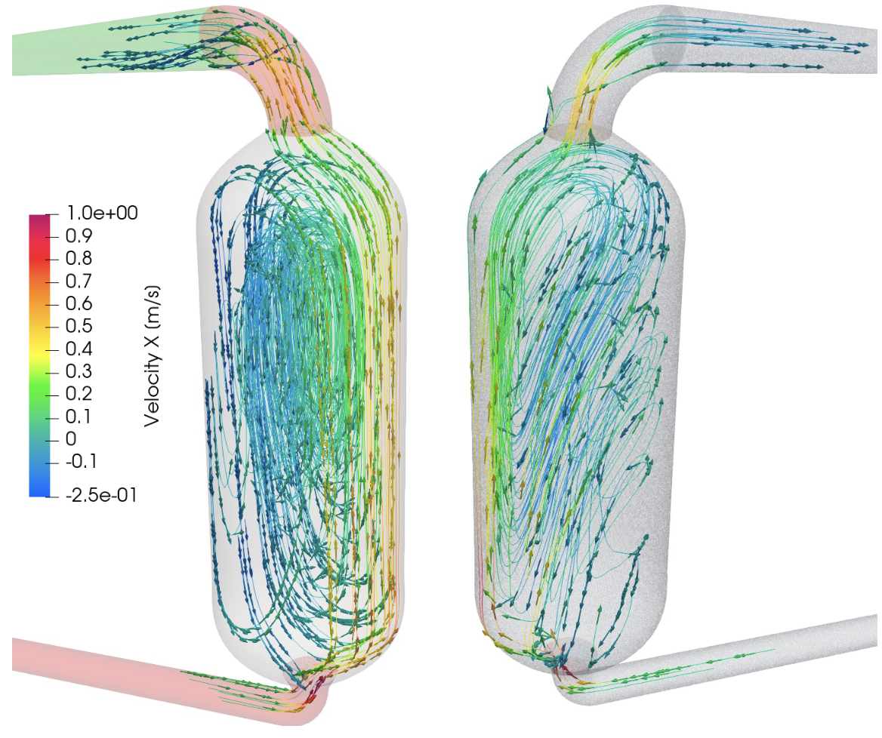
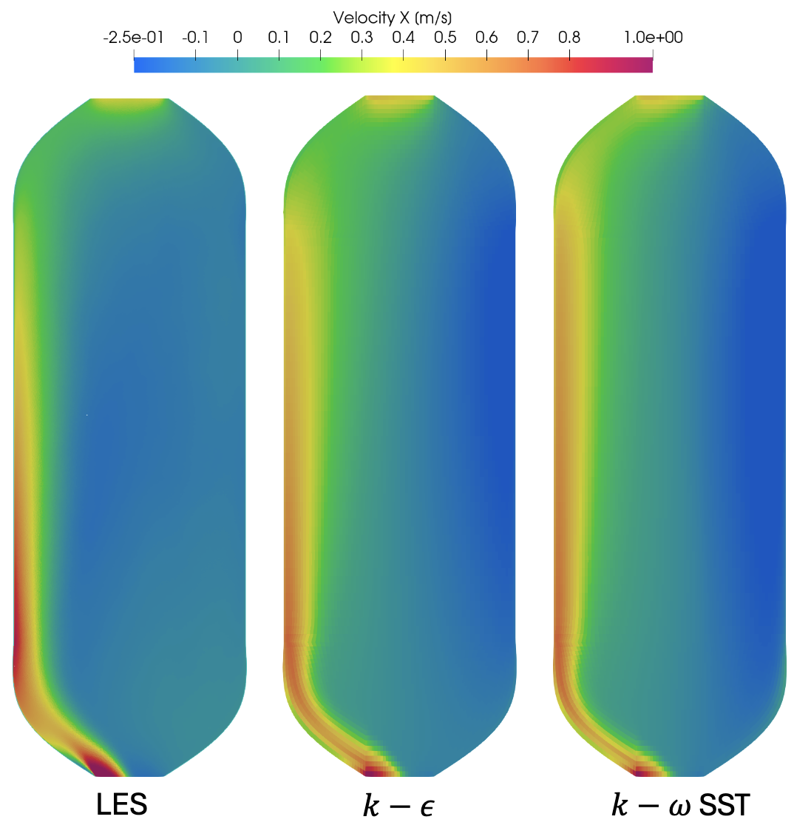
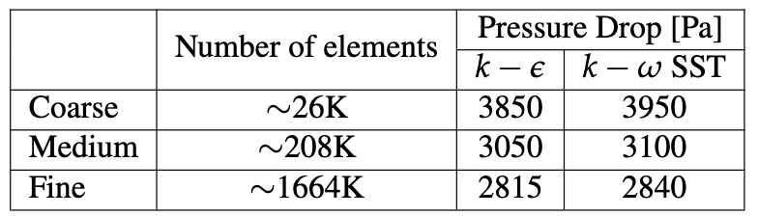
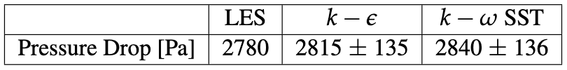
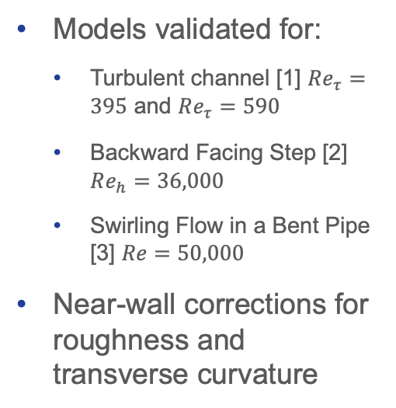
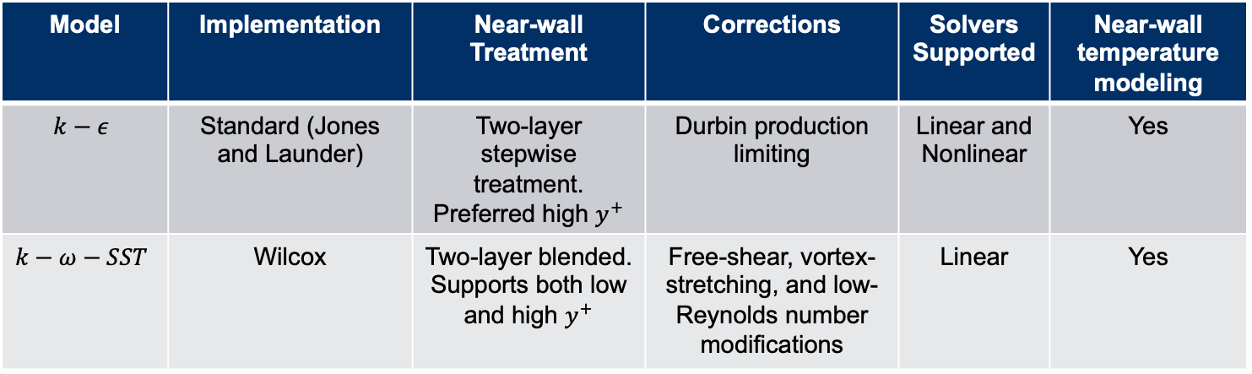

Two-equations RANS Turbulence Modeling
Model | Implementation | Near-wall Treatment | Corrections | Solvers Supported | Near-wall temperature modeling
$$k−ε$$ | Standard (Jones and Launder) | Two-layer stepwise treatment. Preferred high $y^{+}$ | Durbin production limiting | Linear and Nonlinear | Yes
$$k−ω−SST$$ | Wilcox | Two-layer blended. Supports both low and high $y^{+}$ | Free-shear, vortex-stretching, and low-Reynolds number modifications | Linear | Yes
Models validated for:
Turbulent channel [1] $Re_{τ}=395$ and $Re_{τ}=590$
Backward Facing Step [2] $Re_{h}=36,000$
Swirling Flow in a Bent Pipe [3] $Re=50,000$
Near-wall corrections for roughness and transverse curvature
.
RANS
$$k−ω−SST$$
LES
Application to L-MSR (open source MCRE)
1. Mansour, N.N., Kim, J., Moin, P. (1988). Reynolds-stress and dissipation-rate budgets in a turbulent channel flow. J. Fluid Mech., Vol. 194, pp. 15-44
2. Le, H., Moin, P., Kim, J. (1997). Direct numerical simulation of turbulent flow over a backward-facing step. J. Fluid Mech., Vol. 330, pp. 349-374.
3. So, R.M.C., Anwer, M. (1993). Swirling turbulent flow through a curved pipe. Part 2: Recovery from swirl and bend curvature. Exp. Fluids, Vol. 14, pp. 169-177.

Slide 6
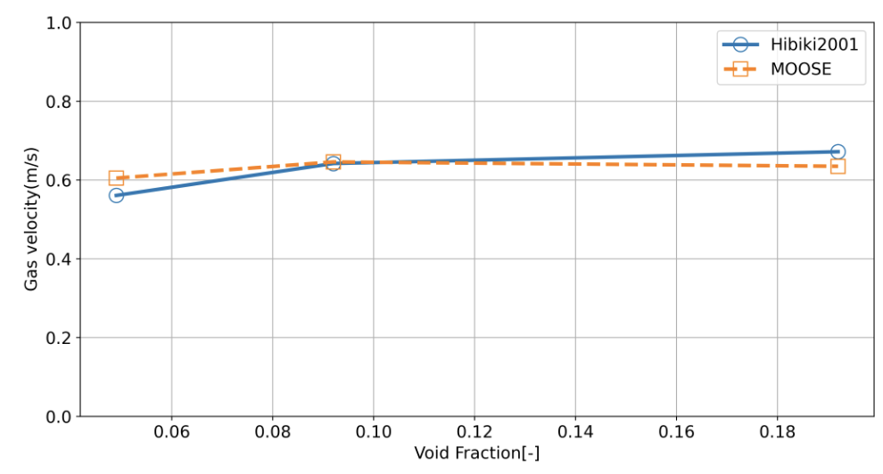
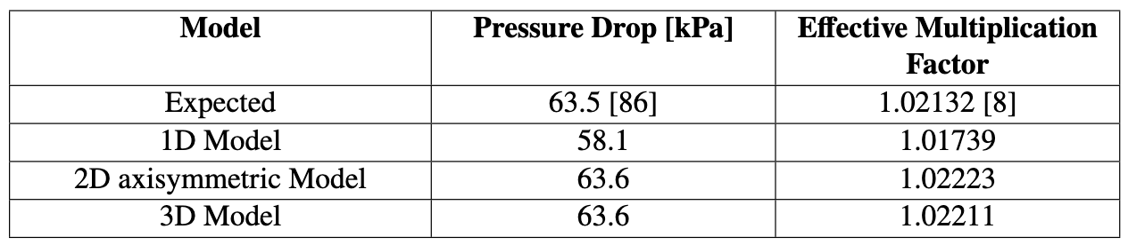
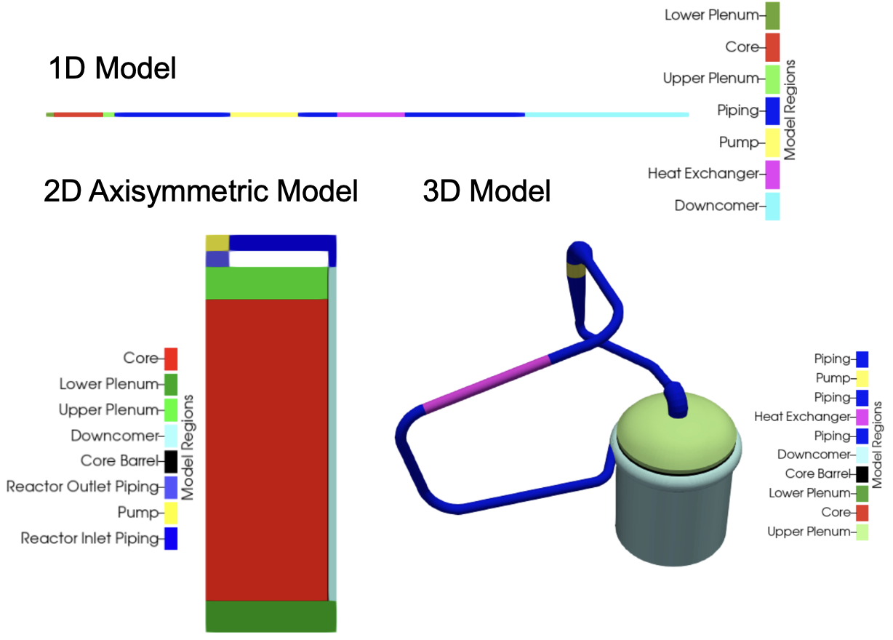
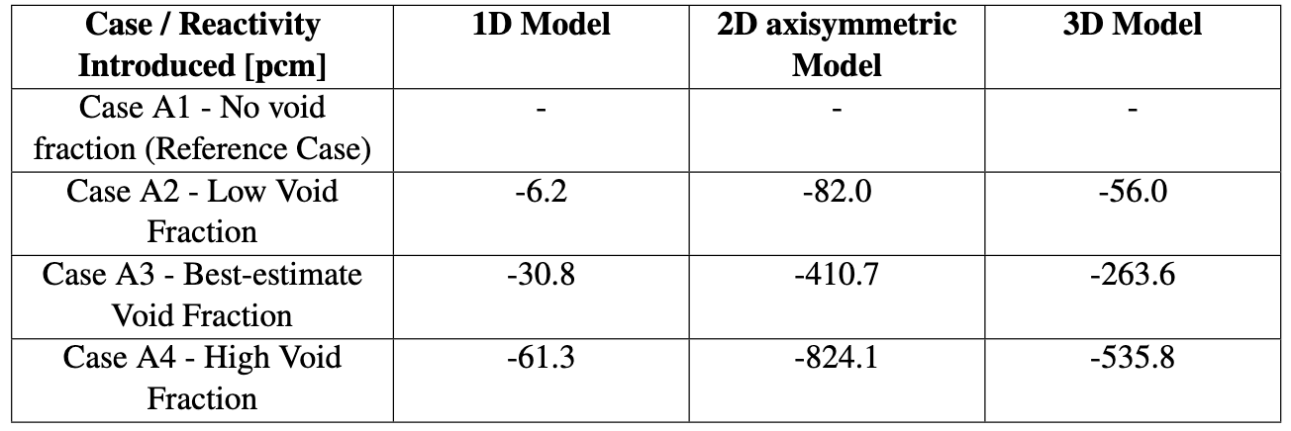
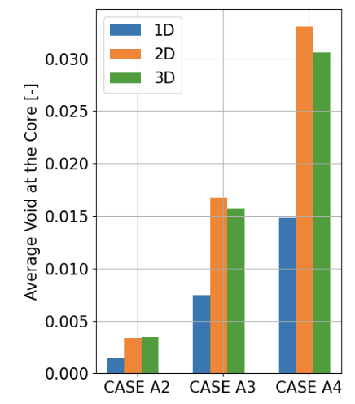
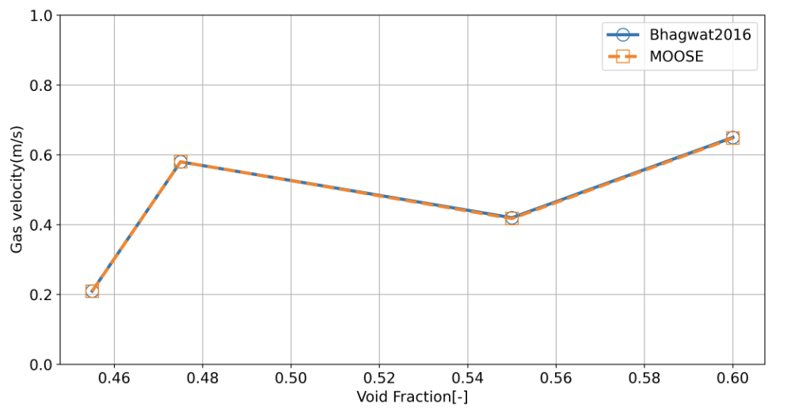
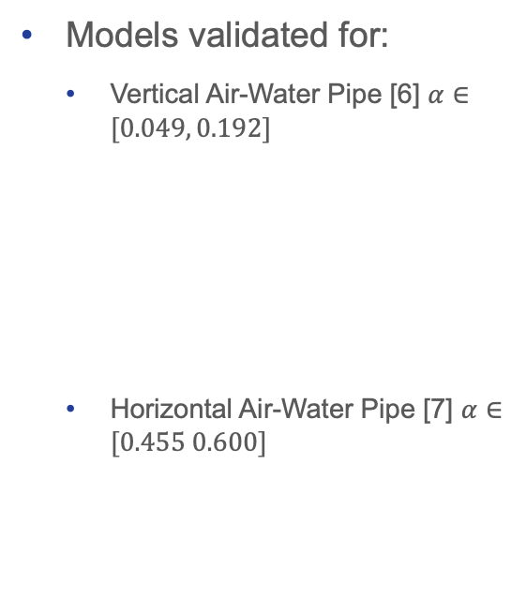
Two-Phase Flow Modeling
Model | Modifications | Solvers Supported | Compatible with wall functions
Drift flux model in porous media formulation | - Generalization to multi-D flows - Porous media support | Linear and Nonlinear | Yes
Models validated for:
Vertical Air-Water Pipe [6] $α∈[0.049, 0.192]$
Horizontal Air-Water Pipe [7] $α∈[0.455 0.600]$
Application to MSRE
6. Ishii, M., & Hibiki, T. (2010). Thermo-fluid dynamics of two-phase flow. Springer Science & Business Media.
7. Hibiki, T., Ishii, M., & Xiao, Z. (2001). Axial interfacial area transport of vertical bubbly flows. International Journal of Heat and Mass Transfer, 44(10), 1869-1888.

Slide 7
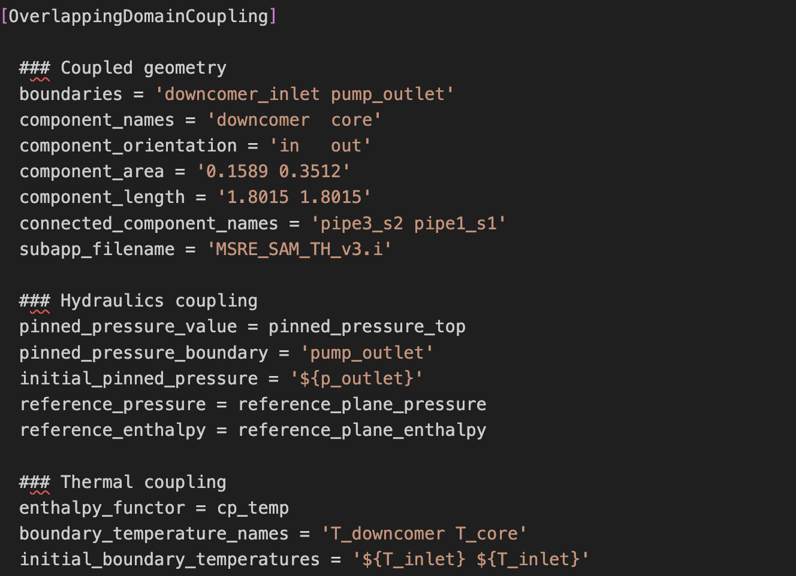
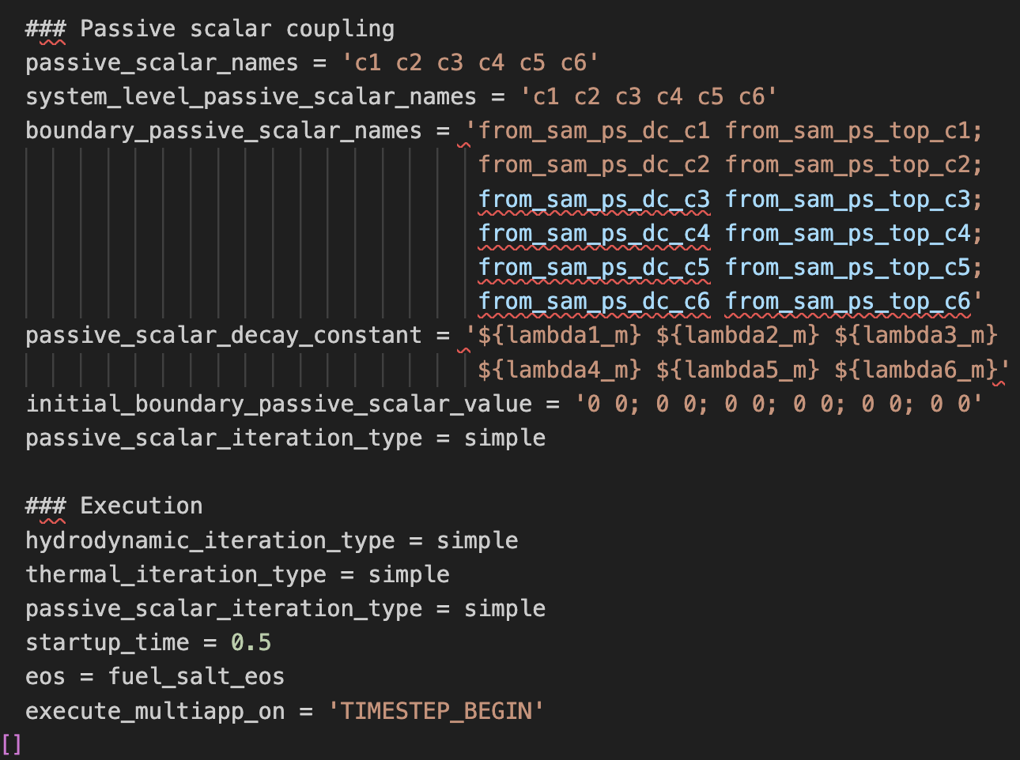
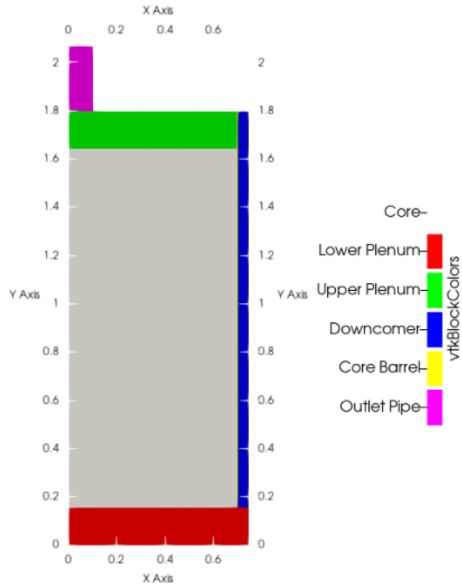
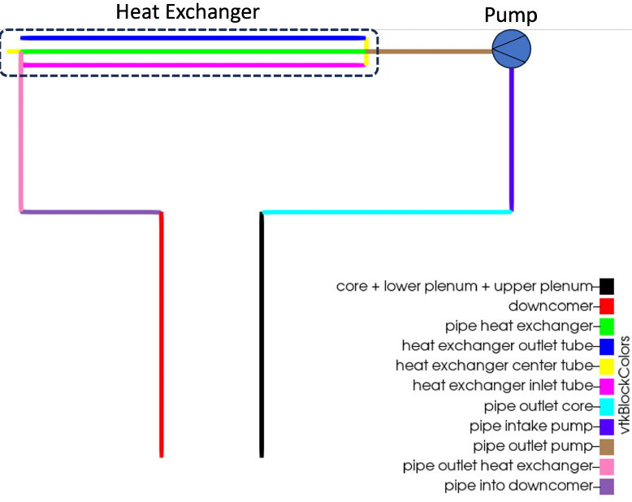
Pronghorn-SAM Domain-Overlapping Coupling 1/2
Example of Domain Overlapping Coupling Action for MSRE
MOOSE Action developed to couple Pronghorn and SAM*
The key principle is to automatically generate pipe components in SAM that represent the overlapped Pronghorn component and to match Pronghorn calculated values in SAM:
Match pressure drop → Friction factors set in SAM
Match enthalpy/temperature rise → heat source set in SAM
Adjust passive scalar concentration → volume source set in SAM
The main components of the coupling action are
Geometric description of the coupled boundaries and their area and length
Boundary where Pronghorn pressure is pinned
Enthalpy function for temperature coupling
Passive scalar decay constants
Execution parameters, including solution method, coupling start time, and equations of state
MSRE Model
Pronghorn Model
SAM Model**
*) Schunert, S., Tano, M. E., & Mohammad Jaradat, M. K. (2023). Overlapping Domain Coupling of Multidimensional and System Codes in NEAMS-Pronghorn and SAM (No. INL/RPT-23-72874-Rev000). Idaho National Laboratory (INL), Idaho Falls, ID (United States).
**) Model developed by Jun Fang and Tingzhou Fei (ANL)

Slide 8
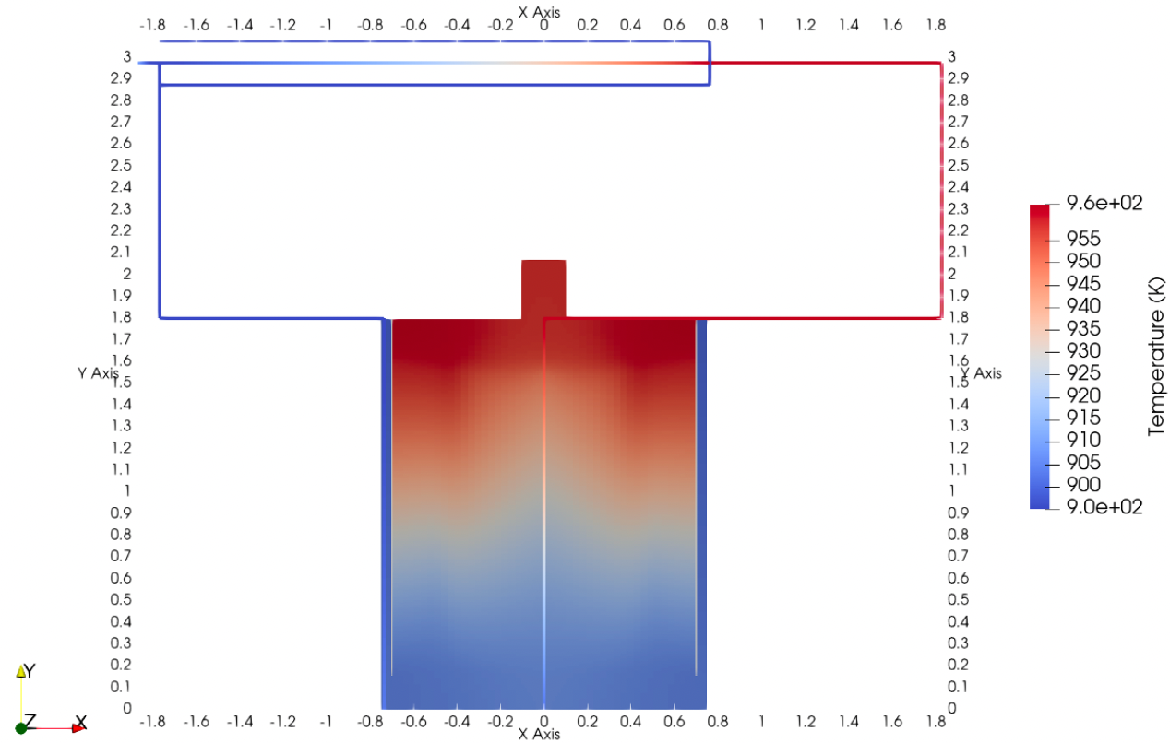
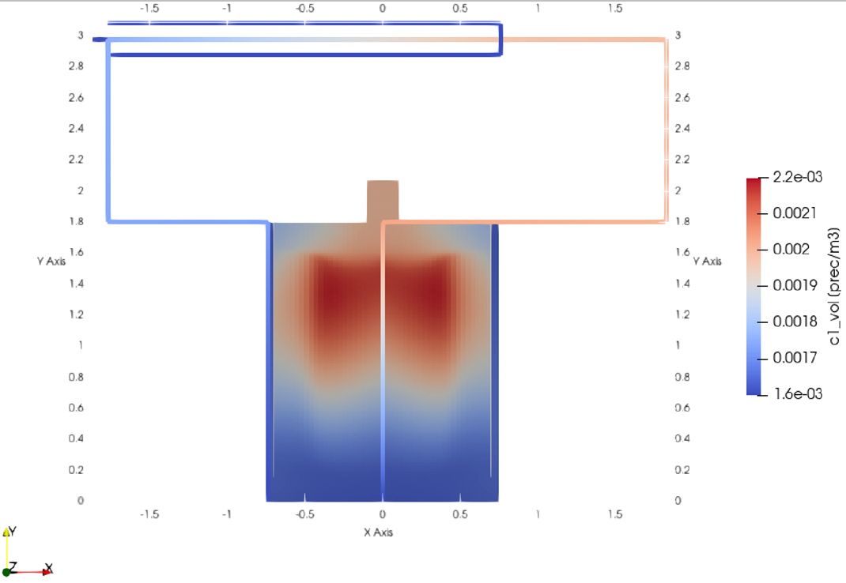
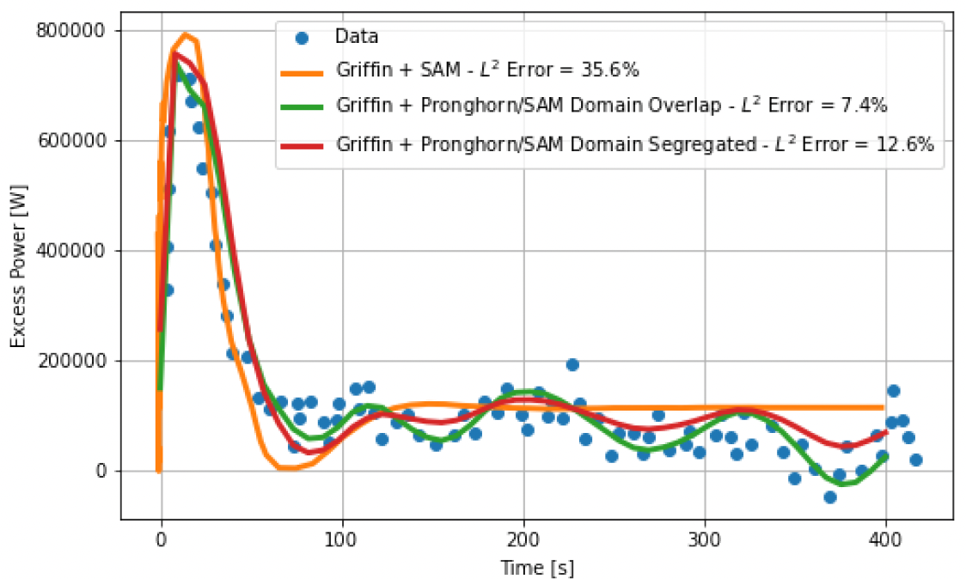

Pronghorn-SAM Domain-Overlapping Coupling 2/2
Demonstration:
Pronghorn-SAM coupling demonstrated for MSRE
For steady-state operation, the coupling methodology has been demonstrated and verified for the full reactor model.
Key limitation:
1D to multiD boundary condition in Pronghorn imposed from SAM models where flow assumptions must be made.
The user must still carefully select the boundary where the coupling is performed to avoid the effects of these boundary conditions.
Coupling validation:
The transient model has been validated for reactivity insertion transients in MSRE.
Pronghorn SAM results showed improved performance due to the higher resolution of the Pronghorn model.
Delayed neutron precursor concentration for group 1 ($λ_{1}=1.3336×{10}^{−2}1/s$)
Temperature Field
Reactivity Insertion Transient at 5MW of thermal power

Slide 9
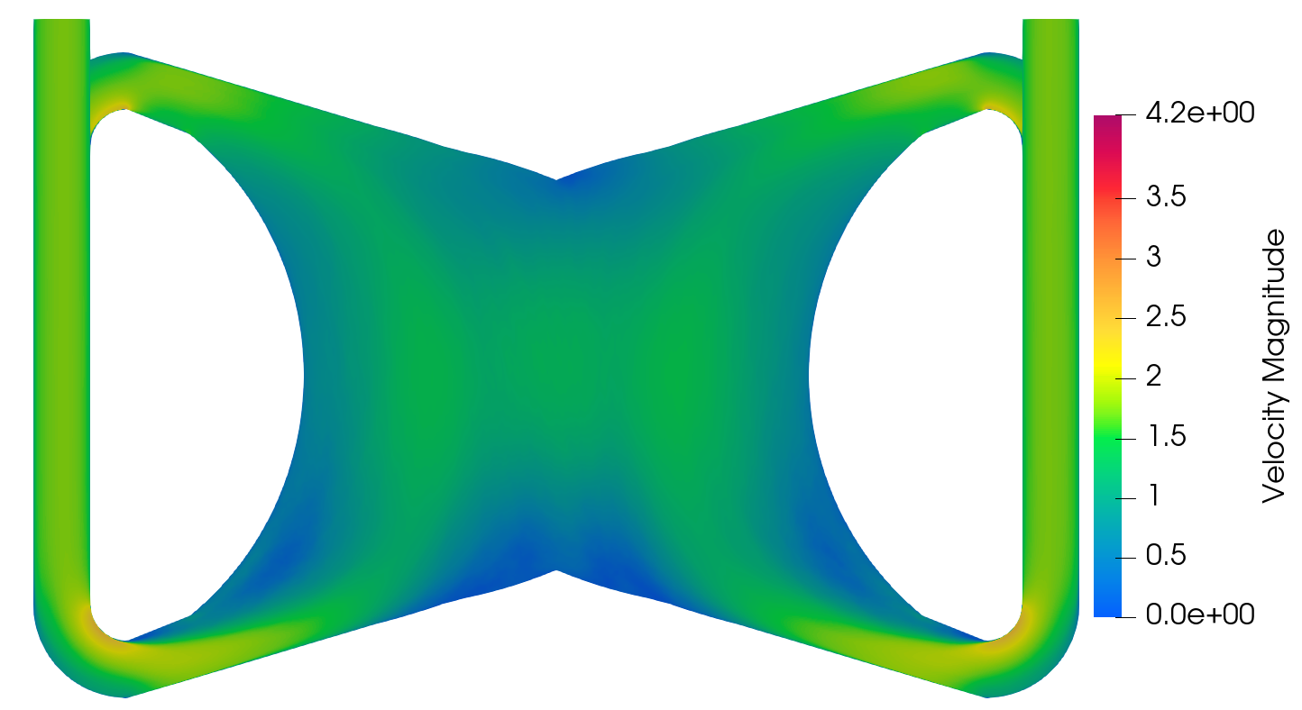
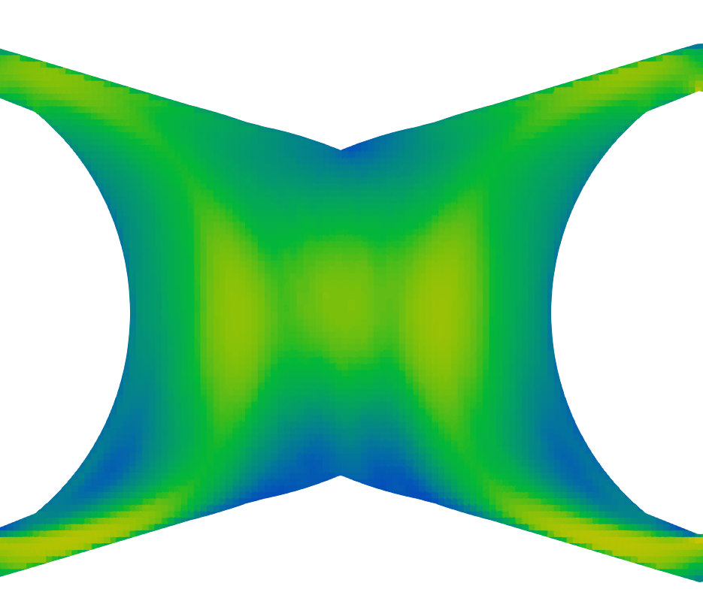
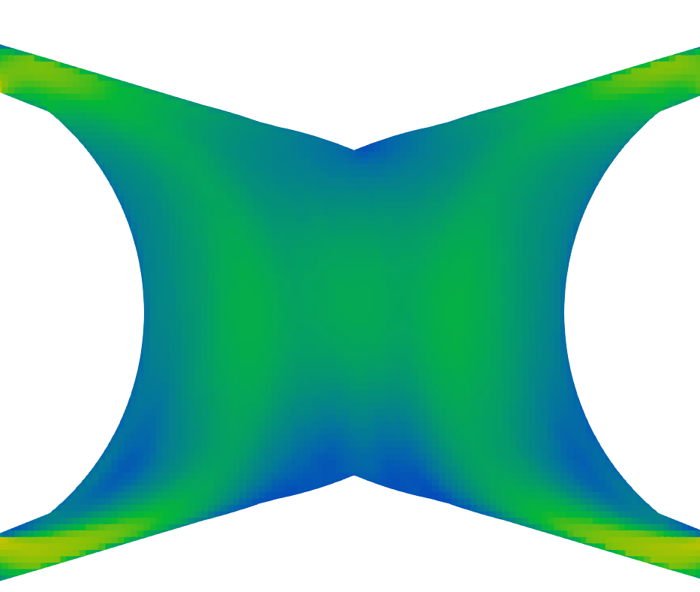
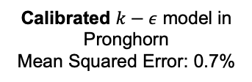
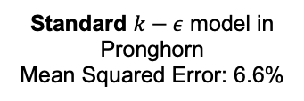
Pronghorn-Nek High-to-Low (HOLO) Coupling
Standard $k−ε$ model in Pronghorn
Mean Squared Error: 6.6%
Calibrated $k−ε$ model in Pronghorn
Mean Squared Error: 0.7%
Time-averaged NekRS LES
Pronghorn RANS turbulent closures implemented as Functors, which allows for a simple calibration from higher-fidelity models
Pronghorn implements an inverse Kalman filter for advection, allowing to obtain good performance advection in coarse meshes
Example for the Molten Salt Fast Reactor (MSFR) core in the right figures
Tano, M., Walker, S., Abou-Jaoude, A., Fang, J., & Shaver, D. (2023). Nek5000-Pronghorn-SAM multiscale modeling of pool-type Molten Salt Reactors. In 20th International Topical Meeting on Nuclear Reactor Thermal Hydraulics, NURETH 2023 (pp. 478-491). American Nuclear Society.

Slide 10
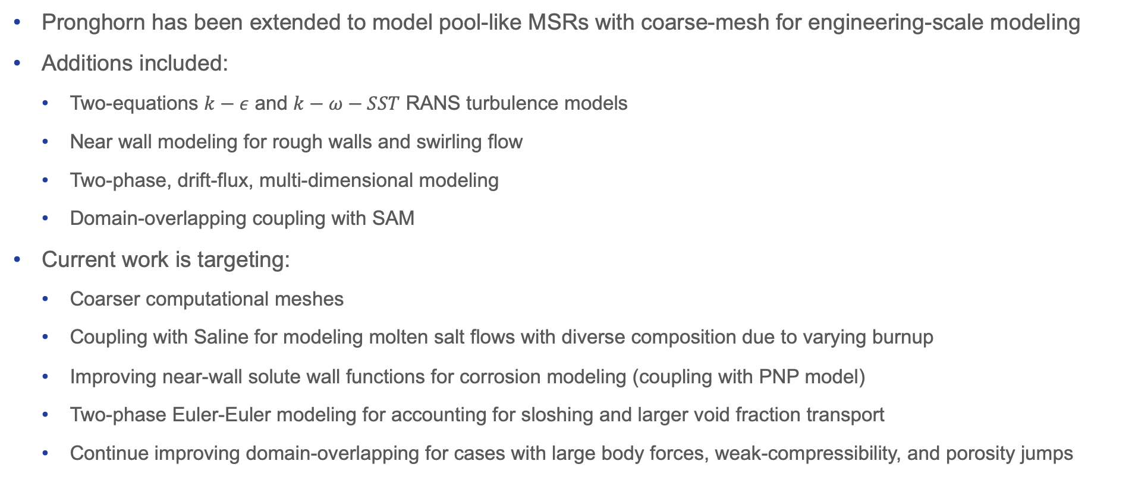
Summary
Pronghorn has been extended to model pool-like MSRs with coarse-mesh for engineering-scale modeling
Additions included:
Two-equations $k−ε$ and $k−ω−SST$ RANS turbulence models
Near wall modeling for rough walls and swirling flow
Two-phase, drift-flux, multi-dimensional modeling
Domain-overlapping coupling with SAM
Current work is targeting:
Coarser computational meshes
Coupling with Saline for modeling molten salt flows with diverse composition due to varying burnup
Improving near-wall solute wall functions for corrosion modeling (coupling with PNP model)
Two-phase Euler-Euler modeling for accounting for sloshing and larger void fraction transport
Continue improving domain-overlapping for cases with large body forces, weak-compressibility, and porosity jumps

Slide 12
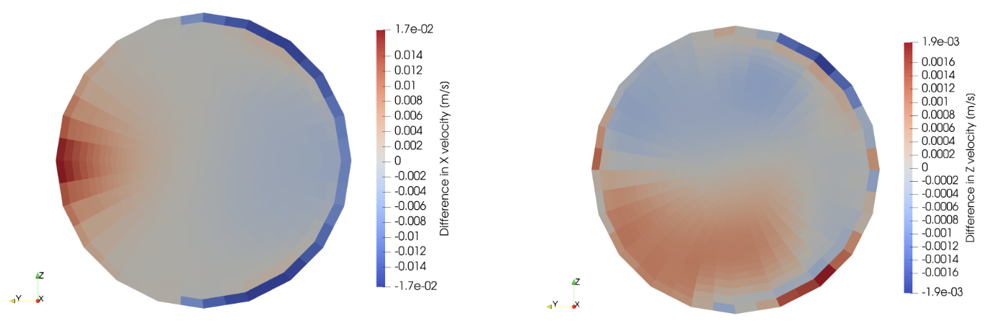
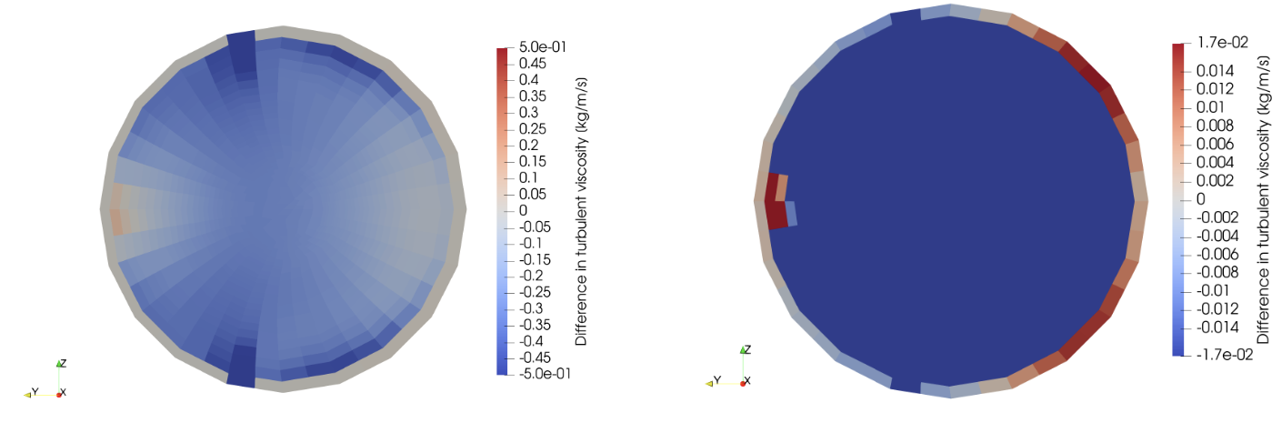
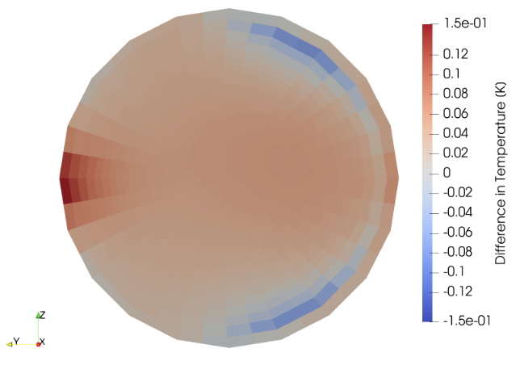
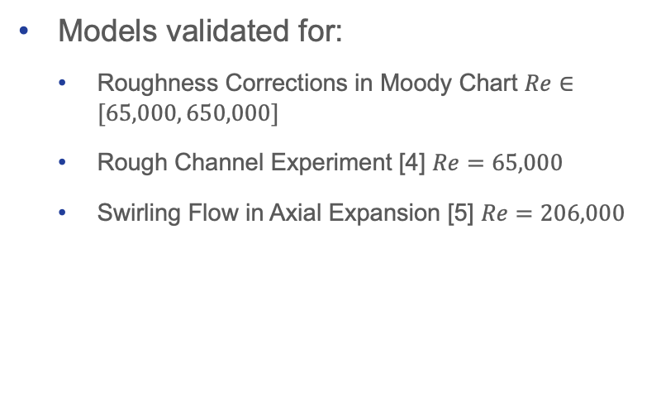
Near-Wall Turbulence Modeling
Correction | Implementation
Roughness correction | Moody-adapted Colebrook and Asymptotic corrections
Transverse curvature correction | Quadratic aggregation of shear velocity
Models validated for:
Roughness Corrections in Moody Chart $Re∈[65,000, 650,000]$
Rough Channel Experiment [4] $Re=65,000$
Swirling Flow in Axial Expansion [5] $Re=206,000$
Application to L-MSR
Impact of Wall Function Corrections
Difference in Temperature
Difference in Velocities for plane ad mid axial height
Difference in Turbulent Viscosity
4. Fujita, H., Hirota, M., Yokosawa, H., Hasegawa, M., Gotoh, I. (1990). Fully developed turbulent flows through Rectangular Ducts with One Roughened Wall. JSME Int. J., Vol. 33, pp. 692-701.
5. Stieglmeier, M., Tropea, C., Weiser, N., Nitsche, W. (1989). Experimental investigation of the flow through axisymmetric expansions. J. Fluids Engineering, Vol. 111, pp. 464-471.

