Slide 2
Review of Running-In Simulation and Verification Efforts for Pebble-Bed Reactors
Presented by: Josh Hanophy
May 8, 2025
NEAMS Annual Review: HTGR & FHR

Slide 3
Overview
Review important points about the running-in phase of operation
Overview of code-to-code verification methodologies
Compare PBR modeling approach in Griffin versus kugelpy
Summary of important code-to-code verification results thus far

Slide 4
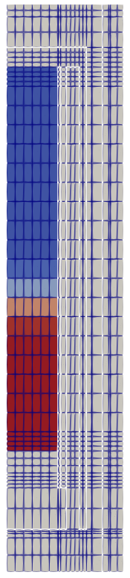
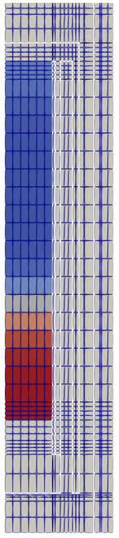
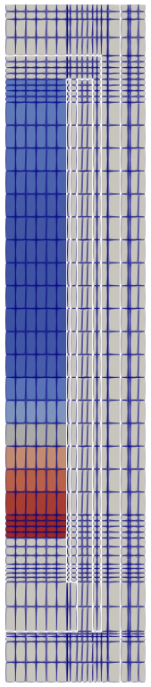
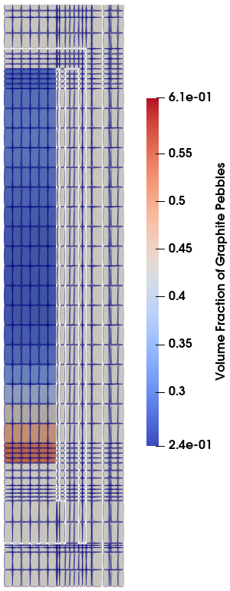
Running-in – Overview
Pebble Bed Reactors (PBRs) start with graphite pebbles filled to a certain height then mix of fuel pebbles and graphite pebbles above this
Graphite pebbles removed from core and replaced with fuel pebbles over time
Power increased from zero to nominal operating level over period of approximately 1 year
Models can inform important questions
How fast can reactor be brought to full power?
What are core configurations with minimum safety margins?
0 days
3.3 days
6.7 days
10 days

Slide 5
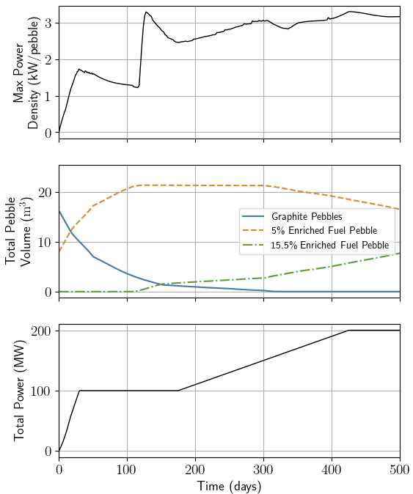
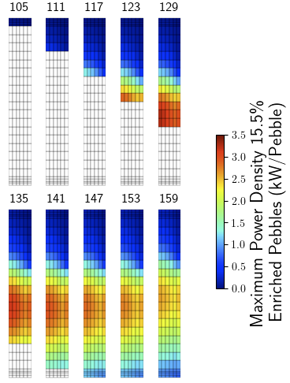
Running-in – Some Important Questions
Significant power spike seen when equilibrium fuel is first added
Results from realistic model including multiphysics
Interested in seeing if similar predictions exist for both Griffin and kugelpy despite their significantly different modeling approaches
Sampe running-in results from a Griffin gas-cooled PBR model

Slide 6
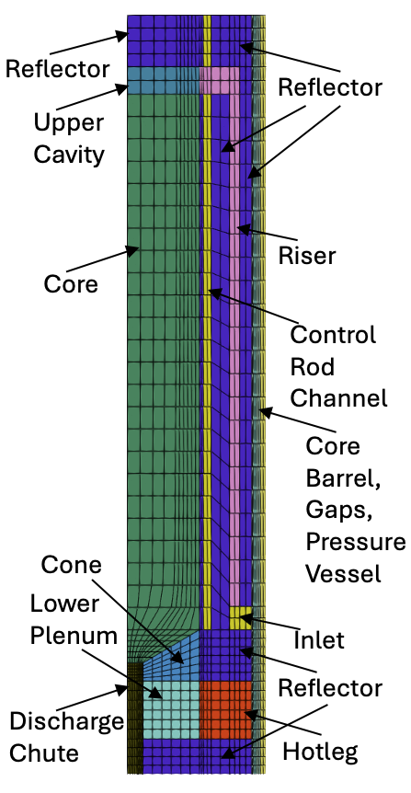
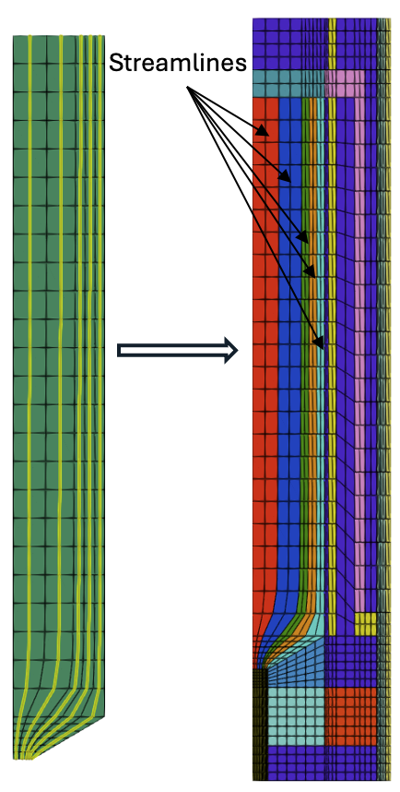
Pebble Bed Modeling with Streamlines in Griffin
Griffin is a deterministic transport code
“Streamline” based approach to modelling pebble bed reactors
Griffin is a MOOSE based application
Major benefits of using Griffin
Fast deterministic solves means transients and “quasi-static” transients like running-in simulation are very fast
Multiphysics can be included in a simple and efficient way
Potential draw back of using Griffin
Deterministic methods requires some method to attain multi-group cross sections
Some question about what errors the homogenized streamline based modeling approach introduces
Streamline schematic and results for generic gas cooled PBR with lower cone modeled

Slide 7
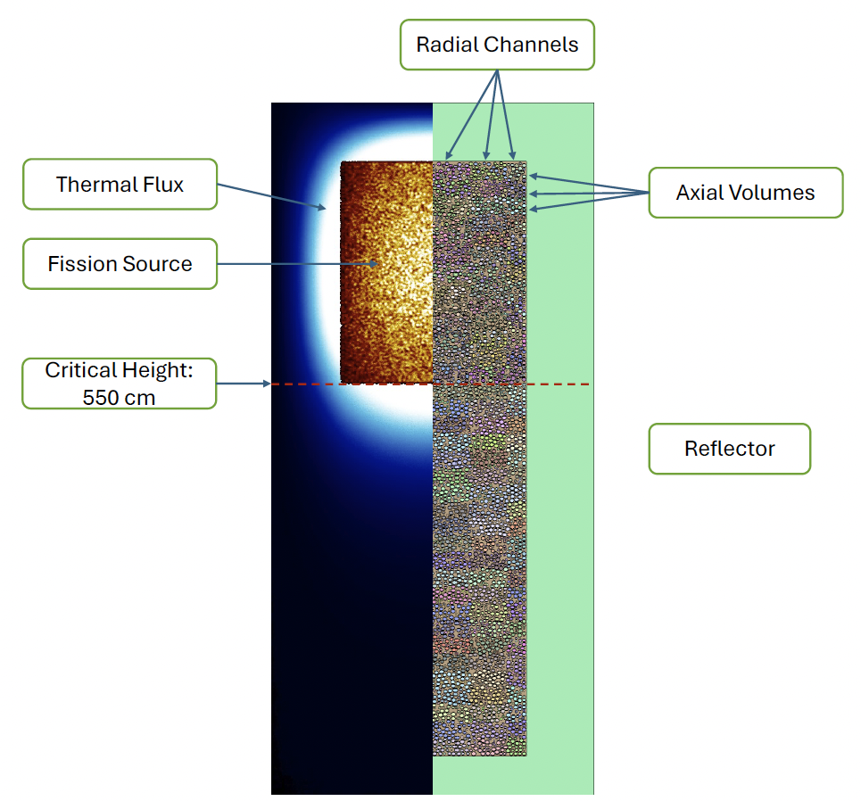
Kugelpy Running-In Overview
kugelpy is a Monte Carlo based code
Different from the approach in Griffin
kugelpy models each pebble vs the homogenized approach in Griffin
kugelpy implements a Lagrangian approach versus Eulerian in Griffin
No numerical diffusion as pebbles move down in kugelpy
Serpent used for the studies so far
Development team at ORNL currently integrating kugelpy with SHIFT
Example of critical height core configuration for the Kugelpy test model

Slide 8
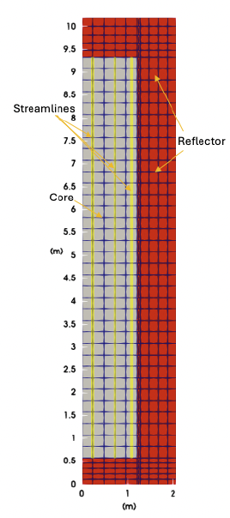
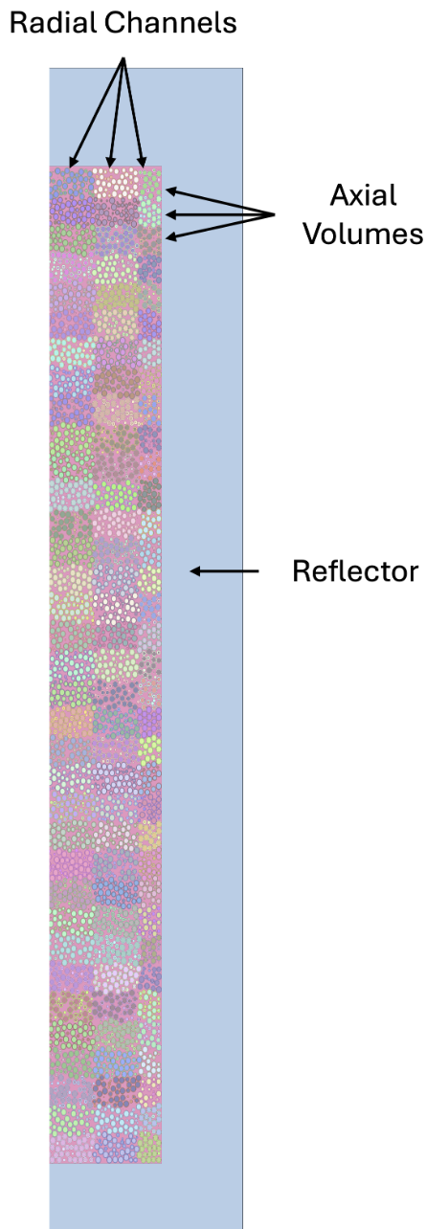
Code-to-Code Verification Study
Griffin
kugelpy
Developed equivalent simplified models in both Griffin and Kugelpy
Both codes perform depletion calculations with fixed temperatures (no multiphysics)
Implementing multiphysics in Kugelpy still a research topic
Enough complicated phenomenology to investigate initially without considering multiphysics
Particularly interested in comparing predictions for the spike in maximum power density when equilibrium fuel introduced
Simplified PBR for initial code-to-code validation studies

Slide 9
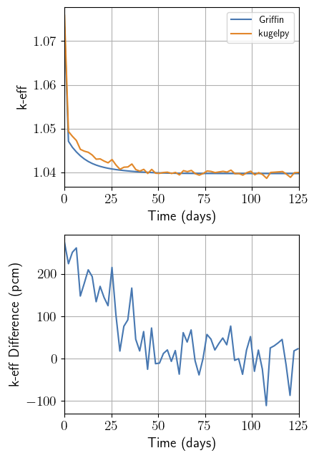
Initial Code-to-Code Testing
Three pebble types utilized for running-in studies
Inert graphite pebble
5% enriched starting fuel pebble
15.5% enriched HALEU fuel
First study with simplified reactor model filled with 40%/60% mixture of graphite pebbles/fresh starting fuel
Important to start with simple study since pre-generated multigroup library used in Griffin model was developed for equilibrium core
Fresh core k-eff from kugelpy 1.07590±0.00036
Griffin prediction is 1.07283, which is lower by approximately 300 pcm
Results from initial calculation with the core full or 40%/60% mixture of graphite pebbles/fresh starting fuel, power at 25 MW, and pebbles flow at 2 pebbles/minute

Slide 10
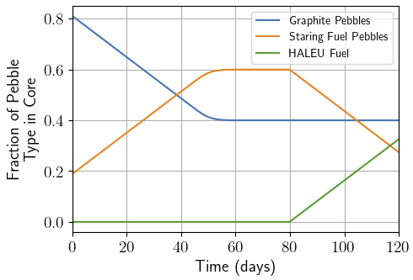
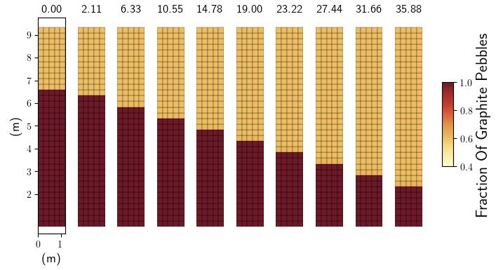
Running-in Started from Sharp Interface
Verification studies started from a sharp interface between graphite pebble region and fueled region with fueled region having 40%/60% mixture of graphite pebbles/fresh starting fuel
Two sets of results reviewed next, both starting from sharp interface then:
fresh feed of 40%/60% graphite pebbles/starting fuel pebbles
fresh feed of 100% HALEU fuel pebbles
All tests involve OTTO cycle (no recycling)

Slide 11
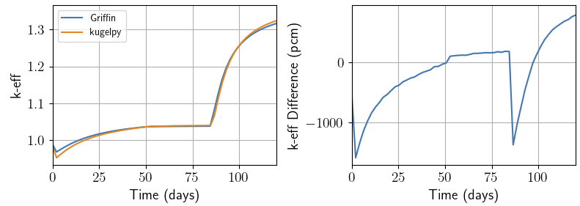
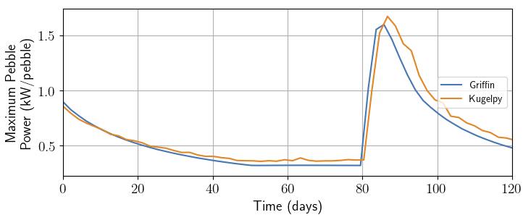
Sharp Interface with Starting Fresh Fuel Feed
Fresh feed of 40%/60% graphite pebbles/starting fuel pebbles
Griffin and Kugelpy predict slightly different critical heights (different eigenvalue at t=0)
Very similar k-eff trend between the two codes
Differences in predicted critical height a mater for more detailed future investigation
Maximum power density prediction very similar between two codes

Slide 12
Conclusions and Future Work
Kugelpy and Griffin use completely different methods for running-in calculations
Similar results seen for key features of running-in simulation including predictions for maximum power density
Spike in power density had been seen in Griffin simulations previously, but not clear it was a physical result; verification with Kugelpy increases confidence it is a physically correct result
Diffusion with pre-generate multigroup cross section library seemed to work well in this study, but some features from more realistic models still need to be tested like:
temperature gradients
void region above core
control rods
recycling of pebbles

